Slide 1
Bubble Chamber Summer 2015
Installation and
Beam Test Schedule
July 8, 2015
https://wiki.jlab.org/ciswiki/index.php/Bubble_Chamber

Slide 2
Test Beamline

Slide 3
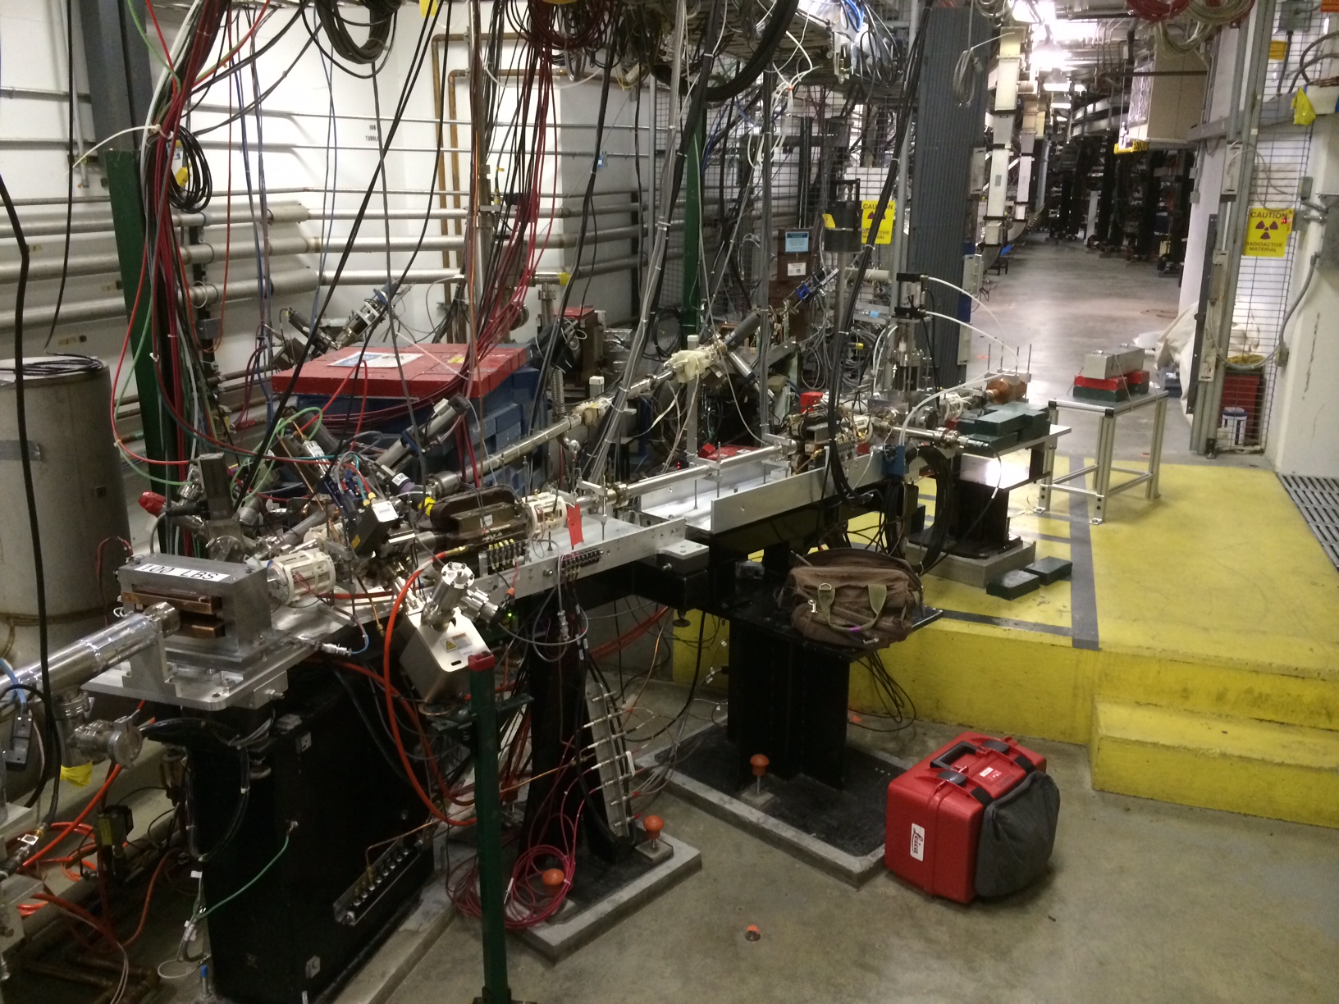

Slide 4
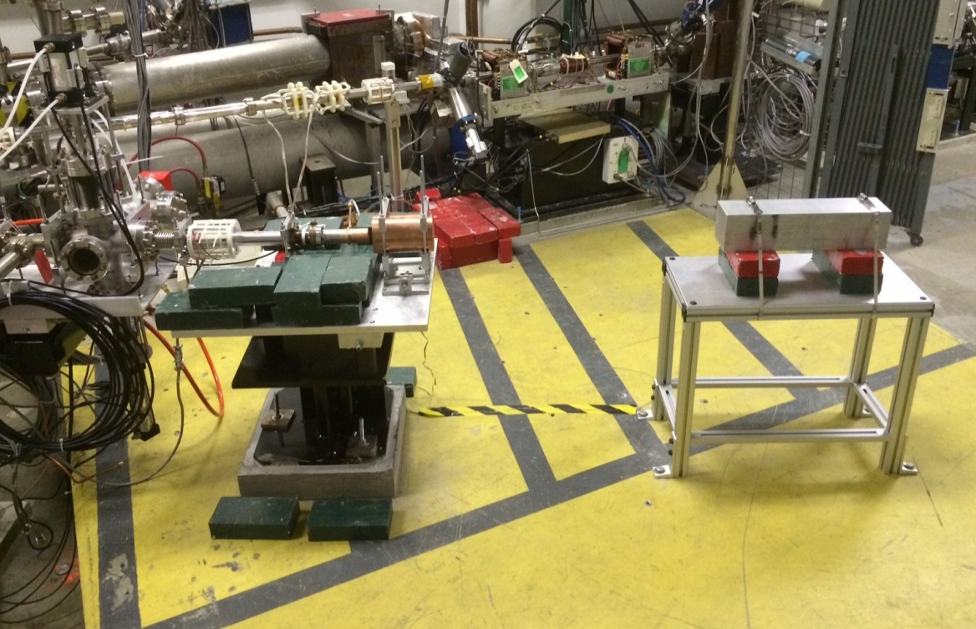
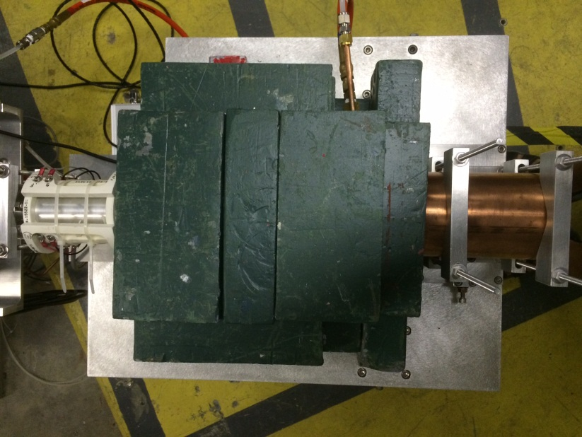

Slide 5
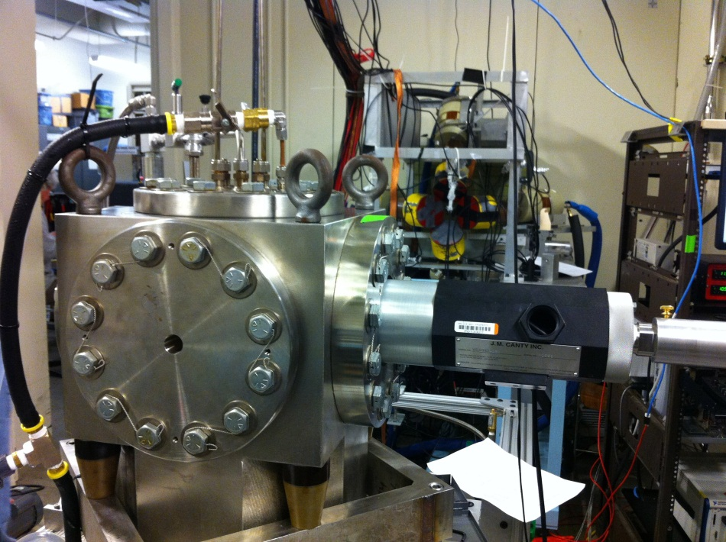
Bubble Chamber
Bubble Chamber at Duke
April 2013
Photon Beam
Entrance

Slide 6
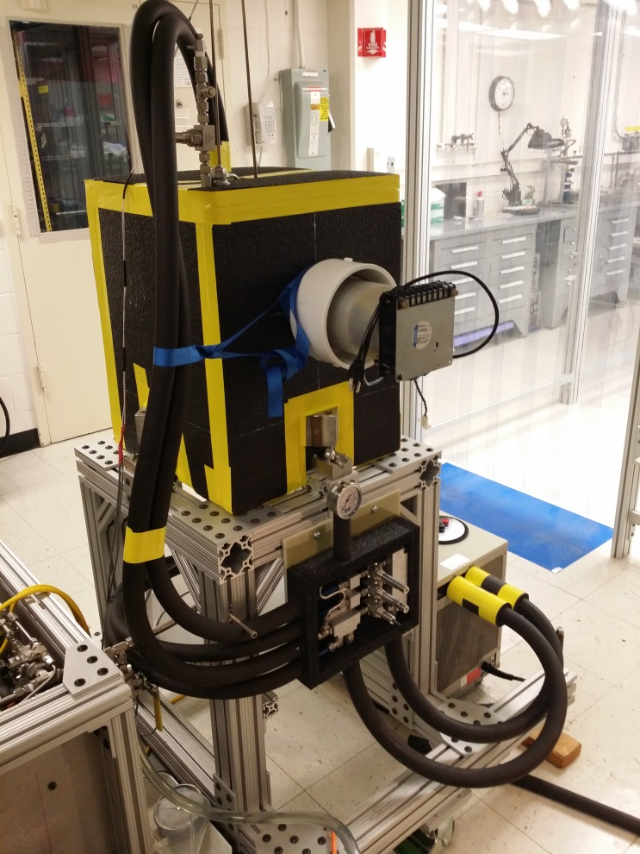
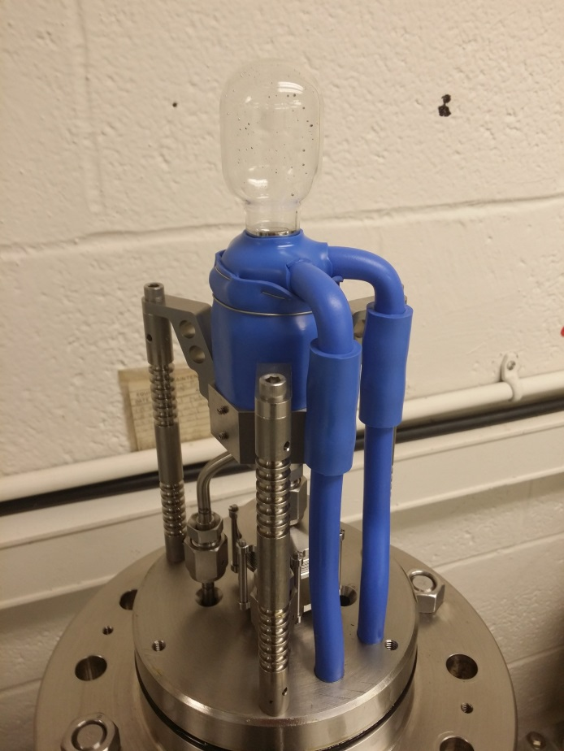
N₂O Bubble Chamber
T = -10˚C
P = 50 atm

Slide 7
Bubble Chamber Safety Reviews
Superheated liquid: N₂O, Nitrous oxide (laughing gas)
At room temperature, it is colorless, non-flammable gas, with slightly sweet odor and taste
High pressure system:
Design Authority: Dave Meekins
T = -10˚C, P = 50 atm
Buffer liquid: Mercury
Closed system
Volume: 150 mL
Electrical Review: 208 V custom-made electrical distribution box
Temporary Operational Safety Procedure (TOSP)
0
2
0
OX
0
3
0

Slide 8
Beam Requirement
Use isotopic pure copper and aluminum
Radiator/dump isolated and current in EPICS readback
Electron K.E.
3.0 – 9.5 MeV
0.01 – 100 µA
Cu
Radiator/Dump
6 mm
Al Beam Pipe
Cu Photon
Collimator
Ceramic
Insulator
Al Photon Dump
40 cm long
Bubble Chamber
Superheated N₂O
3 cm long
-10°C, 50 atm

Slide 9
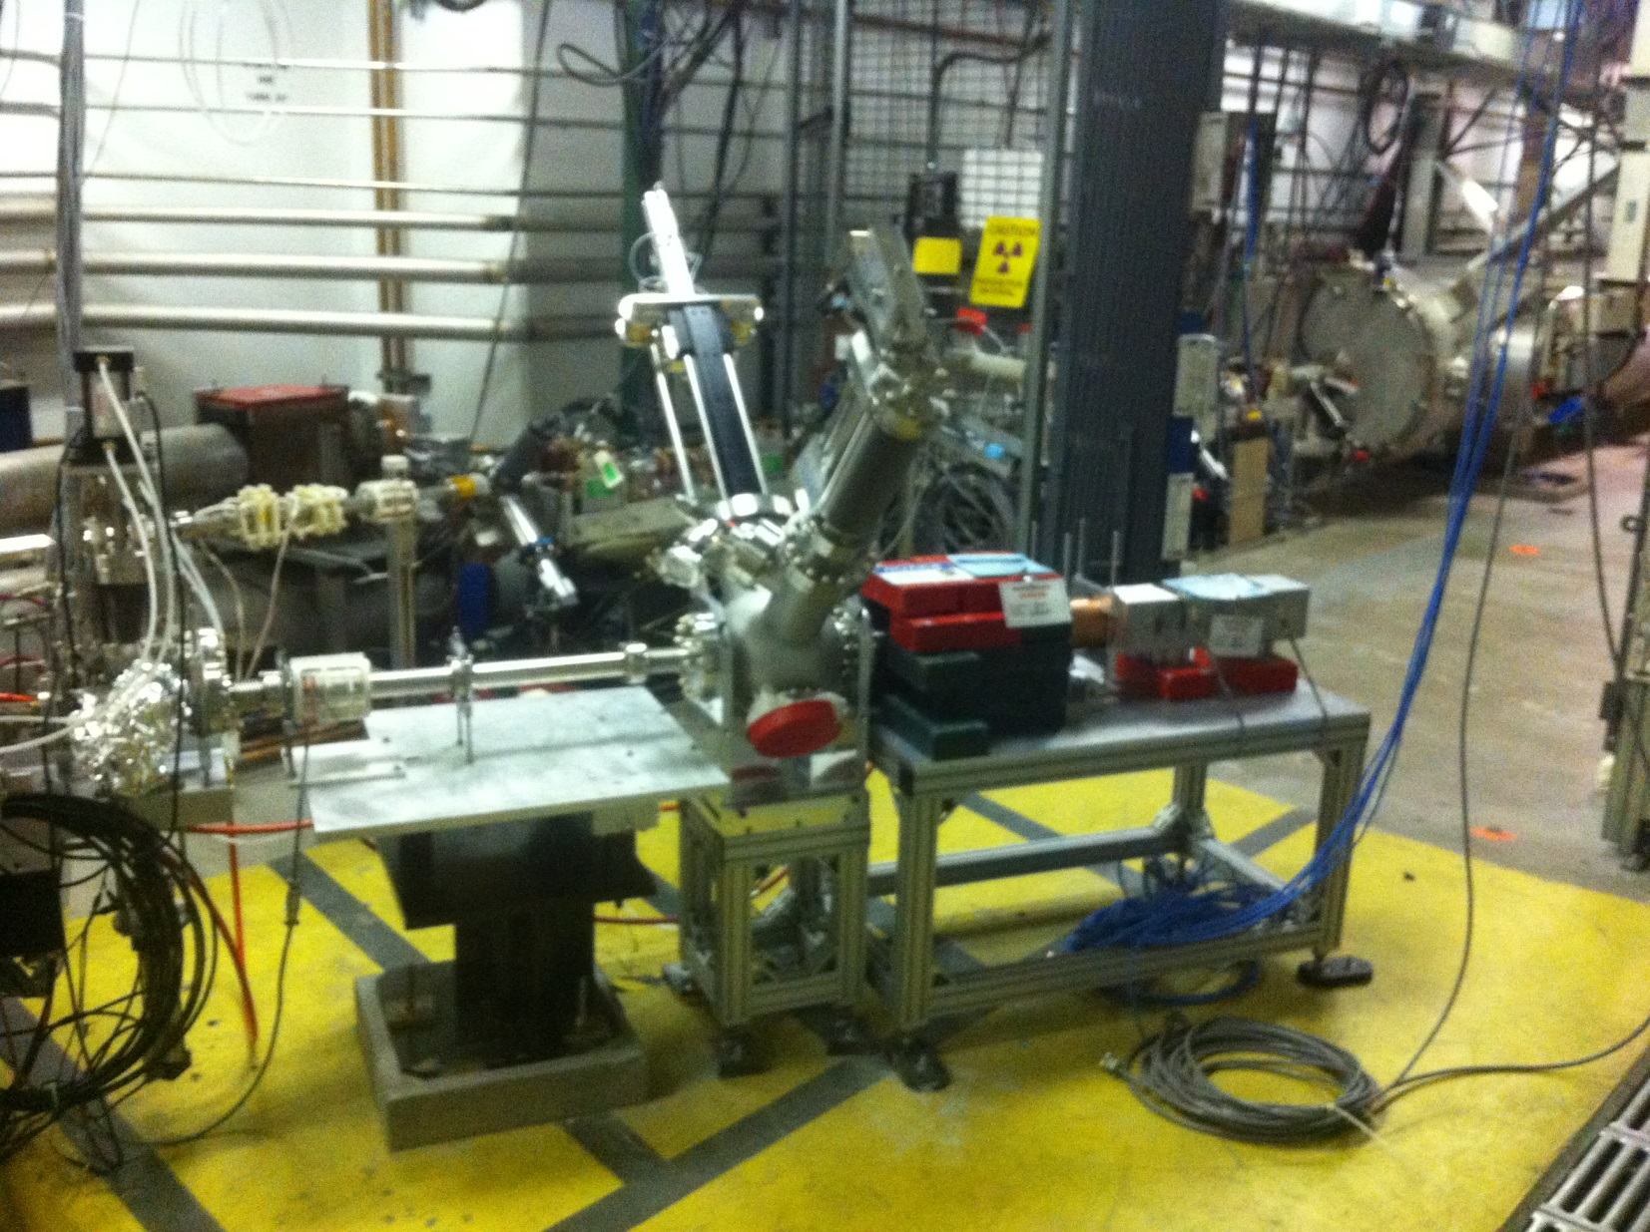
Large Dynamic Range Diagnostic Station (LDRDS) was installed in 5D line for beam test in Spring and Summer
Remove before Bubble Chamber installation

Slide 10
Schedule
July 29: Remove LDRDS and reassemble 5D line (Adderley + LDRDS crew)
July 30 – 31: Survey and Alignment
End-of-July: Bubble Chamber arrives JLab (shipping list and handling instructions will be provided), move to Injector tunnel (Install Group)
August 3 – 5: Install Chamber in 5D line (Brad DiGiovine + Install Group)
August 6 – 7: Safety review and inspection (Meekins + ESH&Q)
August 10 – 11: Survey and Alignment
August 12 – 30: Chamber ideal
August 31 – September 11: Chamber active for engineering run
September 12 – : Chamber ideal

Slide 11
Other Tasks
New laser shutter to terminate beam while Bubble Chamber is processing an event – Chamber will generate a TTL signal that will stay high for period with no beam (Hansknecht)
Thermal analysis of flange radiator/dump to increase administrative current limit from 10 µA CW to 100 µA CW (ME)
Identify OPS Liaison to Bubble Chamber

Slide 12
Beam Operations
Beam Studies: August 10 – 15 (swing shift only)
Momentum measurement (ATLis 13521)
Increase ¼ Cryounit gradient (ATLis 13523)
Measure beam charge at different currents (ATLis 13524)
Engineering Run: August 31 – September 11 (day + swing shifts)
Run plan forthcoming

