Slide 1
2015-LDRD-1a: Generation and Characterization of Magnetized Bunched Electron Beam from DC Photogun for JLEIC Cooler
PIs: Riad Suleiman and Matt Poelker
JLEIC bunched magnetized electron cooler is part of Collider Ring and aims to maintain ion beam emittance and extend luminosity lifetime. Because the cooling rate is estimated to increase by two orders of magnitude in a solenoidal field, generating a magnetized electron beam (to avoid emittance growth when injecting into the solenoid) is desired.
LDRD Scientific Goals:
Generate magnetized electron beam and measure its properties
Explore impact of cathode magnet on photogun operation
LDRD Benefits:
Simulations and measurements will provide insights on ways to optimize JLEIC electron cooler and help design appropriate electron source
JLab will have direct experience magnetizing high current electron beam

Slide 2
Milestones
Year 1: Generate non-magnetized beam. Design, procure and install cathode magnet, pucks and slits. (nearing completion)
Year 2: Generate magnetized beam. Measure mechanical angular momentum and benchmark simulation.
Year 3: Measure photocathode lifetime vs magnetization up to 32 mA.

Slide 3
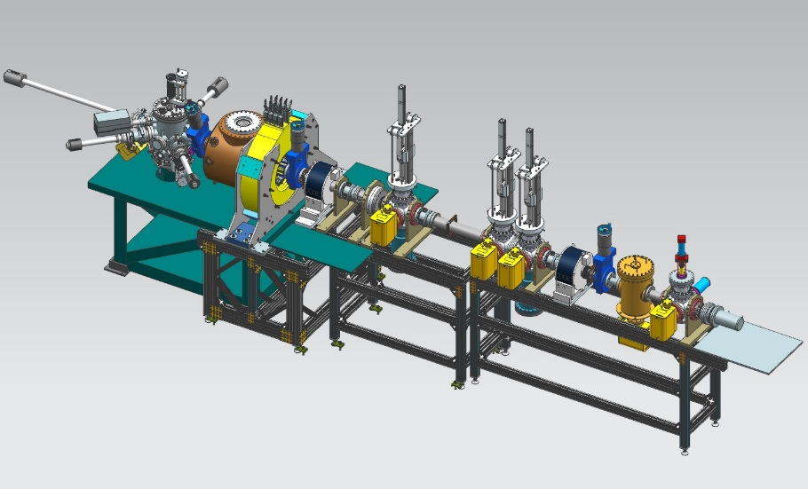
Experimental Overview: Gun Test Stand
Cathode
Solenoid
(B_{z}=2kG)
Beamline
Focusing
Solenoid
Diagnostic Cross 1
(Slit + YAG Screen)
Diagnostic Cross 3
(YAG Screen)
Anode
Green
Laser
K₂CsSb
Photocathode
Three Skew Quads
(Round-to-Flat Beam Transformer)
Diagnostic Cross 2
(Slit + YAG Screen)
Generate magnetized beam:
Laser size:1 – 5 mm, B_{z} = 0 – 2 kG
Bunch charge: 1 – 500 pC
Frequency: 15 Hz – 476.3 MHz
Bunch length: 10 – 100 ps
Average beam currents up to 32 mA
Gun high voltage: 200 – 350 kV

Slide 4
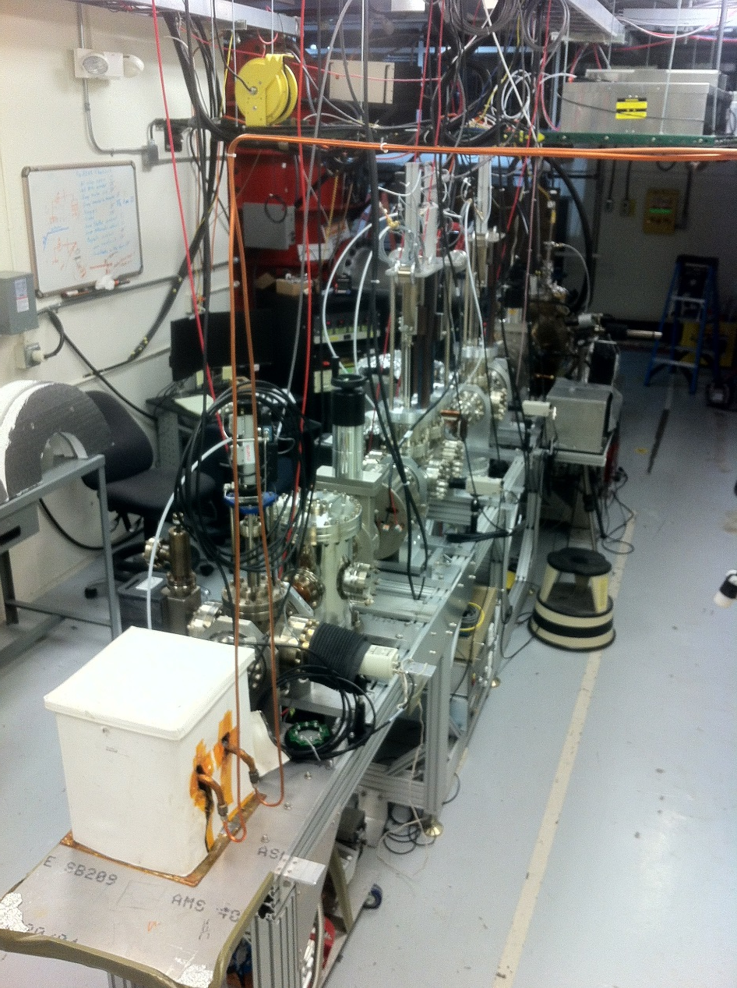
FY16 Accomplishments to date
K₂CsSb Photocathode Preparation Chamber, Gun and Beamline: delivered 1 mA to dump (non-magnetized)
Simulation (Fay Hannon):
Used ASTRA and GPT simulation to design beamline and to locate magnets and diagnostics at optimum positions
Simulated magnetized electron beam properties along beamline for various starting conditions
Simulated a round to flat transformer

Slide 5
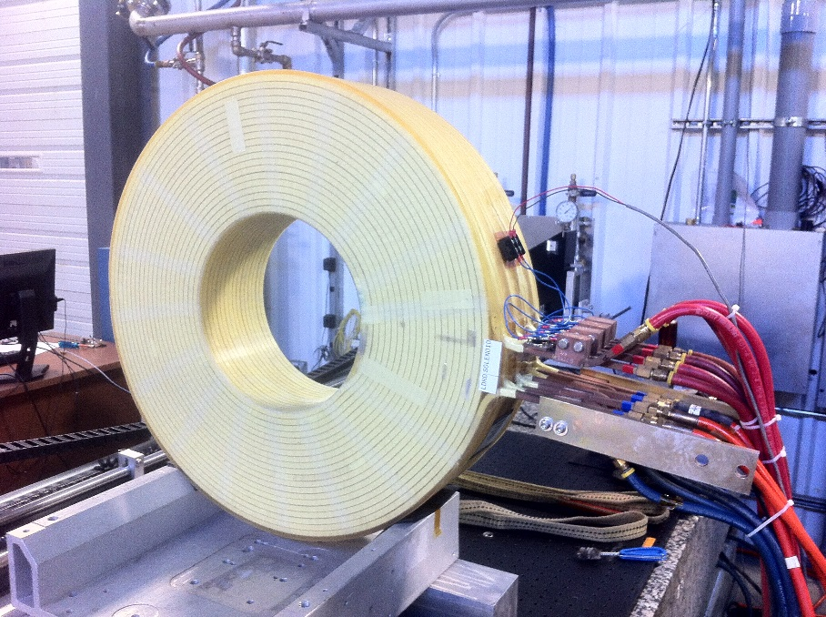
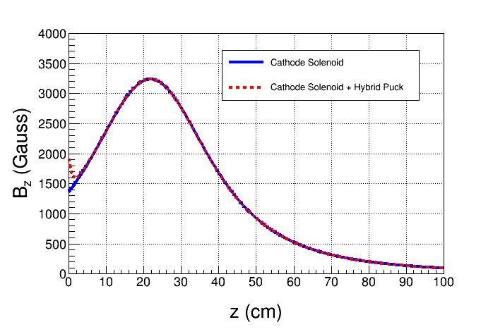
FY16 Accomplishments to date
Cathode Solenoid Magnet
Magnet is now at JLab Magnet Measurement Facility to be mapped
Molybdenum
New Pucks
Designed to enhance magnetic field at cathode to 2.0 kG
Steel

