Slide 1
Summary of Bubble Chamber Beam Test – Sept 2015
November 9, 2015
https://wiki.jlab.org/ciswiki/index.php/Bubble_Chamber

Slide 2
Outline
Chronology
No Beam Measurements
Radiation Hitting Camera
Measuring ¹⁸O(γ,α)¹⁴C
Beam Energy and Position
Summary and List of Improvements
Work since Sept Run
Upcoming Beamline Plan
Schedule

Slide 3
Chronology
Aug 3 – 11 | Chamber installed in Injector.
Sept 8 | TOSP was approved.
Sept 8 – 10 | Chamber filled with natural N₂O.
Sept 10 | Speckles on camera with 0.4 μA.
Sept 11 | Shielded camera. Took data at 7.7 MeV KE (0.4 μA, 30 nA) and 8.0 MeV KE (0.4 μA, 40 nA). Changed operational pressure from 325 psi to 300 psi and measured γ-p reaction on ¹⁴N.
Sept 12 | Pressure scan (300 – 325 psi) at 8.0 MeV KE and 35 nA. Beam position scan on to find maximum bubble rate with 0.4 μA and 320 psi. Tested camera with 10 μA on radiator- need more shielding.
Sept 13 | Added more shielding but could not run at 10 μA (8.0 MeV KE). Changed to 6.5 MeV KE and collected data at 1.0 and 10 μA. Changed beam energy to 4.0 MeV KE and took data at 10 μA. Stopped due to ceramic vacuum leak.
Sept 14 | Applied VacSeal to ceramic. Changed to 8.5 MeV KE and took data at 0.4 μA.
Sept 15 | Replaced ceramic break. Noticed many events with no beam: about one every a few seconds coming from bottom of N₂O glass cell.
Sept 16 | Refilled with fresh N₂O gas, background is less than 1 per minute. Took data at 8.2 MeV KE. Changed to 7.6 MeV KE. But found that background event rate was very high (1 every a few seconds).
Sept 17 | Vented and refilled fresh gas, 1 background event every 30 seconds. Took data at 7.6 MeV KE and 1 μA. Background rate increased to about 1 every 5 seconds after 1 hour of beam time. Took another 30 minutes beam run followed by 30 minutes of background run. Now, one background event every 2 seconds. Bubble chamber September test is completed.

Slide 4
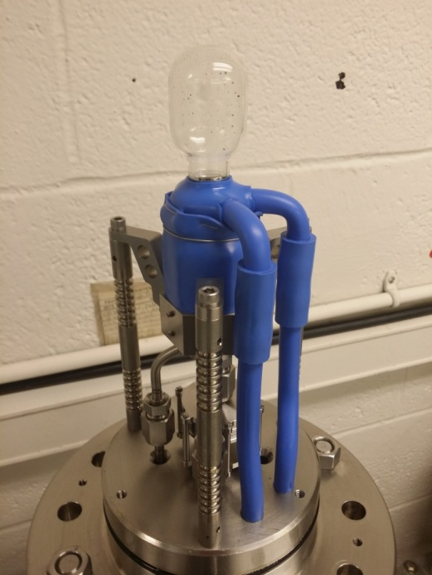
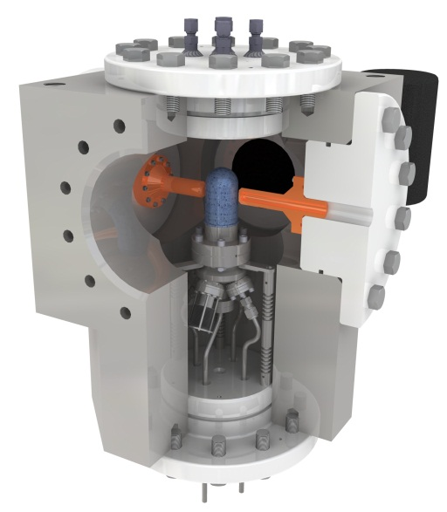
N₂O (Laughing Gas) Bubble Chamber
Notes:
Why the bubble in N2O rises? But not in C4F10. And why the liquid is cloudy for N2O? What was the buffer liquid?
The bubble is far more buoyant in N2O than C4F10 and rises faster. The buffer liquid is water and we had water absorbed in the N2O, but not in C4F10.

Slide 5
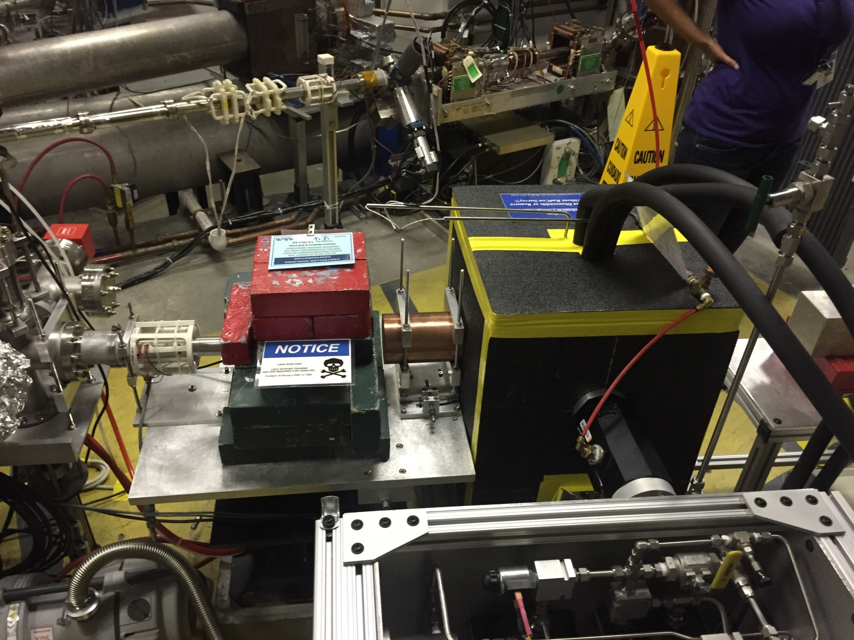
Chamber Installation in Injector

Slide 6
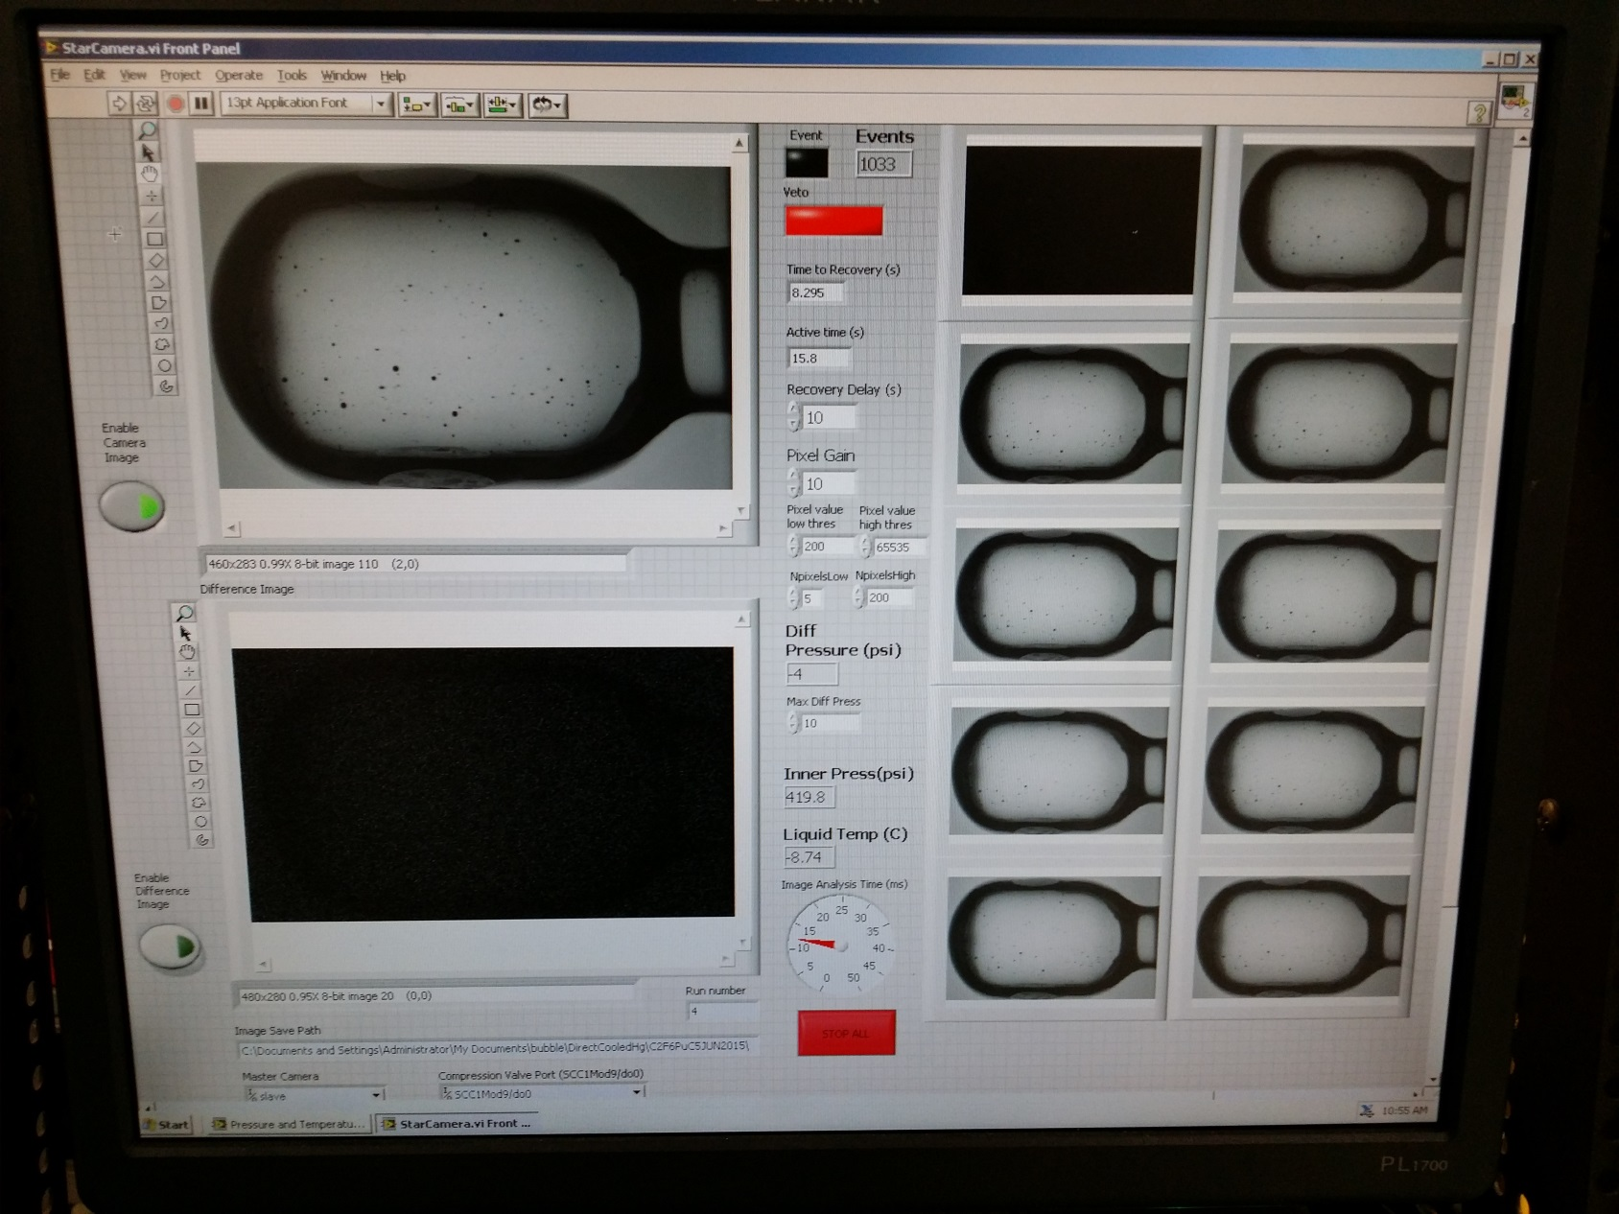
User Interface
LabVIEW

Slide 7
Filling Chamber with N₂O
https://drive.google.com/file/d/0B9ShTslvnOaCeFplbDU5NjZTSWs/view

Slide 8
First Day of September Test
Filled chamber with N₂O. Reached stability in operating temperature:
T = -8˚C, P = 325 psi
For ¹⁴N(γ,p)¹³C, P = 300 psi
Quenching (high) Pressure = 835 psi
Measured very low cosmic ray background of about 1 bubble per 8 minutes in JLab tunnel vs 1 – 2 bubbles per minute at Duke and Argonne
Tested sensitivity with neutron source
Produced 7.7 MeV electron beam on 6 mm Cu radiator

Slide 9
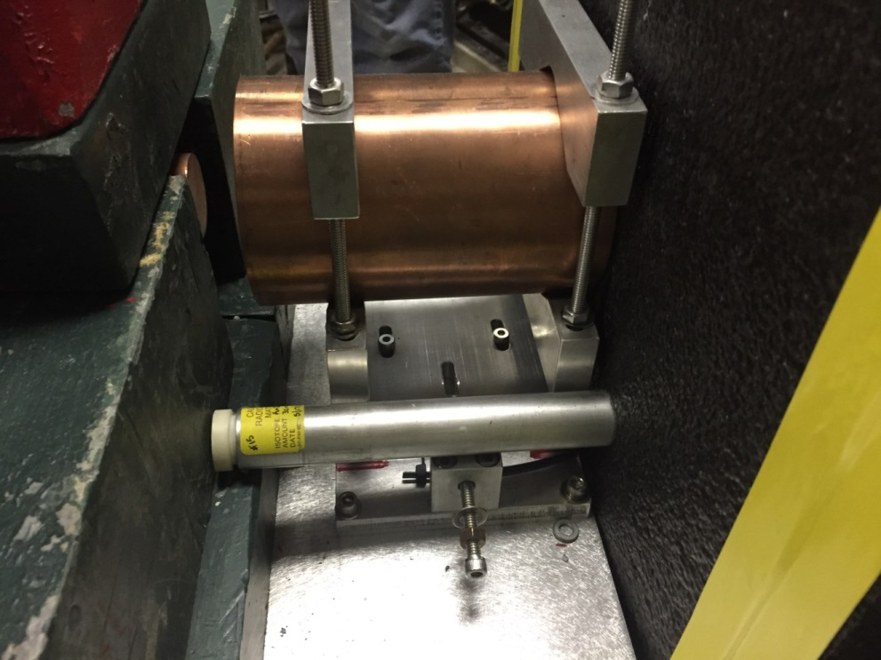
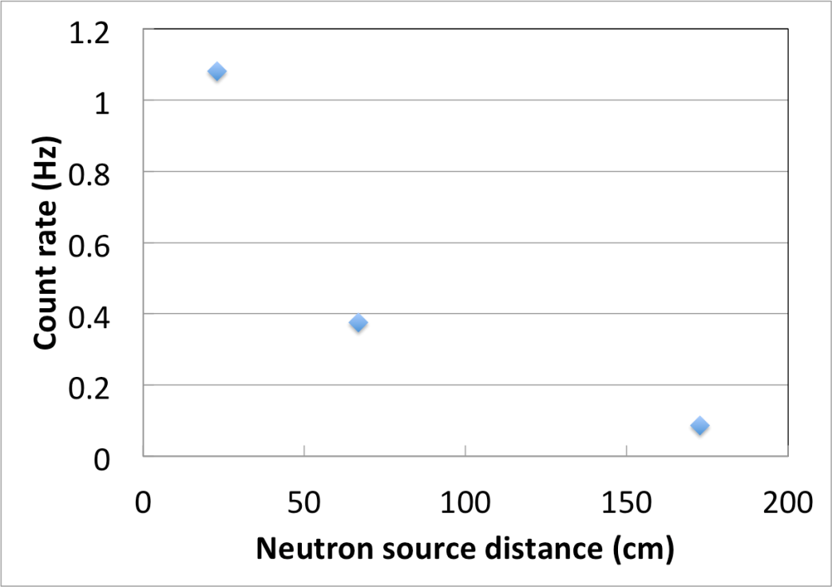
Neutron Source Test
Used Americium–Beryllium (α–n)neutron source (²⁴¹Am⁹Be)
Three distances (source on thermal insulator, 17 in, 59 in)
Obtained expected drop in count rate

Slide 10
Data Taking
Took data from Injector Service Building
Brad will work with accelerator network personnel to be able to take data from MCC

Slide 11
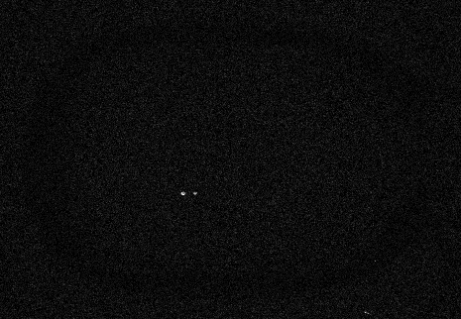
First Photodisintegration Event with Bremsstrahlung Beam
Sep 10, 2015 19:40

Slide 12
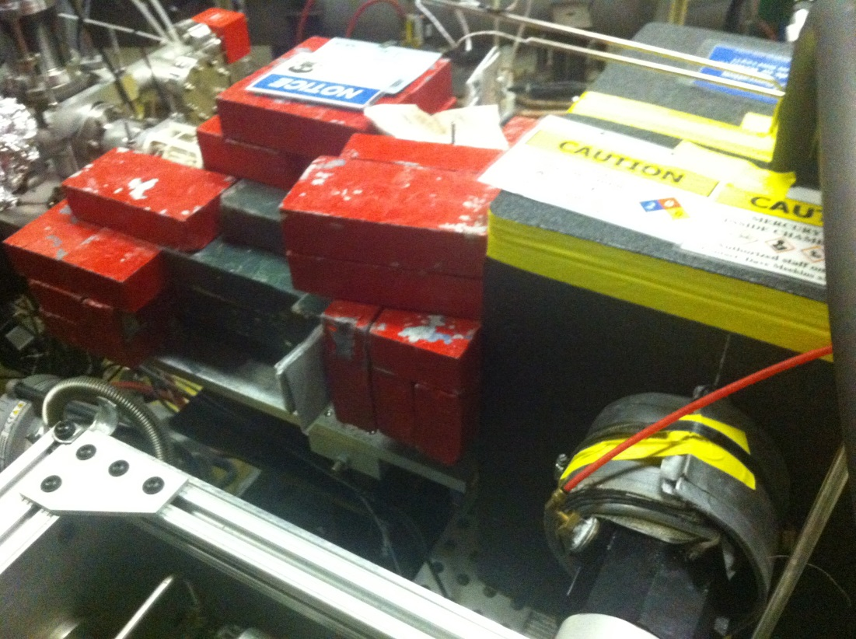
Radiation Hitting Camera
Event trigger at with beam current at 0.4 μA
Solution: shield camera

Slide 13
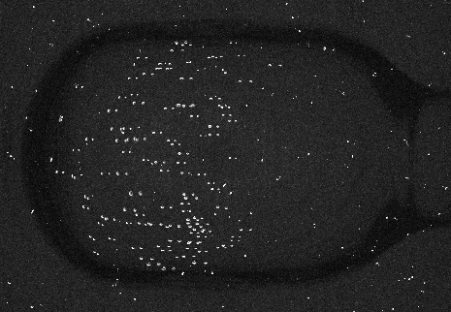
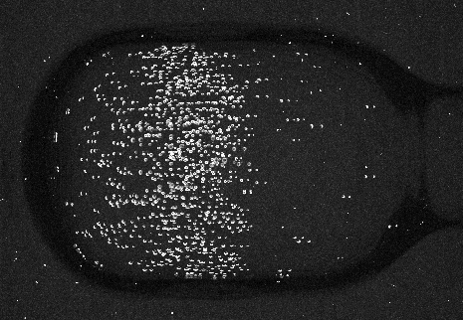
Events in fiducial volume
Two beam energies

Slide 14
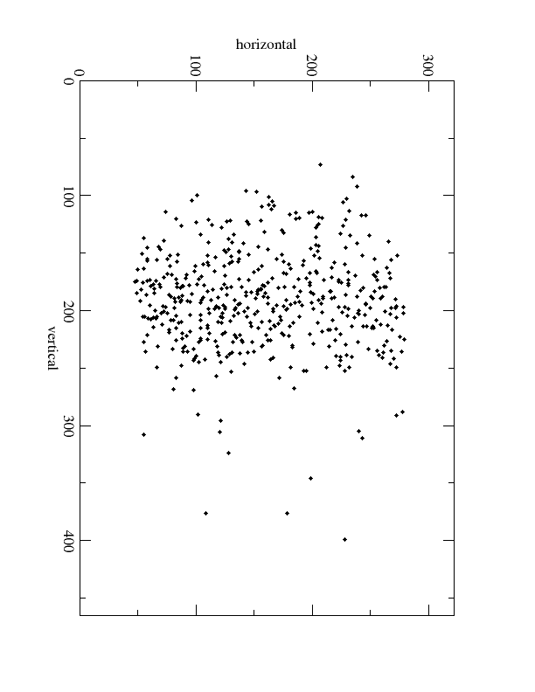
Events in fiducial volume

Slide 15
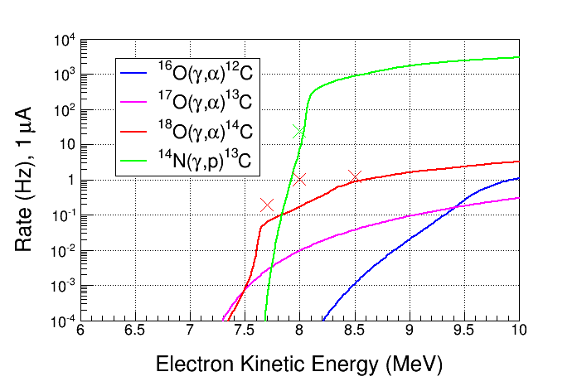
Measuring ¹⁸O(γ,α)¹⁴C Rate
Measured event rate vs beam energy
For natural N₂O, most events are γ-α from ¹⁸O
Measured rate from ¹⁴N(γ,p)¹³C with lower operational pressure
Experimental Rate = Number of bubbles in fiducial volume / (Time • Beam current (μA) )
Time = Run time -
Number of bubbles • Quenching time (5 sec)

Slide 16
Beam Energy Measurements
As of now, beam energies used during September test could be off by few percent
Beam energies used during test:
Set Kinetic Energy (MeV) | Measured Kinetic Energy (MeV)
4.0 | ? ± ?
6.5 | ? ± ?
7.6 | ? ± ?
7.7 | ? ± ?
8.0 | ? ± ?
8.2 | ? ± ?
8.5 | ? ± ?
Use GEANT4 to simulate Bremsstrahlung flux at these energies – find N_{γ}

Slide 17
Beam Position Measurements
What was beam position on radiator during test?

Slide 18
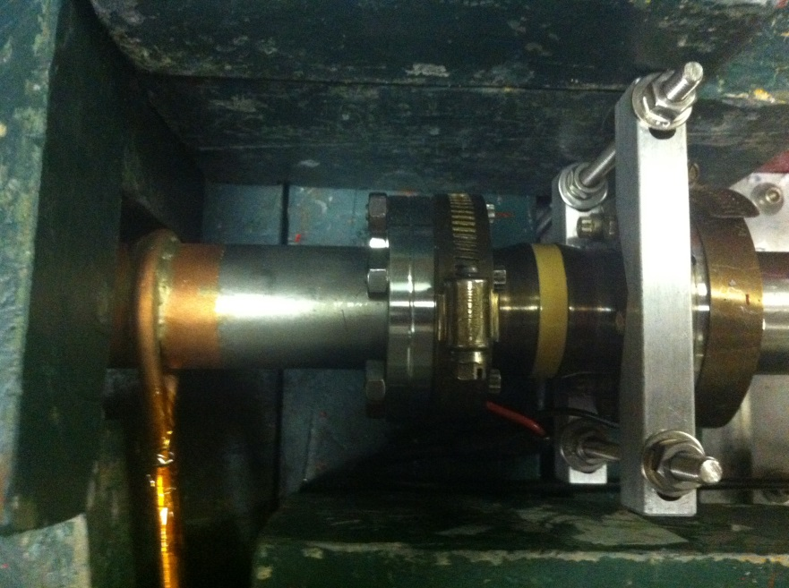
Summary
Plus
Chamber operated as expected in Bremsstrahlung beam
Will be able to measure chamber insensitivity to gammas – we had a high intensity gamma flux on chamber
Measured ¹⁸O(γ,α)¹⁴C cross section at five energies
Found sensitivity as expected to ¹⁴N(γ,p)¹³C when lowering operational pressure
Cosmic background of about 1 bubble per 8 minutes in JLab tunnel vs 1 – 2 bubbles per minute at Duke or Argonne
Minus
Chemistry of mercury – why background rate changed by end of test
Events distribution shows a cone instead of a cylinder – why?
Ceramic break failed
Beam position on radiator
Better alignment

Slide 19
List of Improvement
Easy
Better light coverage
Improve cooling capacity
Introduce a lens to locate camera farther and for better shielding of gammas (camera was sensitive to gammas)
Improve operational pressure control and regulation
Be able to take data from MCC instead of Injector Service Building
Tough
One fluid system – no more mercury
New collimator in chamber

Slide 20
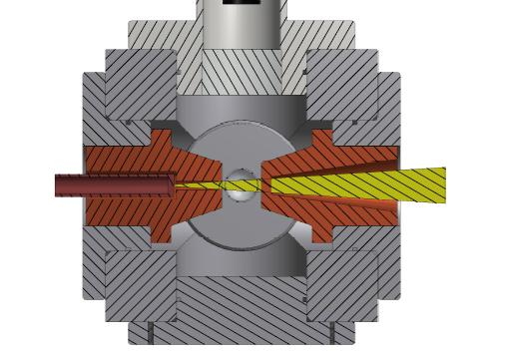
Proposed New Collimator
Advantages (Roy’s idea):
Simple estimation of Bremsstrahlung flux
Lower beam currents: Maximum Bremsstrahlung flux per electron, likely a factor of 10 more flux per electron than we have now.
Less shielding required since we would run lower beam currents.
Far less sensitivity to electron beam alignment and centering.
Must study in GEANT4

Slide 21
Work since Sept Run
Covered about 80% of 2D spectrometer line with steel sheet to shield earth’s magnetic field
Calibrated ¼ cryounit gradients using 2D line
Added mu-metal to 5D line – to add steel sheet in Jan 2016
Grames developed a procedure to set and measure beam energy
Measured beam position on radiator

Slide 22
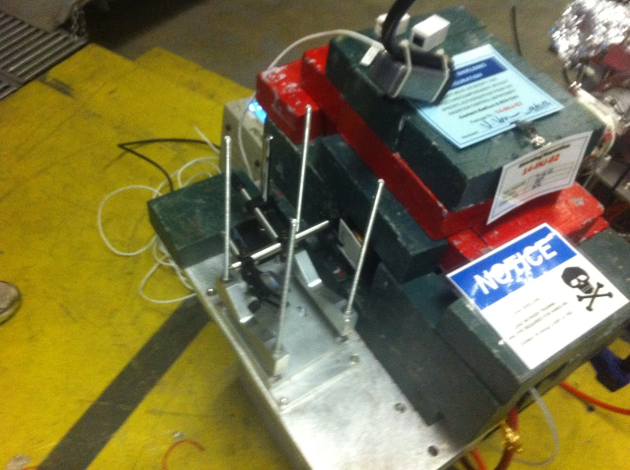
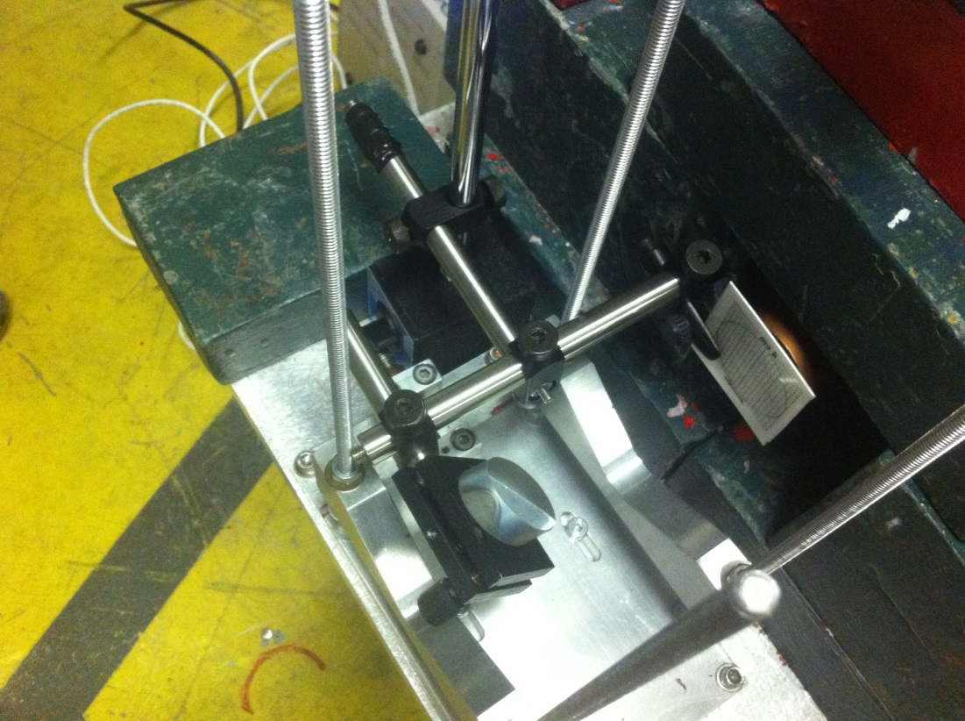
x-ray Fluorescent Screen
x-ray fluorescent screen was installed in front of radiator on Nov 2, 2015
This screen has a special coating that illuminates under x-rays and emits a green light

Slide 23
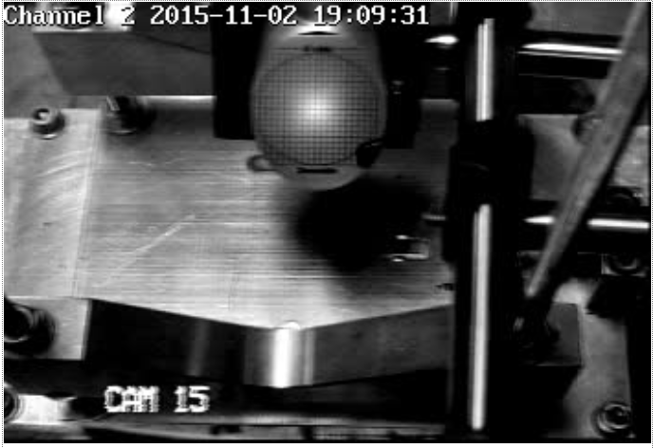
0.5 μA centered on x-ray screen

Slide 24
Upcoming Beamline Plan
Approved to run 10 μA CW and total energy of 10 MeV – redoing realistic thermal analysis to run at 100 μA (if needed?)
Calibrate BCM and measure nA beam currents (how much low? new chamber collimator will require very low currents
Align 5D line
Replace lead shielding with copper and iron
Test the bubble chamber laser shutter (Gumby Shutter) – show photo

Slide 25
Schedule
Chamber was removed and shipped back to Argonne on Nov 2, 2015 for improvements
Beam Schedule in 2016:
Run II: May 30 – June 20, 2016
Run III: Aug 15 – Aug 29, 2016
Injector Facility Development Time
Expectation of PAC days in FY2017
(i.e., no more engineering runs)

Slide 26
Backup Slides

Slide 27
To-Do-List
Gamma angular distribution (send to Roy)
Ask for Survey of beamline
Find old ceramic
Collimator position and dimensions (send to Roy)
Update JTabs screen

