Slide 1
Electric field with NEGs in Gun Chamber
Y. Wang
9/13/2016

Slide 2
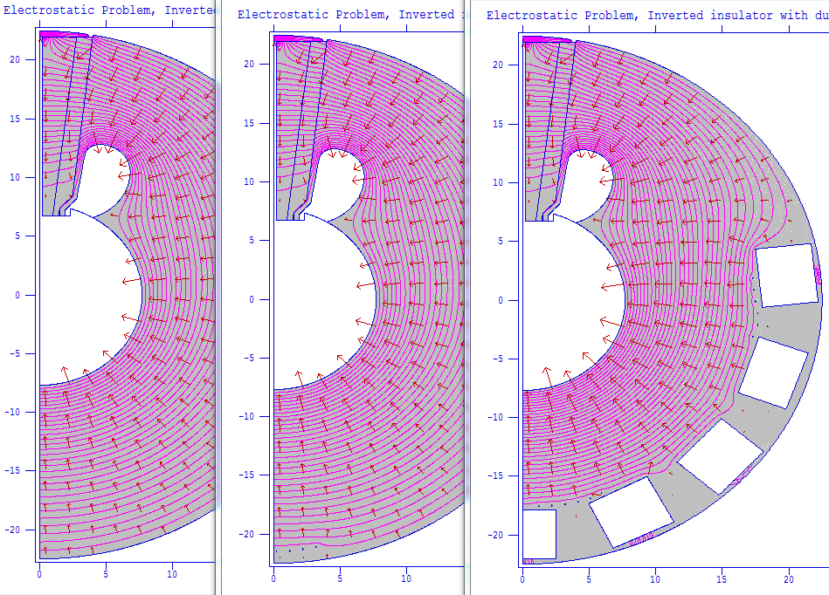
Gun Chamber and NEGs
No NEG
With NEG
Different NEG Configuration

Slide 3
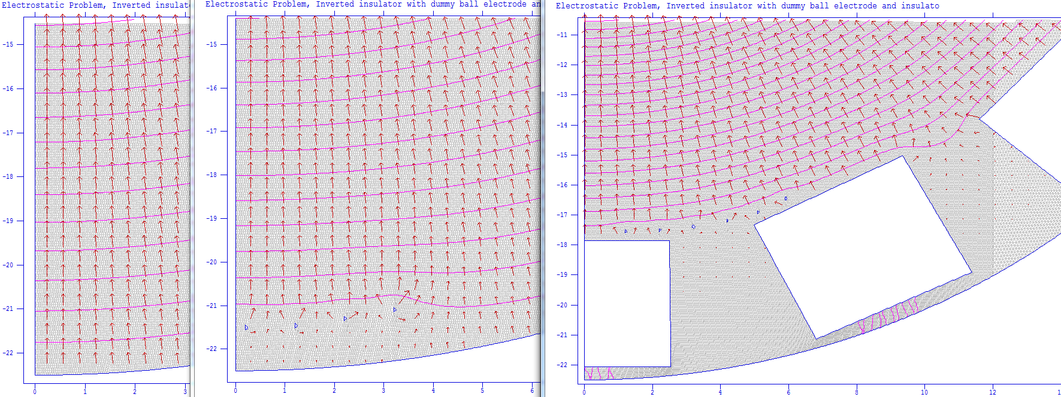
E field with Different Configuration
2.5MV/m
0.9MV/m
0.45M/m
1.4MV/m
1.25MV/m
1.5MV/m
0.5MV/m

Slide 4
Mesh
Mesh wire diameter = 1mm
Mesh size = 10 mm x 10mm

