Slide 1

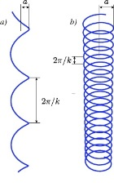
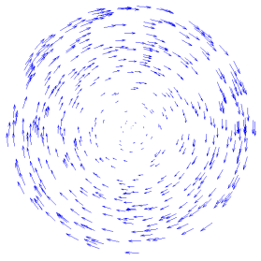


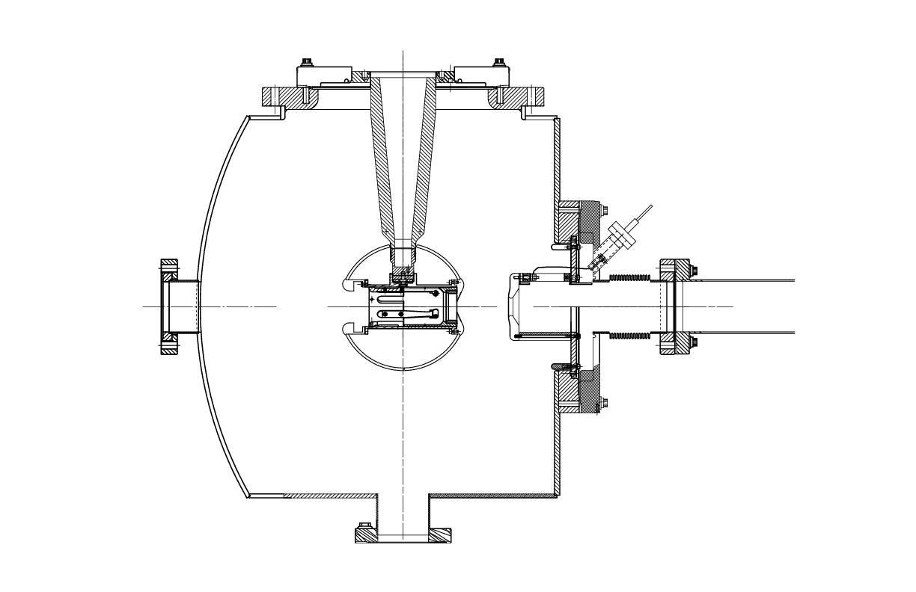
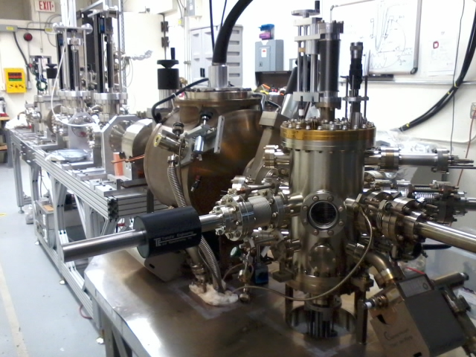
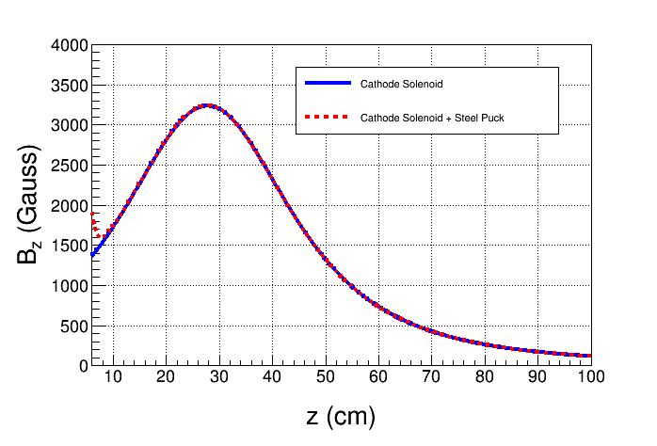
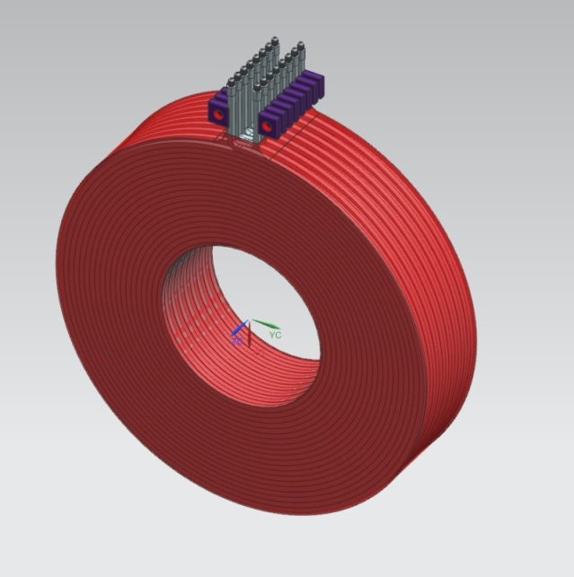
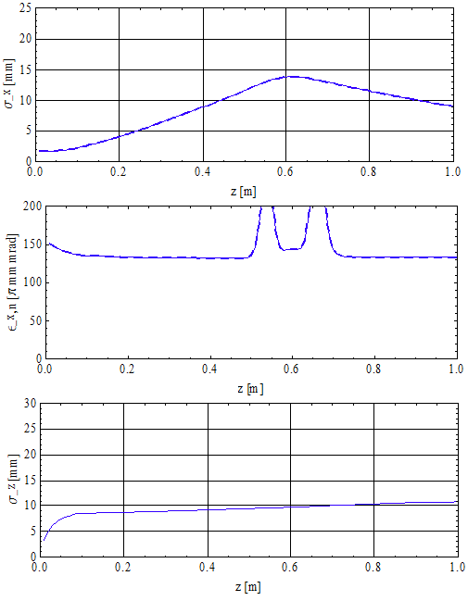
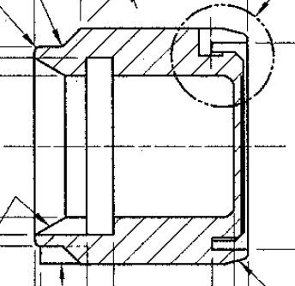
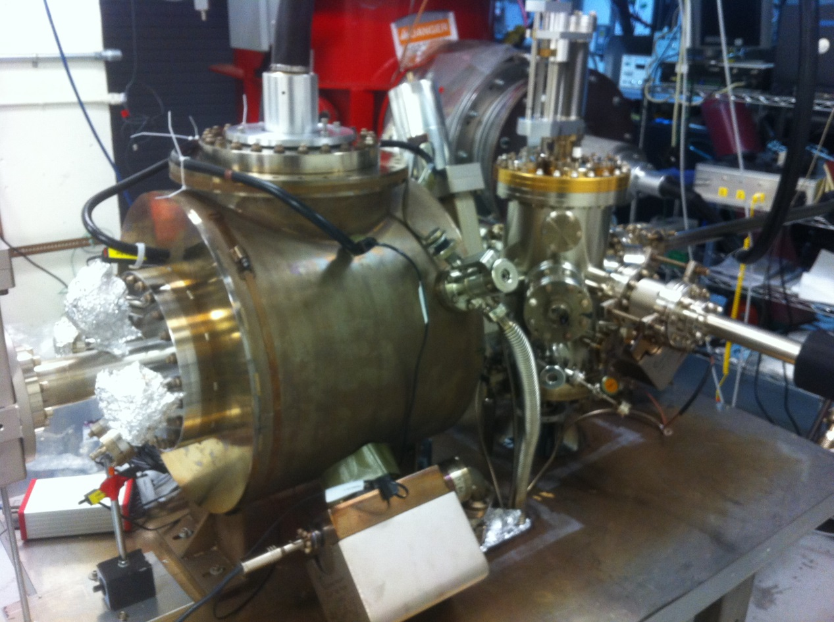
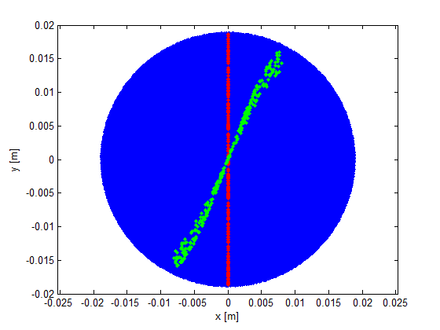


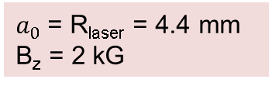
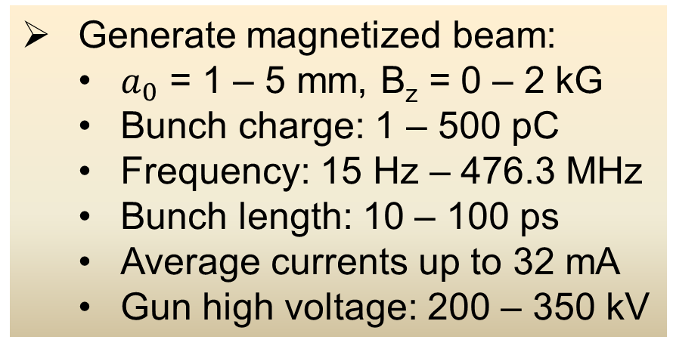
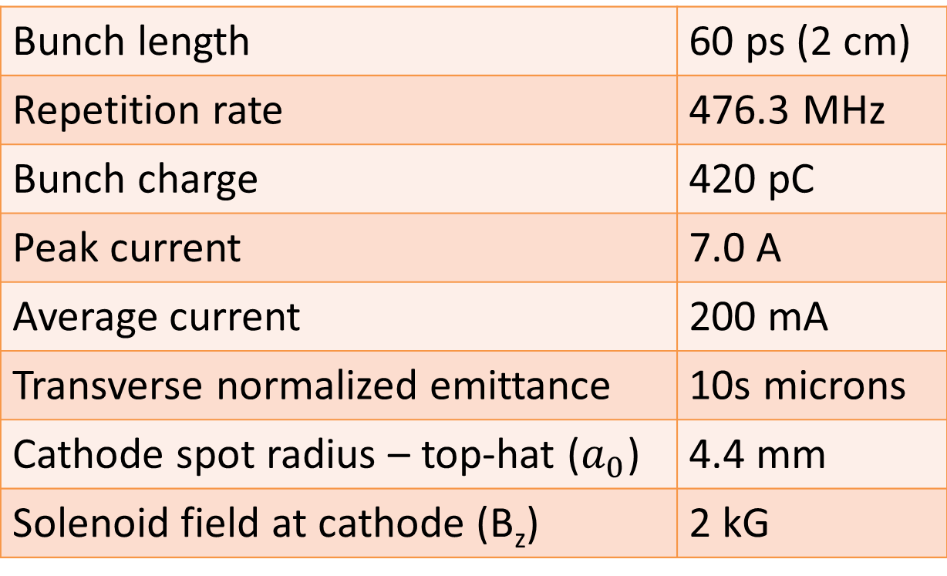
Generation and Characterization of Magnetized Bunched Electron Beam from a DC High Voltage Photogun
R. Suleiman, M. Poelker, J. Benesch, F. Hannon, C. Hernandez-Garcia, Y. Wang (Jefferson Lab)
Motivation
Electron beam is being used inside cooling solenoid where
it suffers an azimuthal kick when it enters. This kick is cancelled by an earlier kick at exit of cathode solenoid.
Experimental Overview
Jefferson Lab Electron Ion Collider (JLEIC) bunched magnetized electron cooler is part of Collider Ring and aims to counteract emittance degradation induced by intra-beam scattering, to maintain ion beam emittance during collisions and extend luminosity lifetime
Cooling Solenoid
Cathode
Solenoid
Injector
Focusing
Solenoid
Diagnostic Cross 1
(Slit + YAG Screen)
Diagnostic Cross 3
(YAG Screen)
Cathode Solenoid
SRF Linac
Cathode
Green
Laser
electron
Anode
ion
K₂CsSb
Photocathode
Three Skew Quads
(Round-to-Flat Beam Transformer)
Magnetized Cooling
Electrons born in strong uniform B_{z}
Upon exit of Cathode Solenoid
Diagnostic Cross 2
(Slit + YAG Screen)
Gun
Electrons helical motion in strong magnetic field increases electron-ion interaction time, thereby significantly improving cooling efficiency. Electron-ion collisions that occur over many cyclotron oscillations and at distances larger than cyclotron radius are insensitive to electrons transverse velocity.
Cooling rates are determined by electron longitudinal energy spread rather than electron beam transverse emittance as transverse motion of electrons is quenched by magnetic field.
This cyclotron motion also provides suppression of electron-ion recombination.
Upon entering Cooling Solenoid
r_{e}= 1.4 mm
B_{cool} = 2 T
Generate magnetized beam:
  $a_{0}$ = 1 – 5 mm, B_{z} = 0 – 2 kG
  Bunch charge: 1 – 500 pC
  Frequency: 15 Hz – 476.3 MHz
  Bunch length: 10 – 100 ps
  Average currents up to 32 mA
  Gun high voltage: 200 – 350 kV
$a_{0}$= R_{laser} = 4.4 mm
B_{z} = 2 kG
= 284 µm
Diagnostics
Bunch length | 60 ps (2 cm)
Repetition rate | 476.3 MHz
Bunch charge | 420 pC
Peak current | 7.0 A
Average current | 200 mA
Transverse normalized emittance | 10s microns
Cathode spot radius – top-hat ($a_{0}$) | 4.4 mm
Solenoid field at cathode (B_{z}) | 2 kG
Solenoid
Cathode Preparation Chamber
Measure mechanical angular momentum
Measure photocathode lifetime versus solenoid field at high currents (up to 32 mA) and high voltages (200 – 350 kV) limited by in-house HV supplies
Study beam halo and beam loss versus magnetization
Use skew quads – Round-to-Flat Beam (RTFB) Transformer – to generate flat beam and measure horizontal and vertical emittances using slit method
Generate very high currents magnetized beam and study beam transport and RTFB versus electron bunch charge
Simulations
Generate magnetized electron beam and measure its properties starting fall 2016
Explore impact of cathode solenoid on photogun operation
Simulations and measurements will provide insights on ways to optimize JLEIC electron cooler and help design appropriate source
Jefferson Lab will have direct experience magnetizing high current electron beam
Cathode Solenoid
Insert a slit into the beamline to select an emittance-dominated beamlet.
Let the beamlet drift to a screen and image it.
$a_{1}$ beam radius measured at Diagnostic Cross 1
$a_{2}$ beam radius measured at Diagnostic Cross 2
D drift between two crosses
p_{z} beam longitudinal momentum
Plans and Summary
Provides 1.4 kG at cathode with standard Molybdenum puck
Moly and carbon steel hybrid puck designed to enhance field to 2.0 kG at cathode
Carbon Steel
Cathode-Anode Gap
6”
Parameter
Cathode Bz | 0.2T
XY_rms, top-hat | 1.5mm
t rms, Gaussian | 23ps
Charge | 0 – 420pC
Gun voltage | 350kV
18”
9.0 cm
12”
10”
Molybdenum
6.4 cm
8”
7.5”
Molybdenum
10 mm
Stainless Steel
2 mm
4 mm
Carbon Steel
Acknowledgement: This work is supported by the Department of Energy, Laboratory Directed Research and Development funding, under contract DE-AC05-06OR23177

