Slide 1
Description of Hardware of UITF 200 keV Mott DAQ
Riad Suleiman

Slide 2
Upgraded Injector Test Facility – Mott data acquisition
4 Helicity Signals,
1 FC, 2 BPMs (X±, Y±)
VXS crate
Integ.
fADC
Counting
fADC
SBC
TI
4 Helicity Signals
Helicity
Trigger
SCA
Out
Amp
Out
590A
Amp/Disc
OR
Fanout
Mott Trigger
E Out
570 Amp
142A
Preamp
E Out
142B
Preamp
T Out
Left (50˚)
Detector
Right (50˚)
Detector
Left (120˚)
Detector
Right (120˚)
Detector
BU-012-050-100
BU-013-050-1000-S

Slide 3
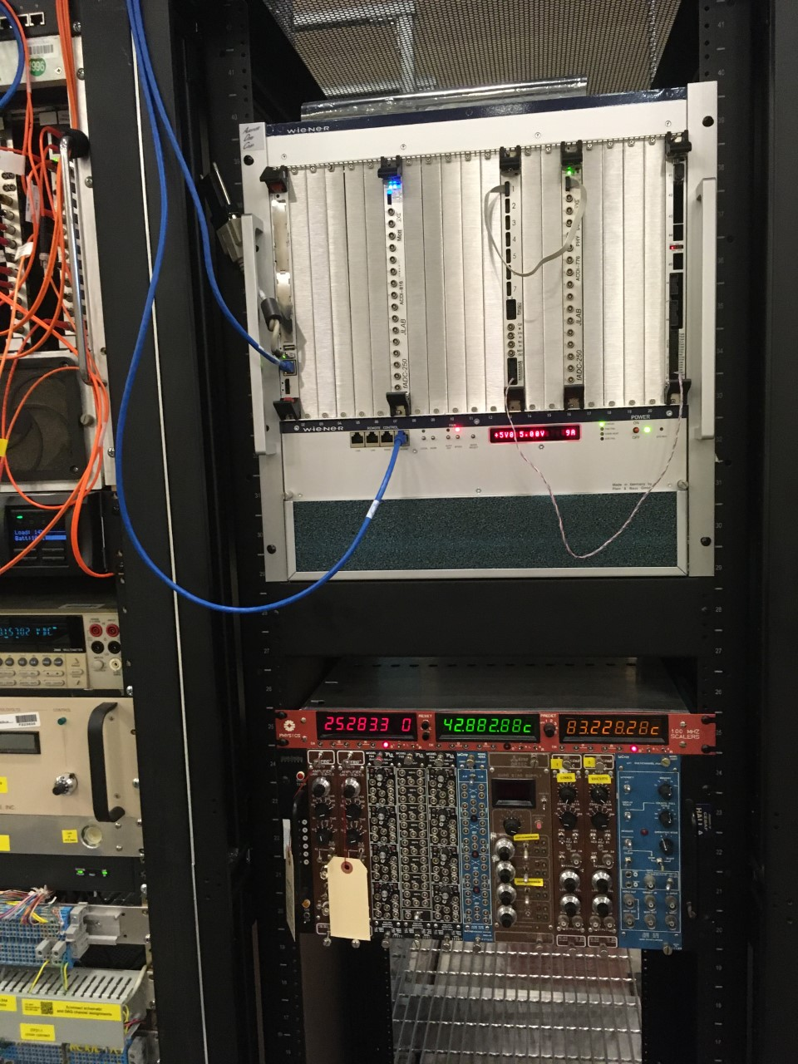
DAQ Hardware
Cable NIM Crate and VXS Crate
Cables from detectors to NIM Crate
Helicity signals from Helicity Board to VXS Crate

Slide 4
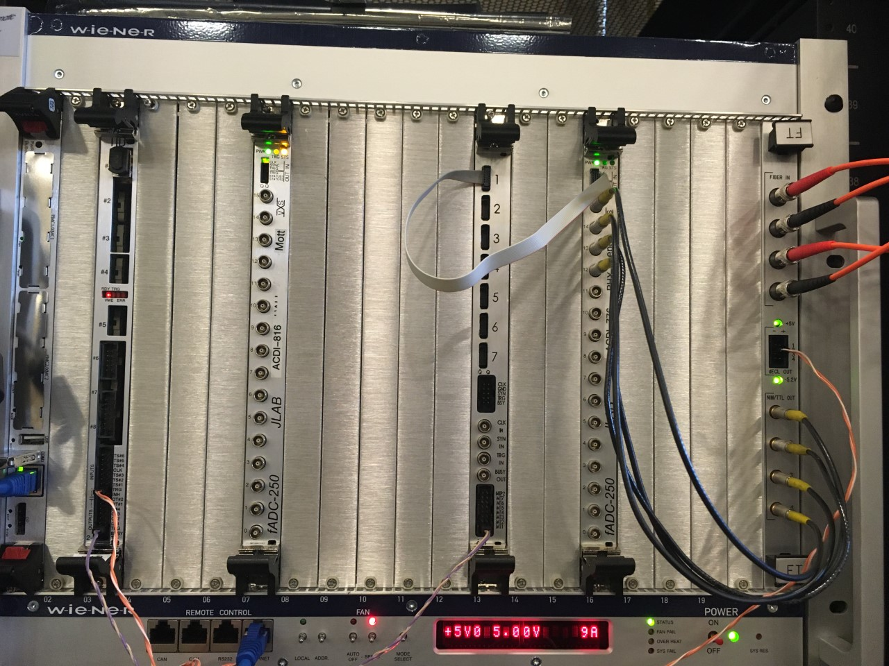
Mott DAQ
Hardware | Rack
itfmdaq0 | ITF 07
Mott VXS Crate | IN02B21
Mott NIM Crate | IN02B21

Slide 5
Mott DAQ crates
VXS Crate
Mott NIM Crate
Slot | Board
1 | Linux SBC
2 | Empty
3 | TID
4 | Empty
5 | Empty
6 | Empty
7 | Mott FADC
8 | Empty
9 | Empty
10 | Empty
11 | Empty
12 | Empty
13 | Distribution Board
14 | Empty
15 | Empty
16 | PEPPo FADC
17 | Empty
18 | Empty
19 | Empty
20 | Empty
21 | FT
Slot | Board
1 | Amplifier
2 | Amplifier
3 | Empty
4 | HV
5 | HV
6 | Empty
7 | Amplifier
8 | Amplifier
9 | Empty
10 | DUAL DELAY MODULE PS792
11 | DUAL DELAY MODULE PS792
12 | DUAL DELAY MODULE PS792

Slide 6
VXS CRATE
VME SBC – iocmdaq1 | TID |  | CAEN V538A |  | DB 1 | Mott FADC |  |  | DB 2 | INT FADC |  |  |  | S1 | S2 |  |  | TDC CAEN V775 |  |  | FT
1
1
1 In
Gate
17 BFM
18 Mott
DetTr
L1A
LEMO
4
LN1
Common
L1A
ECL
4
TRG IN
TRG IN
INH
BUSY
Opsmdaq0
nT_Settle

Slide 7
Mott NIM Crate
LIN 748 ΔE | Octal DISC 705 ΔE | TIM DISC 715 ΔE | QUAD Logic 754 AND | LIN 748 E | TIM DISC 715 E | QUAD Logic 754 OR |  |  | Delay 792 | Delay 792
→ ΔE LEFT ← FADC CH5 OD Ch1 TD CH1 | → ΔE LEFT ← Veto | → ΔE LEFT (2 ns Delay) ← QL AND Ch1 ← S1 Ch13 | → ΔE LEFT → Veto → E LEFT ← QL OR Ch1 ← S1 Ch5 | → E LEFT ← FADC CH1 TD CH1 | → E LEFT (4 ns Delay) ← QL AND Ch1 ← S1 Ch9 | → LEFT RIGHT UP DOWN ← Mott DetTr S1 Ch2 |  |  | → ΔE LEFT 1+2+8 ns ← LIN 748 CH1 | → ΔE RIGHT 4+8 ns ← LIN 748 CH3
 |  |  |  |  |  |  |  |  | → ΔE UP 0.5+4+8 ns ← LIN 748 CH5 | → ΔE DOWN 1+4+8 ns ← LIN 748 CH7

