Slide 1
Description of Hardware of UITF 200 keV Mott DAQ
Riad Suleiman

Slide 2
Upgraded Injector Test Facility – Mott data acquisition
4 Helicity Signals,
1 FC, 2 BPMs (X±, Y±)
VXS crate
Integ.
fADC
Counting
fADC
SBC
TID
4 Helicity Signals
Helicity
Trigger
SCA
Out
Amp
Out
590A
Amp/Disc
OR
Fanout
Mott Trigger
E Out
570 Amp
142A
Preamp
E Out
142B
Preamp
T Out
Left (50˚)
Detector
Right (50˚)
Detector
Left (120˚)
Detector
Right (120˚)
Detector
BU-012-050-100
BU-013-050-1000-S

Slide 3
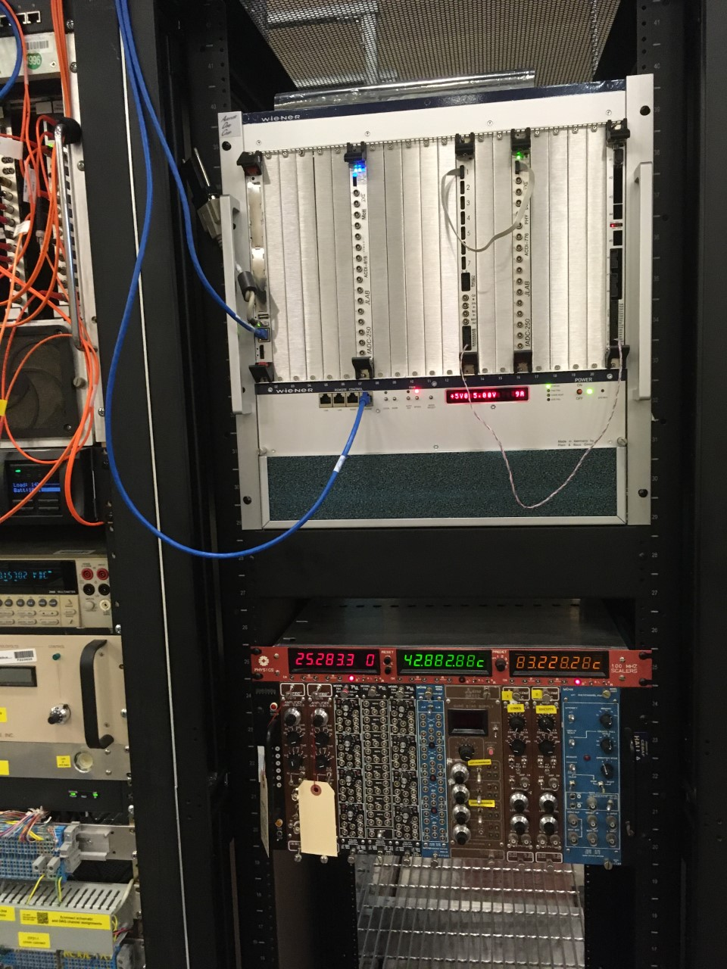
DAQ Hardware
Cable NIM Crate and VXS Crate
Cables from detectors to NIM Crate
Helicity signals from Helicity Board to VXS Crate

Slide 4
Mott DAQ
Hardware | Rack
itfmdaq0 | ITF 07
Mott VXS Crate
Mott NIM Crate

Slide 5
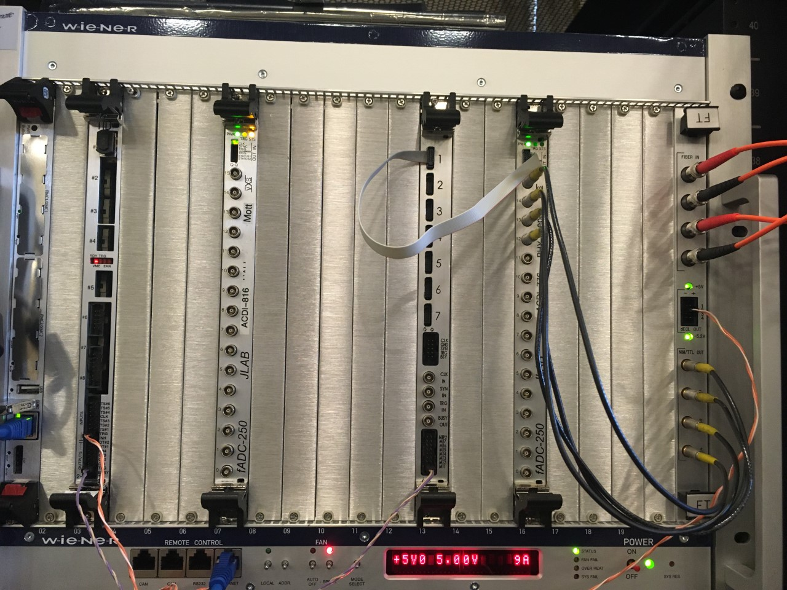
Mott DAQ crates
VXS Crate
Mott NIM Crate
Slot | Board
1 | Linux SBC
2 | Empty
3 | TID
4 | Empty
5 | Empty
6 | Empty
7 | Mott FADC
8 | Empty
9 | Empty
10 | Empty
11 | Empty
12 | Empty
13 | Distribution Board
14 | Empty
15 | Empty
16 | PEPPo FADC
17 | Empty
18 | Empty
19 | Empty
20 | Empty
21 | FT
Slot | Board
1 | 570 Amplifier
2 | 570 Amplifier
3 | Empty
4-5 | ORTEC QUAD BIAS SUPPLY
6 | Empty
7 | 590A Amplifier
8 | 590A Amplifier
9 | Empty
10 | Empty
11 | QUAD GATE/DELAY GENERATOR PS794
12 | LOGIC FAN IN/OUT LeCroy 429A

Slide 6
VXS CRATE
Itfsbcmdaq0 |  | TID |  |  |  | Mott FADC |  |  |  |  |  | Distribution Board |  |  | PEPPo FADC |  |  |  |  | FT
Delayed Helicity
1
T_Settle
Pattern Sync
Pair Sync
TRG
INPUTS
dECL-2
T_Settle
LN1
TM1
TRG OUTPUTS
itfmdaq0

Slide 7
Mott NIM Crate
570 Amp (120°) RIGHT | 570 Amp (120°) LEFT |  | ORTEC QUAD BIAS SUPPLY |  | 590A Amp (50°) RIGHT | 590A Amp (50°) LEFT |  |  | QD 794 | FAN 429A
→ IN E ← OUT E | → IN E ← OUT E |  |  |  | → IN E ← OUT E | → IN E ← OUT E |  |  | → nT_Settle ← 428 ns nT_Settle Trigger | → Delayed Helicity
 |  |  |  |  |  |  |  |  |  | → T_Settle
 |  |  |  |  |  |  |  |  |  | → Pattern Sync
 |  |  |  |  |  |  |  |  |  | → Pair Sync

