Slide 1
Description of Hardware of UITF 200 keV Mott DAQ
Riad Suleiman

Slide 2
Upgraded Injector Test Facility – Mott data acquisition
VXS crate
4 Helicity Signals
Mott
fADC
INT
fADC
SBC
TID
4 Helicity Signals,
1 FC, 2 BPMs (X±, Y±)
Helicity
Trigger
Amp
Out
Amp
Out
Mott Trigger
SCA Out
OR
590A
Amp/Disc
Fanout
E Out
570 Amp
142B
Preamp
E Out
142A
Preamp
Left (120˚)
Detector
Right (120˚)
Detector
Left (50˚)
Detector
Right (50˚)
Detector
BU-013-050-500
BU-013-050-1000-S

Slide 3
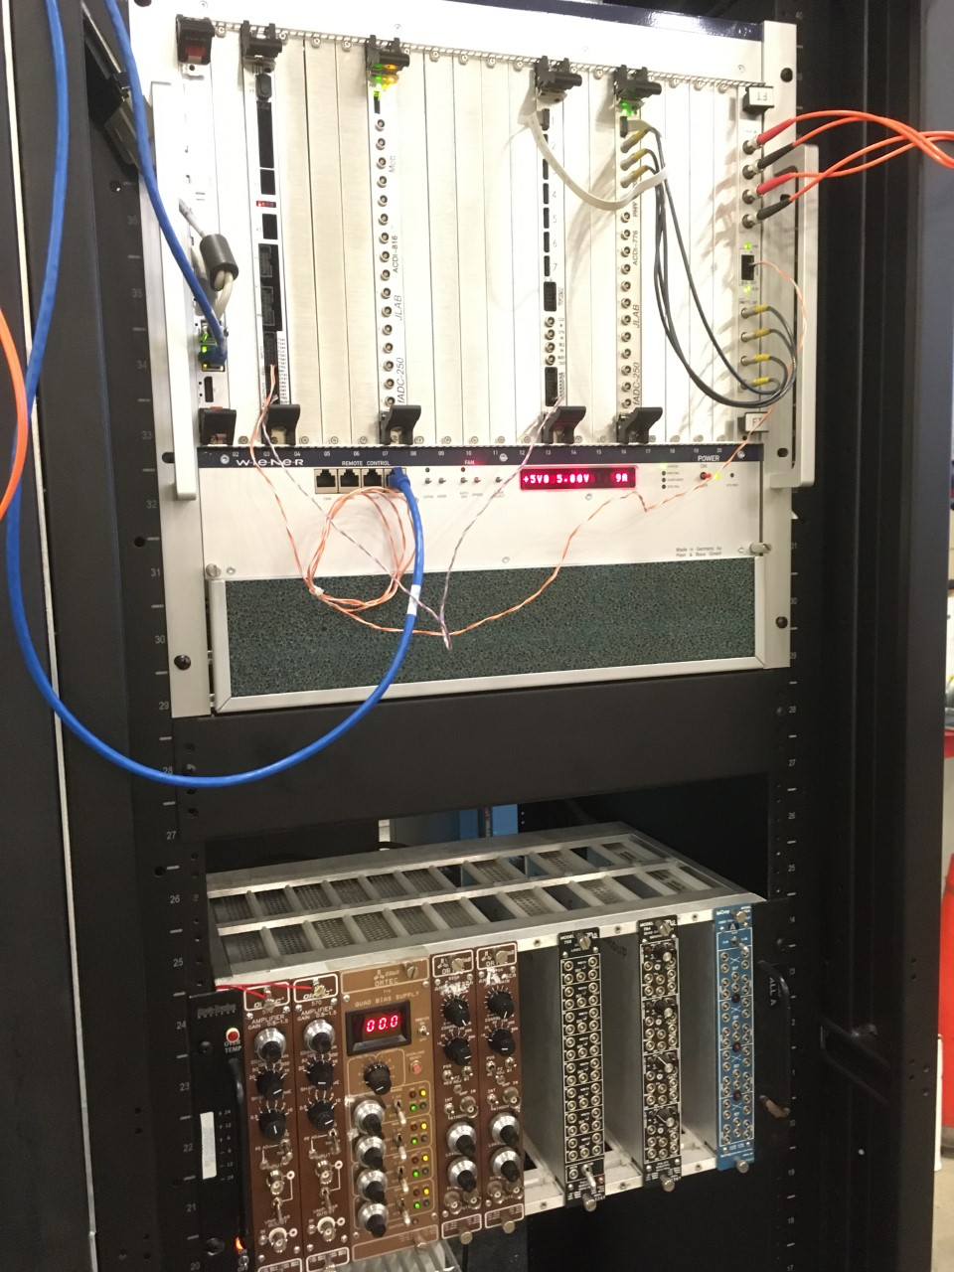
DAQ Hardware
Cable NIM Crate and VXS Crate
Cables from detectors to NIM Crate
Helicity signals from Helicity Board to VXS Crate

Slide 4
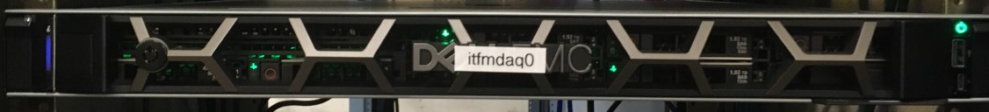
Mott DAQ
Hardware | Rack
itfmdaq0 | ITF 07
Mott VXS Crate
Mott NIM Crate

Slide 5
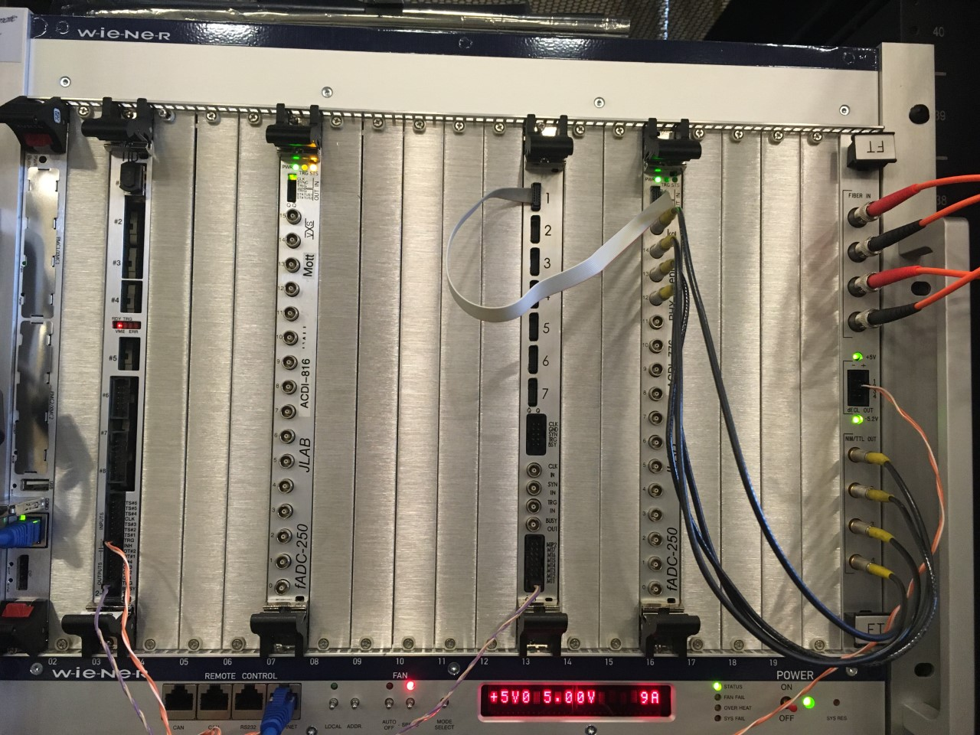
Mott DAQ crates
VXS Crate
Mott NIM Crate
Slot | Board
1 | Linux SBC
2 | Empty
3 | TID
4 | Empty
5 | Empty
6 | Empty
7 | Mott FADC
8 | Empty
9 | Empty
10 | Empty
11 | Empty
12 | Empty
13 | Distribution Board
14 | Empty
15 | Empty
16 | INT FADC
17 | Empty
18 | Empty
19 | Empty
20 | Empty
21 | FT
Slot | Board
1 | 570 Amplifier
2 | 570 Amplifier
3-4 | ORTEC QUAD BIAS SUPPLY
5 | 590A Amplifier
6 | 590A Amplifier
7 | Empty
8 | Empty
9 | Empty
10 | QUAD GATE/DELAY GENERATOR PS794
11 | LEVEL TRANSLATOR
12 | LOGIC FAN IN/OUT LeCroy 429A

Slide 6
VXS CRATE
Itfsbcmdaq0 |  | TID |  |  |  | Mott FADC |  |  |  |  |  | Distribution Board |  |  | INT FADC |  |  |  |  | FT
Delayed Helicity
1
T_Settle
Pattern Sync
Pair Sync
TRG
INPUTS
dECL-2
T_Settle
LN1
TM1
TRG OUTPUTS
itfmdaq0

Slide 7
Mott NIM Crate
570 Amp (50°) LEFT | 570 Amp (50°) RIGHT | ORTEC QUAD BIAS SUPPLY | 590A Amp (120°) LEFT | 590A Amp (120°) RIGHT |  |  |  |  | QD 794 | FAN 429A
→ IN E ← OUT E | → IN E ← OUT E | 142A Preamp (120°) LEFT +115 V | → IN E ← OUT E | → IN E ← OUT E |  |  |  |  | → nT_Settle ← 428 ns nT_Settle Trigger | → Delayed Helicity
 |  | 142A Preamp (120°) RIGHT +115 V
 |  |  |  |  |  |  |  |  |  | → T_Settle
 |  | 142B Preamp (50°) LEFT +115 V |  |  |  |  |  |  |  | → Pattern Sync
 |  | 142B Preamp (50°) RIGHT +115 V
 |  |  |  |  |  |  |  |  |  | → Pair Sync

Slide 8
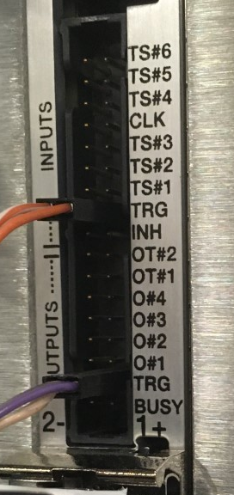
CHANNEL ASSIGNMENT – TRIGGER INTERFACE (TID)
TID Chan | INPUTS
7
6
5
4
3 | TS#3 (DB MT1)
2
1 | TS#1 (Mott DetTr)
0 | TRG ( Delayed nT_Settle)
INH
TID Chan | OUTPUTS
7
6
5
4
3
2 | Distribution Board MT1
1
0

Slide 9
CHANNEL ASSIGNMENT – PREAMPLIFIERS
OUTPUTS | 142A Preamp (120°) LEFT
E | 570 Amp E IN
T OUT | TID
OUTPUTS | 142A Preamp (120°) RIGHT
E | 570 Amp E IN
T OUT | TID
OUTPUTS | 142B Preamp (50°) LEFT
E | 590A Amp E IN
T OUT | -
OUTPUTS | 142B Preamp (50°) RIGHT
E | 590A Amp E IN
T OUT | -

Slide 10


CHANNEL ASSIGNMENT – AMPLIFIERS
Channel | 570 Amp (120°) LEFT
E IN | 142A Preamp E
E OUT | Mott FADC CH0
Channel | 570 Amp (120°) RIGHT
E IN | 142A Preamp E
E OUT | Mott FADC CH1
Channel | 590A Amp (50°) LEFT
E IN | 142B Preamp E
E OUT | INT FADC CH0
SCA OUT
Channel | 590A Amp (50°) RIGHT
E IN | 142B Preamp E
E OUT | INTFADC CH1
SCA OUT

Slide 11
FADC
Mott
INT
FADC Chan | Signal
1
2
3
4
5
6
7
8
9
10
11 | Mott DetTr
12
13 | Delayed Helicity
14 | T_Settle
15 | Pattern–Sync
16 | Pair–Sync
FADC Chan | Signal
1
2
3
4
5
6
7
8
9
10 | Battery
11
12
13 | Delayed Helicity
14 | T_Settle
15 | Pattern–Sync
16 | Pair–Sync

