Slide 1
Description of Hardware of UITF 200 keV Mott DAQ
Riad Suleiman

Slide 2
Upgraded Injector Test Facility – Mott Data Acquisition
VXS crate
4 Helicity Signals
Mott
fADC
INT
fADC
Helicity Decoder
SBC
SD_FP
TID
4 Helicity Signals,
1 FC, 2 BPMs (X±, Y±)
Amp
Out
Amp
Out
Mott Trigger
OR
Helicity
Trigger
590A
Amp/Disc
SCA
Out
Fanout
E Out
570 Amp
142B
Preamp
E Out
142A
Preamp
Left (120˚)
Detector
Right (120˚)
Detector
Left (50˚)
Detector
Right (50˚)
Detector
BU-013-050-500
BU-013-050-1000-S

Slide 3
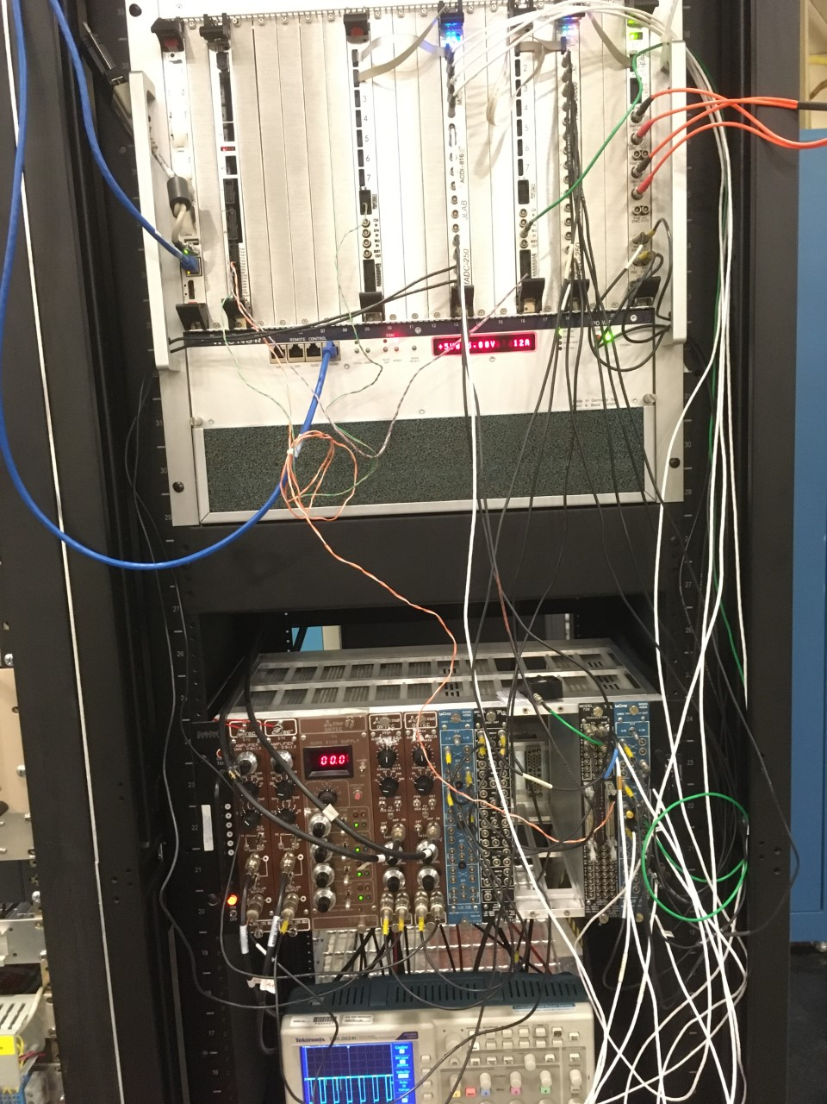
DAQ Hardware
VXS Crate and NIM Crate
Mott detectors, Preamps, Amplifiers and Bias
Supply
Helicity signals from Helicity Board

Slide 4
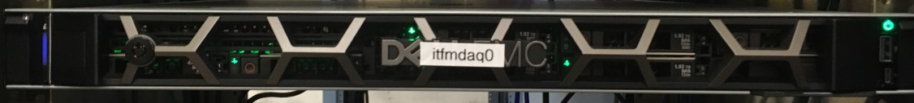
Mott DAQ
Hardware | Rack
itfmdaq0 | ITF 07
Mott VXS Crate
Mott NIM Crate

Slide 5
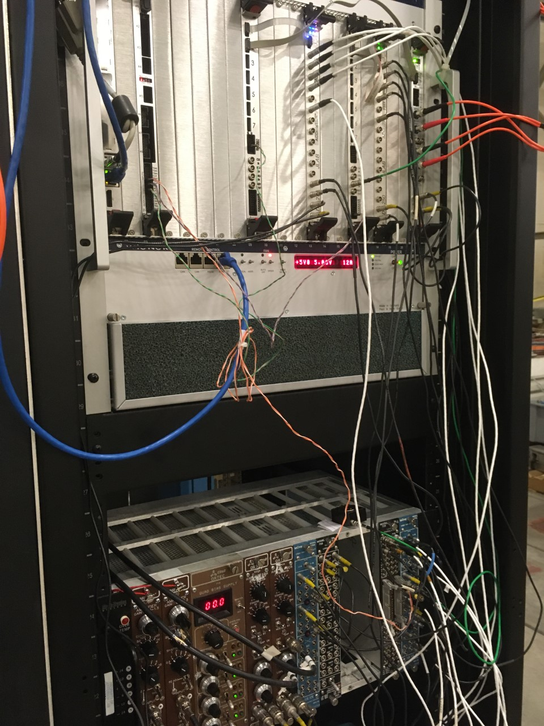
Mott DAQ crates
VXS Crate
Mott NIM Crate
Slot | Board
1 | Linux SBC
2 | Empty
3 | TID
4 | Empty
5 | Empty
6 | Empty
7 | Empty
8 | Empty
9 | FADC250 Signal Distribution Card
10 | Empty
11 | Empty
12 | Empty
13 | Mott FADC
14 | Empty
15 | Empty
16 | FADC250 Signal Distribution Card
17 | Empty
18 | INT FADC
19 | Empty
20 | Empty
21 | Helicity Decoder
Slot | Board
1 | 570 Amplifier
2 | 570 Amplifier
3-4 | ORTEC QUAD BIAS SUPPLY
5 | 590A Amplifier
6 | 590A Amplifier
7 | LOGIC FAN IN/OUT LeCroy 429A
8 | Empty
9 | Empty
10 | Empty
11 | LEVEL TRANSLATOR PS726
12 | LOGIC FAN IN/OUT LeCroy 429A

Slide 6
VXS CRATE
Itfsbcmdaq0 |  | TID |  |  |  | FADC250 Signal Distribution Card |  | Mott FADC |  |  |  | FADC250 Signal Distribution Card |  |  | INT FADC |  |  |  |  | Helicity Decoder
1
1
Delayed Helicity
2
T_Settle
Pattern Sync
TRG IN
Pair Sync
INPUTS:
TS#2
TRG
TRG IN
TM1
LN1
OUTPUTS:
OT#2
R SCA
L SCA
R Amp
R Amp
L Amp
L Amp
itfmdaq0
Mott DetTr
nT_Settle Trigger

Slide 7
Mott NIM Crate
570 Amp (50°) LEFT | 570 Amp (50°) RIGHT | ORTEC QUAD BIAS SUPPLY | 590A Amp (120°) LEFT | 590A Amp (120°) RIGHT | FAN 429A | LOGIC 758 |  |  | LT 726 | FAN 429A
→ IN E ← OUT E | → IN E ← OUT E | 142A Preamp (120°) LEFT +115 V | → IN E ← OUT E ← SCA | → IN E ← OUT E ← SCA | →SCA | →SCA →SCA |  |  | → nT_Settle IN ← TTL/ECL OUT | → Delayed Helicity
 |  | 142A Preamp (120°) RIGHT +115 V |  |  | →SCA
 |  |  |  |  |  |  |  |  |  | → T_Settle
 |  | 142B Preamp (50°) LEFT +115 V |  |  |  |  |  |  |  | → Pattern Sync
 |  | 142B Preamp (50°) RIGHT +115 V
 |  |  |  |  |  |  |  |  |  | → Pair Sync

Slide 8
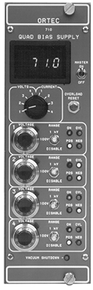
CHANNEL ASSIGNMENT – ORTEC QUAD BIAS SUPPLY
OUTPUTS | Detector | HV
1 | 142A Preamp (120°) LEFT | +115
2 | 142A Preamp (120°) RIGHT | +115
3 | 142B Preamp (50°) LEFT | +115
4 | 142B Preamp (50°) RIGHT | +115

Slide 9
CHANNEL ASSIGNMENT – PREAMPLIFIERS
OUTPUTS | 142A Preamp (120°) LEFT
E | 590A Amp E IN
T OUT | -
OUTPUTS | 142A Preamp (120°) RIGHT
E | 590A Amp E IN
T OUT | -
OUTPUTS | 142B Preamp (50°) LEFT
E | 570 Amp E IN
T OUT | -
OUTPUTS | 142B Preamp (50°) RIGHT
E | 570 Amp E IN
T OUT | -

Slide 10


CHANNEL ASSIGNMENT – AMPLIFIERS
Channel | 590A Amp (120°) LEFT
E IN | 142A Preamp E
E OUT | Mott FADC CH0
SCA | Mott FADC CH2
Channel | 590A Amp (120°) RIGHT
E IN | 142A Preamp E
E OUT | Mott FADC CH1
SCA | Mott FADC CH3
Channel | 570 Amp (50°) LEFT
E IN | 142B Preamp E
E OUT | INT FADC CH0
SCA OUT | -
Channel | 570 Amp (50°) RIGHT
E IN | 142B Preamp E
E OUT | INTFADC CH1
SCA OUT | -

Slide 11
AMPLIFIERS CONTROLS
Controls | 590A Amp (120°) LEFT | 590A Amp (120°) RIGHT
FINE GAIN | 1 | 1
COARSE GAIN | 100 | 100
INPUT POS/NEG | NEG | NEG
OUTPUT UNI-BI | UNI | UNI
PZ ADJ | 50 µs | 50 µs
INT/WINDOW
WINDOW
LOWER LEVEL
LL REF (INT/EXT) (rear panel) | INT (front- panel control) | INT (front- panel control)
SHAPING TIME (side panel) | 1.5 µs | 1.5 µs
Window (internal jumper) | 0 – 1 V | 0 – 1 V
Controls | 570 Amp (50°) LEFT | 570 Amp (50°) RIGHT
FINE GAIN | 1 | 1
COARSE GAIN | 100 | 100
SHAPING TIME
BLR AUTO
PZ ADJ
THRESH
Input Polarity (POS/NEG) | NEG | NEG
COARSE GAIN Attenuation (internal jumper) | X0.1 | X0.1

Slide 12
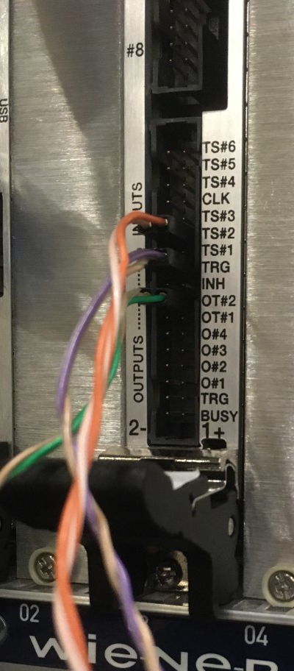
CHANNEL ASSIGNMENT – TRIGGER INTERFACE (TID)
TID Chan | INPUTS
7
6
5
4
3
2 | TS#2 (Mott DetTr)
1
0 | TRG (FADC SDC MT1)
INH
TID Chan | OUTPUTS
7 (OT#2) | SD_FP1 TRG IN
6
5
4
3
2
1
0

Slide 13
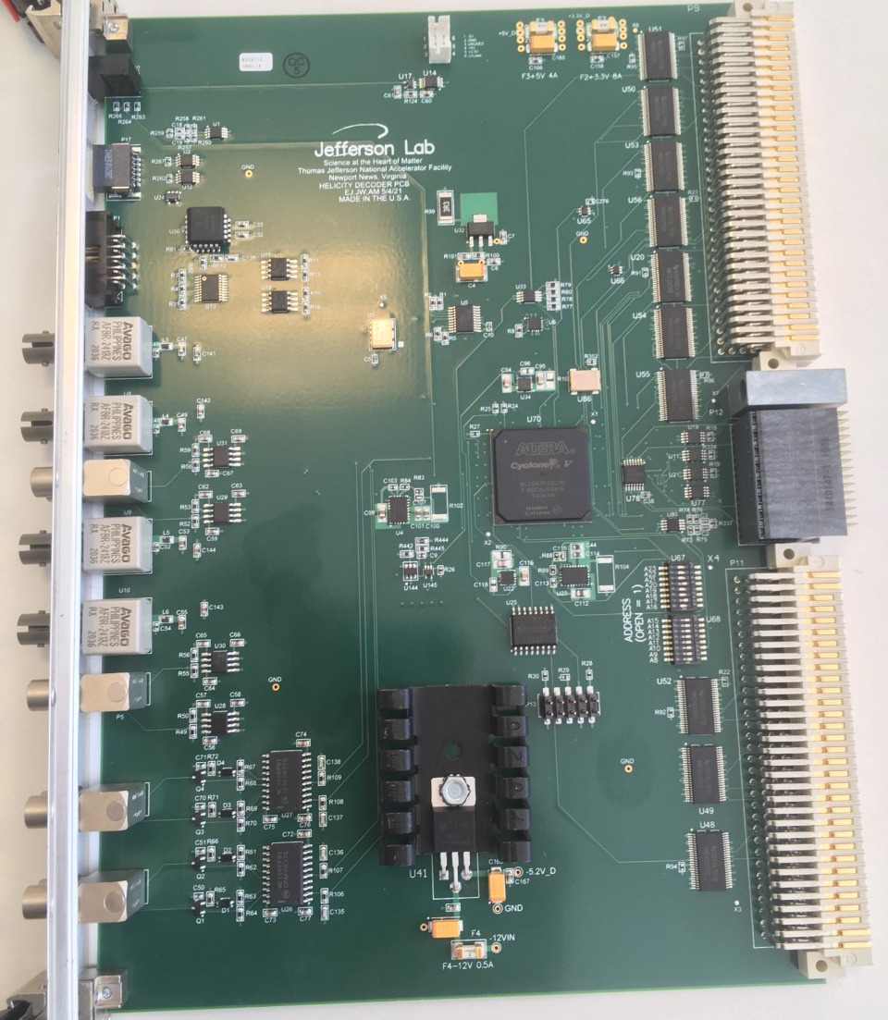
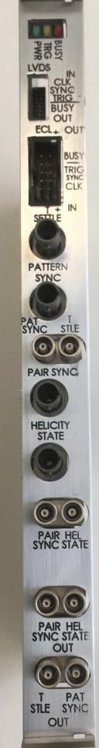
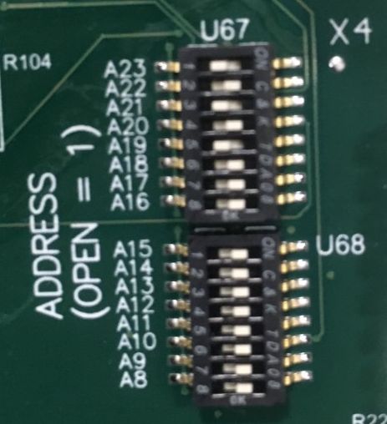
CHANNEL ASSIGNMENT – HELICITY DECODER BOARD
Chan | INPUTS
1
2
3
ADDRESS | 0xA80000
Chan | OUTPUTS
1
2
3

Slide 14
FADC
Mott
INT
FADC Chan | Signal
1 | L EFT Amp
2 | RIGHT Amp
3 | LEFT SCA
4 | RIGHT SCA
5
6
7
8
9
10
11
12
13 | Delayed Helicity
14 | T_Settle
15 | Pattern–Sync
16 | Pair–Sync
FADC Chan | Signal
1 | LEFT Amp
2 | RIGHT Amp
3
4
5
6
7
8
9
10
11
12
13 | Delayed Helicity
14 | T_Settle
15 | Pattern–Sync
16 | Pair–Sync

Slide 15
Mott NIM – QUAD FAN IN/OUT 429A
QUAD FAN IN/OUT
Delayed Helicity – IN
 |  | INT FADC CH12
 |  | Mott DADC CH12
T_Settle – IN
 | INT FADC SDC TRG IN | INT FADC CH13
 | 50 Ω | Mott DADC CH13
Pattern Sync – IN
 |  | INT FADC CH14
 |  | Mott DADC CH14
Pair Sync – IN
 |  | INT FADC CH15
 |  | Mott DADC CH15

Slide 16
Mott NIM – LEVEL TRANSLATOR 726
 | LT
 | NIM IN | TTL/ECL OUT | NIM OUT | NIM OUT
1 | Mott DetTr (NOW a 10.13 kHz NIM Pulser) | TID TS#2 | 50 Ω | SCOPE
2
3
4
5
6
7
8
9
10
11
12
13
14
15
16

Slide 17
Mott NIM – OCTAL LOGIC UNIT PS 758

Slide 18
Mott NIM – QUAD FAN IN/OUT 429A
QUAD FAN IN/OUT
LEFT SCA – IN
 |  | OCTAL LOGIC UNIT
 |  | Mott DADC CH2
RIGHT SCA – IN
 |  | OCTAL LOGIC UNIT
 |  | Mott DADC CH3

Slide 19
Data Taking Modes
Name | Readout | Output | Trigger
Mott_Sample | Mott FADC (Mode=1), INT FADC | Mott_Sample_%d.dat | Mott Detector
Mott_Int | INT FADC | Mott_Int_%d.dat | nT_Settle

Slide 20
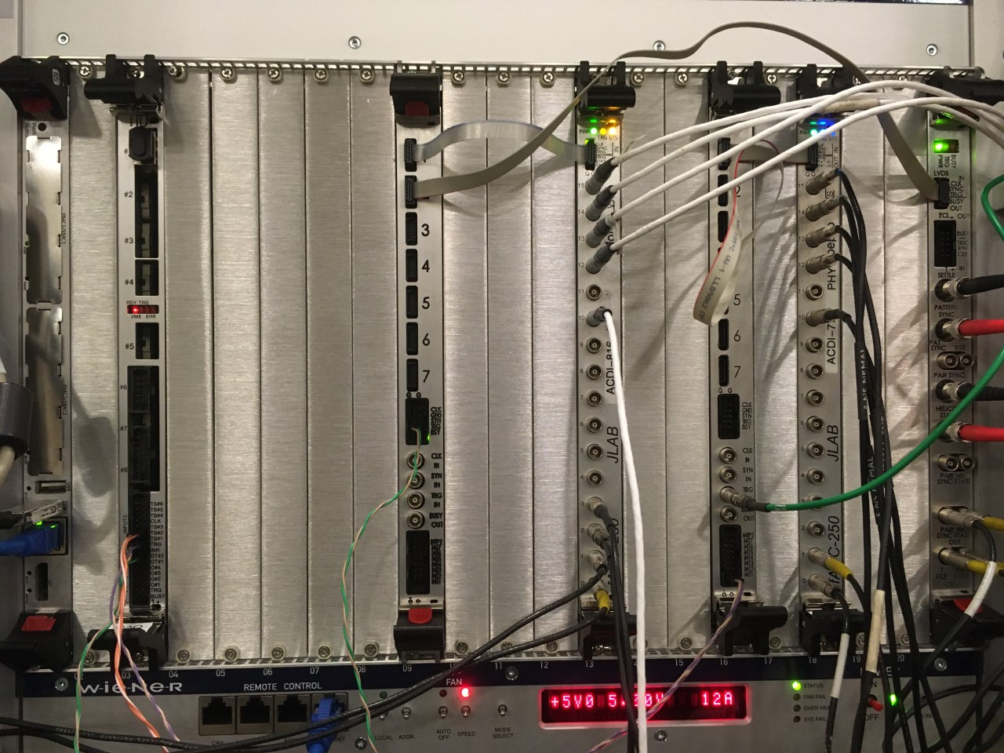
VXS Crate

Slide 21
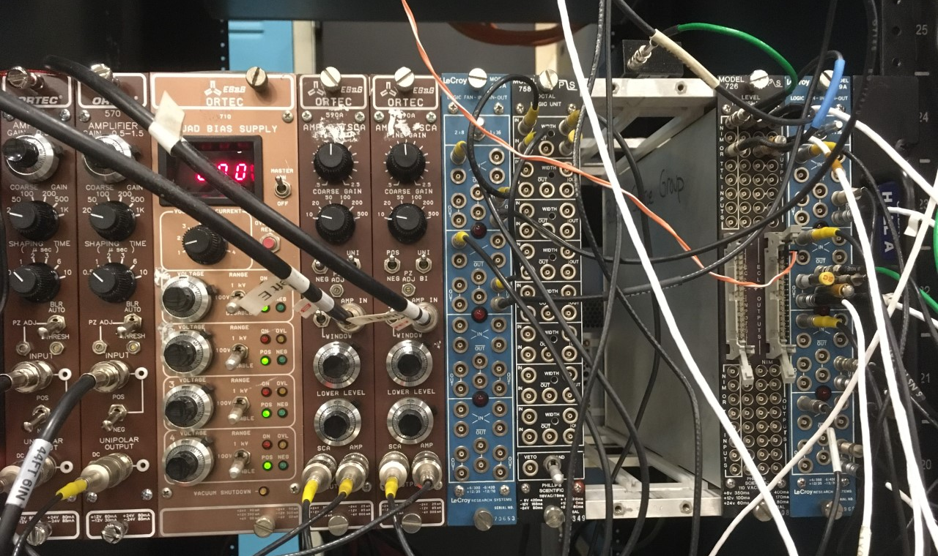
Mott NIM Crate

