Slide 1
Generation and Characterization of Magnetized Bunched Electron Beam from DC Photogun for
MEIC Cooler
Laboratory Directed Research and Development (LDRD) Proposal
Riad Suleiman and Matt Poelker
July 1, 2015

Slide 2
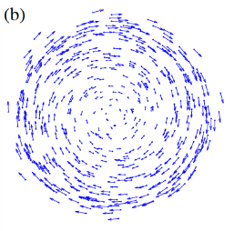
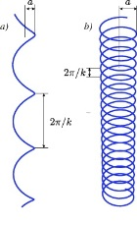
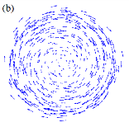
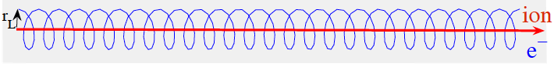
Magnetized Cooling
MEIC magnetized cooler is part of Collider Ring
Goal to maintain ion beam emittance and extend luminosity lifetime
Requires magnetized bunched electron beam
Cooling Solenoid
Cathode Solenoid
SRF
Linac

Slide 3
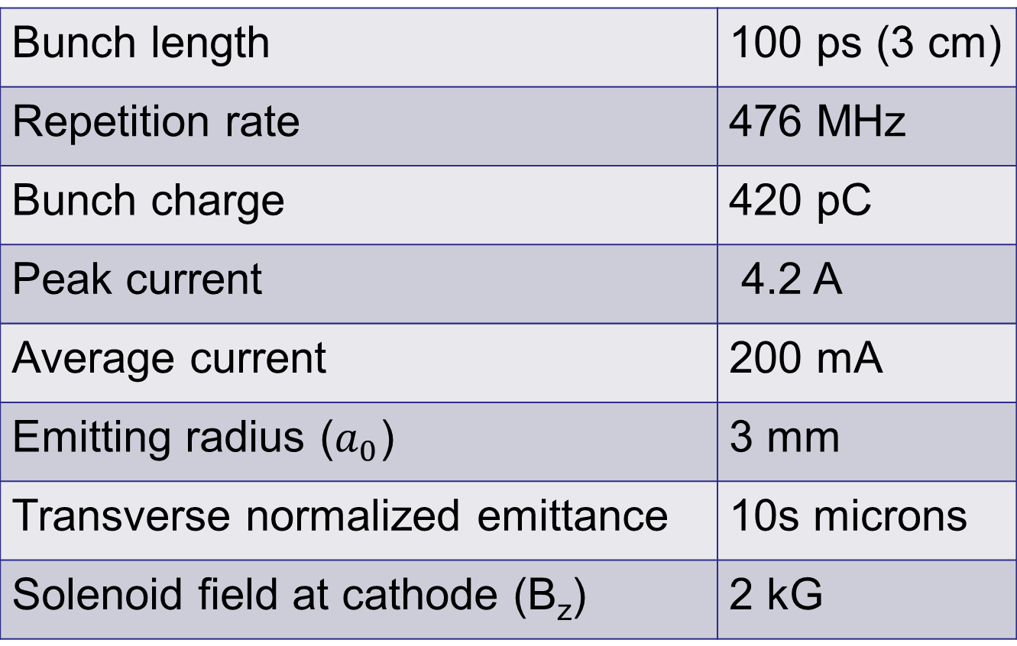
Bunched Magnetized Gun Requirements
Bunch length | 100 ps (3 cm)
Repetition rate | 476 MHz
Bunch charge | 420 pC
Peak current | 4.2 A
Average current | 200 mA
Emitting radius ($a_{0}$) | 3 mm
Transverse normalized emittance | 10s microns
Solenoid field at cathode (B_{z}) | 2 kG

Slide 4
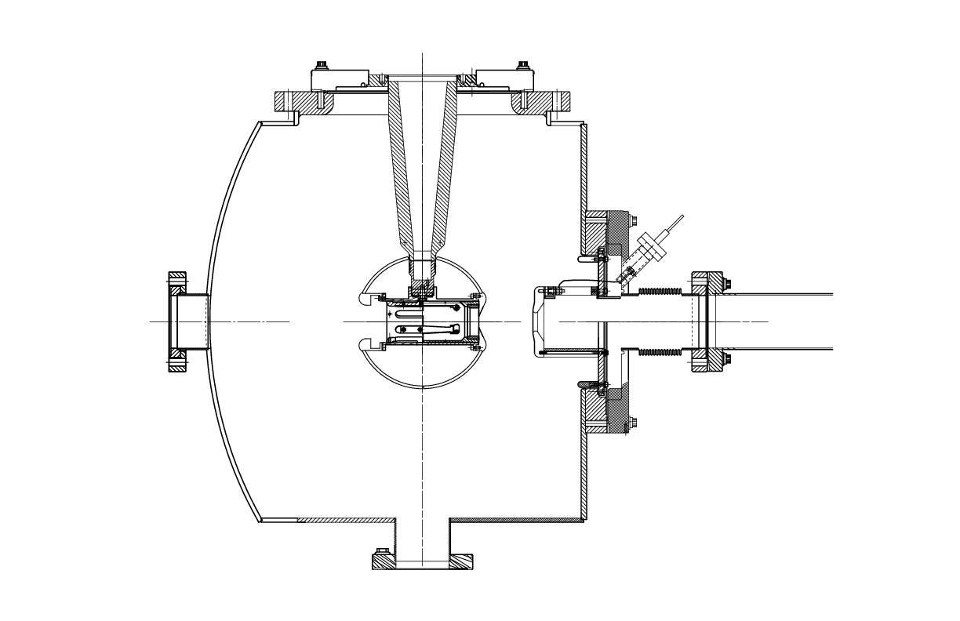

Generation of Magnetized Beam
Cathode Solenoid:
  To produce magnetized beam
Injector Focusing Solenoids:
  For magnetized beam transport
  To compensate space-charge emittance growth
Cathode Solenoid (B_{z}=2 kG)
Focusing Solenoids

Slide 5
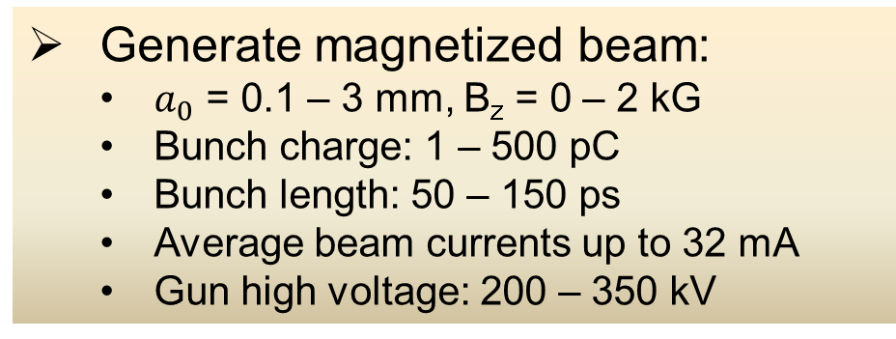
Experimental Overview
Cathode
Solenoid
Diagnostic Cross 3
(YAG Screen)
Cathode
Three Skew Quads
(Round-to-Flat Beam Transformer)
Green
Laser
Anode
K₂CsSb
Photocathode
Injector Focusing Solenoids
Diagnostic Cross 1
(Multislit + YAG Screen)
Diagnostic Cross 2
(H,V slit + YAG Screen)
Generate magnetized beam:
  $a_{0}$ = 0.1 – 3 mm, B_{z} = 0 – 2 kG
  Bunch charge: 1 – 500 pC
  Bunch length: 50 – 150 ps
  Average beam currents up to 32 mA
  Gun high voltage: 200 – 350 kV

Slide 6
Simulation Plan
Beamline design to locate magnets and diagnostics at optimum positions
Simulation of different operating scenarios of bunch charge, magnetization, bunch shape etc. will be benchmarked against measurements of emittance and other beam parameters
As beams will be space charge dominated, there will be some limit to aspect ratio that can be achieved with RTFB transform – simulation will allow us to quantify how good or complete this can be made for different settings
These results will guide injector design for MEIC magnetized electron cooler

Slide 7
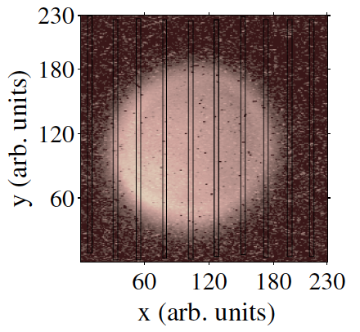
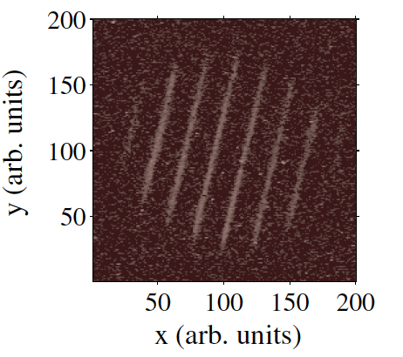
Measurement Plan
Measure mechanical angular momentum
(skew quads off)
σ₁ beam radius measured at Diagnostic Cross 1
σ₂ beam radius measured at Diagnostic Cross 2
D drift between two crosses
p_{z} beam longitudinal momentum
Angular rotation ϕ is measured from beam image at Cross 2 when multislit is inserted at Cross 1
Example of mechanical measurement at Fermilab (Piot et al.)

Slide 8
Use three skew quads – RTFB Transformer – to generate a flat beam with transverse emittance ratios of:
  Measure horizontal and vertical emittances using slit method
Generate very high currents magnetized beam and study beam transport and RTFB transformation versus electron bunch charge
Measure photocathode lifetime versus solenoid field at high currents (up to 32 mA) and high voltages (200 – 350 kV) limited by in-house HV supplies
Study beam halo and beam loss versus magnetization

Slide 9
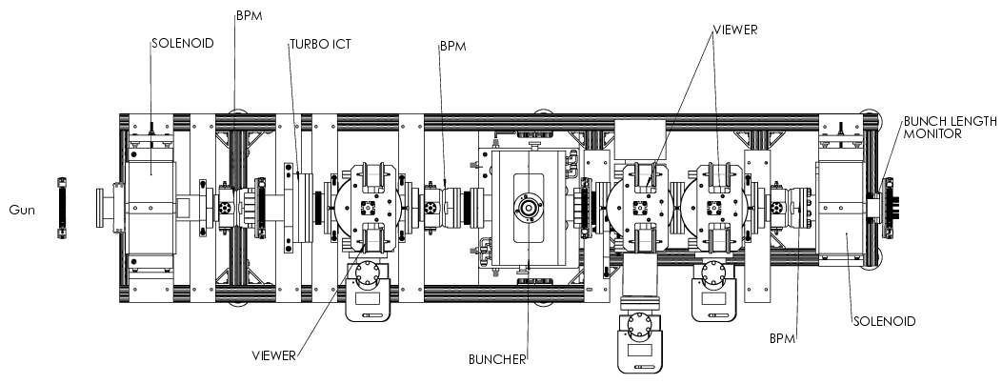
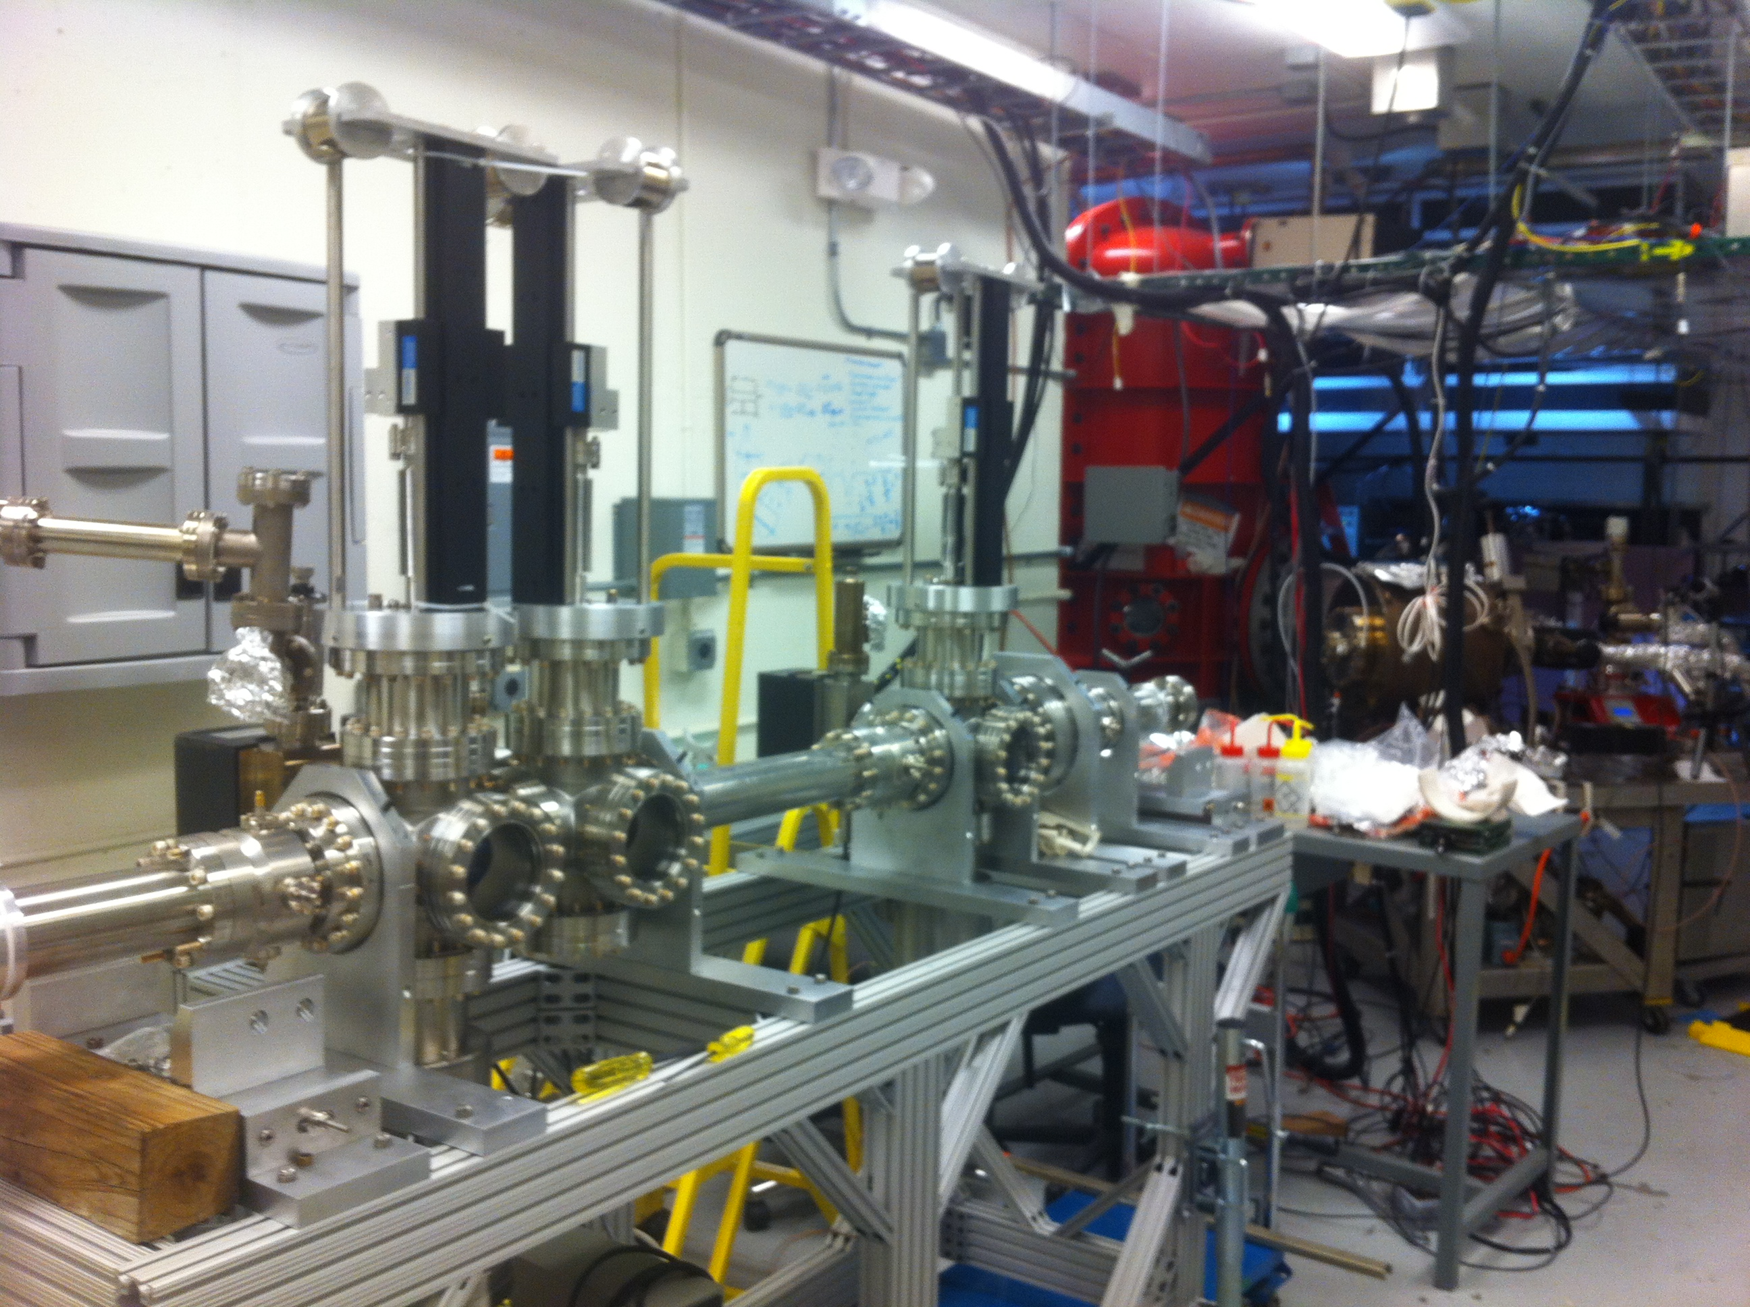
Location of Work: FEL Gun Test Stand

Slide 10
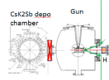
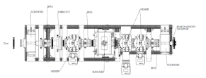

Slide 11
Budget
Materials and Supplies:
Solenoid magnet, or Helmholtz coil-pair
Three skew quadrupoles
Components for three diagnostics crosses
Labor:
Gun magnet design and installation
Relocate old CEBAF arc dipole power supply
Mechanical designer for skew quad magnets and slits
ASTRA and GPT modeling
Postdoc – years 2 and 3 (first year funded by another project to finish developing K₂CsSb photocathode)
FY16 | $339,211
FY17 | $265,850
FY18 | $212,025
Total | $817,086
In response to questions from Review Committee about timeline and budget: we extended this LDRD to a third year

