Slide 1
300 kV gun GPT simulations sphere with long anode Field map interpolation step-size effect on emittance
Gabriel Palacios
gabrielp@jlab.org 02/12/19

Slide 2
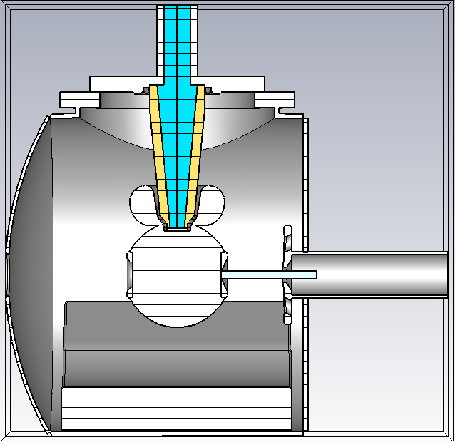
Solidworks: GTS with long anode
GTS beam parameters, Spacecharge ON
Gun is operated at 300 [kV]
Long anode
9 cm cathode-anode gap
Space charge on
5000 particles
Qbunch 20 fC
Laser RMS spotsize xyrms=0.351E-3 [m]
Trms=21.27 [ps]
Mean transverse energy 0.143E-3

Slide 3
Is it the cathode-anode gap fields?
Asymmetry in the “y” direction, acceleration in “z” direction.

Slide 4
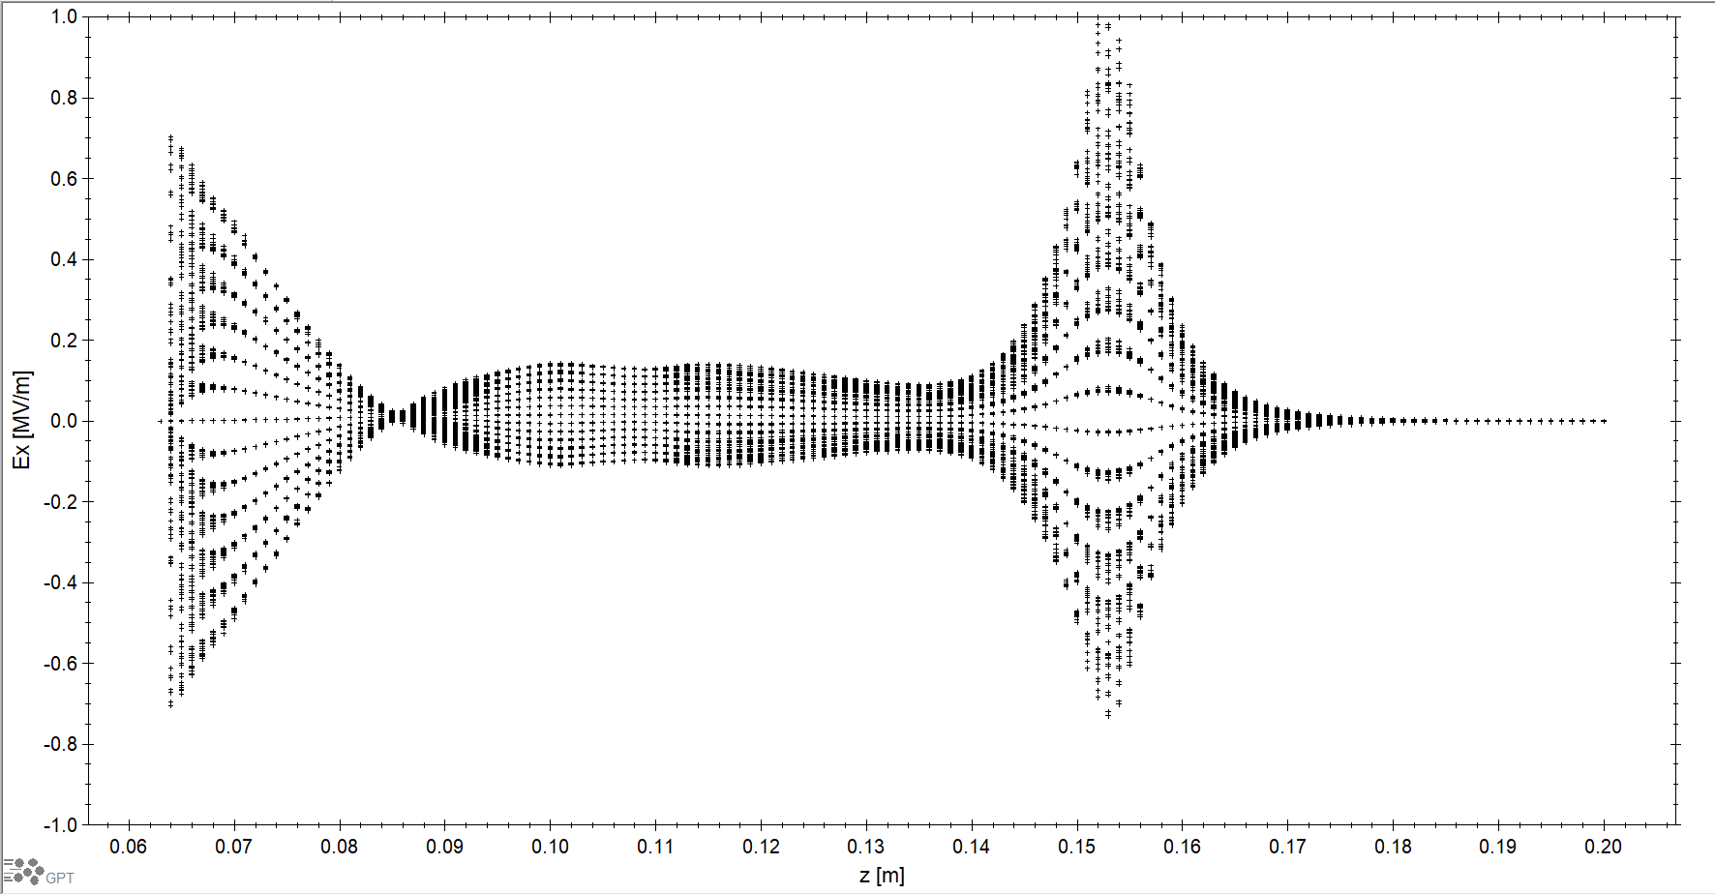
Preliminary results: Fields maps

Slide 5
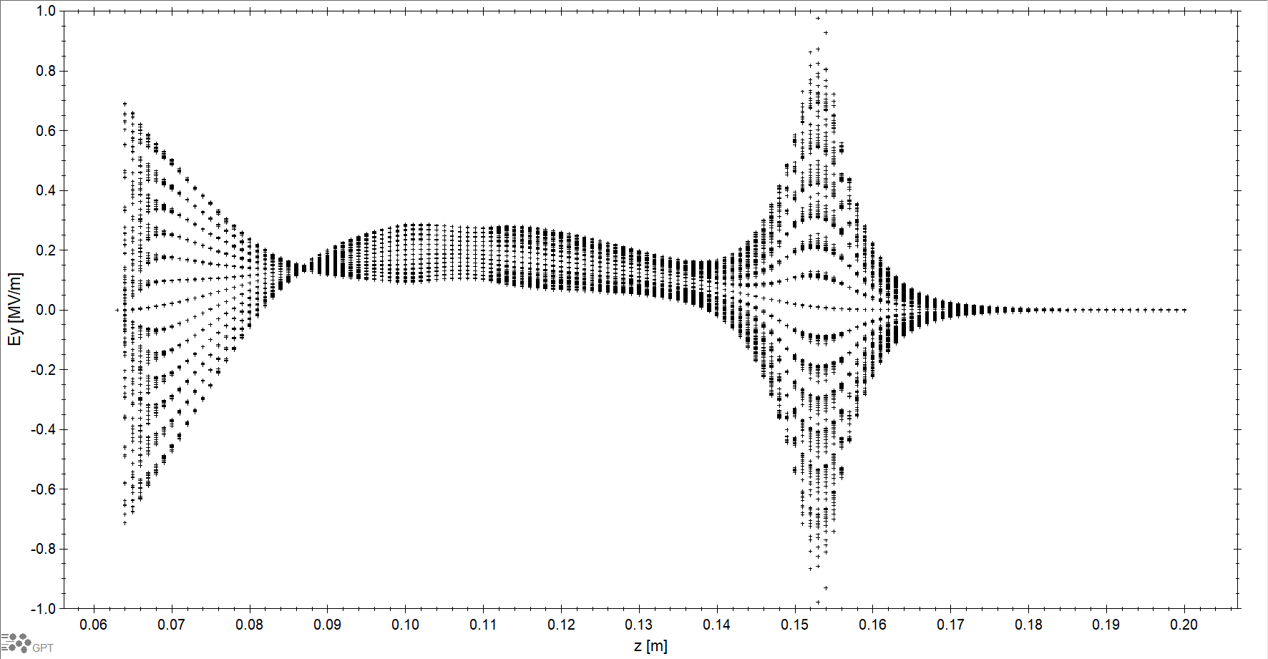
Preliminary results: Fields maps

Slide 6
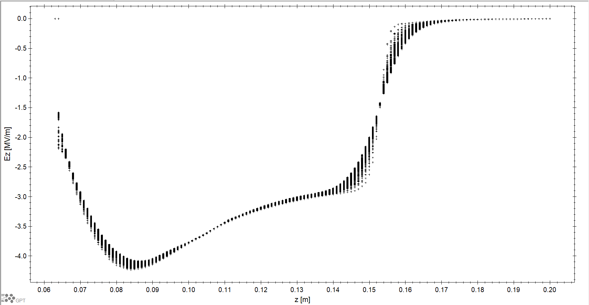
Preliminary results: Fields maps

Slide 7
Normalized emittance with GPT
The field map is generated with three different step size: 0.001 [m], 0.0005 [m] , 0.002 [m]

Slide 8
Normalized emittance
Generated with a displacement in z=0.0634 [m]

Slide 9
Normalized emittance
Generated with a displacement in z=0.0634 [m]

Slide 10
Normalized emittance
Generated with a displacement in z=0.0634 [m]

Slide 11
Now then use a displacement of z= 0.0636

Slide 12
Normalized emittance

Slide 13
Normalized emittance

Slide 14
Normalized emittance

Slide 15
Lessons learned
When displacing the field map, use proper z-value for the particular field-map interpolation.
Use the smaller (thus manageable) files to test, use the big one for a final run.

Slide 16
Fin.

Slide 17
Extras

Slide 18
Standard deviation with GPT
The field map is generated with three different step size: 0.001 [m], 0.0005 [m] , 0.002 [m]

Slide 19
Std_x

Slide 20
Std_y

Slide 21
Std_z

