Slide 1
Bubble Chamber Planning Meeting
07 August 2013

Slide 2
Agenda
Bubble Chamber progress at Argonne
Bubble Chamber cost estimate: procurement and labor
Running at FEL pros and cons
Background from ¹⁷O(γ,n)¹⁶O and subsequent neutron elastic scattering with ¹⁶O and ¹⁴N nuclei
Background from ¹³C(γ,n)¹²C (in case we decide to use CO₂ instead of N₂O)

Slide 3
Cost Estimate
Item | Material Procurement | Shop | Labor
New BPM on Spectrometer line |  | Pipe + BPM ($5,000) | P. Francis (1 week)
New Dipole Magnet | Dipole Magnet ($10,000) |  | Mapping (1 week) + Alignment (2 weeks)
New Power Supply | Power Supply ($5,000) |  | Software (2 days)
New Beamline |  | Pipes + Pedestals ($20,000) | Design (6 weeks) Alignment (2 weeks)
Radiator | 0.02 and 0.10 mm Cu foils ($1,000) |  | Design (1 week)
Sweep Dipole |  |  | Mapping (2 days)
Electron Dump | Pure Cu ($5,000) | Dump + Pipes ($10,000) | Design (2 week)
Cu Collimator | Pure Cu ($3,000) | Collimator + Stand ($5,000)
Photon Dump | Pure Al ($1,000) |  | Design (2 days)
Safety Review |  |  | Engineering + EH&Q ($10,000)
Total | $25,000 | $40,000 | $55,000

Slide 4
Running in FEL? Cons and Pros
Pros | Cons
No other users
9.5 MeV (with FE)
 | Completely new beamline

Slide 5
Electron Beam Properties
Beam Energy, E (MeV) | 3.0 – 8.5
Beam Current (µA) | 0.01–200
Absolute Beam Energy | 0.67%
Relative Beam Energy | 0.1%
Energy Resolution (Spread), σ_{E} /E | 0.06%
Beam Size, σ_{x,y} (mm) | 1 – 2

Slide 6
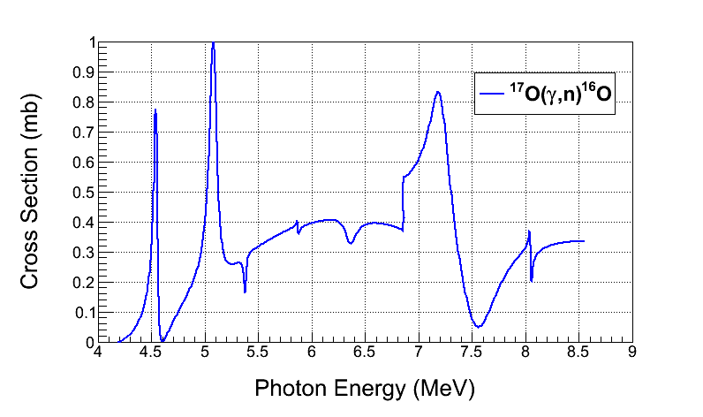
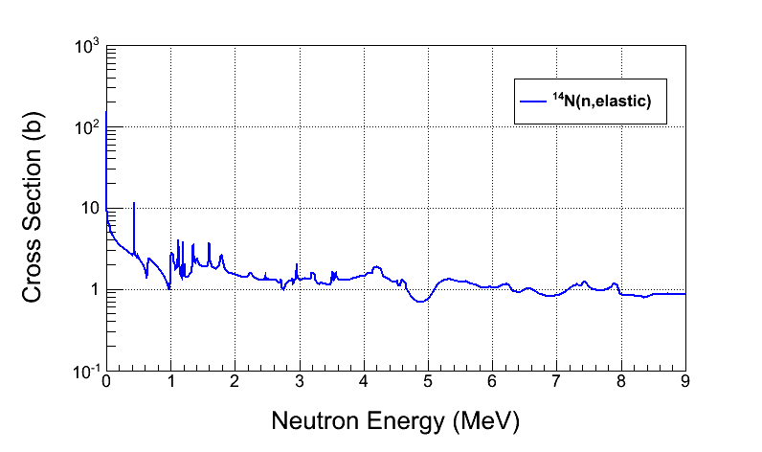
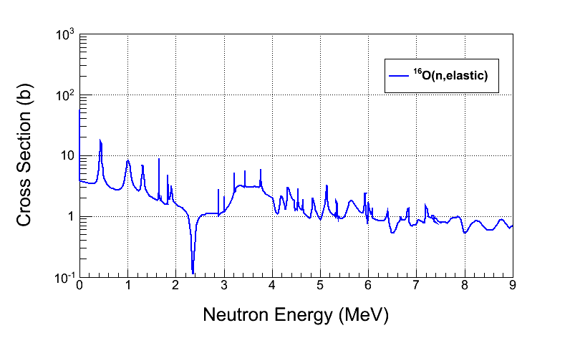
¹⁷O(γ,n)¹⁶O Background

Slide 7
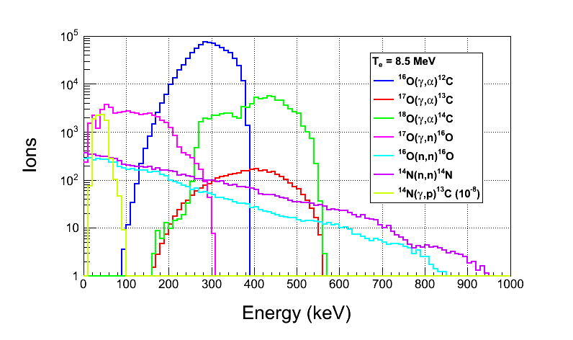
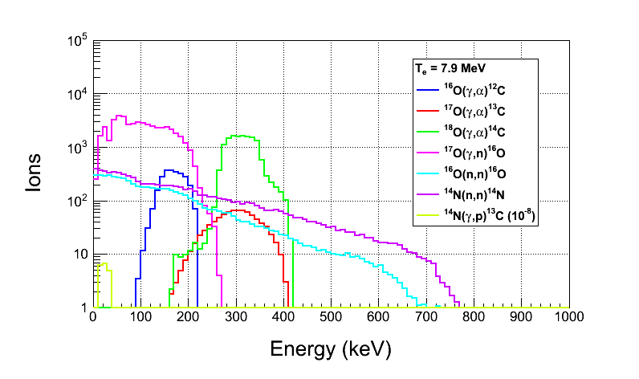
Ion Energy Distribution
Depletion:
¹⁷O depletion=5,000
¹⁸O depletion=5,000
Natural Abundance:
¹⁷O: 0.038%
¹⁸O: 0.205%

Slide 8
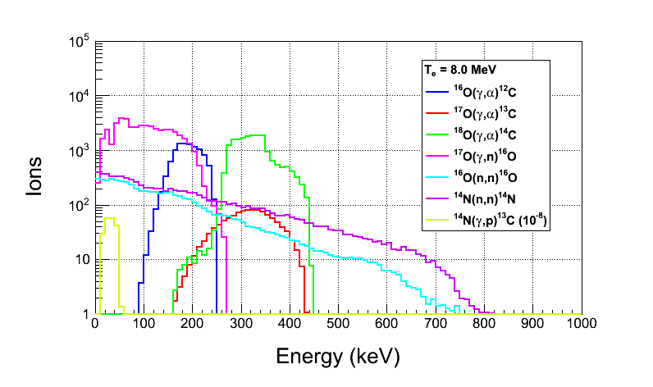
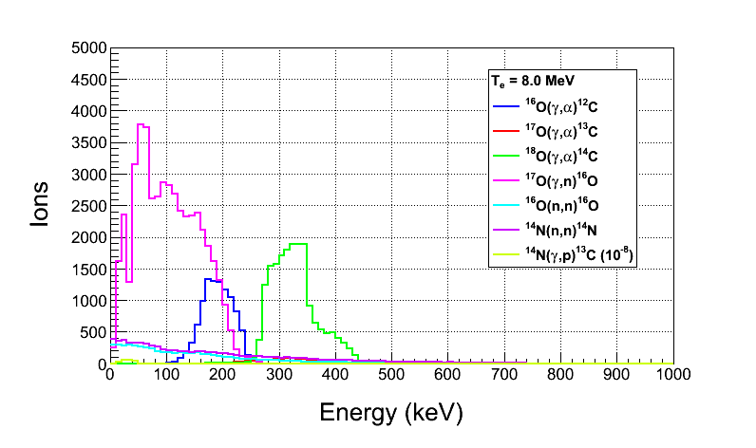
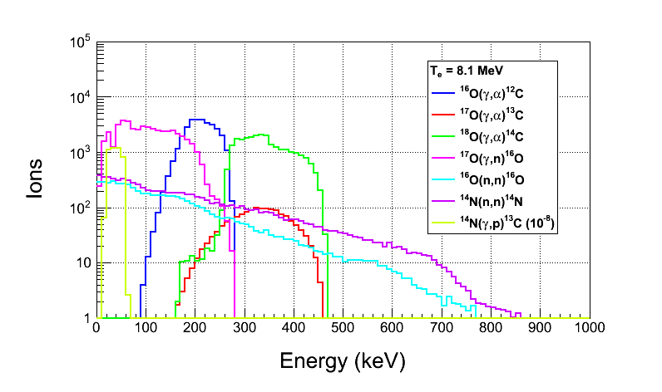
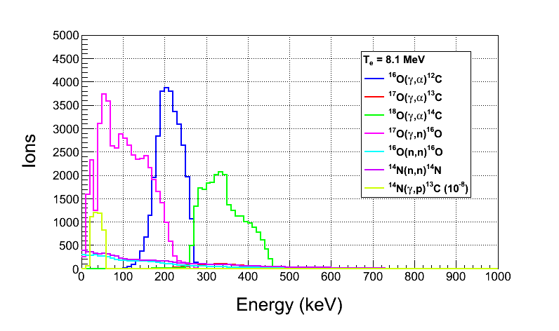

Slide 9
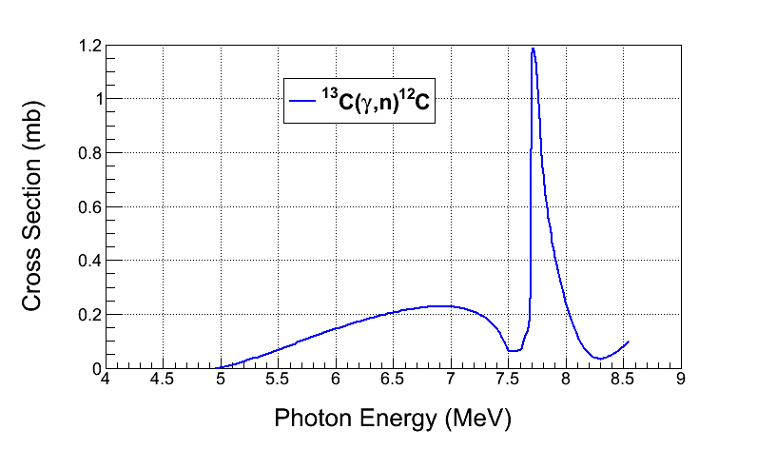
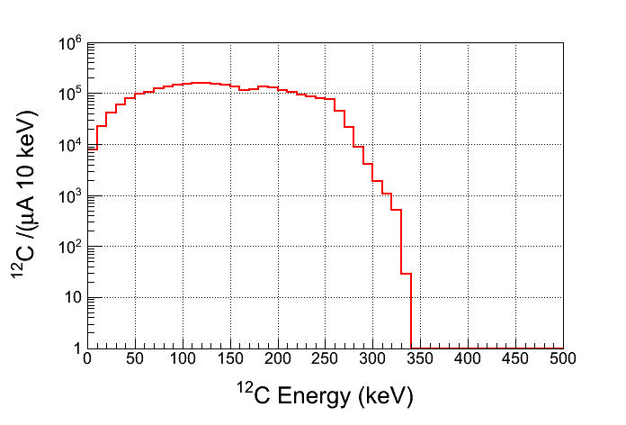
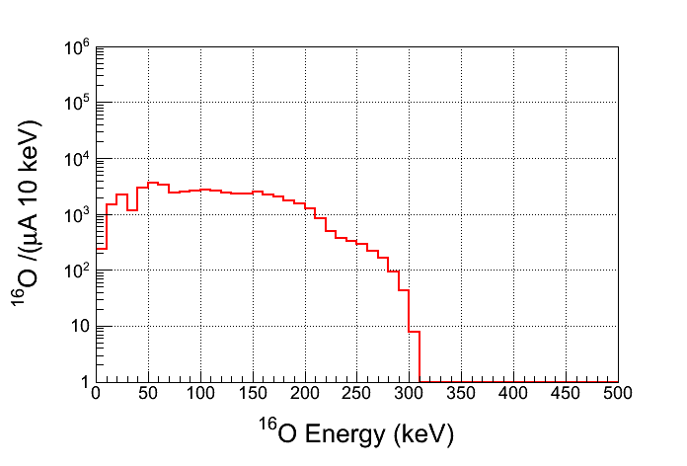
¹³C(γ,n)¹²C Background
Depletion:
¹³C depletion=1,000
Natural Abundance:
¹³C: 1.07%
For comparison, ¹⁷O(γ,n)¹⁶O

