Slide 1
Bubble Chamber Planning Meeting
07 August 2013

Slide 2
Agenda
Bubble Chamber progress at Argonne
Beamline Layout
Bubble Chamber cost estimate: procurement and labor
Background from ¹⁷O(γ,n)¹⁶O and subsequent neutron elastic scattering with ¹⁶O and ¹⁴N nuclei
Background from ¹³C(γ,n)¹²C (in case we decide to use CO₂ instead of N₂O)

Slide 3
Beamline Layout
HARP to measure beam profile
Fast Valve to protect from vacuum failure
Distance between two BPMs = 55” (was 18” for PEPPo)
Camera for OTR light from Cu foil
Electron Dump: isolated to measure beam current, 2 kW
Beam Properties at Radiator:
Beam Kinetic Energy, (MeV) | 3.0 – 8.5
Beam Current (µA) | 0.01 – 100
Absolute Beam Energy | 0.1%
Relative Beam Energy | 0.1%
Energy Resolution (Spread), σ_{T} /T | 0.06%
Beam Size, σ_{x,y} (mm) | 1 – 2

Slide 4
81”
Electron Dump
42”
Radiator
Viewer
Ion Pump
25°
25°
Fast
Valve
Viewer
BPM
HARP
Bubble
Chamber
Valve
Quad
Quad
BPM
Sweep
Dipole
Cu Collimator
Corrector
Photon
Dump
Corrector
Ion
Pump
Faraday
Cup
Vacuum
Window
35”
55”
100”
92”

Slide 5
Cost Estimate
Radiator motion and Sweep Dipole must be in FSD
BCM0L02 and Electron Dump in Beam Loss Accounting (BLA)
Cooled: Radiator and Electron Dump.
Uncooled: Photon Collimator and Photon Dump
Re-use PEPPo radiator and beamline
New beamline components: 2 Super Harps + Fast Valve
Summary of labor cost by group:
Group | Labor
Survey & Alignment | 3 wks x 2
Magnet Test | 1 wk x 2
Engineering Design | 12 wks
Software | 3 wks x 2
EES | 6 wk x 2
EH&Q | 4 wks

Slide 6
Item | Material Procurement | Shop | Labor
New BPM on Spect. line |  | Pipe + BPM ($5,000) | P. Francis (1 week)
New Dipole Magnet | Dipole Magnet ($8,000) Hall Probe ($2,000) |  | Mapping (1 week) EESDC (1 week) Alignment (2 days)
New Power Supply | Power Supply ($5,000) |  | Software (2 weeks)
New Beamline | 2 Super Harps and Fast Valve ($30,000) | Pipes + Pedestals ($20,000) | Design (6 weeks) Alignment (1 week) Software (4 weeks) EES (5 weeks)
Radiator (cooled ladder, FSD) | 0.02 and 0.10 mm Cu foils ($2,000) | $4,000 | Design (2 week) Alignment (2 days)
Sweep Dipole
Electron Dump | Pure Cu ($5,000) | Dump + Pipes ($10,000) | Design (2 week) Alignment (1 day)
Cu Collimator | Pure Cu ($5,000) | Collimator + Stand ($5,000) | Design (1 week) Alignment (1 day)
Photon Dump & Stand | Pure Al ($3,000) | $4,000 | Design (1 week) Alignment (1 day)
Safety Review |  |  | 4 weeks
Install |  |  | 6 weeks
Bubble Chamber |  |  | Alignment (1 week)
Total | $60,000 | $48,000 | $60,000
Total (with overhead) | $75,000 | $60,000 | $90,000

Slide 7
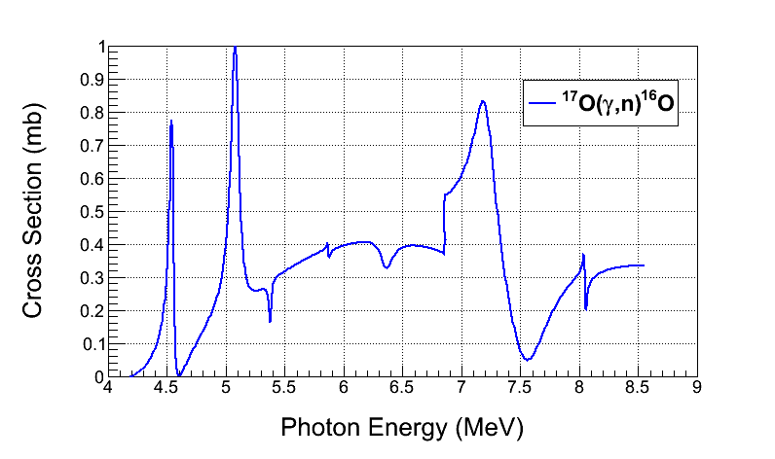
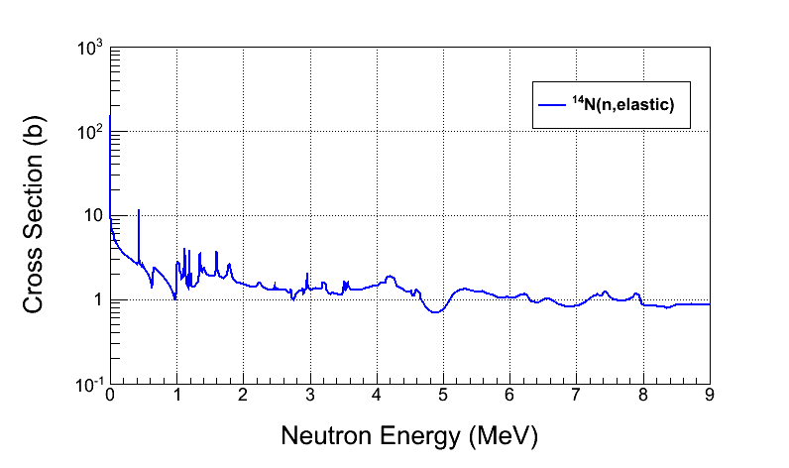
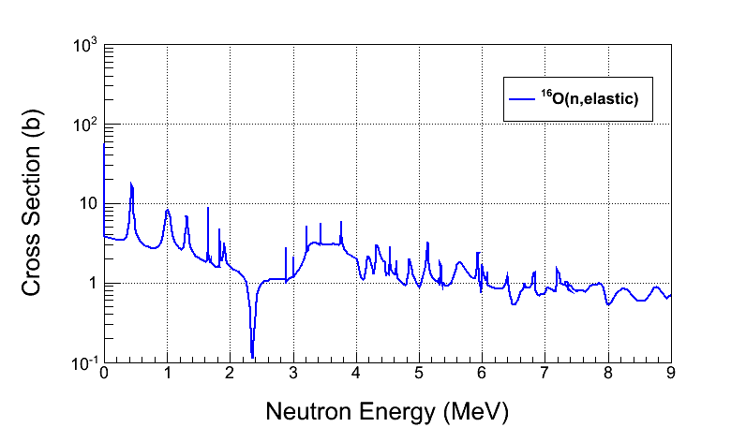
¹⁷O(γ,n)¹⁶O Background

Slide 8
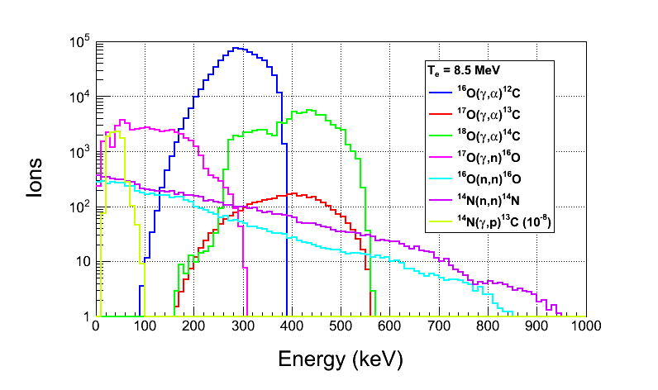
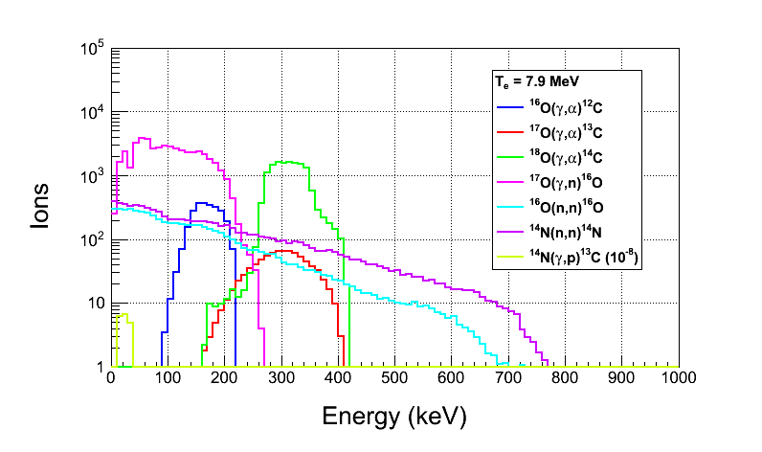
Ion Energy Distribution
Depletion:
¹⁷O depletion=5,000
¹⁸O depletion=5,000
Natural Abundance:
¹⁷O: 0.038%
¹⁸O: 0.205%

Slide 9
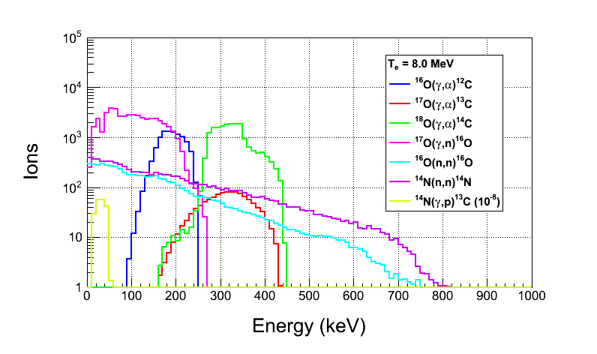
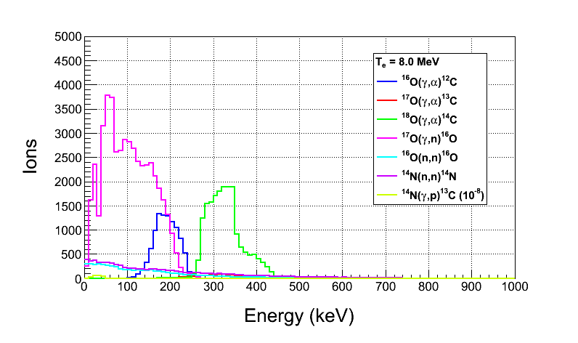
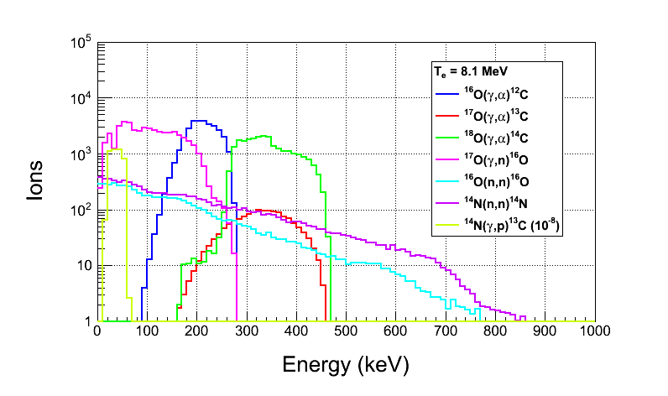
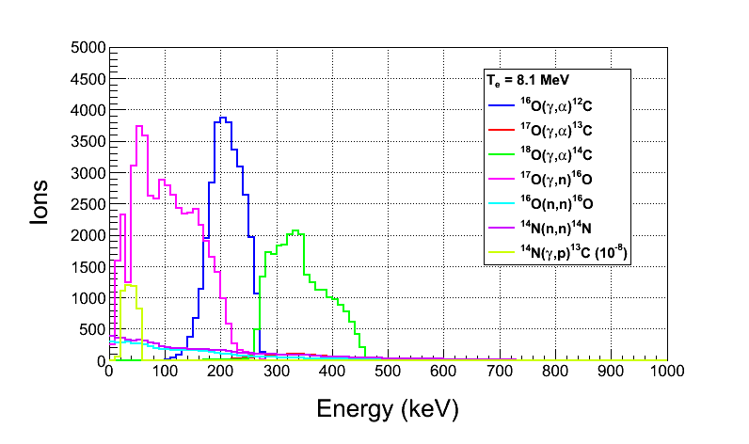

Slide 10
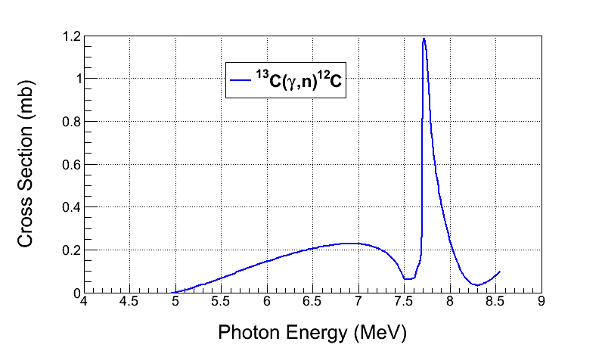
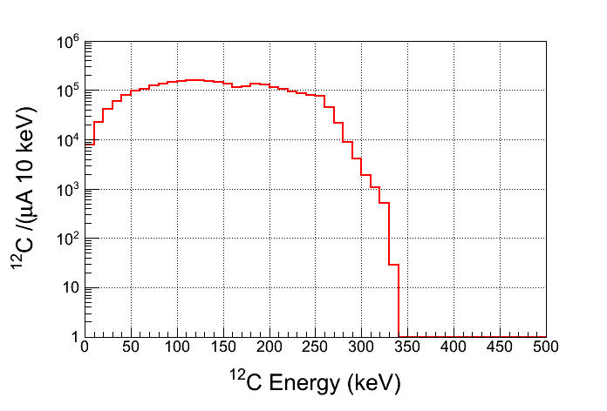
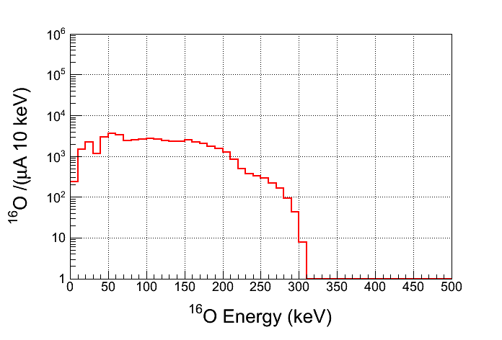
¹³C(γ,n)¹²C Background
Depletion:
¹³C depletion=1,000
Natural Abundance:
¹³C: 1.07%
For comparison, ¹⁷O(γ,n)¹⁶O

