Slide 1
Gun Magnet Design
December 27, 2015

Slide 2
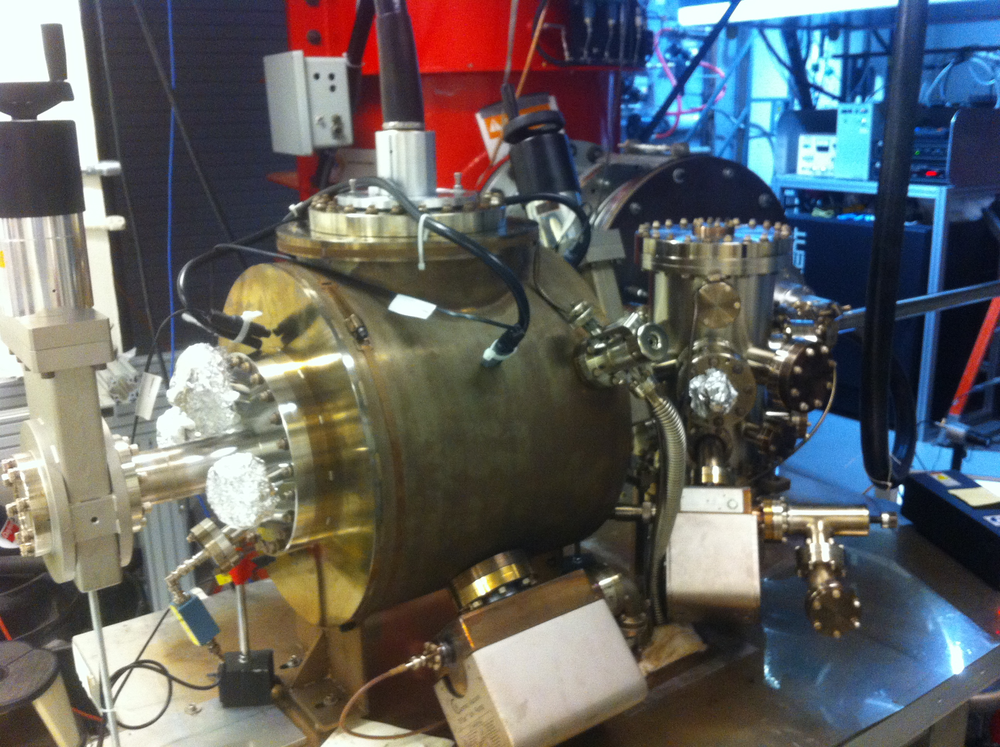
Magnetized Gun
K₂CsSb Preparation Chamber
HV Chamber

Slide 3
Magnetic Field at Cathode
Beam radius | 0.3 cm
Field at cathode (B_{z}) | 2 kG
Magnetization field (???):
Along z:
B_{z} = 2 kG
Varying slowly to be able know value from S&A
Along r:
Radius = 0.5 cm
Uniformity: $\frac{δB_{z}}{B_{z}}<1\%$ (?)
B_{z},B_{r}: relevant to beam transport

Slide 4
HV Chamber
10”
13”
18”
10”
15”

Slide 5
HV Chamber Clearance
HV Cable
Valve
10”
4”
13”
18”
10”
15”

Slide 6
Design 1: Helmholtz Pair
10”
13”
20” (2R)
18”
10”
15”
10” (R)

Slide 7
Design 2: Two coil Magnet
10”
13”
18”
18”
10”
15”
18”

Slide 8
Design 3: One Solenoid + Steel Puck
10”
13”
4”
18”
10”
3”
4”
Steel Puck
Counter-wound solenoid
15”

Slide 9
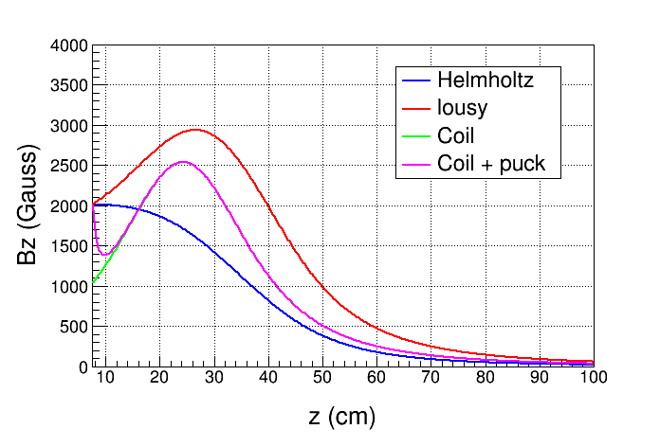
B_{z} vs z

Slide 10
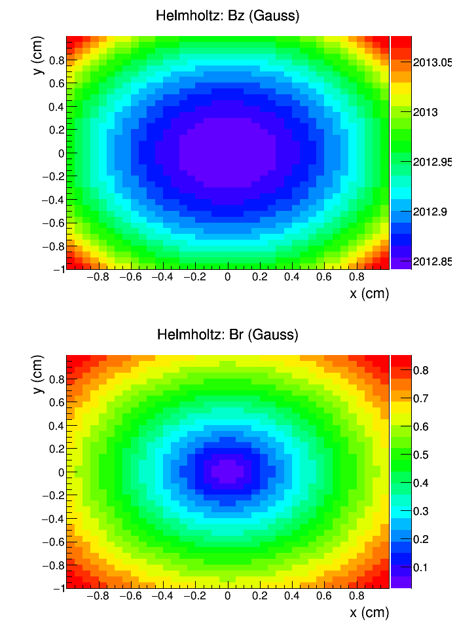
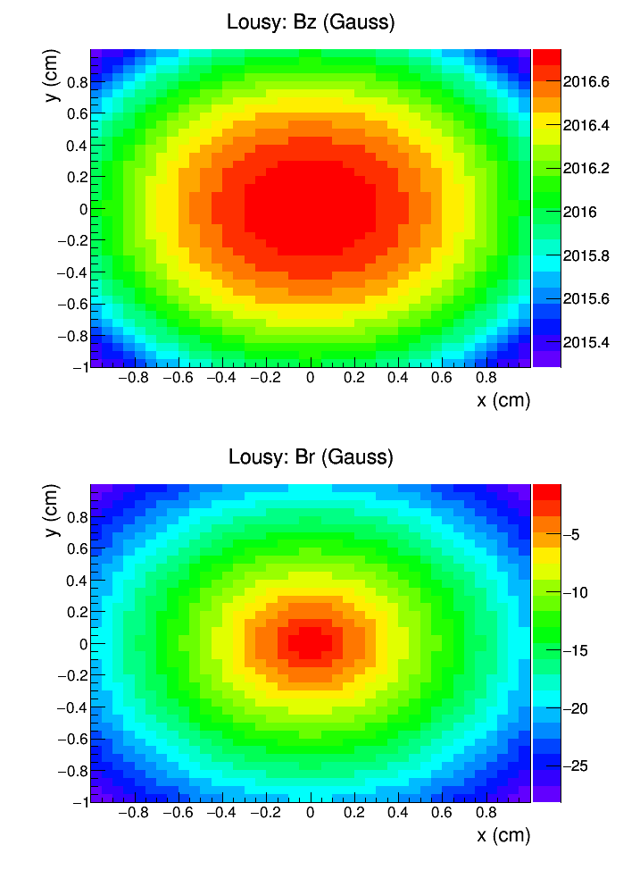

Slide 11
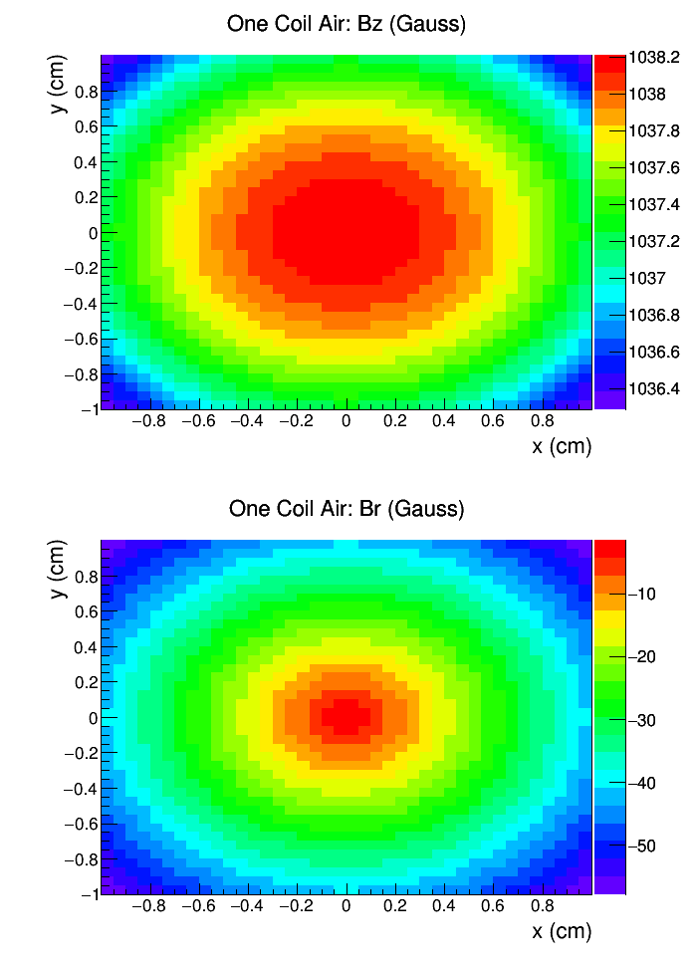
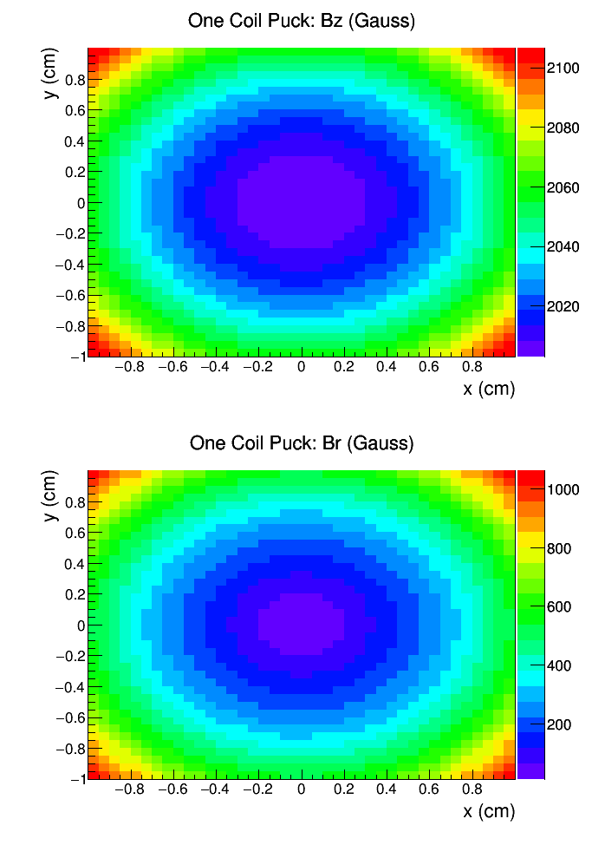

Slide 12
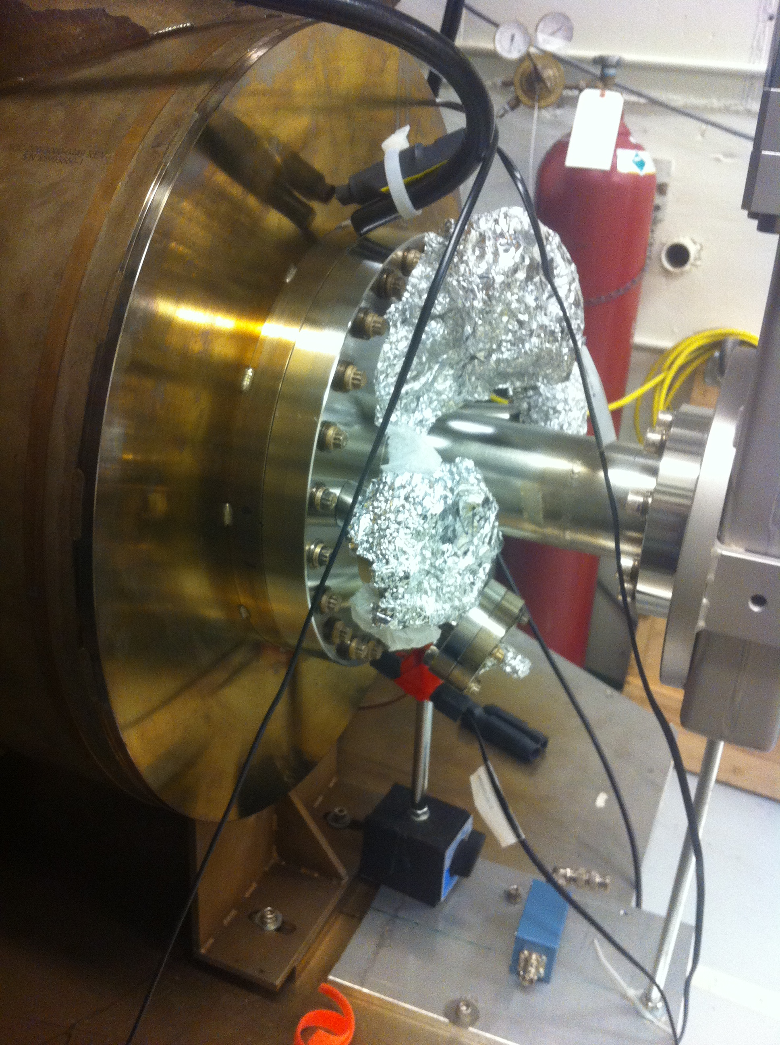

Slide 13
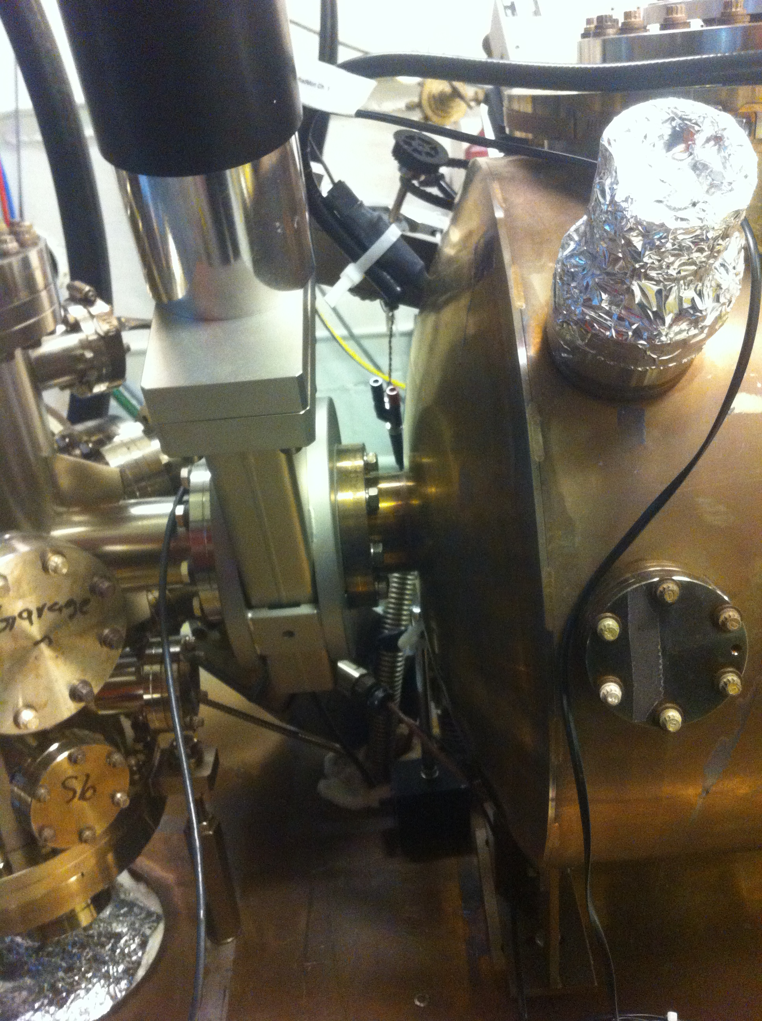

Slide 14
