Slide 1
Field at 325 kV

Slide 2
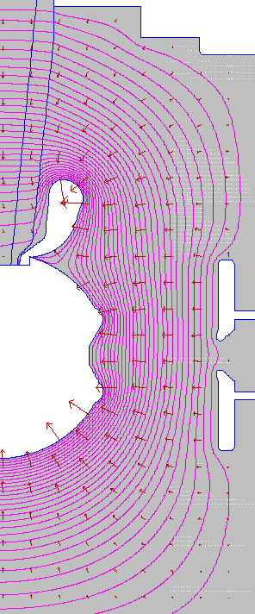
Field at 325kV
11 MV/m
12.6 MV/m
11 MV/m
12 MV/m

