Slide 1
DAQ Speed and Run2 Estimates
April 3, 2015

Slide 2
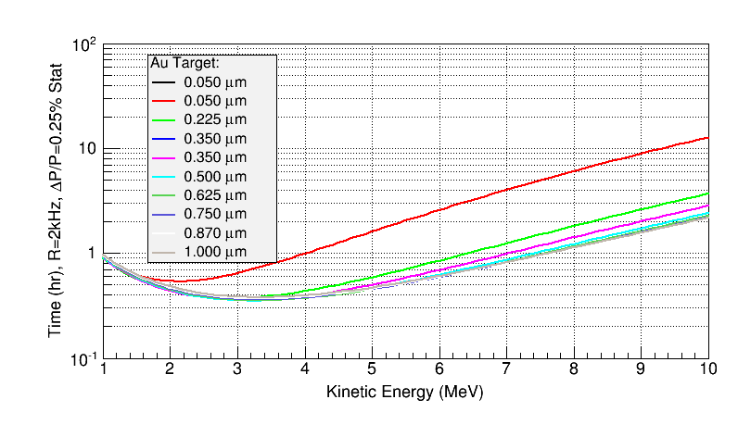

Slide 3
Estimates Assumptions
DAQ Rate limit = 2 kHz, Deadtime = 15%
Dump rate = 100 Hz/µA per detector:
Measured during Run1 5 MeV data at
Discriminator Threshold was 25 mV (or energy of about 1.25 MeV)
Dump Dipole Magnet was at +5A

Slide 4
3 MeV
5 MeV
8 MeV

Slide 5
Dump Event Suppression
Increase Discriminator Threshold – Tested in Run1
Study Dump dipole (+5A, 0A, +5A) – Tested in Run1 (for thinner foils, 0A or -5A may yield lower dump rate)
Laser timing veto – Tested on February 9, 2015
Note: Dump rate depends on electron energy ( ̴1/E)

Slide 6
Run2 Strategy
At 3 MeV:
Dump events will be higher due to energy
Increase Discriminator Threshold
Thick foils will benefit from faster DAQ but very little reduction in overall time required for Run2. Here DAQ speed will help with systematic studies, e.g., many short runs with very high statistics for stability study.
At 8 MeV:
Dump events will be lower due to energy
Elastic rate is too low to benefit from faster DAQ
Suppress dump events will reduce deadtime
Will run at about 5 µA (31 MHz) for all foils (current limited)
What is a reasonable current limit? Run1 was 5 µA

Slide 7
summary of FADC development for faster performance

Slide 9
remaining challenges & plans

