Slide 1
One Coil Gun Magnet
February 2, 2016

Slide 2
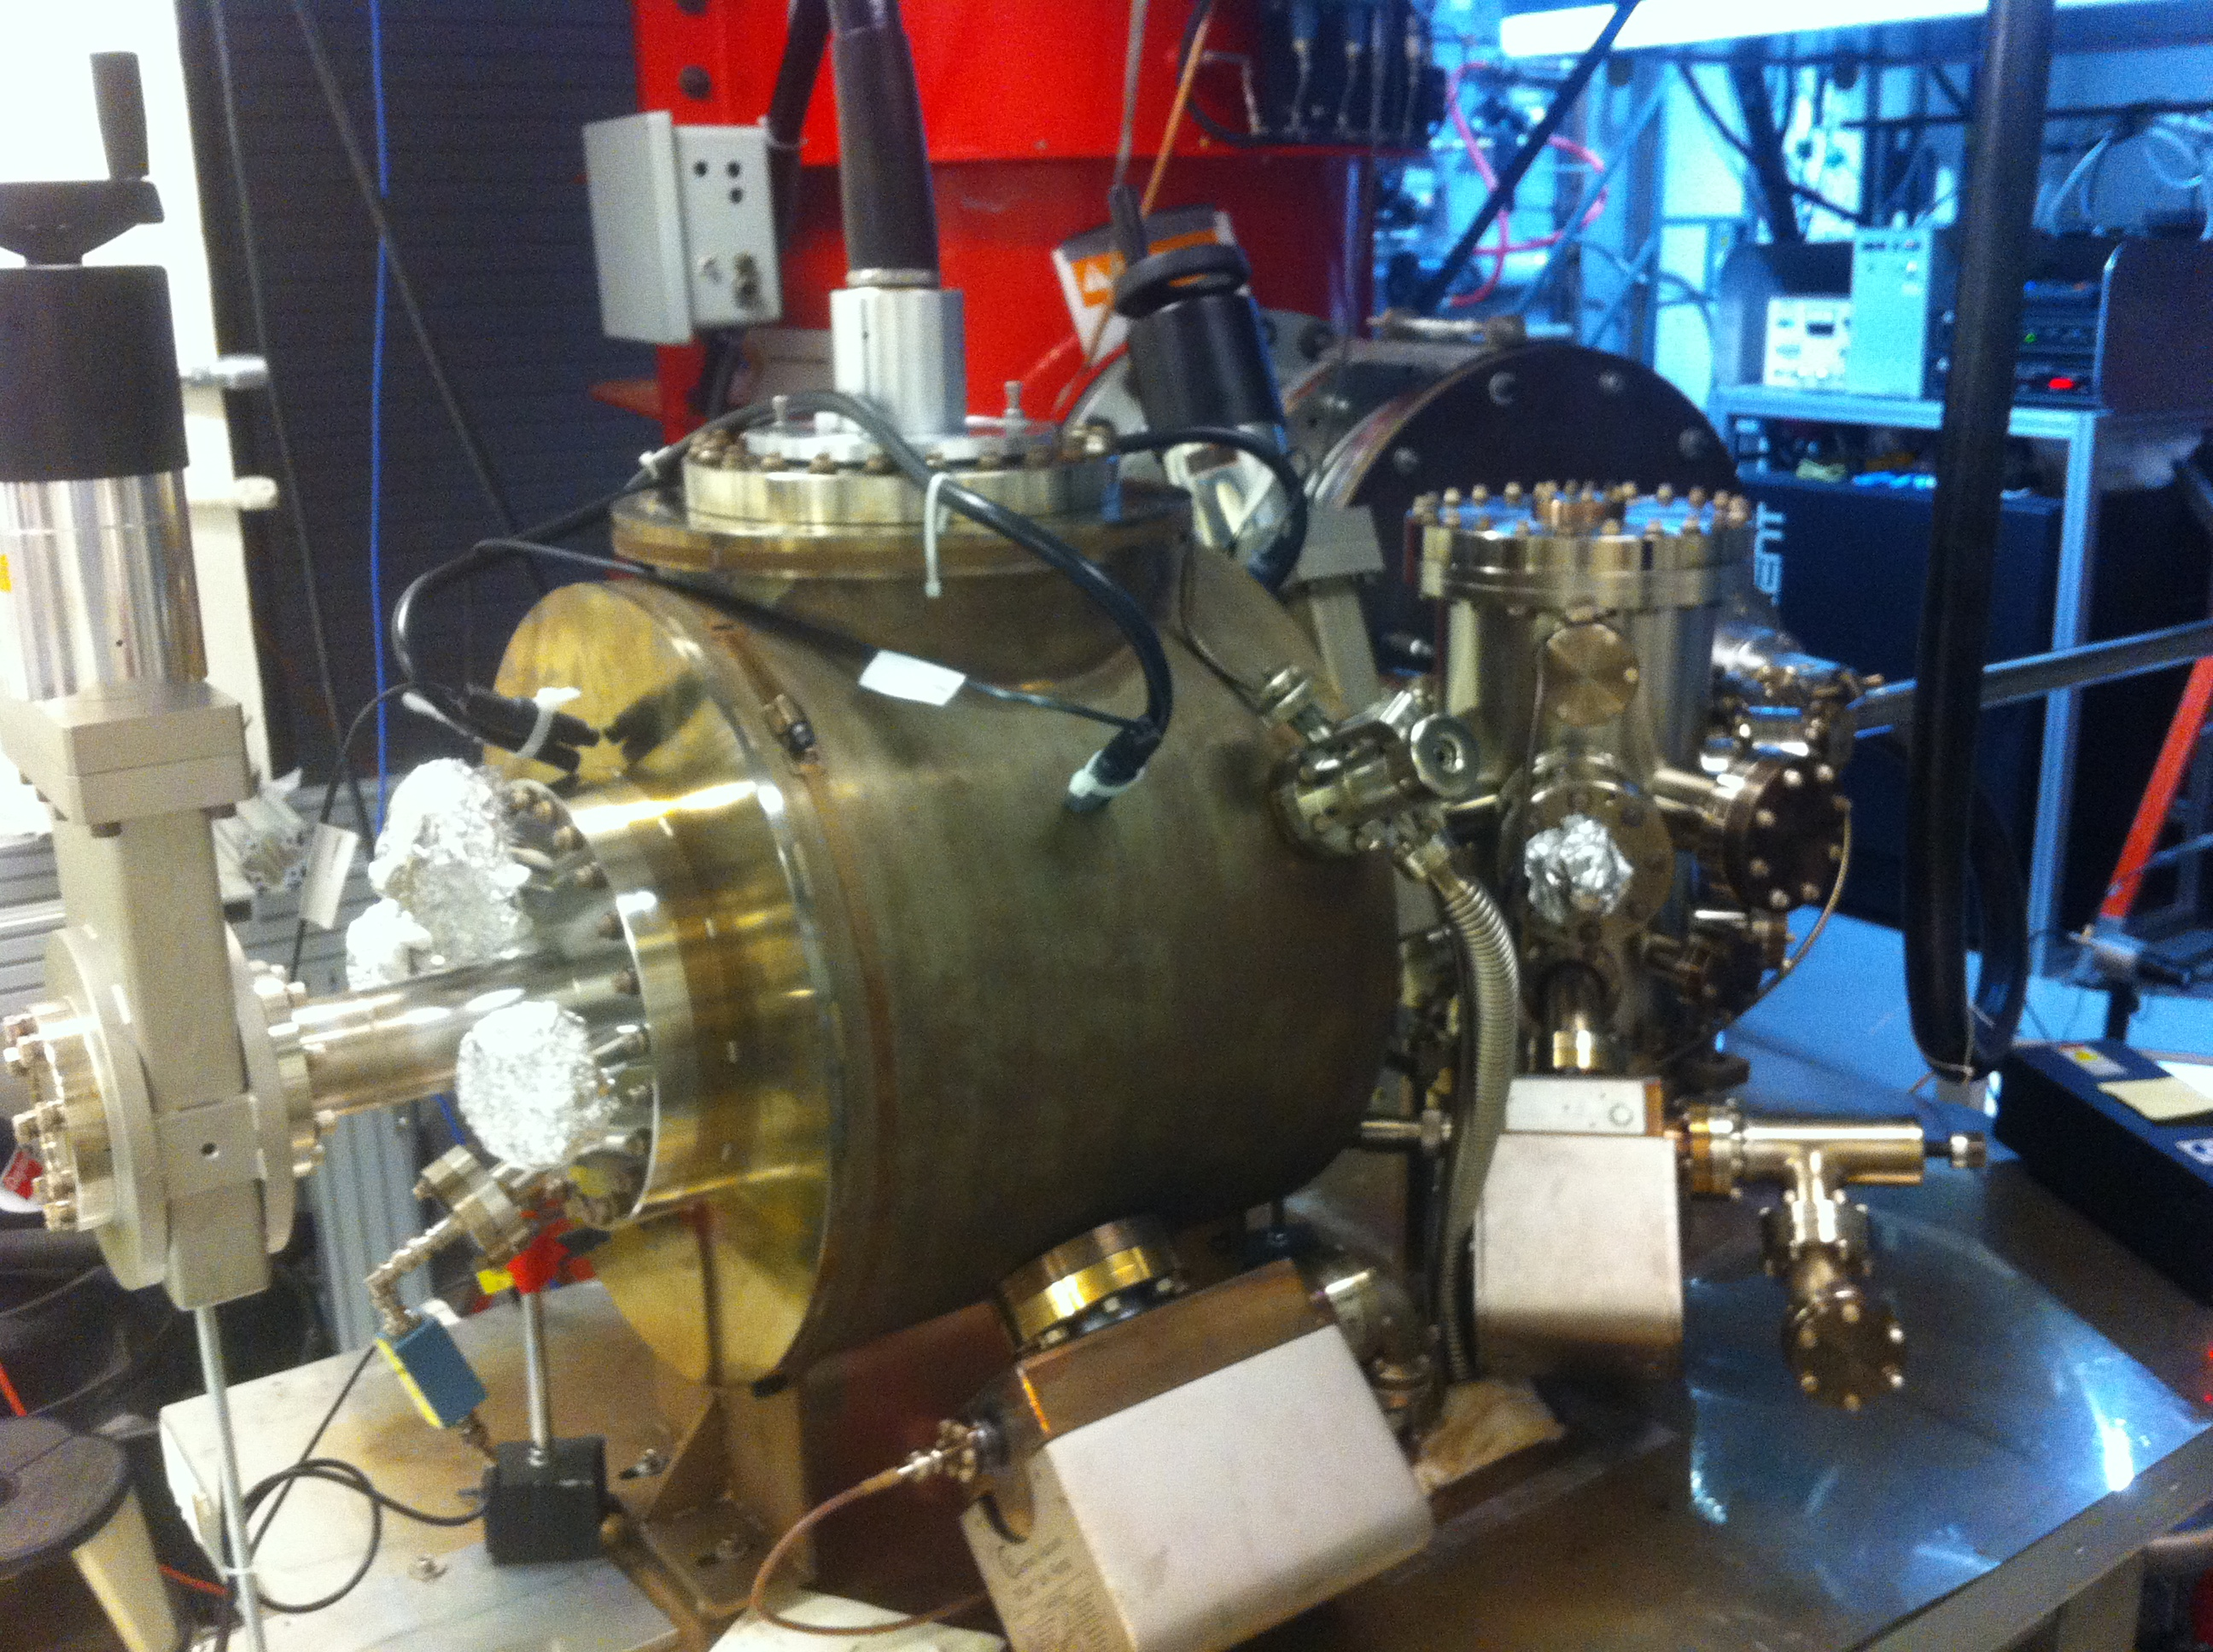
Magnetized Gun
K₂CsSb Preparation Chamber
HV Chamber

Slide 3
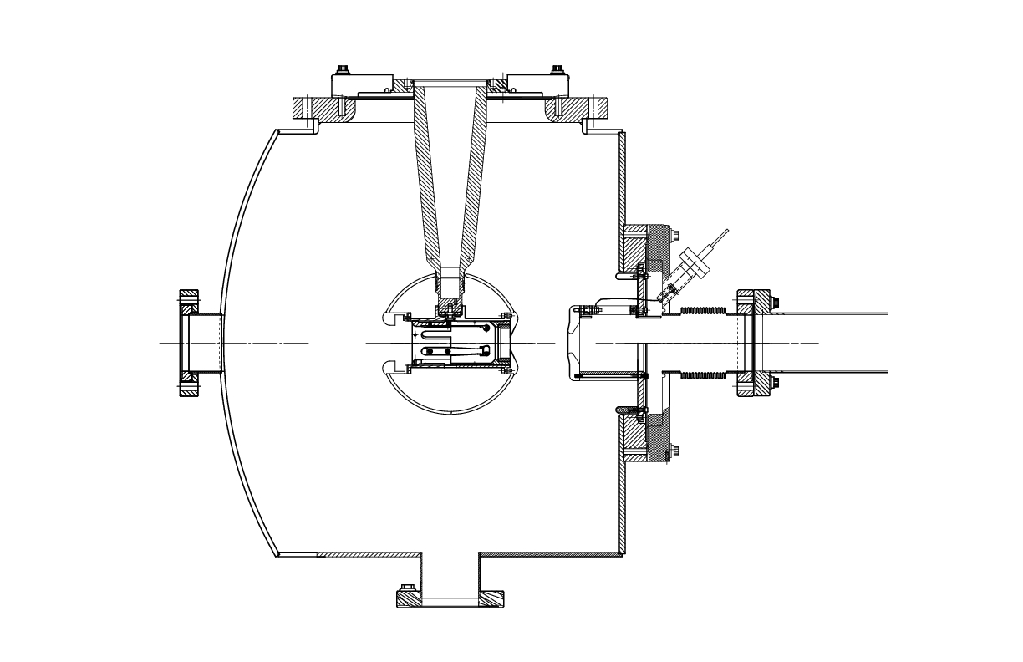
One Coil + Steel Puck
10”
Counter-wound solenoid (?)
13”
4”
18”
10”
3”
4”
Steel Puck
Power Supply:
ARC6-ARC9
320A, 830V
15”

Slide 4
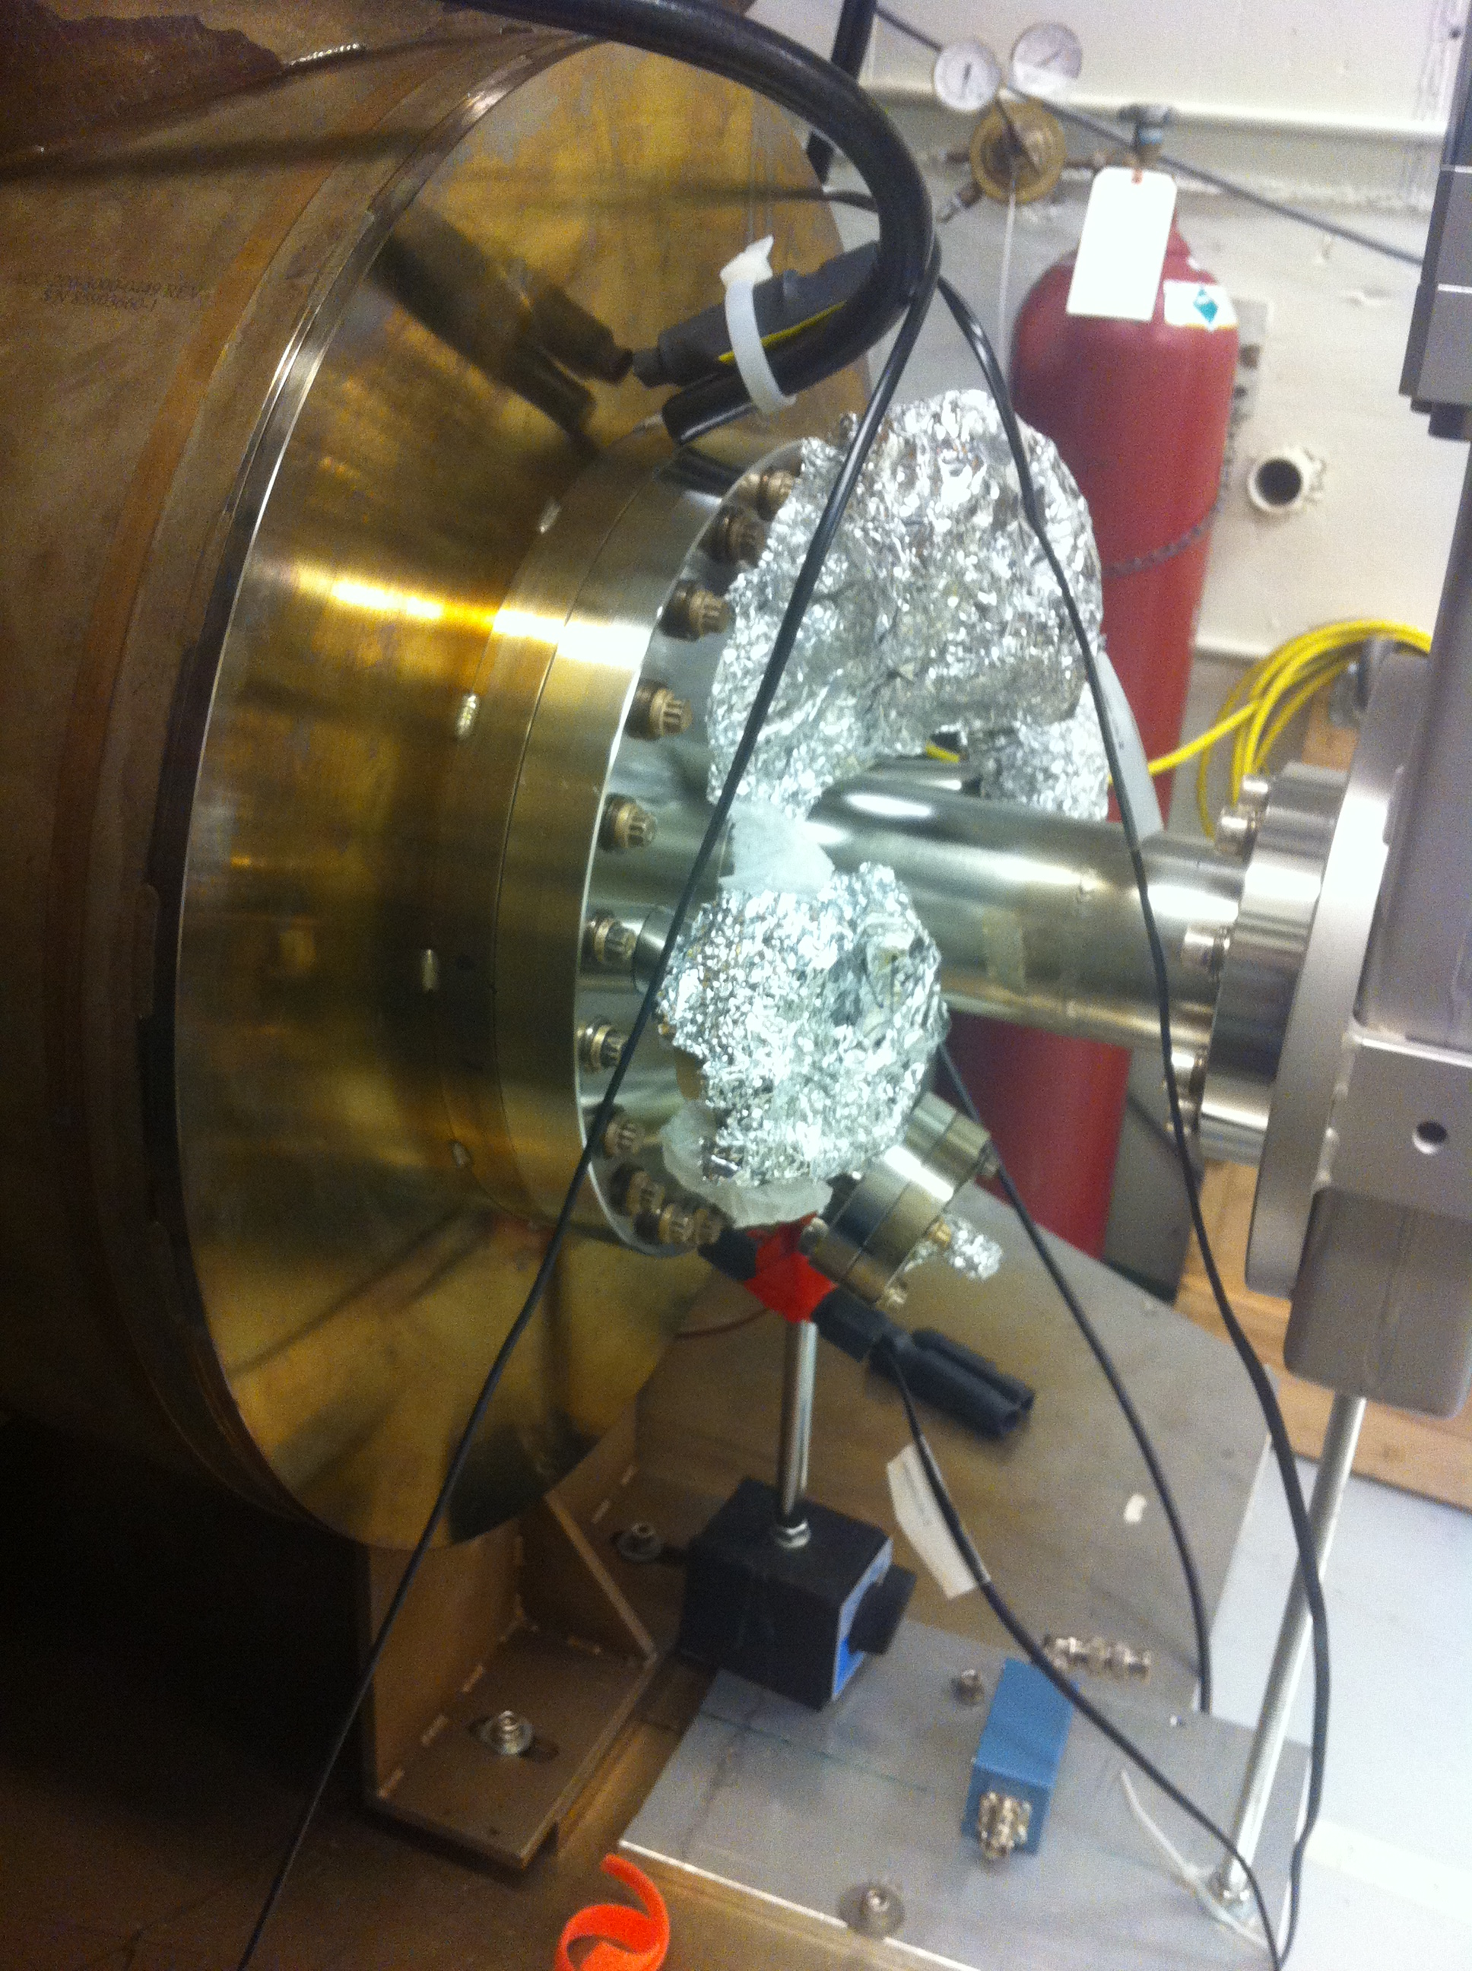

Slide 5
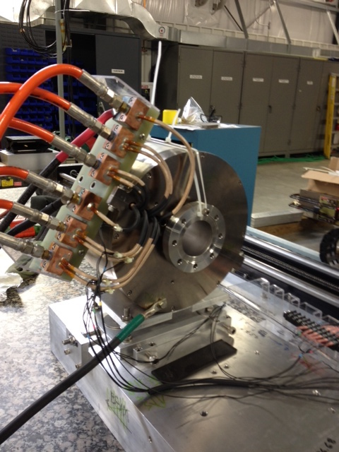
Similar magnet:
PEPPo
MPT Solenoid

Slide 6
Timeline
Power Supply (ARC6-ARC9):
Move to Magnet Lab: February
Test: March
Move to GTS: April
Ready: July 1, 2016
All magnet work has to be completed by September 30, 2016.
Magnet (One Coil):
Design: February and March
Procure: April
Map (with and w/o puck): July
Install: August, 2016

