Slide 1
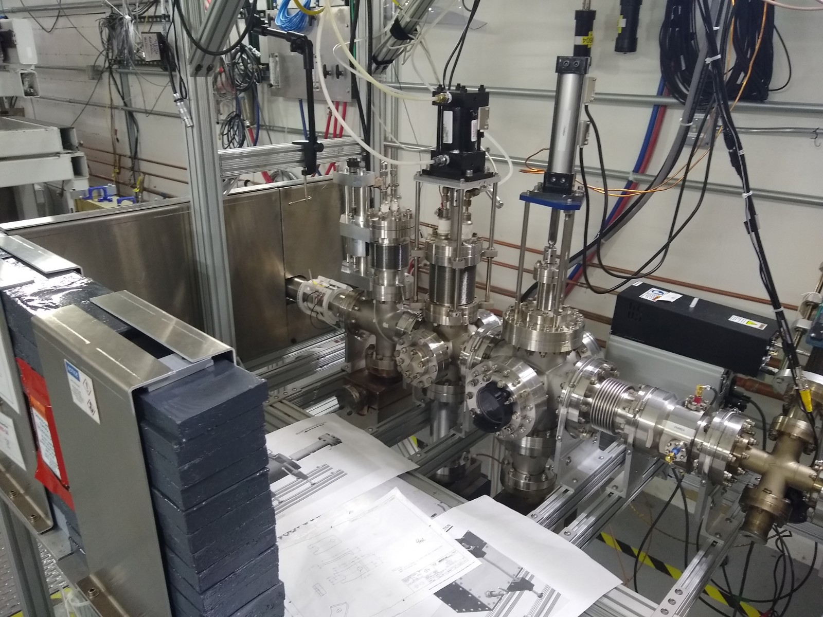
FCUP
Viewer
Lead wall
XRAY HV #3
7mm
in/out
BPM
Harp
XRAY HV #1

Slide 2
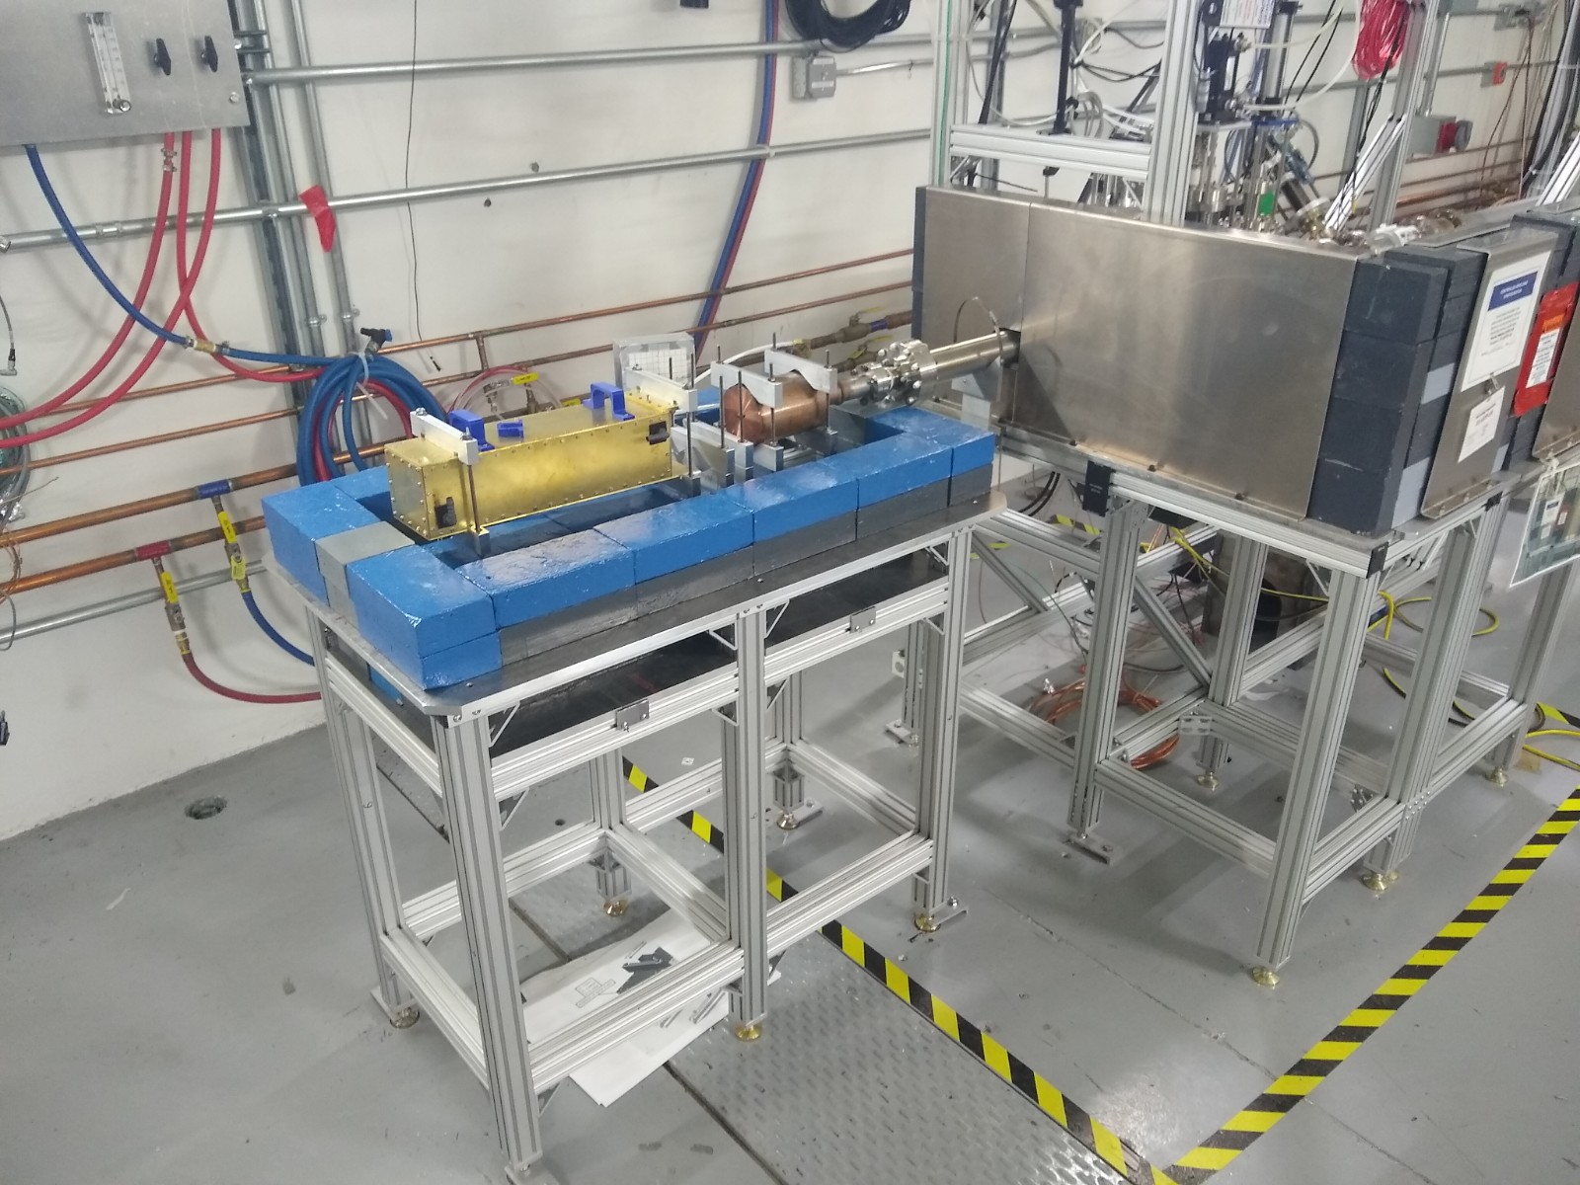
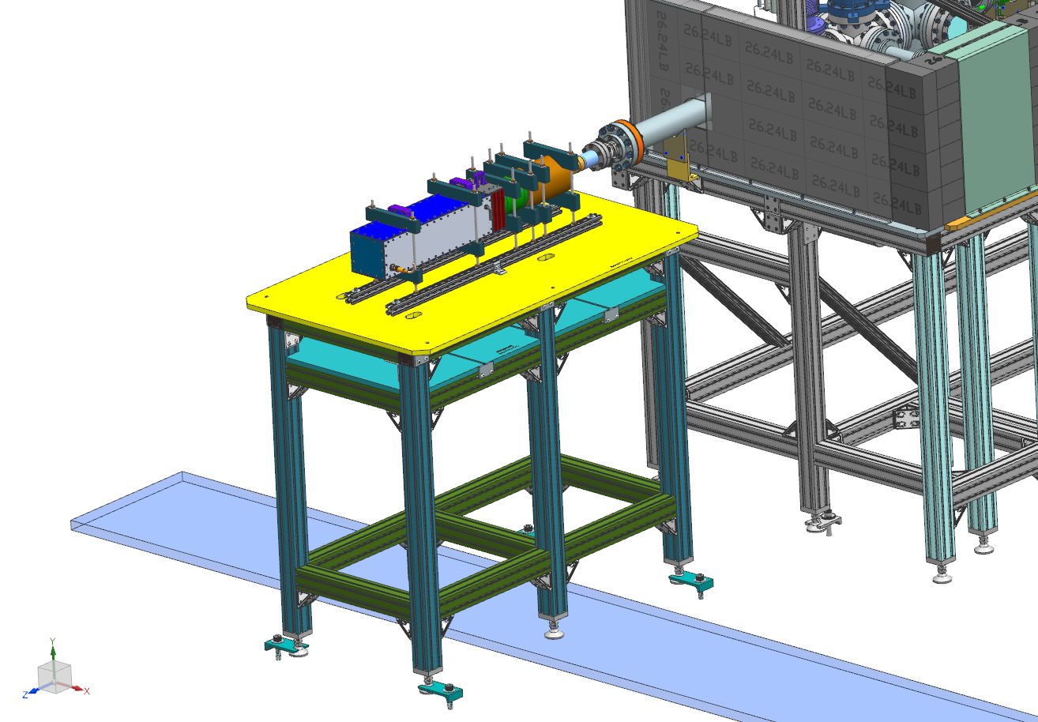
Nice job, looks like model…

Slide 3
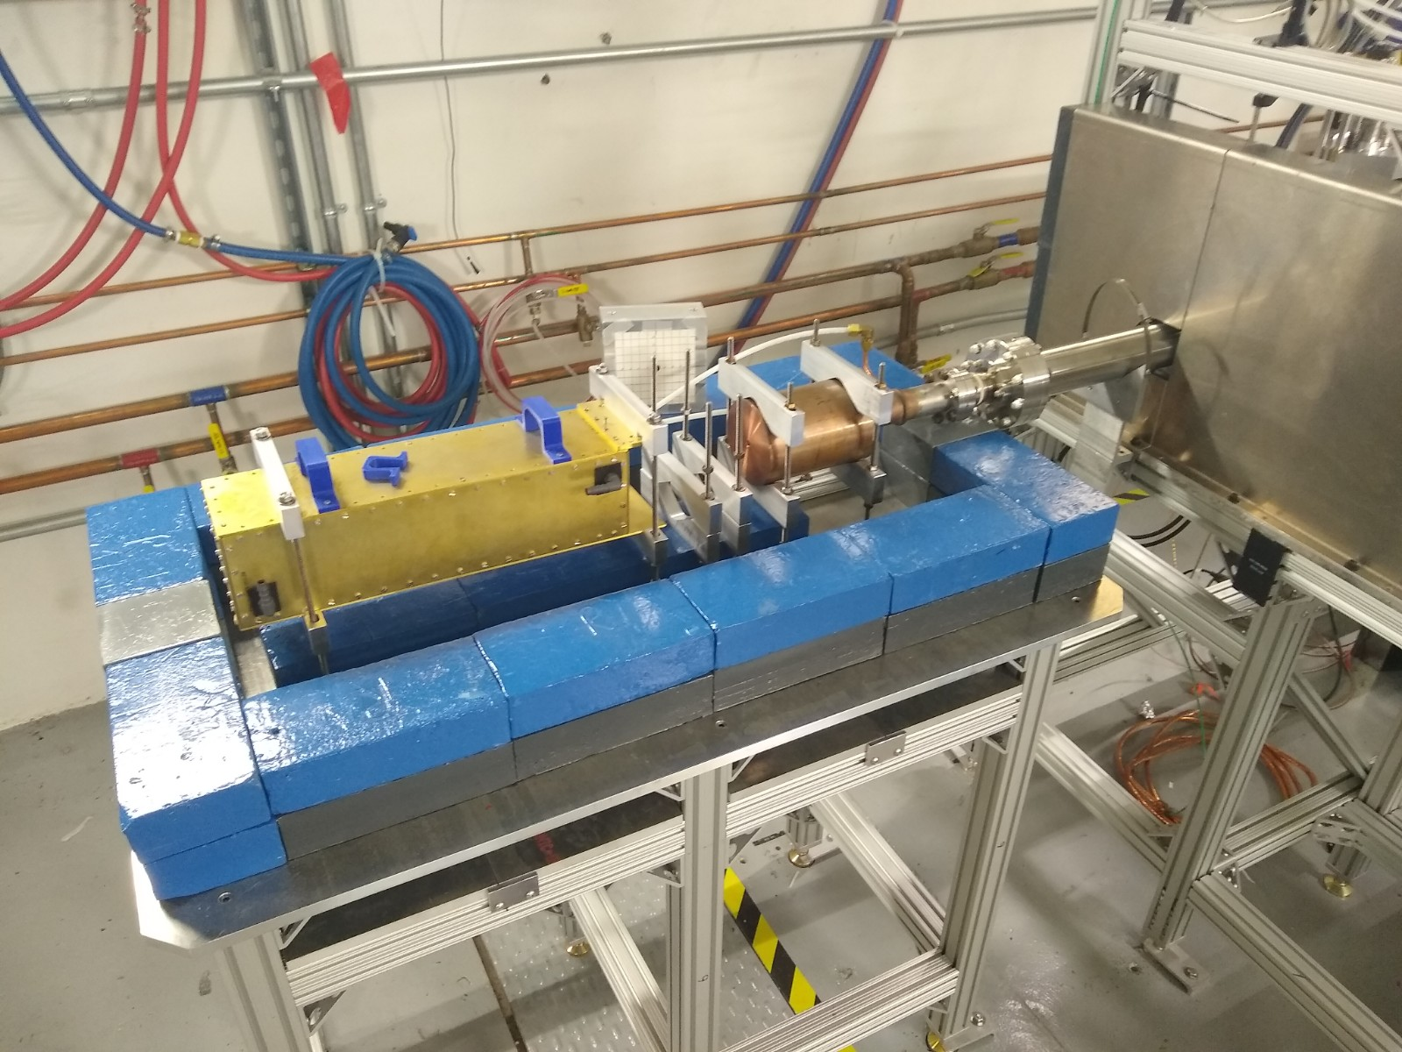
Dump w/ LCW
Lead wall
Detector box
(roughed in)
X-ray card
Aligned collimator
Ceramic
Magnet
Lead footing
1 cable pass thru
Lead shelf
2 cable pass thrus

Slide 4
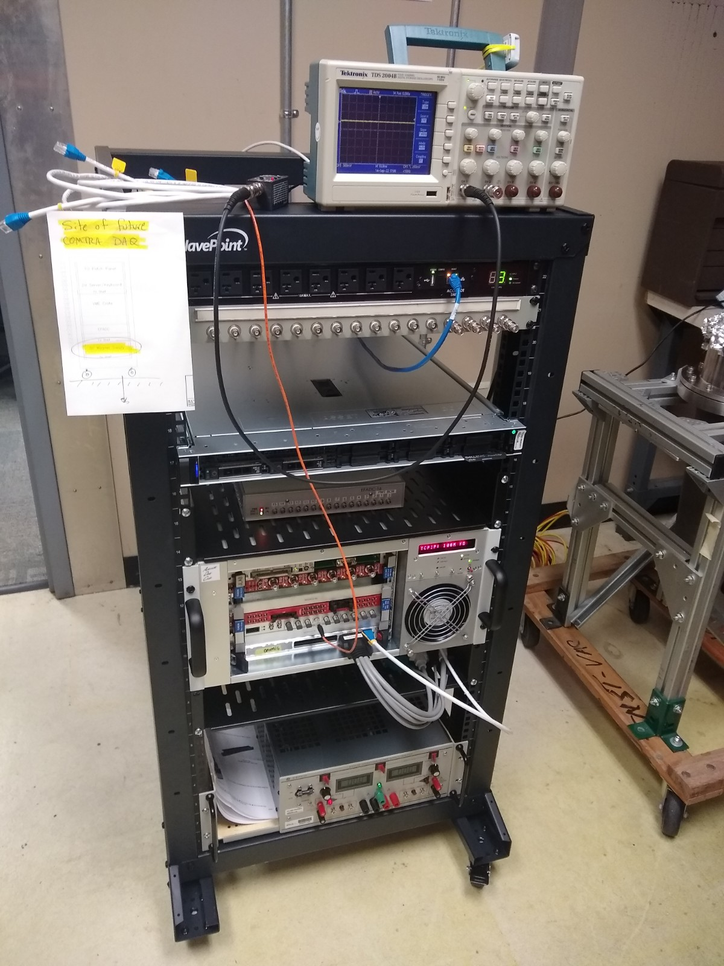
Signal/HV patch panel
Computer
EFADC
HelGen
PMT HV
Kepco PS

Slide 5
For KICKER experiment, HCO all items in straight ahead MeV beam line against updated UED “COMPTRA” workspace
Viewers
BPM’s
Harps
Current monitors
Valves
Ion pumps
Then, for COMTRA experiment (items downstream of IFYM606)…
ISLM606 – Add stepper motor w/ IN, OUT and position control
ISLM606 – Attach A5 current cable
IDLM606 – Attach A6 current cable
ITVM606 – HCO camera works
Maybe…provide one addition FSD flowmeter for ISLM606+IDLM606 in series.
UITF Beam Line Components for COMTRA
ITVM606
ISLM606
IFYM606
IDLM606

Slide 6
IDLM606
This is the COMTRA experiment

Slide 7
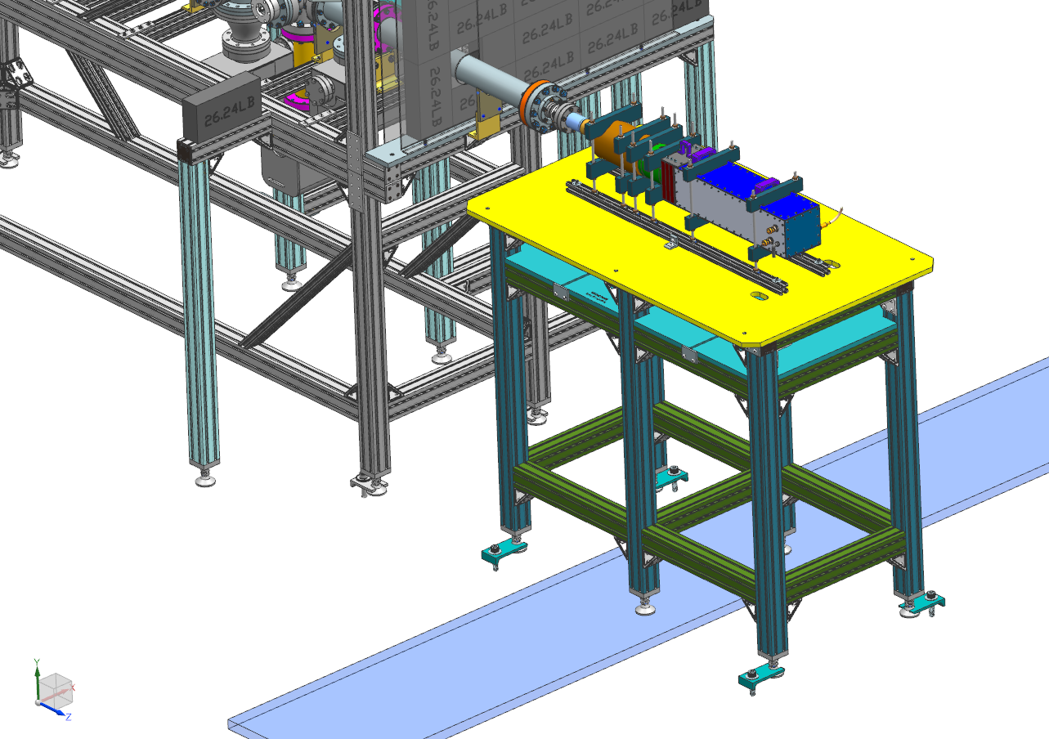
This is the COMTRA experiment
IDLM606

Slide 8
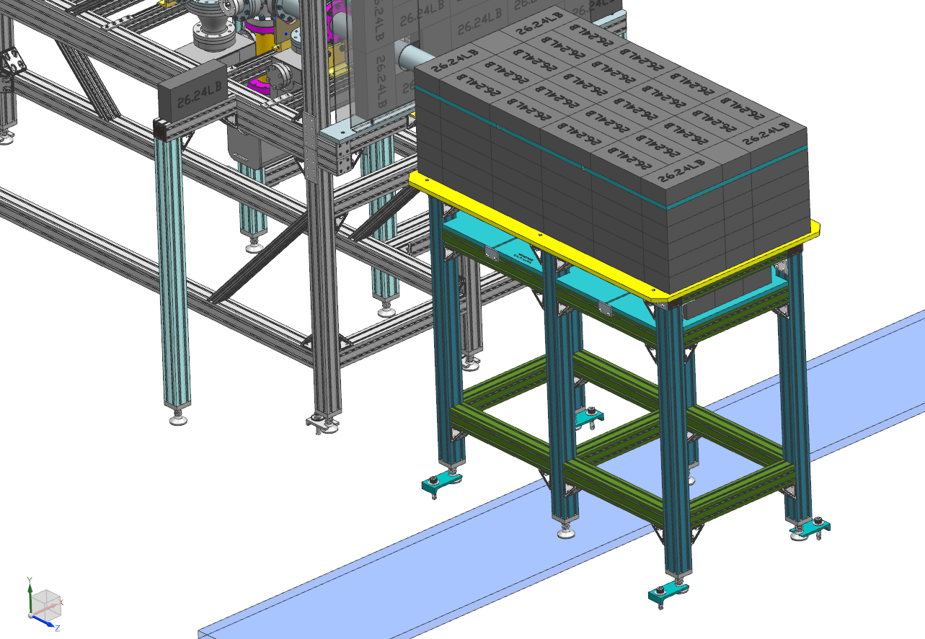
This is the COMTRA experiment

Slide 9
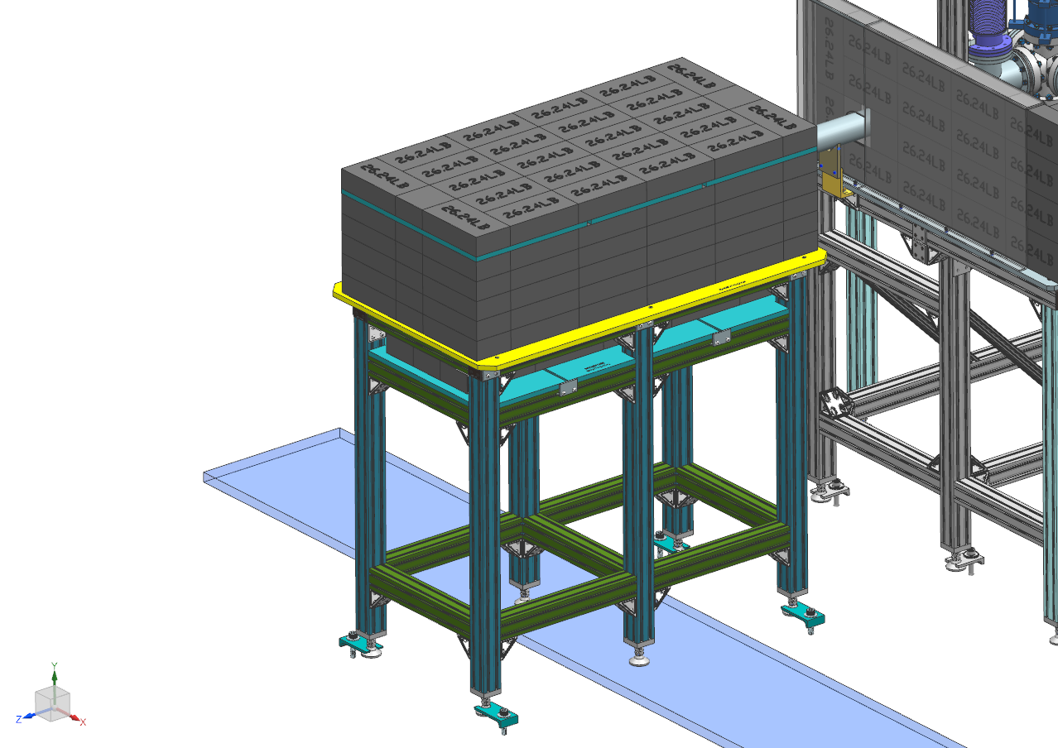
This is the COMTRA experiment

