Slide 1
CEBAF Injector Drawing & Dimensions – SI Units
Josh Yoskowitz

Slide 2
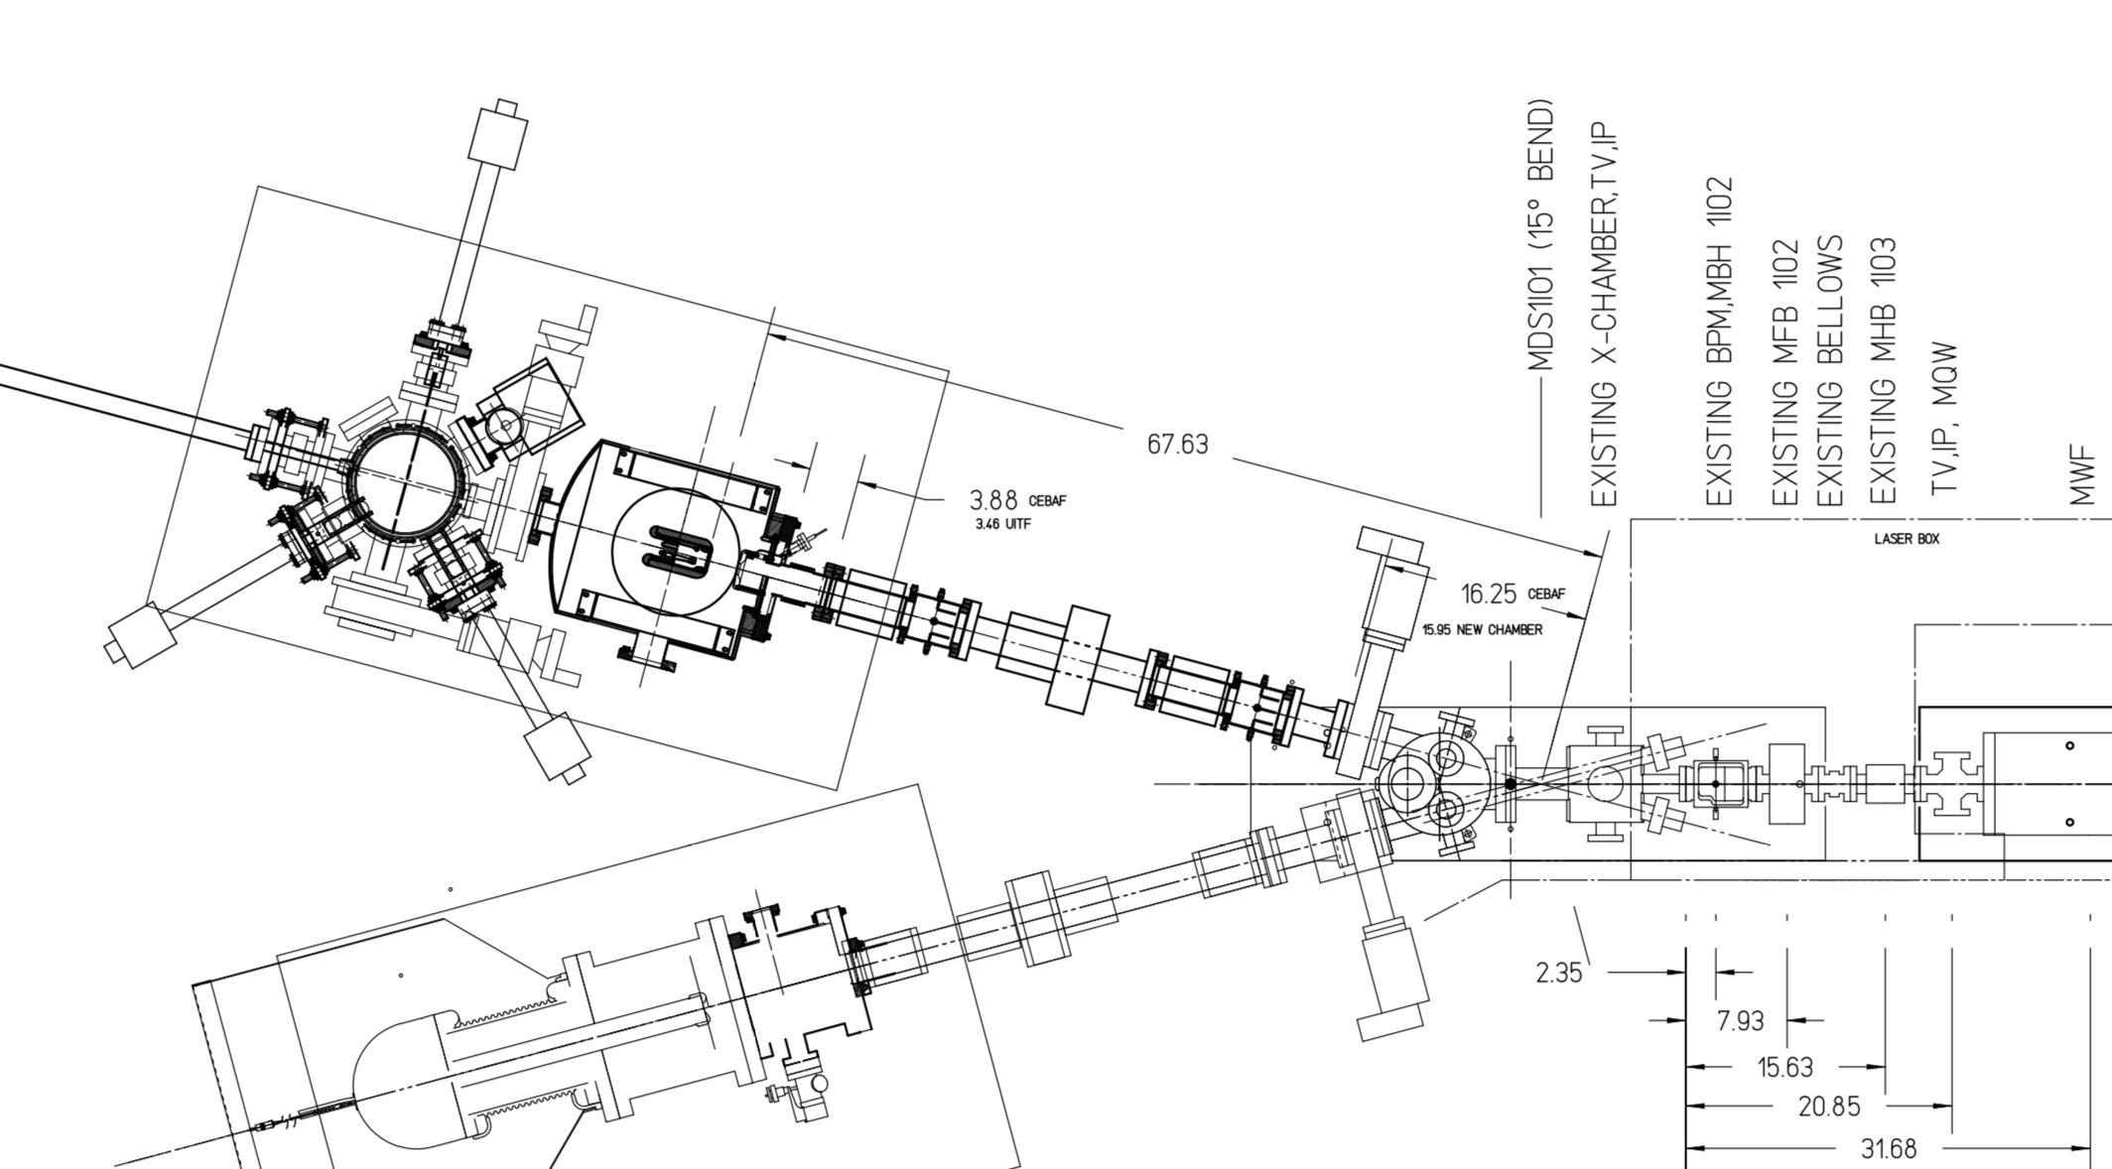
(units = inches)
Gun to Entrance of Wien filter
Cathode-Center Dipole
Two pair of H/V steering coils puts beam on axis
Other H/V coils can stay “off”

Slide 3
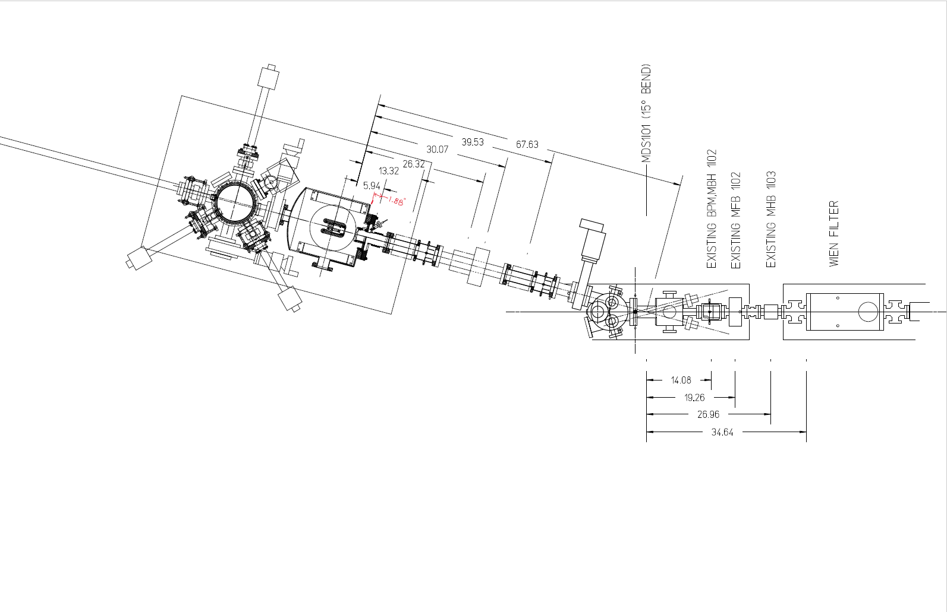
Drawing From Danny Machie
(units are in inches)

Slide 4
Drawing Pt 1: Gun Front Flange to Valve
Front Flange of Gun
Assume 0.0064m uncertainty in measurement (unless otherwise stated)
Cathode
Anode
VBV2I02
MBH2I01 H&V
IPM2I01
MBH2I02 H&V
MFH2I01
MBH2I03 H&V
IPM2I02
0.06
(x,y)
0.1
0.197
0.3137
0.546
0.660
0.8700
0.991
1.19±0.03

Slide 5
Drawing Pt 2: Valve to Vertical Wien Filter Entrance
Assume 0.0064m uncertainty in measurement (unless otherwise stated)
MWF1I04 (entrance)
VBV2I02
ITV2I01
MFB1I02
MDS1I01
ITV1I02
ITV1I03
MBH1I02 H&V
MHB1I03 H&V
0.180
0.25±0.03
0.406
0.38±0.03
0.533
0.737
Front Face of Dipole Magnet
0.864
0.953

Slide 6
Name | Type | Physical Length (m) | Physical ID (m) | Field Map Dimensions (m) | Field Map Name
MBH2I01 H&V | Steering Coil | 0.108 | 0.0603 | xϵ[-0.35,0.35], yϵ[-0.35,0.35], zϵ[-0.35,0.35], step=0.01 | Bfield.txt
IPM2I01 | Beam Position Monitor | 0 | 0.0603
MBH2I02 H&V | Steering Coil | 0.108 | 0.0603 | xϵ[-0.35,0.35], yϵ[-0.35,0.35], zϵ[-0.35,0.35], step=0.01 | Bfield.txt
MFH2I01 | Solenoid | 0.0762 | 0.0603 | Rϵ[0,0.15], zϵ[-0.20,0.20], step=0.001 xϵ[-0.15,0.15], yϵ[-0.15,0.15], zϵ[-0.20,0.20], step=0.005 | Solenoid_FieldMap.txt Solenoid_FieldMap_XYZ.txt
MBH2I03 H&V | Steering Coil | 0.108 | 0.0603 | xϵ[-0.35,0.35], yϵ[-0.35,0.35], zϵ[-0.35,0.35], step=0.01 | Bfield.txt
IPM2I02 | Beam Position Monitor | 0 | 0.0603
VBV2I02 | Valve | 0 | 0.0603
ITV2I01 | Viewer | 0 | 0.0603
MDS1I01 | Dipole | 0.108 | 0.0603 | xϵ[-0.15,0.15], yϵ[-0.15,0.15], zϵ[-0.35,0.35], step=0.001 | 15degDipole_air_corrected.txt
ITV1I02 | Viewer | 0 | 0.0349
MBH1I03 H&V | Steering Coil | 0.108 | 0.0349 | xϵ[-0.35,0.35], yϵ[-0.35,0.35], zϵ[-0.35,0.35] , step=0.01 | Bfield.txt
MFB1I02 | Solenoid | 0.0762 | 0.0349 | Rϵ[0,0.15], zϵ[-0.20,0.20], step=0.001 xϵ[-0.15,0.15], yϵ[-0.15,0.15], zϵ[-0.20,0.20], step=0.005 | Solenoid_FieldMap.txt Solenoid_FieldMap_XYZ.txt
MHB1I03 H&V (not MBH1I03) | Steering Coil | 0.0747 | 0.0349 | xϵ[-0.35,0.35], yϵ[-0.35,0.35], zϵ[-0.35,0.35] , step=0.01 | HB_Steering_Coil_FieldMap.txt
ITV1I03 | Viewer | 0 | 0.0349
MWF1I04 | Entrance to Vertical Wien Filter | 0 | 0.015

