Slide 1
High Power Solid Target for Positron Source at CEBAF
e⁺ Production by Polarized e‒ Beam
Radiation Damage and Heat Load in Target
Design of High Power Target
Target Material Tests with e‒ Beam and Laser
A. Ushakov^{1,2}, S. Covrig¹, J. Grames¹, S. Habet^{1,2}, C. Le Galliard², E. Voutier²
¹ Thomas Jefferson National Accelerator Facility, Newport News, VA,USA
² Université Paris-Saclay, CNRS/IN2P3/IJCLab, Orsay, France
This work is supported by the European Union’s Horizon 2020 Research and Innovation program under Grant Agreement No 824093 and the U.S. DOE, Office of Science, Office of Nuclear Physics, contract DE-AC05-06OR23177.

Slide 2
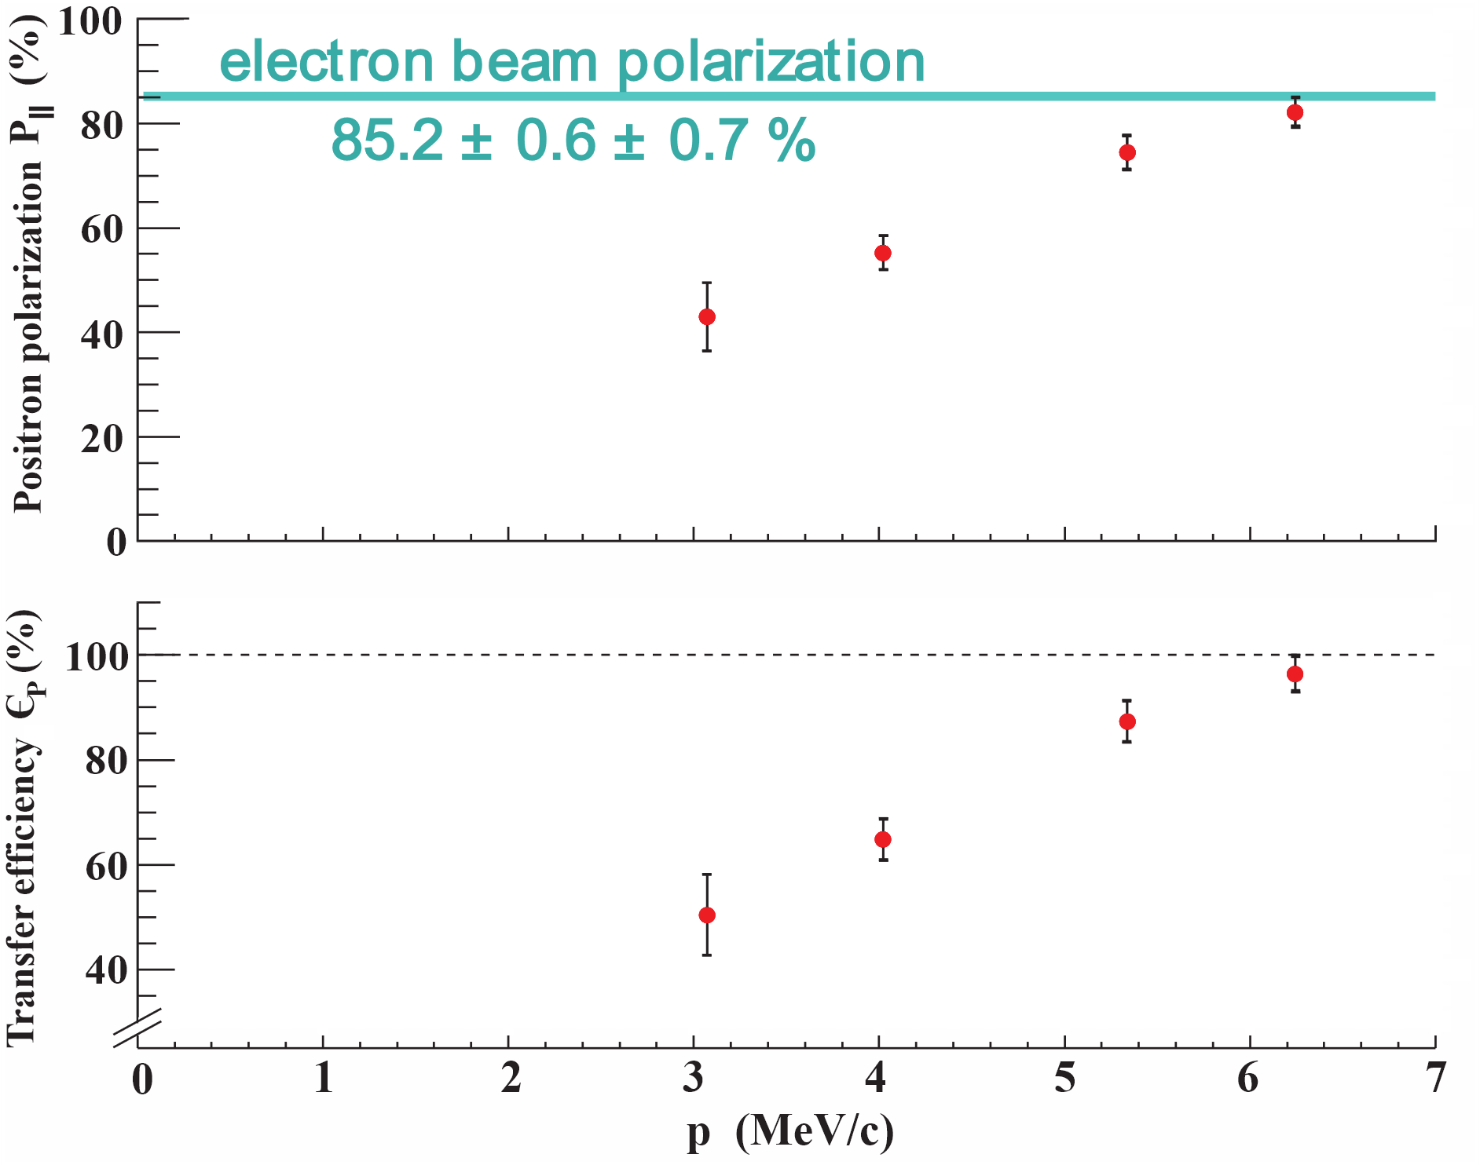
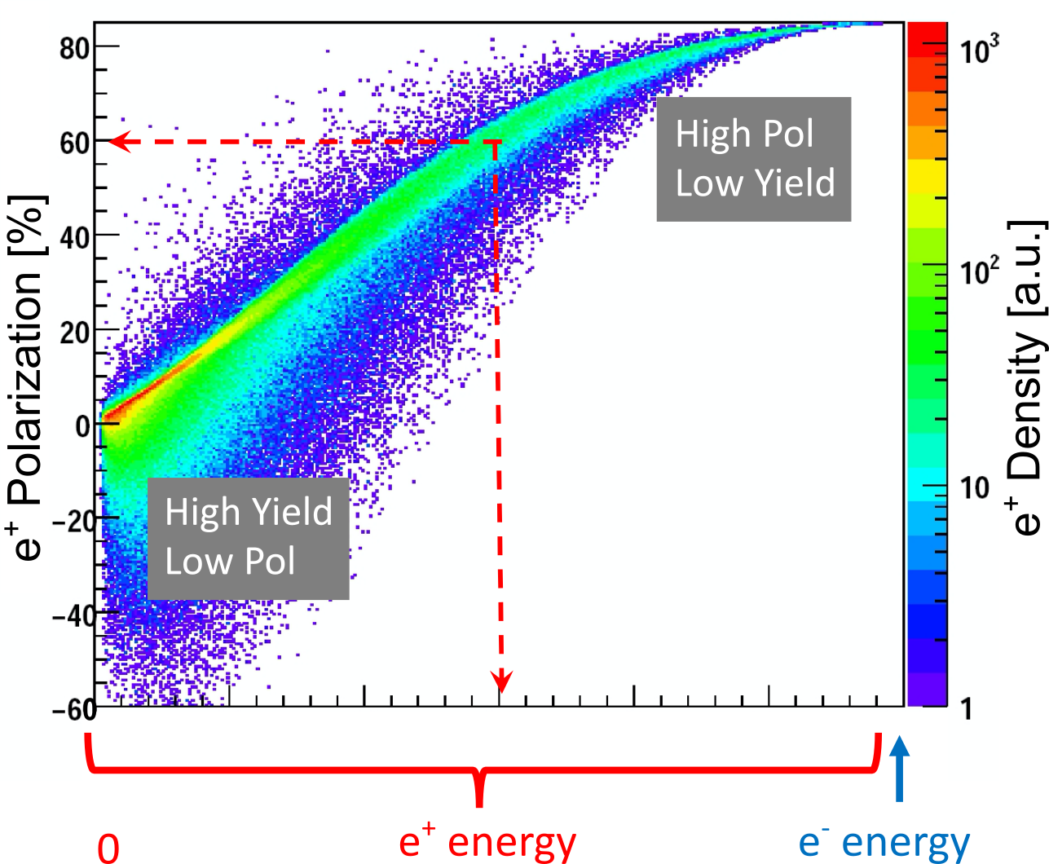
Polarization Transfer from e‒ to e⁺ in a Single High-Z Target
PEPPo (Polarized Electrons for Polarized Positrons) experiment demonstrated the feasibility of using bremsstrahlung of MeV Polarized Electrons for production of Positrons with a high level of polarization.
e⁺ Polarization vs Energy
1 μA @ 8.2 MeV e‒, 1 mm W target
(PEPPo Collaboration) D. Abbott et al. Phys. Rev. Lett. 116 (2016) 214801

Slide 3
Optimal Target Thickness and e⁺ Yield
Yield vs Target Thickness
For e⁺ source at polarized mode and 120 MeV e‒ beam (at maximal Figure-of-Merit FoM = $YP^{2}$):
Optimal Thickness of W Target = 4 mm
e⁺ Yield $\sim$10⁻³
Δp_{e+}/p_{e+} = ±0.05
High-Current e‒ Beam ($\sim$1 mA)
Power Deposition in Target ($\sim$17 kW)
Tungsten

Slide 4
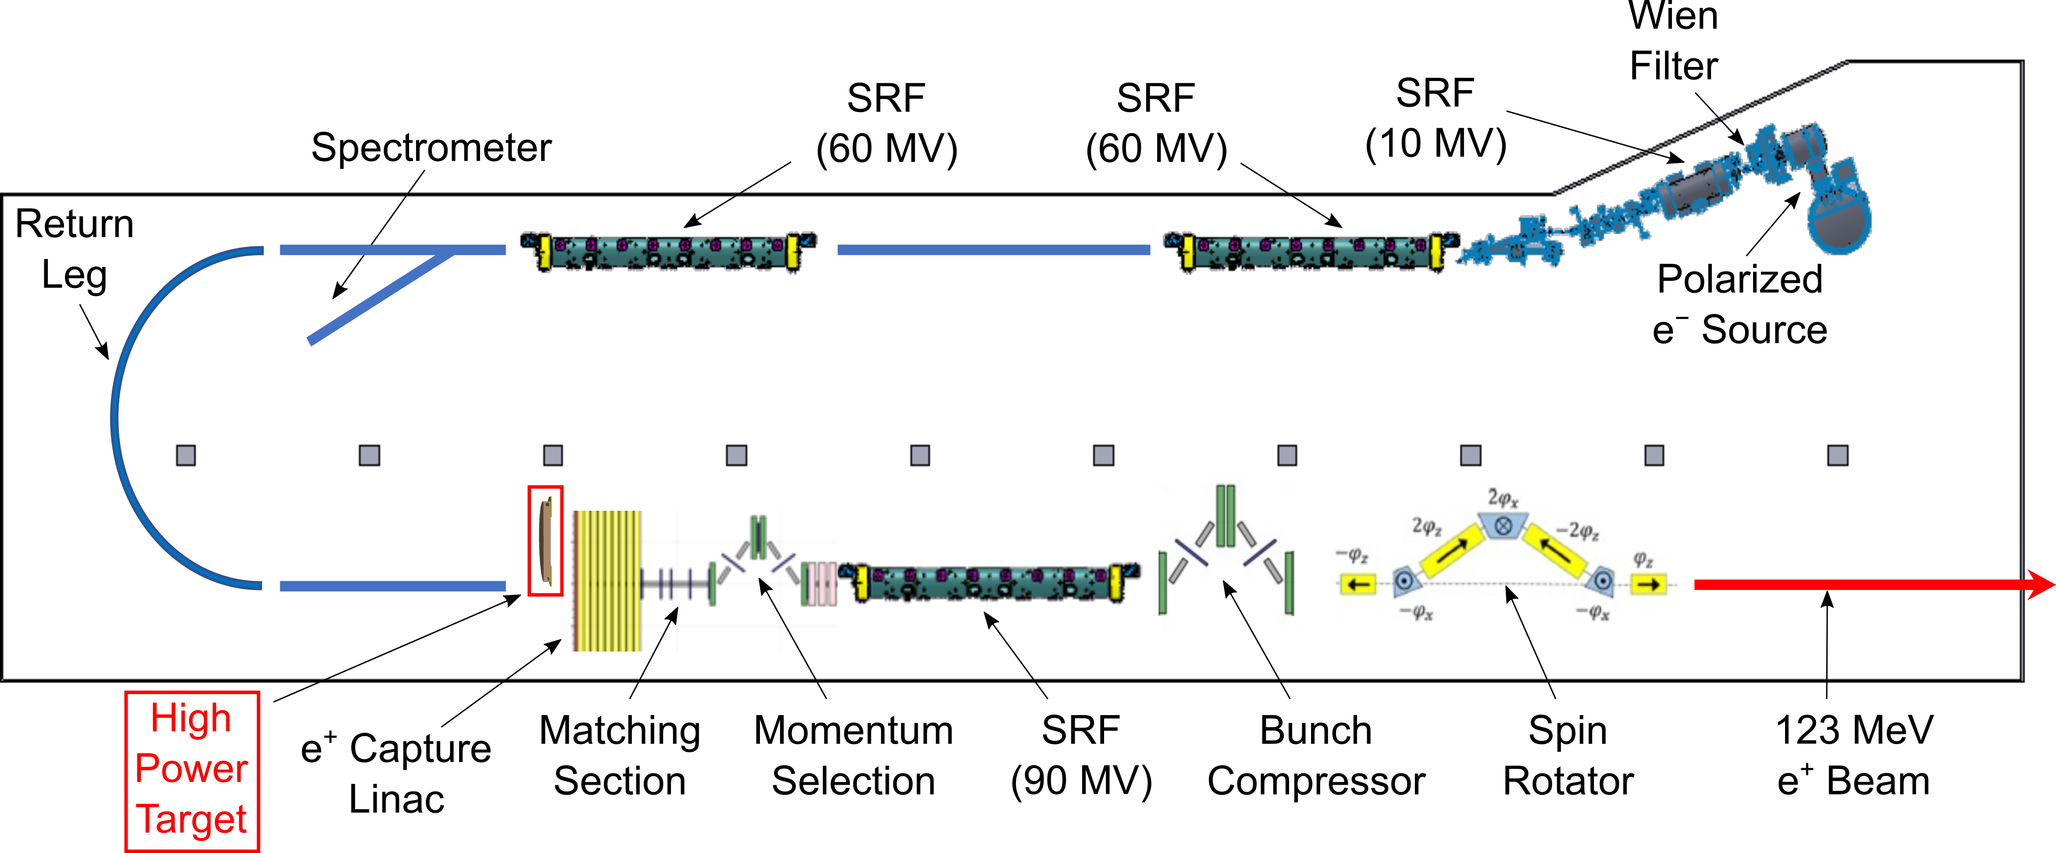
LERF Polarized Positron Injector Concept
Developing polarized e⁺ injector at LERF
High current polarized e⁻ source (10 MeV/10 mA) – C. Hernandez-Garcia
High current 1-3 mA e⁻ LINAC (two C75 CM)
Positron conversion target (~100 kW) – A. Ushakov
Capture of e⁺ beam and momentum selection
e⁺ bunch compression and acceleration to 123 MeV
S. Habet

Slide 5
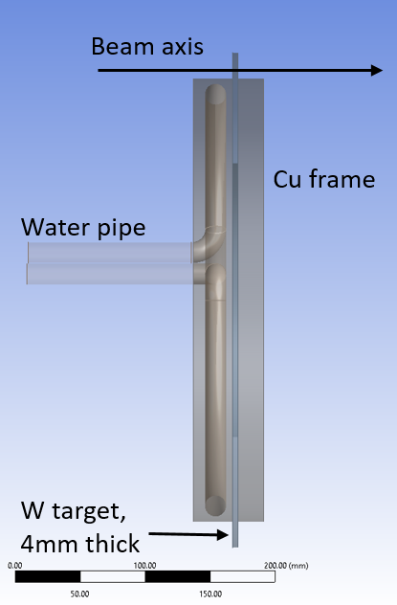
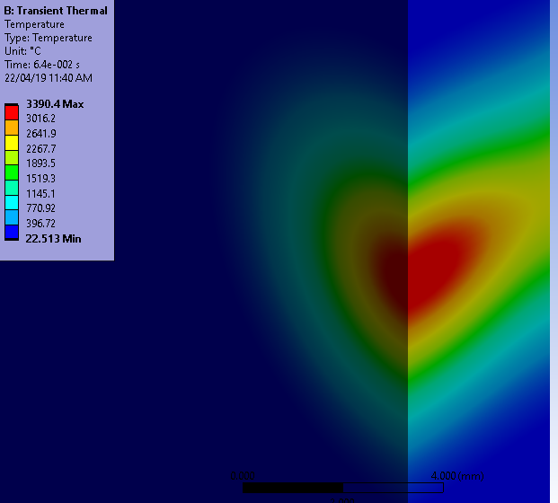
Concept and Challenges of High-Power Target
Target Concept
Target Challenges:
Radiation damage → rotate
High (average) heat → cool and rotate
Material fatigue cause by cycling temperature → study material properties under realistic conditions
Temperature in Stationary Target
1 mA @ 120 MeV cw e‒ beam
σ_{beam} = 1.5 mm
Some parameters of currently considered model of e⁺ target:
Beam passes through the target at R of 18 cm
2.3 m/s target tangential speed at R of 18 cm
Ø16 mm water channel inside Cu disk
1.5 m/s speed of water flow
Static target would melt in 64 ms

Slide 6
Radiation Damage of 17 kW Tungsten Target
Radiation Damage of Stationary Target
Radiation Damage of Rotated Target
120 MeV e‒
1.5 mm rms spot size
Ø36 cm W Target
1 mA @ 120 MeV e‒
1.5 mm rms spot size σ
Max Rad. Damage of Stationary Target
5.7E-22 dpa/e‒
Annual Max Rad. Damage of Rotated Target
0.21 dpa
Tests of target thermal and mechanical properties at such level of rad. damage are planned

Slide 7
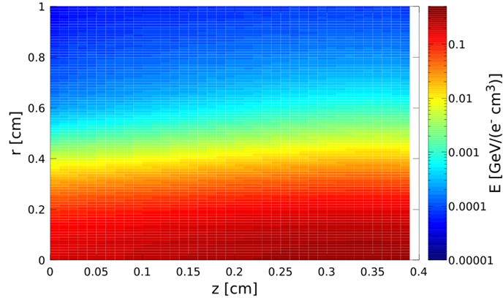
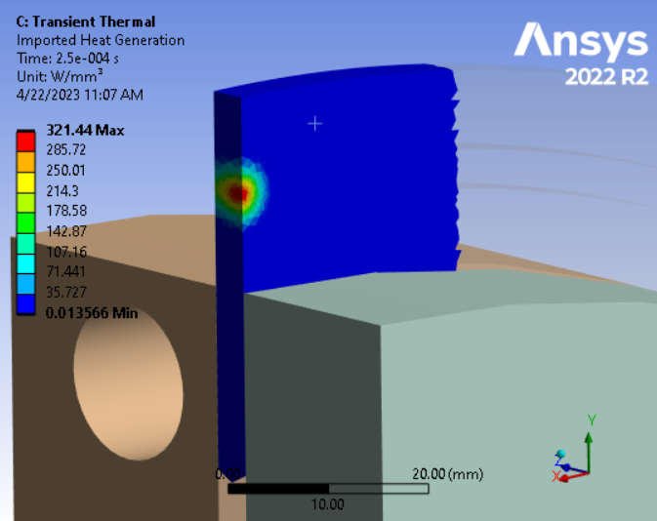
Energy Deposition and Heat Power Density in 17 kW Target
Energy Deposition in W Target
Heat Power Density
120 MeV e‒
1.5 mm RMS spot size
Max E_{dep} = 0.321 GeV/(e‒ cm³)
For 1 mA e‒ beam:
P_{max} = 321 W/mm³

Slide 8
Temperature in Rotated Tungsten Target
Temperature Distribution for Beam Moving with 2.3 m/s
Temperature vs Time
1 mA @ 120 MeV e‒ Beam
1.5 mm rms spot size
2.3 m/s
T_{max} = 681 °C
ΔT_{max} = 188 °C
2 Hz target revolution frequency
PEDD = 28.2 J/g

Slide 9
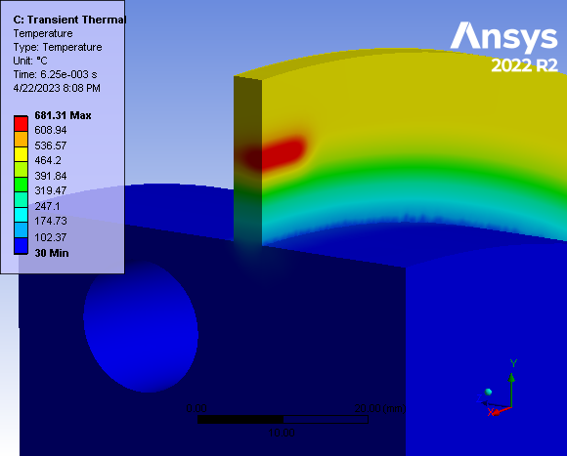
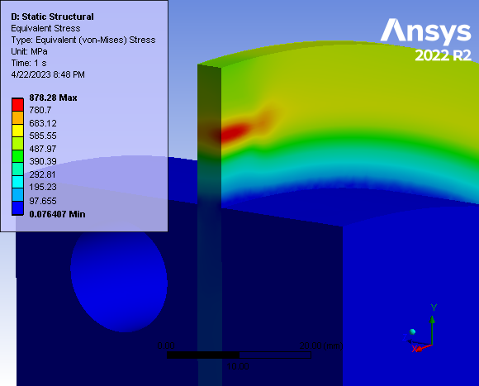
Equivalent von-Mises Stress in Rotated 17 kW Target
Distribution of Temperature
Equivalent von-Mises Stress
T_{max} = 681 °C in Tungsten
σ_{vM max} = 878 MPa
Tests of target fatigue are desired

Slide 10
Test of Target Materials with e‒ Beam at Mainz Microtron (MAMI)
Investigate changes/degradation of target material after 10⁶-10⁷ thermal cycles. Test fatigue of target materials: W, Ta, W-alloys (JLab target) and Ti-alloys (ILC target) at different temperatures
Study impact of radiation damage on target material properties between 0.1 and 0.5 dpa at expected elevated temperatures
MAMI e‒ Beam:
Beam energy: 3.5 MeV
Pulsed current: I $≲$ 50 μA
Pulse length t_{p} $≳$ 0.3 ms
Beam rms size on target: σ $≲$ 250 μm
DESY: S. Riemann
Helmholtz-Zentrum hereon: D. Lott, T. Lengler
IJCLab: S. Habet, C. Le Galliard, E.Voutier
Jefferson Lab: J. Grames, A. Ushakov
University of Hamburg: G. Moortgat-Pick, M. Formela
Johannes Gutenberg University Mainz: K. Aulenbacher, T. Beiser, M. Dehn

Slide 11
Radiation Damage of Tungsten by 3.5 MeV e‒ Beam with 50 µm Spot Size
50 μA → 3.125E+14 e‒/s
For e‒ beam with duty cycle of 22%
(1.1 ms pulse length, 5 ms pulse period)
to reach the damage of 0.21 dpa
9h of irradiation is needed
Material | Displacement Threshold Energy [eV]
W | 90
Ta | 90
Re | 60
Cu | 30
Max Rad. Damage = 1.02E-19 dpa/e‒

Slide 12
Tested Targets and Measured Temperatures (March 31 – April 5, 2023)
1st 5 Targets
2nd 5 Targets
# | Material | Target Size [mm] | Thermo-couples | Pulse Length [ms] | Pulse Period [ms] | T_{ave} [°C] | Irrad. Time [h]
1b | Ti ELI | 0.5x10x42 | Yes | 1.0 | 10. | 421 | 0.7
1a | Ti ELI | 0.5x10x42 | Yes | 1.0 | 10. | 782 | 3.8
1c | Ti ELI | 0.5x10x42 | Yes | 1.1 | 5.0 | 223 | 3.7
2 | Ta | 0.1x10x42 | No | 1.1 | 5.0 | - | 10.6
3 | Ta | 0.1x10x42 | Yes | 0.75 | 10. | 850 | 8.0
4 | W | 0.1x10x42 | Yes | 0.75 | 10. | x | 8.0
5a | Ti ELI | 0.75x10x42 | No | 1.0 | 10. | - | 8.5
5b | ELI alloy | 0.75x10x42 | No | 0.5 | 7.1 | - | 6.0
 |  |  |  |  |  |  | Ʃ 48.3
# | Material | Target Size [mm] | Thermo-couples | Pulse Length [ms] | Pulse Period [ms] | T_{ave} [°C] | Irrad. Time [h]
1a | Ti Grade5 | 0.5x14x42 | Yes | 1.0 | 10. | 108 | 8.5
1b | Ti Grade5 | 0.5x14x42 | Yes | 0.5 | 7.1 | 98 | 5.5
2 | W | 0.1x3x42 | No | 0.4 | 3.7 | - | 6.0
3 | W | 0.1x10x42 | Yes | 1.1 | 5.0 | 197 | 9.1
4 | Ta | 0.1x3x42 | No | 0.4 | 3.7 | - | 5.5
5 | Ti Grade5 | 0.75x14x42 | Yes | 0.5 | 10. | 131 | 21.2
 |  |  |  |  |  |  | Ʃ 55.8
Beam size was estimated by T. Beiser
(based on photos of beam on OTR screen):
2σ_{x} $≲$ 527 µm,
2σ_{y} $≲$ 585 µm
Thermal/electric isolation: Aluminum Oxide with 1.6 mm thickness

Slide 13
Targets after Irradiation
1st 5 Targets
2nd 5 Targets

Slide 14
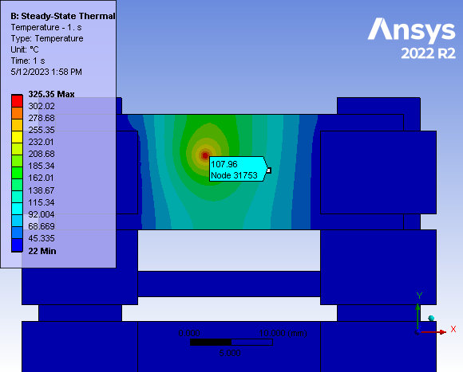
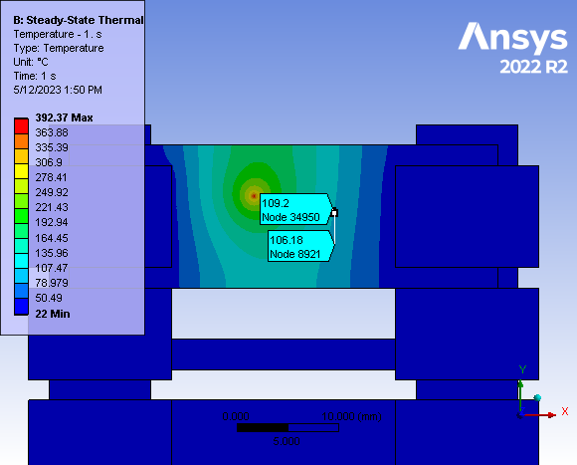
Target 1a: Temperature in 0.5 mm Ti Grade5 (1 ms Pulse Lengh, 10 ms Period)
200 µm rms beam spot size
50 µm rms beam spot size
T_{max} = 325°C
T_{max} = 392°C
Measured T = 108°C

Slide 15
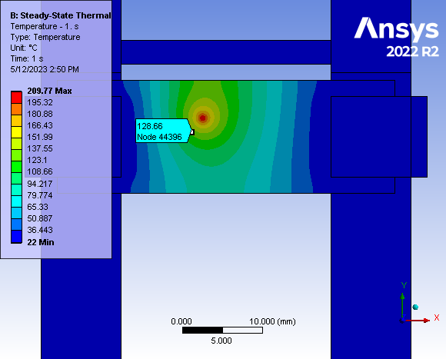
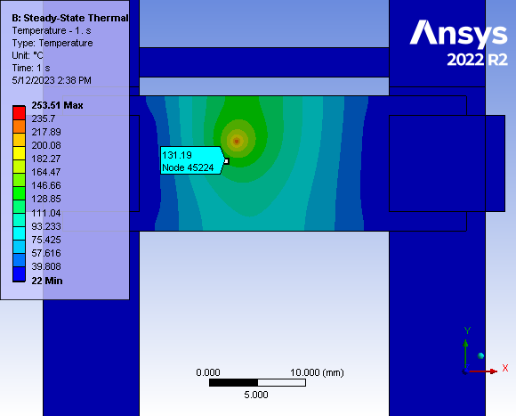
Target 5: Temperature in 0.75 mm Ti Grade5 (0.5 ms Pulse Lengh, 10 ms Period)
200 µm rms beam spot size
50 µm rms beam spot size
T_{max} = 209°C
T_{max} = 353°C
Measured T = 131°C

Slide 16
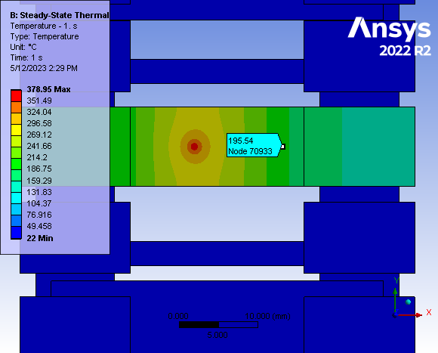
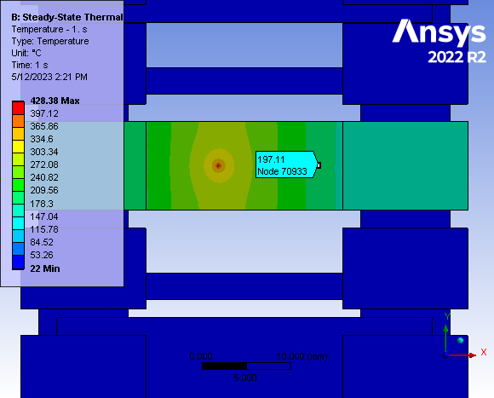
Target 3: Temperature in W (1.1 ms Pulse Lengh, 5.0 ms Period)
200 µm rms beam spot size
50 µm rms beam spot size
T_{max} = 379°C
T_{max} = 428°C
Measured T = 197°C

Slide 17
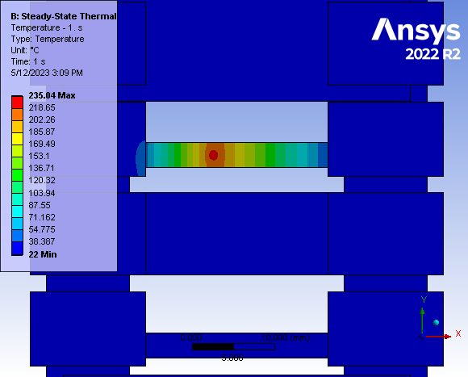
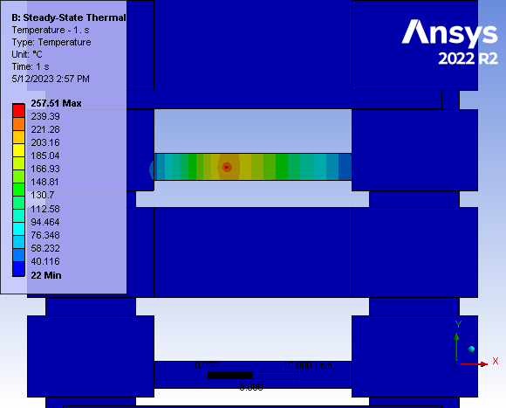
Target 2: Temperature in W (0.4 ms Pulse Lengh, 3.7 ms Period)
200 µm rms beam spot size
50 µm rms beam spot size
T_{max} = 235°C
T_{max} = 257°C

Slide 18
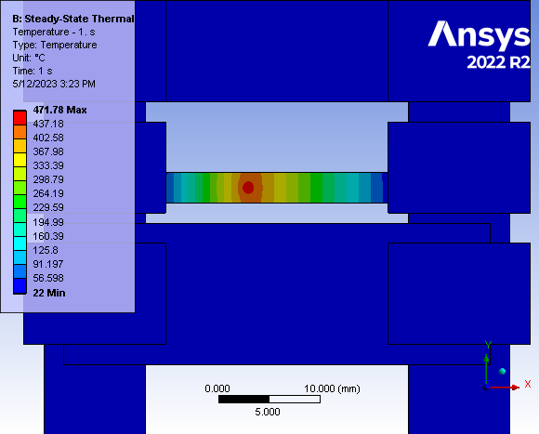
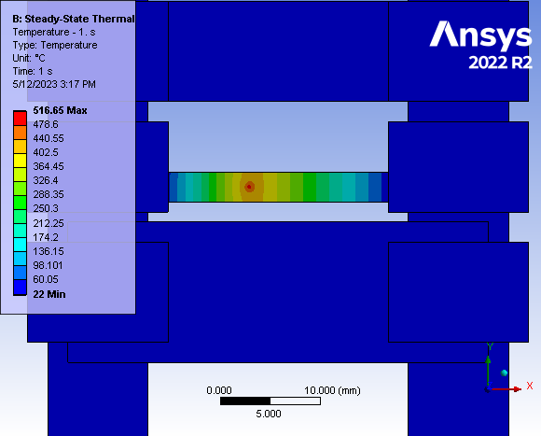
Target 4: Temperature in Ta (0.4 ms Pulse Lengh, 3.7 ms Period)
200 µm rms beam spot size
50 µm rms beam spot size
T_{max} = 472°C
T_{max} = 516°C
Calculations of cycling temperature and analysis of 2nd 5 targets are ongoing

Slide 19
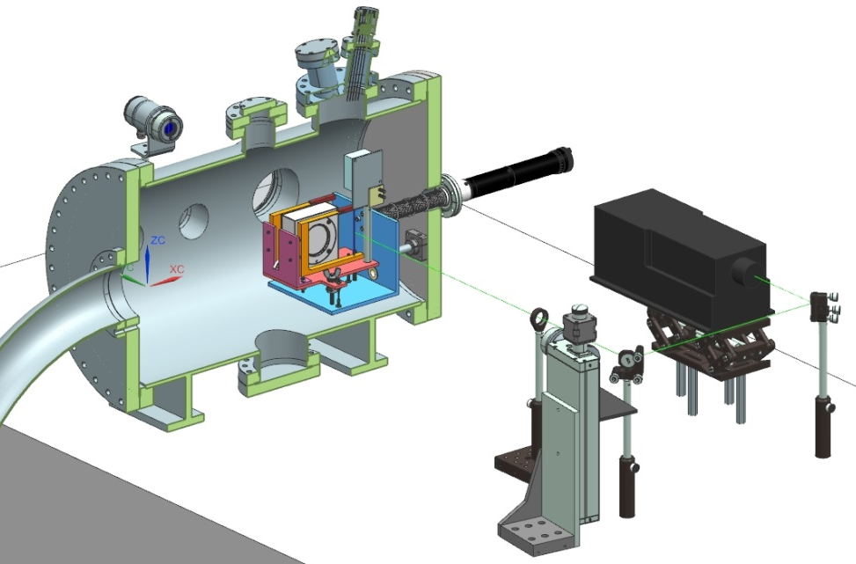
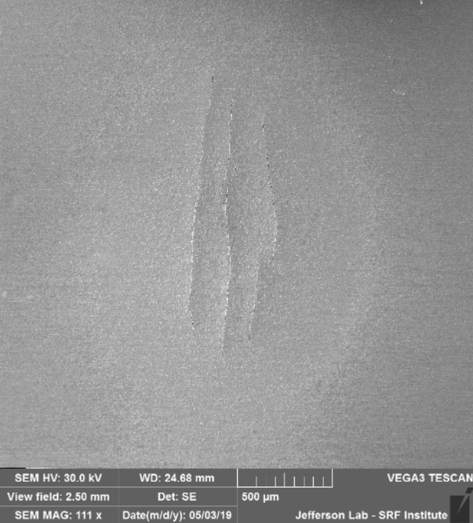
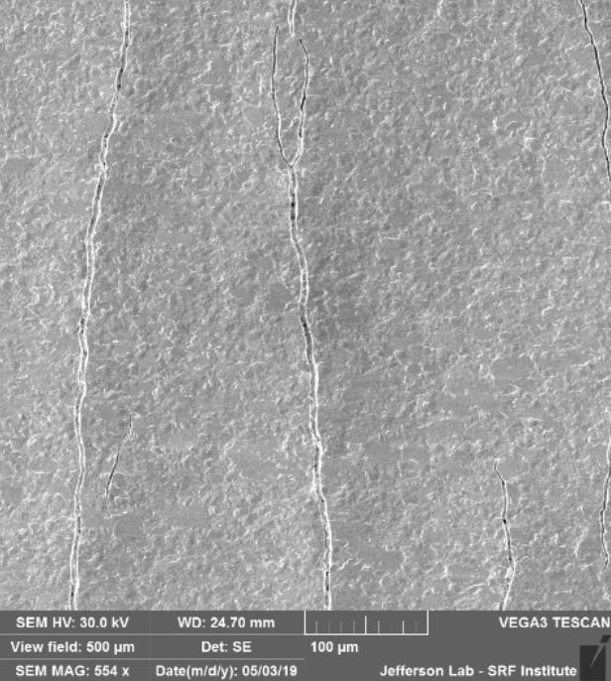
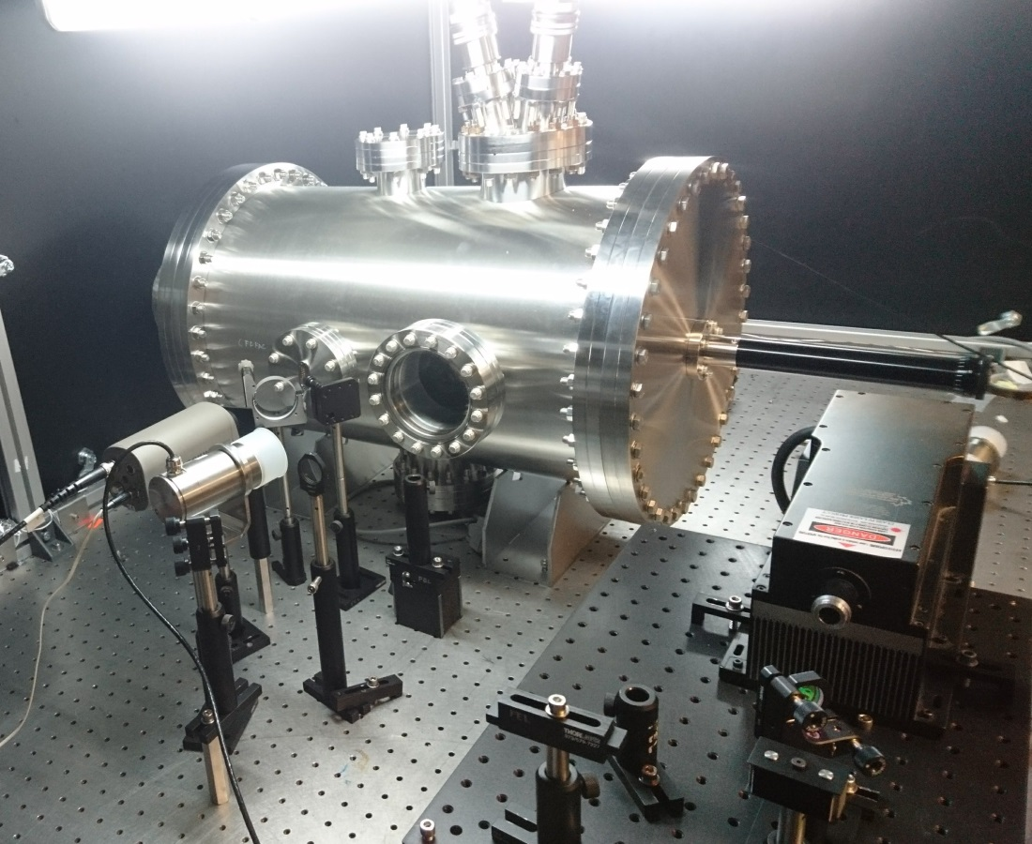
Test of Target Materials with Laser at JLab LERF Laser Lab 6
Existing laser setup will be used for testing e⁺ target materials
10 W lasers (532 nm) were used for testing 18 µm W foils to their limits and beyond [S. Gopinath, S. Covrig “APEX Target Thermal Assessment”, PMAG0000-0001-A0001, 10/29/2020]:
CAD assembly
S. Gopinath
SEM Images of APEX Target with Micro-Fractures at Beam Spot
Experimental Setup

Slide 20
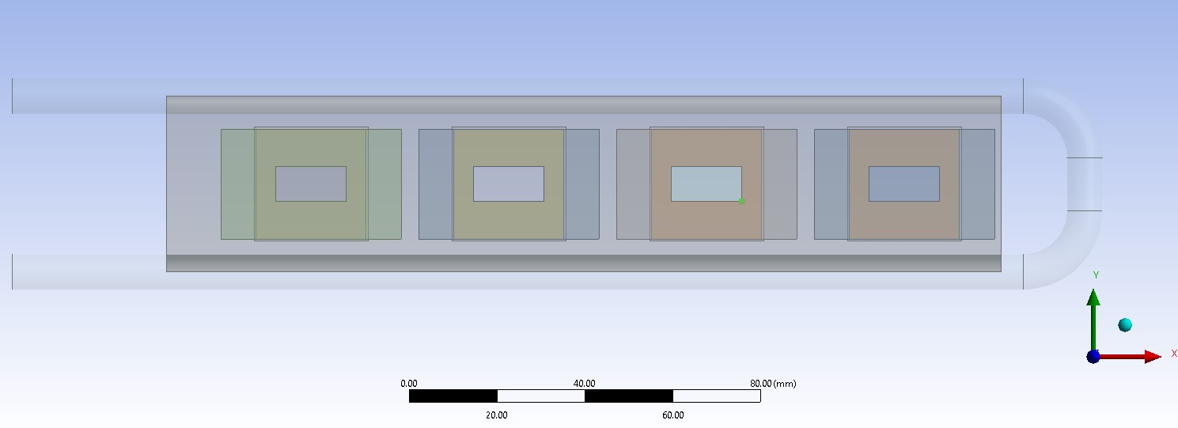
Test of Target Materials with Laser at JLab LERF Laser Lab 6
Design of Low-Power Target (S. Covrig). Beam View
Experimental setup at LERF Laser Lab 6 would allow us to test the high peak heat loads and fatigue of target materials in a wide temperature range
Test of thermal contact conductance between high-Z materials and Cu or Al (Ce⁺BAF and ILC targets)
Possibility of testing low-power stationary target is being studied
Cu Frame
Targets (25x25 mm²)
Cu Washer
e‒ Beam
Cooling Tube
Beam Clearance: 16x8 mm²
Side View
W
e‒ Beam

Slide 21
Summary and Outlook
We are focused on development of 123 MeV e⁺ injector at LERF
Development and test of e⁺ targets:
JLab Phase I: Prototype/proof-of-principle of low-power stationary solid water-cooled target (< 1 kW)
JLab Phase II: High-power rotated solid water-cooled target (17 ‒ 20 kW)
Target material tests:
Test of target materials with pulsed 3.5 MeV e⁺ beam at MAMI was performed on Mar 31 – Apr 5, 2023 (W, Ta, Ti-alloys)
ANSYS calculations of temperature for targets tested at MAMI are ongoing
Study of irradiated targets with PETRA X-rays at DESY will be done soon
Fatigue target tests with a laser at JLab LERF Laser Lab 6 are planned in 2023

