Slide 1
Bubble Chamber: Experimental Overview
August 18, 2015
https://wiki.jlab.org/ciswiki/index.php/Bubble_Chamber

Slide 2
Outline
Nucleosynthesis and ¹²C(α,γ)¹⁶O Reaction
Time Reversal Reaction: ¹⁶O(γ,α)¹²C
Electron Beam Requirements
Bremsstrahlung Beam
Penfold-Leiss Cross Section Unfolding
JLab Projected Results
Test Beamline
Bubble Chamber Test Plan

Slide 3
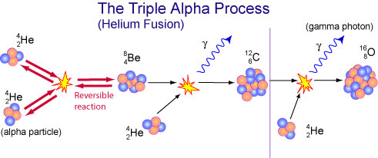
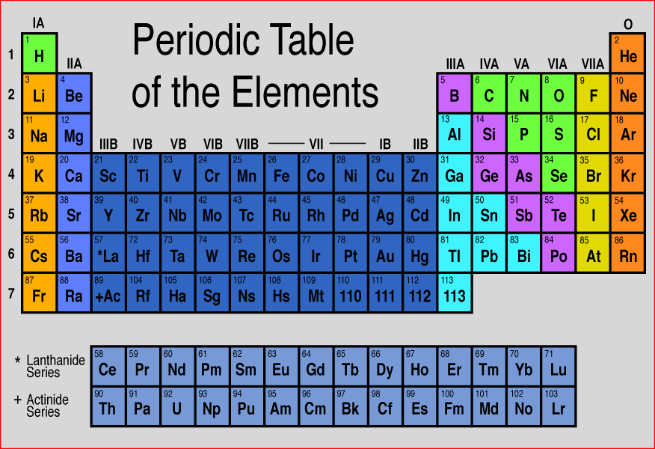
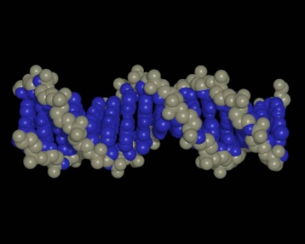
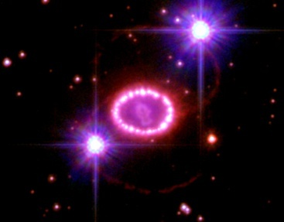
Nucleosynthesis and ¹²C(α,γ)¹⁶O
Stellar Helium burning
The holy grail of nuclear astrophysics:
Affects synthesis of most of elements in periodic table
Sets N(¹²C)/N(¹⁶O) (≈0.4) ratio in universe
Determines minimum mass star requires to become supernova

Slide 4
Heroic Efforts in Search of ¹²C(α,γ)¹⁶O
Previous cross section measurements:
Helium ions on carbon target: ¹²C(α,γ)¹⁶O
Carbon ions on helium gas: ⁴He(¹²C, γ)¹⁶O or ⁴He(¹²C,¹⁶O)γ (Schürmann)
Experiment | Beam Current (mA) | Target (nuclei/cm²) | Time (h)
Redder | 0.7 | ¹²C, 3 10¹⁸ | 900
Ouellet | 0.03 | ¹²C, 5 10¹⁸ | 1950
Roters | 0.02 | ⁴He, 1 10¹⁹ | 5000
Kunz | 0.5 | ¹²C, 3 10¹⁸ | 700
EUROGAM | 0.34 | ¹²C, 1 10¹⁹ | 2100
GANDI | 0.6 | ¹²C, 2 10¹⁸
Schürmann | 0.01 | ⁴He, 4 10¹⁷
Plag | 0.005 | ¹²C, 6 10¹⁸ | 278

Slide 5
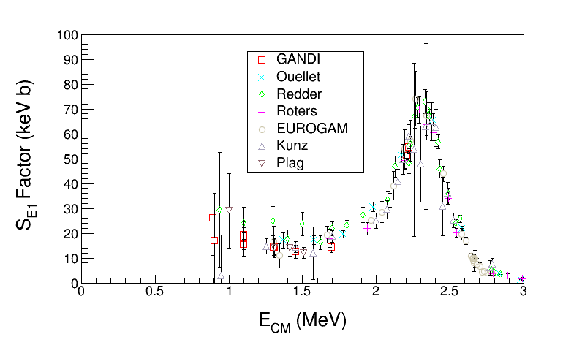
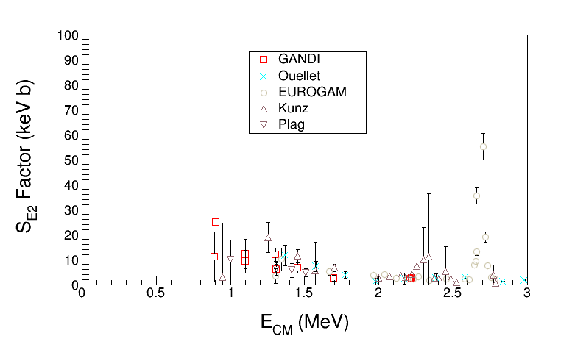
Astrophysical S-Factor ¹²C(α,γ)¹⁶O
Define S-Factor to remove both 1/E dependence of nuclear cross sections and Coulomb barrier transmission probability:
Author | S_{tot}(300) (keV b)
Hammer (2005) | 162±39
Kunz (2001) | 165±50
R-matrix Extrapolation to stellar helium burning at E = 300 keV
Notes:
What do you think about the table shown in this slide? See Schurmann data on slide 44. How did he come up with this small error?

Slide 6
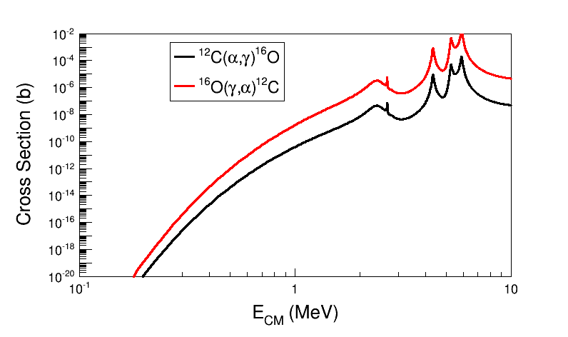
Time Reversal Reaction
¹²C
¹⁶O
MeV
γ
MeV
α
Stellar helium burning at
E = 300 keV, T=200 10⁶ K
Notes:
If we use linearly polarized gammas, we need also to measure the alpha-carbon angular distributions to separate E1 and E2 contributes.
What about right-handed or left-handed circularly polarized gammas? Circularly polarized light is a linear combination of linearly polarized light with a phase phi=90 deg. This is to say we cannot separate E1 and E2 with circularly polarized gammas.
At JLab Injector we can produce left-handed or right-handed gammas (our electron beam in linearly polarized).
To produce linear polarized gammas, we need to use a crystal radiator.
See paper: Y. Xu et al. on the wiki.

Slide 7
New Approach: Reversal Reaction + Bubble Chamber
beam
target
signal
γ + ¹⁶O → ¹²C + α
Extra gain (factor of 100) by measuring time reversal reaction
Bremsstrahlung at JLab $\sim$ 10⁹ γ/s (top 250 keV)
Target density up to 10⁴ higher than conventional targets. Number of ¹⁶O nuclei = $3.5×{10}^{22}$/cm² (3.0 cm cell)
Measures total cross section σ_{tot} (or S_{tot}=S_{E1} + S_{E2})
Solid Angle and Detector Efficiency = 100%
Electromagnetic debris (electrons and gammas, or positrons) do NOT trigger nucleation (detector is insensitive to γ-rays by at least 1 part in 10¹¹)
Notes:
Looking at the number of gammas we will have (slide 37), we will need to be insensitive to gamma-rays by at least 1 part in 10^15. I will keep using the factor of 10^11?

Slide 8
Electron Beam Requirements
Beam Properties at Radiator:
Beam Kinetic Energy, (MeV) | 7.9 – 8.5
Beam Current (µA) | 0.01 – 100
Absolute Beam Energy Uncertainty | <0.1%
Relative Beam Energy Uncertainty | <0.02%
Energy Resolution (Spread), σ_{T} /T | <0.06%
Beam Size, σ_{x,y} (mm) | 1
Polarization | None

Slide 9
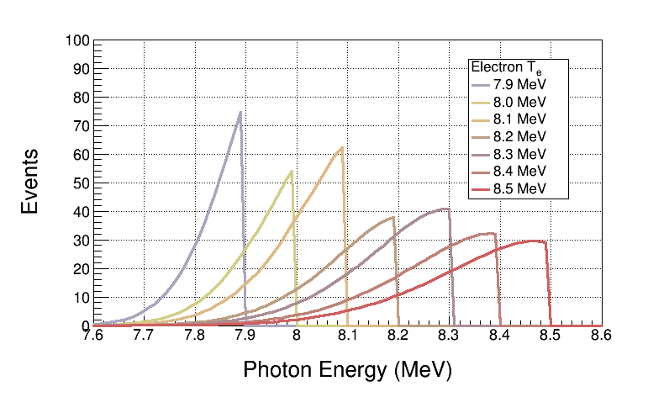
Bremsstrahlung Beam
Use both GEANT4 and FLUKA to calculate Bremsstrahlung spectra (we will not measure Bremsstrahlung spectra)
Monte Carlo simulation of Bremsstrahlung at radiotherapy energies is well studied, accuracy: ±5%
Bremsstrahlung Peaks
¹⁶O(γ,α)¹²C is ideal case for Bremsstrahlung beam and Penfold–Leiss Unfolding:
Very steep cross section; only photons near endpoint contribute to yield
No-structure (resonances)

Slide 10
Penfold-Leiss Cross Section Unfolding
Measure yields at: $E=E_{1}, E_{2}, …, E_{n}$ where, $E_{i}−E_{i−1}=Δ$, $i=2,n$
Solution can be written in two forms:
Or, Matrix form:
Volterra Integral Equation of First Kind
Method of Quadratures: numerical solution of integral equation based on replacement of integral by finite sum

Slide 11
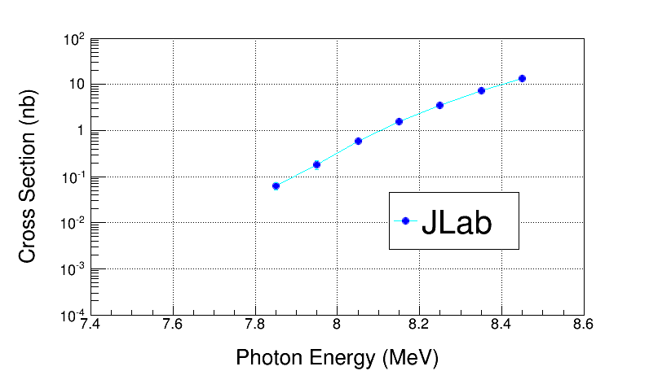
Electron Beam K. E. | Cross Section (nb) | Stat Error (no bg, %) | Stat Error (with bg, %)
7.9 | 0.046 | 4.4 | 24.5
8.0 | 0.185 | 6.0 | 20.7
8.1 | 0.58 | 6.3 | 14.7
8.2 | 1.53 | 8.2 | 13.8
8.3 | 3.49 | 9.1 | 13.3
8.4 | 7.2 | 10.6 | 13.8
8.5 | 13.6 | 12.2 | 14.8
Absolute Beam Energy, δE | 0.1%
Beam Current, δI/I | 3%
Photon Flux, δφ/φ | 5%
Radiator Thickness, δR/R | 3%
Bubble Chamber Thickness, δT/T | 3%
Bubble Chamber Efficiency, ε | 5%
Electron Beam K. E. | Cross Section (nb) | Sys Error (Energy, %) | Sys Error (Total, %)
7.9 | 0.046 | 12.5 | 15.3
8.0 | 0.185 | 10.2 | 13.5
8.1 | 0.58 | 8.3 | 12.2
8.2 | 1.53 | 7.0 | 11.4
8.3 | 3.49 | 6.0 | 10.7
8.4 | 7.2 | 5.3 | 10.5
8.5 | 13.6 | 4.7 | 10.1

Slide 12
JLab Projected ¹²C(α,γ)¹⁶O S-Factor
Statistical Error: dominated by background subtraction from ¹⁸O(γ,α)¹⁴C (depletion = 5,000)
Electron Beam K. E. | Gamma Energy (MeV) | E_{CM} (MeV) | Cross Section (nb) | S_{tot} Factor (keV b) | Stat Error (%) | Sys Error (Total, %)
7.9 | 7.85 | 0.69 | 0.046 | 62.2 | 24.5 | 15.3
8.0 | 7.95 | 0.79 | 0.185 | 48.7 | 20.7 | 13.5
8.1 | 8.05 | 0.89 | 0.58 | 41.8 | 14.7 | 12.2
8.2 | 8.15 | 0.99 | 1.53 | 35.5 | 13.8 | 11.4
8.3 | 8.25 | 1.09 | 3.49 | 32.0 | 13.3 | 10.7
8.4 | 8.35 | 1.19 | 7.2 | 28.8 | 13.8 | 10.5
8.5 | 8.45 | 1.29 | 13.6 | 26.3 | 14.8 | 10.1
Bubble Chamber experiment measures total S-Factor, S_{E1} + S_{E2}
Notes:
Notes:
1- Schurmann at low energy is limited by 16O contamination of 12C ion beam.

Slide 13
Total S-Factor $\sim$ S_{E1}
(S_{E2} is small)

Slide 14
Superheated Targets
List of superheated liquids to be used in experiment:
Readout:
Fast Digital Camera
Acoustic Signal to discriminate between neutron and alpha events
N₂O Targets | ¹⁶O | ¹⁷O | ¹⁸O
Natural Target | 99.757% | 0.038% | 0.205%
¹⁶O Target |  | Depleted > 5,000 | Depleted > 5,000
¹⁷O Target |  | Enriched > 80% | <1.0%
¹⁸O Target |  | <1.0% | Enriched > 80%
Physics
Measure
Backgrounds
Notes:
(g,p) events have acoustic signal similar to (g,a).

Slide 15
Test Beamline

Slide 16
Schematics of Test Beamline
Power deposited in radiator (100 µA and 8.5 MeV) :
6 mm: Energy loss = 8.5 MeV, P = 850 W
Pure Copper and Aluminum (high neutron threshold):
⁶³C(γ,n) threshold = 10.86 MeV
²⁷Al(γ,n) threshold = 13.06 MeV
Electron K.E.
7.9 – 8.5 MeV
0.01 – 100 µA
Cu
Radiator/Dump
6 mm
Al Beam Pipe
Cu Photon
Collimator
Ceramic
Insulator
Al Photon Dump
40 cm long
Bubble Chamber
Superheated N₂O
3 cm long
-10°C, 50 atm
Notes:
Interior Page Design 2

Slide 17
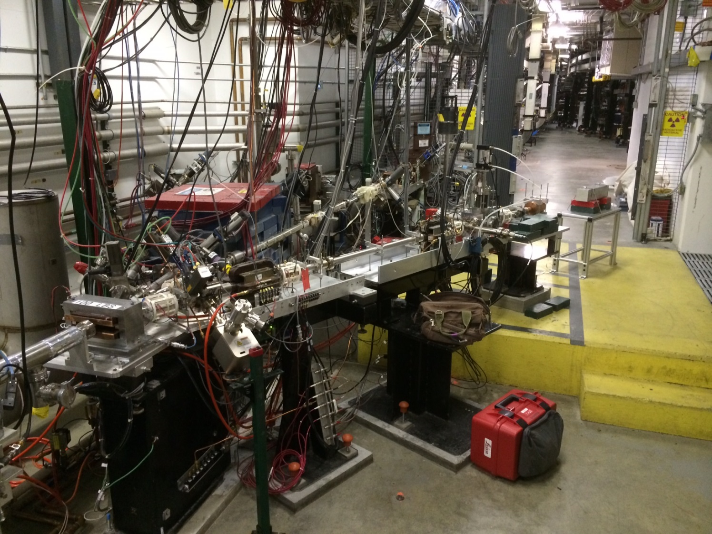
Bubble
Chamber
location
5 MeV
Dipole
5D Spectrometer
Notes:
Interior Page Design 2

Slide 18
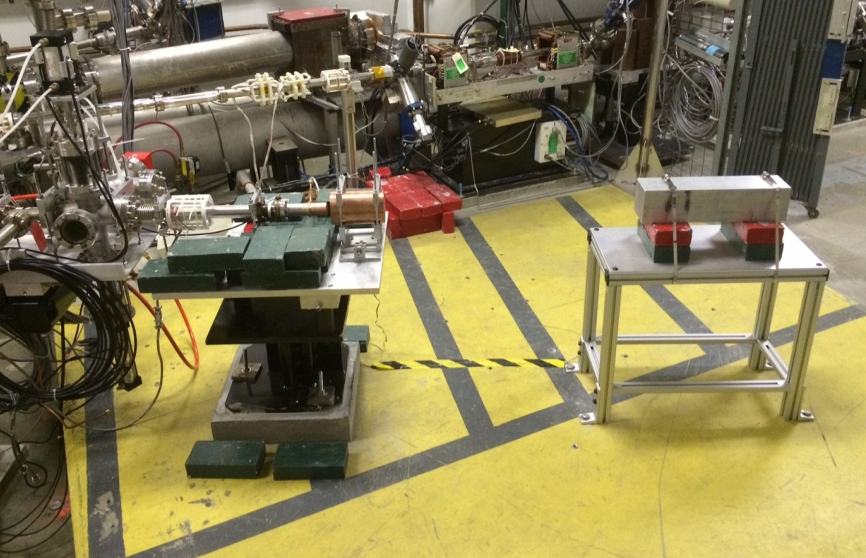
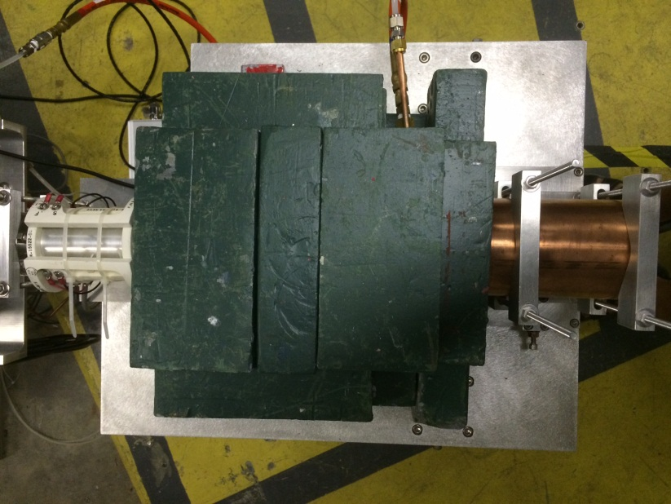
Cu Electron Radiator/Dump
Al Photon Dump
Cu Photon Collimator

Slide 19
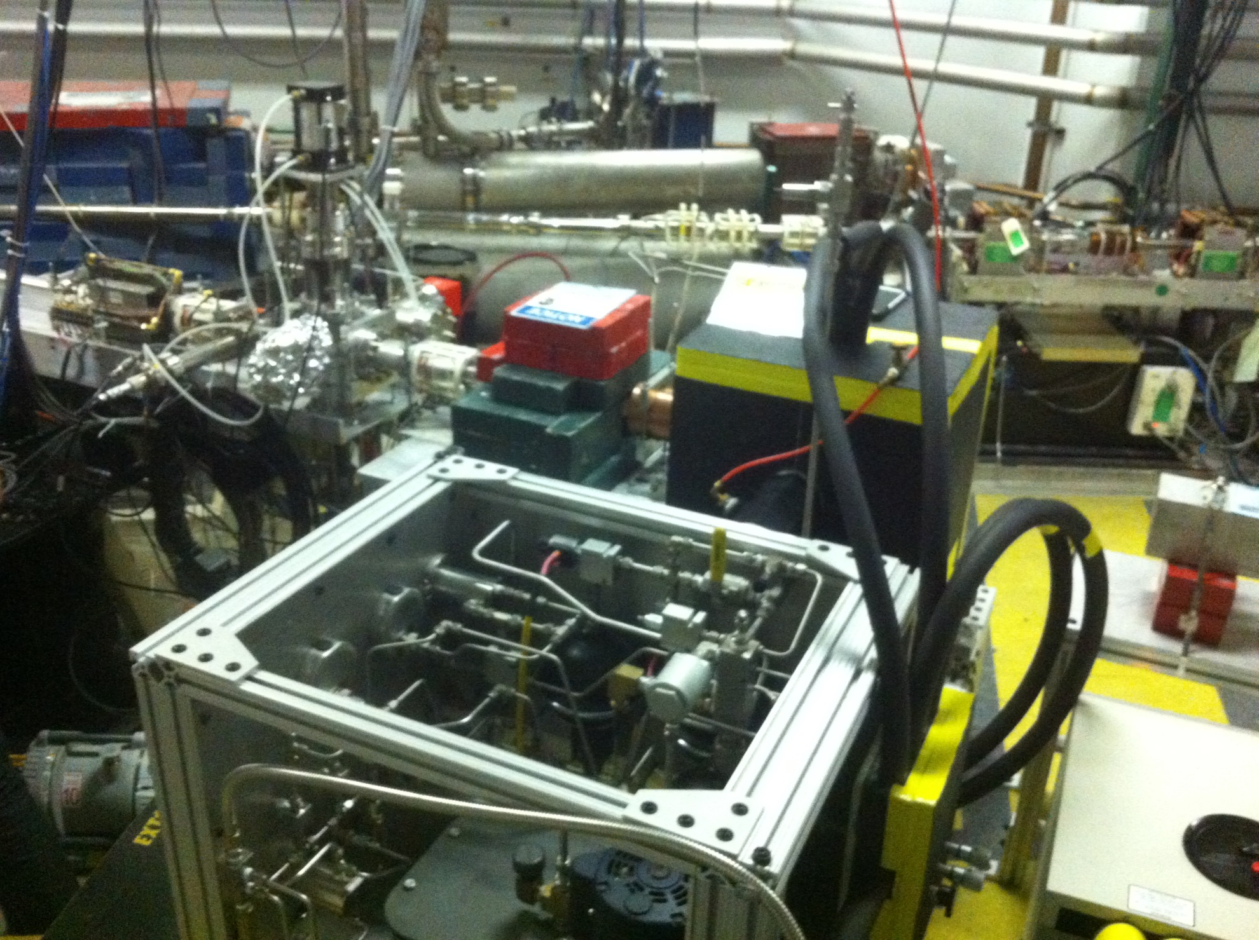
Fast Valve Gauge

Slide 20
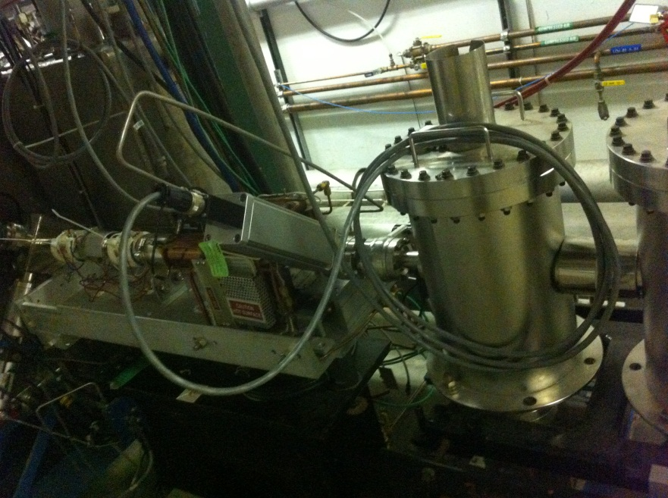
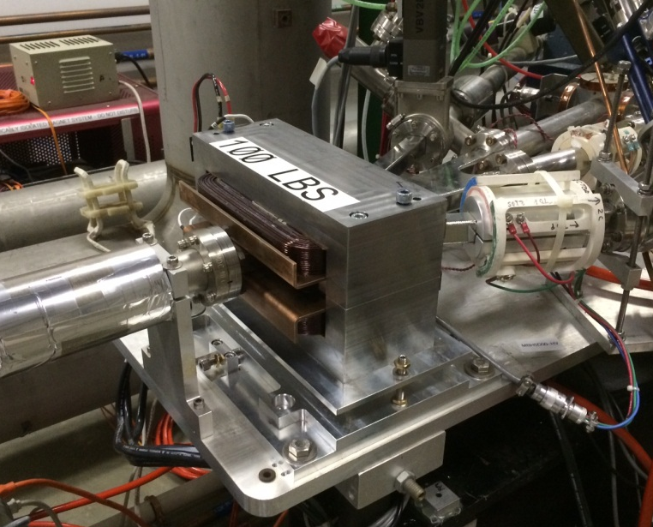
New Beamline Elements
New Beamline elements installed in support of Bubble Chamber experiment:
Fast Valve after ¼ Cryounit
New MDL0L02 Dipole Magnet
Protect ¼ Cryo-unit from vacuum failure

Slide 21
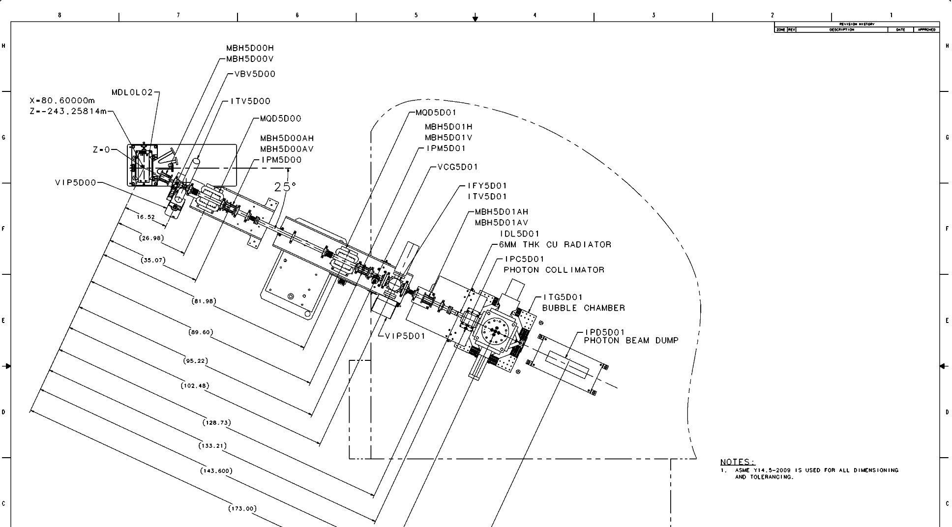
Measuring Absolute Beam Energy
5 MeV
Dipole
Installed new higher field
dipole with better uniformity
Installed new Hall probe:
0.01% accuracy, resolution
to 2 ppm, and a temperature
stability of 10 ppm/°C
Still need to shield Earth’s
and other stray magnetic fields
Beam Position Monitor (BPM)
Electron Beam
Momentum
Notes:
Interior Page Design 2

Slide 22
Test Beamline Commissioning
Beamline was ready since Fall 2014
Approved to run 10 μA CW and 10 MeV/c
Completed hot checkout and beam checkout
Beam Studies completed so far:
Delivered 10.0 μA 10.0 MeV/c for 5 hours in August 2015
Measured beam momentum at different ¼ cryo-unit settings
Measured beam charge at different beam currents
Re-doing realistic thermal analysis to be able to run up to 100 μA

Slide 23
Bubble Chamber Test Plan
Fill with natural N₂O – test bubble chamber systems operation
With beam on bubble chamber radiator (Sept 9 – Sept 18, 2015):
How does CCD camera perform under beam-on conditions?
Count rates on bubble chamber. Do we get single or multiple bubbles from Bremsstrahlung beam exposure?
Measure gamma ray beam spatial profile as reflected by bubble distribution. Is collimator effective in defining the gamma-ray beam?
Background measurements:
Measure beam off environmental background in chamber-injector area
Measure beam on background by looking outside fiducial volume
Measure background with beam to Faraday Cup in CEBAF beamline (about two meters from chamber)
Measure neutron events in chamber. Neutron radiation detectors in injector region will indicate if any neutrons are generated (especially at beam energies higher than 8.5 MeV).

Slide 24
Fill with C₂F₆ – test bubble chamber systems operation. This is planned later in September after first beam test.
With beam (planned in October, 2015)
Measure few data points of from ¹⁹F(γ,α)¹⁵N to perform a Penfold-Leiss unfolding
Compare measured cross section to our Duke data
Fluorine is nice for a first Penfold-Leiss unfolding:
Only one stable natural isotope (¹⁹F)
Low electron beam energy: 4.6 – 5.2 MeV
No background reactions from carbon

Slide 25
Backup Slides

Slide 26
