Slide 1
Generation and Characterization of Magnetized Bunched Electron Beam from DC Photogun for
MEIC Cooler
Laboratory Directed Research and Development (LDRD) Proposal
Riad Suleiman and Matt Poelker
April 16, 2015

Slide 2
Outline
Magnetized Cooling
Electron Beam Requirements
Generation of Magnetized Beam
Proposed Measurements:
  Mechanical angular momentum
  Round-to-Flat Beam (RTFB) transformation
  Magnetized beam transport
  Magnetized photocathode lifetime
  Beam halo and beam loss
Work Place: FEL Gun Test Stand
Budget

Slide 3
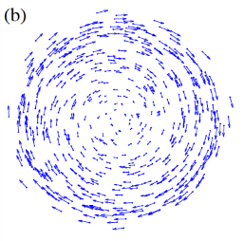
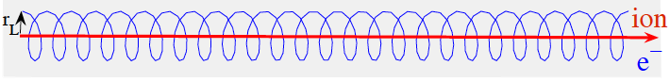
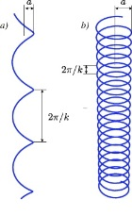
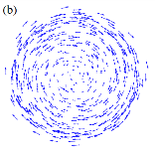
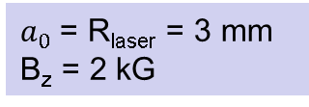
Magnetized Cooling
Cooling Solenoid
Cathode Solenoid
RTFB
Transformer
SRF Linac
FTRB
Transformer
Electrons born in uniform B_{z}
Upon exit of Cathode Solenoid
Upon entering Cooling Solenoid
σ_{e}= 0.95 mm
B_{cool} = 2 T
$a_{0}$= R_{laser} = 3 mm
B_{z} = 2 kG
= 528 µm

Slide 4
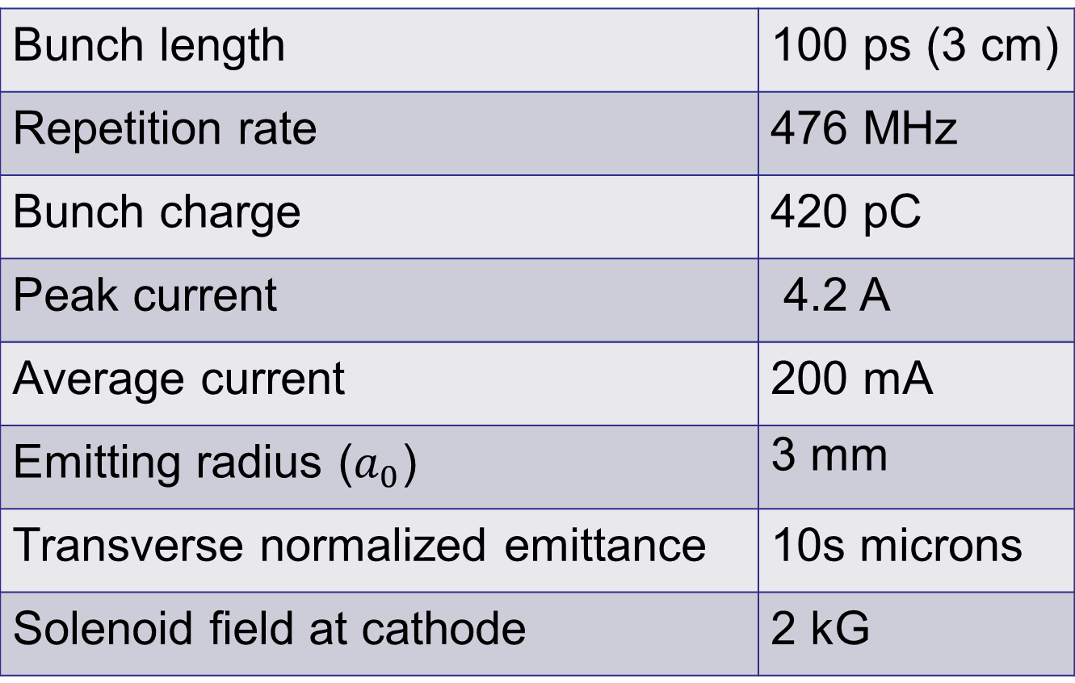
Bunched Magnetized Gun Requirements
Bunch length | 100 ps (3 cm)
Repetition rate | 476 MHz
Bunch charge | 420 pC
Peak current | 4.2 A
Average current | 200 mA
Emitting radius ($a_{0}$) | 3 mm
Transverse normalized emittance | 10s microns
Solenoid field at cathode | 2 kG

Slide 5
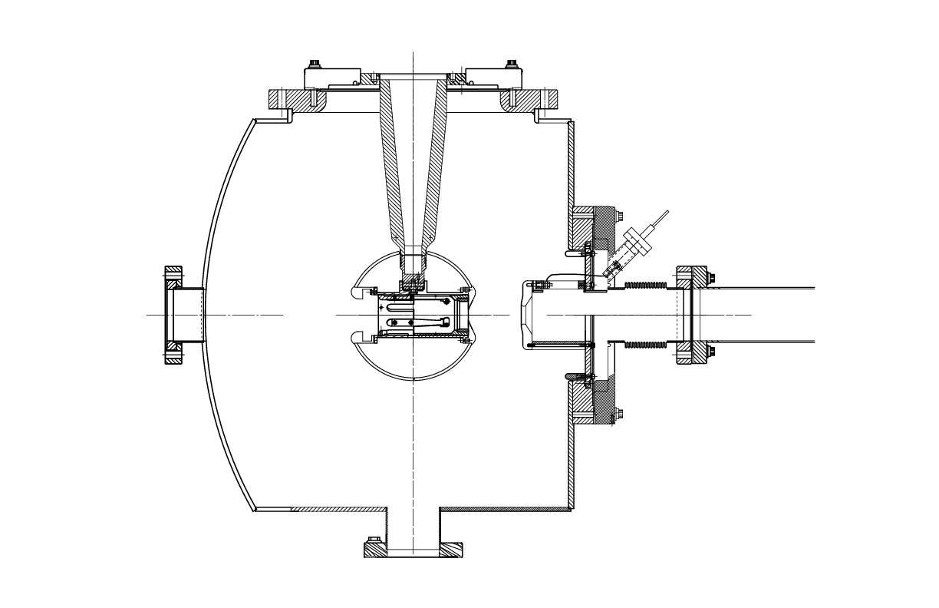

Generation of Magnetized Beam
Cathode Solenoid:
  To produce magnetized beam
Injector Focusing Solenoids:
  For magnetized beam transport
  To compensate space-charge emittance growth
Cathode Solenoid (B_{z}=2 kG)
Focusing Solenoids

Slide 6
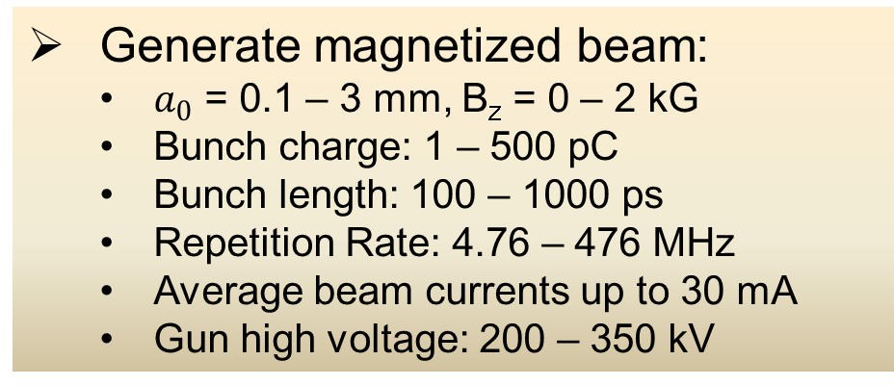
Proposed Beamline
Cathode
Solenoid
Diagnostic Cross 3
(YAG Screen)
Cathode
Three Skew Quads
(Round-to-Flat Beam Transformer)
Green
Laser
Anode
K₂CsSb
Photocathode
Injector Focusing Solenoids
Diagnostic Cross 1
(Multislit + YAG Screen)
Diagnostic Cross 2
(H,V slit + YAG Screen)
Generate magnetized beam:
  $a_{0}$ = 0.1 – 3 mm, B_{z} = 0 – 2 kG
  Bunch charge: 1 – 500 pC
  Bunch length: 100 – 1000 ps
  Repetition Rate: 4.76 – 476 MHz
  Average beam currents up to 30 mA
  Gun high voltage: 200 – 350 kV

Slide 7
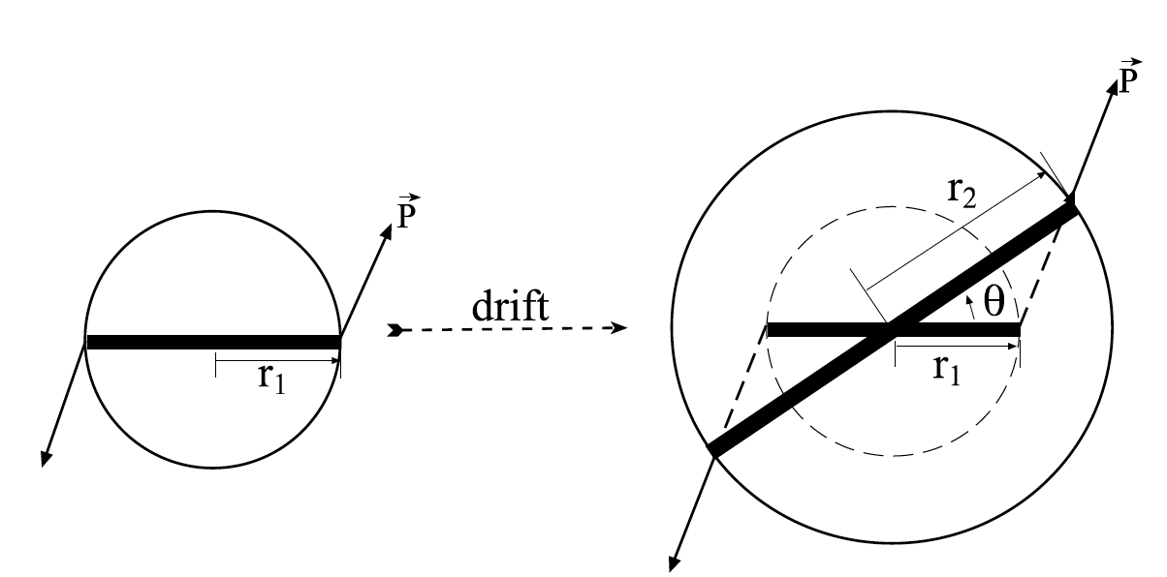
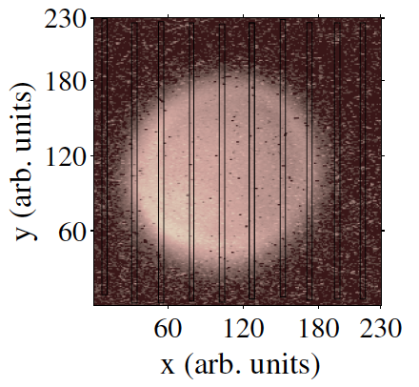
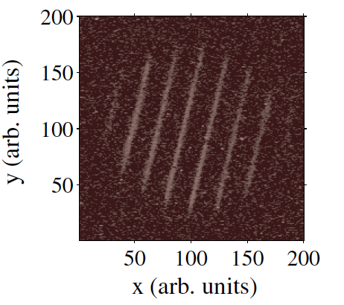
Proposed Measurements
Measure mechanical angular momentum
(skew quads off)
σ₁ beam radius measured at Diagnostic Cross 1
σ₂ beam radius measured at Diagnostic Cross 2
D drift between two crosses
p_{z} beam longitudinal momentum
Angular rotation ϕ is measured from beam image at Cross 2 when multislit is inserted at Cross 1
Example of mechanical measurement at Fermilab (Piot et al.)

Slide 8
Use three skew quads – RTFB Transformer – to generate a flat beam with transverse emittance ratios of:
  Measure horizontal and vertical emittances using slit method
  Cross 2 will be equipped with a horizontal and vertical slits
  Measure size of emittance dominated beamlets passed through slits, after drift distance D, with YAG viewer in Cross 3
  Assume horizontal beam radius measured at Cross 2 is σ_{2h} and horizontal radius of beamlet at Cross 3 is σ_{3h} when vertical slit is inserted at Cross 2, then horizontal emittance is
  Similarly, measure vertical emittance using horizontal slit

Slide 9
Generate very high currents magnetized beam and study beam transport and RTFB transformation versus electron bunch charge
Measure photocathode lifetime versus solenoid field at high currents (up to 30 mA) and high voltages (200 – 350 kV) limited by HV supplies we have
Study beam halo and beam loss versus magnetization:
  Monitor vacuum using ion pumps with very sensitive current readback
  Measure radiation with x-ray detectors placed around gun and beamline
  Measure beam intercepted at floating anode

Slide 10
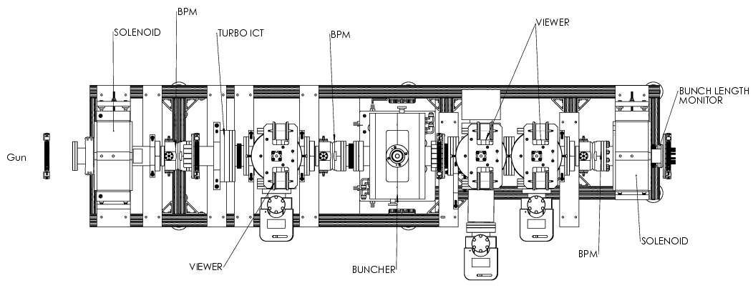
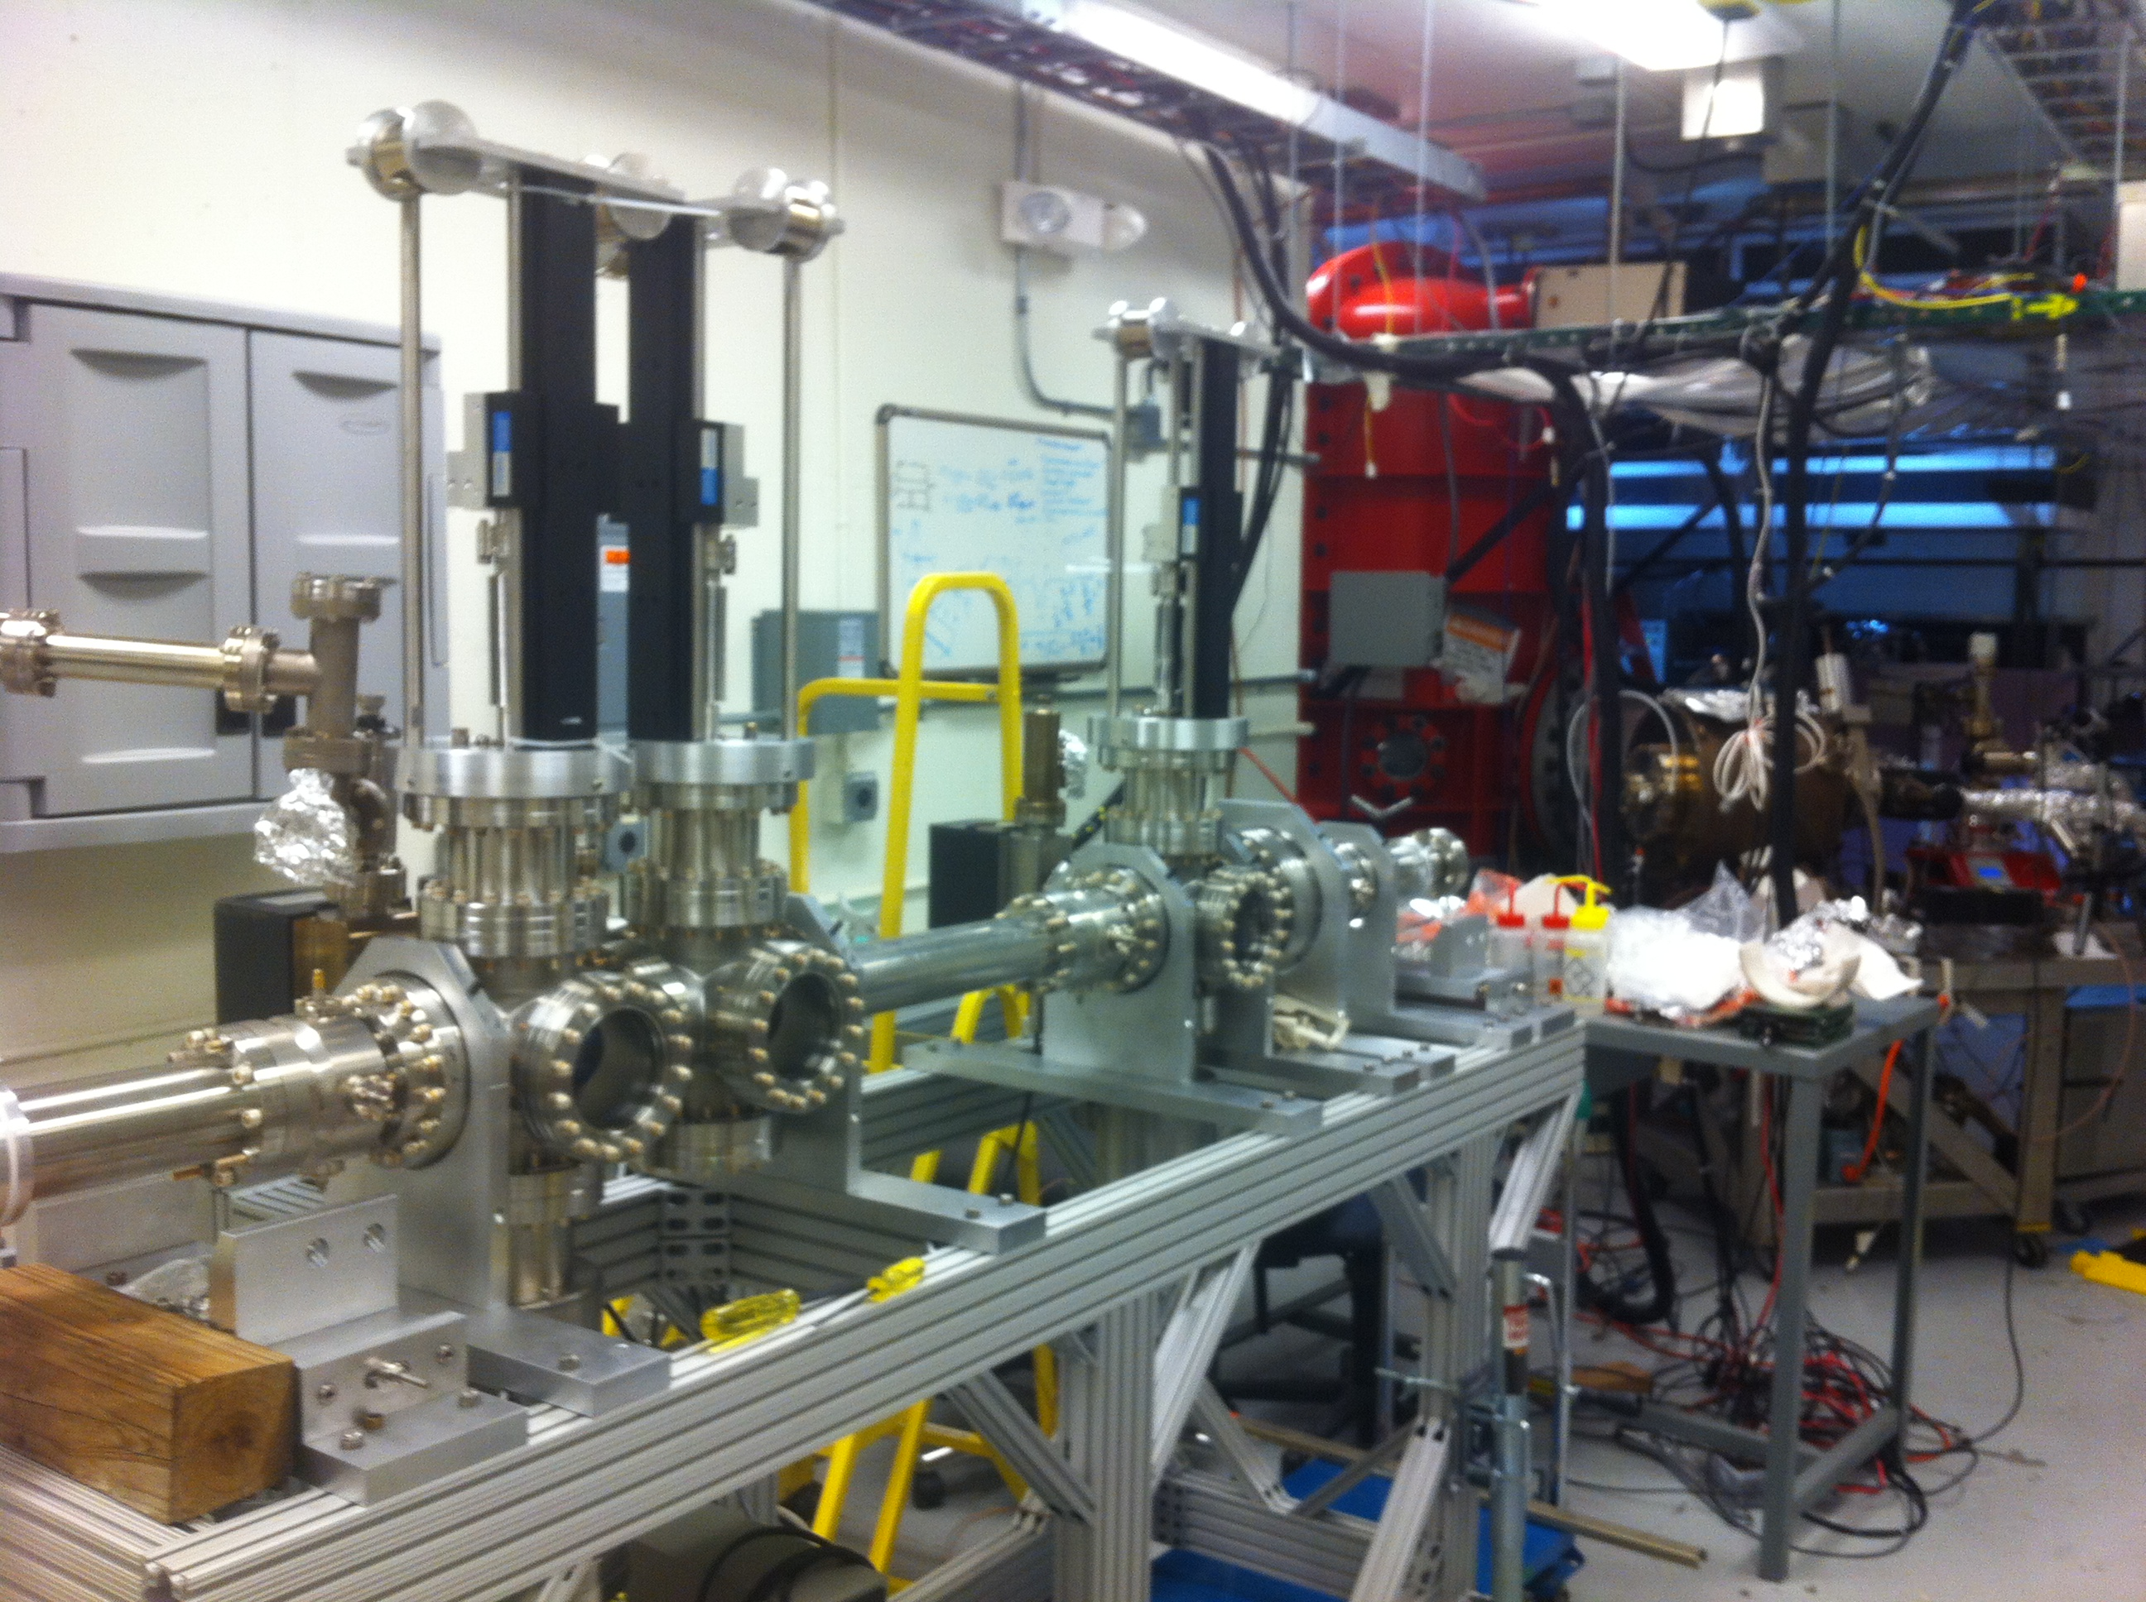
FEL Gun Test Stand

Slide 11
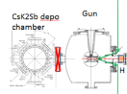
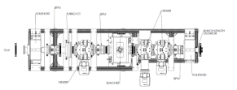

Slide 12
Budget
Procurements
Item | Approximate Cost ($k)
Solenoid magnet or Helmholtz coil-pair | 50
Power supply for gun magnet (500A/150V) | 50
Skew quadrupole magnets (x3 sets) | 15
Cameras | 2.4
PC for cameras | 1
Switcher | 1
YAG viewer | 1
Multislit (1) | 4
Single slit (x2) | 8
Stepper motor translation stages | 10
50% postdoc | 75
Total | 217.4
Labor
Magnet design | 2 wk
Mechanical design for magnets | 2 wk
Mechanical design for slits | 2 wk
ASTRA modeling | 12 wk

