Slide 1
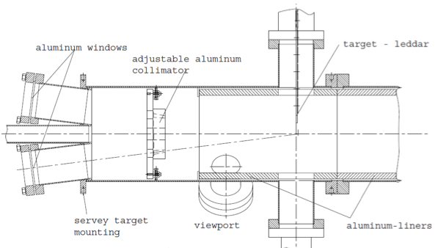
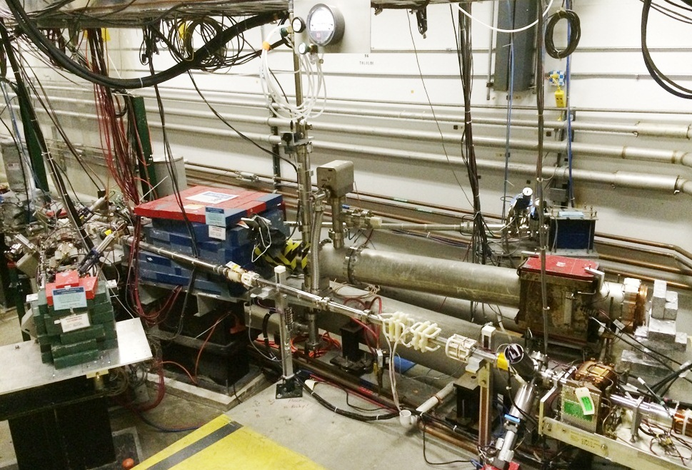
Mott Polarimeter at CEBAF

Slide 2
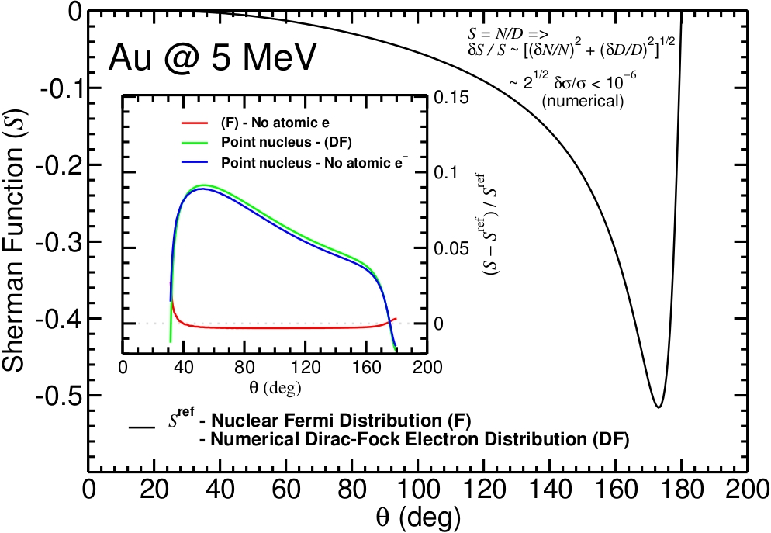
Exploring gold at KE=5.0MeV
X. Roca-Maza

Slide 3
AccurateTest of MeV Mott (ΔP/P)
Precise single-atom Sherman function (theoretical calculations)
Target thickness dependence of elastically scattered e-
Measure asymmetry with small instrumental uncertainty (beam systematics)
Effective Sherman Function
Expected Range of Uncertainty
Theory | 0.5 – 1.0%
Target Thickness | 0.2 – 0.5%
Instrumental | 0.2 – 0.3%
BUDGET | 0.6 – 1.2%
Target Thickness

Slide 4
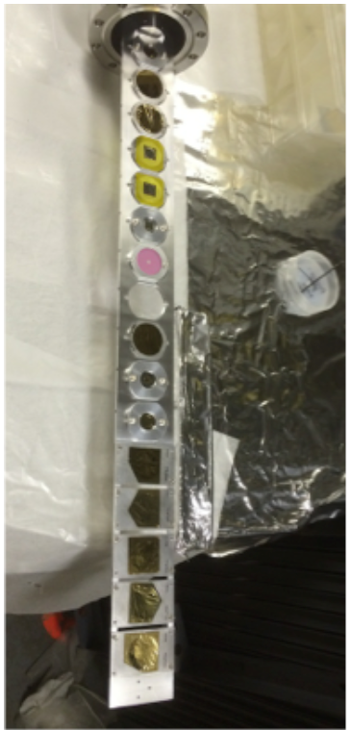
January 2015 - Run 1
Used our apparatus design energy of KE=5.0 MeV
Systematics of asymmetry vs …
Beam position
Beam size
Beam energy spread
Dump background
DAQ dead time
Detector rate
Target thickness extrapolation of
11 foils from 0.05 to 1 micron thick
Precision statistics (1-3 hours for 0.25%)

Slide 5
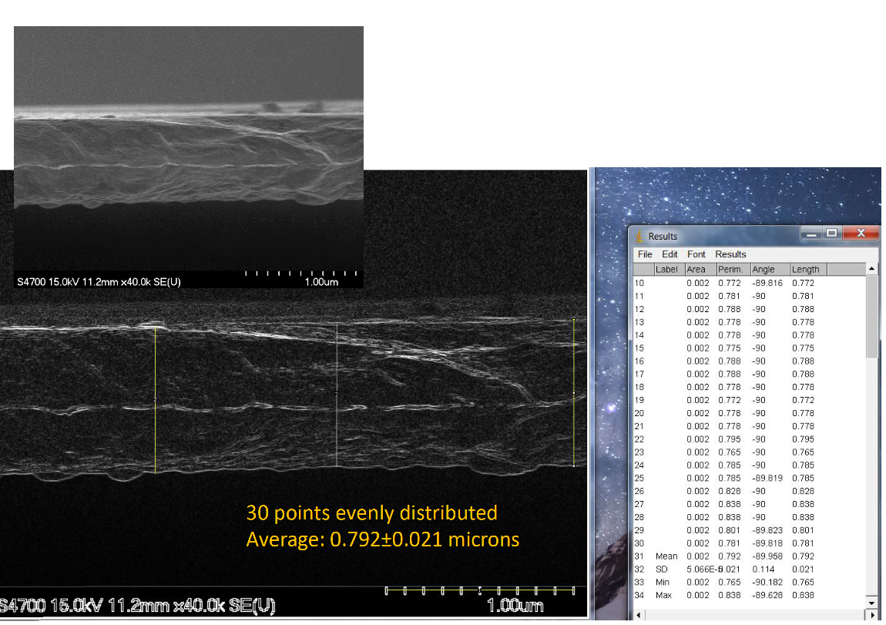
FESEM of “0.75 micron” gold target

Slide 6
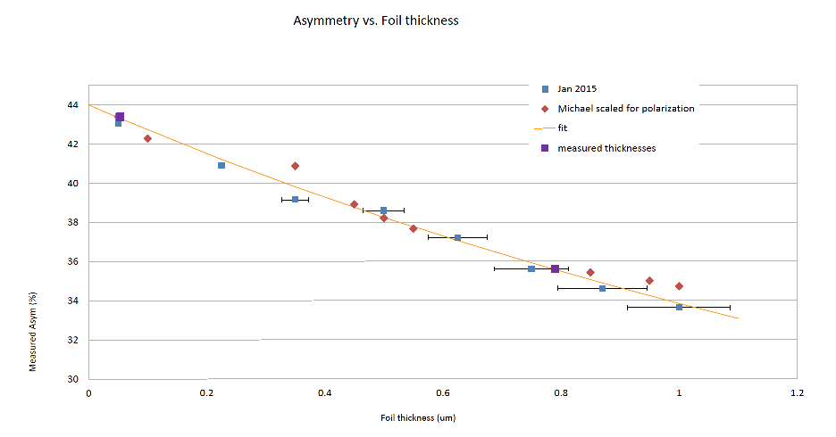

Slide 7
Precision Test of Mott Polarimetry
in the MeV Energy Range
P.A. Adderley¹, T. Gay², J. Grames¹, J. Hansknecht¹,
C. Horowitz³, A. Mamun⁴, M.J. McHugh⁵, A.K. Opper⁵,
M. Poelker¹, X. Roca-Maza⁶, C. Sinclair⁷, M. Stutzman¹,
R. Suleiman¹
¹Jefferson Lab
²University of Nebraska
³Indiana University
⁴Old Dominion University
⁵The George Washington University
⁶University of Milan
⁷Cornell University

