Slide 1
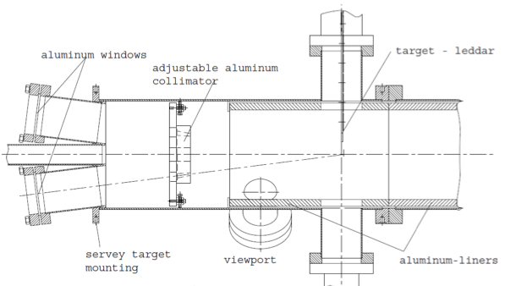
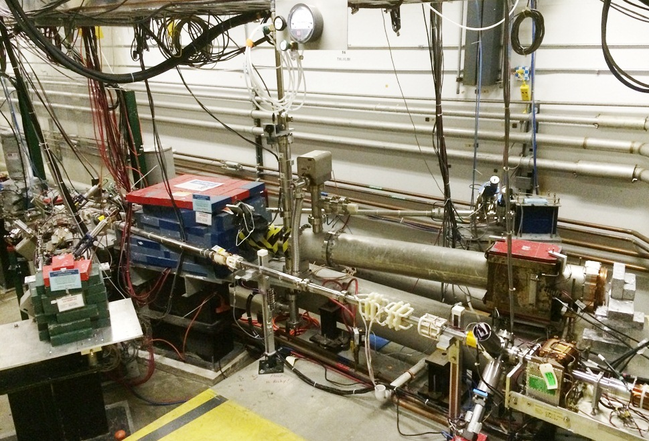
Mott Polarimeter at CEBAF

Slide 2
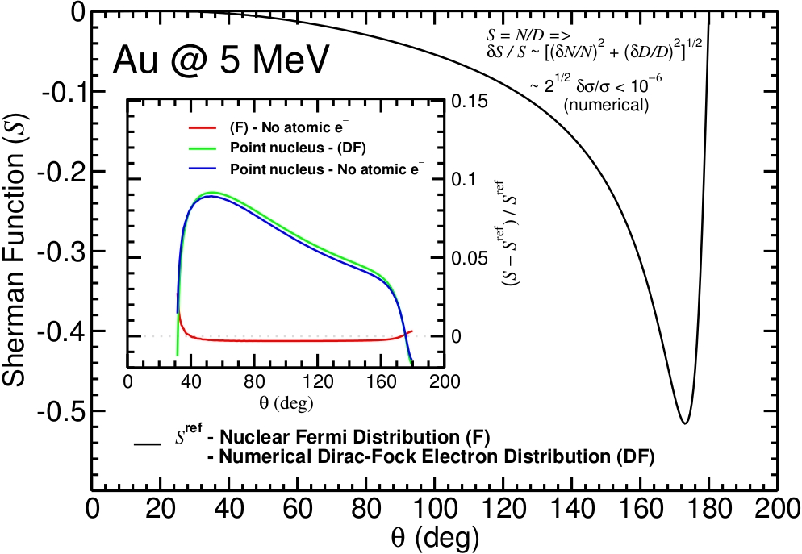
Exploring gold at KE=5.0MeV
X. Roca-Maza

Slide 3
AccurateTest of MeV Mott (ΔP/P)
Precise single-atom Sherman function (theoretical calculations)
Target thickness dependence of elastically scattered e-
Measure asymmetry with small instrumental uncertainty (beam systematics)
Effective Sherman Function
Expected Range of Uncertainty
Theory | 0.5 – 1.0%
Target Thickness | 0.2 – 0.5%
Instrumental | 0.2 – 0.3%
BUDGET | 0.6 – 1.2%
Target Thickness

Slide 4
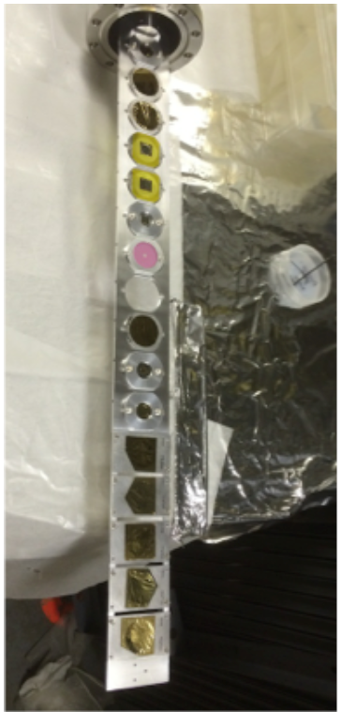
January 2015 - Run 1
Polarimeter design optimized for KE=5.0 MeV
Studied systematics of measured asymmetry vs …
Beam position
Beam size
Beam energy spread
Dump background
DAQ dead time
Detector rate
Measured asymmetry vs. targets of gold …
11 foils from 0.05 to 1 micron thick
High <0.25% statistical precision (1-3 hours/foil)
Measure target thickness “off-line”

Slide 5
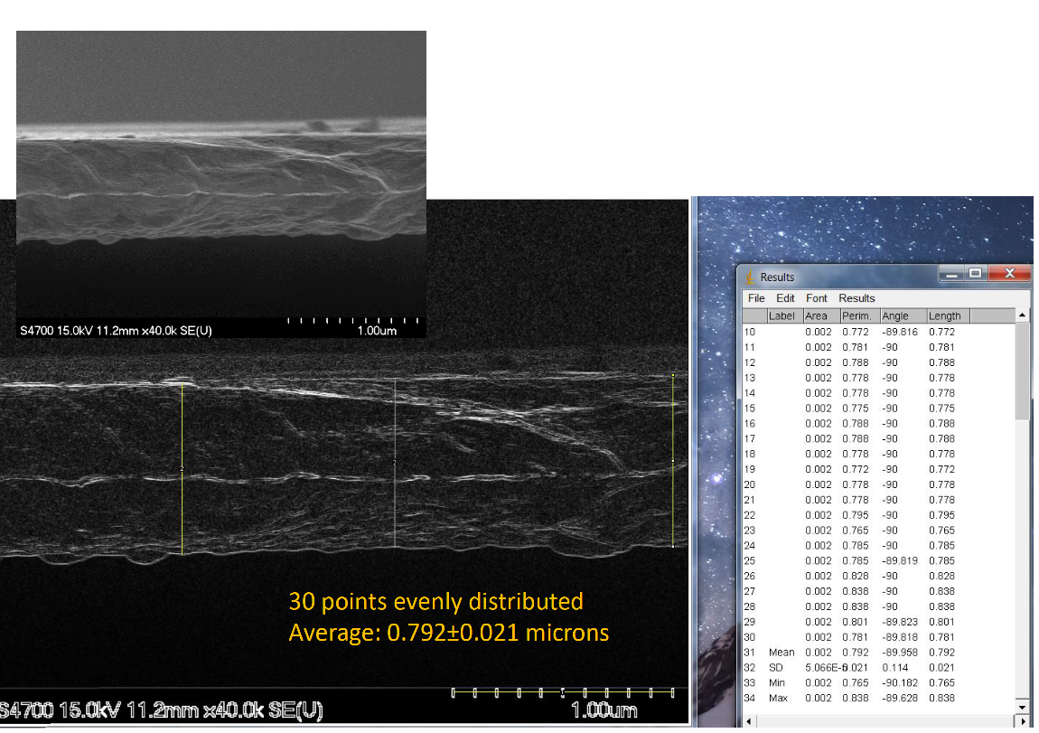
FESEM of “0.75 micron” gold target

Slide 6
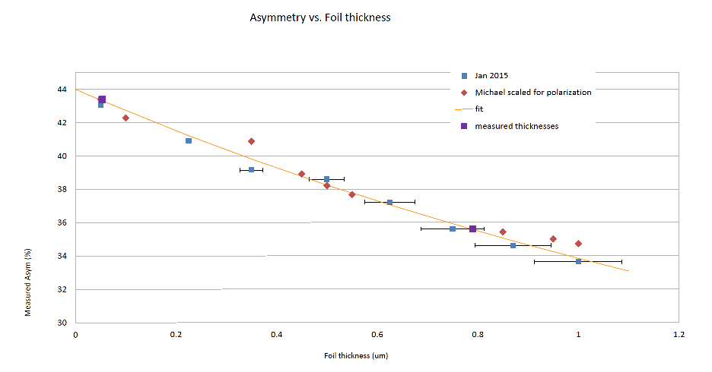
Preliminary on-line analysis of target thickness extrapolation

Slide 7
High Level Summary
The “Mott experiment” is coming at the end of a two year effort for a precision test of the polarimeter…
Form collaboration with theorists to improve and assess Sherman function
Building fast 250 MHz DAQ to record energy and time of all events
Install a new Be+Cu dump for reduced background and higher current (70uA)
Tested different methods to produce 31 MHz e- beam
Re-build higher energy resolution detectors
“Opening” polarimeter for internal survey of critical components
Develop a Geant4 model of detectors response and single/double scattering
Build improved target ladder+controls
Better tools for operational use
Run 1 provided a basis to study systematics of upgraded polarimeter and test precision of Geant4 model to reproduce target thickness extrapolation.
Run 2 will measure the same polarization for three beam energies (KE= 3, 5, 8 MeV) to test the precision of the polarimeter and the accuracy of the theory.

Slide 8
Precision Test of Mott Polarimetry
in the MeV Energy Range
P.A. Adderley¹, T. Gay², J. Grames¹, J. Hansknecht¹,
C. Horowitz³, A. Mamun⁴, M.J. McHugh⁵, A.K. Opper⁵,
M. Poelker¹, X. Roca-Maza⁶, C. Sinclair⁷, M. Stutzman¹,
R. Suleiman¹
¹Jefferson Lab
²University of Nebraska
³Indiana University
⁴Old Dominion University
⁵The George Washington University
⁶University of Milan
⁷Cornell University

