Slide 1






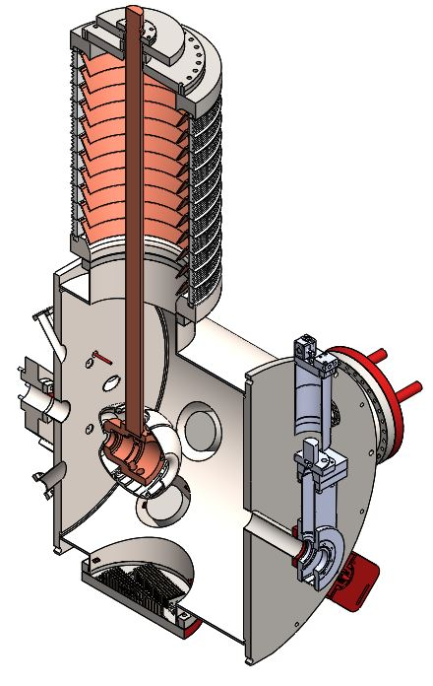
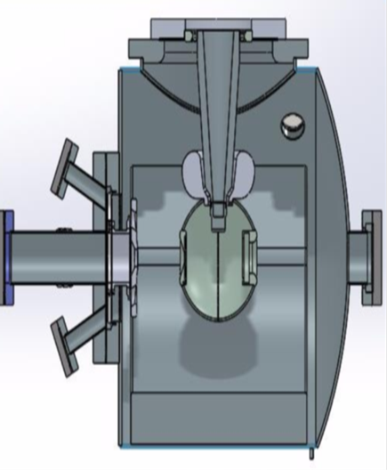
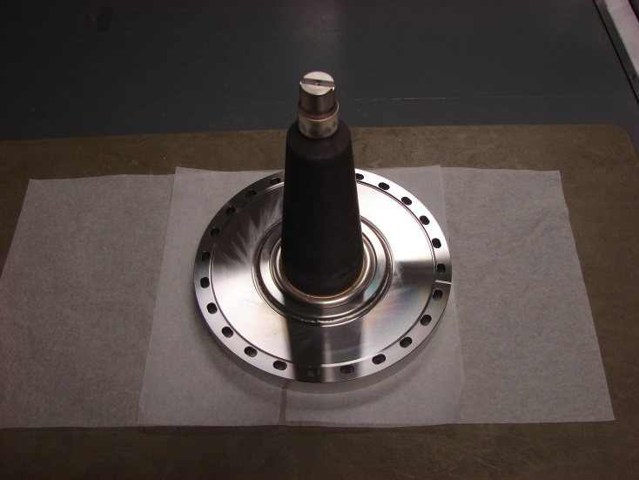
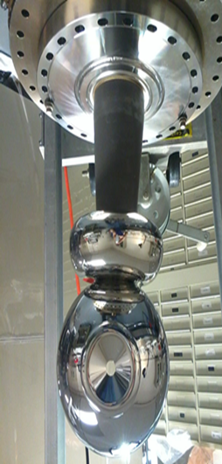
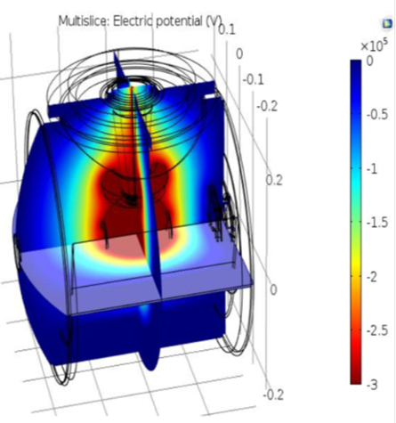
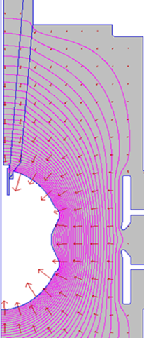
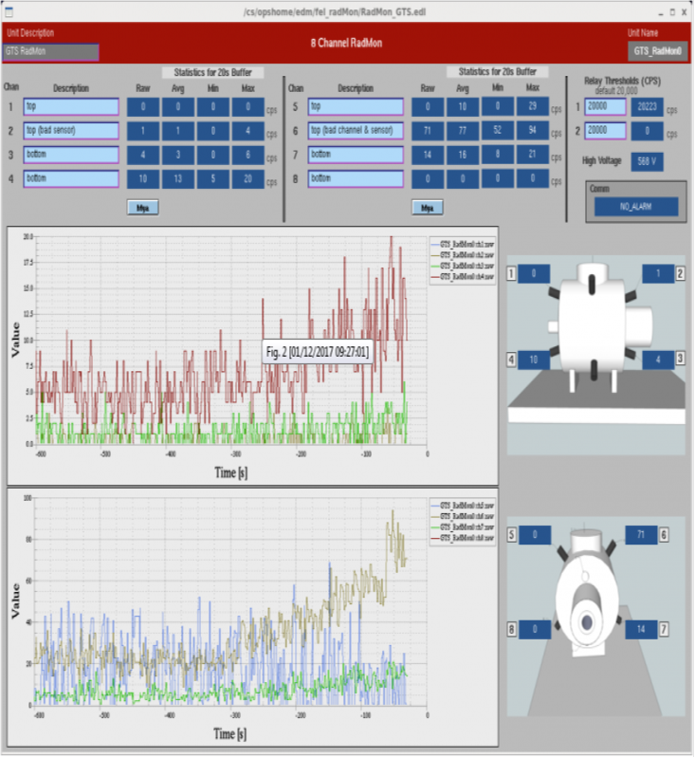
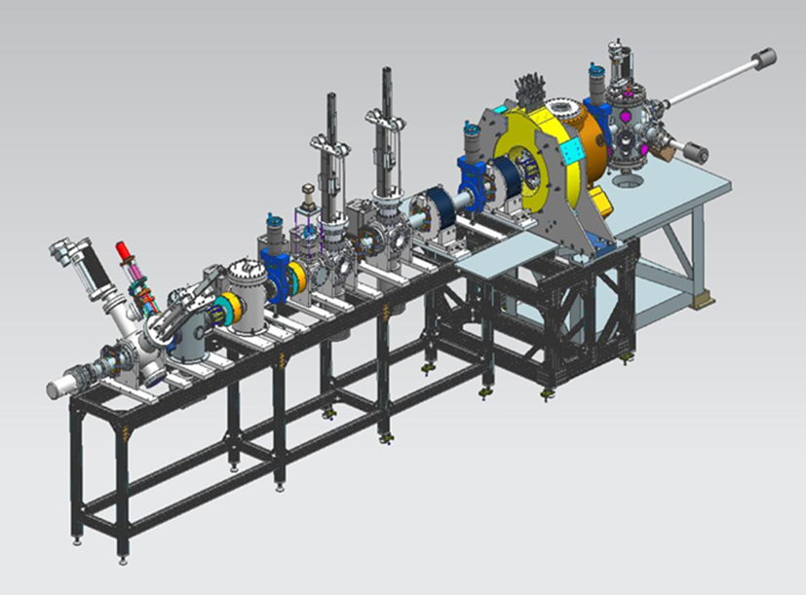
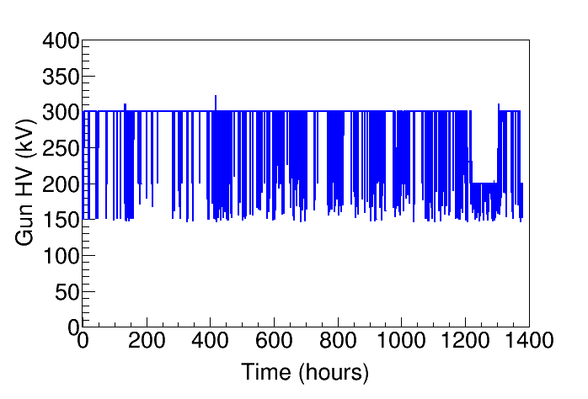
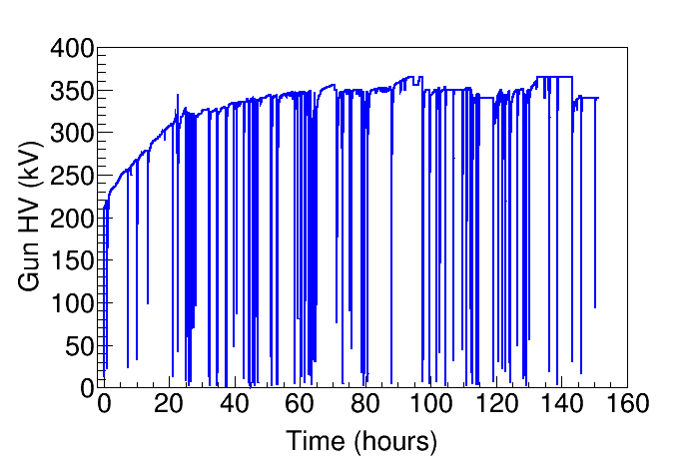
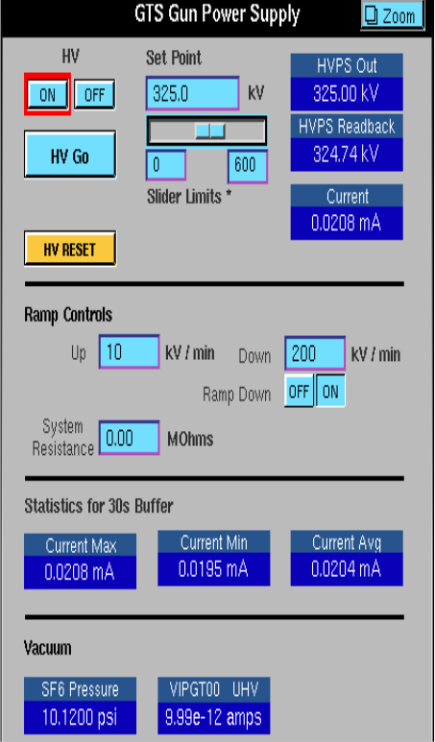


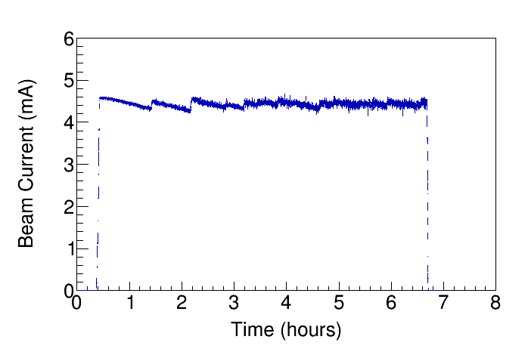
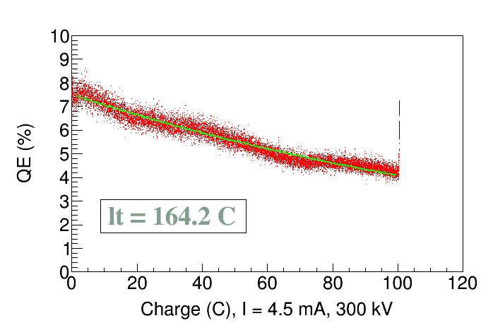
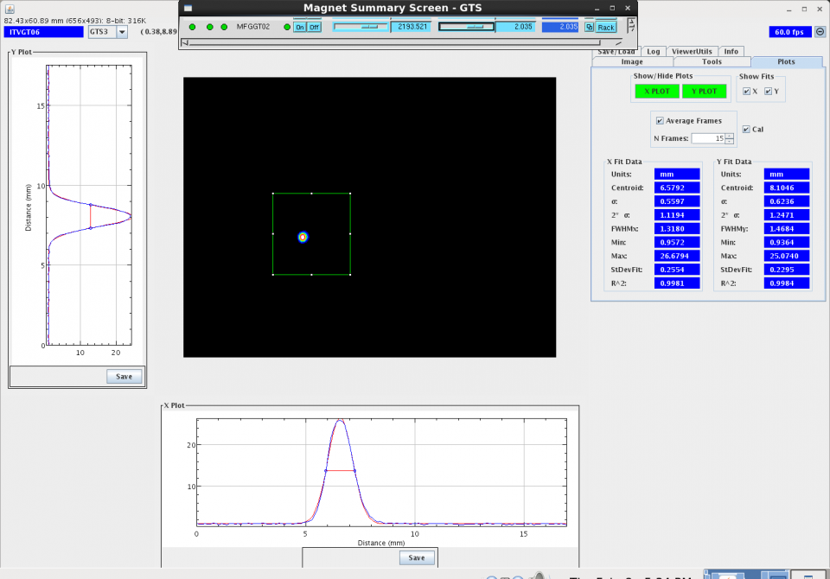
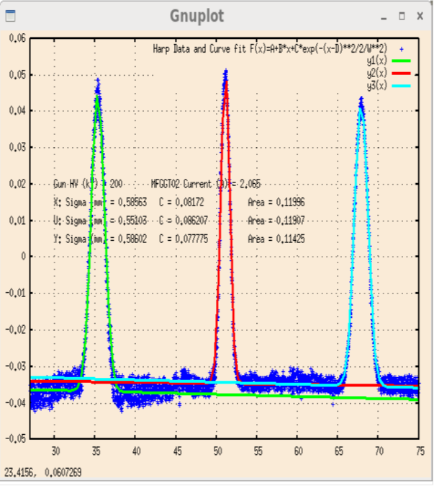
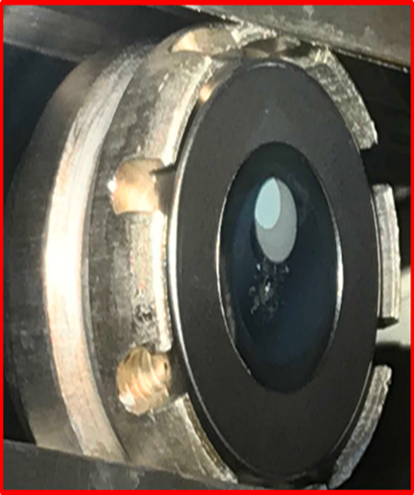
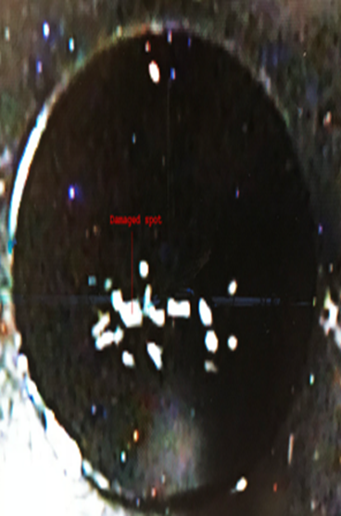
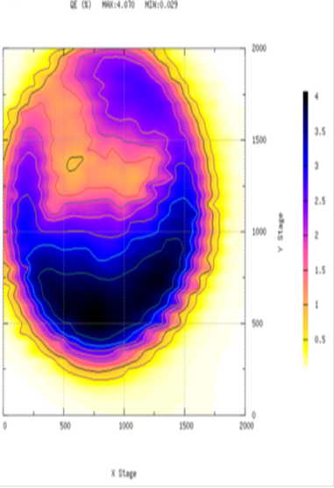
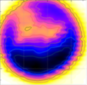
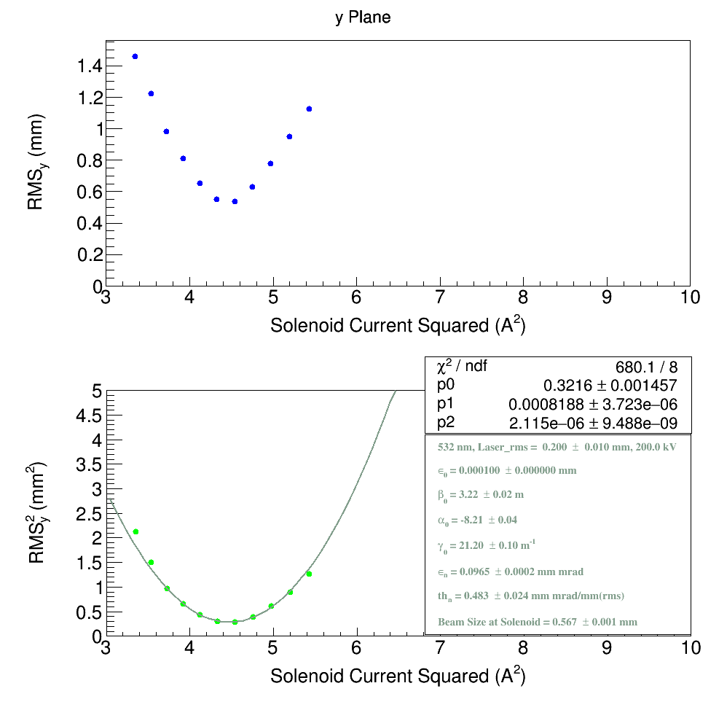
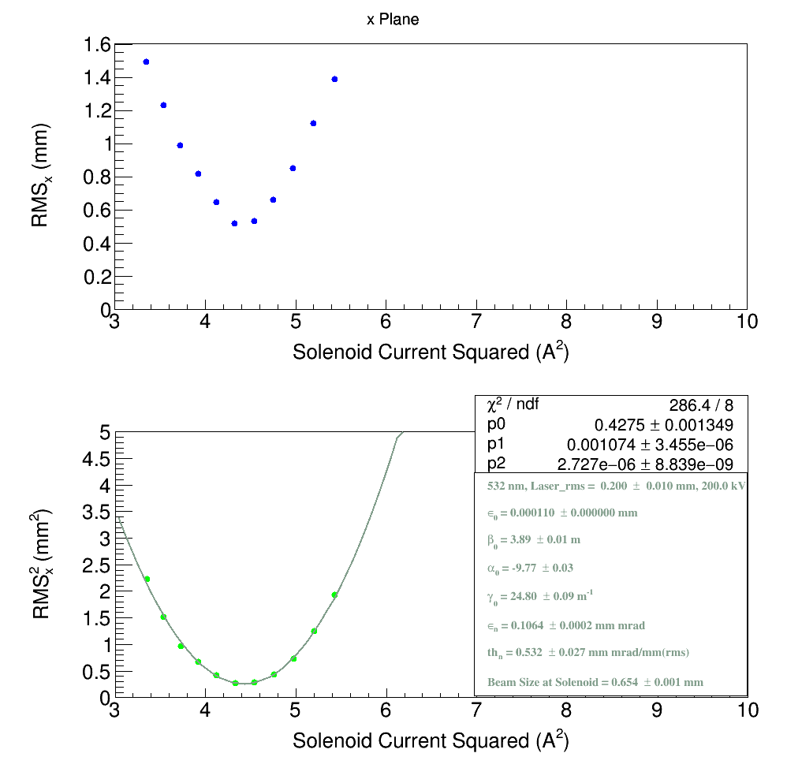

300kV DC High Voltage Gun with Inverted Insulator Geometry and CsK₂Sb Photocathode
Y. Wang, P. Adderley, B. Bullard, J. Benesch, J. Grames, F. Hannon, C. Hernandez-Garcia, J. Hansknecht,
G. Krafft, R. Kazimi, M. Poelker, M. A. Mamun, G. Palacios, R. Suleiman, M. Tiefenback, S. Wijethunga, S. Zhang
Thomas Jefferson National Accelerator Facility
Introduction
Compact DC Gun / Inverted Insulator
Insulator / Shed
Insulator is 97% purity alumina, ~7- inch long. Electric field strength at triple point junction is very
high, up to 100 MV/m, when gun biased to 300kV
Shed lowers the field and protects triple point junction, also linearizes potential along insulator
The goal of this project is to develop a reliable, compact 300kV DC high voltage photogun that operates with alkali-antimonide photocathodes, and to characterize beam quality. Inverted insulator and spherical cathode electrode with shed are the key design features. Preliminary studies show very promising results: gun operates reliably at 300kV; shed protects triple point junction; alkali-antimonide photo-cathodes are less sensitive to ion bombardment than GaAs; beam emittance is low compared to published data.
New design employs inverted-insulator
geometry, which reduces interior surface area
Old gun design
New Design
Insulator
Triple point junction
Shed
Simulation
Poisson & COMSOL are used to simulate electric field and potential
Low Field Emission after HV Conditioning
Required 150 hours to condition gun
Conditioned with Krypton to 350k
Operated at 300kV Minimal field emission
Five-Meter Beamline
Gun chamber
Lenses & correctors
Harp & viewers
Vacuum pumps & dump
Beam Operations
Operates at 300kV
14-month period
1400 hrs beam time
> 100 MV/m
<10 MV/m
CsK₂Sb Photocathode
Photocathodes are made in-house: first deposit Sb layer on substrate, then co-deposit Cs and K while monitoring QE. Mask is used to control active photocathode area. Transfer photocathode to gun
chamber prior to use
Photocathode Lifetime
Photocathode lifetime was measured using 4.5mA
CW beam for several hours, Lifetime 164 C
Beam Profile
Beam profiles are measured using YAG viewer
and wire scanner with low duty factor tune beam.
Prep chamber / Puck / Active area / damaged spots / QE map
Beam Emittance Studies
Summary & Plan
Beam emittance was calculated by varying lens strength and measuring corresponding beam sizes. Studies were conducted under different conditions: varying gun high voltage, laser size, laser position on photocathode, electron beam current. Emittance near damaged spot was also studied.
Designed & built compact DC gun with inverted insulator geometry; HV conditioned gun using Kr gas; operated reliably at 300 kV.
Conducted beam emittance studies.
Low normalized emittances:
~0.1 mm mrad at 0.2 mm laser
rms size and 18 fC bunch charge;
warrants more study
CsK₂Sb photocathode is robust: less sensitive to ion bombardment
but expected longer lifetime
Make CsK₂Sb photocathodes with different thickness Sb layers
Quantify how surface roughness
of the photocathode affects beam
emittance.
Acknowledgement: This work is supported by the Department of Energy, Laboratory Directed Research and Development funding, under contract DE-AC05-06OR23177

