Slide 1
Generation and Characterization of Magnetized Bunched Electron Beam from DC Photogun for
MEIC Cooler
Laboratory Directed Research and Development (LDRD) Proposal
Riad Suleiman and Matt Poelker
June 29, 2016

Slide 2
JLEIC Magnetized Beam LDRD
Generate magnetized electron beam and measure its properties
Explore impact of cathode solenoid on photogun operation
Simulations and measurements will provide insights on ways to optimize JLEIC electron cooler and help design appropriate source
JLab will have direct experience magnetizing high current electron beam

Slide 3
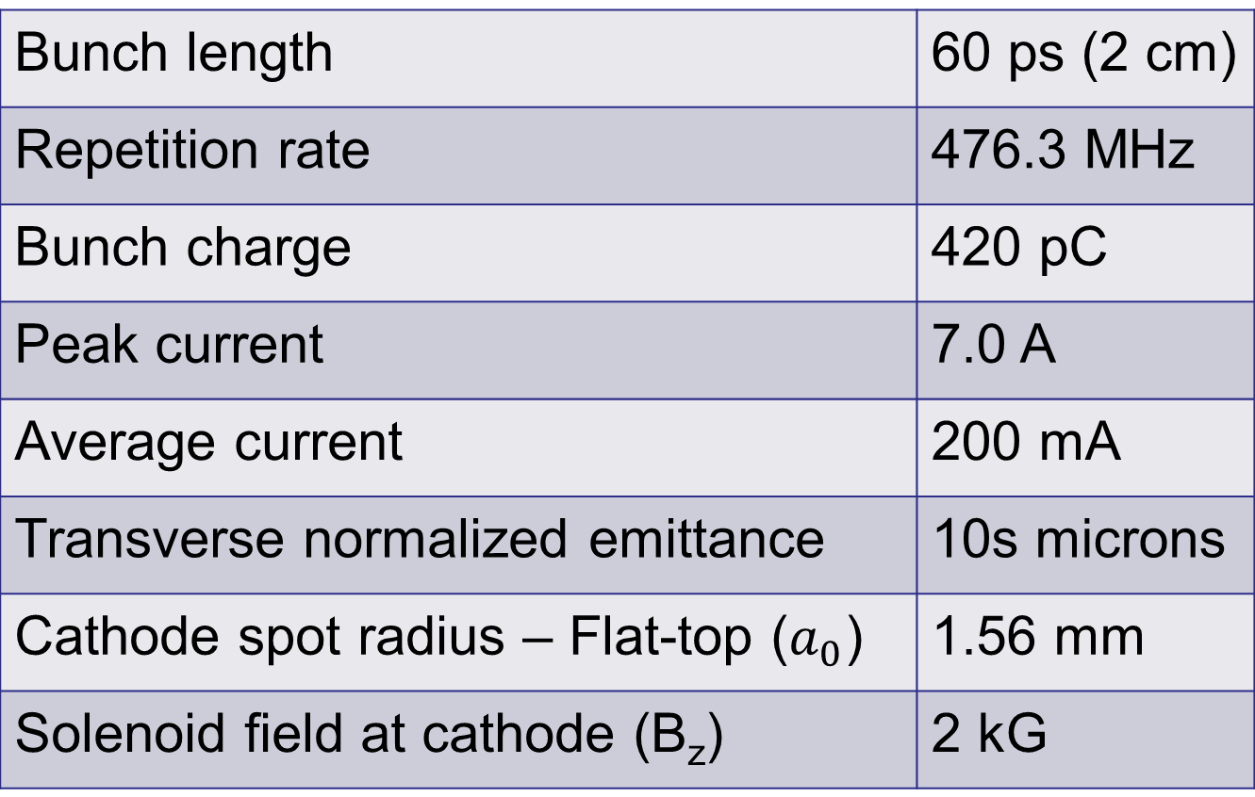
Magnetized Bunched Electron Beam Requirements
Bunch length | 60 ps (2 cm)
Repetition rate | 476.3 MHz
Bunch charge | 420 pC
Peak current | 7.0 A
Average current | 200 mA
Transverse normalized emittance | 10s microns
Cathode spot radius – Flat-top ($a_{0}$) | 1.56 mm
Solenoid field at cathode (B_{z}) | 2 kG

Slide 4
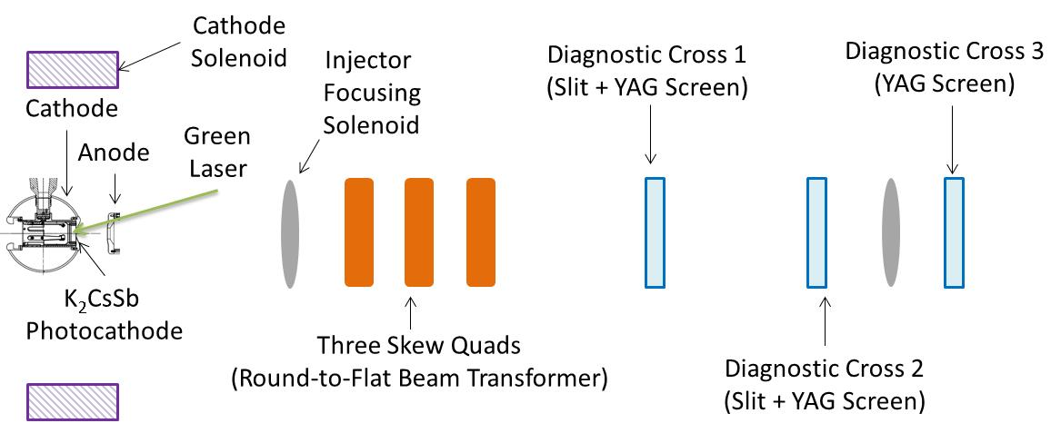
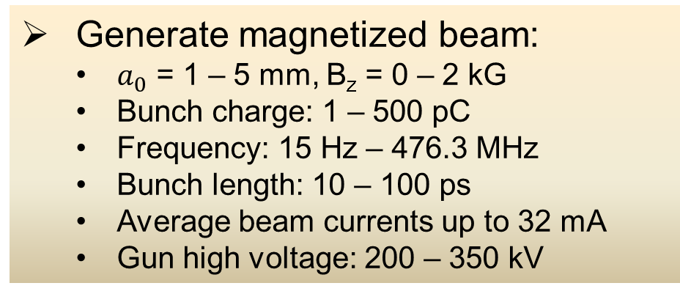
Experimental Overview
Generate magnetized beam:
  $a_{0}$ = 1 – 5 mm, B_{z} = 0 – 2 kG
  Bunch charge: 1 – 500 pC
  Frequency: 15 Hz – 476.3 MHz
  Bunch length: 10 – 100 ps
  Average beam currents up to 32 mA
  Gun high voltage: 200 – 350 kV

Slide 5
Planned Measurements
Measure mechanical angular momentum
Measure photocathode lifetime versus solenoid field at high currents (up to 32 mA) and high voltages (200 – 350 kV) limited by in-house HV supplies
Study beam halo and beam loss versus magnetization
Use skew quads – RTFB Transformer – to generate flat beam and measure horizontal and vertical emittances using slit method
Generate very high currents magnetized beam and study beam transport and RTFB versus electron bunch charge
New supply capable of 200 mA and 300 kV costs about $600,000 (such supplies typically cost $10 per Watt)

Slide 6
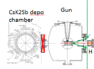
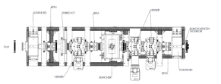
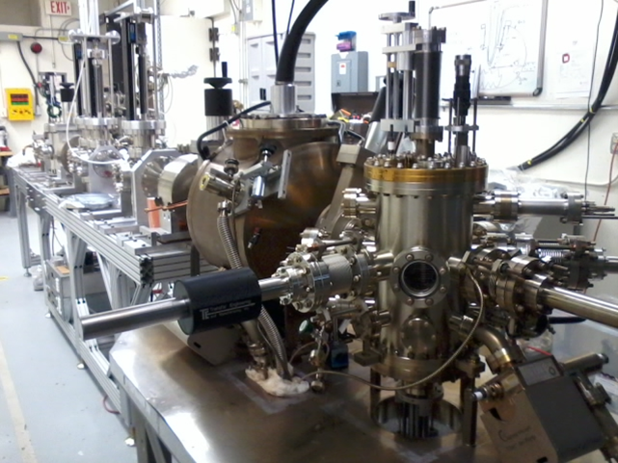
LERF Gun Test Stand

Slide 7
Prior Year Accomplishments
K₂CsSb Photocathode Preparation Chamber, Gun and Beamline: delivered 1 mA to dump
Lasers: ready (LOSP approved)
Gun Test Stand (GTS) OSP: approved for only 10 nA – working with Radiation Group for approval at full current
  Simulation (Fay Hannon):
  Used ASTRA and GPT simulation to design beamline and to locate magnets and diagnostics at optimum positions
  Simulated magnetized electron beam properties along beamline for various starting conditions
  Simulated a round to flat transformer

Slide 8
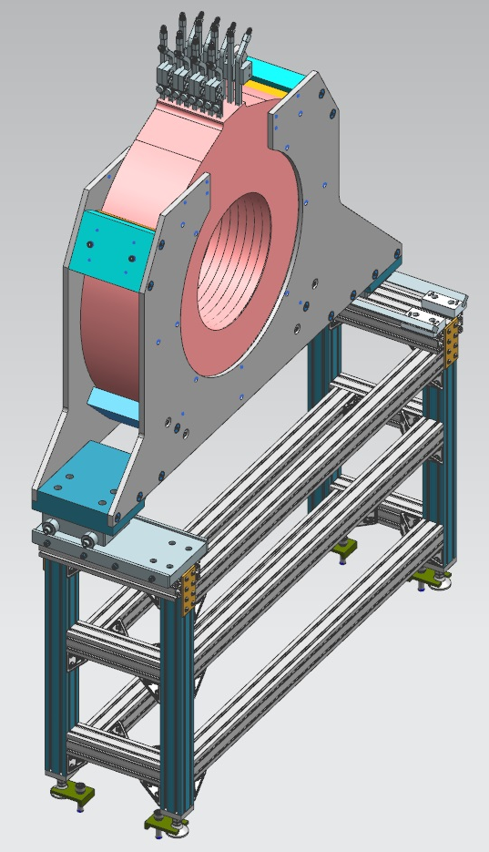
Cathode Solenoid Magnet
Size | 11.811" ID, 27.559" OD, 6.242" Z
Conductor | L=500 m, A=0.53 cm² 16 layers by 20 turns
Coil Weight | 240 kg
Resistance | 0.18 Ω (65°C average T)
Field at Photocathode | 1.4 kG
Voltage | 72 V
Current | 400 A
  Designed and procured, arrives on-site on July 8, 2016
  Cathode Solenoid Power Supply: Use new spare CEBAF Dogleg magnet power supply (500A, 80V)

Slide 9
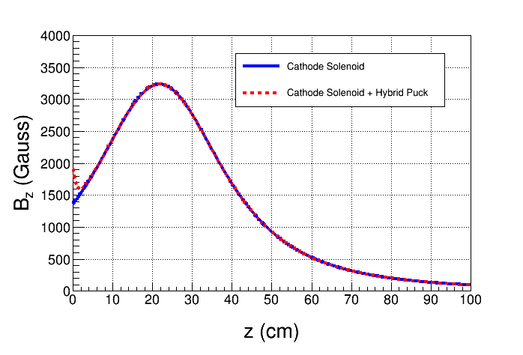
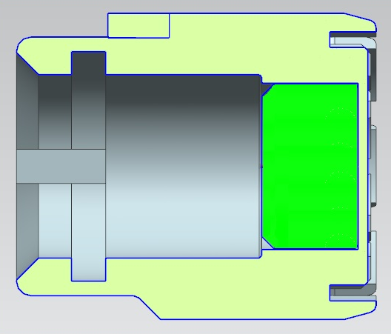
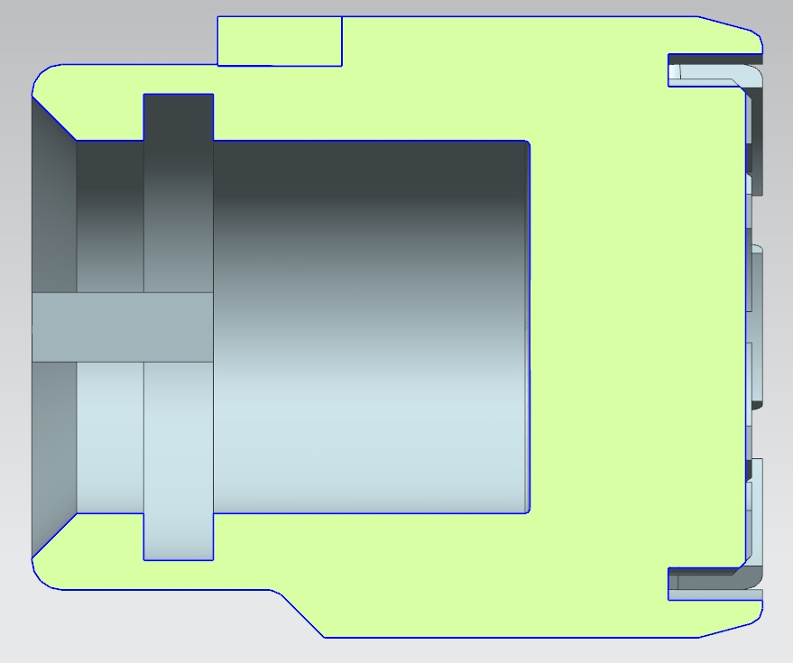
Molybdenum
Steel
Steel
New Steel Pucks
  Designed to enhance field to 2.0 kG at cathode. Two types:
    Molybdenum and carbon steel hybrid puck
    Carbon steel puck

Slide 10
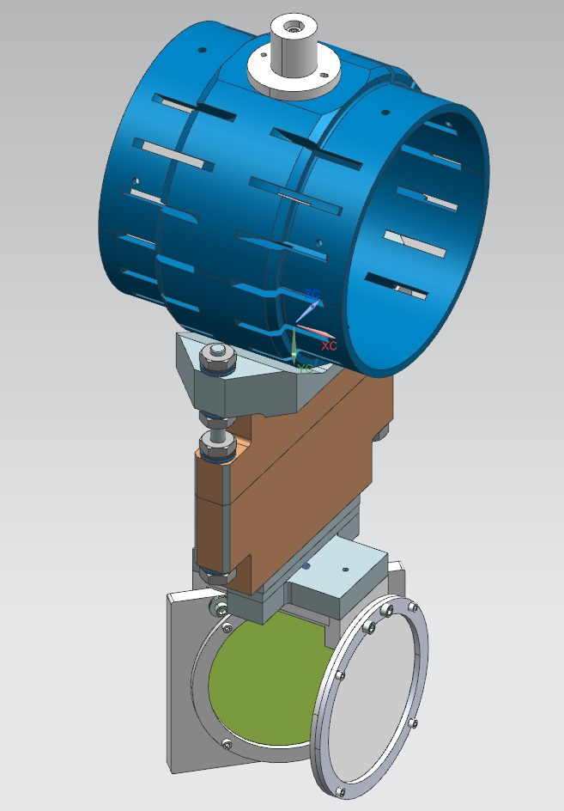
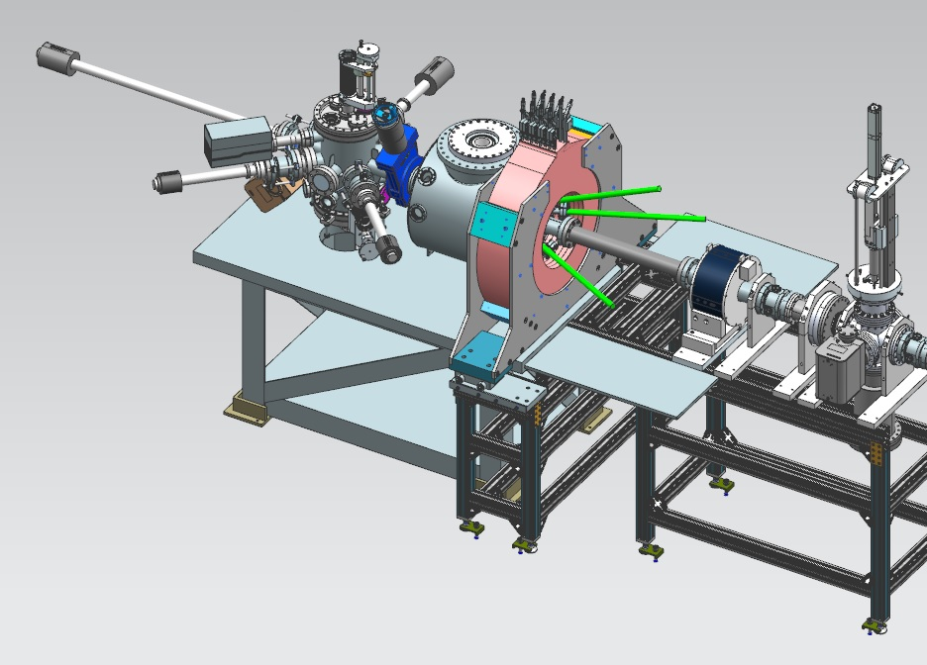
Plans for July – September 2016
Map cathode magnet (without and with new pucks)
Install cathode magnet
Install slits
Load new pucks into Preparation Chamber
Will have to break gun vacuum. Plan to change HV ceramic insulator and HV shed, replace leaky gate valve and add NEG pumps. Improve Preparation Chamber

Slide 11
Budget
FY16 | $339,211
FY17 | $265,850
FY18 | $212,025
Total | $817,086
Materials and Supplies:
  Cathode solenoid magnet and pucks
  Three skew quadrupoles
  Beamline hardware: steering magnets and slits for beam emittance and magnetization measurements
  Laser components
Labor:
  Cathode magnet design and procurement
  Cathode magnet mapping and installation
  Relocate new CEBAF spare dogleg power supply (500A/80V) and provide 480VAC and LCW
  Mechanical designer for cathode magnet support
  Mechanical designer for pucks, slits and beamline
  ASTRA and GPT modeling (Fay Hannon)
  Postdoc – years 2 and 3

Slide 12
Milestones

Slide 13
Year 1 Milestones
Q1 (Oct, Nov, Dec):
    HV condition gun to 350 kV and build K₂CsSb preparation chamber ☑
    Design beamline, locate magnets and diagnostics at optimum positions ☑
    Design cathode solenoid magnet ☑
Q2 (Jan, Feb, Mar):
    Connect existing beamline to gun and instrument beamline ☑
    Procure cathode solenoid magnet ☑
    Design and procure slits ☑
Q3 (Apr, May, Jun):
    Commission exiting beamline with beam ☑
    Measure photocathode lifetime at 5 mA and 350 kV (not magnetized)
    Relocate new spare CEBAF dogleg power supply to GTS
Q4 (Jul, Aug, Sep):
    Install cathode solenoid magnet
    Assemble new beamline and commission with beam
    Design and procure three skew quads ☒ Postponed to year 2

Slide 14
Year 2 Milestones
Q1 (Oct, Nov, Dec):
    Generate magnetized beam
    Measure mechanical angular momentum vs magnetization and laser size
    Benchmark simulation against measurements
Q2 (Jan, Feb, Mar):
    Measure mechanical angular momentum vs bunch charge and bunch length
    Benchmark simulation against measurements
Q3 (Apr, May, Jun):
    Generate very high currents magnetized beam and study beam transport vs electron bunch charge
Q4 (Jul, Aug, Sep):
    Measure photocathode lifetime vs magnetization at 5 mA and 350 kV
    Study beam halo and beam loss vs magnetization

Slide 15
Year 3 Milestones
Q1 (Oct, Nov, Dec):
    Install three skew quads
    Generate flat beam with skew quads – RTFB Transformer – and measure horizontal and vertical emittances using slit method
Q2 (Jan, Feb, Mar):
    Measure RTFB transformation versus electron bunch charge
    Use simulation to quantify how good or complete RTFB transform
Q3 (Apr, May, Jun):
    Change to HV Supply of 32 mA and 200 kV
Q4 (Jul, Aug, Sep):
    Measure photocathode lifetime vs magnetization at 32 mA and 200 kV
    Study beam halo and beam loss vs magnetization

Slide 16
Backup Slides

Slide 17
Magnetized Cooling
JLEIC bunched magnetized electron cooler is part of Collider Ring and aims to counteract emittance degradation induced by intra-beam scattering, to maintain ion beam emittance during collisions and extend luminosity lifetime.
Electrons helical motion in strong magnetic field increases electron-ion interaction time, thereby significantly improving cooling efficiency. Electron-ion collisions that occur over many cyclotron oscillations and at distances larger than cyclotron radius are insensitive to electrons transverse velocity.
Cooling rates are determined by electron longitudinal energy spread rather than electron beam transverse emittance as transverse motion of electrons is quenched by magnetic field
This cyclotron motion also provides suppression of electron-ion recombination

Slide 18
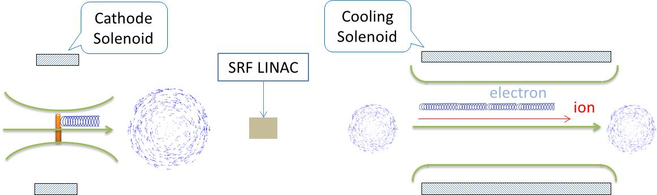
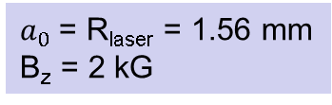
Electron beam is being used inside cooling solenoid where it suffers an azimuthal kick when it enters. This kick is cancelled by an earlier kick at exit of cathode solenoid
Electrons born in strong uniform B_{z}
Upon exit of Cathode Solenoid
Upon entering Cooling Solenoid
r_{e}= 0.7 mm
B_{cool} = 1 T
$a_{0}$= R_{laser} = 1.56 mm
B_{z} = 2 kG
= 36 µm

