Slide 1
ANALYSIS
Target Timing Cut
Energy Threshold Cut [-0.5:+2]
Uses independent BCM calibrations for Run I/II
Uses L/R/U/D cuts COMMON for Run I/II
Calculates Super-ratio Asymmetry and Rate
Uses Final Dec 2016 FESEM thickness report
Run I
Asymmetry
LO (350, 500, 625, 750, 870, 1000)
HI (50, 50, 225, 350)
Stability
LO – 10 x (1000)
HI – 10 x (1000)
Run II
Asymmetry Runs
LO (50, 50, 225, 350, 350, 500, 625, 750, 870, 1000)
Stability Runs
LO – 18 x (1000)

Slide 2
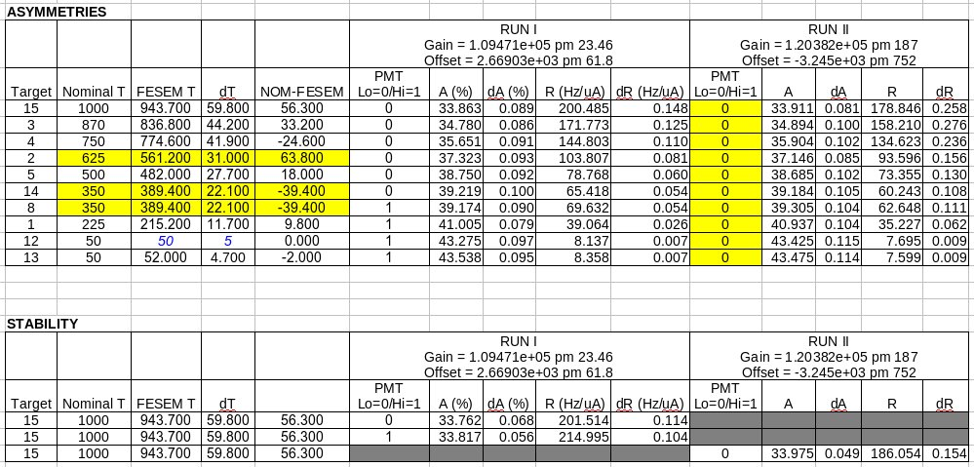

Slide 3
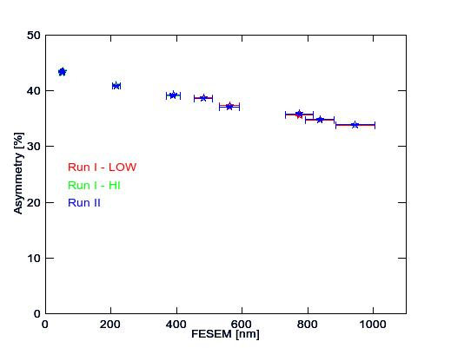

Slide 4
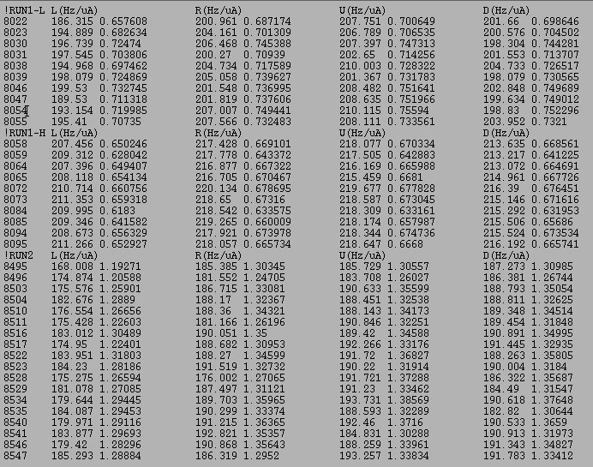
RUN1-LO
RUN1-HI
RUN2-LO

Slide 5
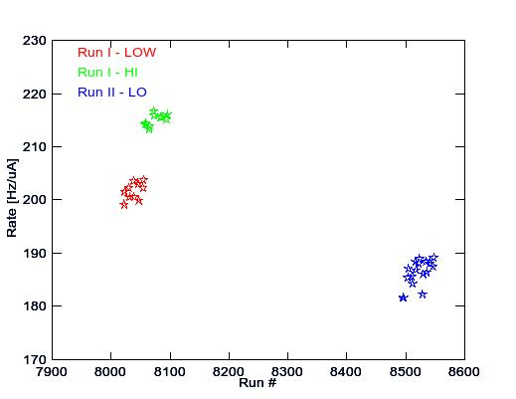

Slide 6
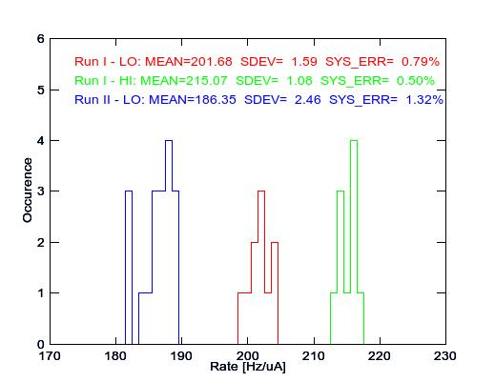

Slide 7
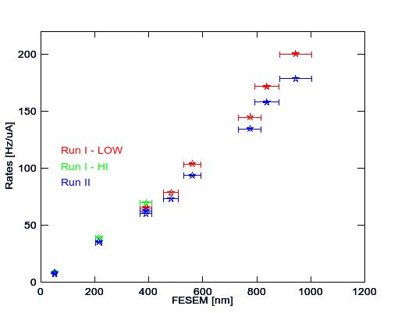
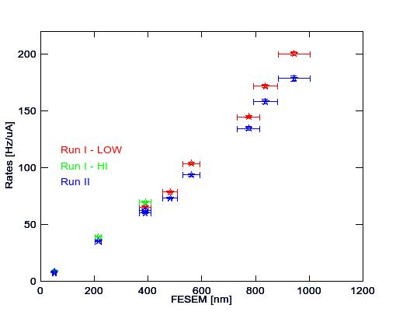
STATISTICS ONLY
STATISTICS + STABILITY SDEV

Slide 8
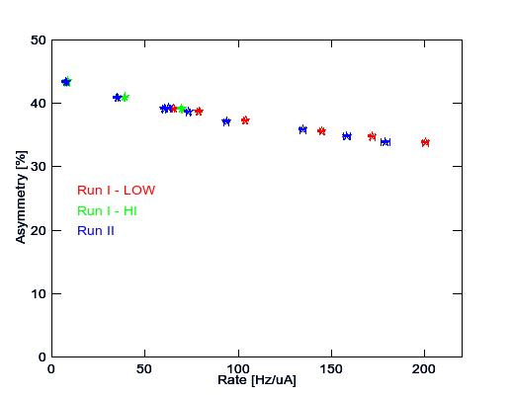
STATISTICS + STABILITY SDEV

