Slide 1
Mott Run Time Estimates
DAQ rate < 5,000 Hz
Beam current < 50 µA
Target thickness extrapolation from Steigerwald is included
Dump events: 25 Hz/µA per detector
Beam polarization: 85%
Statistical error (dp/p): 0.5%

Slide 2
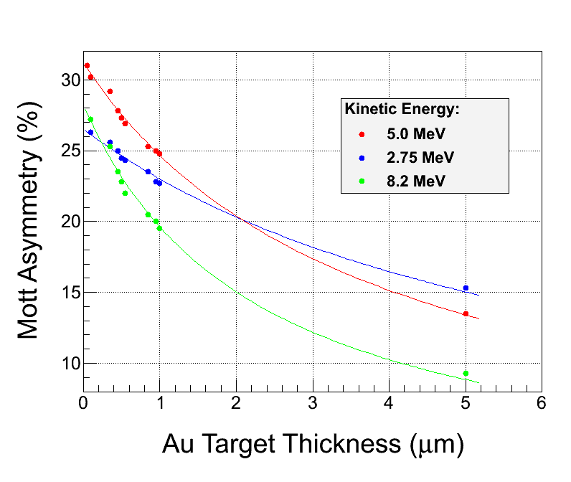
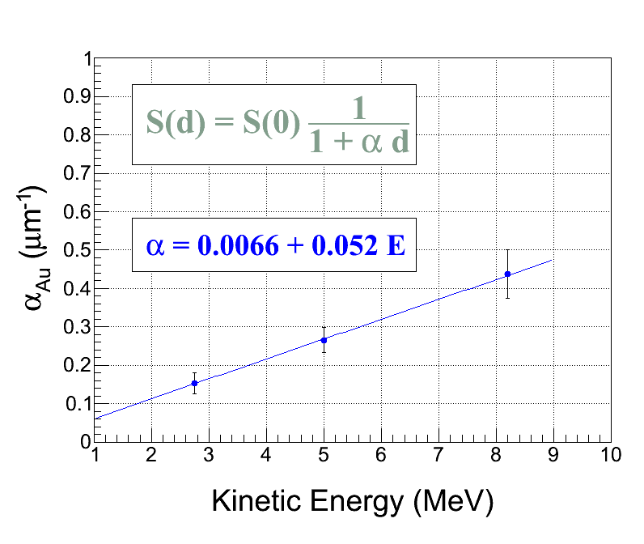
Target Thickness Extrapolation

Slide 3
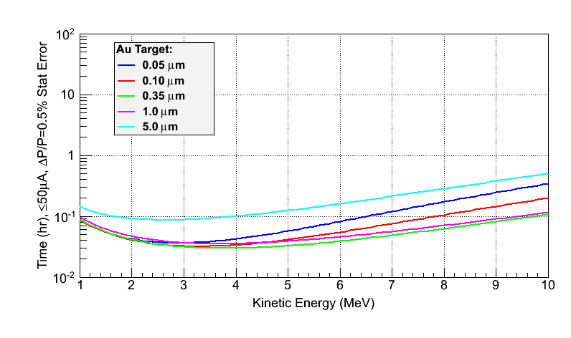
Au Target

Slide 4
Au Target - 3.0 MeV
Target Thickness (µm) | I (µA) | Time (hr) | DAQ Rate (Hz) | Asym (%) | S_{eff}
0.05 | 12.76 | 0.04 | 5000 | -40.49 | -0.4763
0.10 | 7.31 | 0.03 | 5000 | -40.16 | -0.4725
0.35 | 2.33 | 0.03 | 5000 | -38.62 | -0.4543
1.0 | 0.84 | 0.04 | 5000 | -35.11 | -0.4130
5.0 | 0.17 | 0.09 | 5000 | -22.51 | -0.2649

Slide 5
Au Target - 5.0 MeV
Target Thickness (µm) | I (µA) | Time (hr) | DAQ Rate (Hz) | Asym (%) | S_{eff}
0.05 | 29.77 | 0.06 | 5000 | -43.77 | -0.5150
0.10 | 21.19 | 0.04 | 5000 | -43.20 | -0.5083
0.35 | 8.69 | 0.03 | 5000 | -40.57 | -0.4773
1.0 | 3.43 | 0.04 | 5000 | -35.02 | -0.4120
5.0 | 0.73 | 0.12 | 5000 | -19.01 | -0.2237

Slide 6
Au Target - 8.0 MeV
Target Thickness (µm) | I (µA) | Time (hr) | DAQ Rate (Hz) | Asym (%) | S_{eff}
0.05 | 41.54 | 0.17 | 5000 | -38.98 | -0.4586
0.10 | 35.52 | 0.11 | 5000 | -38.19 | -0.4493
0.35 | 20.61 | 0.06 | 5000 | -34.68 | -0.4080
1.0 | 9.85 | 0.07 | 5000 | -27.98 | -0.3292
5.0 | 2.34 | 0.29 | 5000 | -12.79 | -0.1504

Slide 7
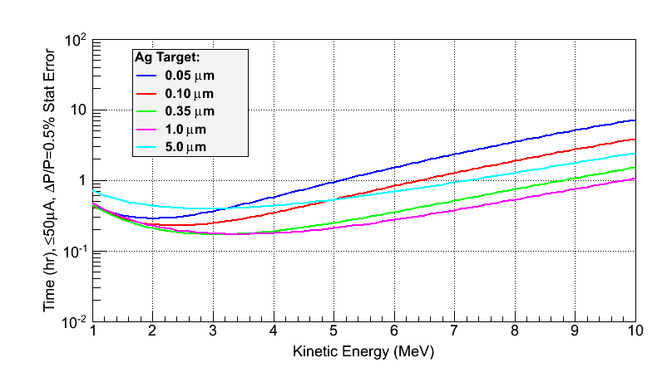
Ag Target - 5.0 MeV
Target Thickness (µm) | I (µA) | Time (hr) | DAQ Rate (Hz) | Asym (%) | S_{eff}
0.05 | 45.18 | 0.95 | 5000 | -22.02 | -0.2591
0.10 | 41.20 | 0.53 | 5000 | -21.74 | -0.2557
0.35 | 28.62 | 0.25 | 5000 | -20.41 | -0.2401
1.0 | 15.95 | 0.21 | 5000 | -17.62 | -0.2073
5.0 | 4.28 | 0.53 | 5000 | -9.57 | -0.1125

Slide 8
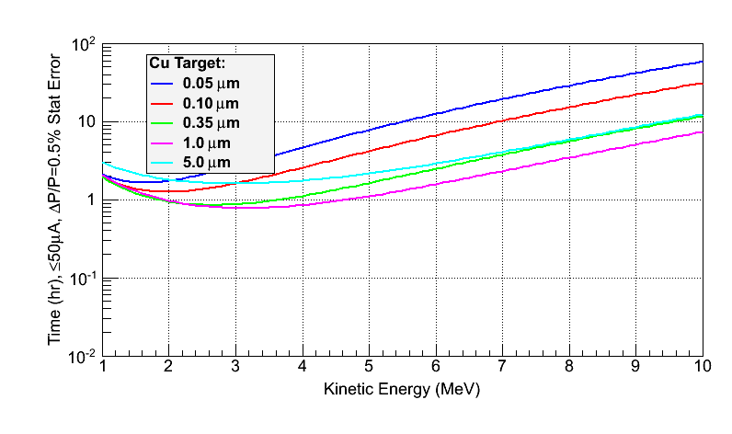
Cu Target - 5.0 MeV
Target Thickness (µm) | I (µA) | Time (hr) | DAQ Rate (Hz) | Asym (%) | S_{eff}
0.05 | 47.87 | 7.82 | 5000 | -11.55 | -0.1359
0.10 | 45.92 | 4.18 | 5000 | -11.40 | -0.13.42
0.35 | 38.13 | 1.63 | 5000 | -10.71 | -0.1260
1.0 | 26.46 | 1.11 | 5000 | -9.24 | -0.1087
5.0 | 9.18 | 2.16 | 5000 | -5.02 | -0.0590

