Slide 1

Polarized Positron Beam
R&D at Jefferson Lab
Joe Grames
Thomas Jefferson National Accelerator Facility
Polarized positron production
The PEPPo experiment
PEPPo based Positron Source
Positrons at CEBAF
Notes:
INJECTOR SCIENTIST AT JEFFERSON LAB
WOULD LIKE TO TELL YOU ABOUT A SMALL EXPERIMENT WE PERFORMED TO PRODUCE POLARIZED POSITRONS AT LOW ENERGY
WILL GET TO THIS COMMENT AT THE END

Slide 2



Polarized Bremmstrahlung and Pair Creation
Bremsstrahlung
Pair Creation
P_{circ}(γ) / P_{z} (e⁻)
P_{z} (e⁺) / P_{circ} (γ)
E_{γ} / T_{e-}
T_{e+} / (E_{γ} – 2m_{e+})
E.A. Kuraev, Y.M. Bystritskiy, M. Shatnev, E.Tomasi-Gustafsson, PRC 81 (2010) 055208
2
Notes:
THE PEPPO METHOD IS PRETTY STRAIGHT-FORWARD
FIRST STAGE IS POLARIZED BREMMSTRHALUNG
SECOND STAGE IS POLARIZED PAIR CREATION
THIS COULD BE DONE IN SEPARATE TARGETS, BUT CONVENIENTLY ALSO IN ONE SINGLE TARGET
WE LEARNED EARLY ON THE CALCULATIONS OF OLSON/MAXIMON WERE NOT CORRECT AT LOW ENERGY, ESPECIALLY PAIR CREATION
NEW CALCULATIONS WERE DONE, THAT AGREE W/ OM AT HIGHER ENERGIES
WE WERE NOT FIRST TO PROPOSE THIS IDEA, SO WHY NOT BEFORE…

Slide 3

Polarized Electrons for Polarized Positrons
The purpose of the PEPPo (Polarized Electrons for Polarized Positrons) experiment at the CEBAF Injector was to demonstrate the feasibility of using bremsstrahlung radiation of MeV energy Polarized Electrons for the efficient production of Polarized Positrons.
J. Grames, E. Voutier et al., JLab Experiment E12-11-105 (2011)

Slide 4
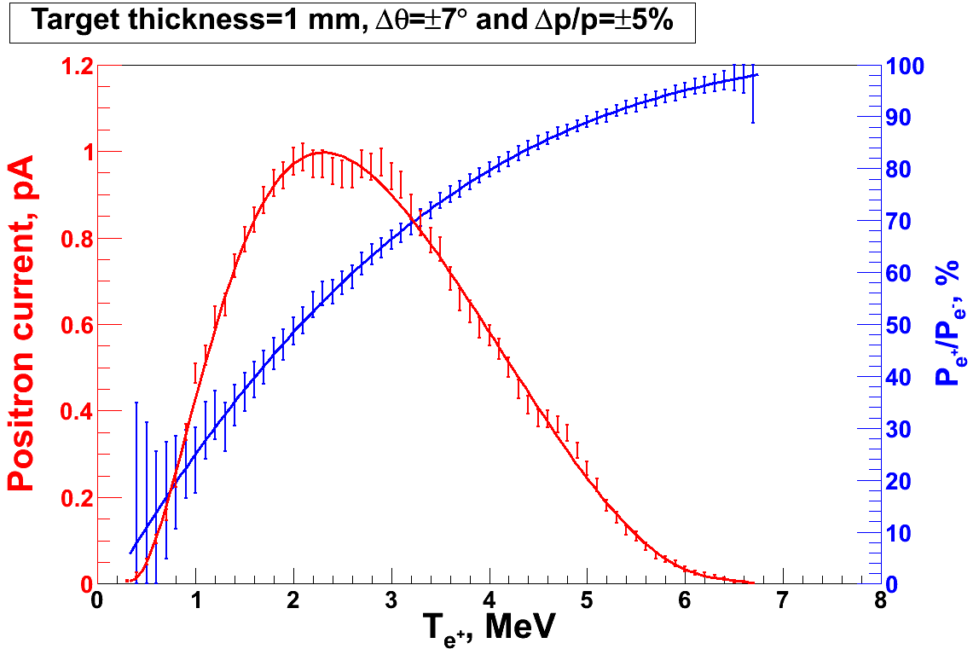
PEPPo Principle of Operation
Geant4
Polarized Electrons
(< 10 MeV/c) strike production target
Positron Transverse and Momentum Phase Space Selection
J. Dumas, PhD Thesis (2011)
E_{e} = 6.3 MeV
I_{e} = 1 µA
T₁ = 1 mm W
P_{e-}
S₁
e⁻
D
T₁
PEPPo
COMPTON TRANSMISSION
Polarized e⁺ convert into polarized γ (P_{γ}) whose transmission through a polarized iron target (P_{T}) depends on P_{γ}.P_{T}
BREMSSTRAHLUNG
Longitudinal e⁻ (P_{e-}) produce elliptical γ whose circular (P_{γ}) component is proportional to P_{e-}
PAIR PRODUCTION
In the same target, γ produce e⁺e⁻ pairs and transfer Pγ into longitudinal (P_{e+}) and transverse polarization averages to zero
S₂
P_{e+}
P_{T}
D
Calorimeter
e⁺
T₂
Compton Transmission Polarimeter
PEPPo measured the longitudinal polarization transfer from 8.25 MeV/c e⁻ to e⁺ in the 3.07-6.25 MeV/c momentum range.

Slide 5
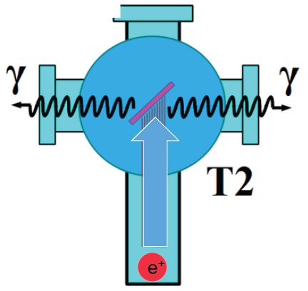
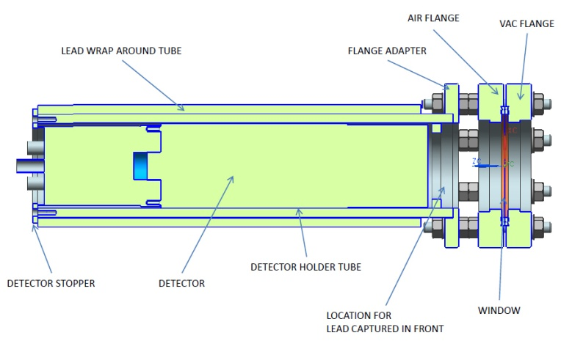
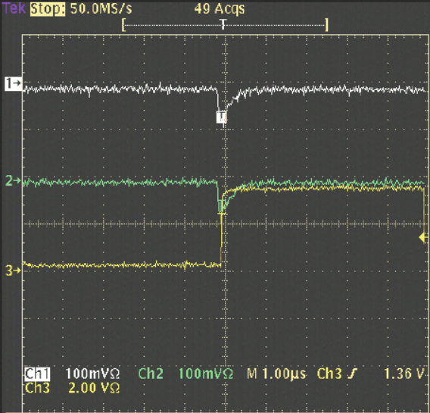
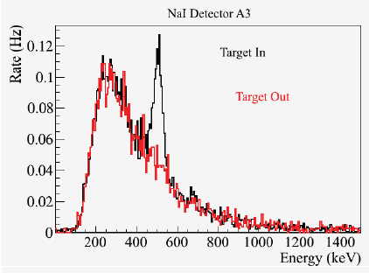
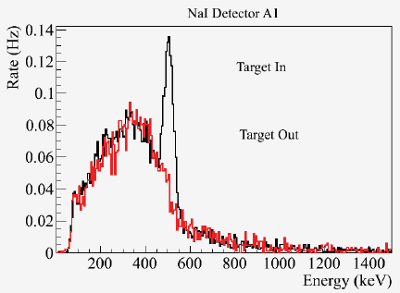
Positron ID and Yield
S₁
Two NaI detectors measured coincidence of back-to-back photons emitted by annihilation of positrons in a viewscreen.
e⁻
e⁺
D
T₁
p_{e-}= 8.2 MeV/c
D
e⁺
S₂
T₂
4 MeV/c e+
10⁻⁵ e⁺/e⁻

Slide 6
Compton Polarimeter Energy & Timing Spectra
The location of the 511 keV peak is an in-situ monitor of the gain of the detection chain and provides a link to radioactive source calibration data.
Compton physics asymmetries are obtained from the polarization sensitive energy deposition in the central crystal.
The coincidence time between the central crystal and a charge sensitive trigger scintillator allow for accidental subtraction.

Slide 7
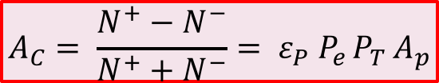
Compton Transmission Analyzing Power
A. Adeyemi (Hampton University)
The experimental Compton asymmetry for a known polarized electron beam provides a measurement of the electron analyzing power (A_{e}) of the polarimeter.
A comparison between the experimental and the GEANT4 simulated response of the polarimeter establishes a calibrated model of the polarimeter.
The positron analyzing power (A_{p}) is then determined by simulation using the calibrated model.
Electron beam polarization
Target polarization
Electron-to-positron
polarization transfer
$$A_{C}= \frac{N^{+}−N^{−}}{N^{+}+N^{−}}= ε_{P} P_{e }P_{T }A_{p}$$
P_{T} = 7.06% ±0.05%_{Sta.}± 0.07%_{Sys.}

Slide 8

PEPPo Result
(PEPPo Collaboration) D. Abbott et al. , Phys. Rev. Lett. 116 (2016) 214801
PEPPo demonstrated efficient polarization transfer from 8.2 MeV/c electrons to positrons, expanding polarized positron production to MeV electron beam energies.
electron beam polarization
85.2 ± 0.6 ± 0.7 %
Whenever producing e⁺ from e⁻, polarization is coming for free
if initial electrons are polarized.

Slide 9
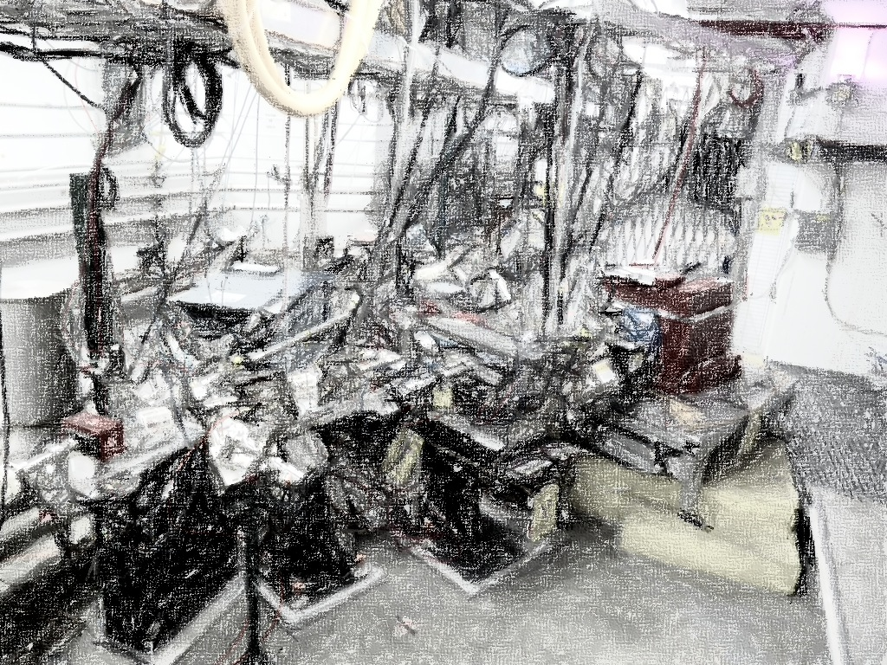
PEPPo Collaboration
P. Adderley¹, A. Adeyemi⁴, P. Aguilera¹, M. Ali¹, H. Areti¹, M. Baylac², J. Benesch¹,
G. Bosson², B. Cade¹, A. Camsonne¹, L. Cardman¹, J. Clark¹, P. Cole⁵, S. Covert¹,
C. Cuevas¹, O. Dadoun³, D. Dale⁵, J. Dumas^{1,2}, E. Fanchini², T. Forest⁵, E. Forman¹,
Freyberger¹, E. Froidefond², S. Golge⁶, J. Grames¹, P. Guèye⁴, J. Hansknecht¹,
P. Harrell¹, J. Hoskins⁸, C. Hyde⁷, R. Kazimi¹, Y. Kim^{1,5}, D. Machie¹, K. Mahoney¹,
R. Mammei¹, M. Marton², J. McCarter⁹, M. McCaughan¹, M. McHugh¹⁰, D. McNulty⁵, T. Michaelides¹, R. Michaels¹, C. Muñoz Camacho¹¹, J.-F. Muraz², K. Myers¹²,
Opper¹⁰, M. Poelker¹, J.-S. Réal², L. Richardson¹, S. Setiniyazi⁵, M. Stutzman¹,
R. Suleiman¹, C. Tennant¹, C.-Y. Tsai¹³, D. Turner¹, A. Variola³, E. Voutier^{2,11},
Y. Wang¹, Y. Zhang¹²
¹ Jefferson Lab, Newport News, VA, US ² LPSC, Grenoble, France ³ LAL, Orsay, France
⁴ Hampton University, Hampton, VA, USA ⁵ Idaho State University & IAC, Pocatello, ID, USA
⁶ North Carolina University, Durham, NC, USA ⁷ Old Dominion University, Norfolk, VA, US
⁸ The College of William & Mary, Williamsburg, VA, USA ⁹ University of Virginia, Charlottesville, VA, USA ¹⁰ George Washington University, Washington, DC, USA ¹¹ IPN, Orsay, France
¹² Rutgers University, Piscataway, NJ, USA ¹³ Virginia Tech, Blacksburg, VA, USA
Many thanks for support from SLAC E166, DESY, Princeton, Cornell, International Linear Collider Project and Jefferson Science Associates

Slide 10



Figure of Merit
R. Dollan, K. Laihem, A. Schälicke, NIM A 559 (2006) 185, J. Dumas, J. Grames, E. Voutier, JPos09, AIP 1160 (2009) 120, J. Dumas, Doctorate Thesis (2011)
The polarization distribution of generated positrons is typical of bremsstrahlung induced pair creation with a production rate dominated by low-energy particles.
The positron energy at optimum FoM is about half of the electron beam energy.
Optimum
FoM
Optimum energy

Slide 11
FoM vs. CEBAF Injector Beam Energy
J. Dumas, Doctorate Thesis (2011)
In the 10-100 MeV energy range one can estimate at the optimum FoM
  conversion efficiency ε of about 10⁻⁵ - 10⁻³ e⁺/e⁻
  electron polarization transfer at optimum FoM is approx flat at 75%
Simplistic, but reasonable, collection cuts on momentum dp/p<10% and emission angle<10° mimic the acceptance and define source performance.

Slide 12
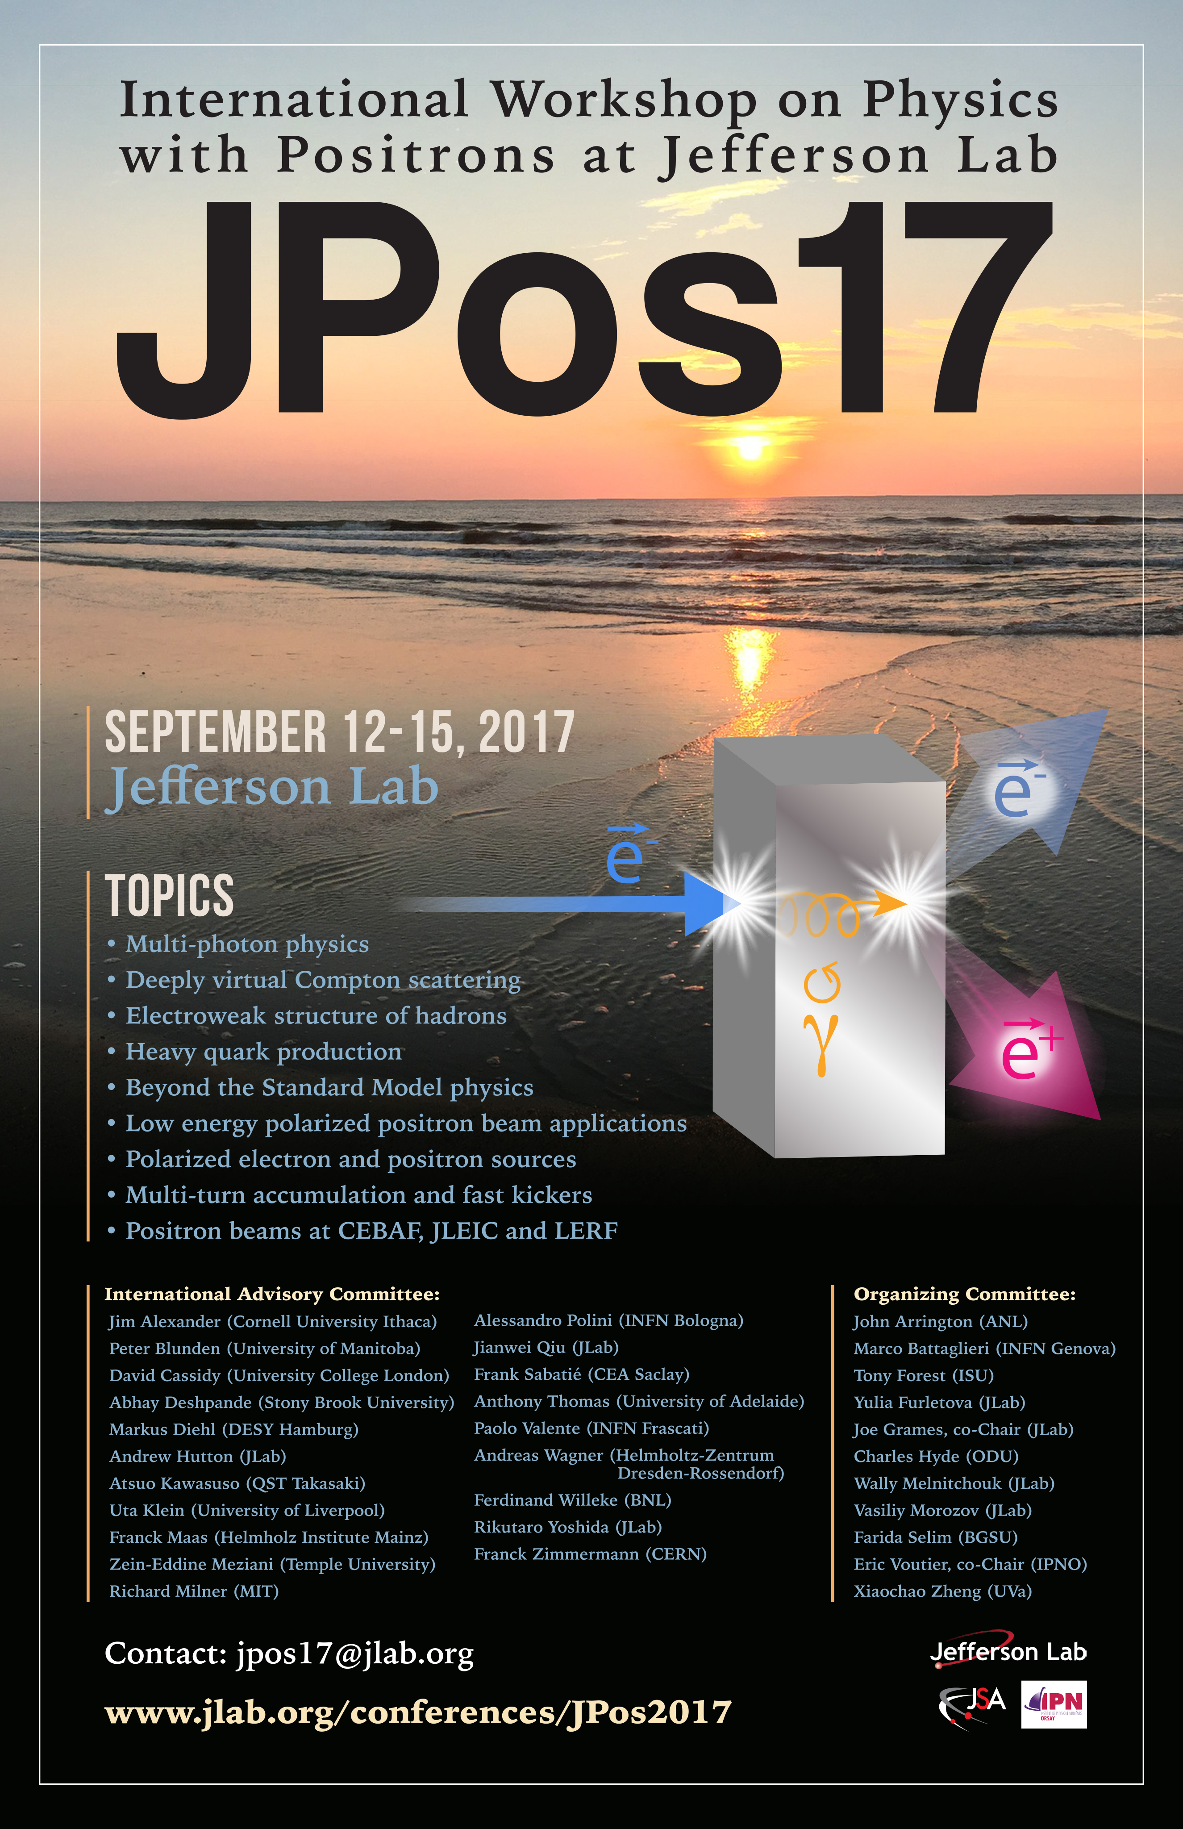
JPos17 Sep 12-15 @ Jefferson Lab
The JPos17 International Workshop, to be held mid-september at the Jefferson Laboratory, intends to review the scientific and technological bases for polarized and unpolarized positron beams in the context of CEBAF 12 GeV, JLEIC, and low energy applications.
www.jlab.org/conferences/JPos2017
The JPos17 and JLab Positron Working Group efforts will serve as a basis for the a White Paper on Positron Physics at JLab.
wiki.jlab.org/pwg pwg@jlab.org
Please Join Us !!

Slide 13
A Polarized Positron Source at CEBAF
Many factors can drive the solution (I challenge you … put three people in a room for 30 min and you’ll come up with 4 or 5 approaches!)
  Positron yield goes like the beam power
  A lower energy electron drive beam will require higher beam current, however, offers greater access selecting a compromise between positron polarization and beam intensity than a ‘hotter’ positron beam produced by high energy e- beam.
One possible solution would employ the CEBAF Full Energy Injector ~123 MeV to produce positrons.
  Collecting ~60 MeV e⁺ (optimum FoM) with ~few 10⁻⁴ e⁺/e⁻ efficiency suggests that 100’s of microAmp or perhaps 1 milliAmp polarized e⁻ beam and a high power converter (>100’s kW beam power) is required to produce a positron beam intensity I_{e+} > 100 nA with a positron polarization P_{e+} > 65%.

Slide 14
CEBAF GaAs Photocathode Evolution
Bulk GaAs
Strained GaAs:
GaAs on GaAsP
Superlattice GaAs:
Layers of GaAs on GaAsP
100 nm
100 nm
2 μm
14 Layers
625 μm
350 μm
QE ~ 5%, 30 mA/W
Pol ~ 35% @ 780 nm
QE ~ 0.2%, 1 mA/W
Pol ~ 75% @ 850 nm
QE ~ 1%, 6 mA/W
Pol ~ 85% @ 780 nm
P_{e-} 35% 35% 75% 75% 85% 89%
I_{e-} 30μA 100μA 50μA 100μA 150μA 200μA
1995 1998 1999 2000 2004 2012 2016
Spin Polarized Electron programs (particularly PV Users) have
driven the need for improved performance over last 20+ years
Notes:
FOR US AT JLAB, HOWEVER, SAW THIS AS AN OPPORTUNITY TO EXPLOIT WHAT WE’VE BEEN DOING W/ POLARIZED E- BEAMS FOR TWO DECADES
OVER THAT TIME THE SPIN PROGRAM HAS DRIVEN IMPROVEMENT
GAAS PHOTOCATHODES THAT BREAK DEGENERACY, YET RETAIN HIGH QUANTUM EFFICIENCY
THIS MEANS HIGH SPIN POLARIZATION (85%) AND HIGH QE (>1%)
LEARNING HOW TO SUSTAIN THIS FOR LONG PERIODS MAKES THIS VIABLE

Slide 15


Lifetime studies at mA Beam Current
High current (1-10 mA) studies with low-P photocathodes demonstrated that charge lifetime is improved by increasing laser spot size (spreading out ion damage).
Measurements are underway using the CEBAF polarized source to characterize lifetime vs. spot size with high-P (>85%) photocathodes.
Phys. Rev. ST Accel. Beams 14, 043501 (2011)
CEBAF Polarized Inverted Load Lock Gun
Slope is proportional to QE Decay
Increasing laser size reduces QE decay proportionally
1mA

Slide 16

Polarization Studies at mA Beam Current
CEBAF Mott Polarimeter
For the first time, the spin polarization of a high-P superlattice photocathode is measured directly from low to milliAmpere intensity.
The spin polarization of a high current (mA) beam is measured at CEBAF by extracting and accelerating a small fraction of the beam to a sub-percent accuracy Mott polarimeter.

Slide 17
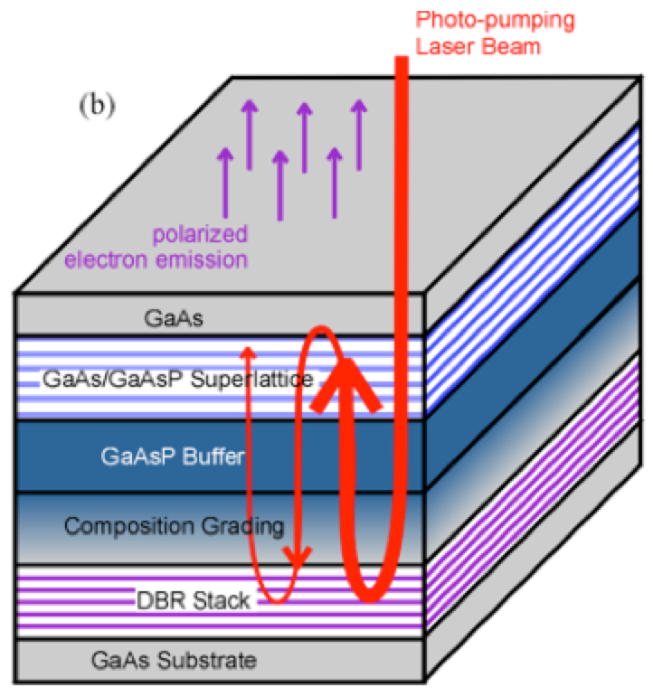
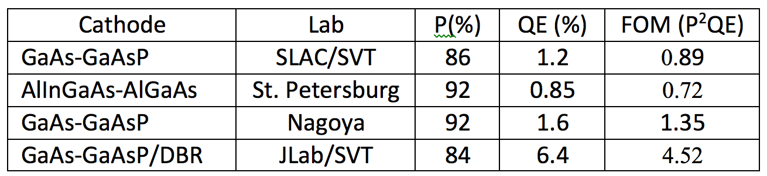
High Polarization Photocathode R&D
GaAs/GaAsP superlattice photocathode with GaAsP/AlAsP Distributed Bragg Reflector (DBR)
The highest QE & FOM of any reported high polarization photocathode
CEBAF
SLSP
Photocathode
DBR Stack
DBR (R&D)
Substrate
Paper ready for APL submission: W. Liu, S. Zhang, M. Stutzman, M. Poelker, Y. Chen, W. Lu, and A. Moy

Slide 18
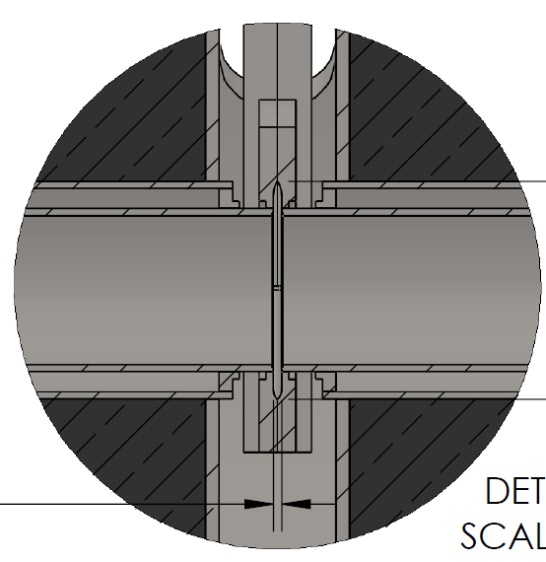
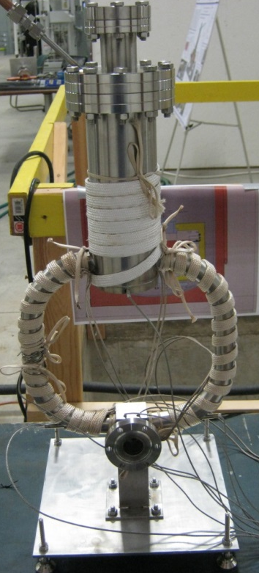
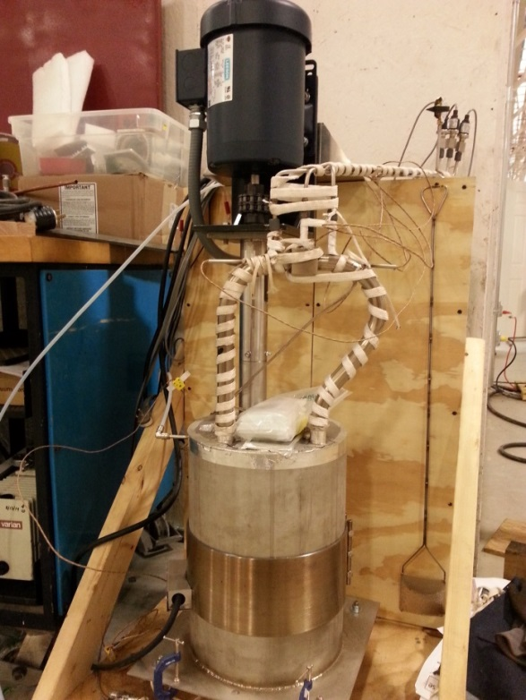
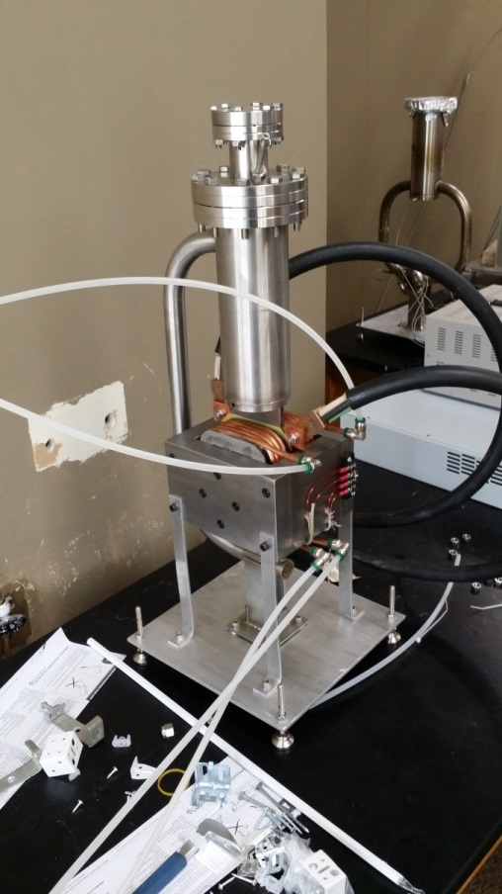

High Power Target R&D
Liquid Metal Target – lead-bismuth eutectic (LBE)
  High Z = 82, 83
  Low melting point: 124°C
  High boiling point: 1670°C
Multiple LBE targets tested on various accelerators
  Natural Circulation
  Mechanical Pumping
  Electromagnetic Pumping
Approaching 10 kW power level, CW
Stainless Steel Windows (0.25mm)
LBE (2mm)
Output (e⁻,e⁺,γ)
Input (e⁻)
Slide courtesy of James McCarter

Slide 19
Summary
The PEPPo technique provides access to highly spin-polarized positrons in a reliable, radioactive-less, and low-cost method, opening access to a wide community.
A high-energy polarized positron beam program in the context of CEBAF 12 GeV (and JLEIC) based on the PEPPo technique is being explored.
Your attendance and input at JPos17 is welcomed, please visit: https://www.jlab.org/conferences/JPos2017/
If you would like to participate in the newly formed Jefferson Lab Positron Working Group please visit: wiki.jlab.org/pwg

Slide 20
Back Up Slides

Slide 21
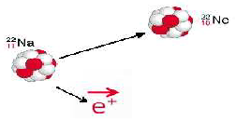




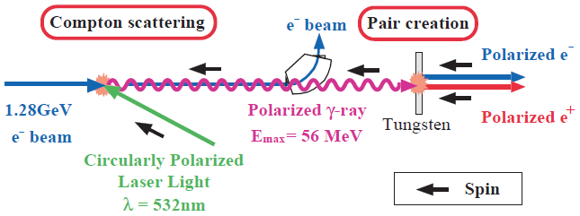
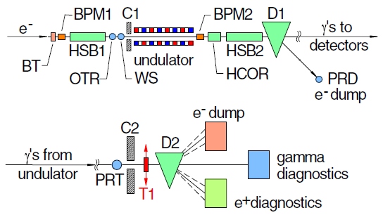
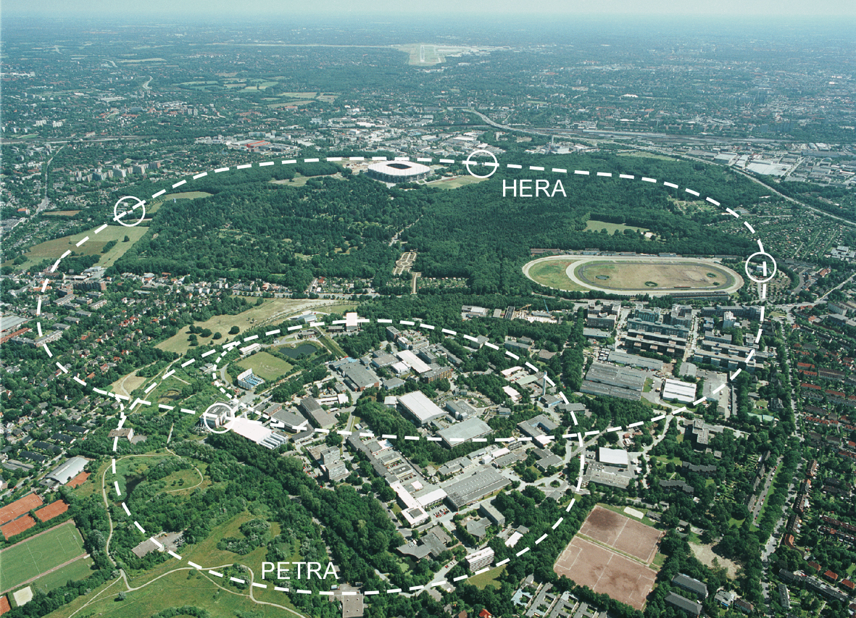
Collecting Polarized Positrons
Polarized β⁺ Decay
L.A. Page & M. Heinberg. Phys. Rev.
106(6):1220-1224 (1957)
Sokolov-Ternov Effect
D. Barber , AIP Conf. Proc. 588, 338 (2001)
HERA 27.5 GeV e+/e-
Polarized due to parity non-conservation in the weak interaction
P(e⁺) ~ 40 %
P(e⁺) ~ 70 %
Compton Backscattering (KEK)
T. Omori et al, PRL 96 (2006) 114801
Helical Undulator (SLAC E166)
G. Alexander et al, PRL 100 (2008) 210801
47.7GeV
P(e⁺) = 73 ± 15_{(stat)} ± 19_{(syst)} %
P(e⁺) = 80 ± 7_{(stat)} ± 9_{(syst)} %
Notes:
TO PROVIDE SOME CONTEXT, POLARIZED POSITRONS CAN BE COLLECTED IN A NUMBER OF WAYS
BETA DECAY – WEAK INTERACTION (NOT EFFICIENT FOR RF ACCEL)
ST – QUANTUM EMISSION OF SYNC. RAD. (NOT COMPATIBLE W/ CW BEAM)
PAIR PRODUCTION BY POLARIZED GAMMAS (PLAUSIBLE, BUT HIGH TECHNICAL CHALLENGE – INTENSE LASERS, HIGH ENERGY BEAMS)
WE WONDERED IF WE COULD SIMPLY USE OUR POLARIZED ELECTRON BEAM

Slide 22
CEBAF Polarized Electron 10 MeV Injector
PEPPo ran at the CEBAF injector, taking advantage of the existing beam diagnostics that determine with precision the properties of the polarized electron beam entering the PEPPo apparatus.
Intensity controls
10 pA – 1 µA
Energy measurement
dp/p < 0.5%
Polarization measurement
dP/P < 2%
Laser
PEPPo
Polarization controls
    30 Hz fast heilicity reversal (delayed)
    Slow laser polarization reversal (half-wave plate)
    4π spin rotator
Variable energy
3.1-8.2 MeV/c

Slide 23
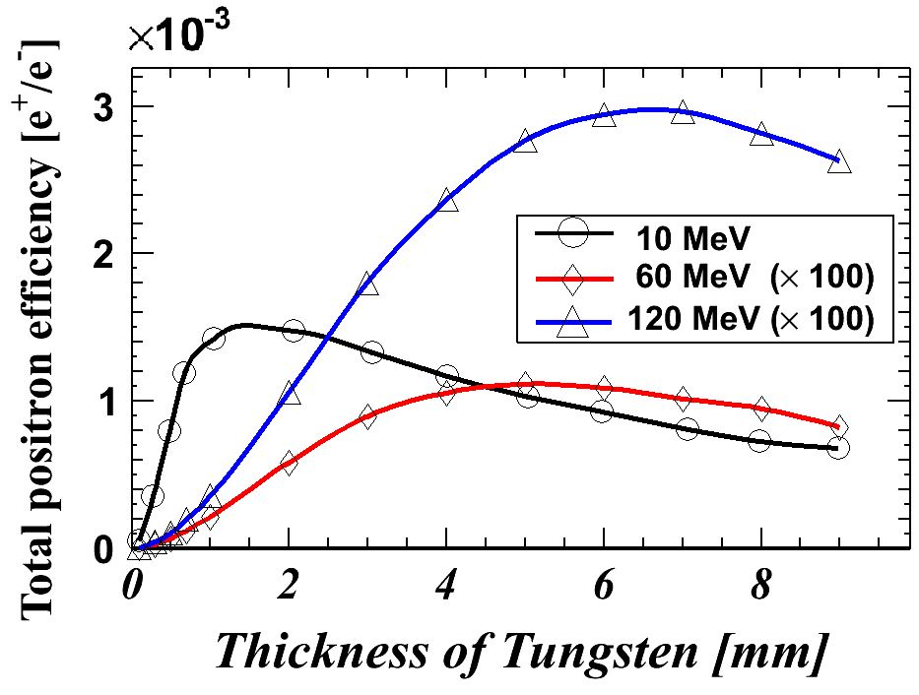
Positron Yield using 10 MeV Electrons
Electro-magnetic Shower
e⁺ yield ~ e⁻ beam power (E*I)
High Z-target increases yield
Operate at low energy below photo-neutron threshold to mitigate radioactivity
10 MeV e⁻ shower
e⁺/e⁻ yield ~ 0.1 % (optimized)
Collection efficiency ~ 1-10 %
>100nA e⁺ at IP2 for CEBAF => >1.0 milliAmp e⁻ beam

Slide 24
Polarized Positrons at JLEIC
A group (J. Grames, J. Guo, F. Lin, V. Morozov, E. Voutier, Y. Zhang) is exploring a polarized positron injector suitable for Jefferson Lab Electron Ion Collider (JLEIC).
L ≥10³³cm⁻²s⁻¹ P_{e+}≥40%
(An Early Career Award proposal will be submitted.)
e⁺
Bunch structure from an e⁺ injector:
68.1 MHz bunch train, 1.6 us
110 bunches (I = 4.6 uA)
67 fC
×30
A pulsed positron beam with low average current (>10 nA) is required for injection into JLEIC with a reasonably short injection time (minutes) and reasonably high equilibrium polarization (>40%).
…
35 μs
1.05 ms
20 ms
~ 50 Hz, I_{ave}= 10.5 nA
J. Grames, SPIN 2016 @ UIUC, Sep 26-30 2016
24

Slide 25
JLEIC/CEBAF Positron Injector
Polarized
Electron
10 MeV Injector
500-Turn
Accumulator Ring
(22m)
Harmonic
Extraction Ring
(22m)
Positron Conversion/Collection Efficiency ~ 10⁻⁴
Bunch
Management
to CEBAF/JLEIC
10 MeV polarized e⁻
1.33 pC @ 1500 MHz
10 MeV pol e⁻
0.67 nC bunches
@ 1500 MHz
10 MeV polarized e⁻
0.67 nC @ 68.1 MHz
5-7 MeV Polarized e⁺
67 fC @ 68.1 MHz
 | Polarized Electron Source | Accumulator/ Extractor Rings | Electrons at Converter | Polarized Positron Source | R&D Challenge
JLEIC | Ave = 100 μA 1.33 pC @ 1500 MHz 2 mA w/ DF=5% | Ave = 1 A 1500 MHz | Ave = 100 uA 68.1 MHz 44 mA @ DF=0.23% | Ave = 10 nA 68.1 MHz 4.4 uA @ DF = 0.23% | Electron accumulator Harmonic extraction Target: 440 kW peak
CEBAF | Ave = 1-10 mA 4-40 pc @ 250 MHz (cw) | Not Necessary | Ave = 1-10 mA 250 MHz (cw) | Ave = 100 nA - 1 μA 250 MHz (cw) | High-QE photocathode High voltage gun Target: 10-100 kW ave
Slide courtesy of Fanglei Lin
J. Grames, SPIN 2016 @ UIUC, Sep 26-30 2016
25

