Slide 1
GPT Simulations for Jay’s Solenoids
Alicia Hofler, Jay Benesch, Reza Kazimi, and Joe Grames

Slide 2
Outline
Jay’s solenoid models vs. beam measurements
Single solenoid behavior comparison
Solenoid behavior in chopper system
Conclusion

Slide 3
Fopt: Poisson vs. Opera3d Models of Installed Solenoids: FD, FA, FG, FL

Slide 4
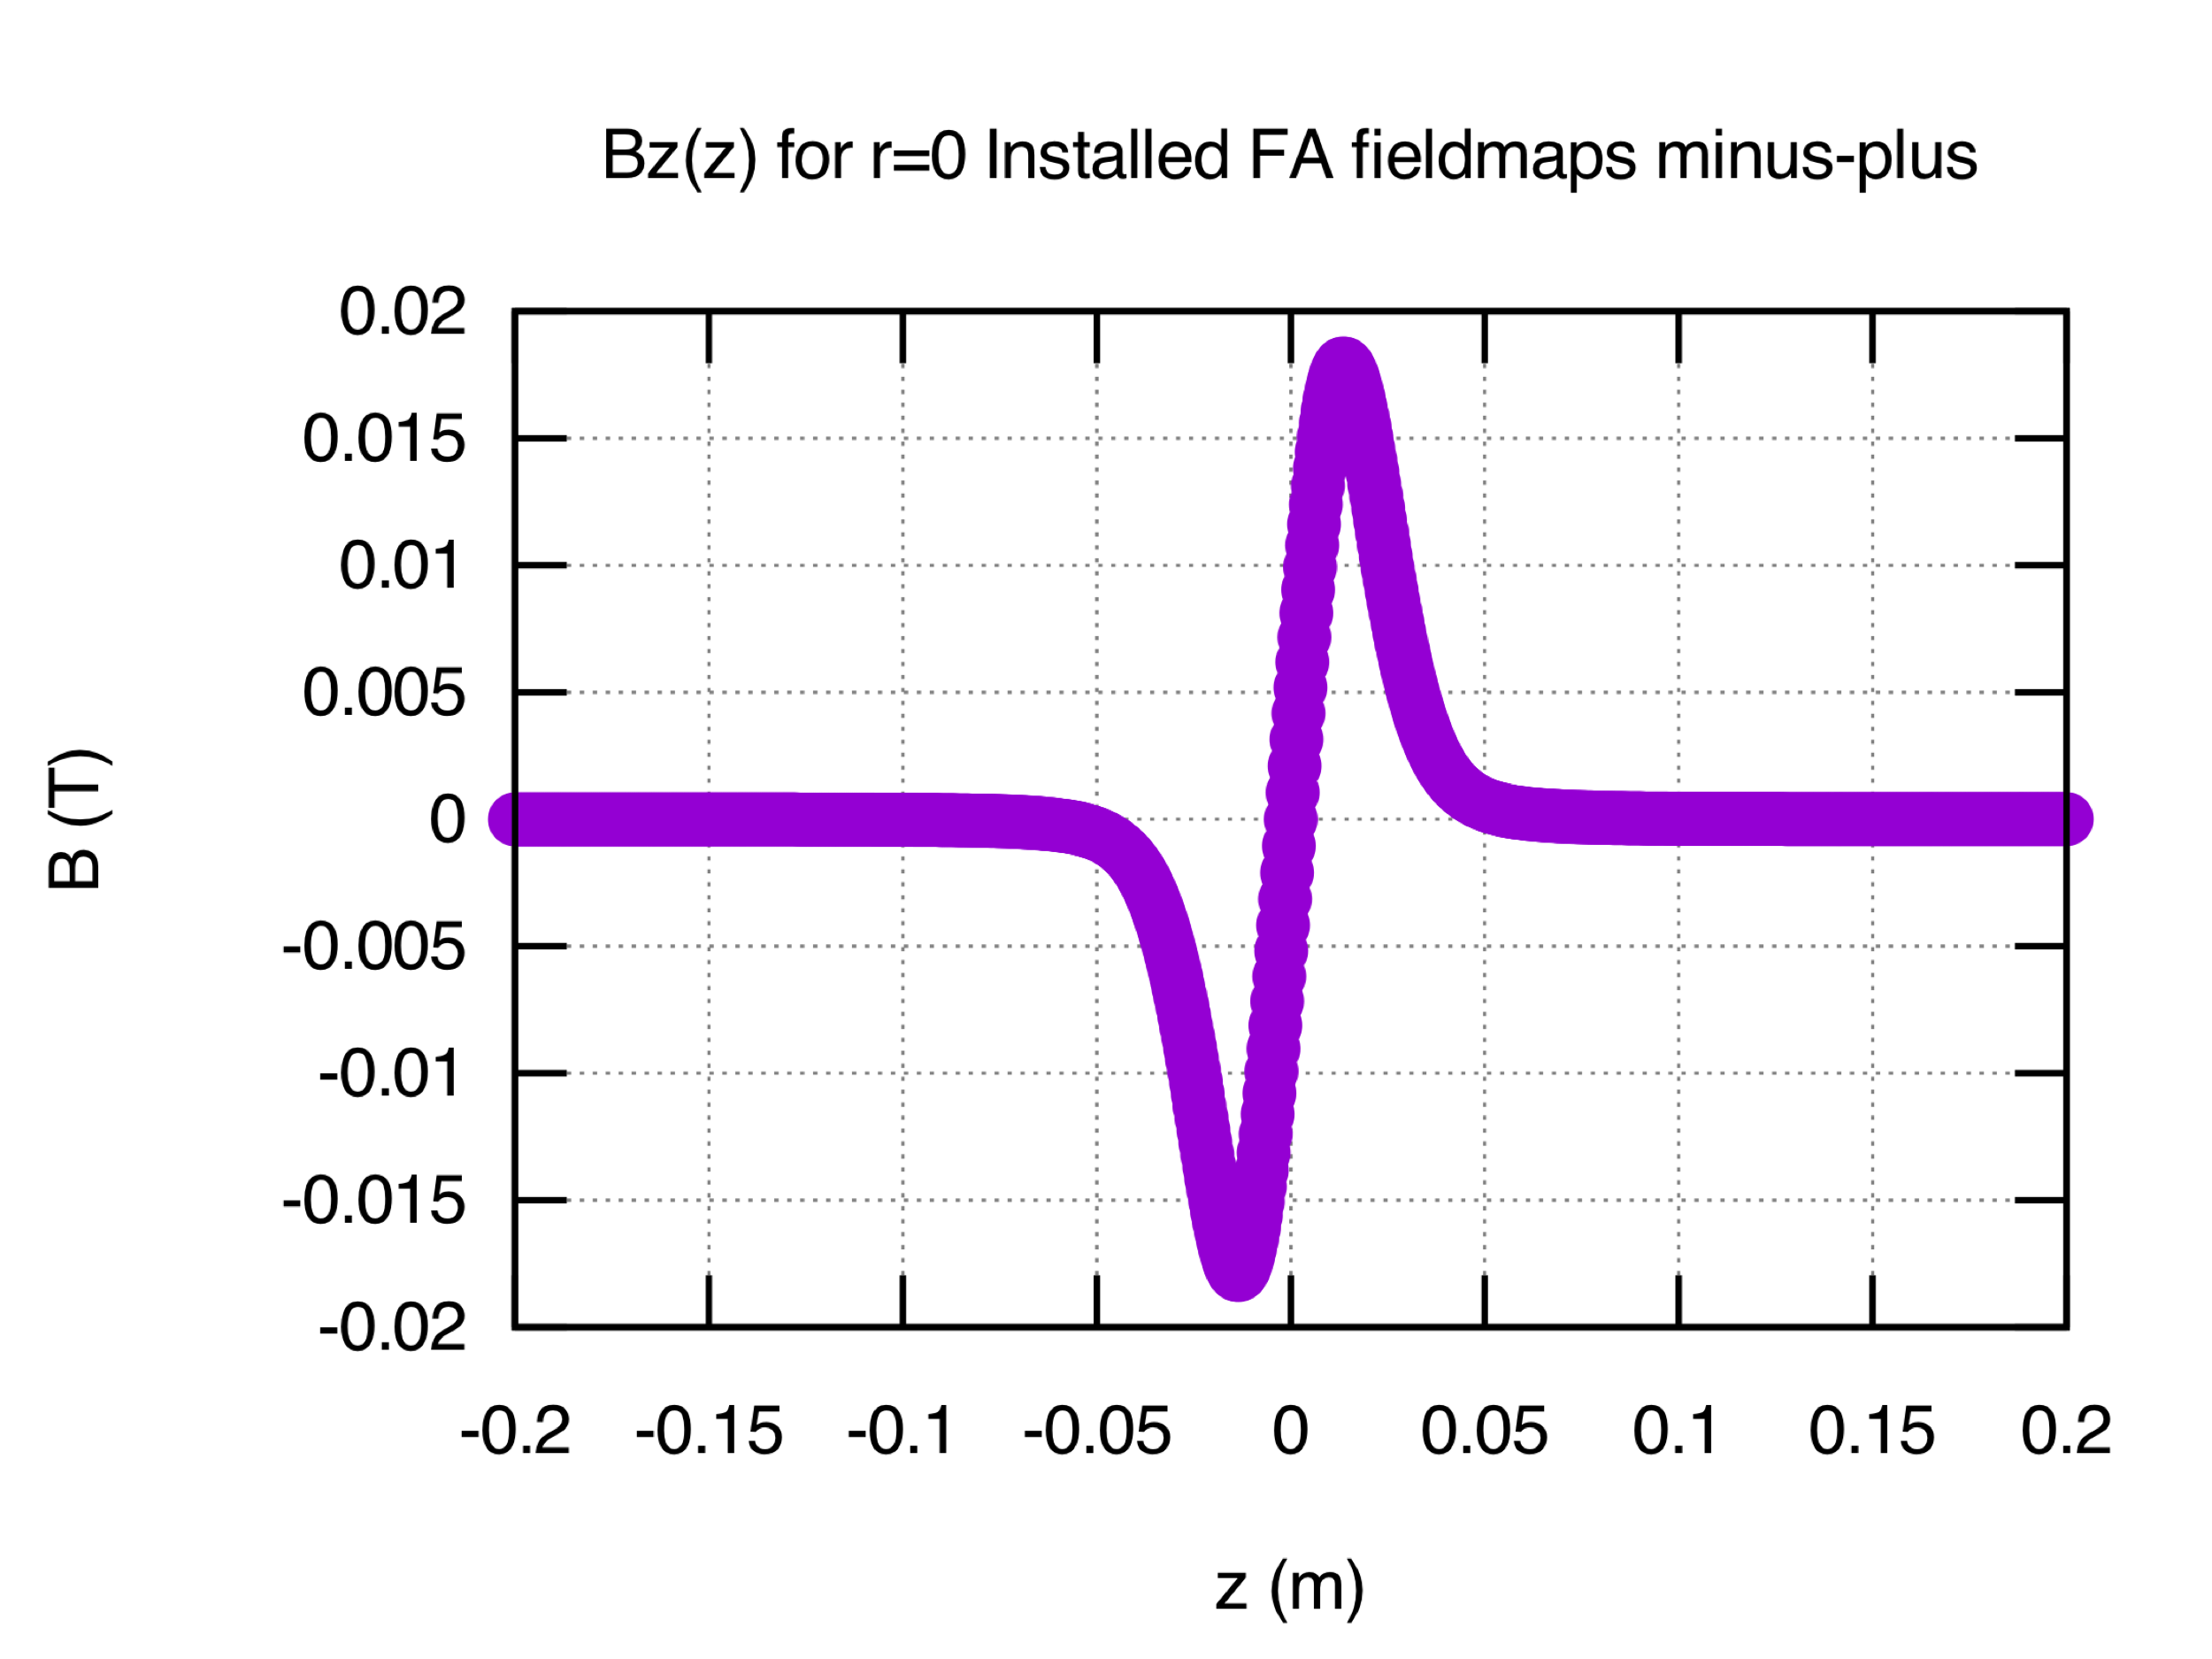
Jay’s New Design as FD and FA: Stand Alone Assessment

Slide 5
FD: Behavior at 15 mm

Slide 6
FD: Behavior at 15 mm

Slide 7
FA: Behavior Near Solenoid Center

Slide 8
FA: Behavior Near Solenoid Center

Slide 9
FD and FA: Residual Horizontal Displacement

Slide 10
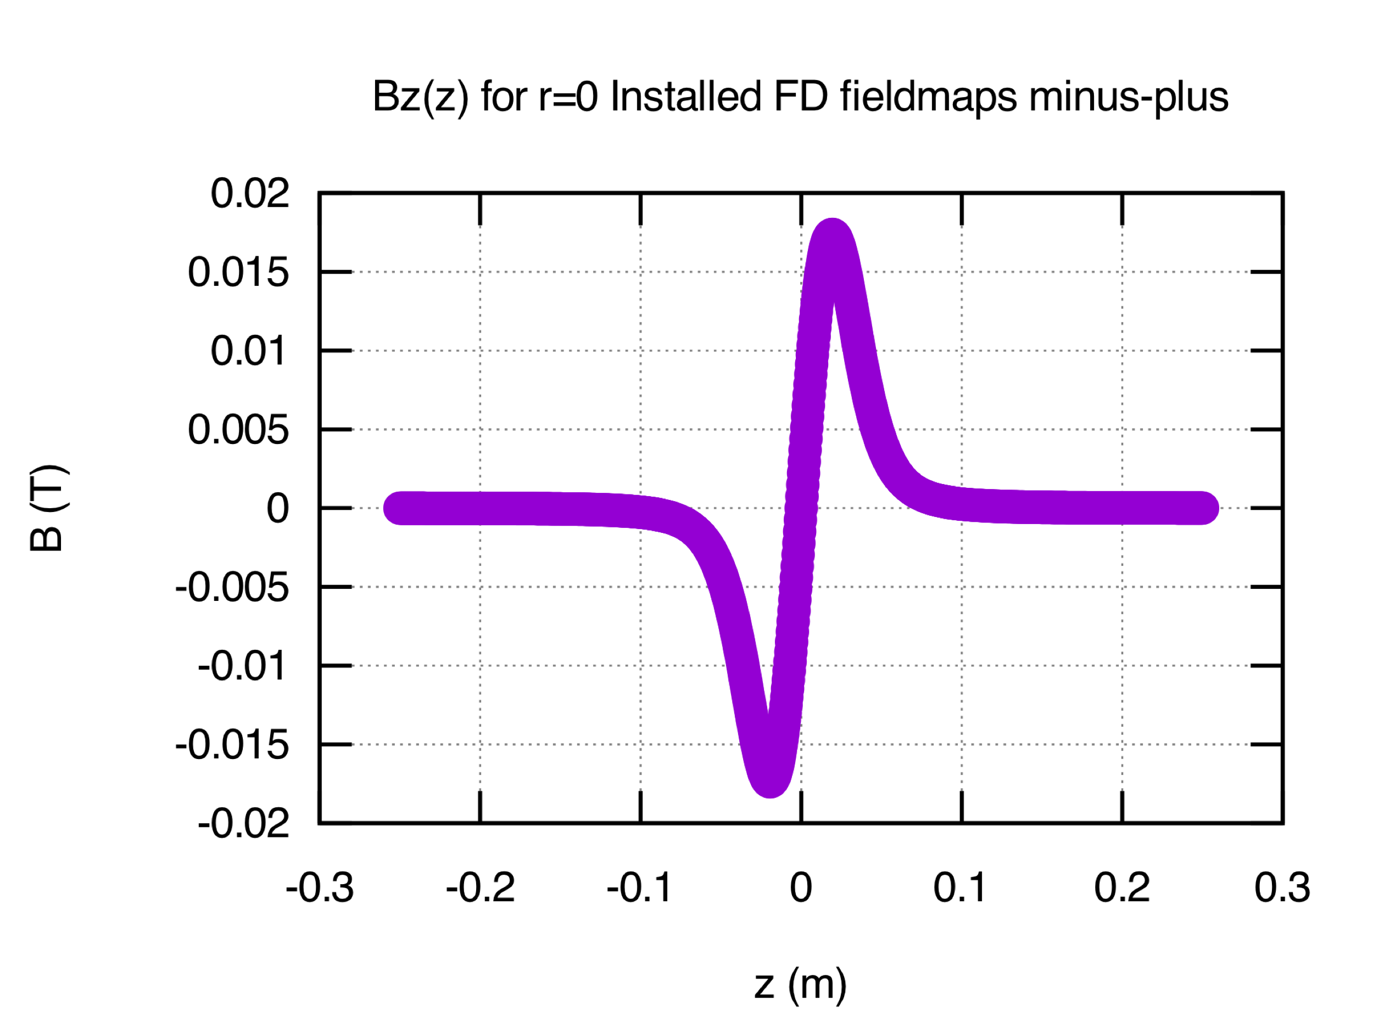
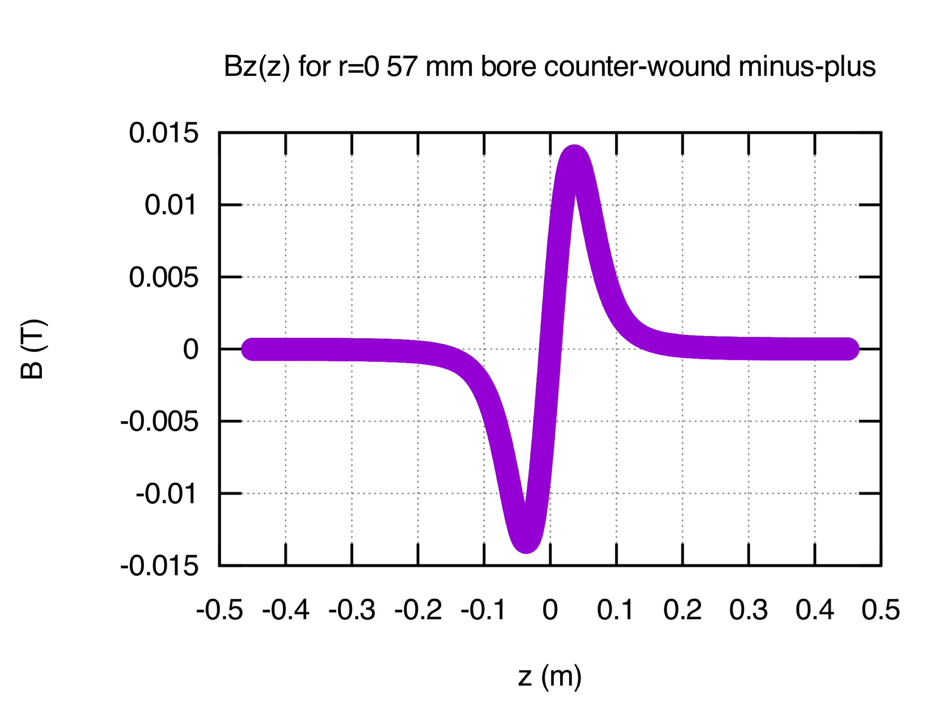
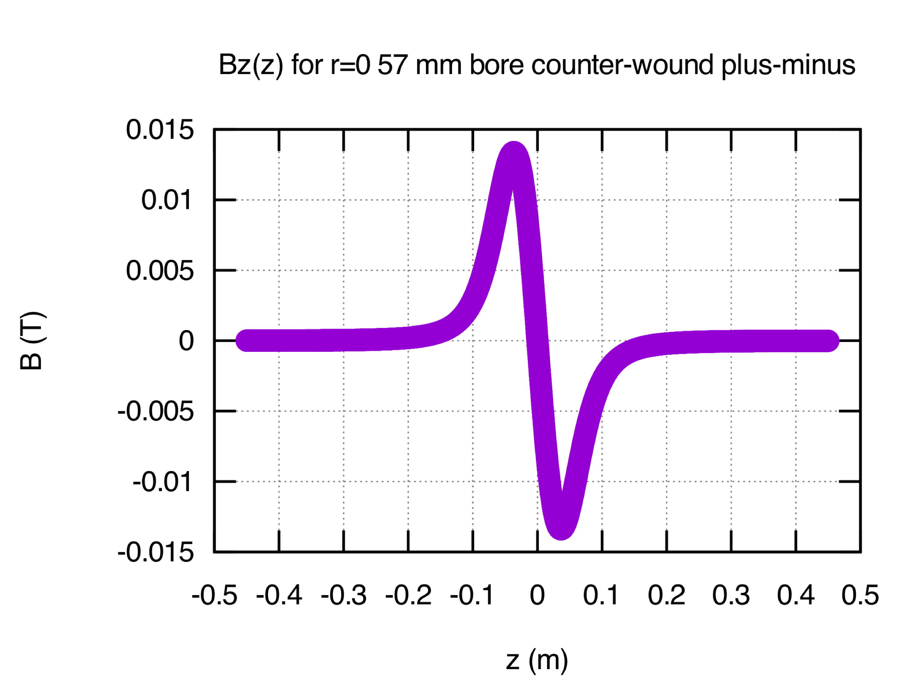
Jay’s New Design as an FD in Chopper System
Installed FD field sense (a.k.a. mpmp)
FD1: -Bz +Bz
FD2: -Bz +Bz
Compare new design
Following installed FDs
Alternate FD2: +Bz –Bz (a.k.a. mppm)

Slide 11
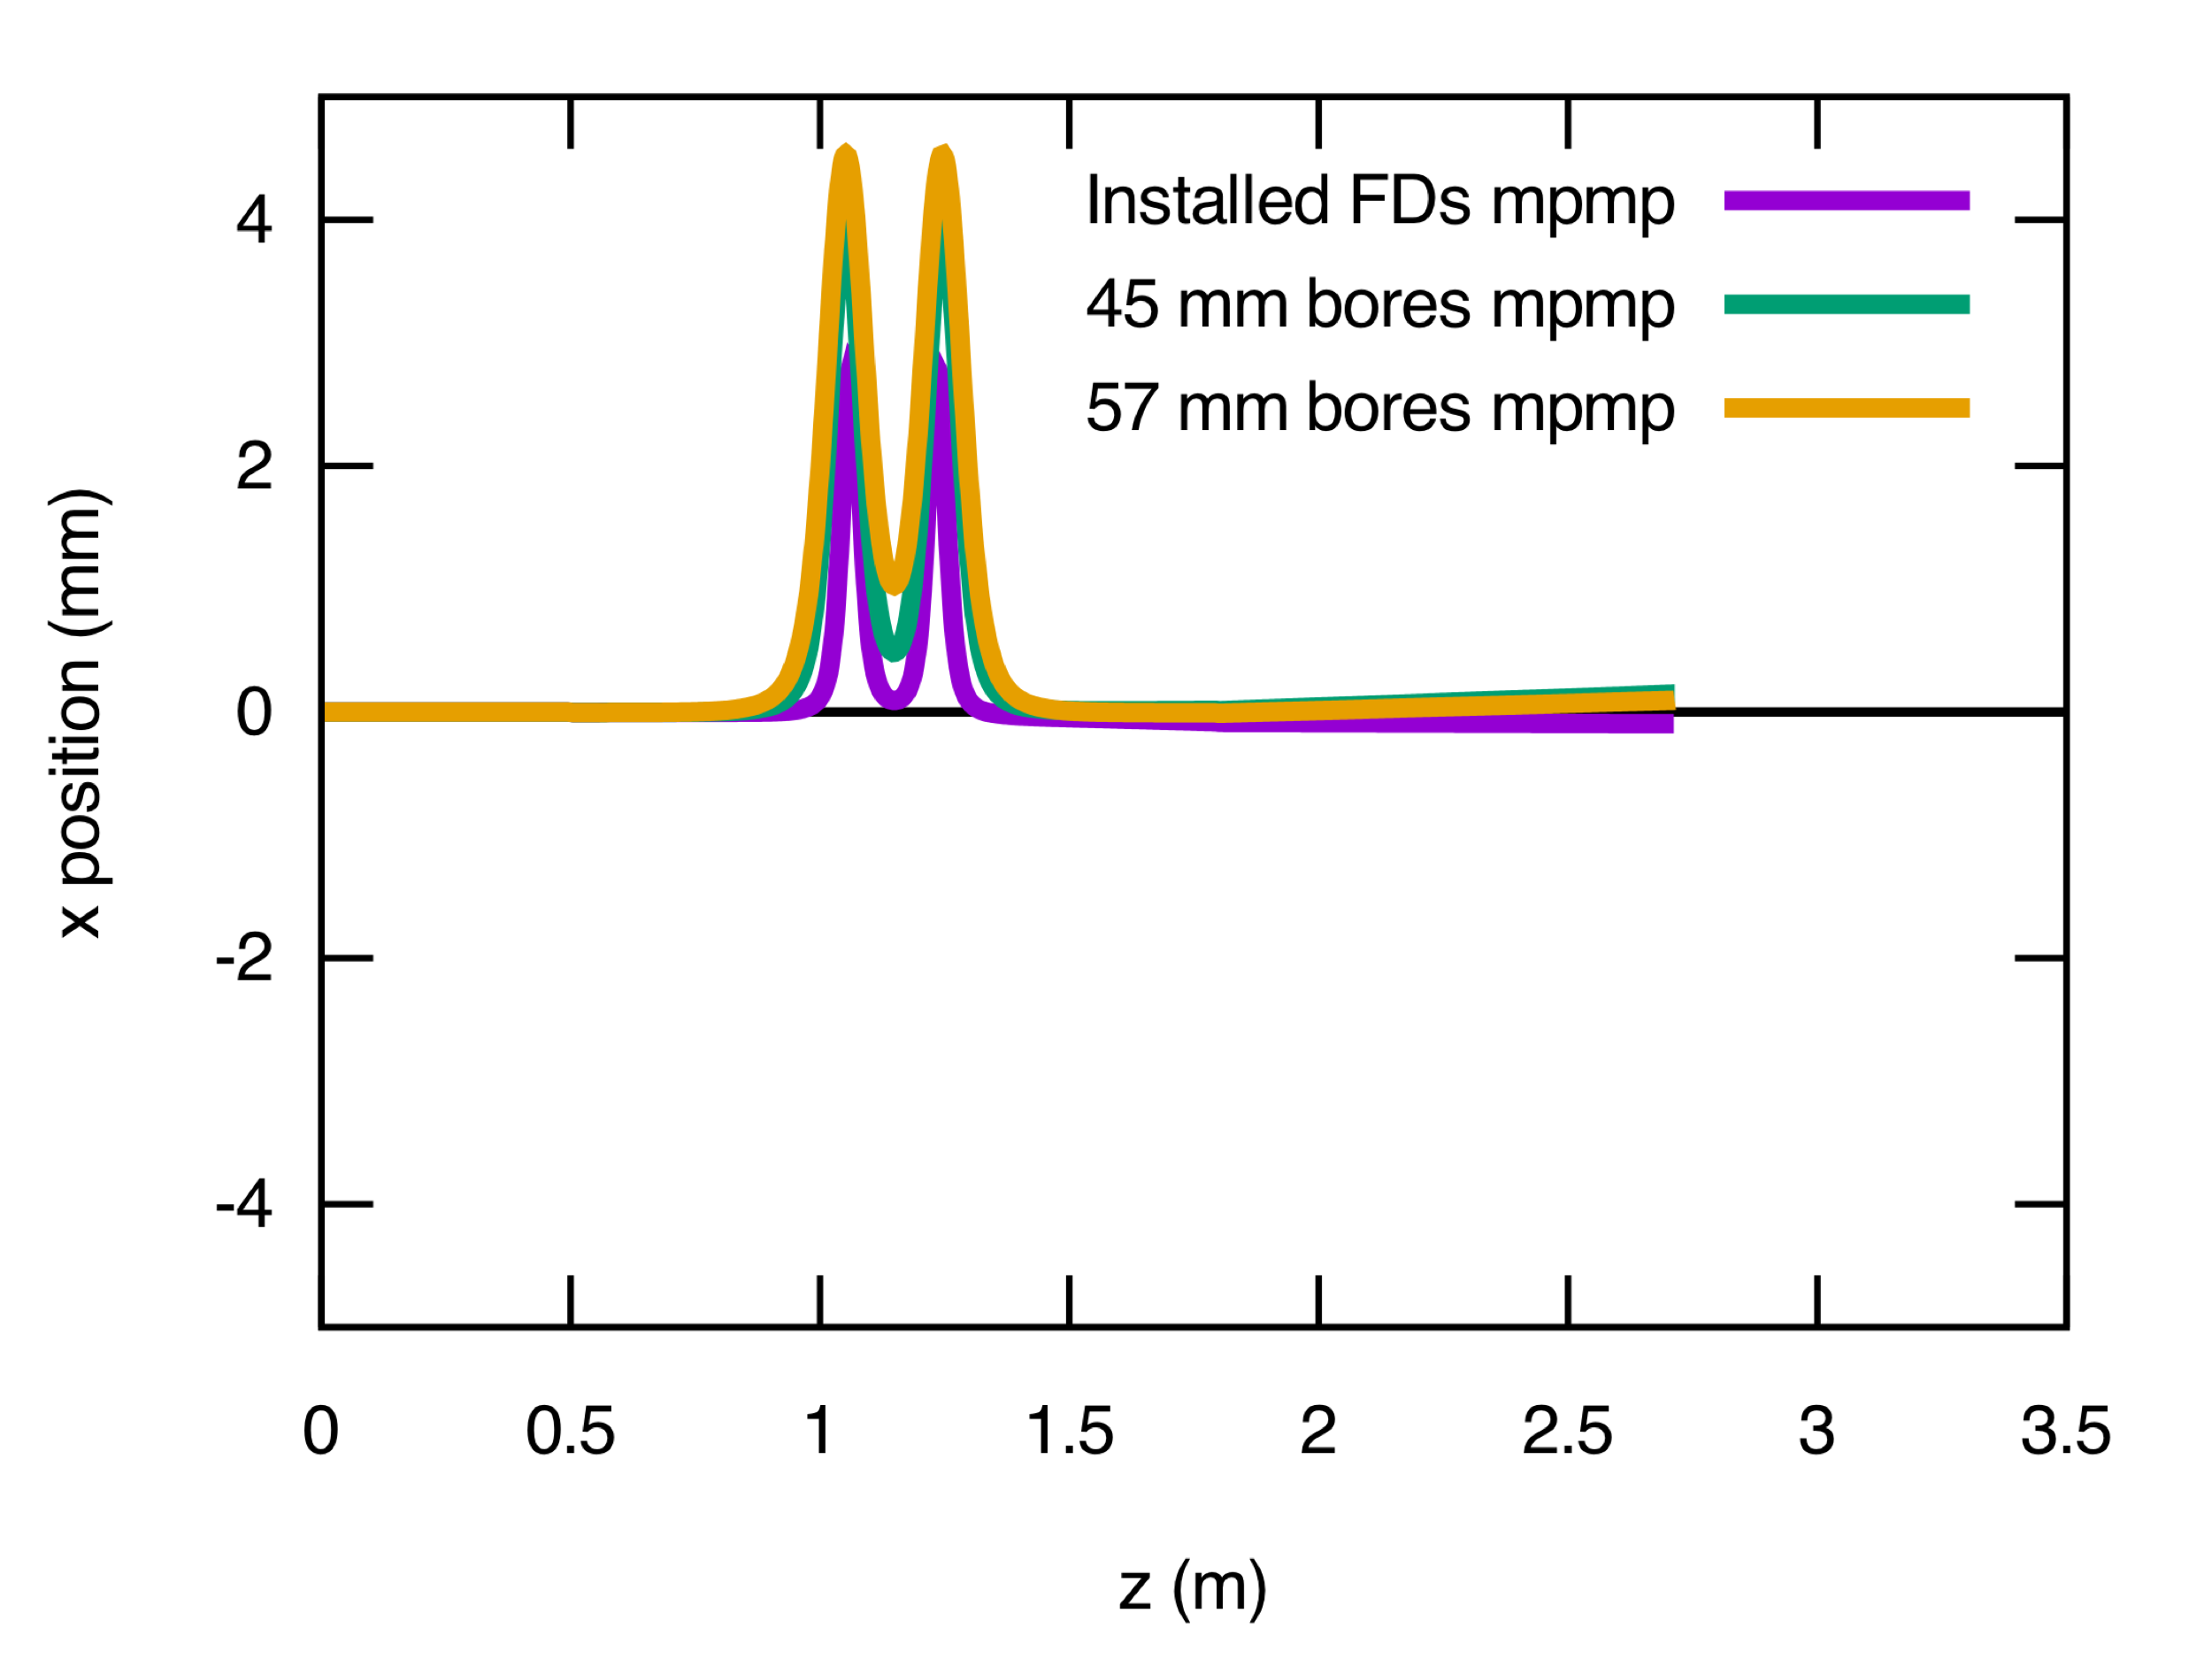
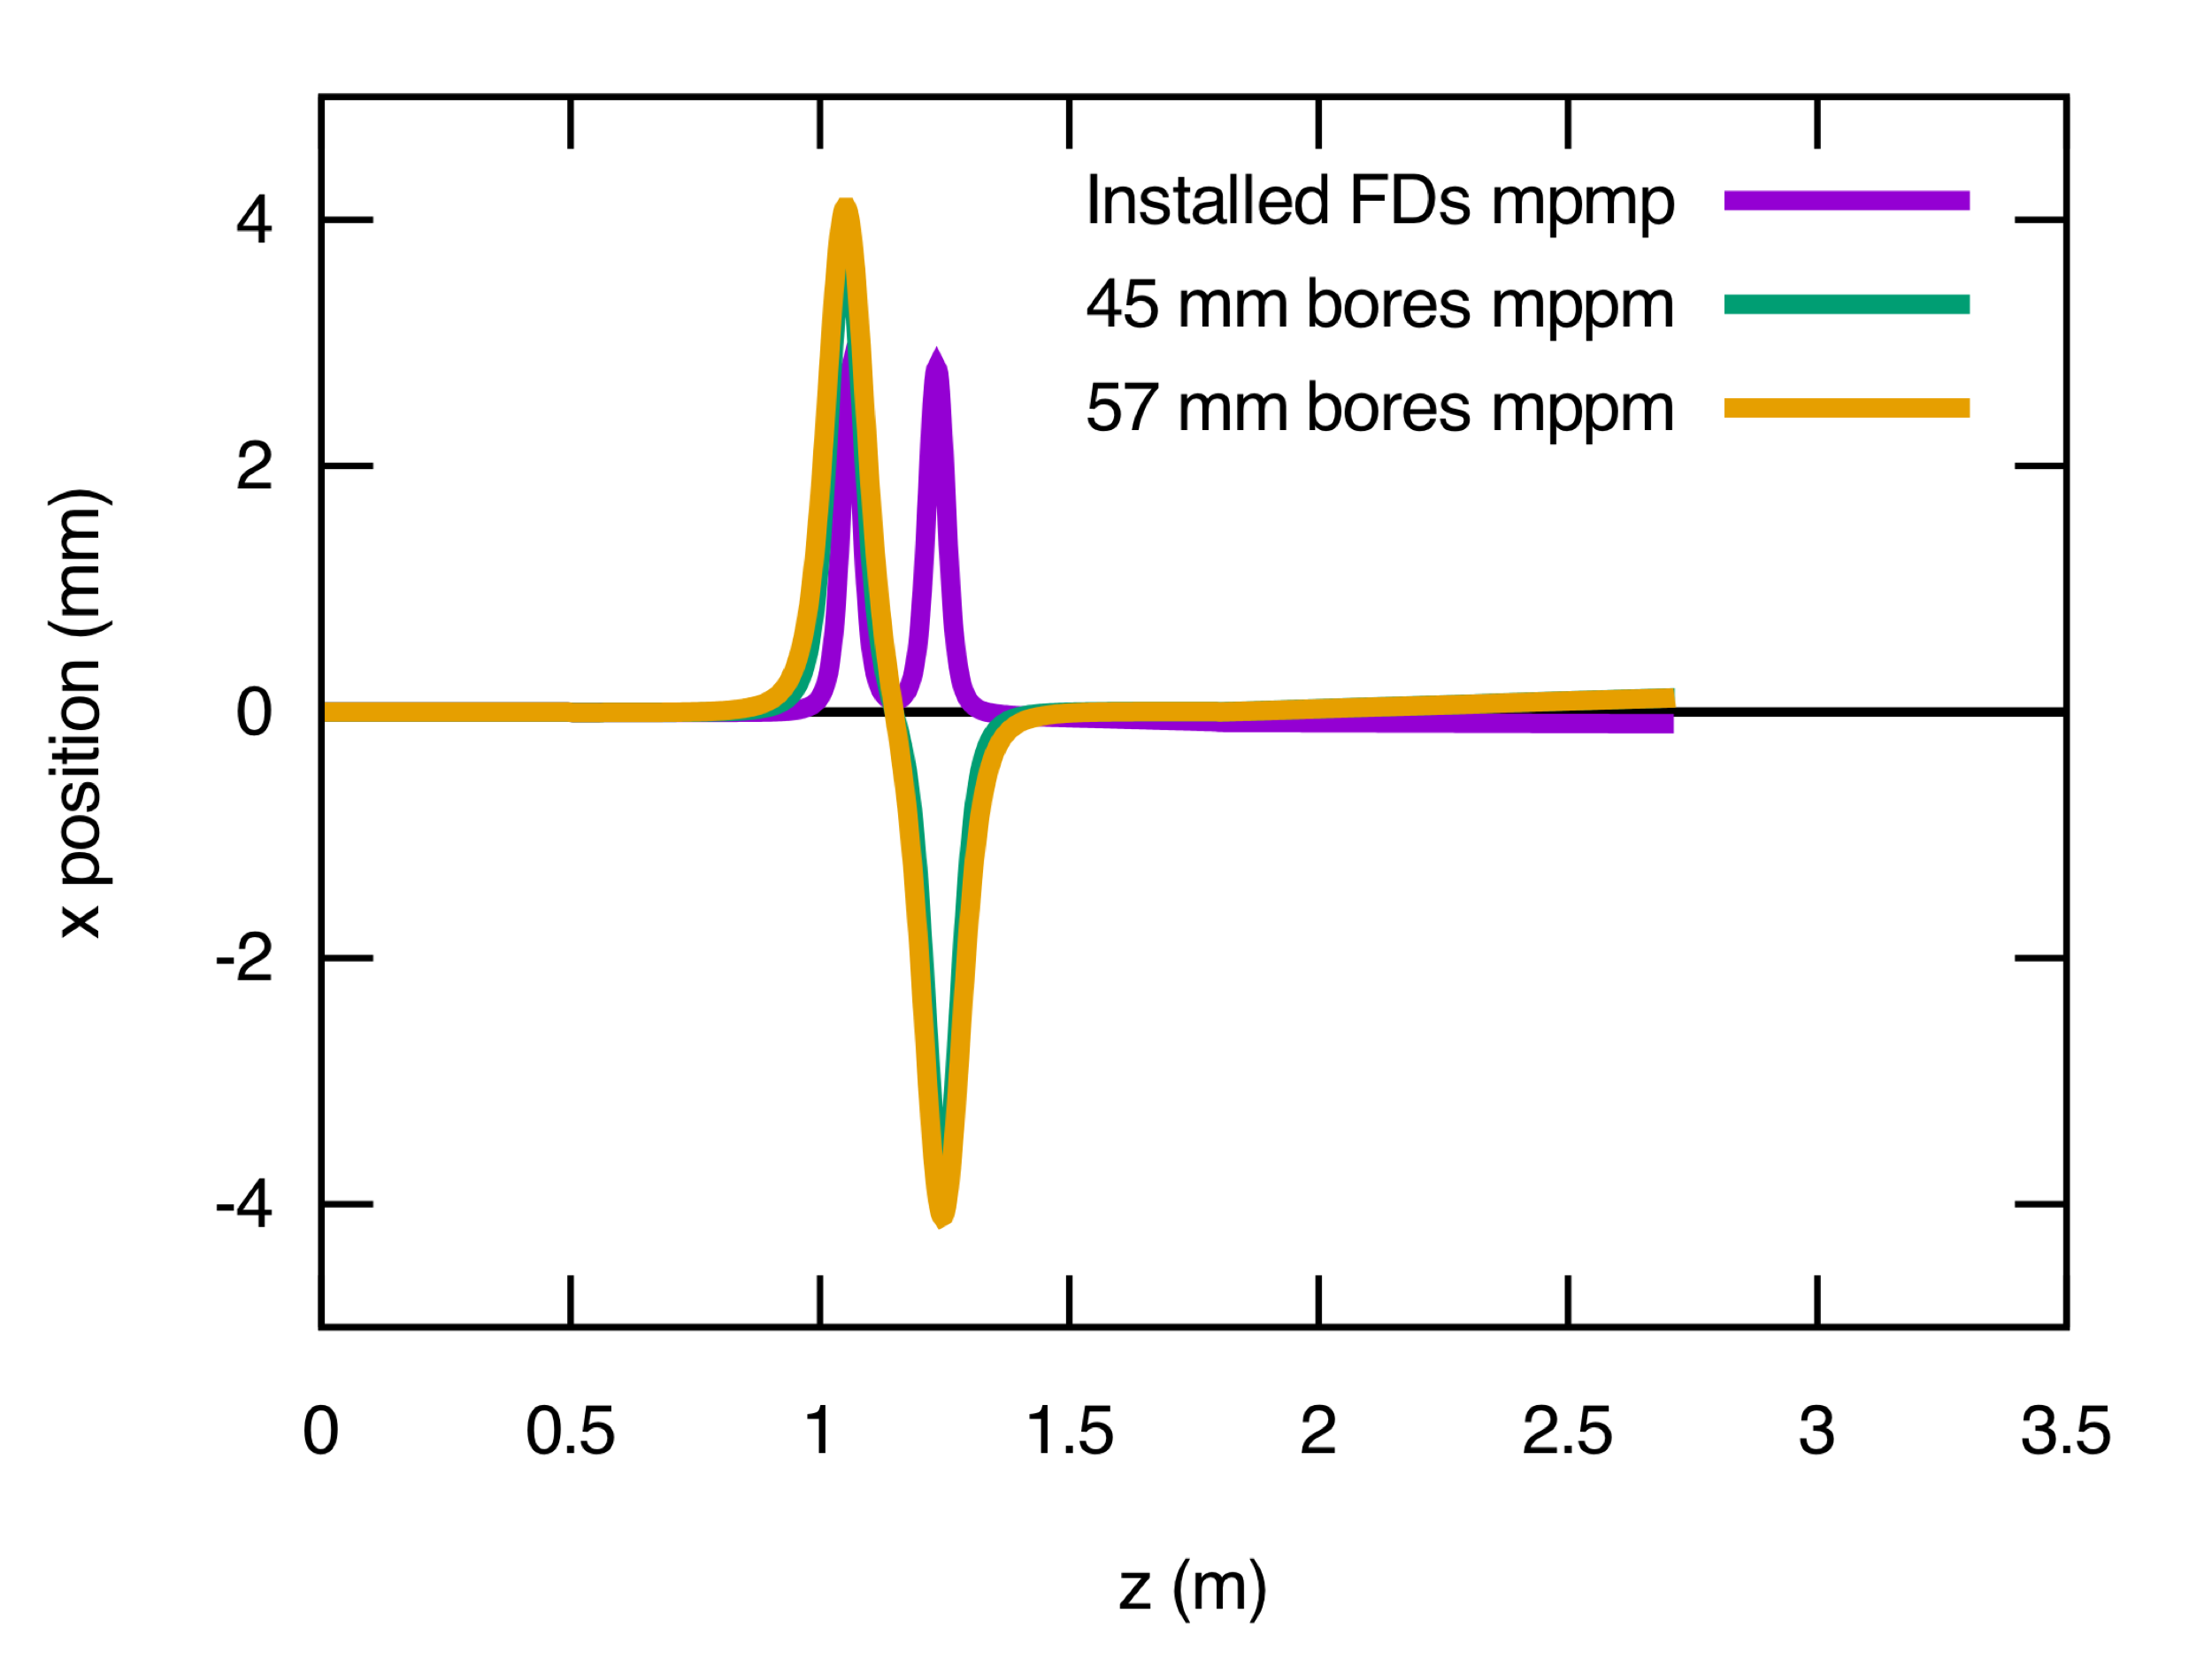
FD Relative Field Orientations: Optimal RF and Solenoids

Slide 12
Chopper 1 and 2 X/Y ON Optimal RF and Solenoids – Master Slit

Slide 13
Chopper 1 and 2 X/Y ON Lower RF Amplitude – Master Slit

Slide 14
Chopper 1 and 2 X/Y ON Higher RF Amplitude – Master Slit

Slide 15
Chopper 1 and 2 X/Y ON Optimal RF and Solenoids – Downstream CH2

Slide 16
Chopper 1 and 2 X/Y ON Lower RF Amplitude – Downstream CH2

Slide 17
Chopper 1 and 2 X/Y ON Higher RF Amplitude – Downstream CH2

Slide 18
Chopper 1 and 2 Y ON Optimal RF and Solenoids – Master Slit

Slide 19
Chopper 1 and 2 Y ON Lower RF Amplitude – Master Slit

Slide 20
Chopper 1 and 2 Y ON Higher RF Amplitude – Master Slit

Slide 21
Conclusion
Jay’s new design is a viable replacement for all injector solenoids
In the chopper, the field arrangement for the new design must be modified from mpmp to mppm given the z displacement of the hall slits in the chopping chamber.
The mppm arrangement should be checked with beam for operational sensitivities.

