Slide 1
1 mm radius blend in
5.5 mm diameter hole

Slide 2
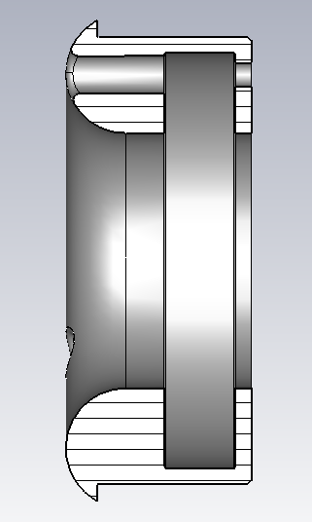
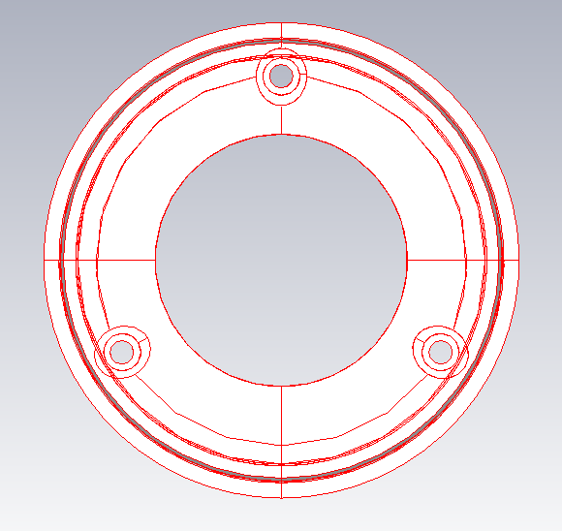

Slide 3
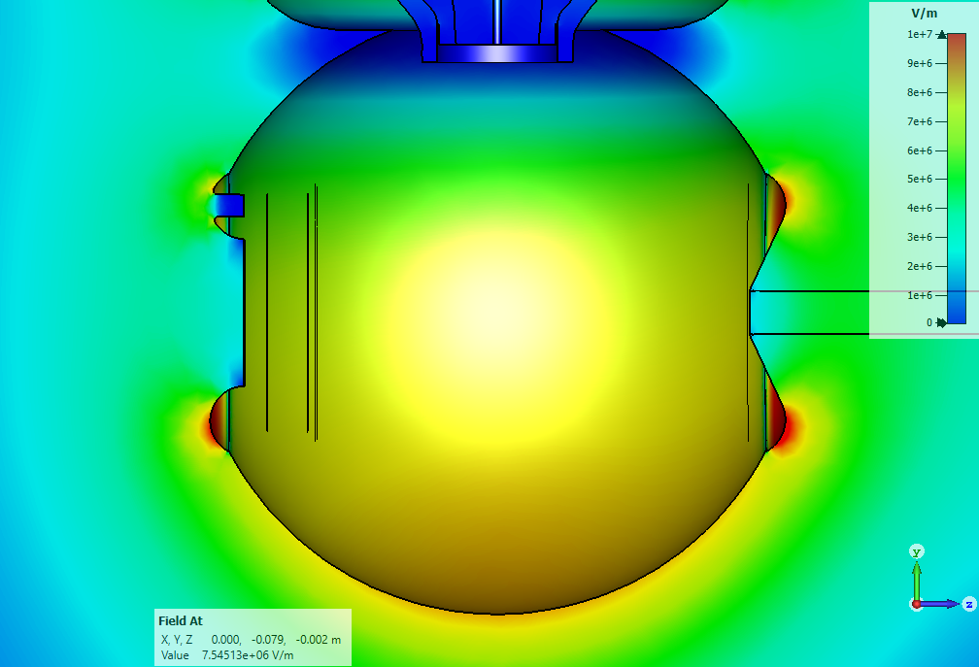
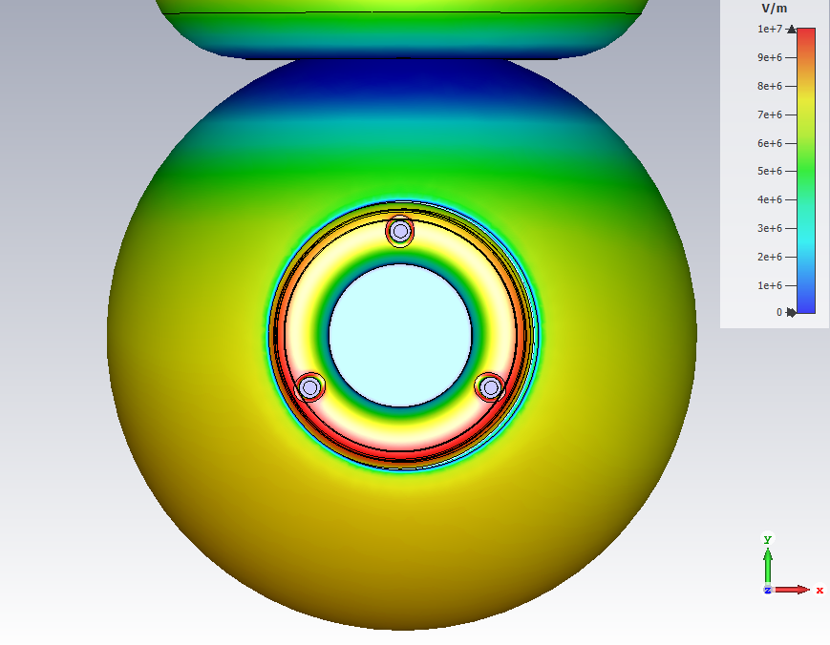
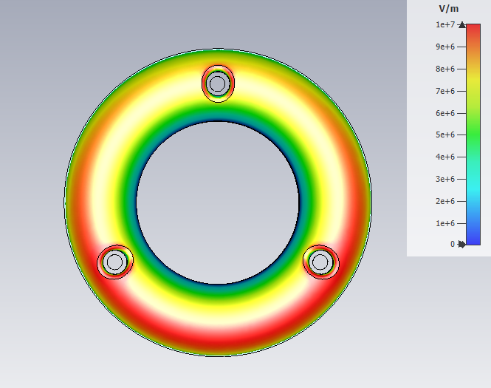
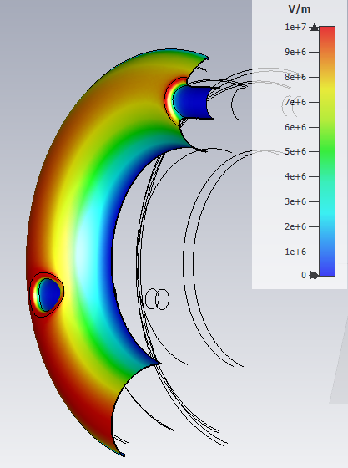
Cathode with Pierce geometry
-350 kV
10.8 MV/m
12 MV/m
13 MV/m
10 MV/m

Slide 4
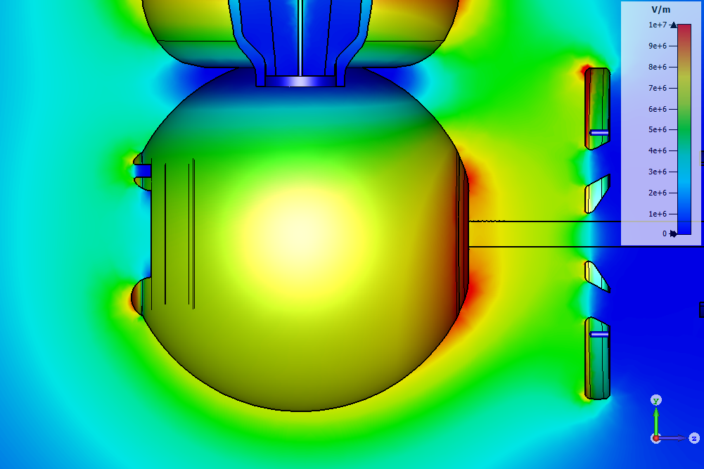
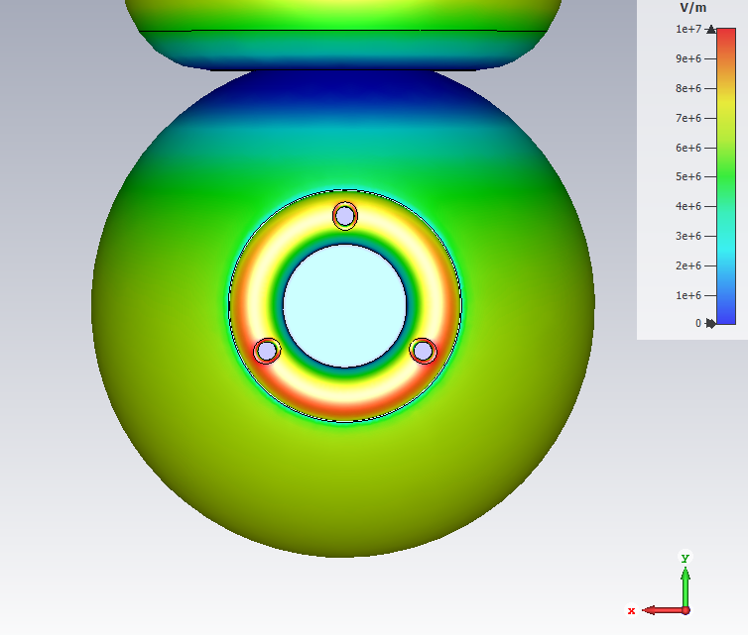
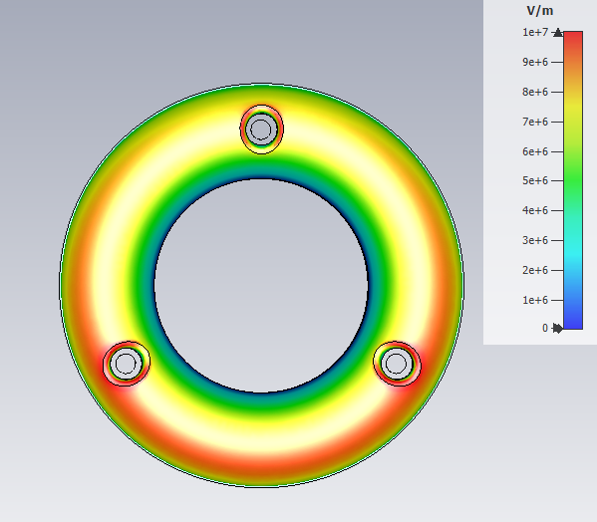
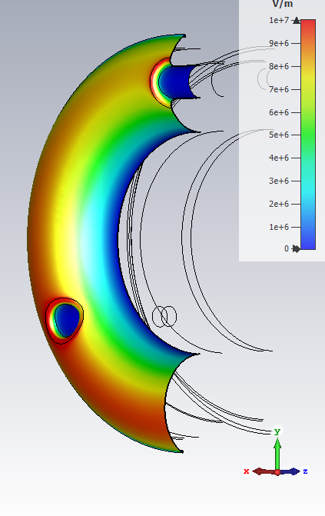
Flat cathode front
Hole diameter: 5.5 mm
Blend radius: 1 mm
-350 kV
10 MV/m
12 MV/m
12 MV/m
9.3 MV/m

Slide 5
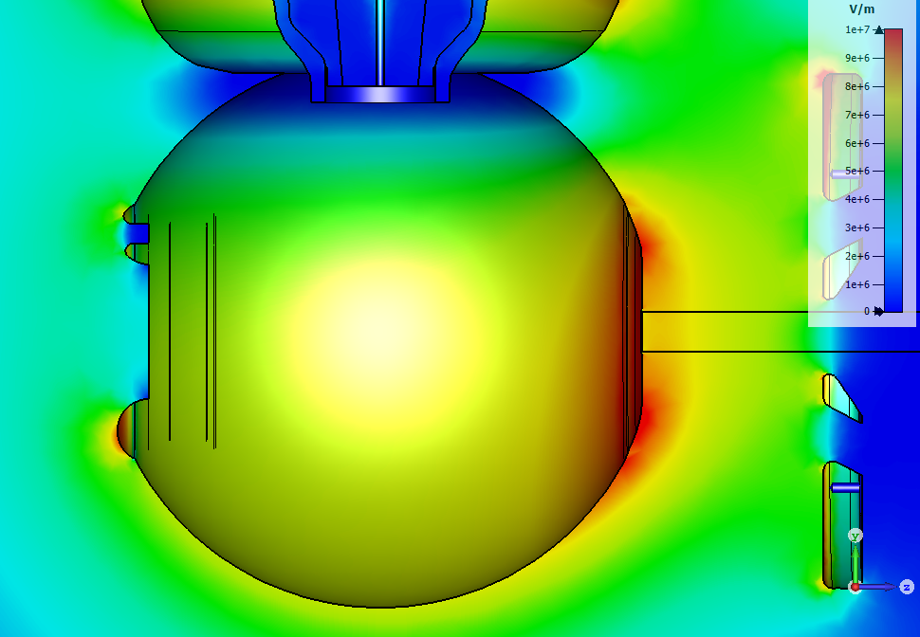
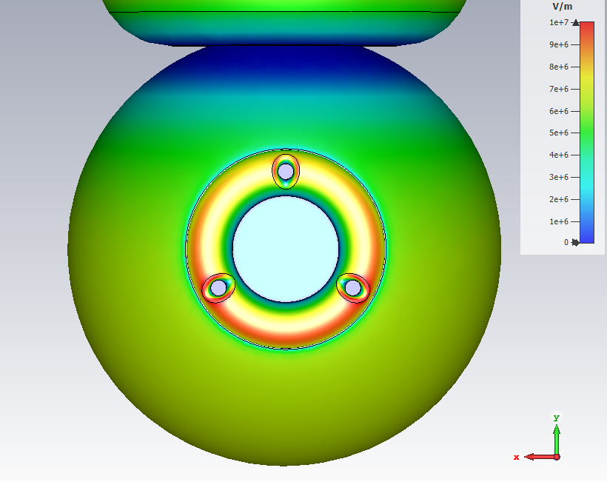
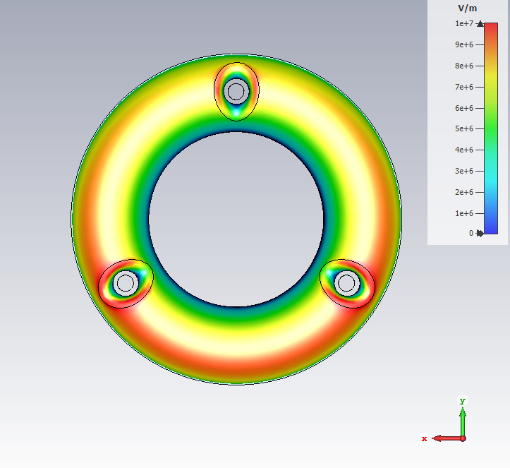
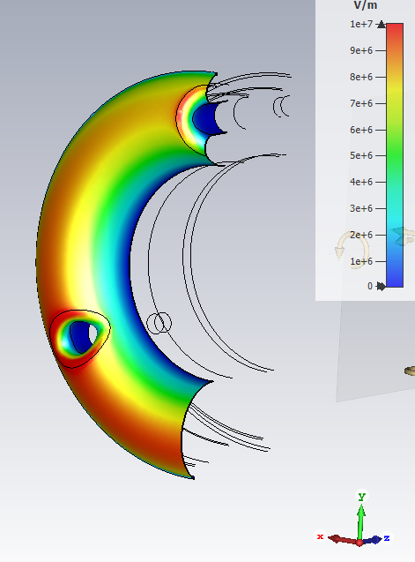
Flat cathode front
Hole diameter: 5.5 mm
Blend radius: 2 mm
-350 kV
10 MV/m
11.5 MV/m
11.4 MV/m
9.2 MV/m

Slide 6
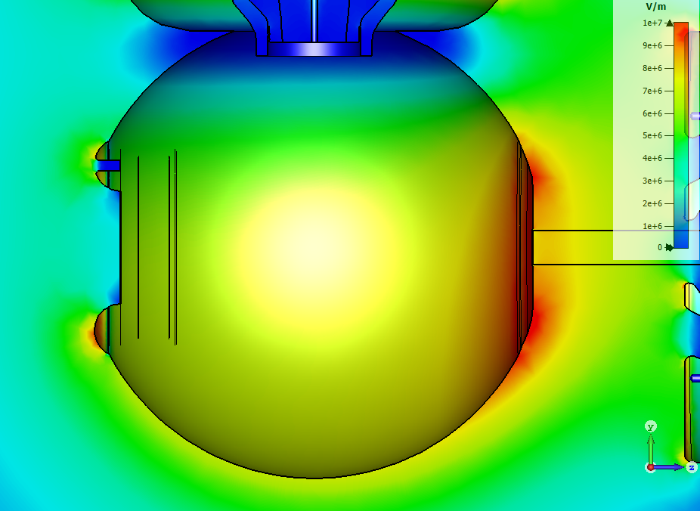
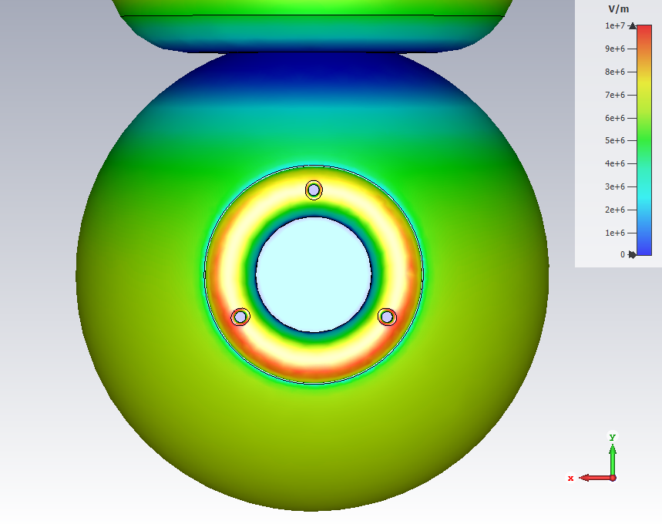
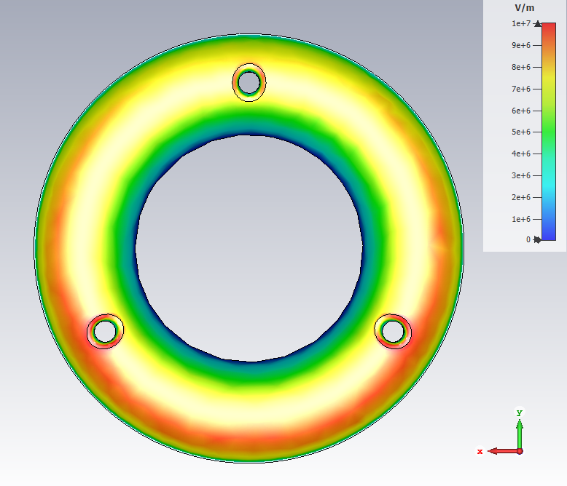
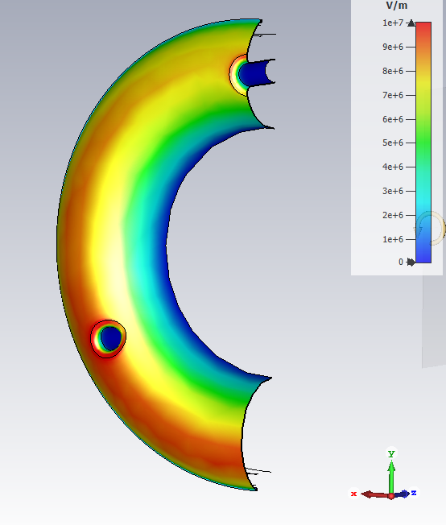
Flat cathode front
Hole diameter: 3.5 mm
Blend radius: 1 mm
-350 kV
9.6 MV/m
11.3 MV/m
11.4 MV/m
9.4 MV/m

Slide 7
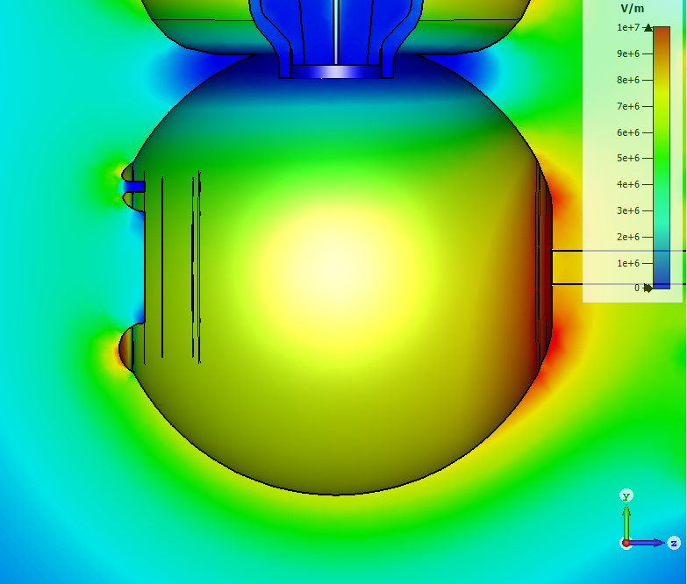
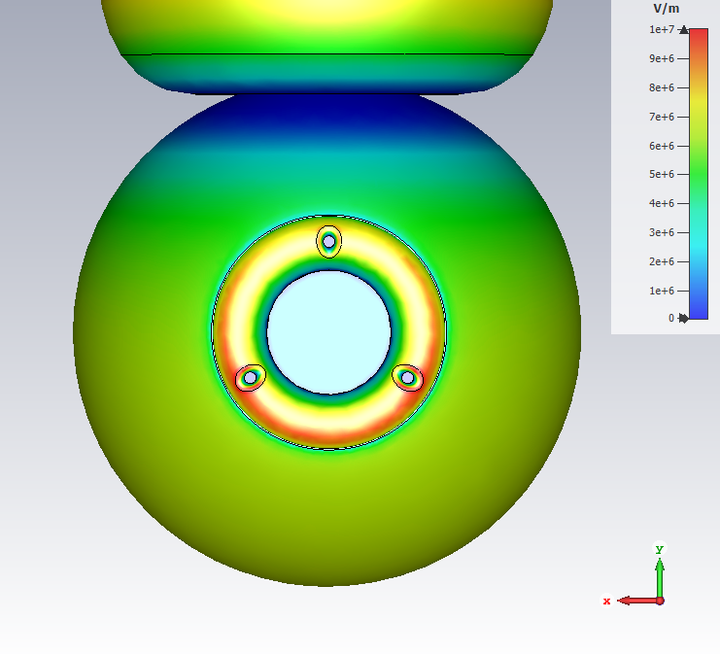
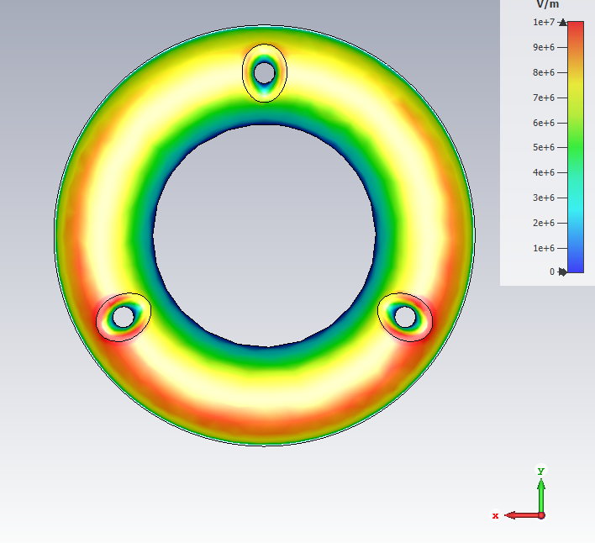
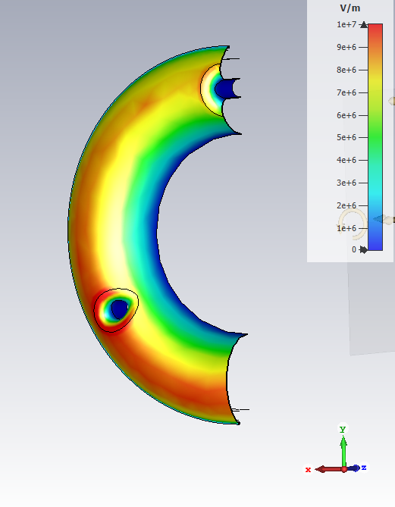
Flat cathode front
Hole diameter: 3.5 mm
Blend radius: 2 mm
-350 kV
9.0 MV/m
11.3 MV/m
10.5 MV/m
9.3 MV/m

Slide 8
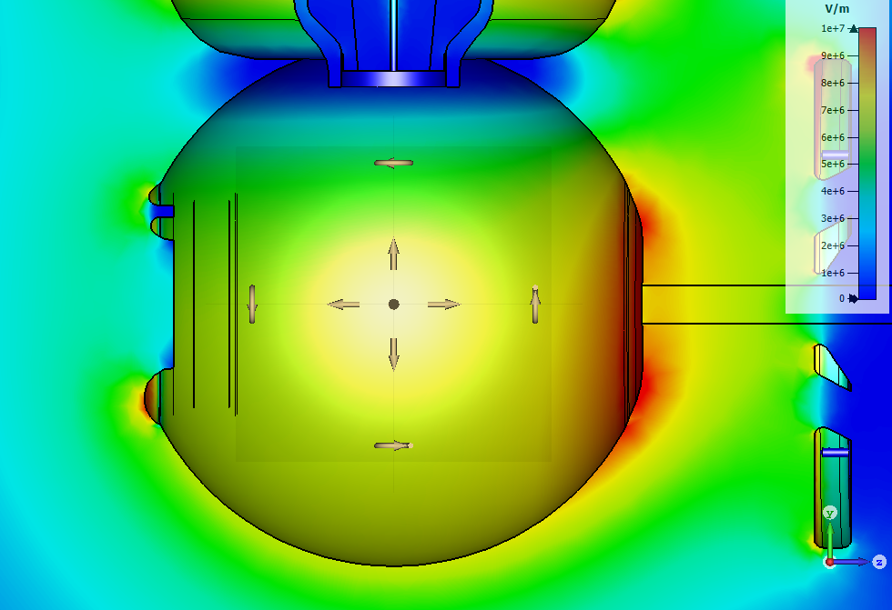
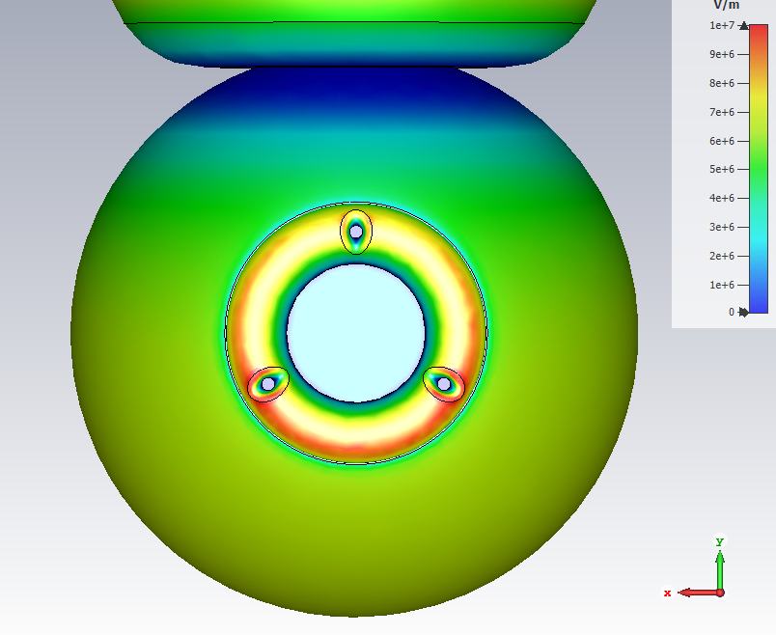
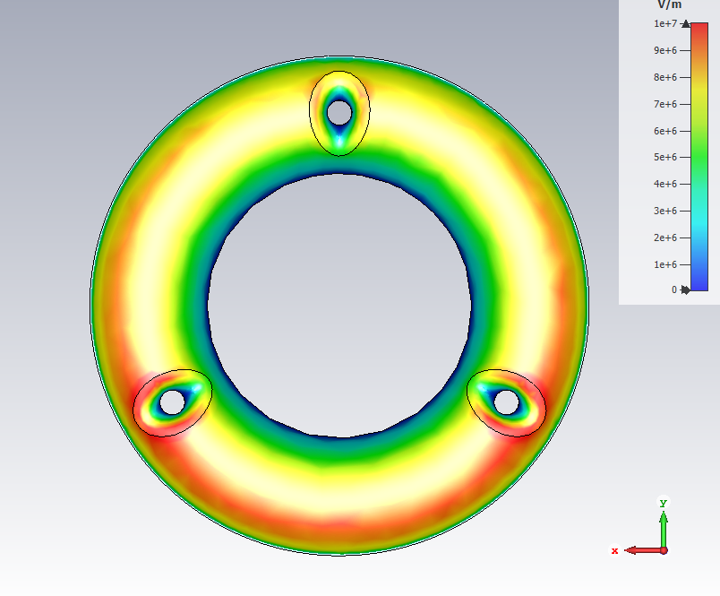
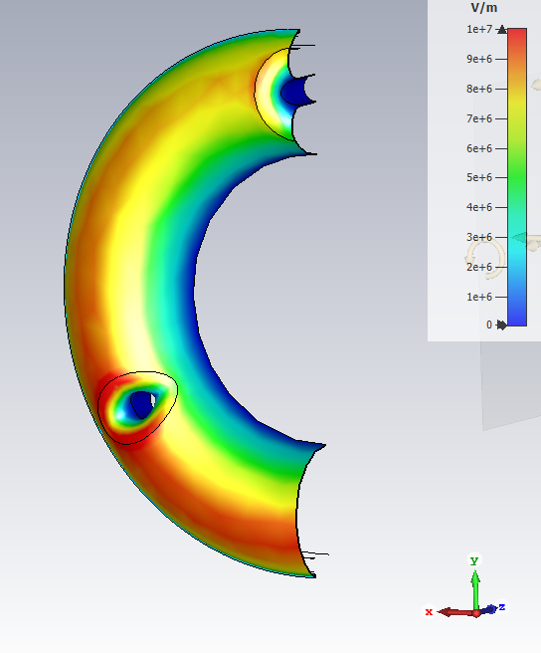
Flat cathode front
Hole diameter: 3.5 mm
Blend radius: 2.5 mm
-350 kV
9.2 MV/m
10.9 MV/m
10.5 MV/m
9.4 MV/m

