Slide 1
Bubble Chamber
Installation and
Beam Test Schedule
https://wiki.jlab.org/ciswiki/index.php/Bubble_Chamber

Slide 2
Summer 2014 SAD:
Fast Valve after ¼ Cryounit
New MBV0L02 Dipole Magnet
Install Bubble Chamber for Test Run
Safety
Schedule for October 2014 Beam Test

Slide 3
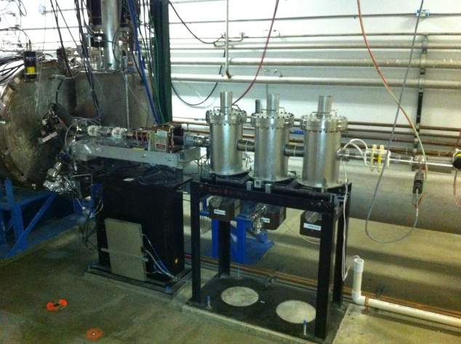
Fast Valve after ¼ Cryounit:
Heckman: ordered fast valve
Kortze: to order controller electronics, complete installation
Install Group: to move DP station after cryounit to make room for valve
Survey/Alignment: to check DP station
MPS: to integrate fast valve in FSD
Trigger gauge to be installed in 5D line
New Fast Valve to protect from vacuum failure in front of ¼ Cryo-unit

Slide 4
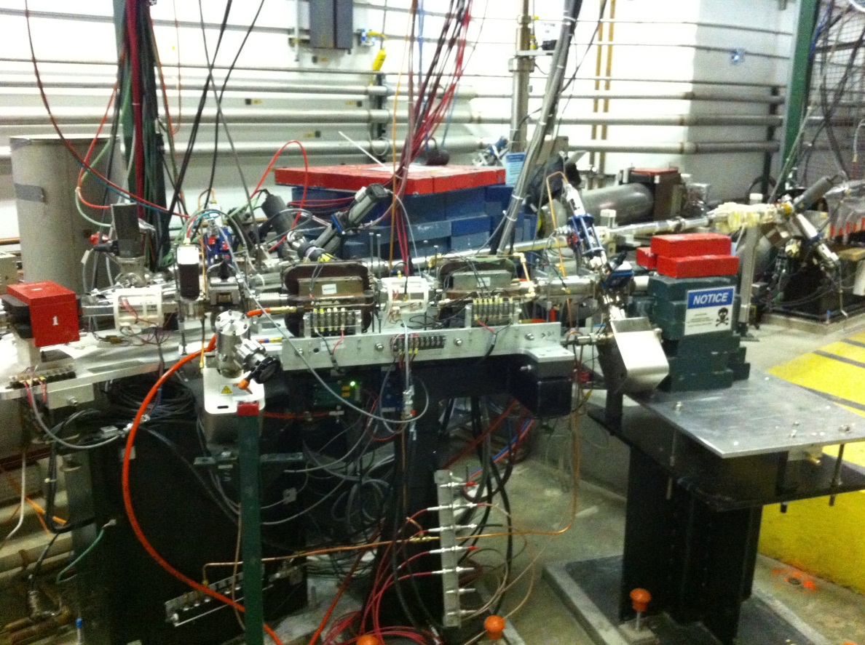
New MBV0L02 Dipole Magnet
Benesch/ME: to complete design, find vendor, get quotes, place order
Suleiman: to order Hall Probe system
Magnet mapping
Survey/Alignment
Power Supply: 10 A Trim Card
5 MeV Dipole

Slide 5
Install Bubble Chamber for Test Run
Suleiman/ME: to complete design modifications for 5D line and bubble footprint
EGG: to do vacuum work
Install Group: to crane bubble chamber and hardware to tunnel
Survey/alignment to set points for bubble chamber, support alignment
Facilities: to provide power to Bubble Chamber Compressor
EGG: to include “No Beam” signal from Bubble chamber in laser Shutter
Suleiman/ME: design and build Photon Collimator and Photon Dump
Suleiman/ME: design cupper for Flange radiator/dump
ME: Thermal analysis of Flange radiator/dump
New beamline Components: (1) Corrector (2) Superharps
Need to have an installation plan, pre-review by late April

Slide 6
BCM
2D
Spectrometer
Mott Polarimeter
5 MeV
Dipole
5D Spectrometer
Bubble
Chamber
location

Slide 7
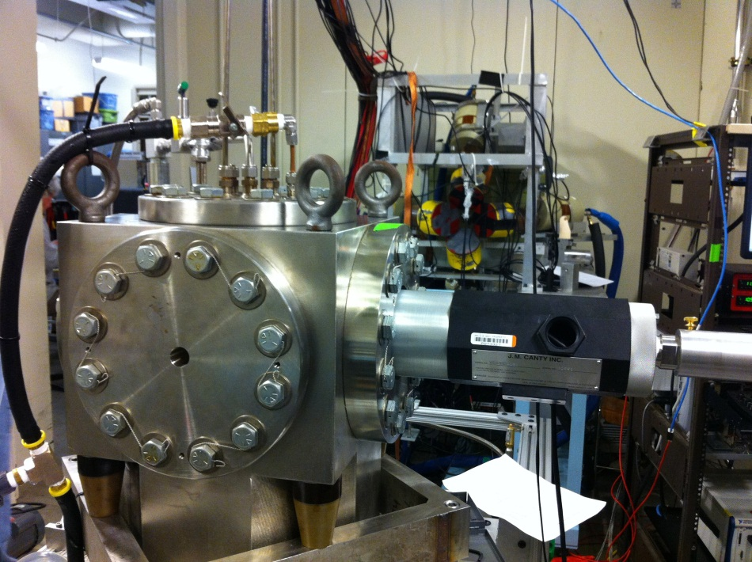
5D Spectrometer
Bubble Chamber at HIGS
April 2013
Photon Beam
Entrance

Slide 8
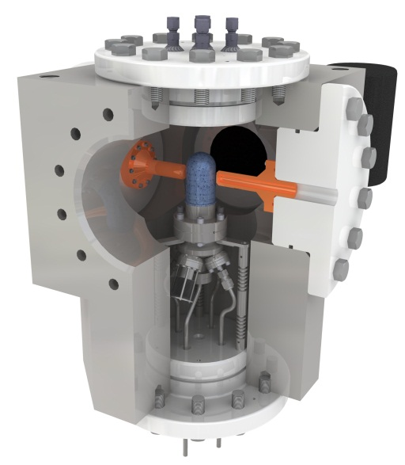
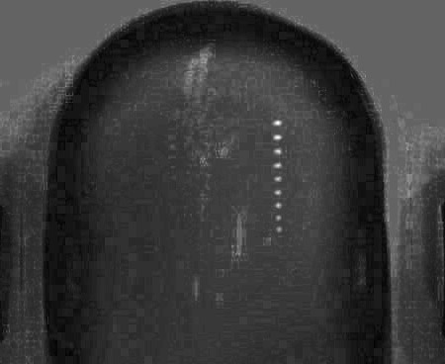
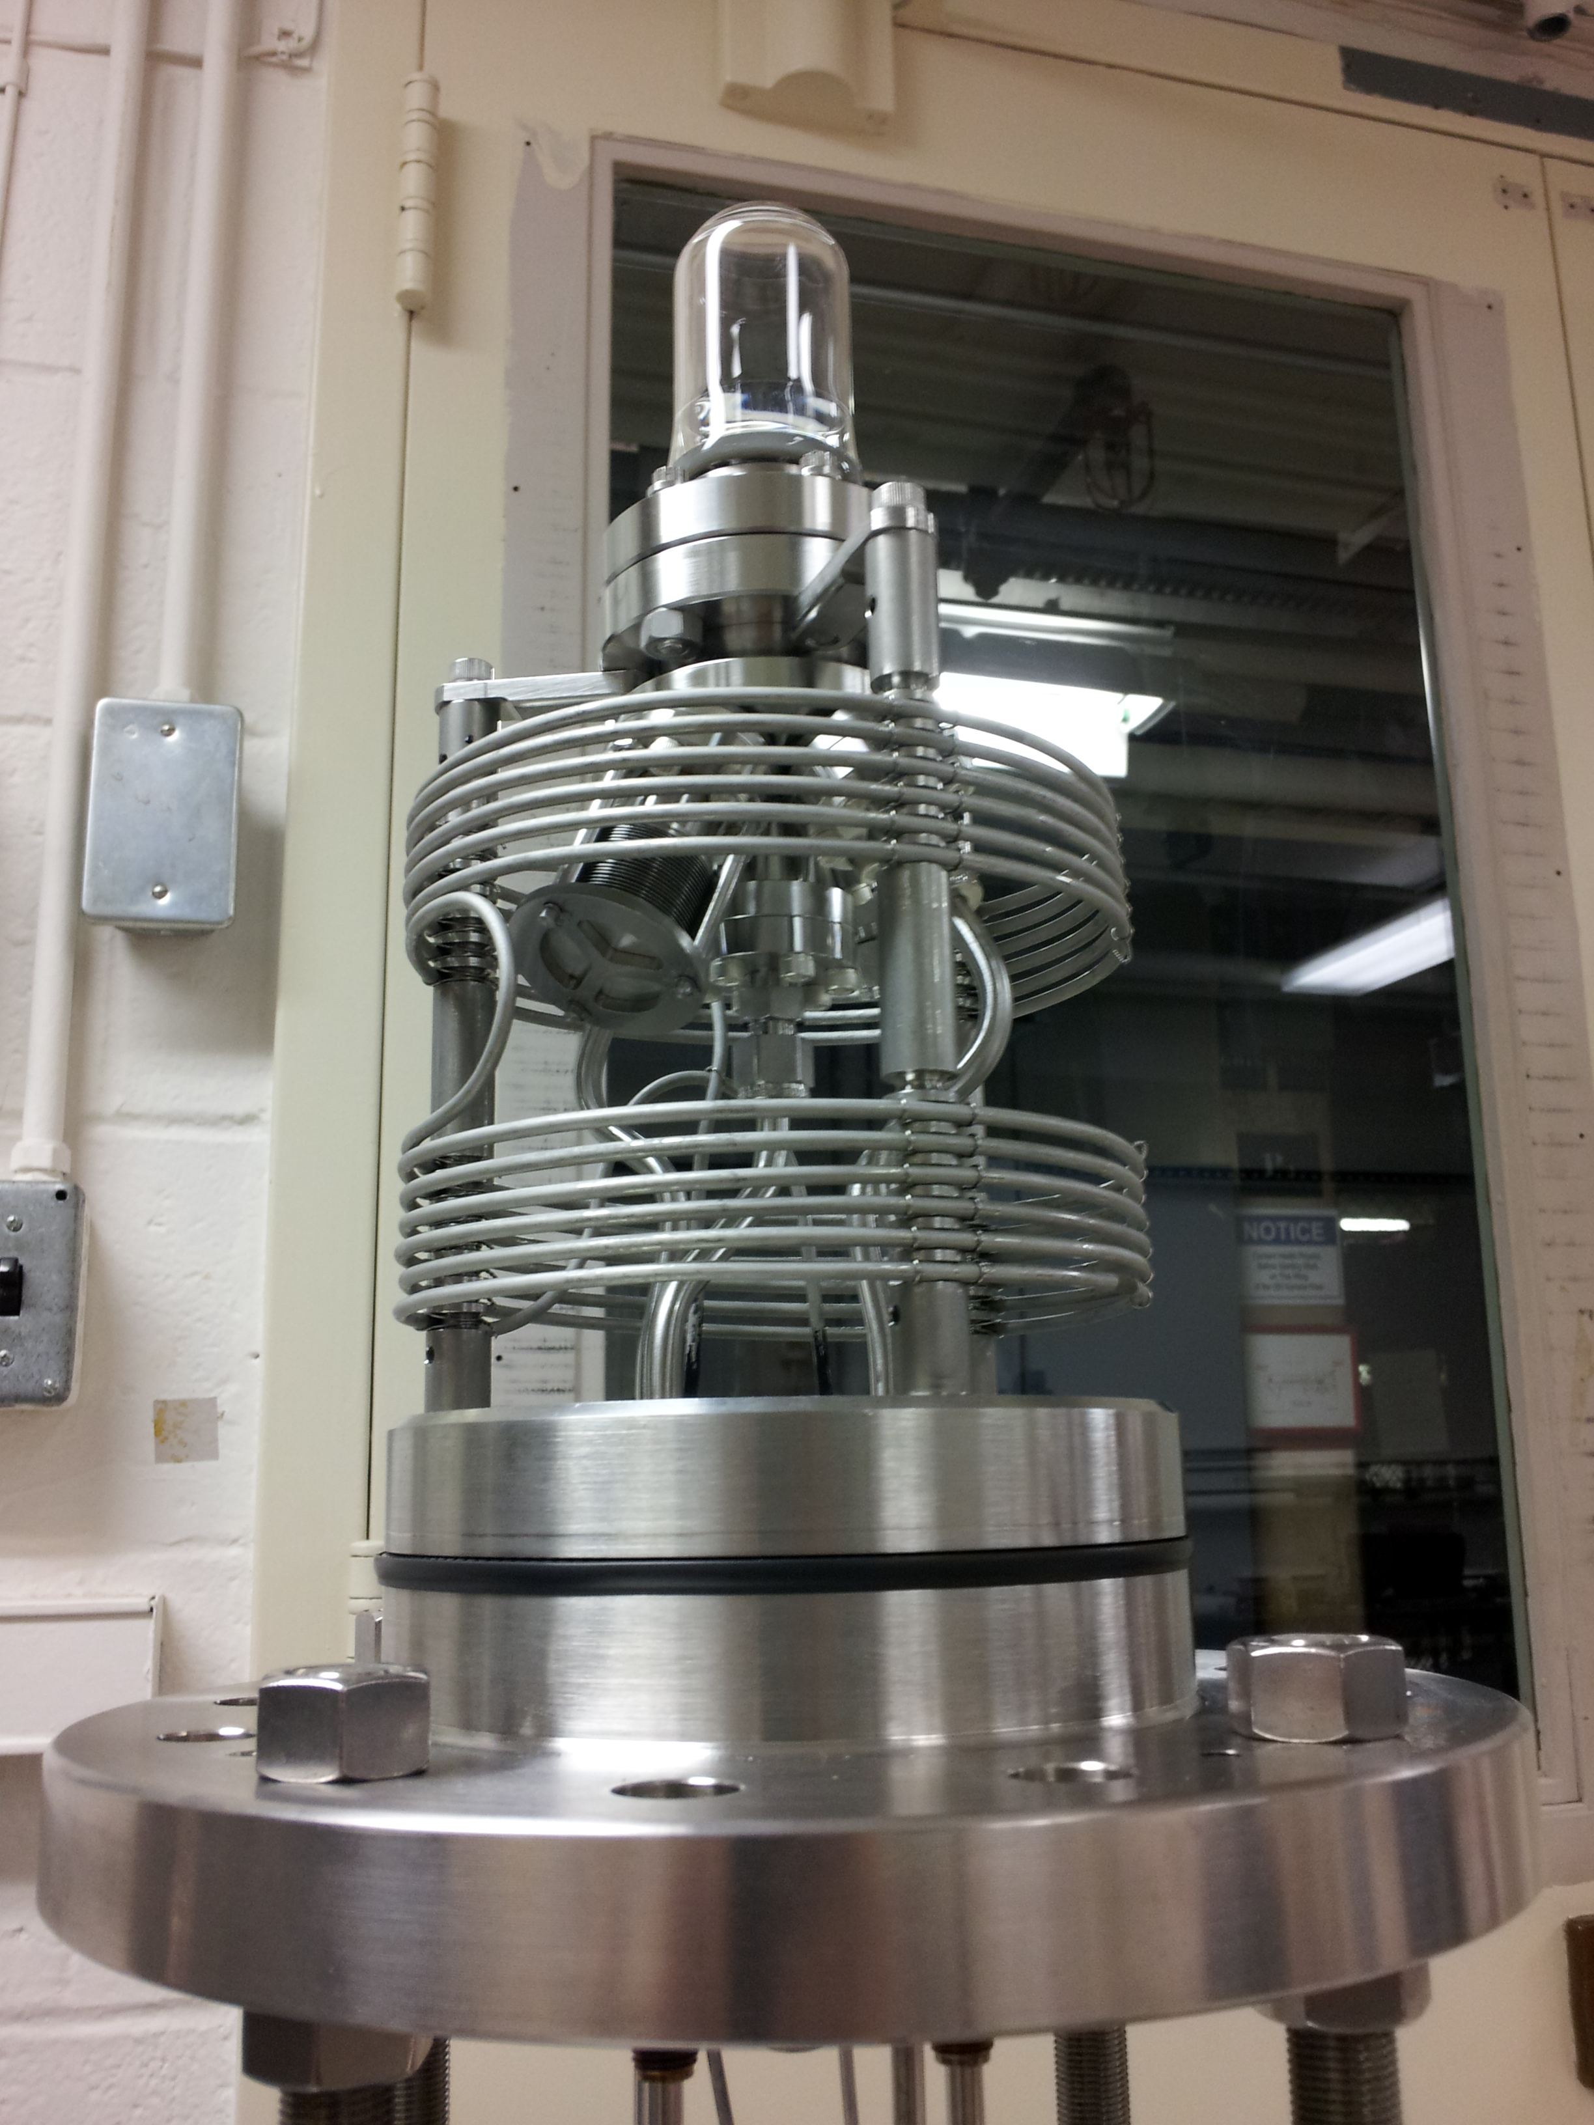
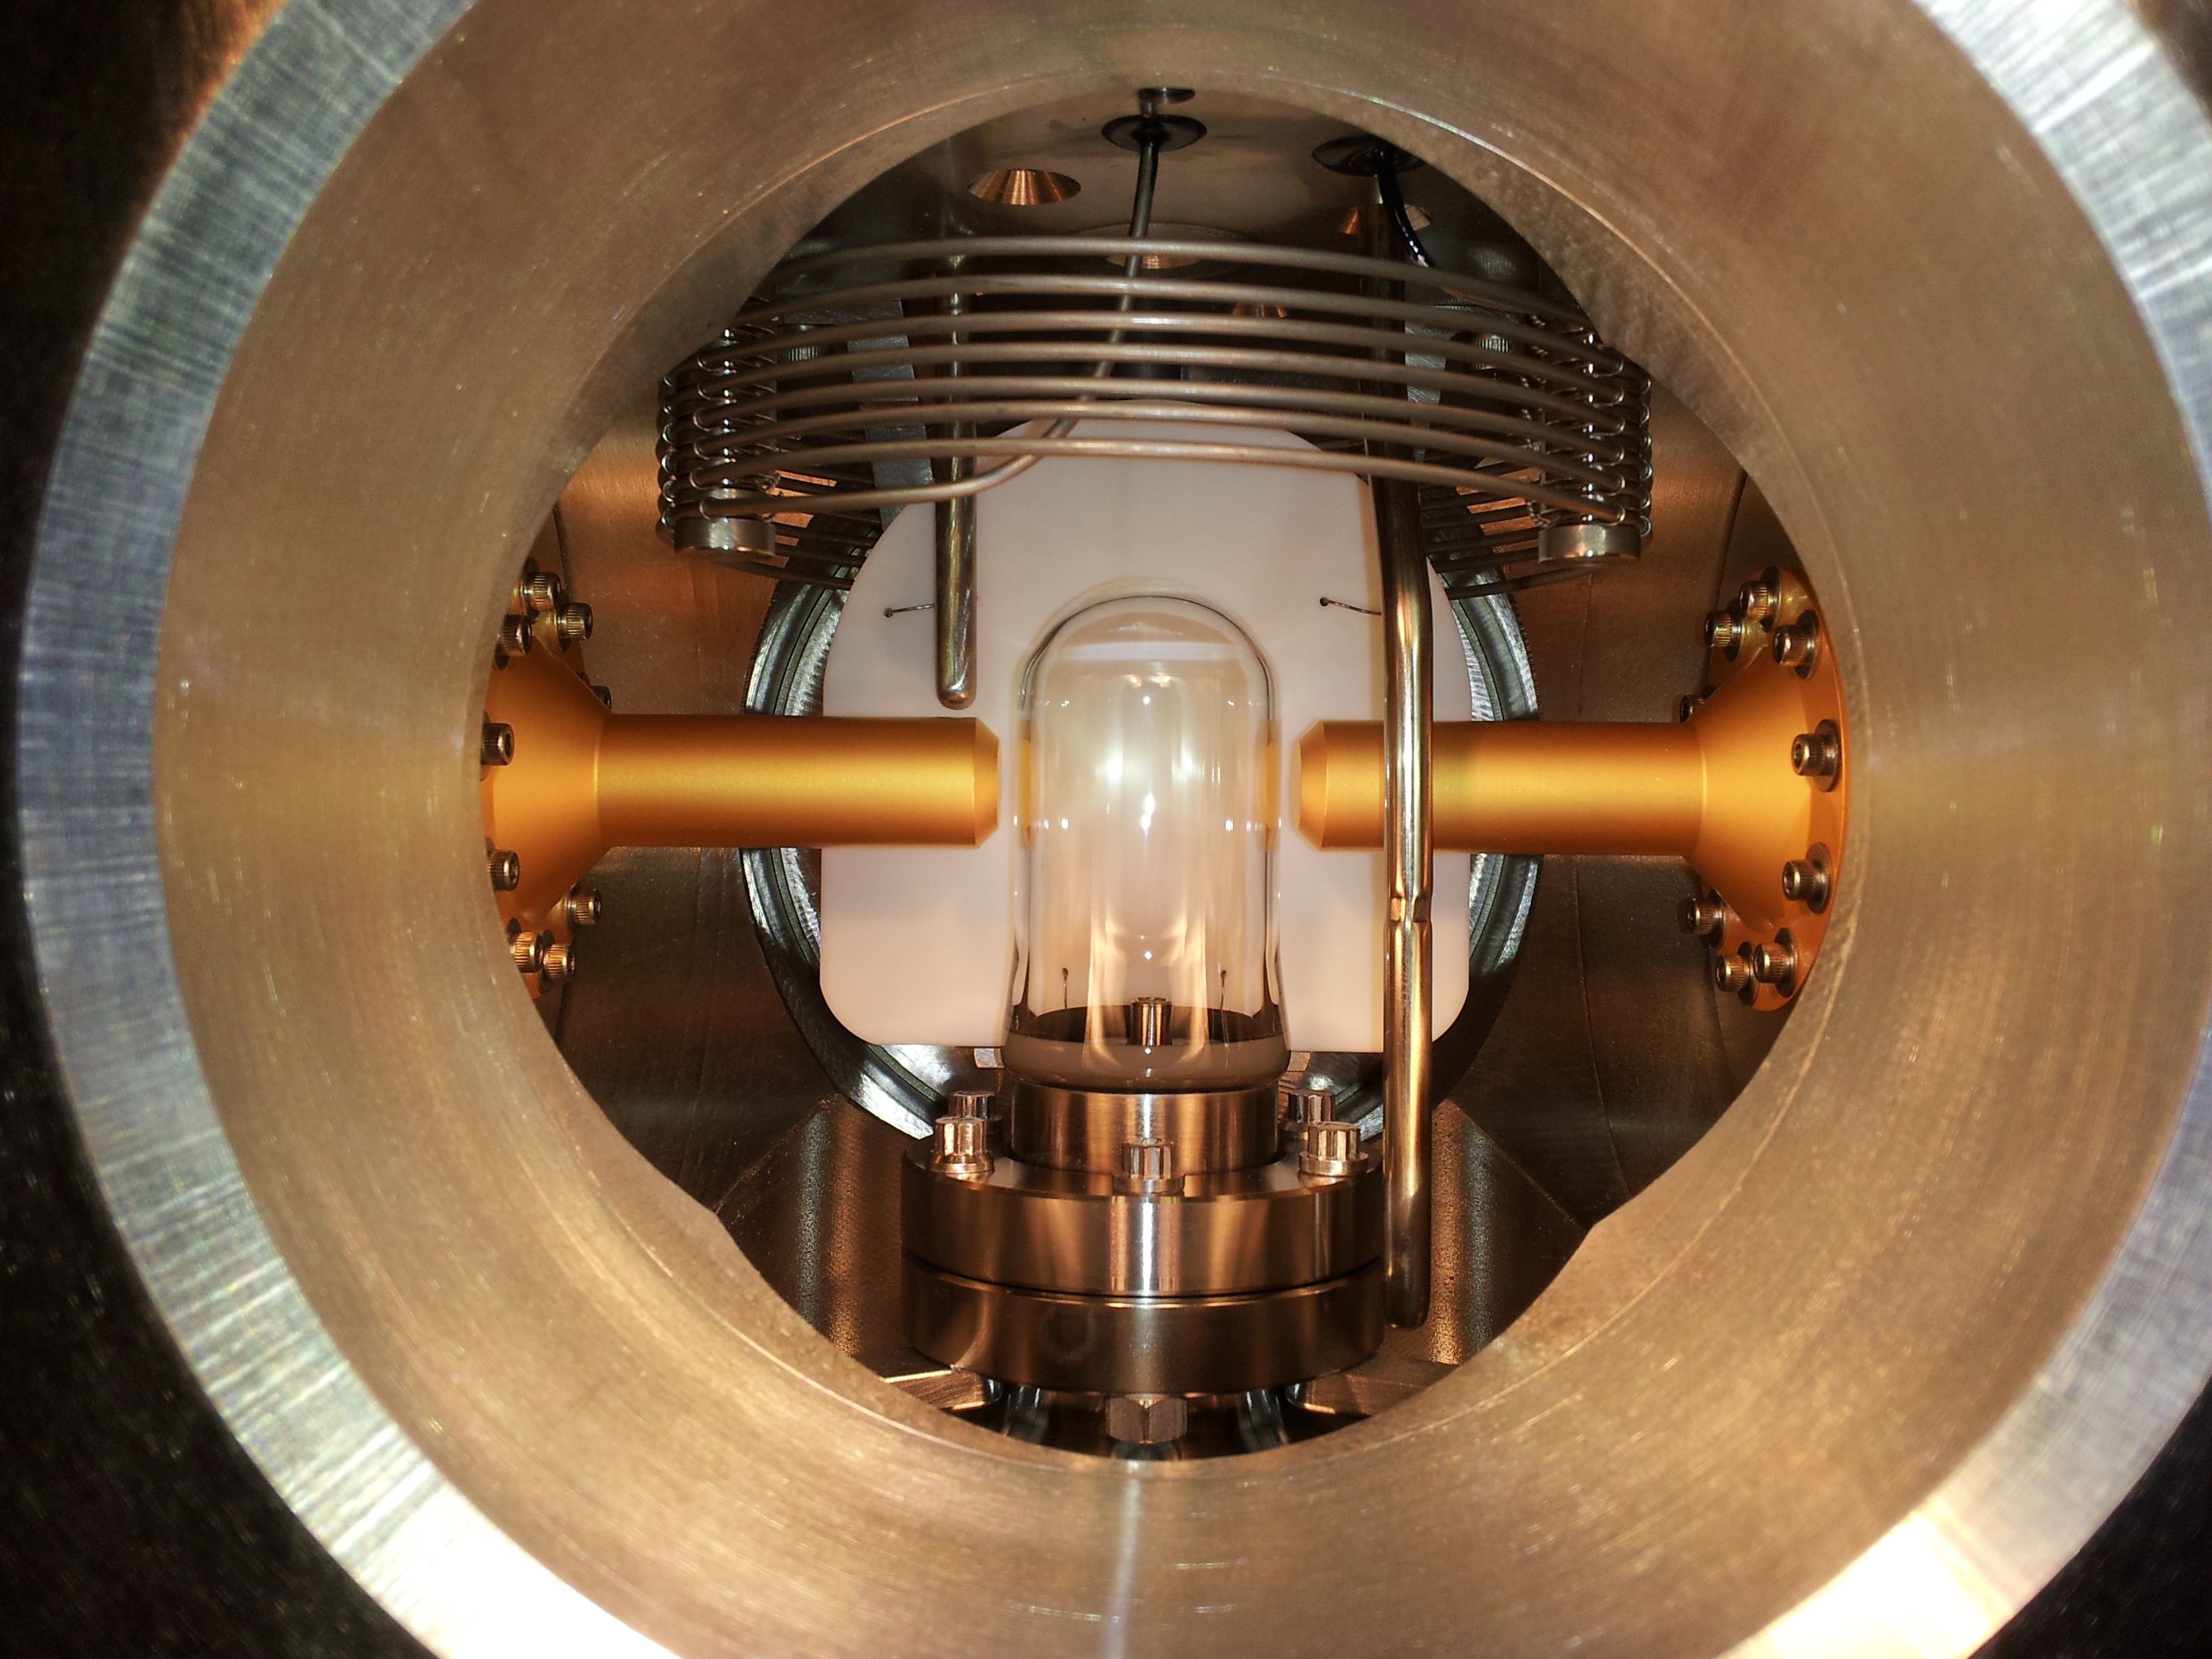
N₂O Bubble Chamber
T = -5˚C
P = 60 atm
First γ+O→α+C bubble
April 2013

Slide 9
Beamline
For 2014 beam test, replace with flange
New Dipole
Magnet
2 Superharps t o measure
Beam profile and absolute
beam position

Slide 10
Schematics
Use pure Copper and Aluminum
Flange isolated and current in EPICS readback
Electron K.E.
3.0 – 8.7 MeV
0.01 – ? µA
Flange Cu
Radiator/Dump
? mm
Al Beam Pipe
Cu Photon
Collimator
Al Photon Dump
10 cm long
20 cm diameter
Bubble Chamber
Superheated N₂O
3 cm long
-5°C, 60 atm

Slide 11
Beam Requirements
Beam Properties at Radiator:
February 16, 2014: With one trip/hour (all are 0L02-8 ARC trips) GMeas are: 0L02-7 = 10.22 MV/m and 0L02-8 = 10.40 MV/m. Beam Kinetic Energy = 8.7 MeV
We may also need to helium process the ¼-cryounit
Beam Kinetic Energy, (MeV) | 7.9–8.7
Beam Current (µA) | 0.01–?
Absolute Beam Energy Uncertainty | <0.1%
Relative Beam Energy Uncertainty | <0.02%
Energy Resolution (Spread), σ_{T} /T | <0.06%
Beam Size, σ_{x,y} (mm) | 1–2

Slide 12
Safety
Superheated liquid: N₂O, Nitrous oxide (laughing gas)
At room temperature, it is colorless, non-flammable gas, with slightly sweet odor and taste
High pressure system:
Design Authority: Dave Meekins
T = -5˚C
P = 60 atm
Buffer liquid: Mercury
Closed system
Volume: 135 mL
0
2
0
OX
0
3
0

Slide 15
