Slide 1
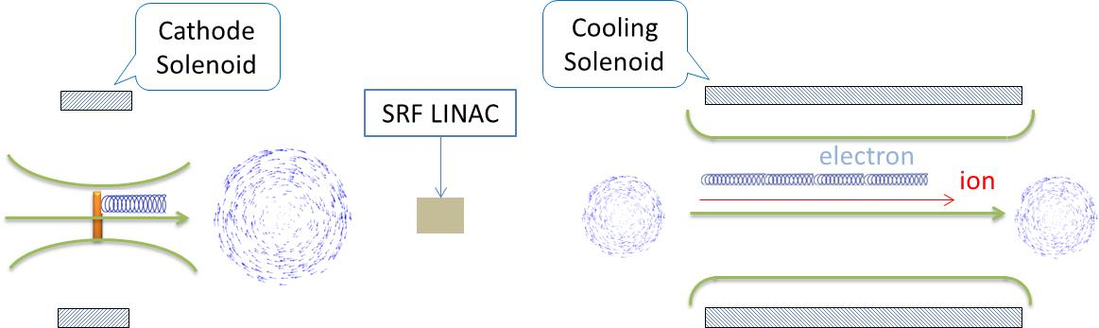
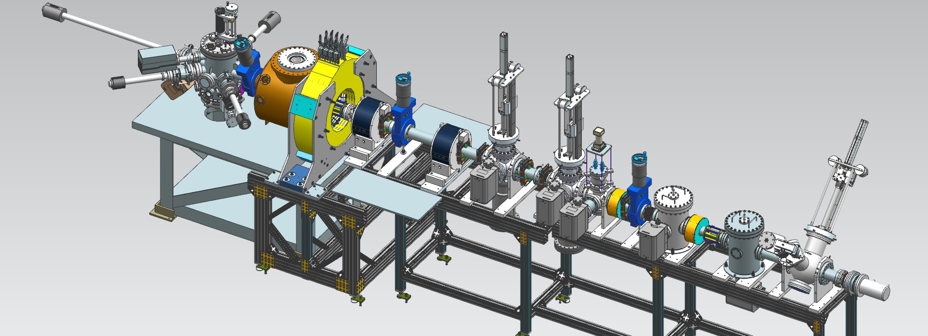
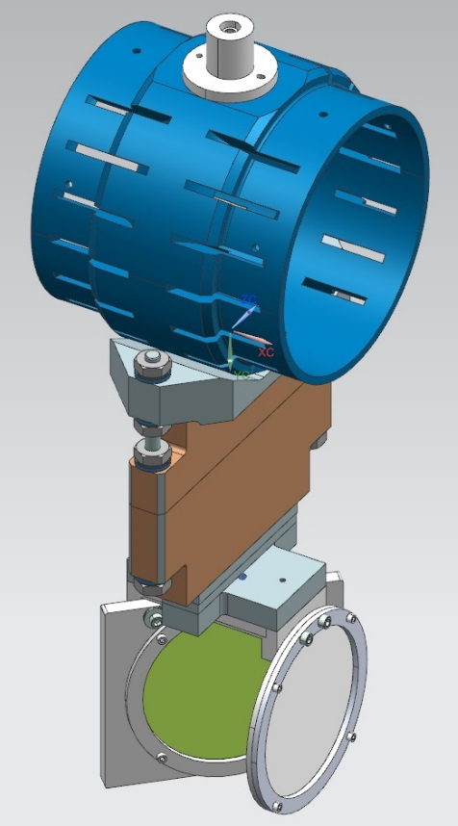
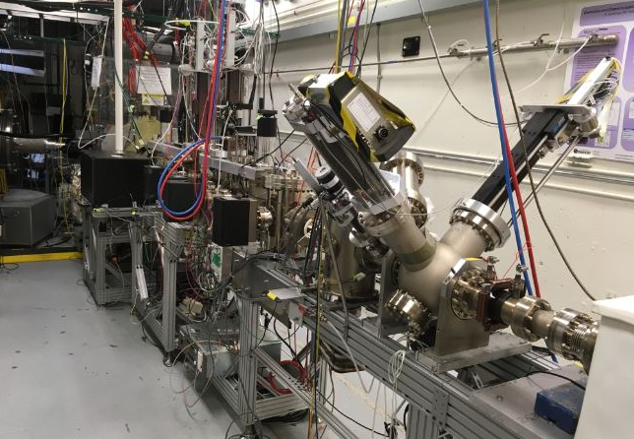
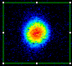
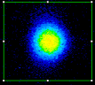
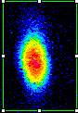
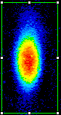



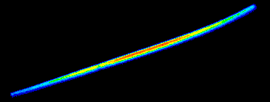
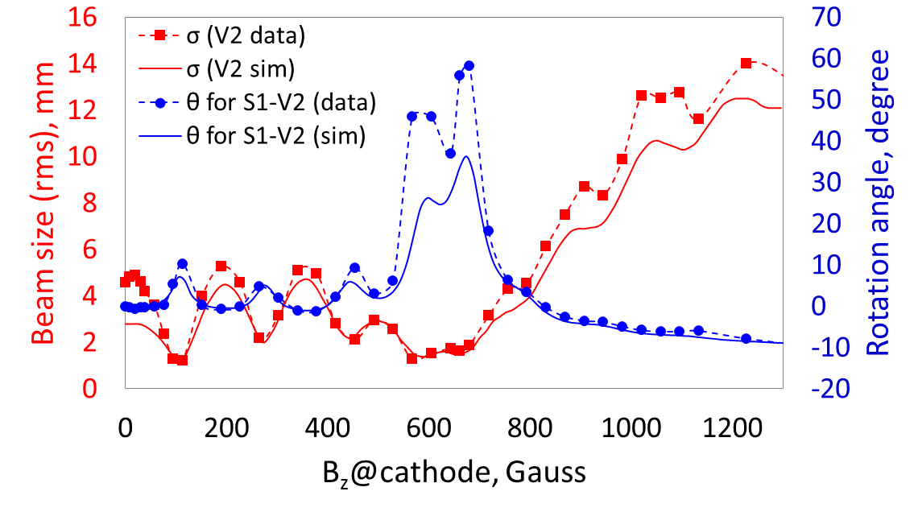
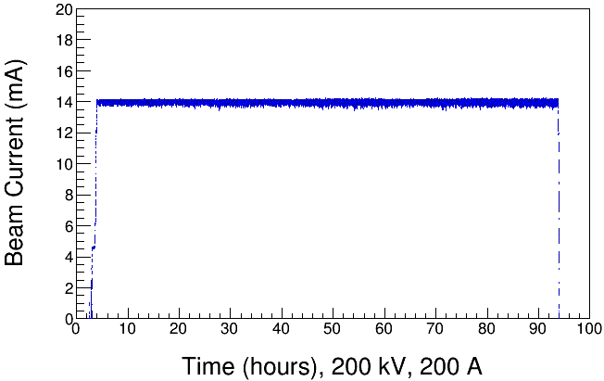
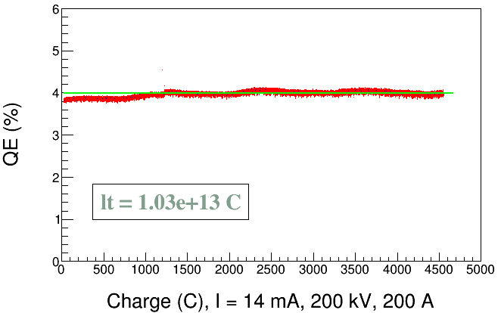
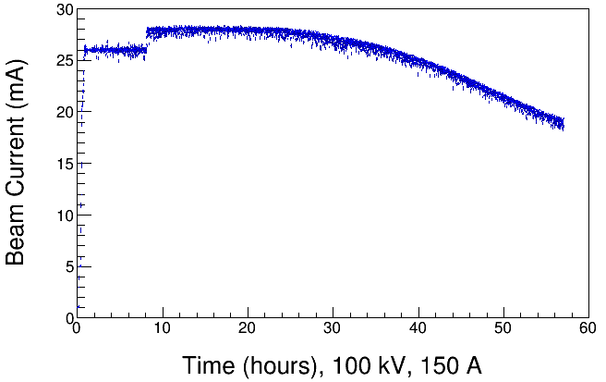
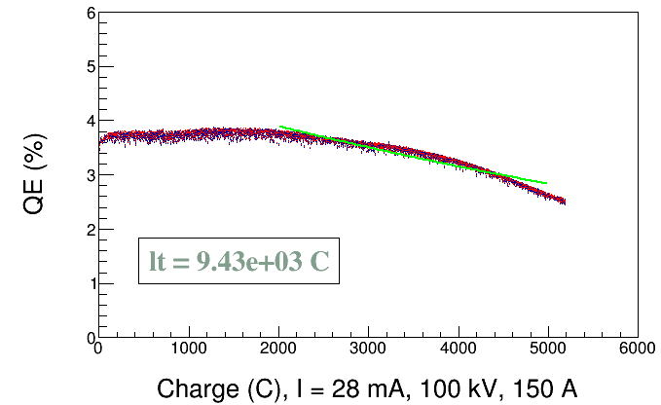
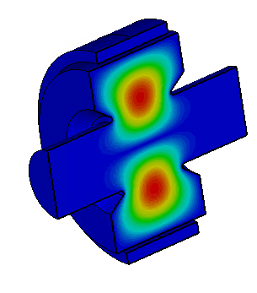
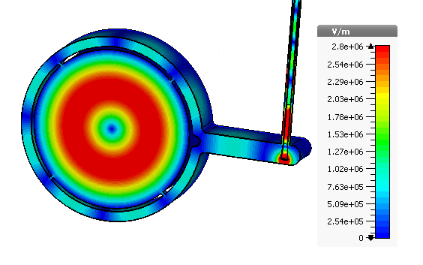
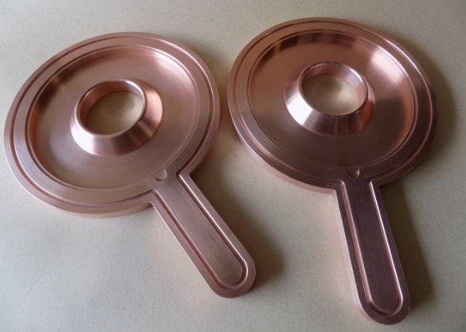

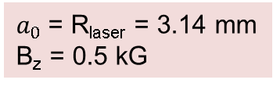
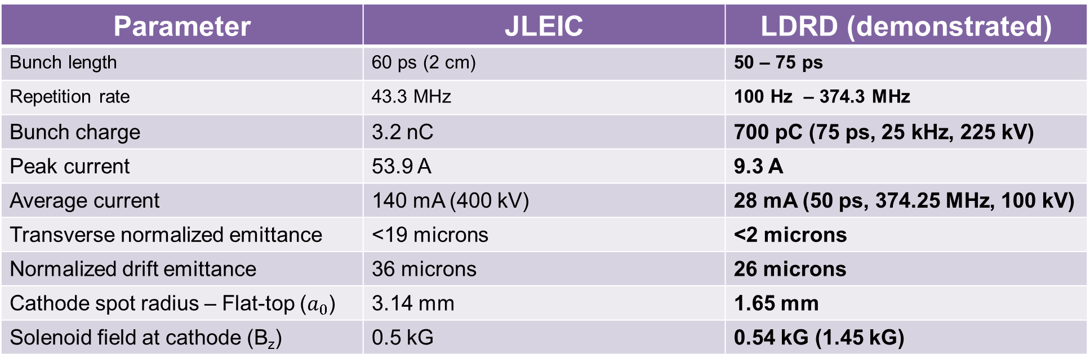
Generation and Characterization of Magnetized Bunched Electron Beam from DC High Voltage Photogun for
JLEIC Cooler
R. Suleiman and M. Poelker October 12, 2018
Motivation
Electron beam suffers an azimuthal kick at entrance of cooling solenoid. But this kick can be cancelled by an earlier kick at exit of photogun. That is purpose of cathode solenoid
Experimental Overview
Jefferson Lab Electron Ion Collider (JLEIC) bunched magnetized electron cooler is part of Collider Ring and aims to counteract emittance degradation induced by intra-beam scattering, to maintain ion beam emittance during collisions and extend luminosity lifetime
Gun HV Chamber
Beamline Solenoids
Photocathode
Preparation
Chamber
Beam Dump
Magnetized Cooling
Cathode Solenoid
Ion beam cooling in presence of magnetic field is much more efficient than cooling in a drift (no magnetic field):
Electron beam helical motion in strong magnetic field increases electron-ion interaction time, thereby significantly improving cooling efficiency
Electron-ion collisions that occur over many cyclotron oscillations and at distances larger than cyclotron radius are insensitive to electrons transverse velocity
Cooling rates are determined by electron longitudinal energy spread rather than electron beam transverse emittance as transverse motion of electrons is quenched by magnetic field
Magnetic field suppresses electron-ion recombination
Electrons born in strong uniform B_{z}
Upon exit of Cathode Solenoid
Upon entering Cooling Solenoid
r_{e}= 0.7 mm
B_{cool} = 1 T
Viewer Screens
$a_{0}$= R_{laser} = 3.14 mm
B_{z} = 0.5 kG
= 36 µm
Shield Tube
Parameter | JLEIC | LDRD (demonstrated)
Bunch length | 60 ps (2 cm) | 50 – 75 ps
Repetition rate | 43.3 MHz | 100 Hz – 374.3 MHz
Bunch charge | 3.2 nC | 700 pC (75 ps, 25 kHz, 225 kV)
Peak current | 53.9 A | 9.3 A
Average current | 140 mA (400 kV) | 28 mA (50 ps, 374.25 MHz, 100 kV)
Transverse normalized emittance | <19 microns | <2 microns
Normalized drift emittance | 36 microns | 26 microns
Cathode spot radius – Flat-top ($a_{0}$) | 3.14 mm | 1.65 mm
Solenoid field at cathode (B_{z}) | 0.5 kG | 0.54 kG (1.45 kG)
Slit
Viewer Screen
Use slit and viewer screens to measure mechanical angular momentum
Use Beamline solenoid and viewer screen to measure drift emittance
Magnetization Measurements
Drift Emittance
High Bunch Charge
Summary
Beam and beamlet observed on successive viewers
K_{x}Cs_{y}Sb photocathode preparation chamber, gun, solenoid and beamline - all operational
Photogun operated reliably up to 300 kV
Cathode solenoid can trigger field emission but we have learned how to prevent this
Have successfully magnetized electron beams and measured rotation angle and drift emittance
Used a gain-switched drive laser (374.25 MHz, 50 ps) to generate 28 mA magnetized beam with RF structure at 100 kV (using 30 mA / 225 kV Spellman Supply, 3 kW power limited)
Successfully fabricated bialkali antimonide photocathode with QE ~ 9% on molybdenum substrate that provided longer charge lifetime
Positive bias on anode helps to prevent sudden QE loss from ion-induced micro-arcing events
Demonstrated high bunch charge up to 700 pC
0 G at photocathode
1511 G at photocathode
Beam size too large to transport cleanly
Beam Size and Rotation: Experiment vs GPT simulation
Measured drift emittance for different spot sizes (rms) at 200 kV
GPT simulation and experimental results show encouraging agreement
Encountered space-charge-limited regime between 100-300 pC
Need longer laser pulses and higher gun voltage to get nC bunches
0.3 mm rms spot size
High Average Current Magnetized Beam
Focusing by cathode magnetic field causes mismatch oscillations resulting in repeated focusing inside cathode solenoid field which affects beam size at exit of solenoid field and resulted in varying beam expansion rate in field free region
Rotation angles are influenced by focusing in cathode solenoid
Modelled apparatus using ASTRA & GPT
Designed and built non-invasive magnetometer - TE₀₁₁ Cavity - to measure beam magnetization. To be installed and commissioned:
14 mA, 725 G, 90 h run
Laser rms = 0.9 mm, 303 MHz, 60 ps (FWHM)
Gun HV = 200 kV, Gun Solenoid = 200 A
K_{x}Cs_{y}Sb photocathode on molybdenum
28 mA, 544 G, 50 h run
Laser rms = 1.4 mm, 374.25 MHz, 50 ps (FWHM)
Gun HV = 100 kV, Gun Solenoid = 150 A
K_{x}Cs_{y}Sb photocathode on molybdenum
Thanks to: P. Adderley, J. Benesch, B. Bullard, J. Delayen, J. Grames, J. Guo, F. Hannon, J. Hansknecht, C. Hernandez-Garcia, R. Kazimi, G. Krafft, M. A. Mamun, M. Stefani, Y. Wang, S. Wijiethunga, J. Yoskovitz, S. Zhang
Acknowledgement: This work is supported by the Department of Energy, Laboratory Directed Research and Development funding, under contract DE-AC05-06OR23177

