Slide 1
ASY-R30-3: Hinged anode tilts
Gabriel Palacios Serrano
03/01/2021
gabrielp@jlab.org

Slide 2
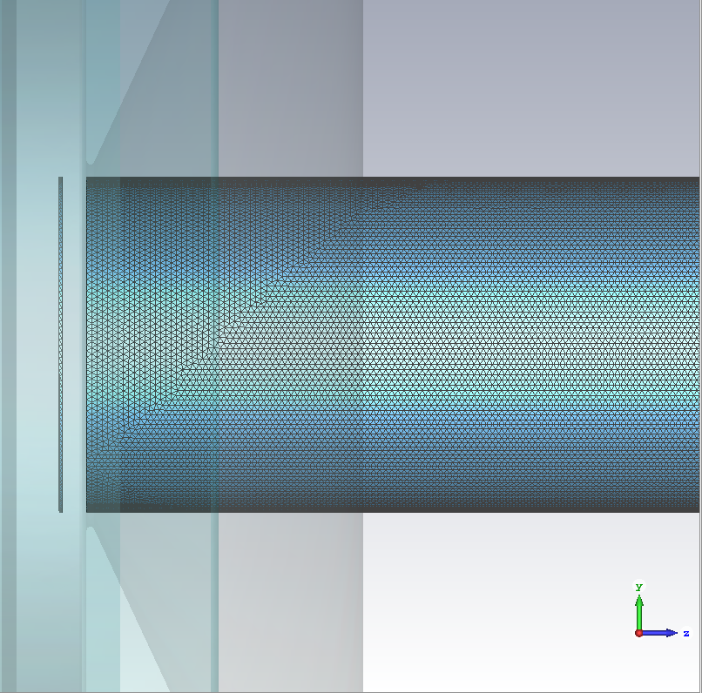
Model with finer mesh
0.5 mm max mesh step size
Hinge location

Slide 3
0deg: x-y at z-positions

Slide 4
-2.0deg: x-y at z-positions

Slide 5
Angle

Slide 6
Average beam position

Slide 7
extras

Slide 8
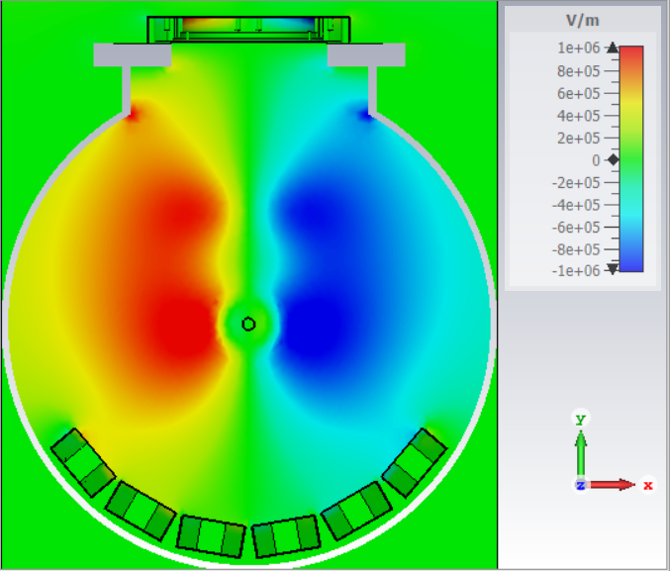
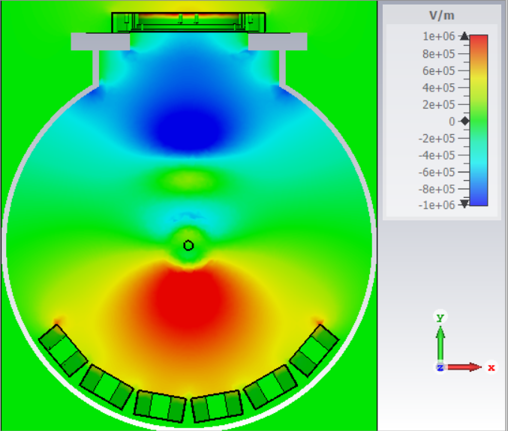
Potential isolines
Electric field Ex
Electric field Ey

Slide 9
Uncertainty
Stack-up errors
Assembly
Machining alignment
How much do we change when shifting from 0.5 mm mesh to 0.2 mm mesh ?
Files start getting large
Simulation runtime increases

Slide 10
How to fix?
Scan for minimum mesh size that gives us what we expect from the physics!
Namely, Ex = Ey = 0 at the z=0 line
Graded mesh with sections of fine and sections of large step size
0.5 mm max mesh step size

