Slide 3
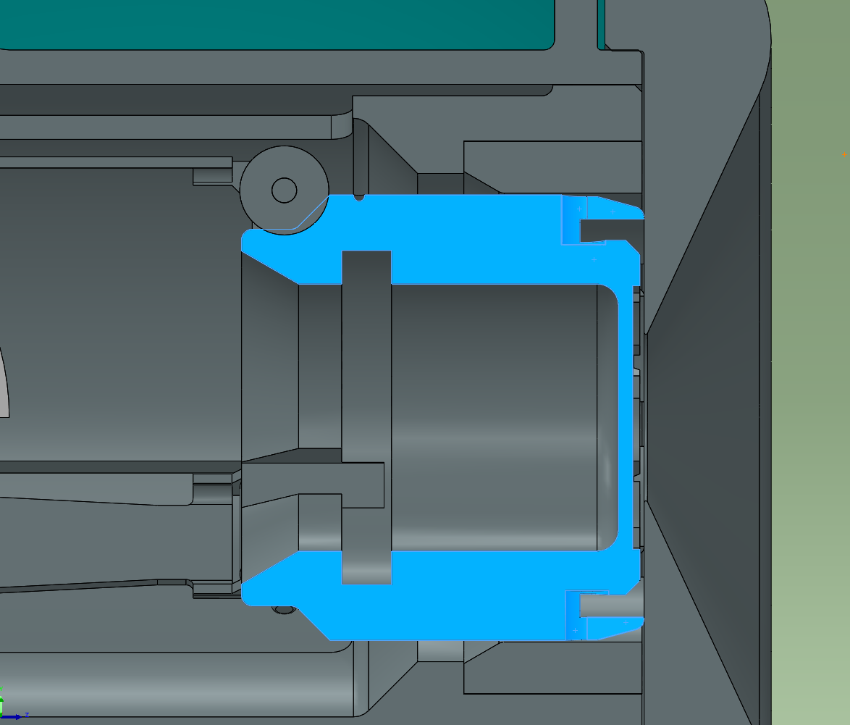

Slide 4
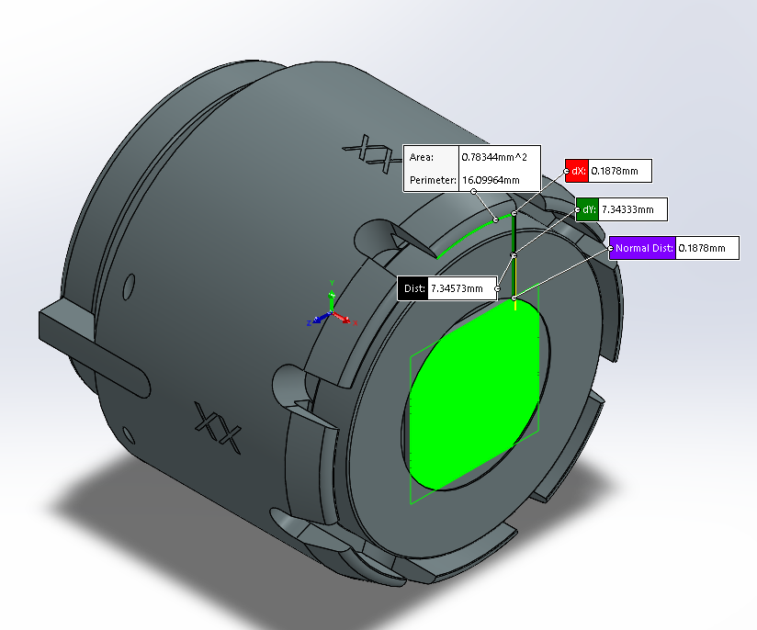
0.0330-(0.0010+0.0246) = 0.0074

Slide 5
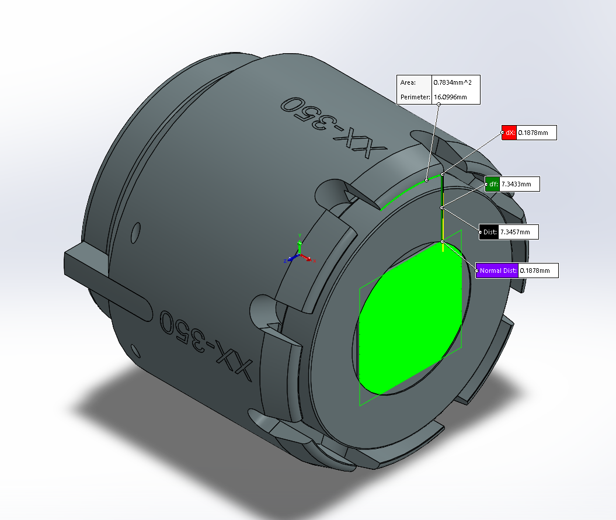
0.0222-(0.0010+0.0138) = 0.0074

Slide 6
