Slide 1
PQB Requirements at JLEIC
April 13, 2017

Slide 2
Parity Violation
Electromagnetic (EM) interaction is same for Right-handed and Left- handed electrons (Parity is conserved)
Weak interaction is different for Right-handed and Left-handed electrons: Left-handed electrons interact weakly but Right-handed do not (Parity is violated)
Particle | Electric Charge | Weak Charge
 | Right/Left | Right-handed | Left-handed
e | -1 | 0 | -½
Up quark | +⅔ | 0
Down quark | -⅓ | 0
proton | +1 | 0 | 1-4sin²θ_{W} (=0.08)
Neutron | 0 | 0 | 1

Slide 3


Parity Reversal
Under Parity Reversal, Right-handed electron becomes Left-handed electron (Helicity Reversal)
  Changing electron’s spin direction (Helicity Reversal) is equivalent to Parity Reversal
Spin
Electron
Momentum
Right-handed Electron
(+Helicity)
Mirror
Left-handed Electron
(–Helicity)

Slide 4
Experimental Techniques
How to carry out a parity violation (PV) experiment:
  Scatter longitudinally polarized electrons off un-polarized target (i.e., hydrogen, deuterium, helium, lead)
  Reverse beam helicity (±) with Pockels Cell, measure detected signals (D±) and currents (I±) per helicity, then calculate physics asymmetry (A _{physics}):
  Repeat millions of measurements
  Statistical distribution of these measurements is Gaussian: Mean is average asymmetry and error is width of Gaussian divided by square root of number of asymmetry measurements
  Average asymmetry is very small (1 – 50 ppm)
1/15th of a second

Slide 5
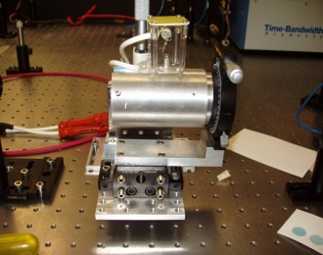
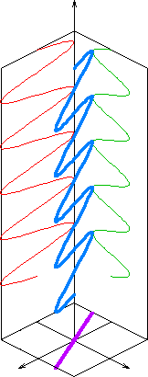
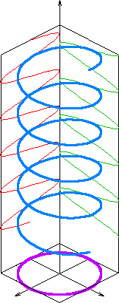
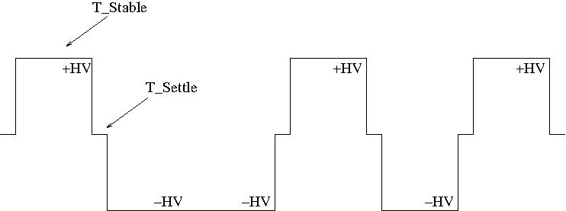
Pockels Cell
Pockels Cell is voltage controlled quarter wave plate
Changes polarization of laser from linearly-polarized light to circularly polarized light
E Field
Linearly
Polarized Light
Circularly
Polarized Light
+HV: Right-handed circularly polarized light → +Helicity electron
-HV: Left-handed circularly polarized light → -Helicity electron
Pockels Cell HV

Slide 6
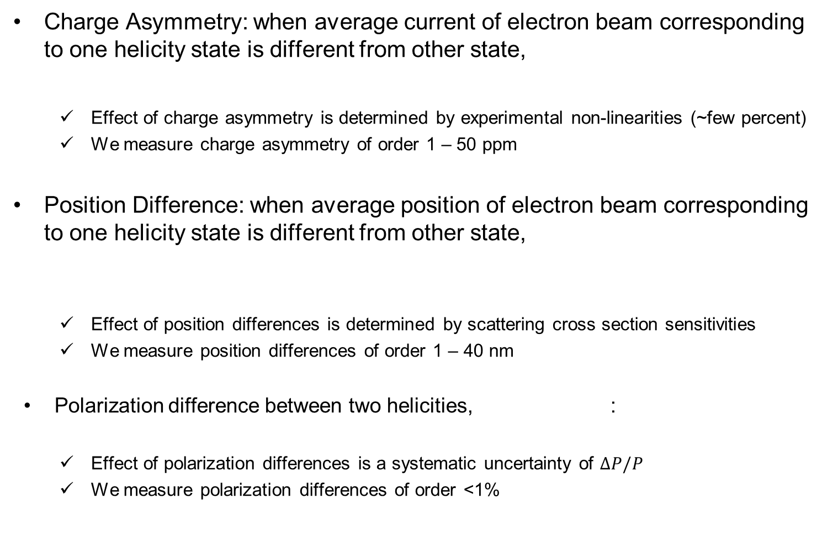
Helicity Correlated Beam Properties
Charge Asymmetry: when average current of electron beam corresponding to one helicity state is different from other state,
  Effect of charge asymmetry is determined by experimental non-linearities (~few percent)
  We measure charge asymmetry of order 1 – 50 ppm
Position Difference: when average position of electron beam corresponding to one helicity state is different from other state,
  Effect of position differences is determined by scattering cross section sensitivities
  We measure position differences of order 1 – 40 nm
Polarization difference between two helicities, :
  Effect of polarization differences is a systematic uncertainty of $∆P/P$
  We measure polarization differences of order <1%

Slide 7
PQB Requirements at CEBAF

Slide 8
Attenuator
IA
Rotatable GaAs
Photocathode
Gain-switched Diode Laser and Fiber Amplifier
LP HWP LP
PC WP LP
Shutter
Helicity Control Board
Helicity Flip Fiber
HV Supply
(0 – 90 V)
15° Dipole
nHelicity
Flip Fiber
Vacuum
Window
Delayed
Helicity Fiber
T-Settle
Fiber
Hall
RHWP
Charge Feedback (IA)
V-Wien Filter
Target
DAQ
Spin Solenoids
BCM
Charge Feedback (PITA)
H-Wien Filter
BPMs
Position
Feedback
Pockels
Cell
HV Supply
(0 – ±4000 V)
CEBAF
5 MeV
Helicity Magnets
PZT
Mirror
IHWP
Electron
Beam

Slide 9
Experiment | Energy (GeV) | Pol (%) | I (µA) | Target | A_{pv} (ppb) | Charge Asym (ppb) | Position Diff (nm) | Angle Diff (nrad) | Size Diff (δσ/σ)
HAPPEx-I (Achieved) | 3.3 | 38.8 68.8 | 100 40 | ¹H (15 cm) | 15,050 | 200 | 12 | 3
G0-Forward (Achieved) | 3.0 | 73.7 | 40 | ¹H (20 cm) | 3,000-40,000 | 300±300 | 7±4 | 3±1
HAPPEx-II (Achieved) | 3.0 | 87.1 | 55 | ¹H (20 cm) | 1,580 | 400 | 2 | 0.2
HAPPEx-III (Achieved) | 3.484 | 89.4 | 100 | ¹H (25 cm) | 23,800 | 200±10 | 3 | 0.5±0.1 | 10⁻³
PREx-I (Achieved) | 1.056 | 89.2 | 70 | ²⁰⁸Pb (0.5 mm) | 657±60 | 85±1 | 4 | 1 | 10⁻⁴
QWeak-I (Achieved) | 1.155 | 89.0 | 180 | ¹H (35 cm) | 281±46 | 8±15 | 5±1 | 0.1±0.02 | 10⁻⁴
QWeak | 1.162 | 90 | 180 | ¹H (35 cm) | 234±5 | <100±10 | <2±1 | <30±3 | <10⁻⁴
PREx-II | 1.0 | 90 | 70 | ²⁰⁸Pb (0.5mm) | 500±15 | <100±10 | <1±1 | <0.3±0.1 | <10⁻⁴
MOLLER | 11.0 | 90 | 85 | ¹H (150 cm) | 35.6±0.74 | <10±10 | <0.5±0.5 | <0.05±0.05 | <10⁻⁴

Slide 10
PQB Requirements at JLEIC

Slide 11

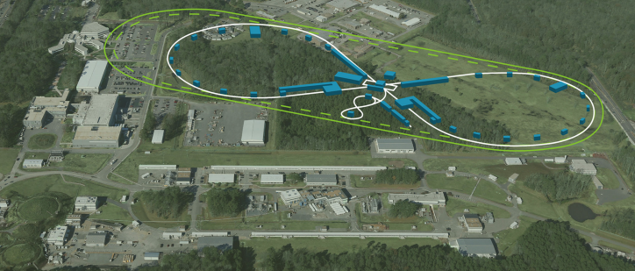
JLEIC

Slide 12
JLEIC Polarized Source
Bunch Charge
26 pC – 6.6 pC
Helicity Reversal
220 bunches
at 68.05 MHz
(14.69 ns)
72.07 µs
700 ms – 12 ms
…
…
…
…
3.233 µs
Damping Time
3 GeV – 12 GeV
Pockels cell switching time at CEBAF today ~70 µs. Planned for Moller Exp. ~10 µs
Source rate of 68.05 MHz is 1/7th Collider collision rate of 476.3 MHz (PEP-II cavities)
Harmonic number of ring is 3416 and revolution time is 7.17 µs
Half ring is filled with one helicity (1540 bunches – 3.233 µs) and second half is filled with opposite helicity (1540 bunches – 3.233 µs)
Two gaps between two helicities (each 0.353 µs) allow for beam abort, ion cleaning, turning on/off injection kicker, and detector readout
Injection cycles repeat until ring is filled to required current

Slide 13
Time Structure of Polarized e⁻ Injection
Mid-cycle 1, inject the 1st of every 7 buckets in the ring
Bunch train, up polarization
Bunch train, down polarization
220 bunches, 3.233µs
(I_{ave}= 0.9mA @6GeV CEBAF)
14.69 ns, 68.05 MHz (7 ring buckets)
2ns, 476.3 MHz(ring freq.)
13 pC bunch
Waiting for damping 12-700ms
……
Waiting for 72.07µs
……
3416*10.5turns/476.3MHz=75.3ms
12-700ms, ~2× e-ring damping time at different energy
Note that:
An average injected beam current of tens-of-nA level (same as or lower than initial injection beam current) can maintain a high equilibrium polarization in whole energy range
Same time structure of polarized electron injection can be applied to both initial and top-off injections at a certain energy, but charge per bunch may/can vary
 | Unit | Energy
 | GeV | 3 | 6 | 10
Charge per bunch | pC | 26 | 13 | 8
Peak current (CW) | mA | 1.8 | 0.9 | 0.55
Pulse current | µA | 0.015 | 0.035 | 0.175
Injection time | min. | 23 | 10 | 0.5

Slide 14
Collider Ring Issues
Helicity stable time is 3.233 µs and detector readout time is 0.353 µs – for CEBAF, helicity stable time is 1 ms to 33 ms and detector readout time is 70 µs
Electron-ion bunches collides for many hours before bunches are aborted and fresh ones are injected in rings
Continuous top-off injections will be used to apply charge feedback to zero charge asymmetry
Gear switching, where number of ion bunches is different than electron punches, is necessary – each electron bunch will interact with all ion bunches instead of one electron bunch interacts with same ion bunch all times
No random helicity flipping or delayed helicity reporting is possible
We asked CASA to consider spin flipping in the electron ring similar to the ion ring.

Slide 15
Polarized ions, non-polarized Electrons?
Access different combination of observables
Can fill ion ring with two helicities or one helicity – may use weak solenoid to flip helicity
Physics asymmetry is comparable
Ion Ring has 1 ms to 0.1 sec spin flipping with week solenoid

Slide 16
Example
Assume A_{physics} = 100 ppm
Charge asymmetry of 1% and detector non-linearities of 2%
  Error on asymmetry is 200 ppm → must implement charge feedback
P⁺ = 80% and P– =70%
  Error on asymmetry is about 13 ppm, no need for polarization feedback.

Slide 17
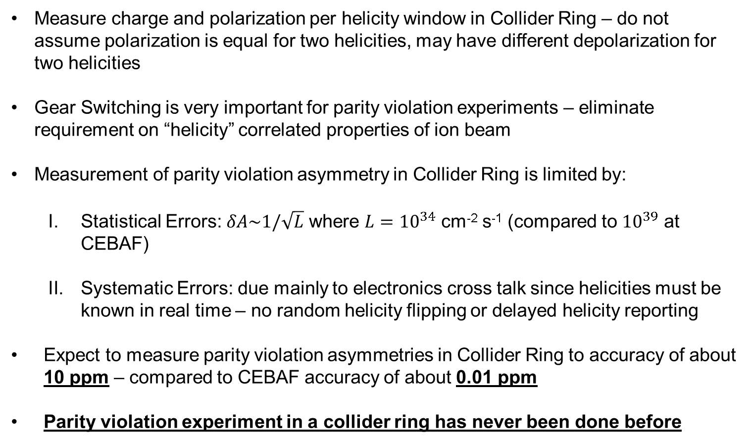
Summary
Measure charge and polarization per helicity window in Collider Ring – do not assume polarization is equal for two helicities, may have different depolarization for two helicities
Gear Switching is very important for parity violation experiments – eliminate requirement on “helicity” correlated properties of ion beam
Measurement of parity violation asymmetry in Collider Ring is limited by:
  Statistical Errors: $δA\sim 1/\sqrt{L}$ where $L={10}^{34}$ cm⁻² s⁻¹ (compared to ${10}^{39}$ at CEBAF)
  Systematic Errors: due mainly to electronics cross talk since helicities must be known in real time – no random helicity flipping or delayed helicity reporting
Expect to measure parity violation asymmetries in Collider Ring to accuracy of about 10 ppm – compared to CEBAF accuracy of about 0.01 ppm
Parity violation experiment in a collider ring has never been done before

Slide 18
APPENDIX I: Report of the Community Review of EIC Accelerator R&D

Slide 19
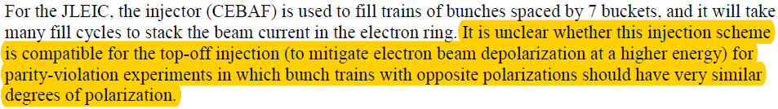
G. Injectors
Discussion :
Risk :
Recommendations :

Slide 20
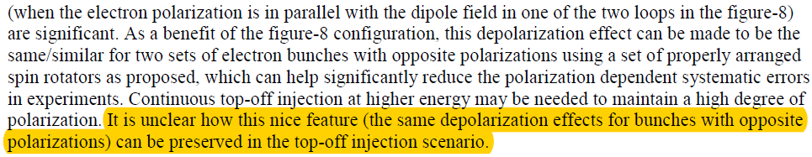
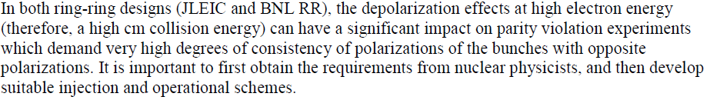
K. Polarization Manipulation
Discussion :
Risk :
Recommendations :

Slide 21
APPENDIX II: Electronic Cross-talk & Ground Loop Elimination in CEBAF Injector

Slide 22
Electronic Cross-talk & Ground Loop Elimination in Injector
VME Crate of Helicity Control Board is floating and powered with isolation transformer.
Helicity Board generates two real time helicity signals: Helicity Flip and nHelicity Flip. Current drawn by board does not depend on helicity state.
Helicity signal is generated by pseudo-random bit generator. No correlation between helicity signal and any other signal in Accelerator or in Hall.
Outside world receives only Delayed Helicity signal. This signal tells what helicity was in the past so there is no knowledge of real time helicity.
Helicity Magnets VME Crate which receives one of the two real time helicity signals (nHelicity Flip) is also floating and powered by isolation transformer.
Real time helicity signal (Helicity Flip) that goes to Laser Hut is isolated. All electronics that can see real time helicity are floating (next slide).
All helicity-correlated beam asymmetries (position, angle, charge, energy, and size – and thus beam scraping) are minimized so helicity is the only real time property of beam that is changing.
Programming of voltage setpoints of Pockels Cell and IA’s (both receive Helicity Flip signal) in Laser Hut passes through galvanic isolation card and there are no readbacks of these voltages.

Slide 23
Normal Grounded VME CRATE
(slow status and control - nothing occurs at helicity flip rate)
16 bit DAC: Pockels Cell (PC) ±HV setpoints (0 – ±4000 V)
16 bit DAC: Hall A, B, C Intensity Attenuator (IA) HV setpoints
RS-232: Rotating half-wave plate (RHWP) and laser attenuators
Discrete Digital I/O: Insertable half-wave plate (IHWP)
FLOATING VME CRATE
Helicity Control Board
Helicity Flip Fiber
IA0 Fiber
IA1 Fiber
Injector Service Building
Injector Tunnel Laser Hut
Optical Switch Control
Galvanic Analog/Digital Isolation Card
PC +HV Supply
Fast High Voltage Switch
Floating Analog/Digital I/O
PC -HV Supply
IHWP
RHWP &
Attenuators
IA
HV Supply
PockelsCell
AC Power Source
Floating DC Power
To Floating Components
Halls IA’s
Floating Circuit Common

Slide 24
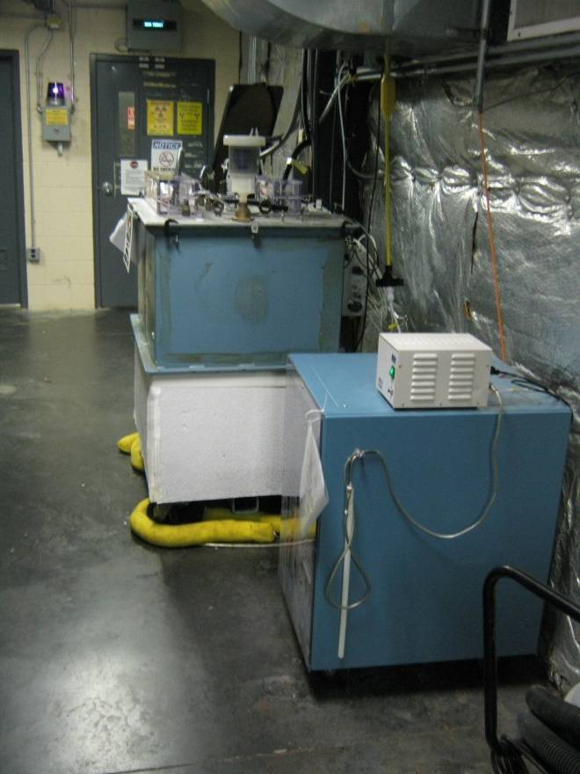
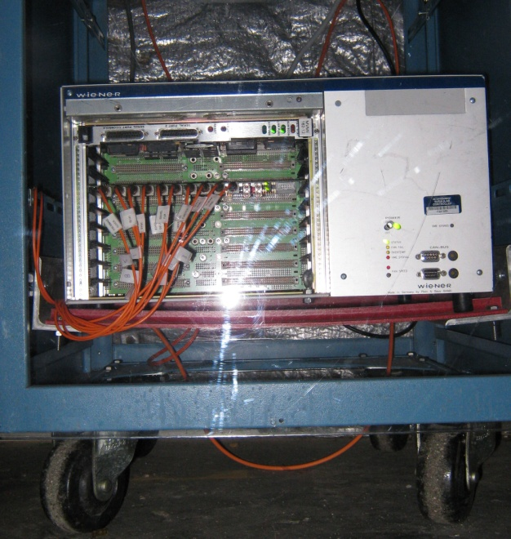
Fiber Cable
Isolation Transformer
Power Cable with Ground Pin Cut
Ground Rod
Floating VME Crate

Slide 25
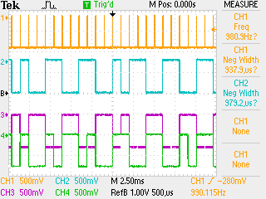
T_Settle
Helicity Flip
8– flips delay
nHelicity Flip
Delayed Helicity

