Slide 1
MDL0L02 Dipole Field
July 6, 2016

Slide 2
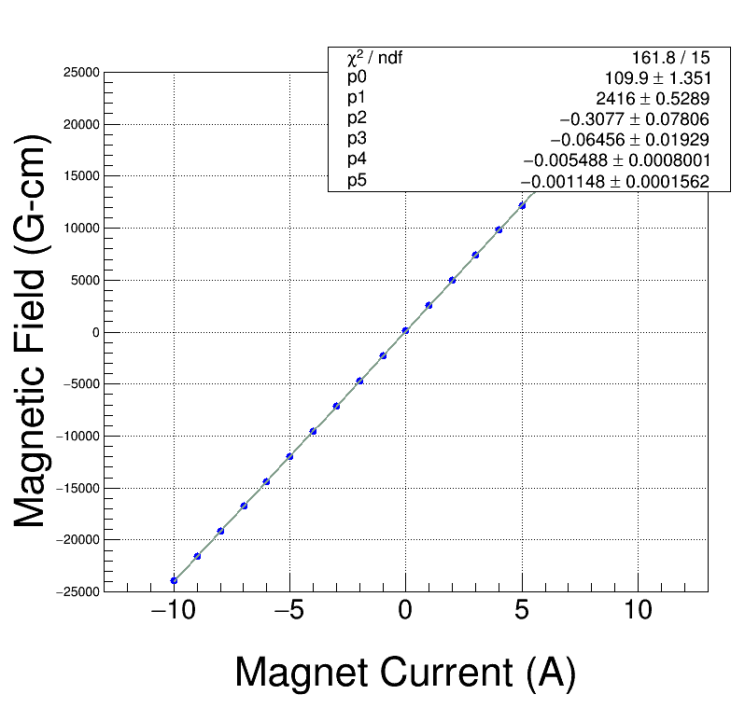
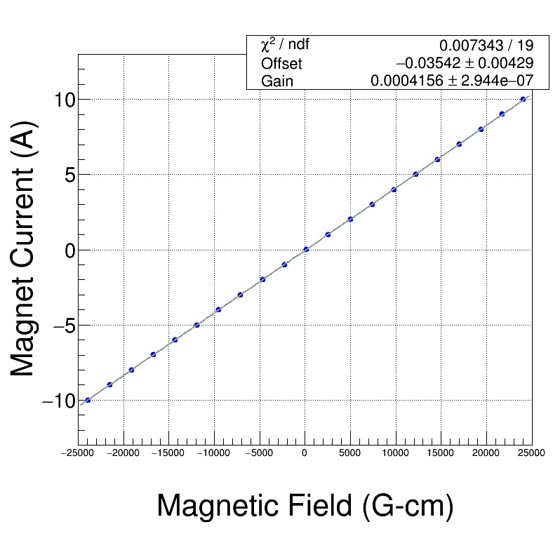
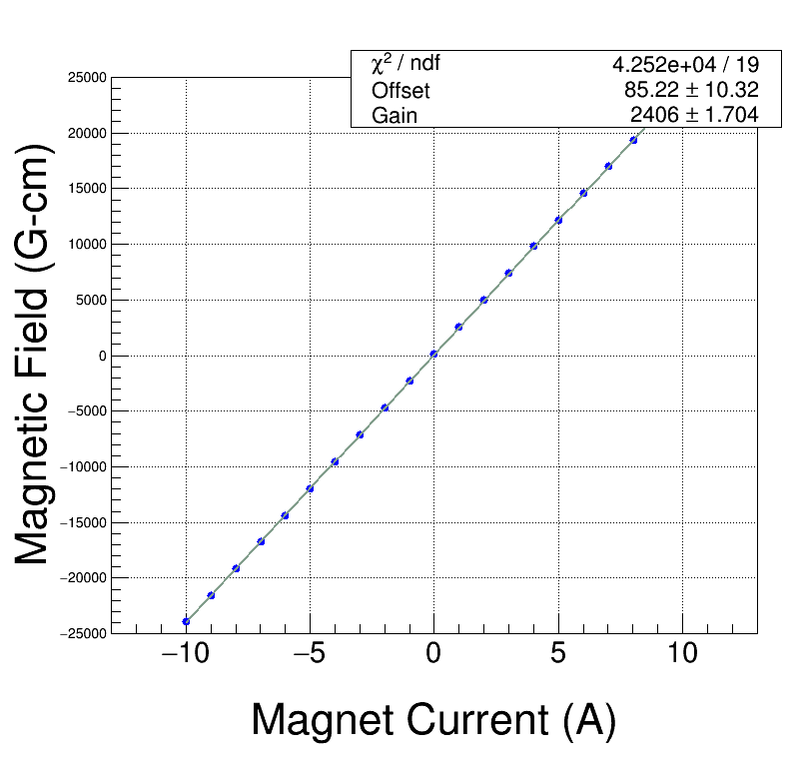
Field Map
Meas. Date: 8/29/2014
Coil used: Hall Probe Stepper
Current (A) Strength (Gauss-cm)
-------------- -------------------
-9.992 -23944.2
-8.996 -21569.6
-7.991 -19169.0
-6.990 -16769.5
-5.990 -14360.7
-4.993 -11954.6
-3.994 -9542.8
-2.989 -7116.1
-1.989 -4698.2
-0.990 -2283.6
0.003 126.0
1.009 2548.4
2.009 4960.8
3.009 7374.6
4.010 9785.8
5.010 12192.0
6.010 14589.8
7.011 16980.4
8.013 19360.4
9.015 21720.5
10.014 24038.1

Slide 3
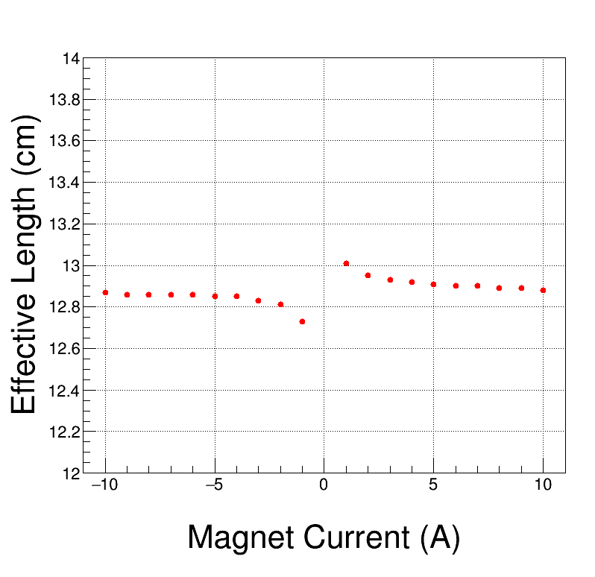
Field Map Effective Length
Meas. Date: 8/29/2014
Coil used: Hall Probe Stepper
Current (A) Eff. L (cm)
-------------- -------------------
10.00 12.88
9.00 12.89
8.00 12.89
7.00 12.90
6.00 12.90
5.00 12.91
4.00 12.92
3.00 12.93
2.00 12.95
1.00 13.01
0.00 16.39
-1.00 12.73
-2.00 12.81
-3.00 12.83
-4.00 12.85
-5.00 12.85
-6.00 12.86
-7.00 12.86
-8.00 12.86
-9.00 12.86
-10.00 12.87

Slide 4
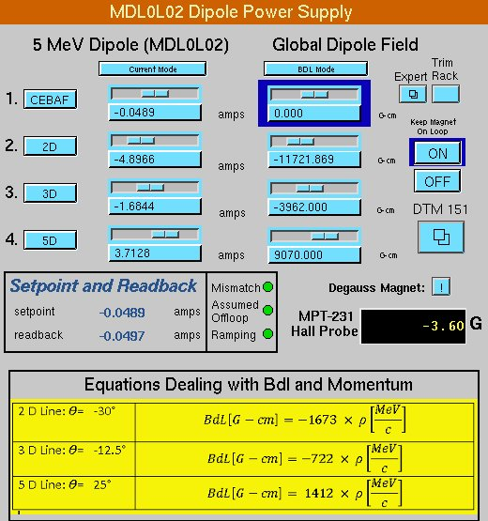
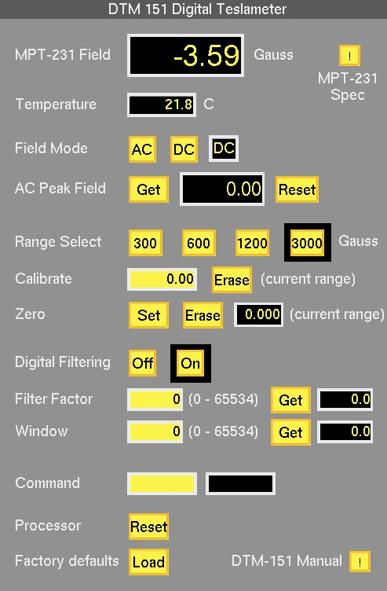
0 BdL

Slide 5
Distance from dipole center (cm) | <By> (G)
(Upstream) -15 | 0.4
-14 | 0.4
-13 | 0.3
-12 | 0.3
-11 | 0.2
-10 | 0.1
-9 | 0.0
-8 | -0.6
-7 | -2.2
-6 | -3.7
-5 | -3.9
-4 | -4.1
-3 | -3.9
-2 | -4.2
-1 | -3.9
0 | -3.8
1 | -3.9
2 | -3.9
3 | -4.0
4 | -3.8
5 | -3.9
6 | -2.1
7 | -0.6
8 | 0.0
9 | 0.1
10 | 0.3
11 | 0.6
12 | 0.6
13 | 0.6
14 | 0.6
(Downstream) 15 | 0.6
Dipole Survey (March 20, 2016)
On Hysteresis
I = -0.0489 A
BdL = 0.000 G-cm
Hall Probe = -3.98 G*
Zero is center of dipole and survey was done along 0L Region using a hand-held Hall probe
*Accuracy: ±(0.03% of reading +0.006% of full scale) max
Hall Probe = -3.98 G ± 0.18 G

Slide 6
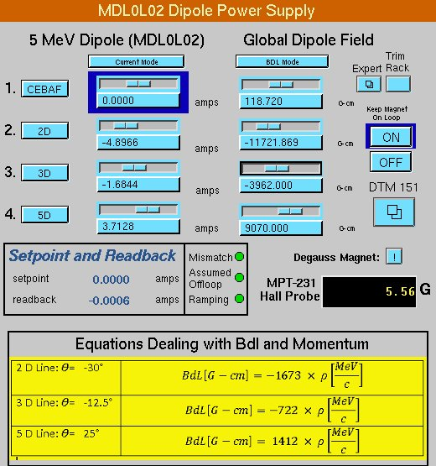
0 Current

Slide 7
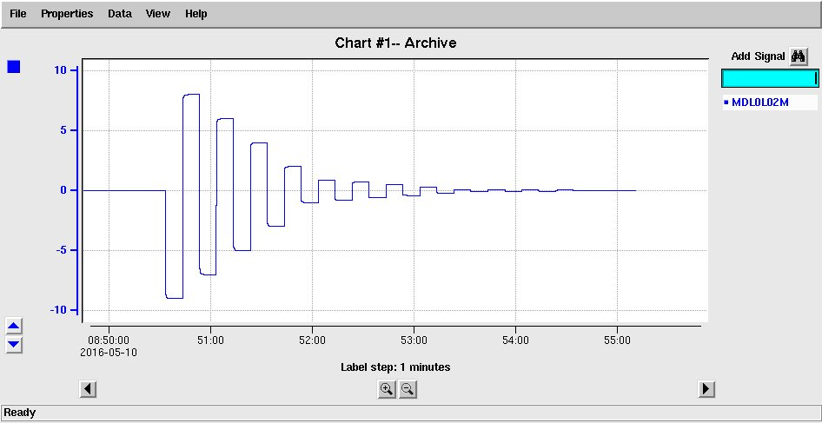
Degaussed

Slide 8
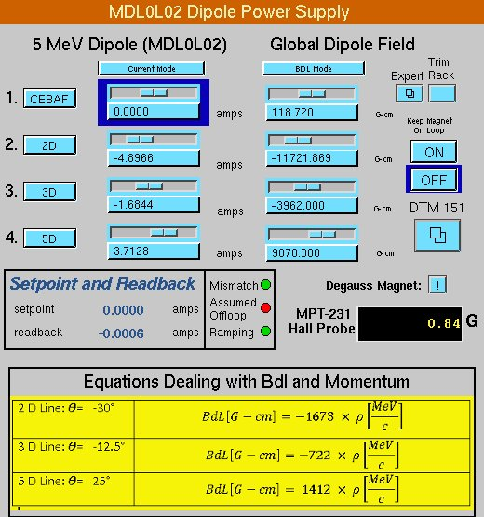
Degaussed

Slide 9
Test at Magnet (March 15, 2016)
With cables from trim card swapped at magnet (after degaussing), Hall Probe = -0.26 G
With current cables disconnected, Hall Probe = -0.06 G
With cables back to normal at magnet (after degaussing), Hall Probe = +0.50 G
With current set to zero and magnet degaussed, the Hall Probe measures +0.5 G. At this setting, we measured about +1.3 mA of current to magnet using KEITHLEY DMM7510 in series with MDL0L02.

Slide 10
Trim Card Set Current | DMM Measured Current
0.0 | +0.0011
1.0 | 1.0008
2.0 | 2.0002
3.0 | 3.0010
4.0 | 4.0009
5.0 | 5.0014
6.0 | 6.0014
7.0 | 7.0018
8.0 | 8.0034
9.0 | 9.0042
9.0 | 9.0044
8.0 | 8.0044
7.0 | 7.0034
6.0 | 6.0030
5.0 | 5.0030
4.0 | 4.0025
3.0 | 3.0024
2.0 | 2.0013
1.0 | 1.0009
0.0 | +0.0016
-1.0 | -0.9984
-2.0 | -1.9985
-3.0 | -2.9992
-4.0 | -3.9988
-5.0 | -4.9986
-6.0 | -5.9982
-7.0 | -6.9980
-8.0 | -7.9987
-9.0 | -8.9986
0.0 | +0.0013
Use KEITHLEY DMM7510 in series with MDL0L02 to measure current powering magnet
For Bubble Chamber, we are especially interested in momenta around 5.5 MeV/c (fluorine measurement) and 8.5 MeV/c (oxygen measurement)
Corresponding magnet currents are 3.2 A and 5.0 A. At these currents, Trim card is good to about 1 to 2 mA.

Slide 11
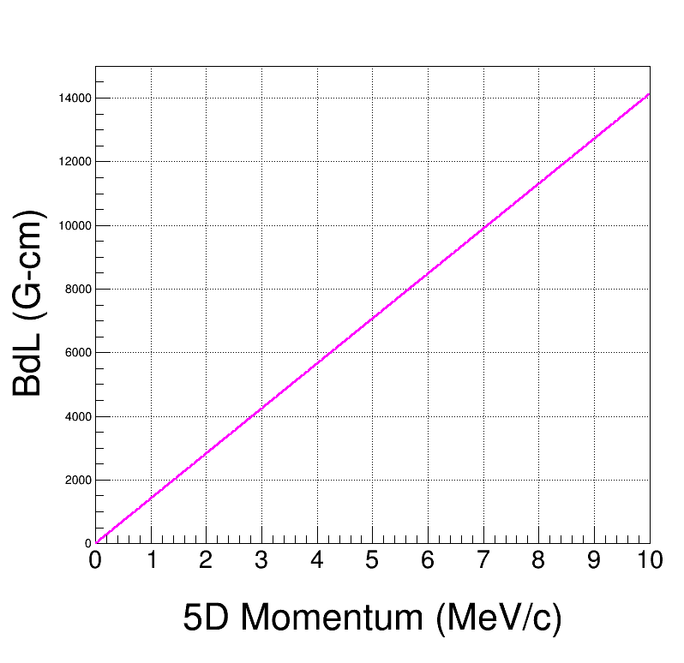
Beam Momentum in 5D (opera – Jay)
BdL = -4.811 + 1416.2*p - 1.2399*p² + 0.1646*p³ - 0.009795*p⁴ + 0.00021257*p⁵
Jay's Tech Note TN-15-017, page 9.

Slide 12
Scanned Dipole current from 9.0 to -9.0 A (with ON hysteresis) and recorded Bdl and Hall Probe readings
March 20, 2016

Slide 13
From Field Map
Current (A) | Core Field (G)
10.01 | 1863.40
9.01 | 1682.70
8.01 | 1499.15
7.01 | 1314.35
6.01 | 1128.70
5.01 | 942.75
4.01 | 756.15
3.01 | 569.25
2.01 | 382.25
1.01 | 195.15
0.00 | 7.40
-0.99 | -179.45
-1.99 | -366.65
-2.99 | -554.15
-3.99 | -742.50
-4.99 | -929.65
-5.99 | -1116.25
-6.99 | -1302.90
-7.99 | -1489.25
-9.00 | -1675.60
-9.99 | -1860.05
Current (A) Hall Probe (G)
9.0 1676.84
8.0 1494.811
7.0 1311.098
6.0 1126.72
5.0 941.599
4.0 755.813
3.0 569.625
2.0 382.975
1.0 196.247
0.0 9.73
-1.0 -176.974
-2.0 -363.63
-3.0 -550.311
-4.0 -736.641
-5.0 -922.818
-6.0 -1108.806
-7.0 -1294.494
-8.0 -1480.191
-9.0 -1665.526
From Current
Scan

Slide 14
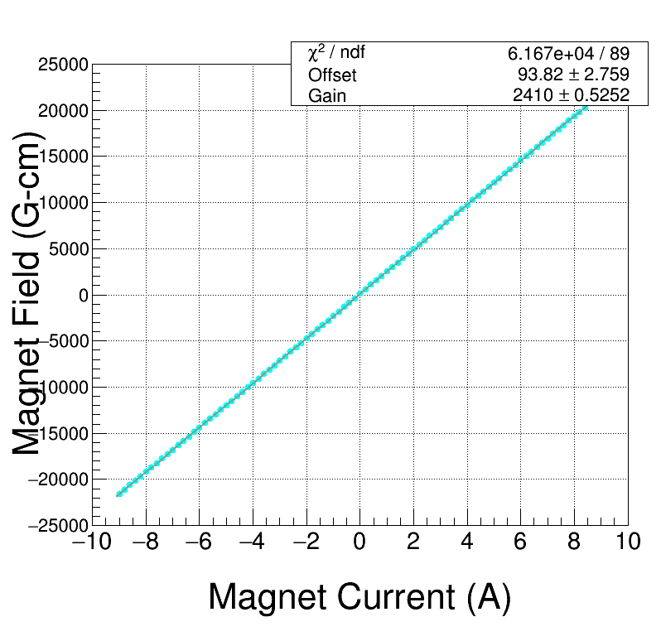
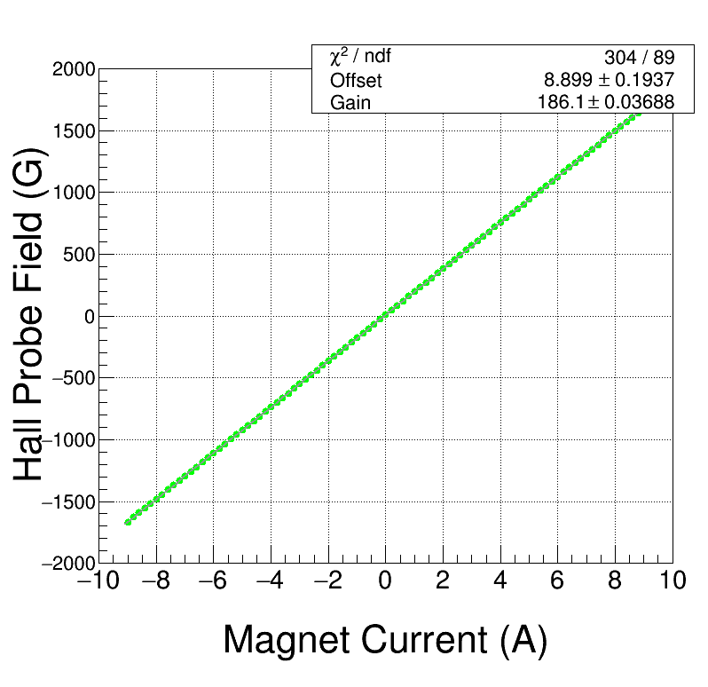
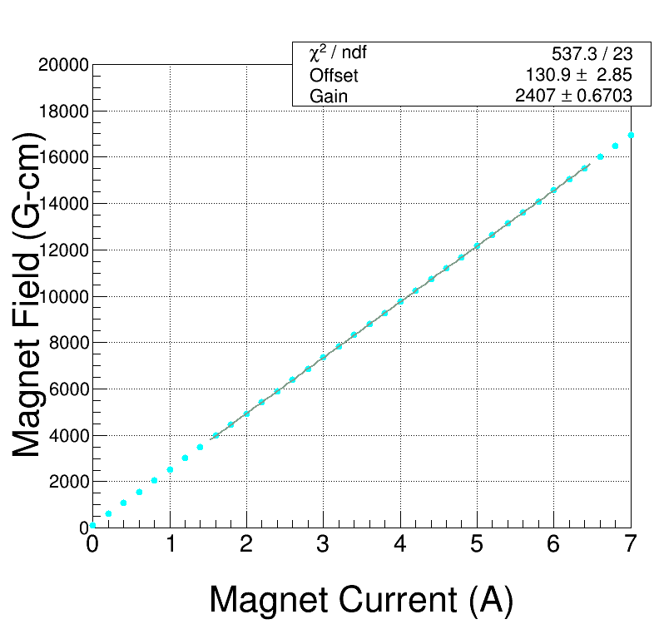
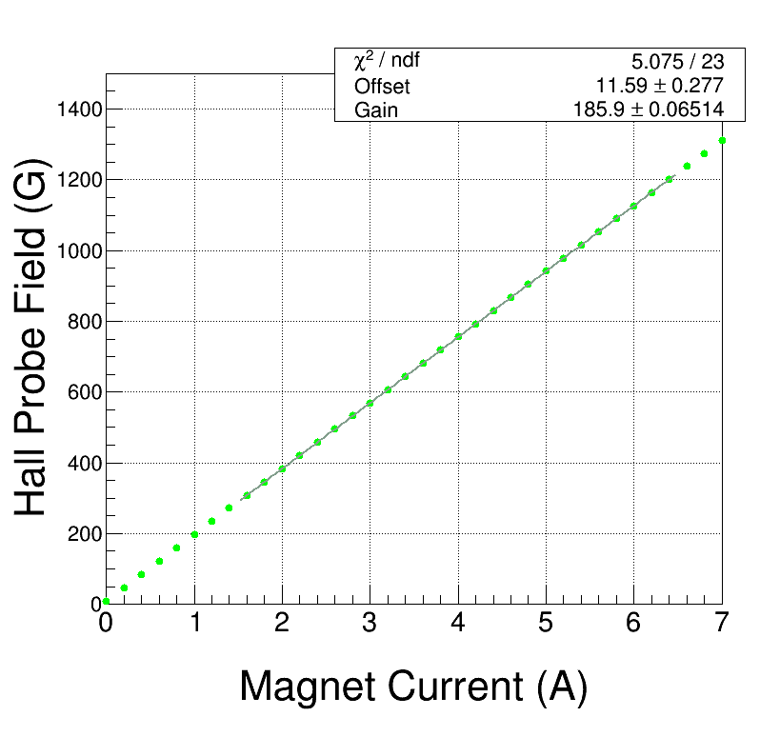

Slide 15
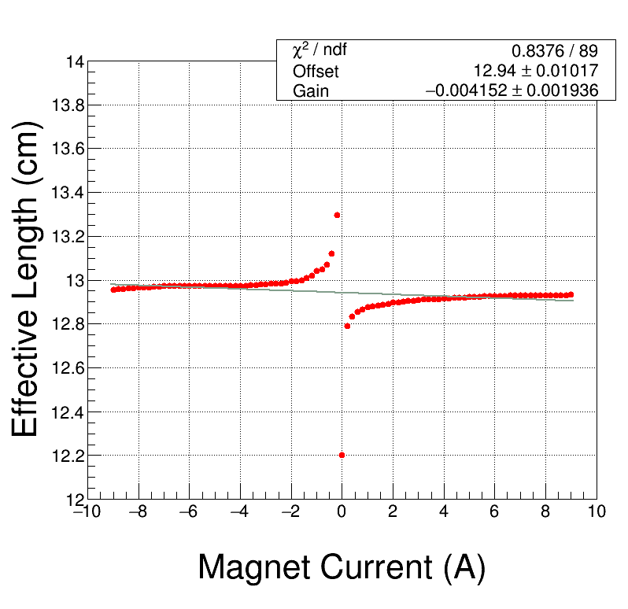
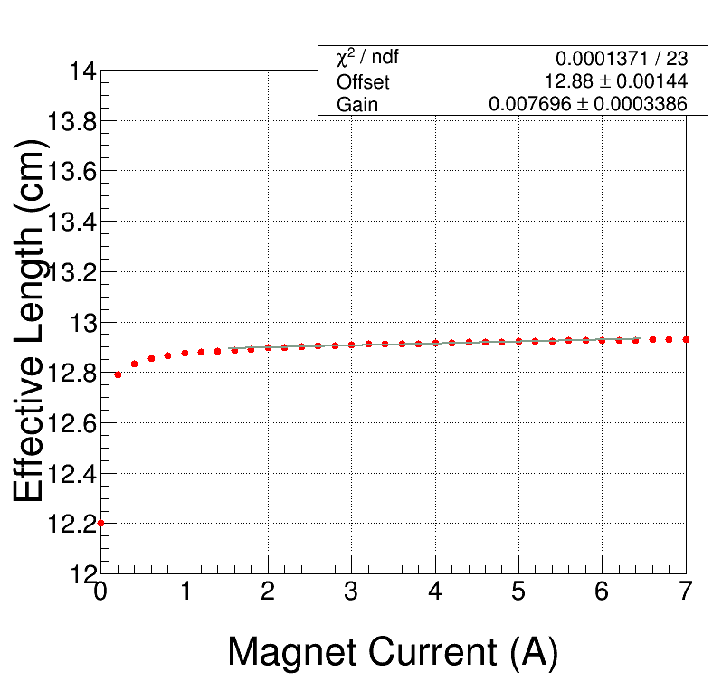
Field Ratio
BdL / Hall Probe

Slide 16
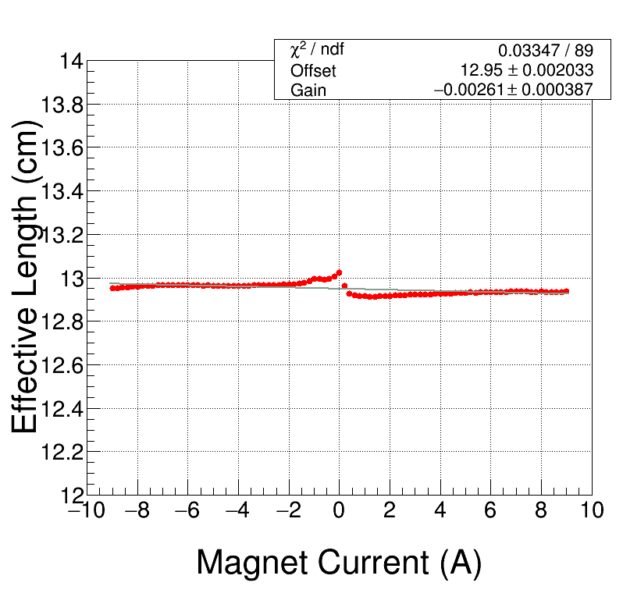
(BdL+8.0) / Hall Probe
(i.e., added small offset to field map)

Slide 17
Scanned Dipole current from 9.0 to -9.0 A (with ON hysteresis) and recorded Bdl and Hall Probe readings
May 11, 2016

Slide 18
From Field Map
Current (A) | Core Field (G)
10.01 | 1863.40
9.01 | 1682.70
8.01 | 1499.15
7.01 | 1314.35
6.01 | 1128.70
5.01 | 942.75
4.01 | 756.15
3.01 | 569.25
2.01 | 382.25
1.01 | 195.15
0.00 | 7.40
-0.99 | -179.45
-1.99 | -366.65
-2.99 | -554.15
-3.99 | -742.50
-4.99 | -929.65
-5.99 | -1116.25
-6.99 | -1302.90
-7.99 | -1489.25
-9.00 | -1675.60
-9.99 | -1860.05
Current (A) Hall Probe (G)
9.0 1679.413
8.0 1497.175
7.0 1313.228
6.0 1128.575
5.0 943.145
4.0 757.186
3.0 570.716
2.0 383.856
1.0 196.884
0.0 10.084
-1.0 -176.862
-2.0 -363.784
-3.0 -550.767
-4.0 -737.396
-5.0 -923.895
-6.0 -1110.12
-7.0 -1296.09
-8.0 -1481.945
-9.0 -1667.458
From Current
Scan

Slide 19
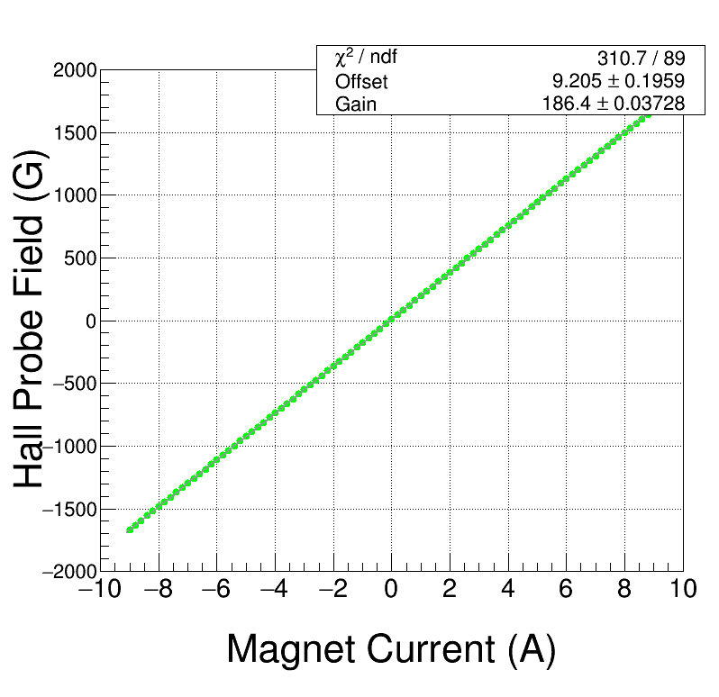
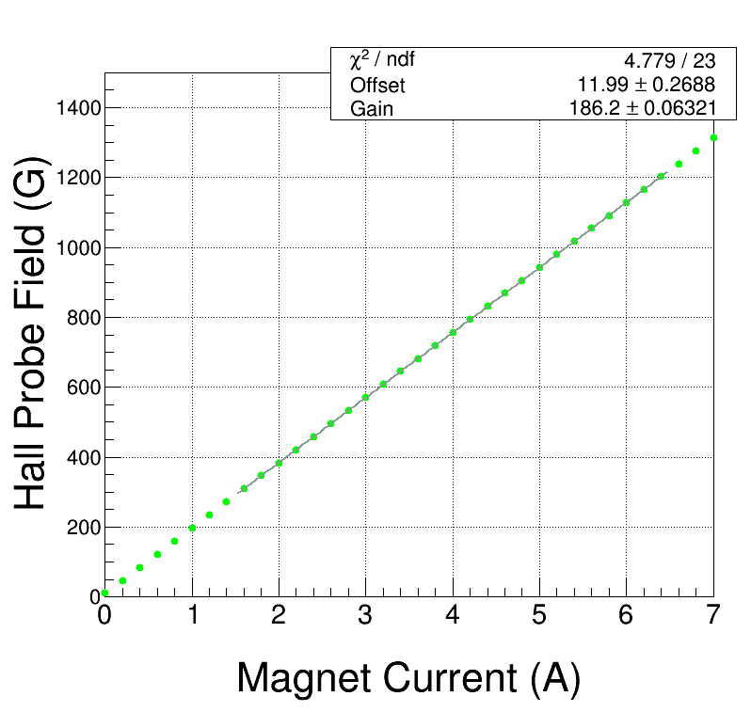

Slide 20
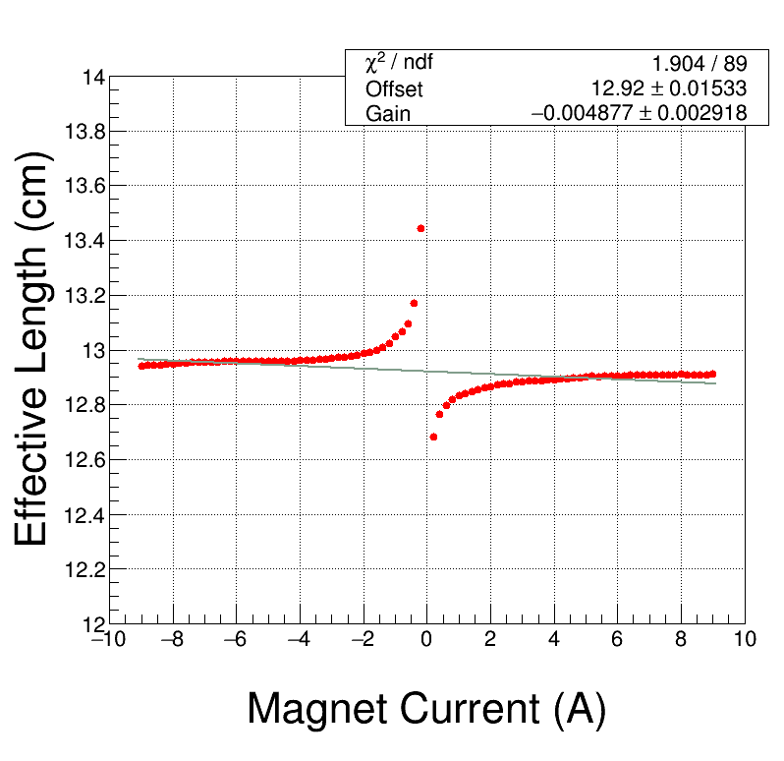
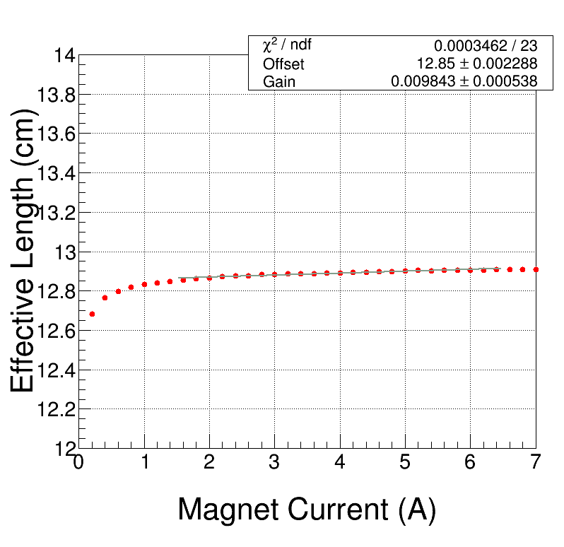
Field Ratio
BdL / Hall Probe

Slide 21
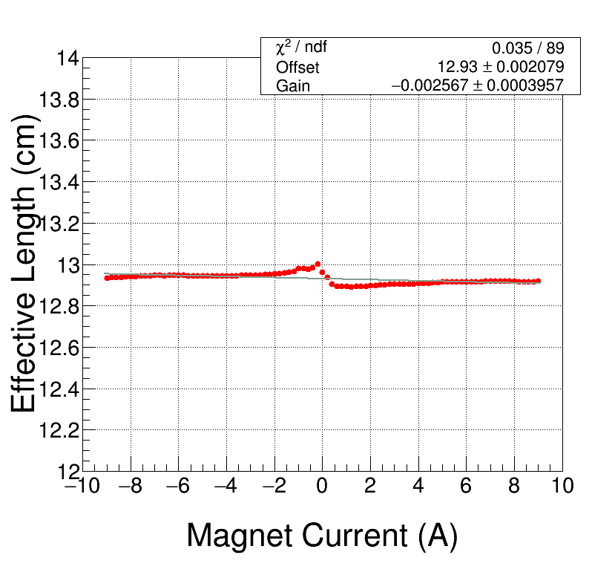
(BdL+12.0) / Hall Probe
(i.e., added small offset to field map)

Slide 22
Summary - I
Hints that there are problems with Field Map:
Measured Hall Probe field in Injector is a bit too large when BdL is set to zero
Effective Length from Field Map depends on magnet current
Recommend to use spare magnet to resolve this problem
For magnet currents below 6 A, Trim Card is good to 2 mA
Is MPT-231 Hall Probe mounted right inside MDL0L02? Should use G10 to hold probe parallel to magnet
Hall Probe MPT-231 measurements at very small fields vary by about 0.2 – 0.3 G, due to exact hysteresis history
Jay’s model is good to 0.1% (see Tech Note TN-15-017)
Either due to errors in current measurement and/or environmental fields

Slide 23
Summary - II
For Beam Energy Measurement:
CEBAF : BdL $≠$ 0 (due to field map error), instead:
BdL = Hall Probe * Magnetic Length (or use my field survey)
BdL $\sim$ -3.6 G * 12.9 cm = -46 G-cm. Treat as another horizontal corrector.
Spectrometer Lines (2D, 3D, 5D): magnet currents between 2 A and 6 A are most relevant. Till we check field map, we will assume a 46 G-cm error on field measurements.
 | Error
Trim Power Supply | 2 mA
Magnet Model | 0.1%
Field Map | 46 G-cm
For Mott Energy Measurements

