Slide 1
Parity Quality Beam (PQB) Working Group Report
OPS StayTreat
Riad Suleiman
Friday July 17, 2015

Slide 2
Upcoming Parity Violation Experiments
Experiment | Energy (GeV) | Pol (%) | I (µA) | Target | A_{pv} (ppb) | Maximum Charge Asym (ppb) | Maximum Position Diff (nm) | Maximum Angle Diff (nrad) | Maximum Size Diff (δσ/σ)
QWeak (Achieved) | 1.155 | 89.0 | 180 | ¹H (35 cm) | 281±46 | 8±15 | 5±1 | 0.1±0.02 | 10⁻⁴
PREx-II | 1.0 | 90 | 70 | ²⁰⁸Pb (0.5mm) | 500±15 | 100±10 | 1±1 | 0.3±0.1 | 10⁻⁴
C-REx | 2.2 | 90 | 150 | ⁴⁸Ca (5mm) | 2000±42 | 100±10 | 1±1 | 0.3±0.1 | 10⁻⁴
MOLLER | 11.0 | 90 | 60 | ¹H (150 cm) | 35.6±0.74 | 10±10 | 0.5±0.5 | 0.05±0.05 | 10⁻⁴
PREx-II is tentatively scheduled for Hall A in 2017
C-REx is tentatively scheduled for Hall A in 2017
MOLLER is planned for Hall A in 2022

Slide 3
Issues from QWeak
Beam Halo: there was beam halo that could develop a large helicity-correlated charge asymmetry
Beam halo charge asymmetry was found to depend on:
Beam loss at Injector Apertures
Laser phase
Machine tuning
What can we do to help?
BCM Resolution is not suitable for MOLLER:
QWeak achieved 65 ppm but MOLLER requires 10 ppm
BCM digital receiver bench studies found that local oscillator phase and amplitude noise is a likely cause of 65 ppm noise floor
Try new digital receivers
Improve phase/amplitude noise of local oscillator

Slide 4
Hall A 2015/2016 Beamline Plan for PQB
Install QWeak halo monitor in Hall A beamline
Equip two BCMs with new-style digital receivers
Install QQQ cavity triplet in Hall A beamline
Reinstate Hall A beam modulation system (air-core coils and associated control/drive electronics)
Beam modulation and accelerator Fast Feedback: is there a need to pause FFB when modulation is ON? does FFB implement a digital notch filter to attenuate modulation frequency (QWeak: 125 Hz for 20 s every 320 s) while passing all other frequencies?
Need software support
To be ready for beam studies this Fall

Slide 5
Synchrotron Radiation @ 11 GeV
Total synchrotron radiation (SR)
power (integrated over solid angle):
Energy loss per electron per Arc:
E_{loss} [MeV] = 0.04423 E⁴ [GeV] / ρ[m]
Area | ρ (m) | Energy Loss (MeV)
Arc 1 | 5.09 | 0.019
Arc 2 | 10.2 | 0.122
Arc 3 | 10.2 | 0.576
Arc 4 | 20.4 | 0.878
Arc 5 | 20.4 | 2.095
Arc 6 | 30.6 | 2.851
Arc 7 | 30.6 | 5.220
Arc 8 | 30.6 | 8.818
Arc 9 | 30.6 | 14.000
Hall A Arc | 40.1 | 3.070
Total |  | 38 MeV
Energy gain per
Linac is 1090 MeV

Slide 6
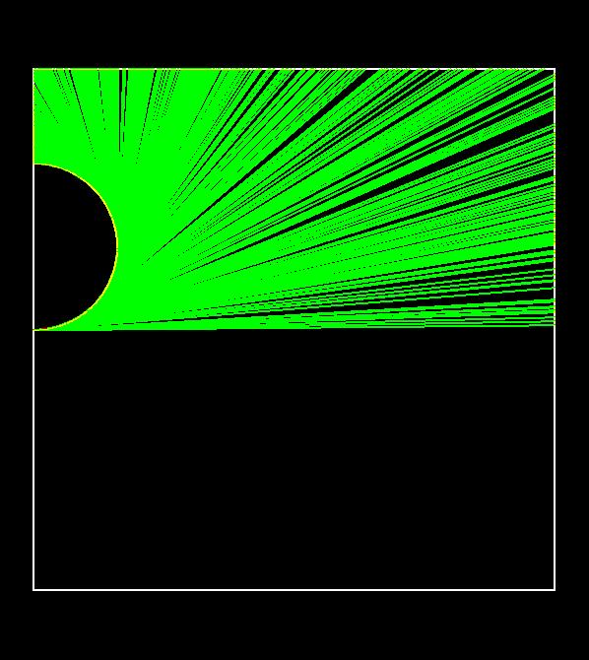
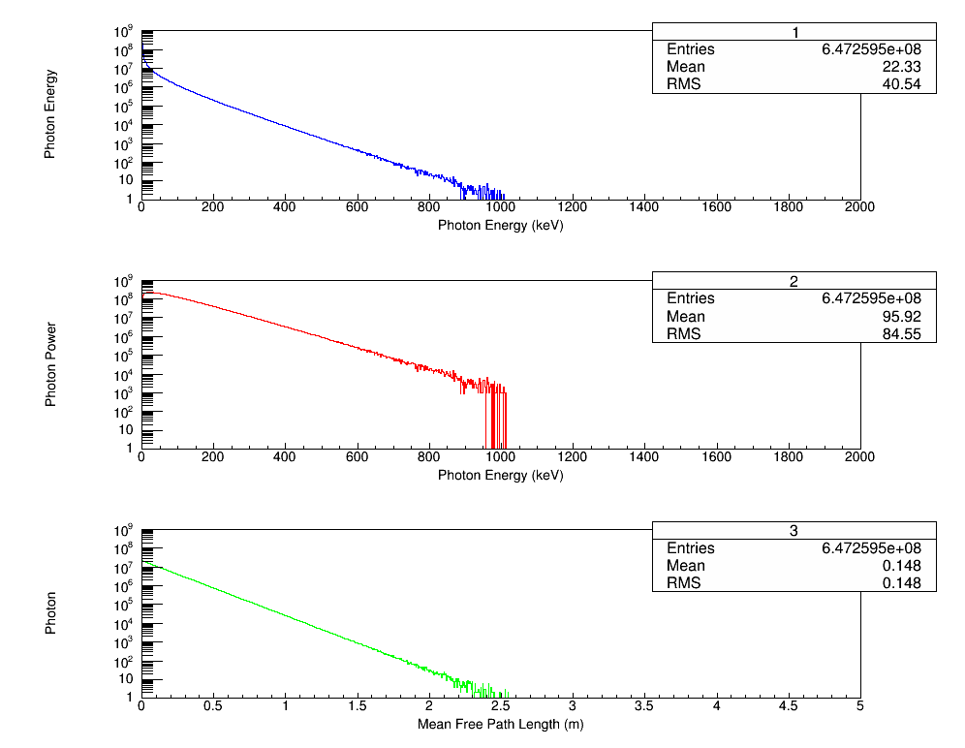
Simple GEANT4 Model:
10⁶ electrons at 10 GeV, Arc 9: ρ=30.6 m
Average of n=647 photons per electron, each $\left\langle ε\right\rangle$=22.33 keV
Energy spread due to SR in Arc 9
No non-gaussian tails since number of photons per electron per Arc is large ($n\sim 65 E$ [GeV])

Slide 7
Transverse Geometric Emittance and Energy Spread:
Provided by Yves
Area | Δp/p (10⁻³) | ε_{g,x} (nm) | ε_{g,y} (nm)
Inj Chicane | 0.5 | 4.00 | 4.00
Arc 1 | 0.05 | 0.41 | 0.41
Arc 2 | 0.03 | 0.26 | 0.23
Arc 3 | 0.035 | 0.22 | 0.21
Arc 4 | 0.044 | 0.21 | 0.24
Arc 5 | 0.060 | 0.33 | 0.25
Arc 6 | 0.090 | 0.58 | 0.31
Arc 7 | 0.104 | 0.79 | 0.44
Arc 8 | 0.133 | 1.21 | 0.57
Arc 9 | 0.167 | 2.09 | 0.64
Arc 10 | 0.194 | 2.97 | 0.95
Hall D | 0.18 | 2.70 | 1.03
Damping
Synchrotron
Radiation
Energy spread in Hall A is $\sim 2×{10}^{−4}$
Values are calculated at start of each Arc

Slide 8
What are the issues? Any polarization dependencies?
Yves to implement an ELEGANT model to calculate spin precision with SR included – standard 6 GeV formula will not work
Adiabatic Damping: amplitude of betatron oscillations (e.g., helicity-correlated position and angle differences etc.) is still damped by square root of ratio of momenta
Polarization Dependencies (?):
Total SR power depends on transverse polarization, ${ P}_{pol}/P_{unpol}\sim {10}^{−4}$
Spin-flip SR (Sokolov–Ternov self-polarization effect) of about
Total SR power for longitudinal polarized electrons is spin independent but power radiated into space above and below orbital plane is different and thus spin dependent ($A\sim {10}^{−5}$) – principle of Spin-Light Polarimeter
Helicity-correlated SR → Helicity-correlated emittance growth
Both cancel with helicity reversal
Notes:
References:
1. A Spin-Light Polarimeter for Multi-GeV Longitudinally Polarized Electron Beams.
P. Mohanmurthy and D. Dutta, IEEE TRANSACTIONS ON NUCLEAR SCIENCE 61, 528 (2014).
http://dx.doi.org/10.1109/TNS.2013.2291114
2. An observation of the spin dependence of synchrotron radiation intensity.
S. A. Belomesthnykh et al., Nucl. Instrum. Methods, 227, 173 (1984).
http://dx.doi.org/10.1016/0168-9002(84)90119-0
3. https://wiki.jlab.org/ciswiki/index.php/PQB_Meeting_April_30,_2015

Slide 9
Beam Studies:
Measure helicity-correlated beam properties in Hall A:
Energy difference at 1C12 in middle of Hall A Arc
Position and angle differences
Charge asymmetry
Measure beam halo
Measure at 1 GeV and confirm QWeak results
Measure at 11 GeV to study SR effects

Slide 10
Tasks Summary

Slide 11
Laser Table Tasks
Task | Sub Tasks | Date | Description
2 kHz Helicity Reversal |  | MOLLER | Requires 10 µs settle time – No ringing (not required for PREX-II, but hoped to test at this time). No Kerr Cell.
 | RTP Pockels Cell |  | Buy test crystals to characterize, design RTP quarter-wave system.
 | KD*P re-design |  | Model E-field to maximize Pockels Cell uniformity, buy a properly engineered, one with the correct cell-diameter-to-laser-beam-diameter aspect ratio
Pockels Cell Stewart Platform |  | 2016 | For remote optimization using e-beam. Assemble, build control software, qualify

Slide 12
Injector Tasks
Task | Sub Tasks | Date | Description
Reinstate Injector Parity DAQ
Improve 2-Wien Flip Optics |  | PREx-II
Injector Matching |  | PREx-II | Maximize damping
Helicity-correlated Beam Size Monitor |  | PREx-II | Looking for ideas!
Upgrade Helicity Magnet controls |  | PREx-II
Locate Helicity Magnets to span (x,x') and (y,y') to minimize both position and angle |  | Fall 2015
Augment helicity steering dipoles with helicity size quads |  | PREx-II
Share Injector apertures' current read-back with parity DAQ |  | Fall 2015
MOLLER Feedback to minimize transverse polarization |  |  | Once a shift, adjust Wien angle

Slide 13
Accelerator Tasks
Task | Sub Tasks | Date | Description
Study Depolarization at Higher Passes
 | Energy stability and precession to Hall
Synchrotron Radiation |  | MOLLER
 | Spin precession
 | Adiabatic damping
 | Polarization dependence
 | Helicity-correlated emittance growth
MOLLER (g-2) Spin Flip |  |  | Change beam energy by 100 MeV (few reversals)

Slide 14
Hall A Tasks
Task | Sub Tasks | Date | Description
Reinstate Hall A Parity DAQ
Beam Halo
 | Install QWeak halo monitors in Hall A | Fall 2015
BCM Resolution
 | New cavities and receivers | Fall 2015
 | BCM receiver bench studies and beam studies | Fall 2015
Beam Modulation |  | Fall 2015
Beam Polarimetry
Spin Dance
Beam Matching and Optics
Phase Trombone

