Slide 1
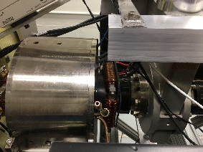
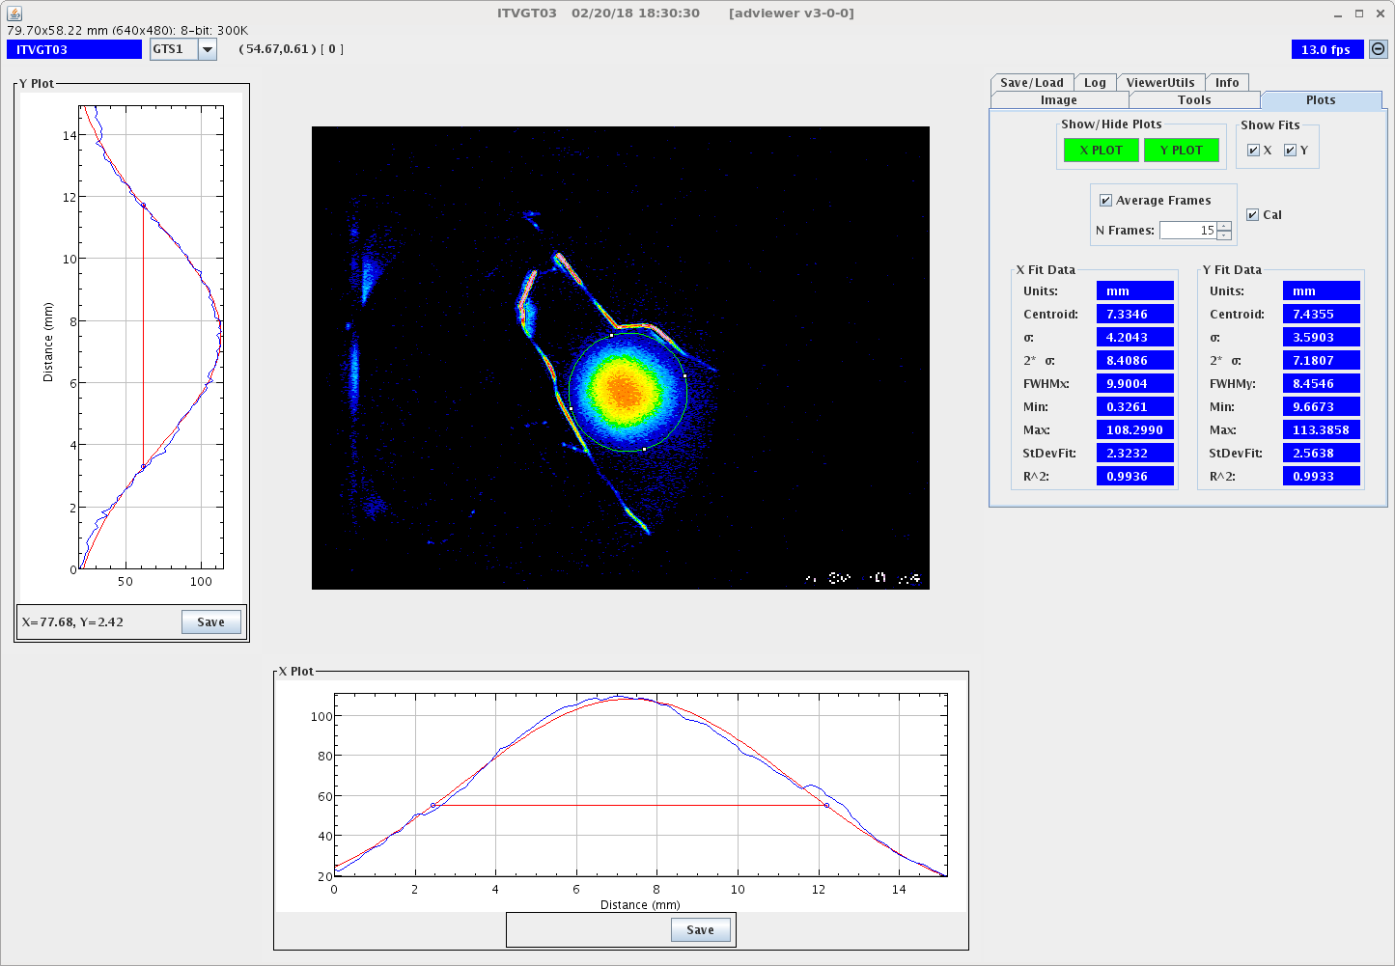
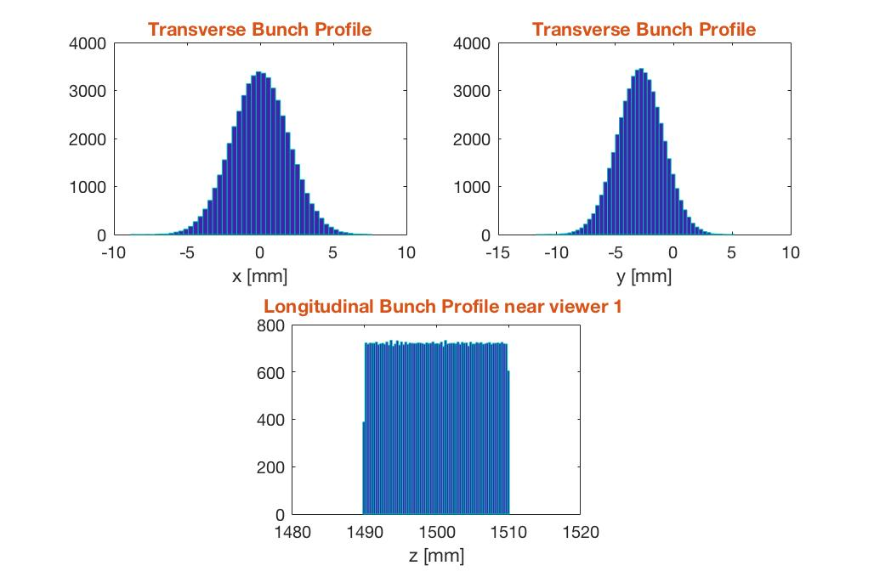
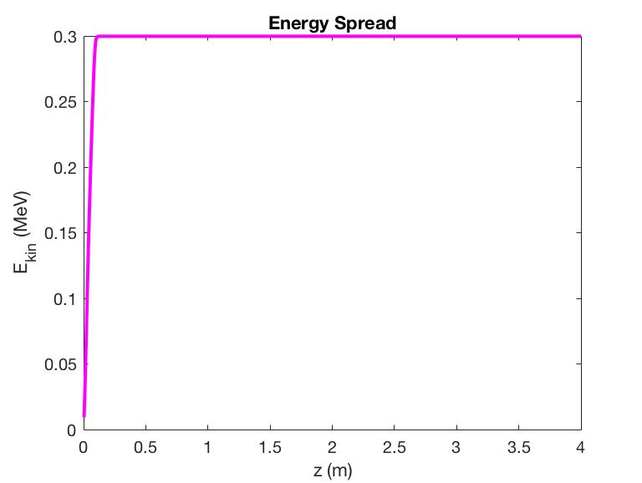
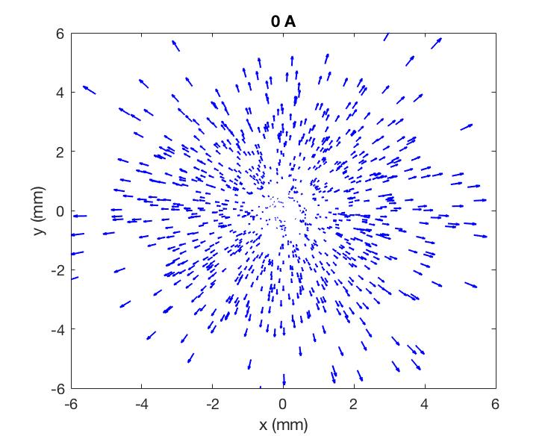
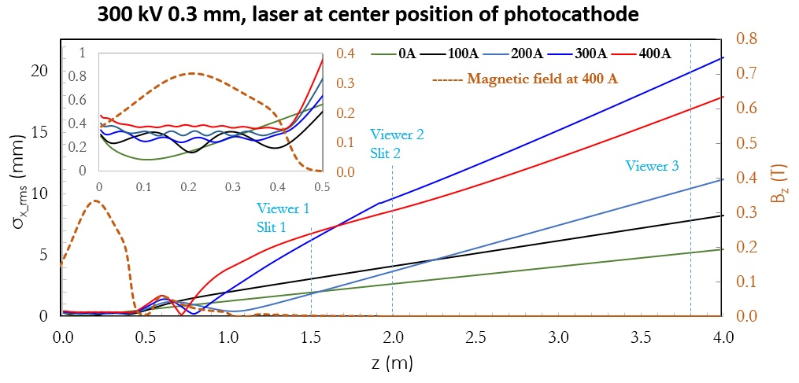
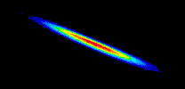
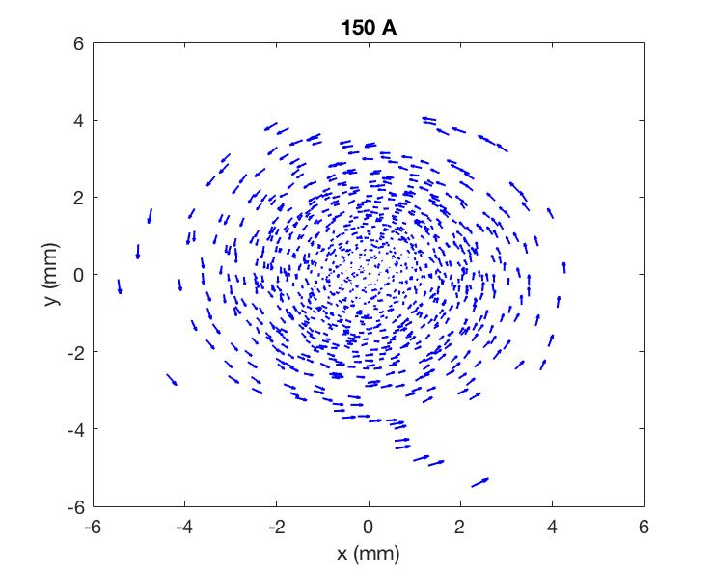
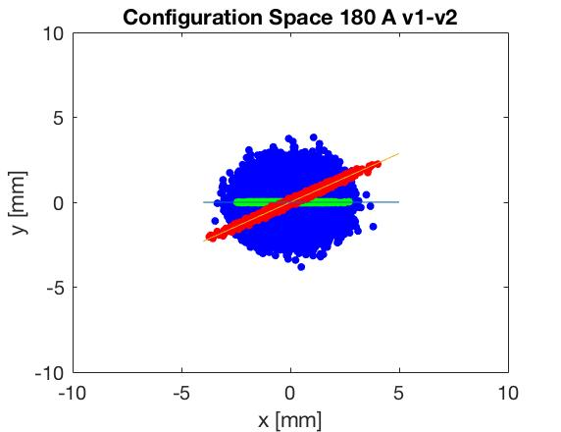
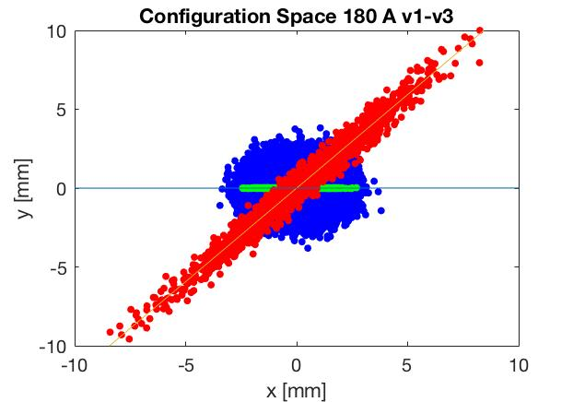
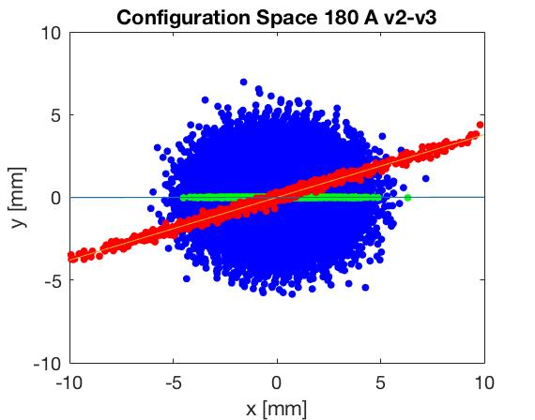
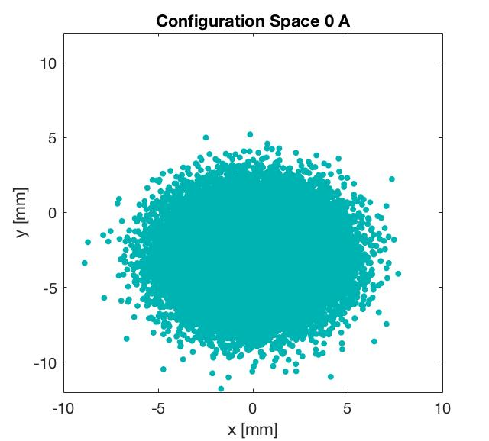
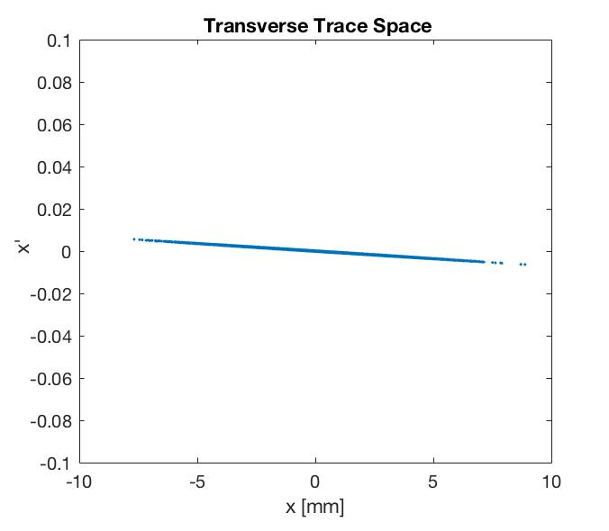
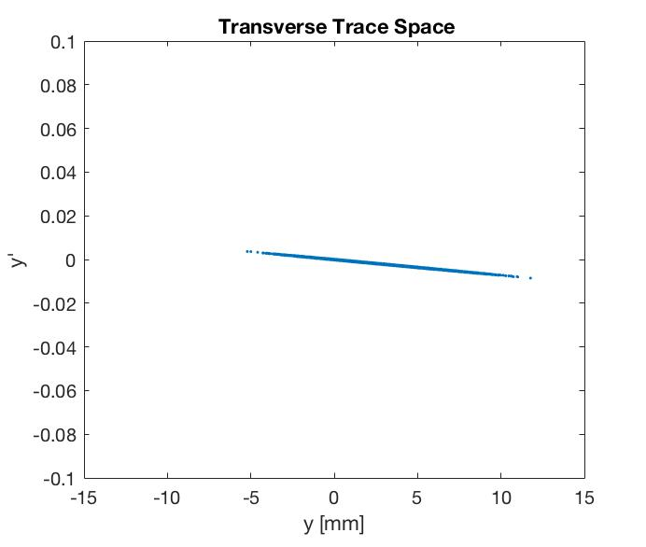
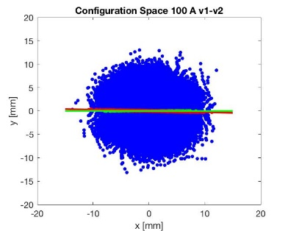
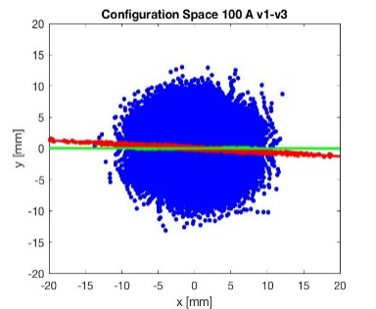
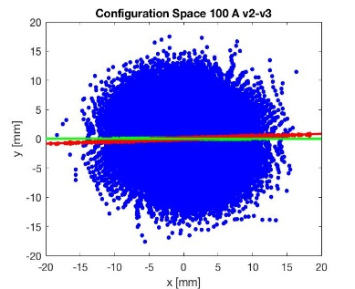
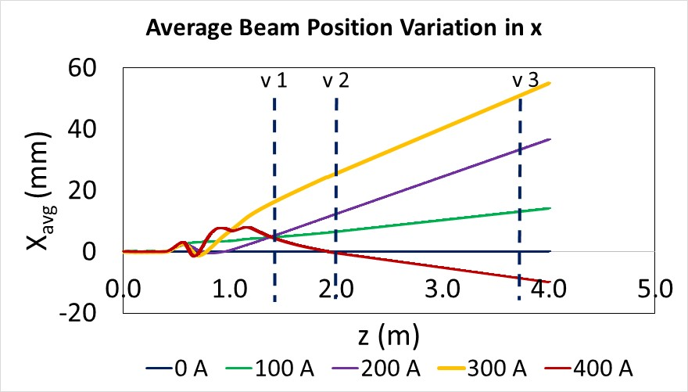
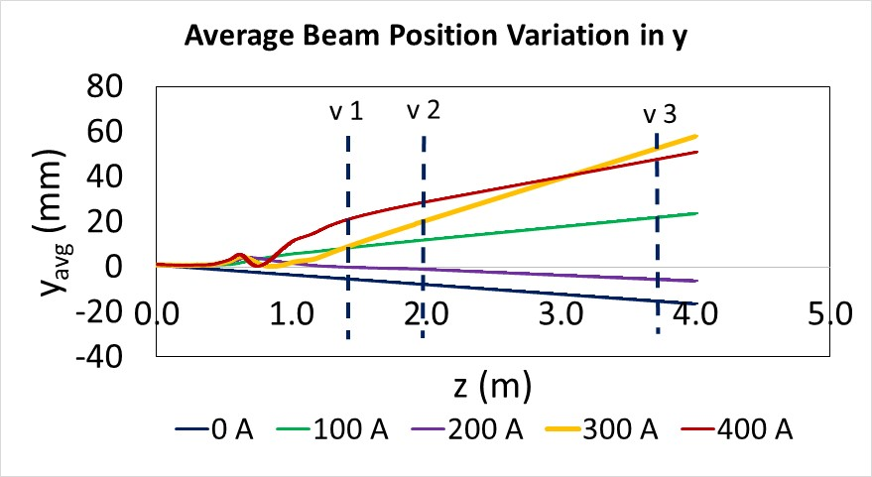
SIMULATION STUDY OF THE MAGNETIZED ELECTRON BEAM
S. A. K. Wijethunga¹, J. R. Delayen¹, G. A. Krafft^{1,2}, F. E. Hannon², R. Suleiman²,
M. Poelker², J. Benesch², M. A. Mamun²
¹Department of Physics, Old Dominion University, Norfolk, Virginia 23529, USA
²Thomas Jefferson National Accelerator Facility, Newport News, Virginia 23606, USA
Electron cooling of ion beams is important for electron ion colliders to obtain the required high luminosity. Cooling can be enhanced using a magnetized electron beam where the cooling process occurs inside a solenoid field. This presentation describes a comparison of measured and predicted values of electron beam size and rotation angle along the beamline for different magnetizing photogun solenoid settings, using ASTRA and GPT software and a magnetized electron beam generated from a DC high voltage photogun. In addition, ASTRA simulations helped inform the importance of using an accurate magnetic field map by modelling the mismatch oscillations that arise in the magnetizing solenoid.
INTRODUCTION
Beam Line
Modelling
Cathode
Cathode
Solenoid
Diagnostic Cross
(Slit + YAG Screen)
Diagnostic Cross
(YAG Screen)
Anode
Green
Laser
Injector Focusing Solenoids
K₂CsSb
Photocathode
Injector Focusing
Solenoid
Injector Focusing
Solenoid
Beam line is modeled using ASTRA (A Space Charge Tracking Algorithm) and GPT (General Particle Tracer) software separately.
ASTRA used 1D electric field map and GPT used 2D electric field map.
Magnetic field map is distorted by metal housing of the nearby focusing solenoids.
MATLAB is used to post-processing and calculate beam sizes and rotation angles.
Simulation Parameters
Injector Focusing Solenoids
4 m
Max magnetic field, B_{z} at the cathode | 0.1511 T
Transverse beam size, Gaussian | 0.301 mm
Longitudinal beam size, Uniform | 24 ps
Gun voltage | 300 kV
Horizontal offset of the laser | 0 mm
Vertical offset of the laser | 0.5 mm
Mean transverse energy | 0.130 eV
Gun Test Stand consists of a K₂CsSb photocathode preparation chamber, DC high-voltage photogun operating at -300 kV, cathode solenoid magnet to magnetize the beam, and a beamline with two YAG screen-slit combinations at 0.5 m and 2.0 m, a YAG-screen at 3.75 m, four injector focusing solenoids, steering magnets, harp, and beam dump.
Beam Profile
Measurements:
Beam at 0 A on solenoid, on 1st Screen
ASTRA: Beam at 0 A on solenoid, on 1st Screen
ASTRA: Beam Rotation
ASTRA Simulation Results
Beam Profile
Energy Profile
Mismatch Oscillations
Rotation angle variation of a diverging beam - 180 A
Slit 1-Viewer 2
Slit 1-Viewer 3
Slit 2-Viewer 3
ASTRA:
Beam at 0 A on solenoid, on 1st Screen
Trace Space
Rotation angle variation of a converging and diverging beam
- 100 A
Magnetic field is not uniform in z.
Thus, no transverse equilibrium occurs and unbalanced forces inside the magnetic field cause the mismatch oscillations.
Larmor frequency increases with the B field.
General formula to find the rotation angle $:$
Measurements vs Simulations (ASTRA & GPT)
$$φ_{rot}=\tan^{−1}\left(\frac{{\dot{θ}z}/{v_{z}}}{1−z/f}\right)$$
Converging $α>0, z>f→ \frac{π}{2}<φ_{rot}<π$
At waist $α=0, z=f →$ 0 $<φ_{rot}<\frac{π}{2}$
Diverging $α<0, z<f→$ 0 $<φ_{rot}<\frac{π}{2}$
ASTRA
GPT
$\dot{θ}$-rotation from magnetization, z-drift length, $v_{z}$-velocity in z direction, f-focal length
ASTRA Simulation Results Cont’d
Simulation results depend significantly on the field maps
Beam gets kicked off axis quickly,
use steering magnets to bring on axis
Summary and Outlook
Successfully simulated the magnetized beam using ASTRA and GPT software showing good agreement with the measurements.
Beam sizes and rotation angles oscillate rapidly due to focusing and de-focusing effects.
Mismatch oscillations occurred due to the non-uniform magnetic field map which results to unbalanced forces inside the magnetic field.
Convergence of the beam results in negative rotation angles.
Accuracy of the field maps greatly affect the simulation results.
Increase the bunch charge and continue simulations on space charge effect of the magnetized beam.
Simulate the emittance vs laser size for maximum gun solenoid current.
GPT and ASTRA show same variations with the measurements.
Gun solenoid magnetizes the beam but also focuses the beam.
Rotation angle influenced by Larmor oscillations in the gun solenoid.
Negative angles occurs due to the beam convergence.
Other slit–viewer combinations showed the same pattern.
Acknowledgement: This work is supported by the Department of Energy, Laboratory Directed Research and Development funding, under contract DE-AC05-06OR23177
sajini@jlab.org

