Slide 1
A holiday story of the charge life(time) of a photocathode

Slide 2
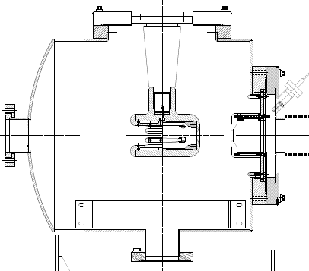
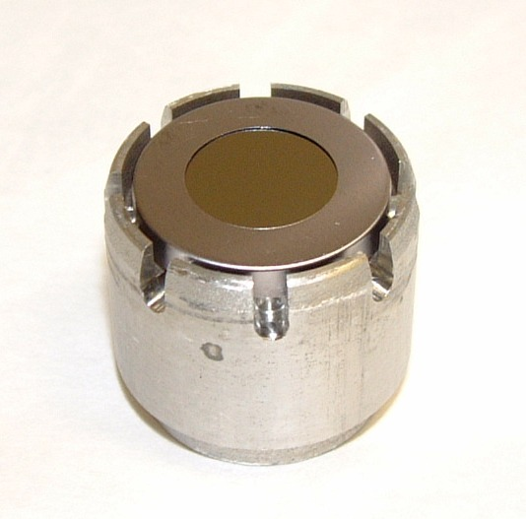
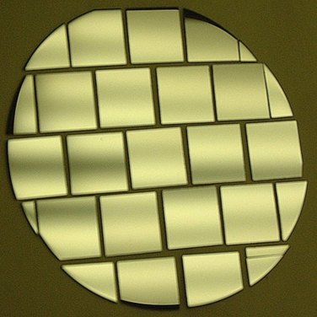
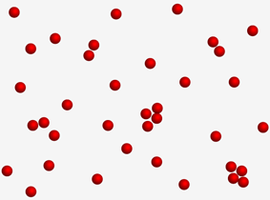
1. PHOTOCATHODE
2. HIGH VOLTAGE
Puck (Mo)
Ring (Ta)
High-P
GaAs/GaAsP
3. LASER BEAM
4. ELECTRON BEAM
5. NAUGHTY
GAS ATOMS
Quantum Efficiency = Number Electrons IN / Number Photons OUT
Initial QE for GaAs/GaAsP is about 1%

Slide 3
Any gas in chamber can be ionized by electron beam, accelerated back toward the photocathode and
limit photocathode operational lifetime

Slide 4
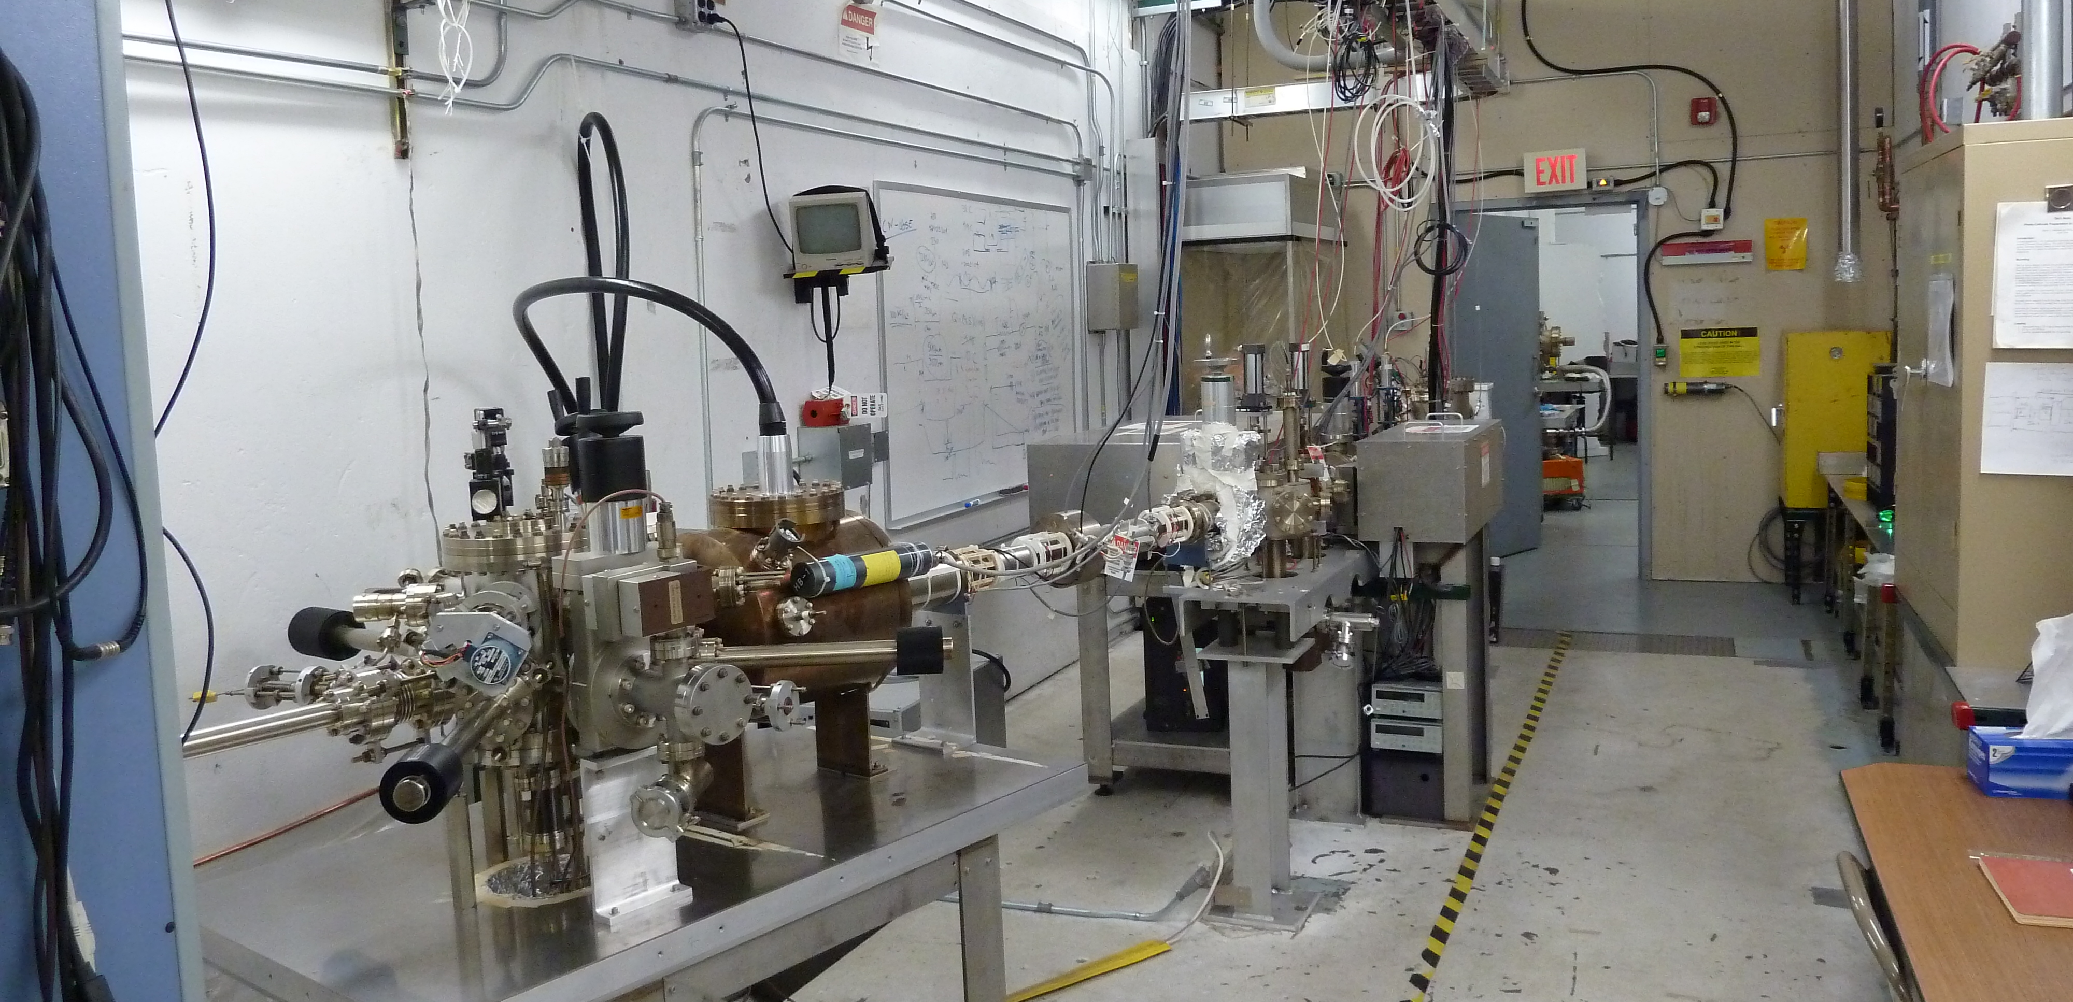
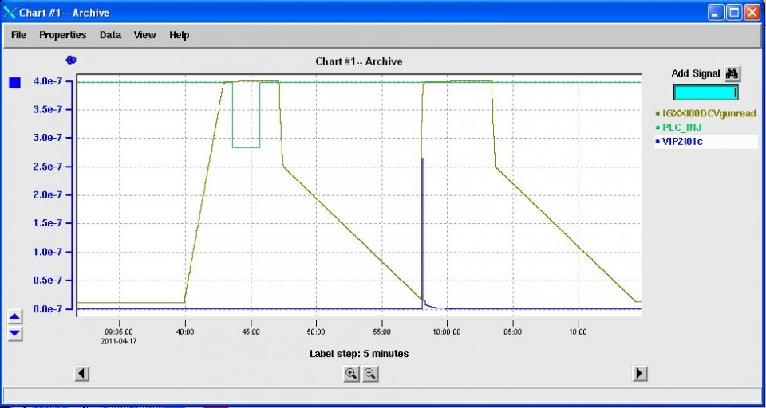
We know there are many ways to foul the charge lifetime because our group has been able to study these dependencies, especially at the Injector Test Cave.
We aim to transfer “best performance” to CEBAF; this can be challenging because we operate the gun differently - e.g. multiple beams and more manipulations of the gun.
One example dependency is the affect of gun High Voltage on vacuum load
HV Supply
Ramping
Off
HV Supply
Tripping
Off
Vacuum
Load
Burst

Slide 5
Typical reasons why gun HV has been turned OFF
Terminate beam for personnel safety e.g. machine/hall access
Terminate beam for machine safety e.g. BCM fault
Holiday shutdown
With an eye on transferring best practices to CEBAF the Safety Santa Group championed our request to “…keep the high voltage ON !?!”.
New PSS scheme proposed to Safety Review Board and approved
New beam termination method added to laser table
Overhaul of PSS system & laser table during Summer’16 SAD !!!
The gun High Voltage is still interlocked and faults
OFF when necessary, but otherwise remains ON !!!

Slide 6
Spring 2016 (before)
Fall 2016 (after)

Slide 7
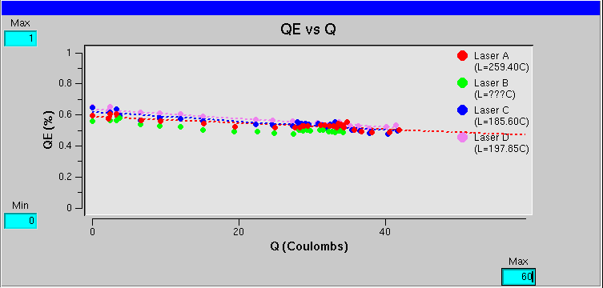
We are now achieving charge lifetime equal or above 200C.
Historical values depend on program, but often about 150C.
Result more similar to Test Cave operation ... an encouraging result !

