Slide 1
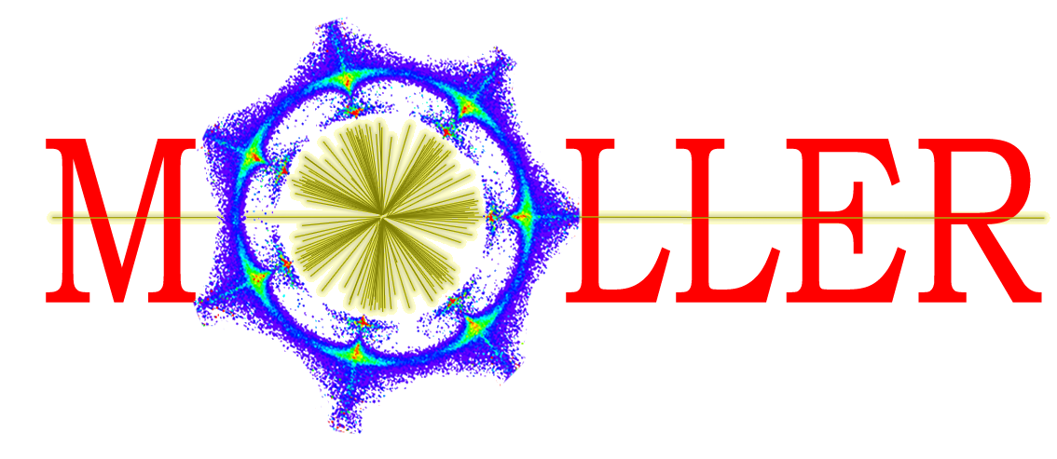
MOLLER Accelerator Project
November 1, 2023
Riad Suleiman

Slide 2
Introduction
MOLLER: Measurement Of Lepton Lepton Elastic Reactions
Physics Outcome: an ultra-precise measurement of the
weak-mixing angle using Møller scattering https://moller.jlab.org/cgi-bin/DocDB/public/ShowDocument?docid=998
Organization:
  Accelerator Parity-Quality-Beam Liaison: Riad Suleiman
  APEL: Yves Roblin
  Ops Hall A Liaison: Daniel Moser and Adam Schoene
  Hall A Liaison: Ciprian Gal
  MOLLER Liaison: Caryn Palatchi and Kent Paschke
  MOLLER PQB Meeting: Wednesdays 3-4 MCC Conf room

Slide 3
Parity-Violating Experiments at CEBAF
PV Experiment | Energy (GeV) | Pol (%) | I (µA) | Target | A_{pv} (ppb) | Charge Asym (ppb) | Position Diff (nm) | Angle Diff (nrad) | Size Asym(δσ/σ)
HAPPEx-I 1998 – 1999 | 3.3 | 38.8 68.8 | 100 40 | ¹H (15 cm) | 15,050 | 200 | 12 | 3 | <10⁻³
G0-Forward 2003 – 2004 | 3.0 | 73.7 | 40 | ¹H (20 cm) | 3,000-40,000 | 300±300 | 7±4 | 3±1 | <10⁻³
HAPPEx-II 2004 – 2005 | 3.03 | 87.1 | 55 | ¹H, ⁴He (20 cm) | 1,580 | 400 | 2 | 0.25 | <10⁻³
G0-Backward 2006 – 2007 | 0.359, 0.688 | 85.8 | 60 | ¹H, ²H (20 cm) | 9,700-37,400 | -30±300 | 47±9 | 1.2±0.5 | <10⁻³
HAPPEx-III 2009 | 3.484 | 89.4 | 100 | ¹H (25 cm) | 23,800 | 200±10 | 3 | 0.5±0.1 | <10⁻³
PVDIS 2009 | 6.067 | 89.0 | 105 | ²H (20 cm) | 60,000-160,000 | 100 | 100 | 40 | <10⁻³
PREx-I 2010 | 1.056 | 89.2 | 70 | ²⁰⁸Pb (0.5 mm) | 657±60 | 85±1 | 4 | 1 | <10⁻⁴
QWeak 2010 – 2012 | 1.162 | 88.7 | 180 | ¹H (34 cm) | 226.5±9.3 | 20.5±1.7 | -4.6±0.2 | -0.07±0.01 | <10⁻⁴
PREx-II 2019 | 0.953 | 89.7 | 70 | ²⁰⁸Pb (0.5 mm) | 550±18 | 20.7±0.2 | 2.2±4 | 0.3±0.3 | <6x10⁻⁵
CREx 2019-2020 | 2.18 | 87.1 | 150 | ⁴⁸Ca (5 mm) | 2668±113 | -88±26 | -5.2±3.6 | -0.13±0.08 | <6x10⁻⁵
MOLLER 2026-2028 | 10.8 | 90 | 65 | ¹H (125 cm) | 35.6±0.74 | <10 | <0.6 | <0.12 | <10⁻⁵

Slide 4
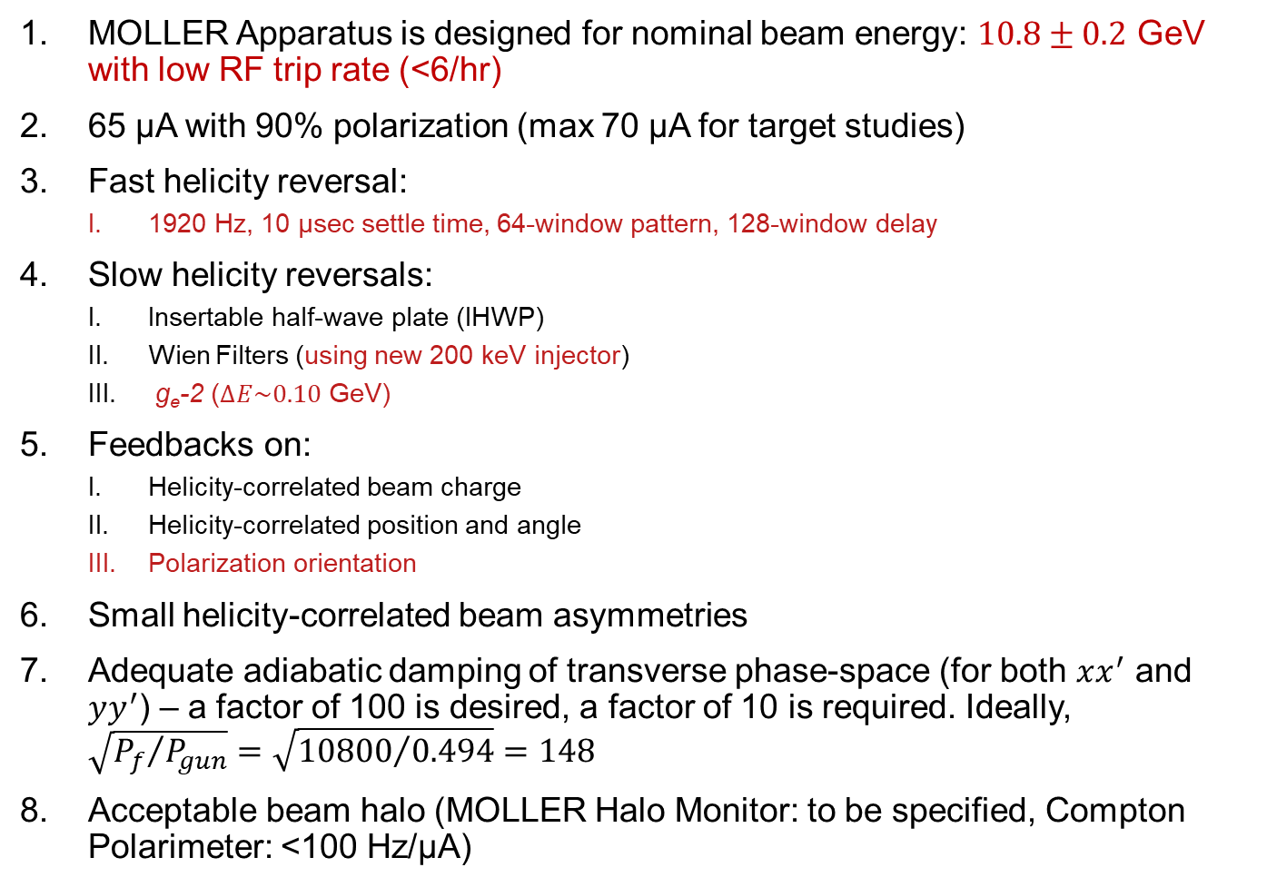
MOLLER Quick Summary – Notable Things for MOLLER
MOLLER Apparatus is designed for nominal beam energy: $10.8±0.2$ GeV with low RF trip rate (<6/hr)
65 µA with 90% polarization (max 70 µA for target studies)
Fast helicity reversal:
  1920 Hz, 10 µsec settle time, 64-window pattern, 128-window delay
Slow helicity reversals:
  Insertable half-wave plate (IHWP)
  Wien Filters (using new 200 keV injector)
  g_{e}-2 ($∆E\sim 0.10$ GeV)
Feedbacks on:
  Helicity-correlated beam charge
  Helicity-correlated position and angle
  Polarization orientation
Small helicity-correlated beam asymmetries
Adequate adiabatic damping of transverse phase-space (for both $xx^{′}$ and $yy^{′}$) – a factor of 100 is desired, a factor of 10 is required. Ideally, $\sqrt{{P_{f}}/{P_{gun}}}=\sqrt{{10800}/{0.494}}=148$
Acceptable beam halo (MOLLER Halo Monitor: to be specified, Compton Polarimeter: <100 Hz/µA)

Slide 5
CEBAF Long Term Schedule – potential conflicts
MOLLER experiment in Hall A: installation starts in March 2025 and physics run starts in March 2026 for three years
Hall A (MOLLER)
0.26 pC @ 249.5 MHz (4 ns, 65 µA average beam current)
Hall B
0.002 pC @ 249.5 MHz (4 ns, 50 nA average beam current)
Hall C
0.12 pC @ 249.5 MHz (4 ns, 35 µA average beam current)
Hall D (K_{L})
0.32 pC @ 15.6 MHz (64 ns, 5 µA average beam current)
  One task aims to study co-operation of MOLLER with K-long experiment in Hall D

Slide 6
MOLLER Requirements
Details about MOLLER action items can be found here: https://wiki.jlab.org/ciswiki/index.php/Parity_Quality_Beam
MOLLER has other requirements that can be found here: https://wiki.jlab.org/ciswiki/images/7/7b/MOLLER_beam_requirements_22March2023.pdf
Accelerator jobs are summarized in next four slides (listed are Deliverable Dates)
Abbreviation | Staff/People | Group
CIS | Accelerator | Center for Injectors and Sources
CASA | Accelerator | Center for Advanced Studies of Accelerators
Ops-Inj | Accelerator | Injector group
Ops-SW | Accelerator | Accelerator software Group
Ops-MCC | Accelerator | MCC Operations Group
I&C | Engineering | Instrumentation and Controls Group (EESICS)
SSG | Engineering | Safety Systems Group
Fast Electronics | Physics | Fast Electronics Group
Hall A | Physics | Hall A group
RCG | EH&S | Radiological Control Group
MOLLER | Users | MOLLER Collaboration

Slide 7
MOLLER Accelerator Jobs
Helicity Generator boards (June 2024)
    Groups (CIS, MOLLER, Fast Electronics, Ops-SW)
Helicity Decoder boards (August 2024)
    Groups (CIS, MOLLER, Fast Electronics)
New RTP High Voltage (HV) Driver (June 2024)
    Groups (CIS, MOLLER, I&C, Ops-SW)
Upgrade Intensity-Attenuator (IA) system (August 2024)
    Groups (CIS, MOLLER, I&C, Ops-SW)
Upgrade Helicity Magnets control (December 2024)
    Groups (CIS, CASA, MOLLER, I&C, Ops-SW)
Feedback on polarization orientation (March 2025)
    Groups (CIS, Ops-Inj, MOLLER, CASA)
Wien filters slow reversal – Wien Flip (December 2024)
    Groups (Ops-Inj, CIS, MOLLER)

Slide 8
MOLLER Accelerator Jobs … continued
Injector transmission and parity-quality beam (December 2024)
    Groups (Ops-Inj, CIS, MOLLER)
Matching and adiabatic damping from 200 keV to Hall A (December 2024)
    Groups (CASA, CIS, Ops-Inj, MOLLER)
Fast Feedback (FFB) system resurrection (December 2024)
    Groups (CASA, Ops-SW, I&C)
Compton Polarimeter setup (March 2025)
    Groups (CASA, Hall A)
Beam Modulation (March 2025)
    Groups (Hall A, CASA, Ops-SW, I&C, MOLLER)
Phase Advance (March 2025):
    Groups (CASA, MOLLER)

Slide 9
MOLLER Accelerator Jobs … continued
Study co-operation of MOLLER with K-long experiment in Hall D (June 2024)
    Groups (CIS, Ops-Inj, CASA, MOLLER, Hall A)
Control of charge asymmetry on Halls B, C, and D beams (March 2025)
    Groups (MOLLER, CIS, Ops-SW)
Parity-Quality Beam (PQB) studies in Injector and Hall (March 2025)
    Groups (MOLLER, CIS, Ops-Inj, CASA)
17. Halo Monitors in Hall A (March 2025)
    Groups (Hall A, MOLLER, I&C, Ops-SW, SSG)
18. Robust beam mis-steer protection / fast shutdown detectors in MOLLER apparatus (March 2025)
    Groups (Hall A, MOLLER, RCG, SSG, Ops-MCC)

Slide 10
MOLLER Accelerator Jobs … continued
New BPM Digital Receivers in Hall A line – instead of Sample/Hold cards (March 2025)
    Groups (Hall A, MOLLER, I&C, Ops-SW)
New BCMs electronics in Hall A line (March 2025)
    Groups (Hall A, MOLLER, I&C, Ops-SW)

