Slide 1
e⁺ Beam Tracking in 1st Capture Solenoid
Magnetic Field and Beam Tracking in CST Studio Suite
Beam Tracking of 60 MeV e⁺ and 10 MeV e⁺ in 1st Solenoid (GPT)
A. Ushakov

Slide 2
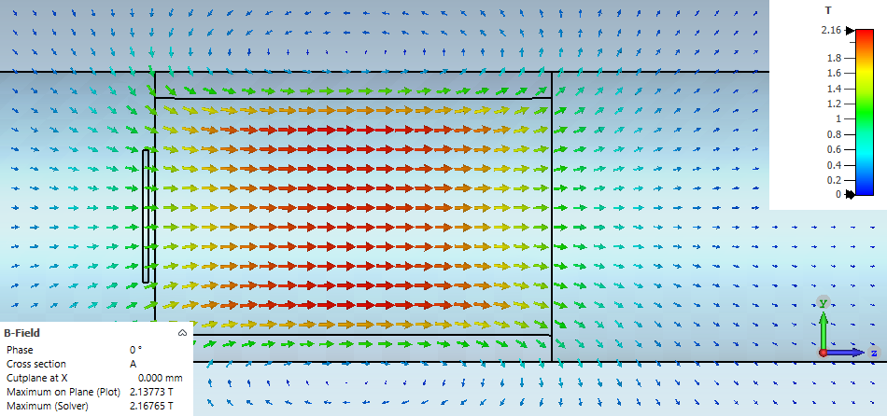
Beam, Target, Solenoid Parameters and Field (CST)
Primary Beam: 1 mA @ 120 MeV
Beam Size: σ_{x} = σ_{y} = 1 mm
Target Material: Tungsten
Target Thickness: 4 mm
Solenoid:
Length: 30 cm
Radius: 10 cm
Current: 2E6 A*Turns/m
Solenoid-to-Target Distance: 5 mm

Slide 3
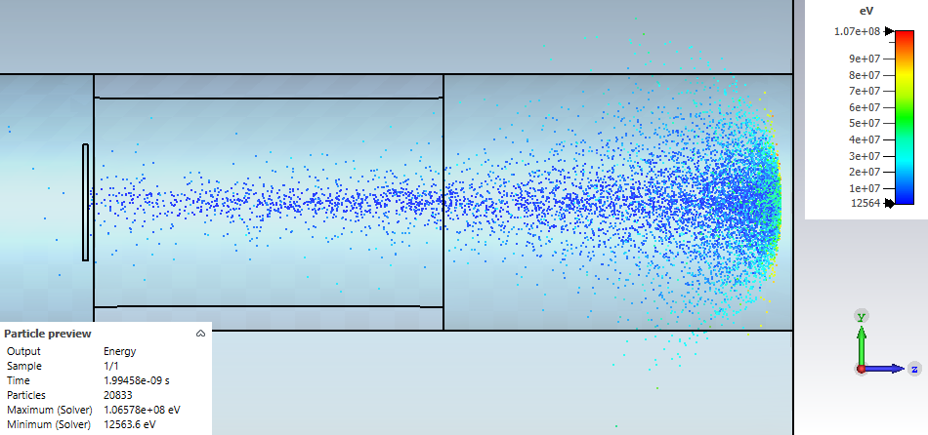
Tracking of Positrons in CST

Slide 4
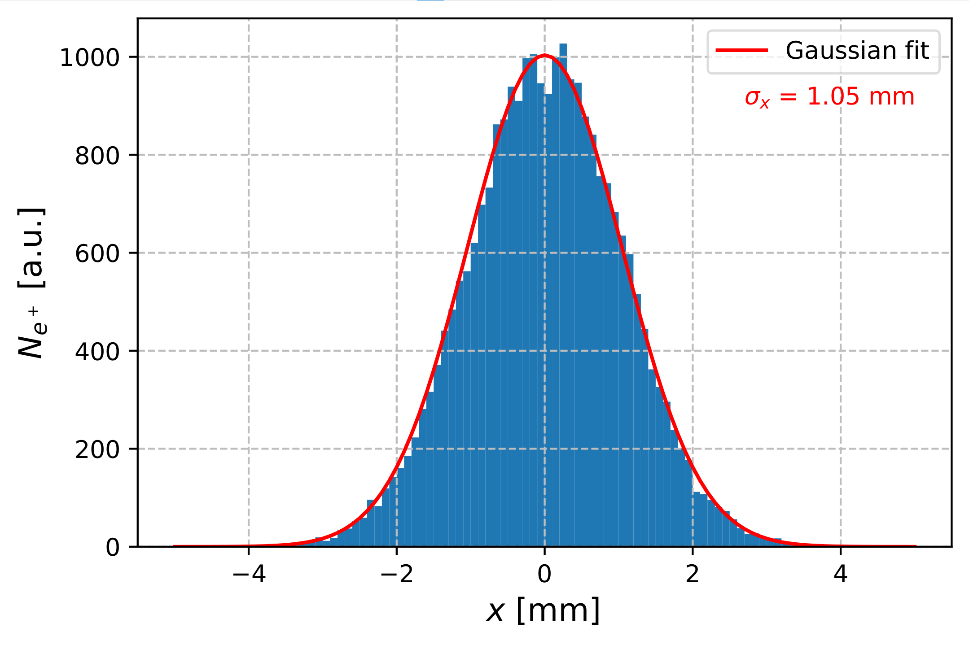
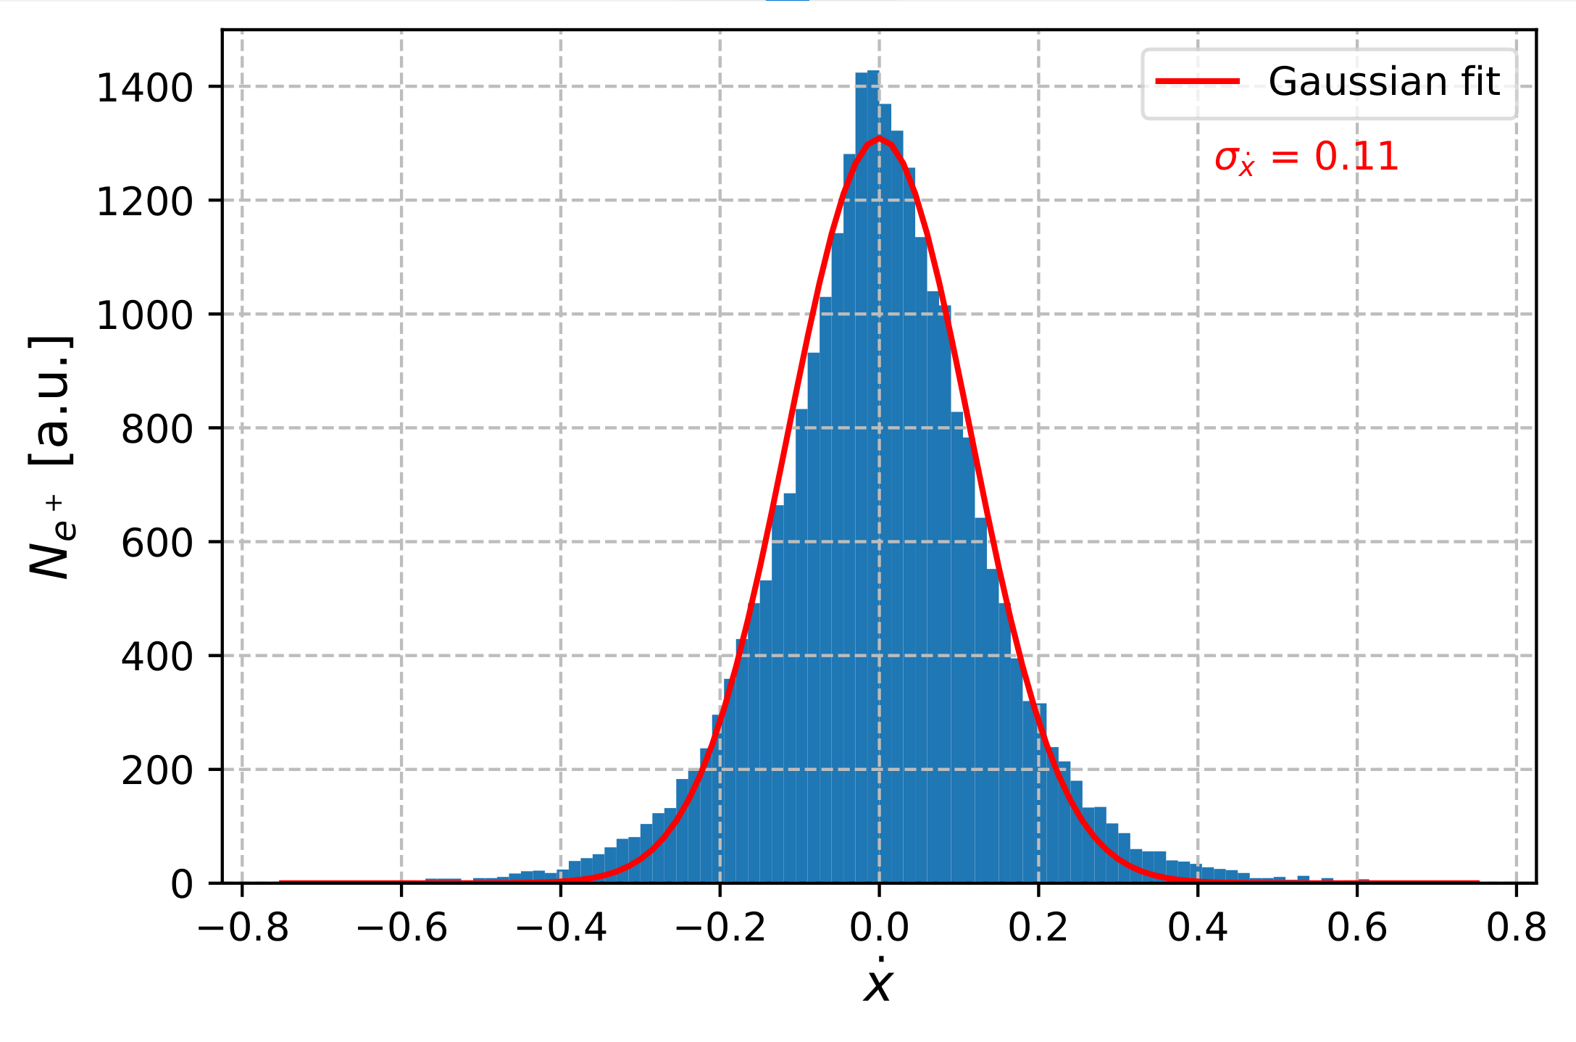
Distributions of e⁺ at Target Exit in Forward Direction. E_{e+} = 60 MeV $±$ 3 MeV
N_{e-} = 10⁷
N_{e+} = 26093

Slide 5
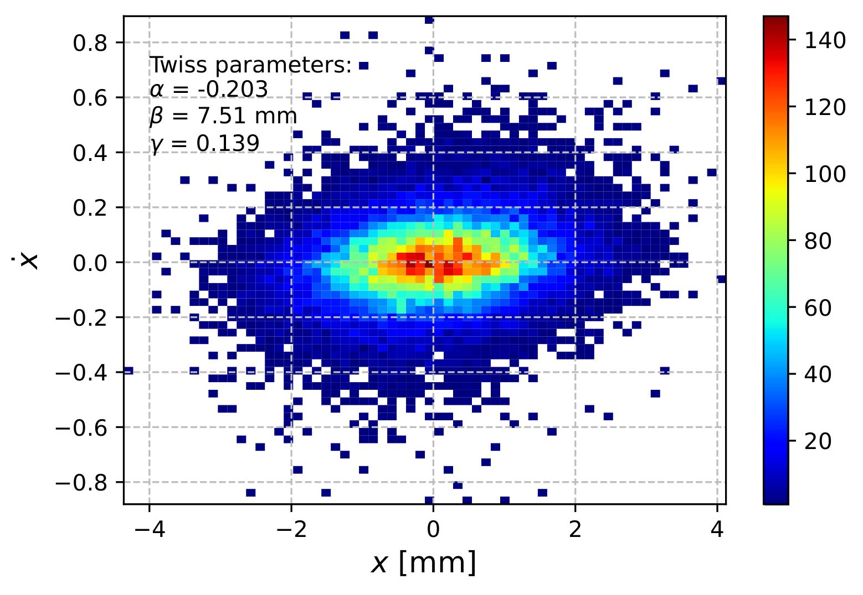
X-X’ Phase Space of Positrons in Forward Direction. E_{e+} = 60 MeV $±$ 3 MeV
Mean E = 59.85 MeV
ε_{x} = 0.143 mm·rad
ε_{norm x} = 16.9 mm·rad
N_{e-} = 10⁷
N_{e+} = 26093

Slide 6
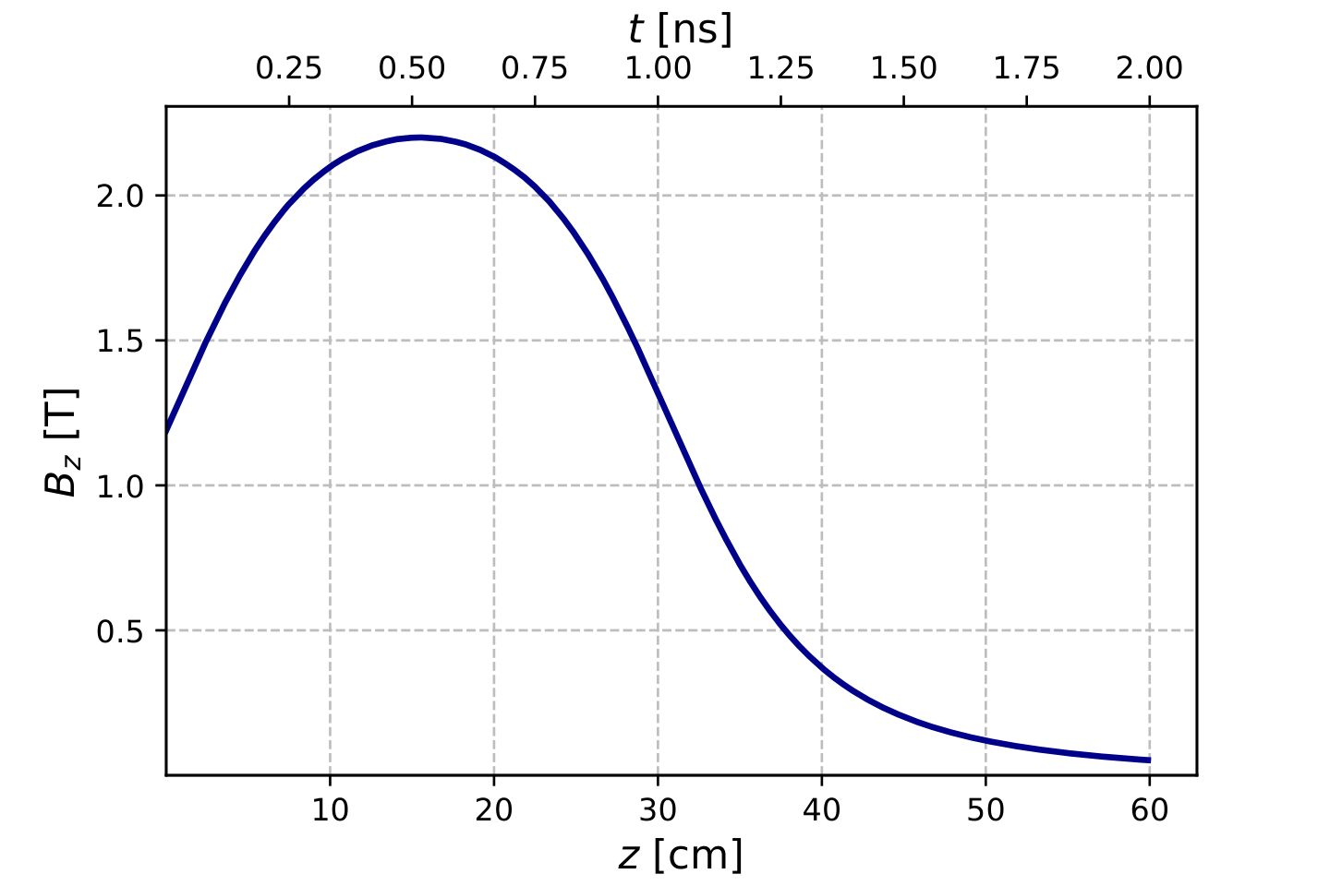
Field Profile on Beam Axis (GPT). Max B_{z} = 2.2 T for 2.1 A*Turns/m

Slide 7
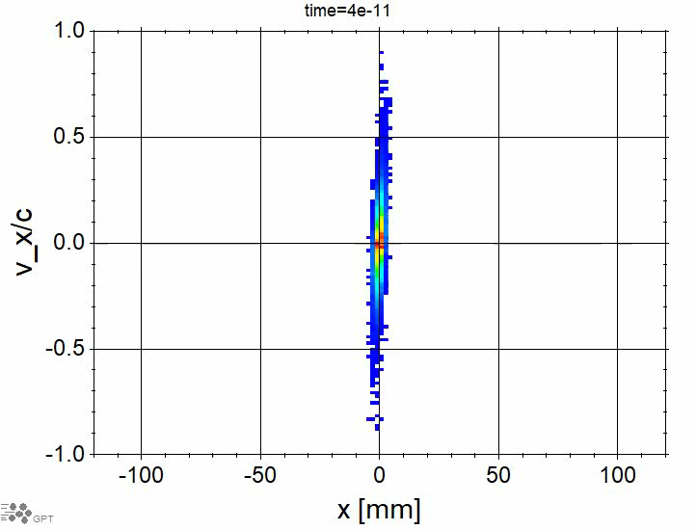
60 MeV e⁺: Time Evolution of Phase Space in 2.2 T Solenoid (max B_{z}(r = 0))

Slide 8
60 MeV e⁺: Example of 20 e⁺ Trajectories

Slide 9
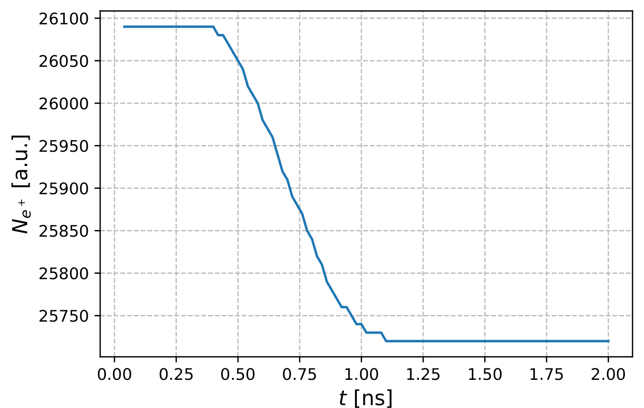
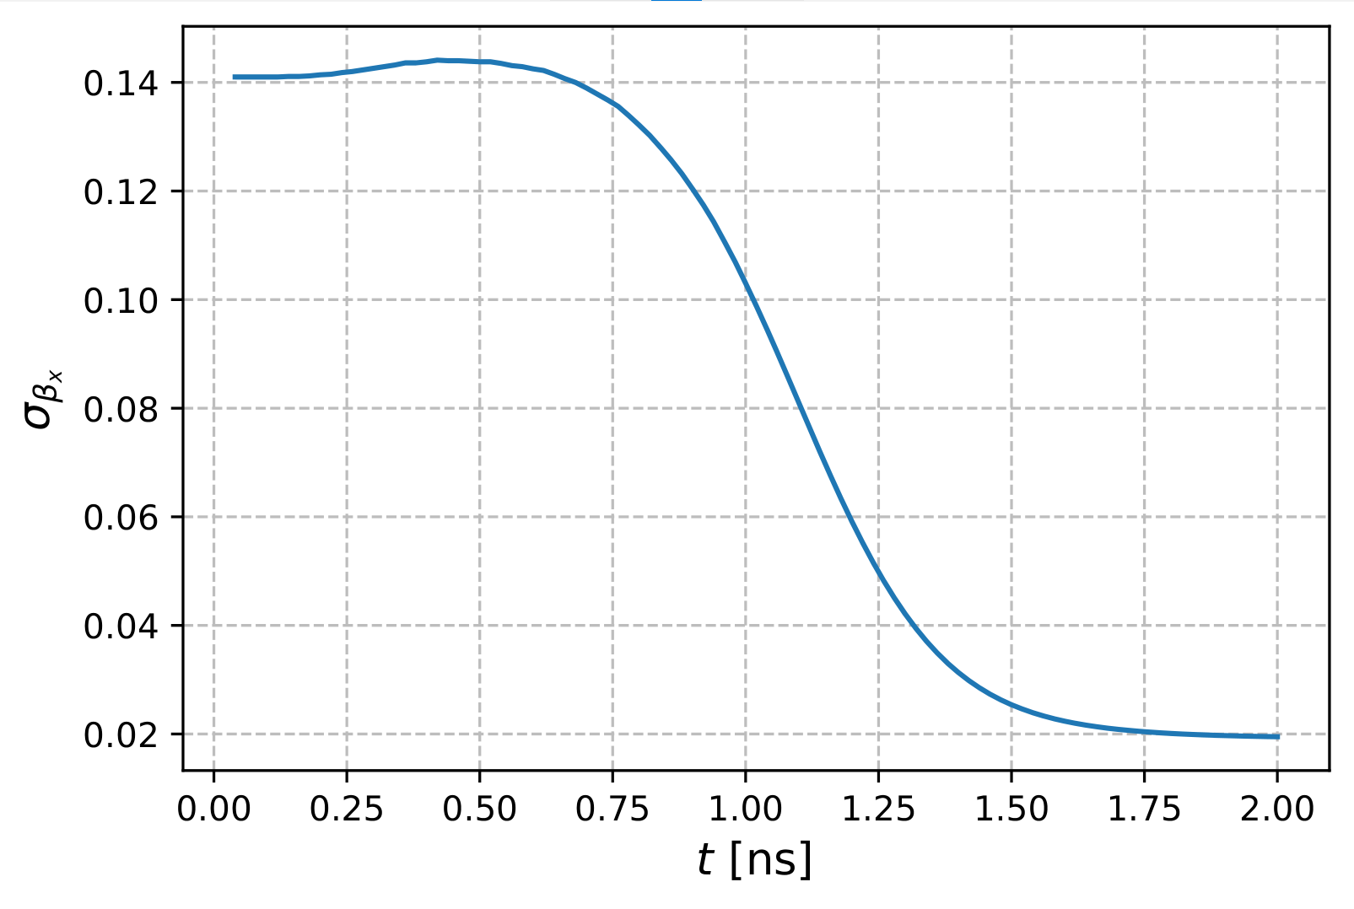


60 MeV e⁺: Positron Losses and Beam Divergence
Number of e⁺ vs Time (10⁷ primary e⁻)
RMS $β_{x}$ vs Time
$$β_{x}= v_{x}/c$$

Slide 10
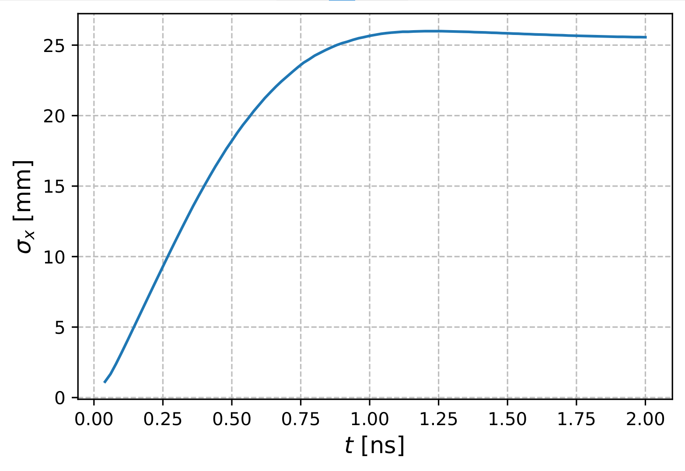
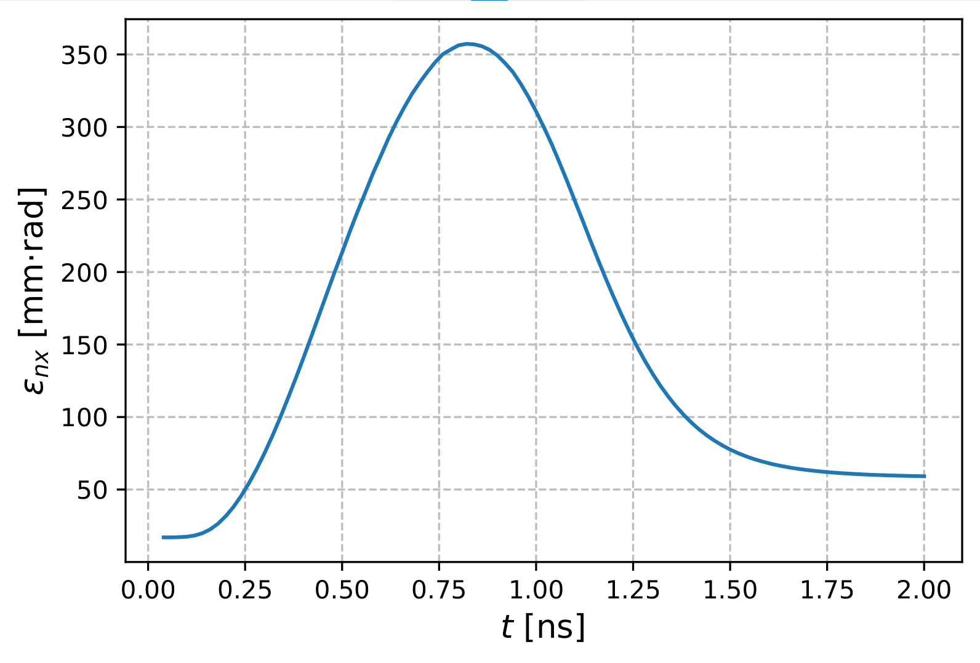
60 MeV e⁺: Beam Size and Normalized Emittance
Beam Size vs Time
Normalized Emittance vs Time

Slide 11
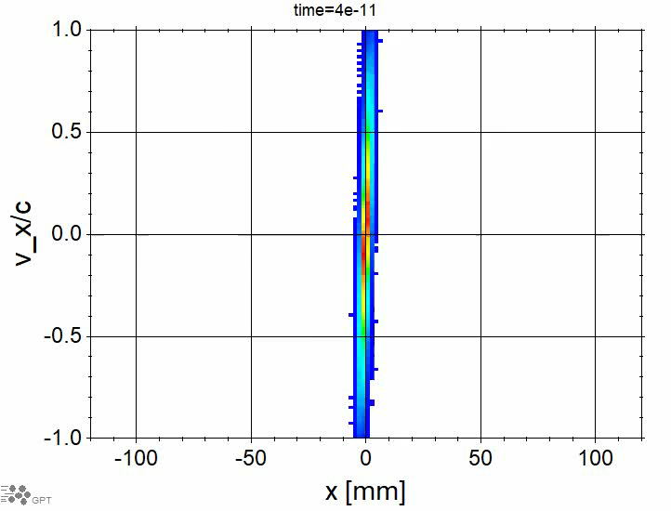
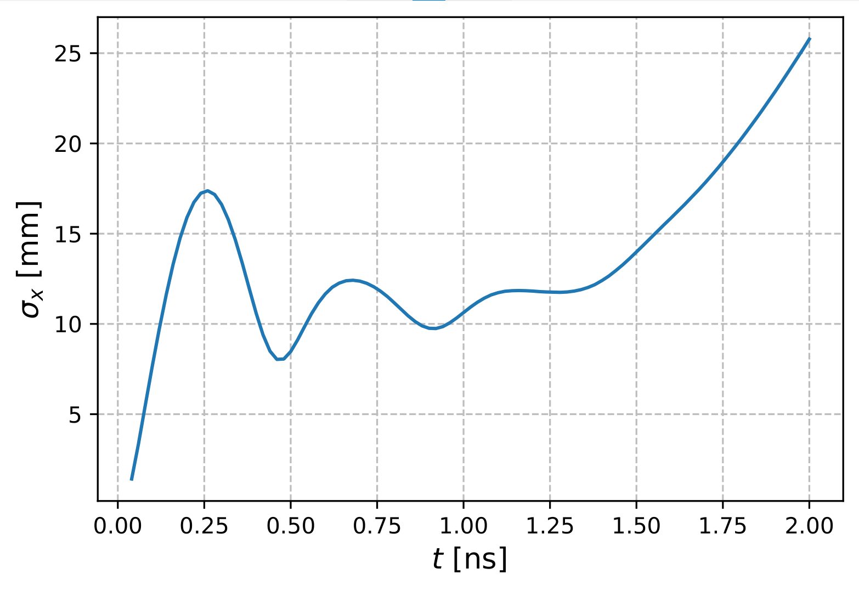
10 MeV e⁺: Time Evolution of Phase Space in 2.2 T Solenoid (max B_{z}(r = 0))

Slide 12
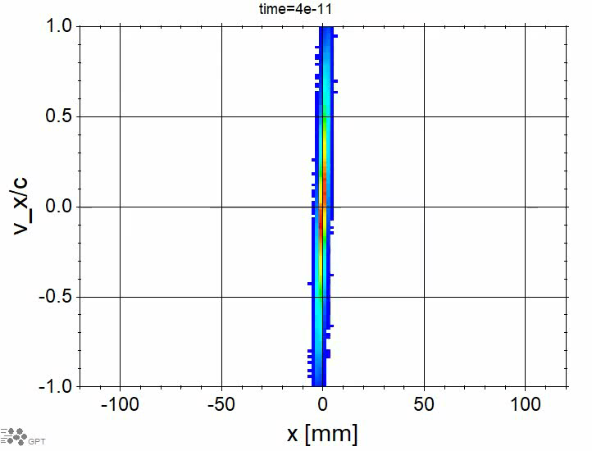
10 MeV e⁺: Time Evolution of Phase Space in 0.34 T Solenoid (max B_{z}(r = 0))

Slide 13
10 MeV e⁺: Example of 20 e⁺ Trajectories

Slide 14
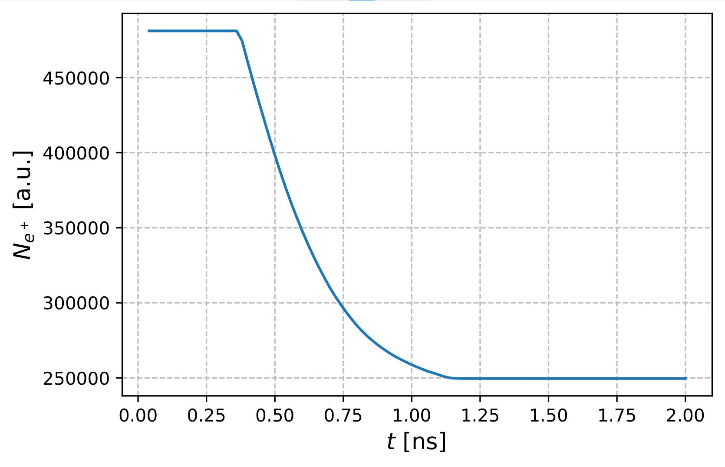
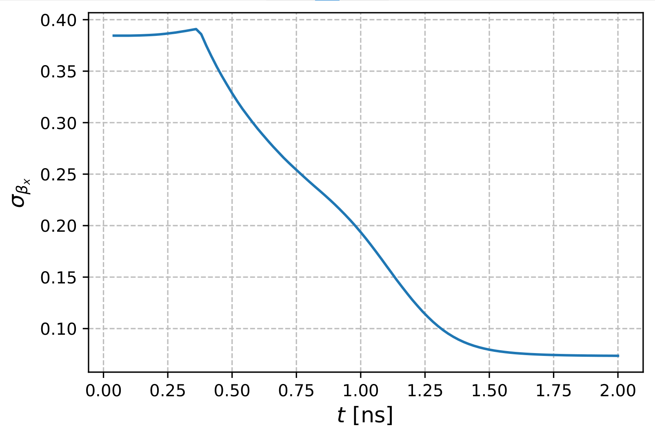
10 MeV e⁺: Positron Losses and Beam Divergence
Number of e⁺ vs Time (10⁷ primary e⁻)
RMS $β_{x}$ vs Time

Slide 15
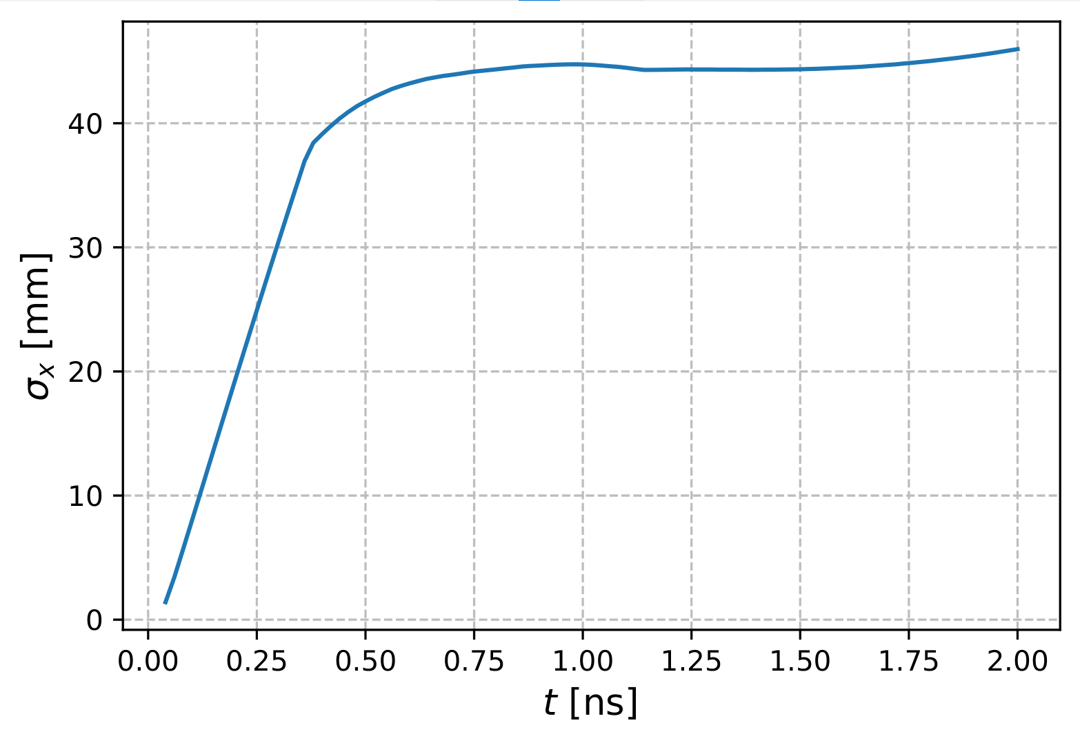
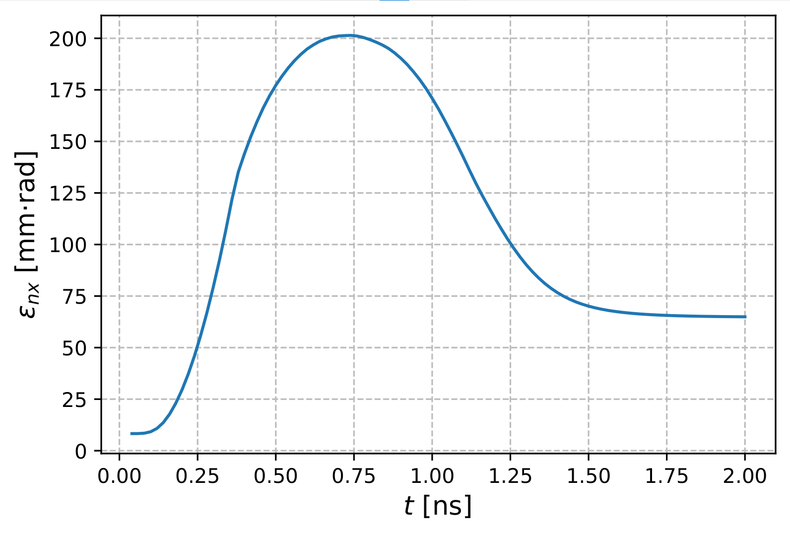
10 MeV e⁺: Beam Size and Normalized Emittance
Beam Size vs Time
Normalized Emittance vs Time

Slide 16
Next Steps
Optimal target position relative to solenoid:
  Vary target-to-magnet distance
  Target in the middle of solenoid
  Target between 2 solenoids
Change/optimize dimensions of solenoid (inner radius, length)
Tapered solenoid with a high field near the target (Adiabatic Matching Device AMD)

