Slide 1
MDL0L02 Dipole Field Offset
August 12, 2016

Slide 2
Field Map
Meas. Date: 8/29/2014
Coil used: Hall Probe Stepper
Current (A) Strength (Gauss-cm)
-------------- -------------------
-9.992 -23944.2
-8.996 -21569.6
-7.991 -19169.0
-6.990 -16769.5
-5.990 -14360.7
-4.993 -11954.6
-3.994 -9542.8
-2.989 -7116.1
-1.989 -4698.2
-0.990 -2283.6
0.003 126.0
1.009 2548.4
2.009 4960.8
3.009 7374.6
4.010 9785.8
5.010 12192.0
6.010 14589.8
7.011 16980.4
8.013 19360.4
9.015 21720.5
10.014 24038.1

Slide 3
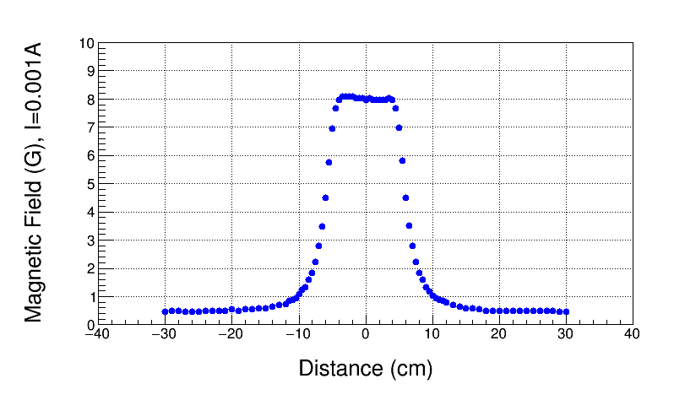
Field Map, I=0.001A
On Hysteresis

Slide 4
Spare DL Magnet at MMF
August 10, 2016

Slide 5
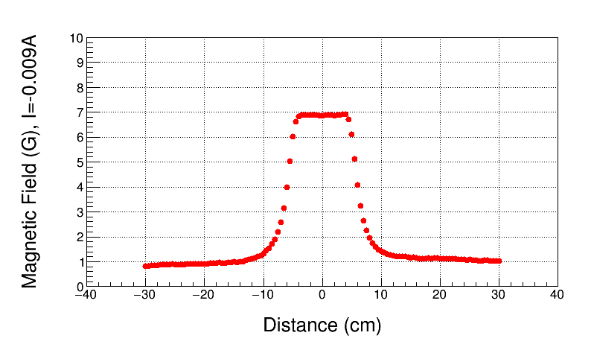
Field Map, I=-0.009A
On Hysteresis

Slide 6
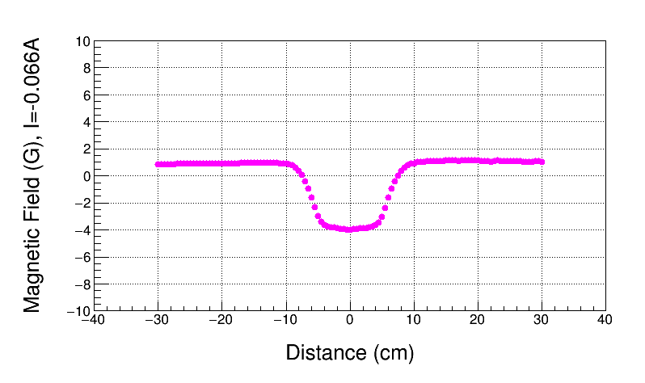
0 BdL, I=-0.066A
On Hysteresis
Used Field Map to find 0 BdL

Slide 7
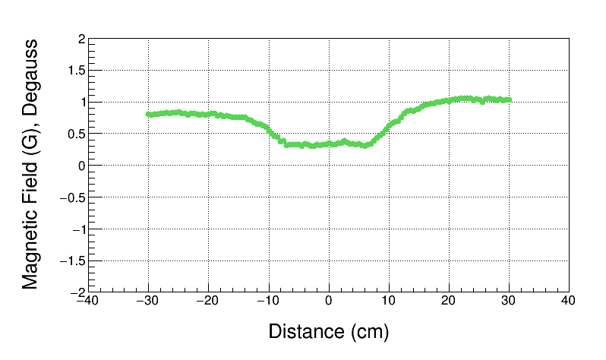
Degaussed, Power Supply OFF
BdL = 42 G-cm, this is Field Map offset

Slide 8
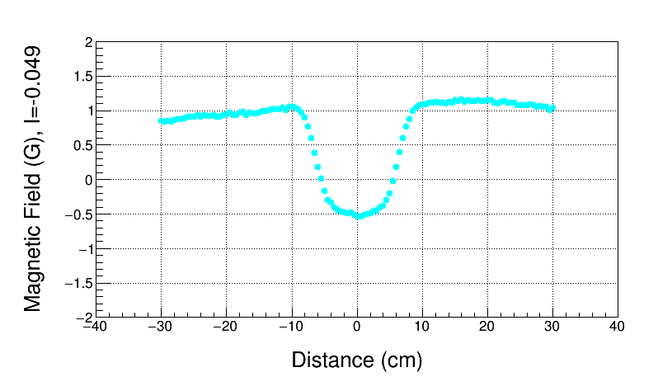
0 BdL, I=-0.049A (with no Offset)
On Hysteresis
Used Field Map with offset subtracted to find 0 BdL
BdL = 43 G-cm – Offset $\sim$ 0

Slide 9
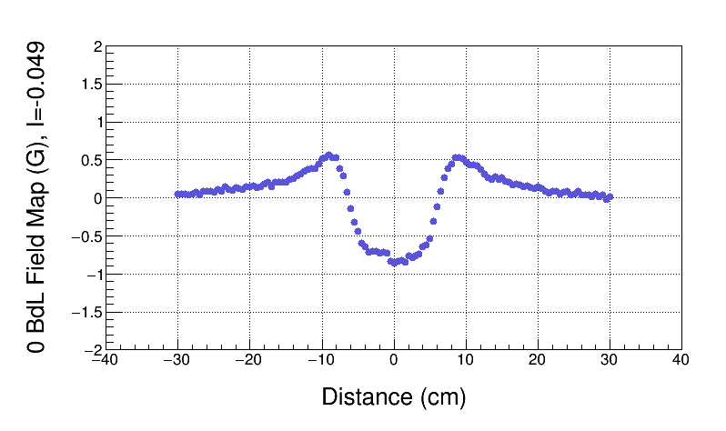
True 0 BdL Field Map

Slide 10
Summary - I
Field Map Offset is found by mapping degaussed magnet with power supply off
Field Map Offset of Spare DL magnet = 42 G-cm
By comparing Spare magnet Field Map and Field Map of installed magnet, Offset of installed magnet is about 20±5 G-cm since environmental fields at MMF are today higher ($\sim$1 G) than during mapping of magnet installed in CEBAF ($\sim 0.5$ G) in August 2014
Request to modify CEBAF Field Map: Subtract 20 G-cm
When mapping environmental fields in CEBAF Injector, DL magnet must be degaussed

Slide 11
Summary - II
For Beam Energy Measurement:
CEBAF : BdL $≠$ 0 (due to field map error), instead:
BdL = -Offset
BdL $\sim$ -20 G-cm. Treat as another horizontal corrector.
Spectrometer Lines (2D, 3D, 5D): subtract 20 G-cm from Field Map
 | Error
Trim Power Supply | 2 mA
Magnet Model (to find momentum from field map) | 0.1%
Field Map Offset | 5 G-cm
For Mott Energy Measurements

