Slide 1
MDL0L02 Dipole Field Offset
August 12, 2016

Slide 2
CEBAF DL Magnet at Injector
May 10, 2016

Slide 3
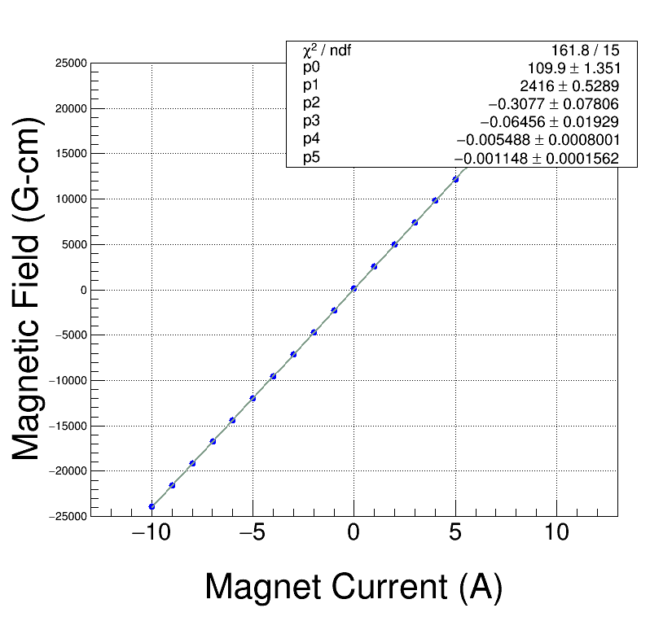
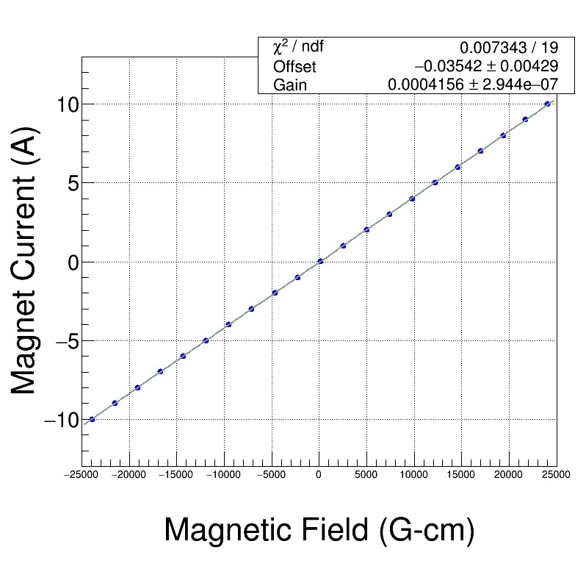
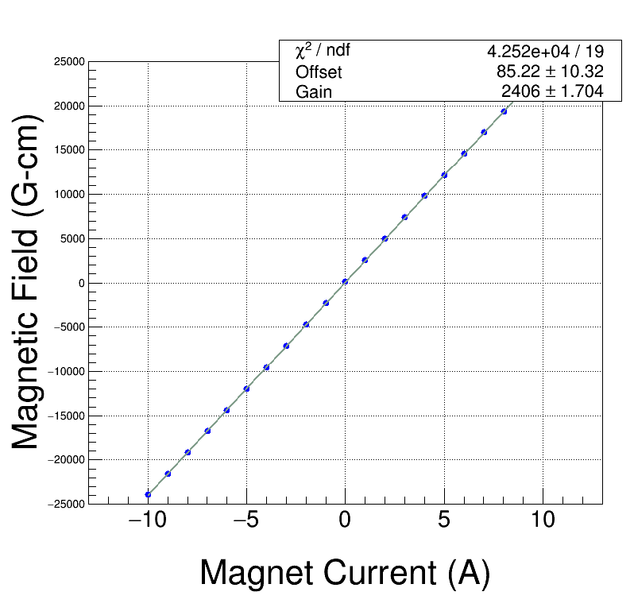
Field Map
Meas. Date: 8/29/2014
Coil used: Hall Probe Stepper
Current (A) Strength (Gauss-cm)
-------------- -------------------
-9.992 -23944.2
-8.996 -21569.6
-7.991 -19169.0
-6.990 -16769.5
-5.990 -14360.7
-4.993 -11954.6
-3.994 -9542.8
-2.989 -7116.1
-1.989 -4698.2
-0.990 -2283.6
0.003 126.0
1.009 2548.4
2.009 4960.8
3.009 7374.6
4.010 9785.8
5.010 12192.0
6.010 14589.8
7.011 16980.4
8.013 19360.4
9.015 21720.5
10.014 24038.1

Slide 4
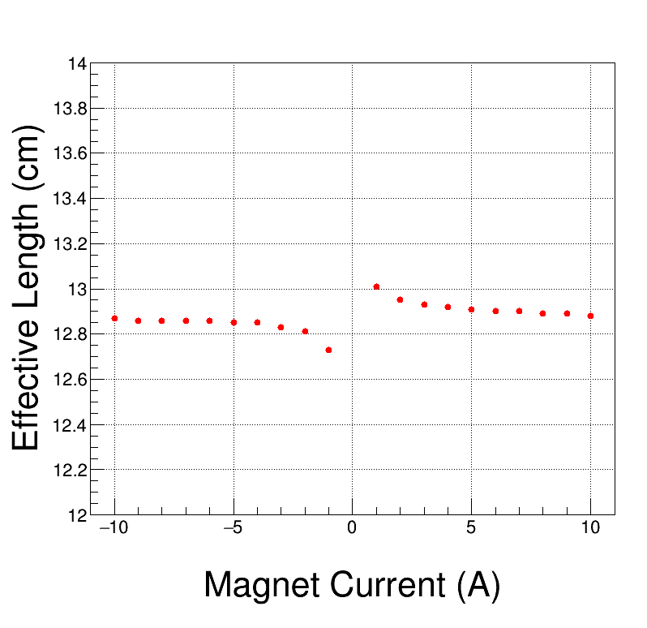
Field Map Effective Length
Meas. Date: 8/29/2014
Coil used: Hall Probe Stepper
Current (A) Eff. L (cm)
-------------- -------------------
10.00 12.88
9.00 12.89
8.00 12.89
7.00 12.90
6.00 12.90
5.00 12.91
4.00 12.92
3.00 12.93
2.00 12.95
1.00 13.01
0.00 16.39
-1.00 12.73
-2.00 12.81
-3.00 12.83
-4.00 12.85
-5.00 12.85
-6.00 12.86
-7.00 12.86
-8.00 12.86
-9.00 12.86
-10.00 12.87

Slide 5
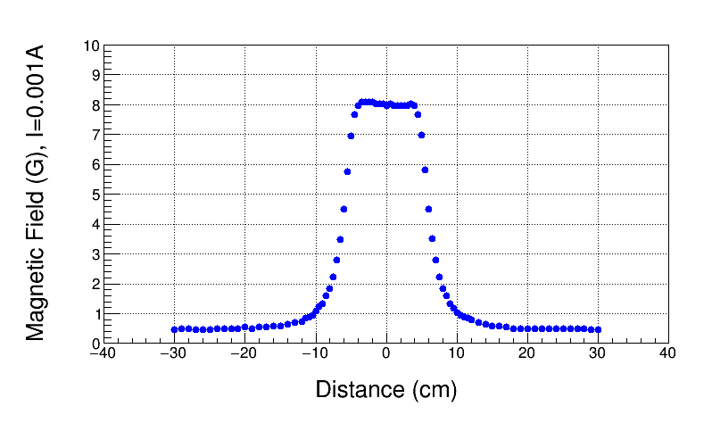
Field Map, I=0.001A
On Hysteresis

Slide 6
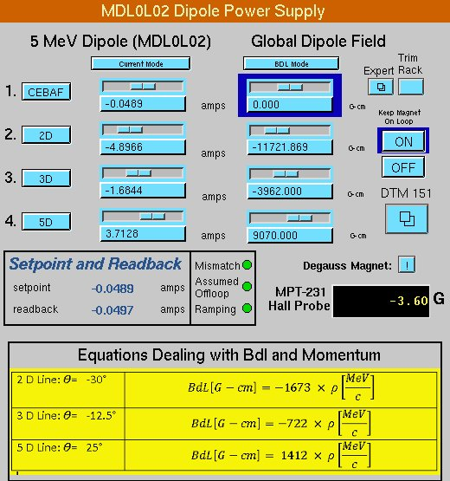
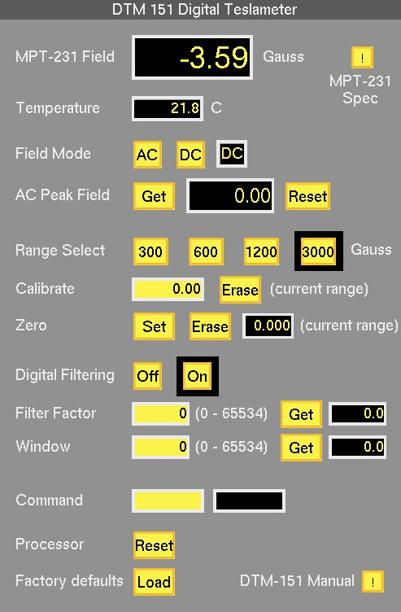
0 BdL

Slide 7
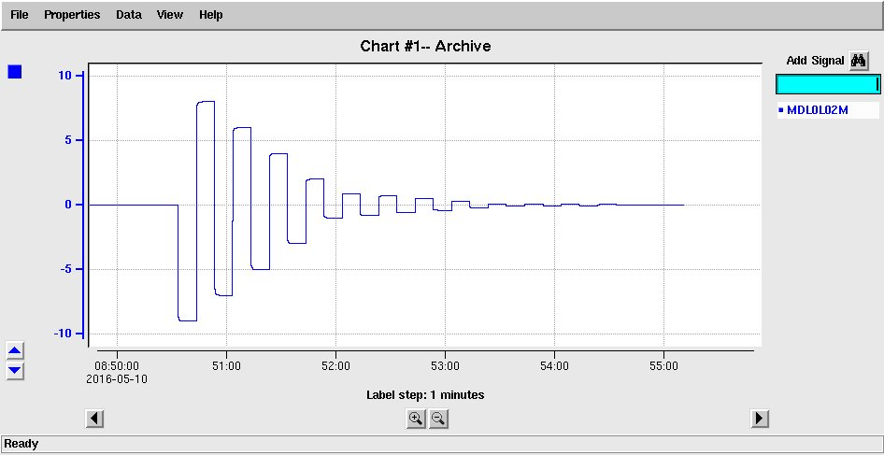
Degaussed

Slide 8
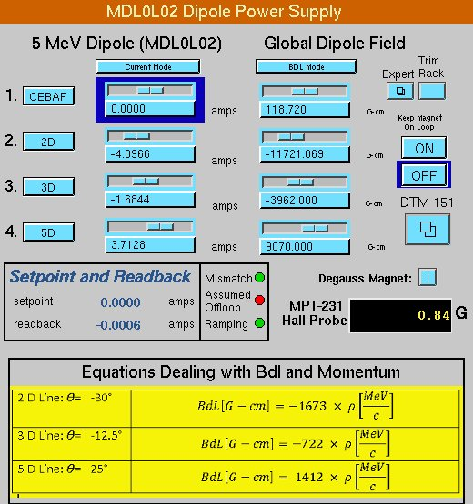
Degaussed

Slide 9
Spare DL Magnet at MMF
August 10, 2016

Slide 10
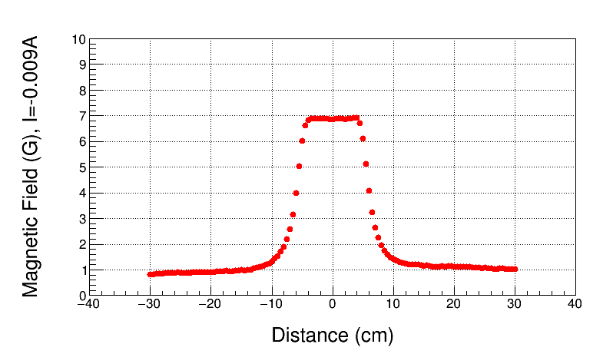
Field Map, I=-0.009A
On Hysteresis

Slide 11
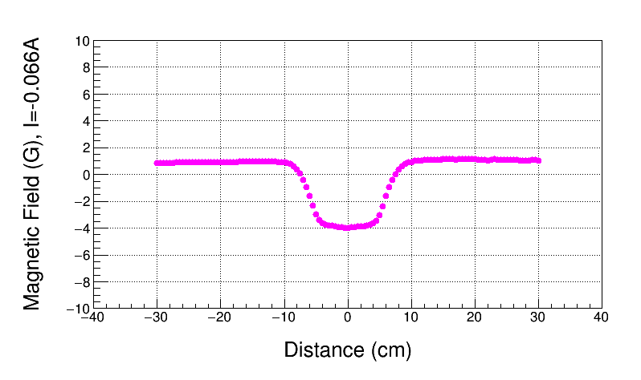
0 BdL, I=-0.066A
On Hysteresis
Used Field Map to find 0 BdL

Slide 12
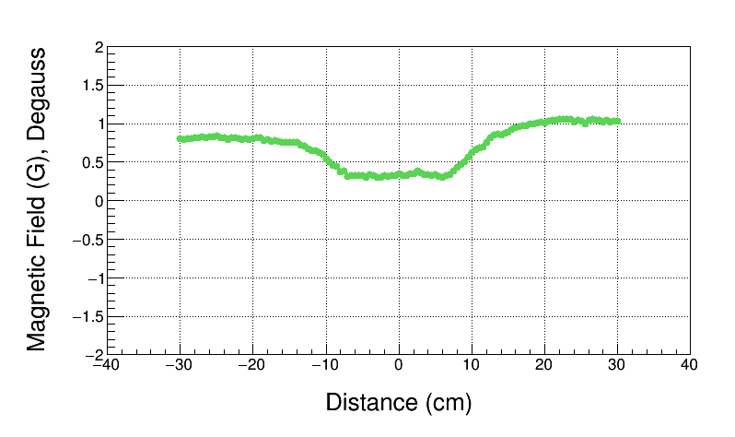
Degaussed, Power Supply Off
BdL = 42 G-cm, this is Field Map Offset

Slide 13
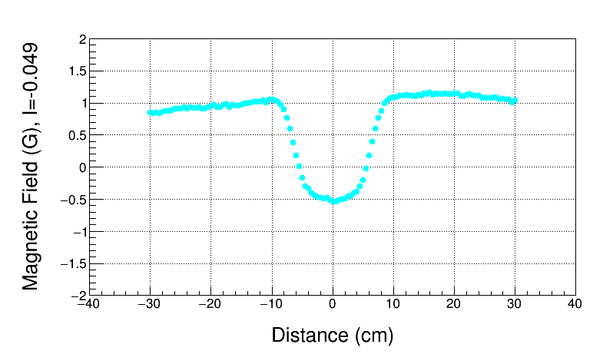
0 BdL, I=-0.049A (with no Offset)
On Hysteresis
Used Field Map with offset subtracted to find 0 BdL
BdL = 43 G-cm – Offset $\sim$ 0

Slide 14
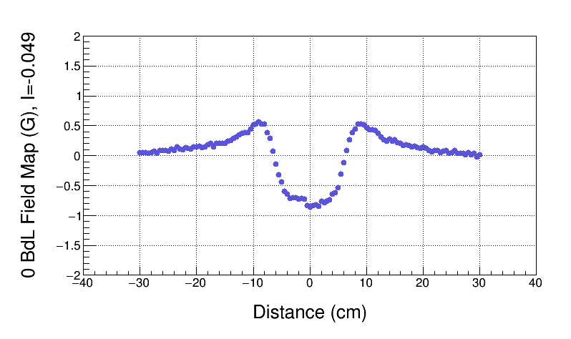
True 0 BdL Field Map

Slide 15
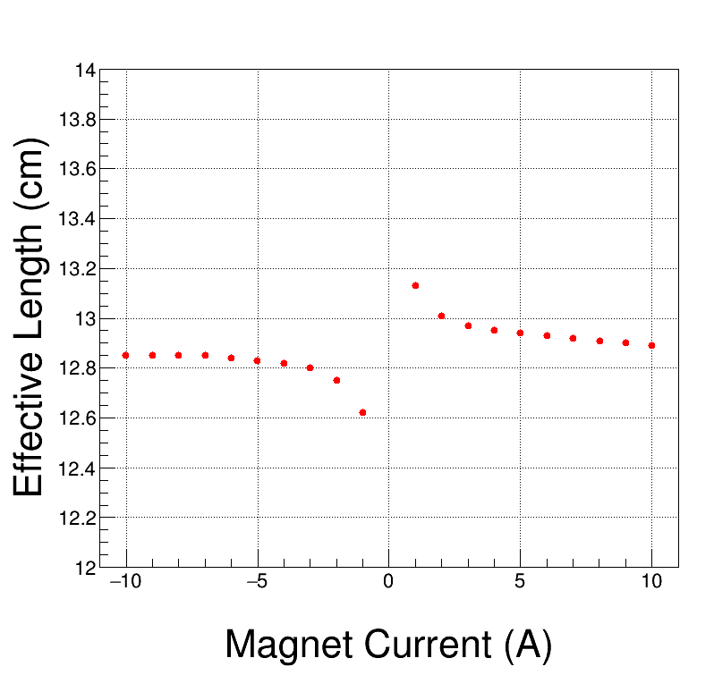
Field Map Effective Length
Meas. Date: 8/10/2016
Coil used: Hall Probe Stepper
Current (A) Eff. L (cm)
-------------- -------------------
10.007 12.89
9.007 12.90
8.006 12.91
7.003 12.92
6.001 12.93
5.001 12.94
4.000 12.95
2.999 12.97
1.998 13.01
0.998 13.13
-0.009 20.02
-1.002 12.62
-2.002 12.75
-3.002 12.80
-4.008 12.82
-5.007 12.83
-6.005 12.84
-7.005 12.85
-8.007 12.85
-9.013 12.85
-10.010 12.85

Slide 16
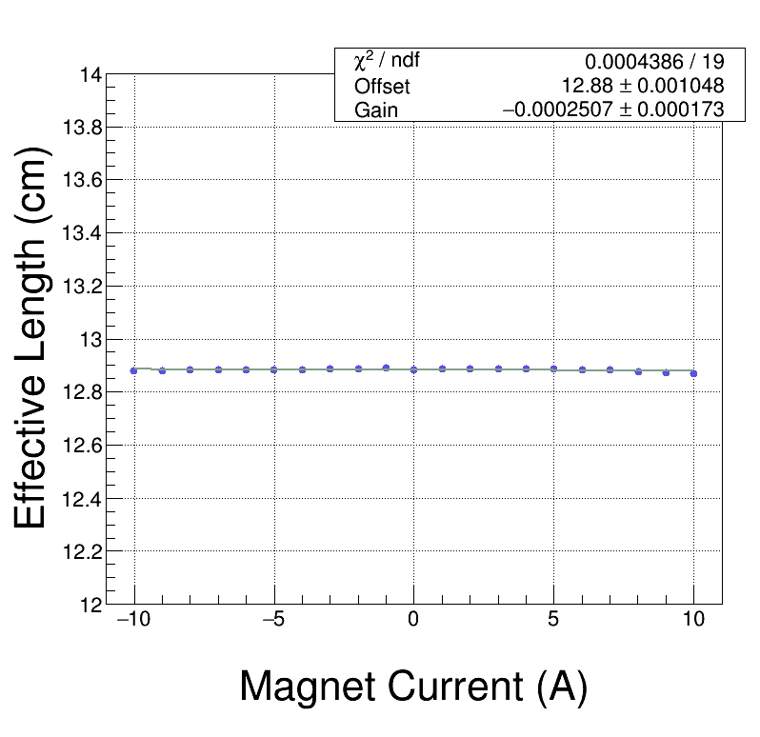
New Effective Length
New Effective Length calculated with Offset of 49.0 G-cm

Slide 17
Summary - I
Field Map Offset is found by mapping degaussed magnet with power supply off
Field Map Offset of Spare DL magnet = 42 G-cm
By comparing Spare magnet Field Map and Field Map of installed magnet, Offset of installed magnet is about 27±7 G-cm since:
Environmental fields at MMF higher are today ($\sim$1 G) than during mapping of magnet installed in CEBAF ($\sim 0.5$ G) in August 2014
New Effective Length is now independent of magnet current
Request to modify CEBAF Field Map: Subtract 27 G-cm
When mapping environmental fields in CEBAF Injector, DL magnet must be degaussed first

Slide 18
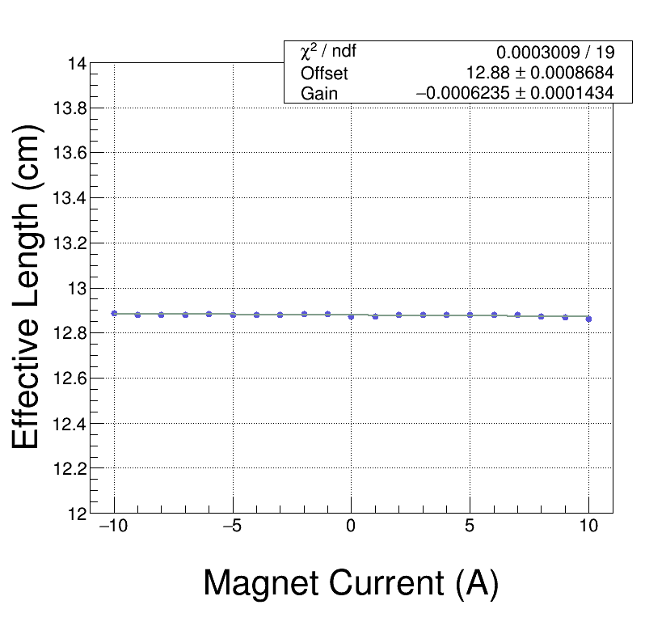
New Effective Length
New Effective Length calculated with Offset of 27.0 G-cm

Slide 19
Summary - II
For Beam Energy Measurement:
CEBAF : BdL $≠$ 0 (due to field map error). Instead: BdL = -Offset $\sim$ -27 G-cm (treat as another horizontal corrector)
Spectrometer Lines (2D, 3D, 5D): subtract 27 G-cm from Field Map
 | Error
Trim Power Supply | 2 mA
Magnet Model (to find momentum from field map) | 0.1%
Field Map Offset | 7 G-cm
For Mott Energy Measurements

