Slide 1

Polarized Positron Beam
R&D at Jefferson Lab
Joe Grames
Center for Injectors and Sources, Jefferson Lab
The PEPPo experiment
Positron Beams at CEBAF
JPos17 and JLab PWG
Notes:
INJECTOR SCIENTIST AT JEFFERSON LAB
WOULD LIKE TO TELL YOU ABOUT A SMALL EXPERIMENT WE PERFORMED TO PRODUCE POLARIZED POSITRONS AT LOW ENERGY
WILL GET TO THIS COMMENT AT THE END

Slide 2



Polarized Bremmstrahlung and Pair Creation
Bremsstrahlung
Pair Creation
P_{circ}(γ) / P_{z} (e⁻)
P_{z} (e⁺) / P_{circ} (γ)
E_{γ} / T_{e-}
T_{e+} / (E_{γ} – 2m_{e+})
E.A. Kuraev, Y.M. Bystritskiy, M. Shatnev, E.Tomasi-Gustafsson, PRC 81 (2010) 055208
2
Notes:
THE PEPPO METHOD IS PRETTY STRAIGHT-FORWARD
FIRST STAGE IS POLARIZED BREMMSTRHALUNG
SECOND STAGE IS POLARIZED PAIR CREATION
THIS COULD BE DONE IN SEPARATE TARGETS, BUT CONVENIENTLY ALSO IN ONE SINGLE TARGET
WE LEARNED EARLY ON THE CALCULATIONS OF OLSON/MAXIMON WERE NOT CORRECT AT LOW ENERGY, ESPECIALLY PAIR CREATION
NEW CALCULATIONS WERE DONE, THAT AGREE W/ OM AT HIGHER ENERGIES
WE WERE NOT FIRST TO PROPOSE THIS IDEA, SO WHY NOT BEFORE…

Slide 3

Polarized Electrons for Polarized Positrons
The purpose of the PEPPo (Polarized Electrons for Polarized Positrons) experiment at the CEBAF Injector was to demonstrate the feasibility of using bremsstrahlung radiation of MeV energy Polarized Electrons for the efficient production of Polarized Positrons.
J. Grames, E. Voutier et al., JLab Experiment E12-11-105 (2011)

Slide 4
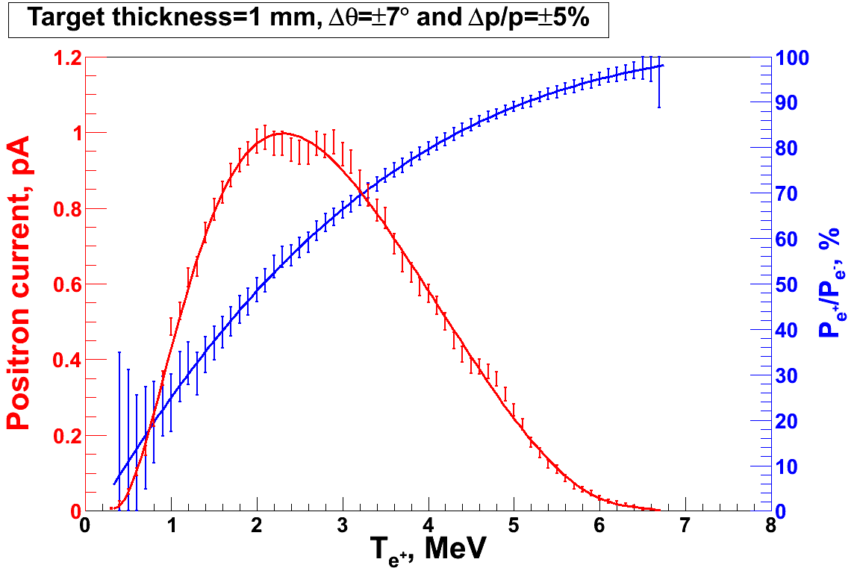
PEPPo Principle of Operation
Geant4
Polarized Electrons
(< 10 MeV/c) strike production target
Positron Transverse and Momentum Phase Space Selection
J. Dumas, PhD Thesis (2011)
E_{e} = 6.3 MeV
I_{e} = 1 µA
T₁ = 1 mm W
P_{e-}
S₁
e⁻
D
T₁
PEPPo
COMPTON TRANSMISSION
Polarized e⁺ convert into polarized γ (P_{γ}) whose transmission through a polarized iron target (P_{T}) depends on P_{γ}.P_{T}
BREMSSTRAHLUNG
Longitudinal e⁻ (P_{e-}) produce elliptical γ whose circular (P_{γ}) component is proportional to P_{e-}
PAIR PRODUCTION
In the same target, γ produce e⁺e⁻ pairs and transfer Pγ into longitudinal (P_{e+}) and transverse polarization averages to zero
S₂
P_{e+}
P_{T}
D
Calorimeter
e⁺
T₂
Compton Transmission Polarimeter
PEPPo measured the longitudinal polarization transfer from 8.25 MeV/c e⁻ to e⁺ in the 3.07-6.25 MeV/c momentum range.

Slide 5
Compton Transmission Polarimeter Spectra
Energy
Central
Detector
Coincidence
Trigger and
Central Detector
Compton physics asymmetries are obtained from the polarization sensitive energy deposition in the central crystal.
The location of the 511 keV peak is an in-situ monitor of the gain of the detection chain and provides a link to radioactive source calibration data.
The coincidence time between the central crystal and a charge sensitive trigger scintillator allows for accidental subtraction.

Slide 6
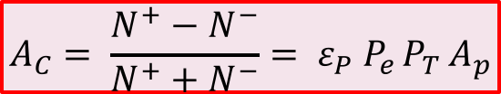
Compton Transmission Analyzing Power
A. Adeyemi (Hampton University)
The experimental Compton asymmetry for an electron beam of known polarization provides a measurement of the electron analyzing power (A_{e}) of the polarimeter.
A comparison between the experimental and the GEANT4 simulated response of the polarimeter establishes a calibrated model of the polarimeter.
The positron analyzing power (A_{p}) is then determined by simulation using the calibrated model.
Electron beam polarization
Target polarization
Electron-to-positron
polarization transfer
$$A_{C}= \frac{N^{+}−N^{−}}{N^{+}+N^{−}}= ε_{P} P_{e }P_{T }A_{p}$$
P_{T} = 7.06% ±0.05%_{Sta.}± 0.07%_{Sys.}

Slide 7

PEPPo Result
(PEPPo Collaboration) D. Abbott et al. , Phys. Rev. Lett. 116 (2016) 214801
PEPPo demonstrated efficient polarization transfer of 8.2 MeV/c polarized electrons to positrons, expanding polarized positron production using MeV electron beam energies.
electron beam polarization
85.2 ± 0.6 ± 0.7 %
Whenever producing e⁺ from e⁻, polarization is coming for free
if initial electrons are polarized.

Slide 8
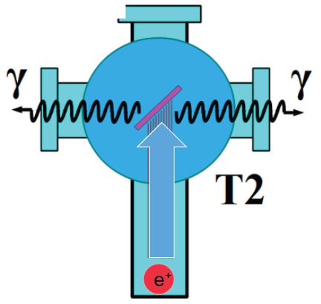
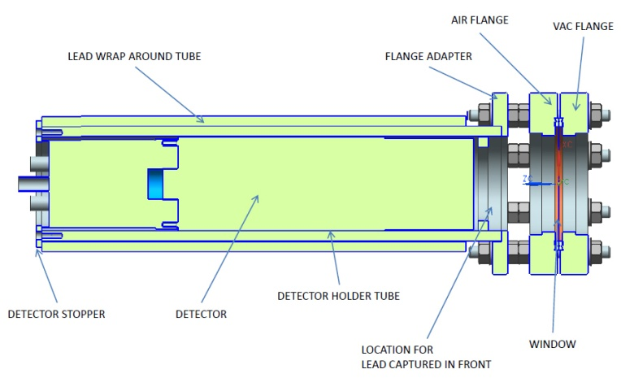
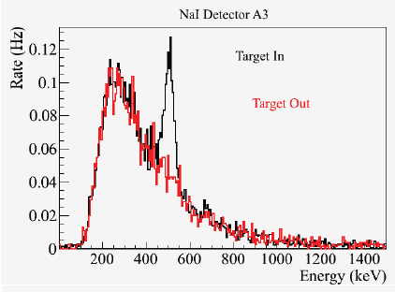
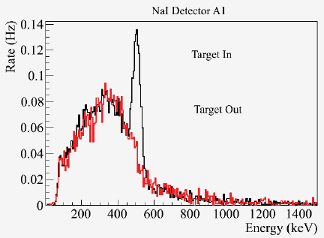
Positron Yield
S₁
Two NaI detectors measured coincidence of back-to-back photons emitted by annihilation of positrons in a viewscreen.
e⁻
e⁺
D
T₁
p_{e-}= 8.2 MeV/c
A3
D
e⁺
S₂
T₂
A1
For these data we had a yield of ~10⁻⁵ e⁺/e^{-.}
A3
A1

Slide 9
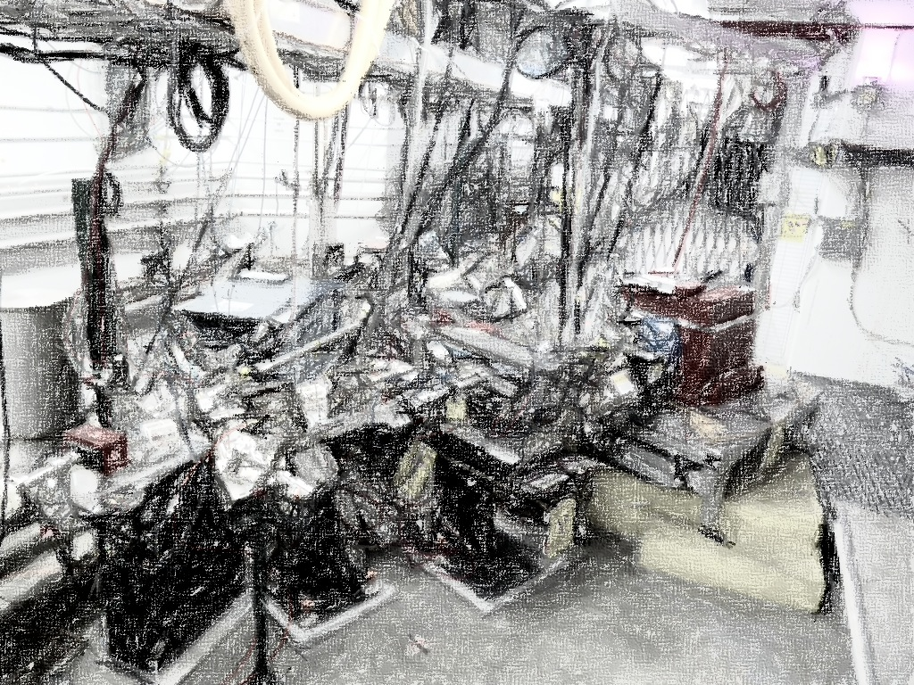
PEPPo Collaboration
P. Adderley¹, A. Adeyemi⁴, P. Aguilera¹, M. Ali¹, H. Areti¹, M. Baylac², J. Benesch¹,
G. Bosson², B. Cade¹, A. Camsonne¹, L. Cardman¹, J. Clark¹, P. Cole⁵, S. Covert¹,
C. Cuevas¹, O. Dadoun³, D. Dale⁵, J. Dumas^{1,2}, E. Fanchini², T. Forest⁵, E. Forman¹,
Freyberger¹, E. Froidefond², S. Golge⁶, J. Grames¹, P. Guèye⁴, J. Hansknecht¹,
P. Harrell¹, J. Hoskins⁸, C. Hyde⁷, R. Kazimi¹, Y. Kim^{1,5}, D. Machie¹, K. Mahoney¹,
R. Mammei¹, M. Marton², J. McCarter⁹, M. McCaughan¹, M. McHugh¹⁰, D. McNulty⁵, T. Michaelides¹, R. Michaels¹, C. Muñoz Camacho¹¹, J.-F. Muraz², K. Myers¹²,
Opper¹⁰, M. Poelker¹, J.-S. Réal², L. Richardson¹, S. Setiniyazi⁵, M. Stutzman¹,
R. Suleiman¹, C. Tennant¹, C.-Y. Tsai¹³, D. Turner¹, A. Variola³, E. Voutier^{2,11},
Y. Wang¹, Y. Zhang¹²
¹ Jefferson Lab, Newport News, VA, US ² LPSC, Grenoble, France ³ LAL, Orsay, France
⁴ Hampton University, Hampton, VA, USA ⁵ Idaho State University & IAC, Pocatello, ID, USA
⁶ North Carolina University, Durham, NC, USA ⁷ Old Dominion University, Norfolk, VA, US
⁸ The College of William & Mary, Williamsburg, VA, USA ⁹ University of Virginia, Charlottesville, VA, USA ¹⁰ George Washington University, Washington, DC, USA ¹¹ IPN, Orsay, France
¹² Rutgers University, Piscataway, NJ, USA ¹³ Virginia Tech, Blacksburg, VA, USA
Many thanks for support from SLAC E166, DESY, Princeton, Cornell, International Linear Collider Project and Jefferson Science Associates

Slide 10



Figure of Merit (e.g. E_{e-} = 60 MeV)
R. Dollan, K. Laihem, A. Schälicke, NIM A 559 (2006) 185,
J. Dumas, J. Grames, E. Voutier, JPos09, AIP 1160 (2009) 120
J. Dumas, Doctorate Thesis (2011)
The polarization distribution of generated positrons is dominated by low-energy events.
The positron energy at the optimum FoM (P²I) is about half of the electron beam energy.
Optimum
FoM
Optimum energy

Slide 11
Using the CEBAF Polarized Electron Injector
J. Dumas, Doctorate Thesis (2011)
In the 10-100 MeV electron beam energy one can simulate at the FoM, with dp/p < 10% and angle<10°
  conversion efficiency (ε) varies from about 10⁻⁵ - 10⁻³ e+/e-
  electron polarization transfer is “flat” ~75% at FoM
Using a 100 MeV electron beam and a more realistic momentum spread dp/p <1% (ΔE ~ 1 MeV) the conversion efficiency is 1-5 x 10⁻⁴.

Slide 12
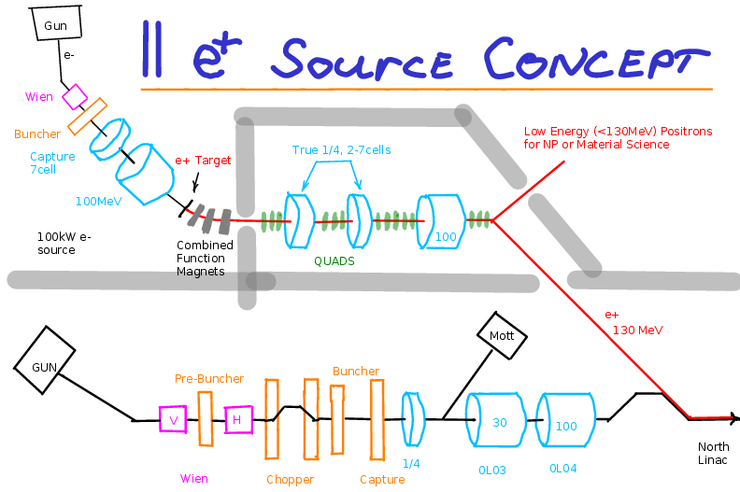
Concept for a Dedicated e+ Source
What are some requirements to use a 100 MeV electron beam for generating a positron beam with intensity I_{e+} > 100 nA and polarization P_{e+} > 65% (at max FoM) ?
  Collecting e+ at 60 MeV with ~10⁻⁴ e⁺/e⁻ efficiency suggests ~1 mA polarized electron beam and a high power conversion target (typ. >10% in target).
Concept for dedicated Positron Injector
Concept S. Golge Thesis
Drawing A. Freyberger
Existing
CEBAF
Electron
Injector

Slide 13
CEBAF GaAs Photocathode Evolution
Bulk GaAs
Strained GaAs:
GaAs on GaAsP
Superlattice GaAs:
Layers of GaAs on GaAsP
100 nm
100 nm
2 μm
14 Layers
625 μm
350 μm
QE ~ 5%, 30 mA/W
Pol ~ 35% @ 780 nm
QE ~ 0.2%, 1 mA/W
Pol ~ 75% @ 850 nm
QE ~ 1%, 6 mA/W
Pol ~ 85% @ 780 nm
P_{e-} 35% 35% 75% 75% 85% 89%
I_{e-} 30μA 100μA 50μA 100μA 150μA 200μA
1995 1998 1999 2000 2004 2012 2017
Spin Polarized Electron programs (particularly PV Users) have
driven the need for improved performance over last 20+ years
Notes:
FOR US AT JLAB, HOWEVER, SAW THIS AS AN OPPORTUNITY TO EXPLOIT WHAT WE’VE BEEN DOING W/ POLARIZED E- BEAMS FOR TWO DECADES
OVER THAT TIME THE SPIN PROGRAM HAS DRIVEN IMPROVEMENT
GAAS PHOTOCATHODES THAT BREAK DEGENERACY, YET RETAIN HIGH QUANTUM EFFICIENCY
THIS MEANS HIGH SPIN POLARIZATION (85%) AND HIGH QE (>1%)
LEARNING HOW TO SUSTAIN THIS FOR LONG PERIODS MAKES THIS VIABLE

Slide 14


Photocathode Lifetime at mA Beam Currents
High current (1-10 mA) studies with low-P photocathodes demonstrated that charge lifetime is improved by increasing laser spot size (spreading out ion damage).
Measurements are underway using the CEBAF polarized source to characterize lifetime vs. spot size with high-P (>85%) photocathodes with intensities of 0.5-2 mA
Phys. Rev. ST Accel. Beams 14, 043501 (2011)
CEBAF Polarized Inverted Load Lock Gun
Slope is proportional to QE Decay
Increasing laser size reduces QE decay proportionally
1mA

Slide 15

Electron Polarization at mA Beam Current
CEBAF Mott Polarimeter
For the first time, the spin polarization of a high-P superlattice photocathode is measured from low to milliAmpere intensity.
The spin polarization of a high current (mA) beam is measured at CEBAF by extracting and accelerating a small fraction of the beam to a sub-percent accuracy Mott polarimeter.

Slide 16
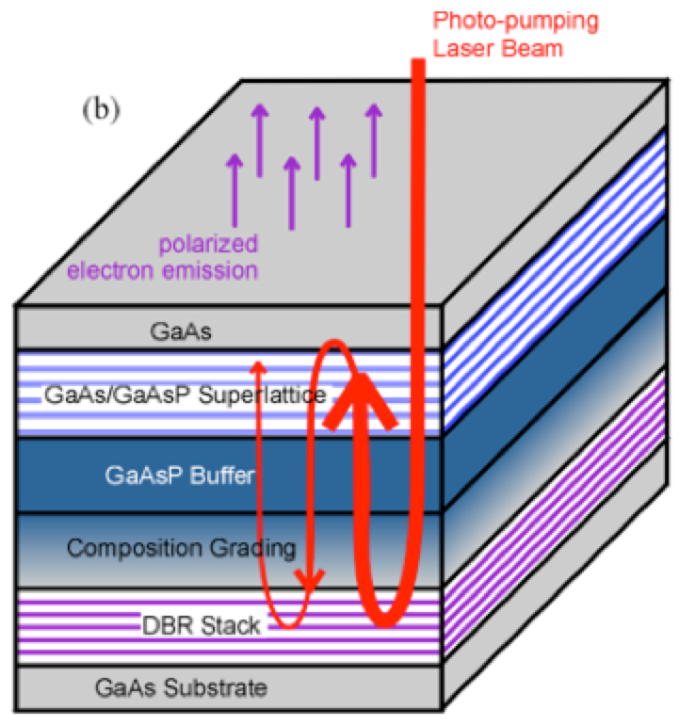
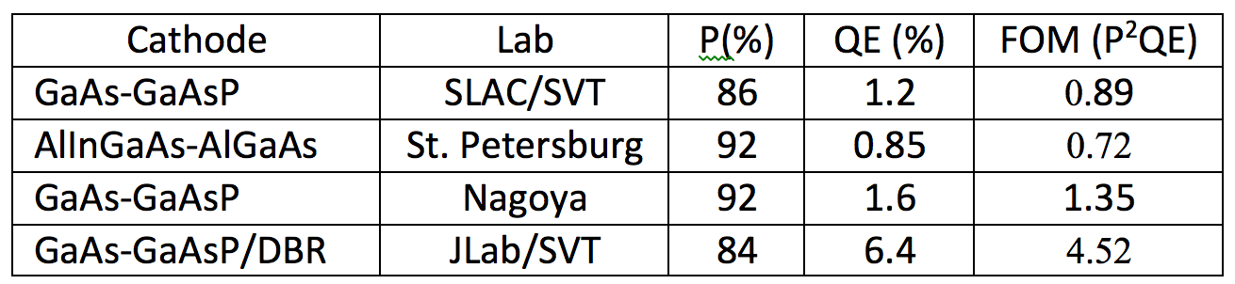
High Polarization Photocathode R&D
GaAs/GaAsP superlattice photocathode with GaAsP/AlAsP Distributed Bragg Reflector (DBR)
The highest QE & FOM of any reported high polarization photocathode
CEBAF
SLSP
Photocathode
DBR Stack
DBR (R&D)
6.4
Substrate
W. Liu, S. Zhang, M. Stutzman, M. Poelker, Y. Chen, W. Lu, and A. Moy
Appl. Phys. Lett. 109, 252104 (2016)

Slide 17
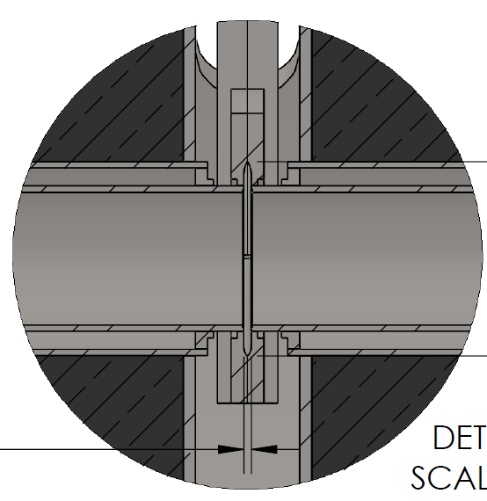
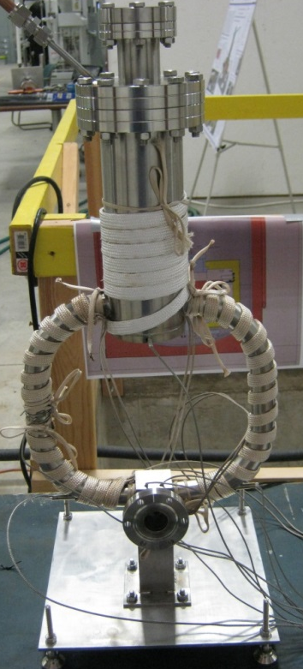
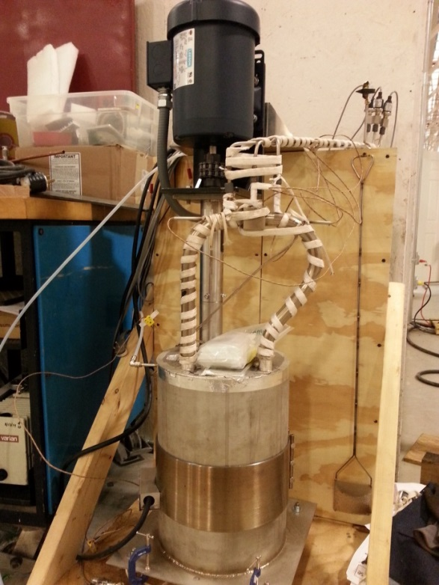
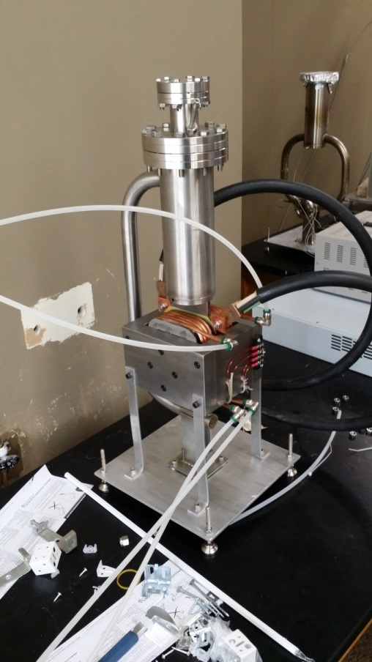

High Power Target R&D
Liquid Metal Target – lead-bismuth eutectic (LBE)
  High Z = 82, 83
  Low melting point: 124°C
  High boiling point: 1670°C
Multiple LBE targets tested on various accelerators
  Natural Circulation
  Mechanical Pumping
  Electromagnetic Pumping
Approaching 10 kW power level, CW
Stainless Steel Windows (0.25mm)
LBE (2mm)
Output (e⁻,e⁺,γ)
Input (e⁻)

Slide 18
Still, many issues to discuss and resolve…
Magnetic Recirculation (e⁻ beam goes clockwise)
  Inverted direction requires long transfer line and difficult inject-/extraction
  Clockwise direction requires reversal of unipolar dipole power supplies; focusing quadrupole and steering correctors have bipolar supplies
Low Current Operation (to tune-up and “see” the beam)
  Most of the Accelerator and Hall B is blind to <100 nA
  “Peak intensity” macro-pulse (1.5% duty factor) challenging
Delivering Positron Beams (setting up the machine)
  Requires setting up CEBAF initially with an electron beam
  Additional LINAC beam position monitors are needed for monitoring the low intensity beam between recirculation arcs
  Requires a number of well-placed upgrade receivers for 10 nA operation
  Supplemental monitors (SLM, wire scanners/OTR screens) will be needed to monitor the beam during operation

Slide 19

JPos17 @ Jefferson Lab
The JPos17 International Workshop (Sep 12-15) at Jefferson Laboratory will review the Scientific and Technical basis for positron beams (polarized and unpolarized) in context of CEBAF 12 GeV, JLEIC, and for Low Energy Applications.
www.jlab.org/conferences/JPos2017
JPos17 and the Jefferson Lab Positron Working Group will serve as a basis to develop a White Paper on Positron Physics at JLab.
wiki.jlab.org/pwg pwg@jlab.org
Please Join Us !!!

Slide 20
Summary
The PEPPo technique provides access to highly spin-polarized positrons opening access to a wide community.
A high-energy polarized positron beam program in the context of CEBAF 12 GeV (and JLEIC) based on the PEPPo technique is being explored.
Your input is important and timely:
    JPos17 => www.jlab.org/conferences/JPos2017/
    JLab PWG => wiki.jlab.org/pwg
I would like to acknowldge Larry Cardman, Arne Freyberger, Yves Robin, Michael Tiefenbeck, and Eric Voutier for their comments and input to this talk.

Slide 21
Back Up Slides

Slide 22
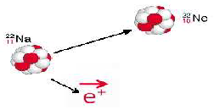




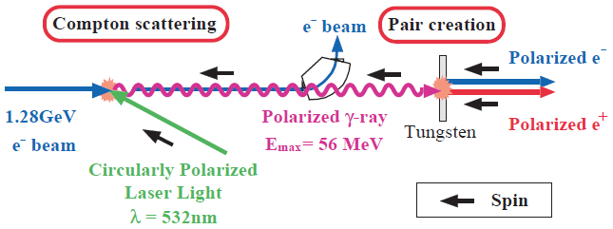
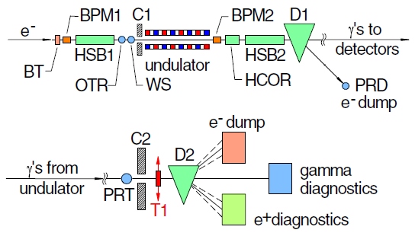
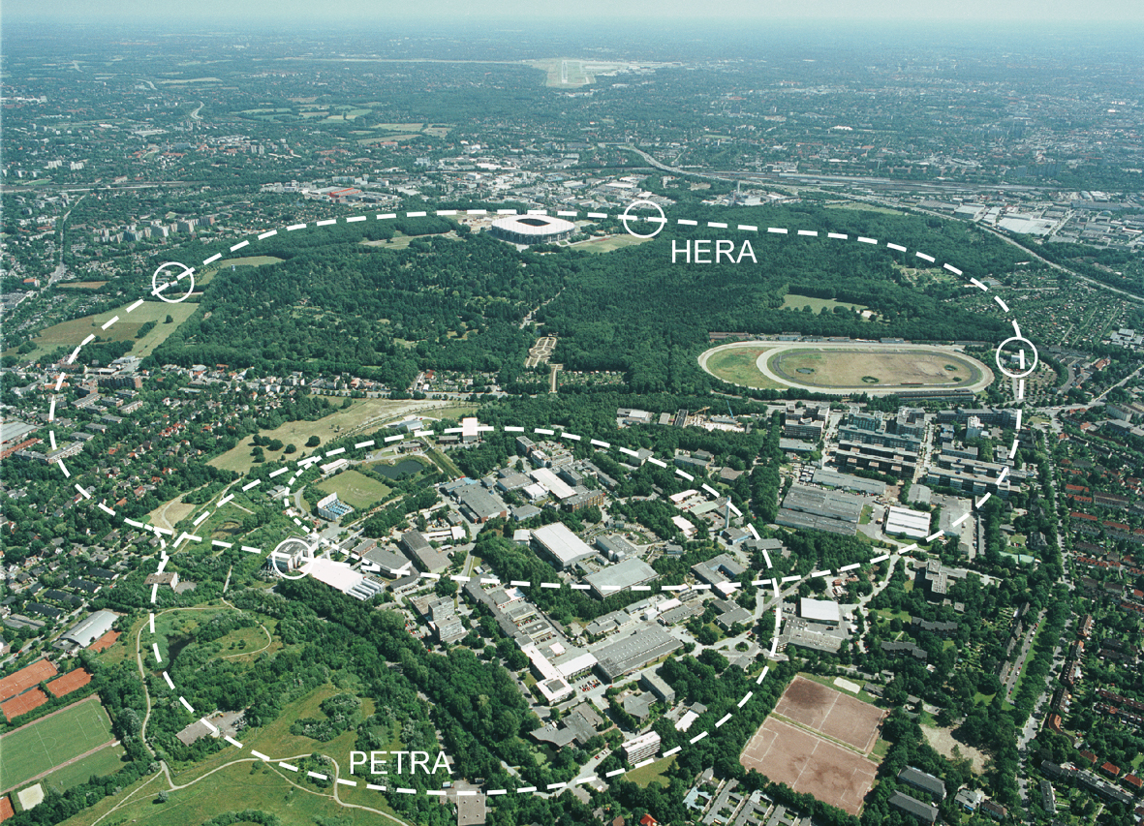
Collecting Polarized Positrons
Polarized β⁺ Decay
L.A. Page & M. Heinberg. Phys. Rev.
106(6):1220-1224 (1957)
Sokolov-Ternov Effect
D. Barber , AIP Conf. Proc. 588, 338 (2001)
HERA 27.5 GeV e+/e-
Polarized due to parity non-conservation in the weak interaction
P(e⁺) ~ 40 %
P(e⁺) ~ 70 %
Compton Backscattering (KEK)
T. Omori et al, PRL 96 (2006) 114801
Helical Undulator (SLAC E166)
G. Alexander et al, PRL 100 (2008) 210801
47.7GeV
P(e⁺) = 73 ± 15_{(stat)} ± 19_{(syst)} %
P(e⁺) = 80 ± 7_{(stat)} ± 9_{(syst)} %
Notes:
TO PROVIDE SOME CONTEXT, POLARIZED POSITRONS CAN BE COLLECTED IN A NUMBER OF WAYS
BETA DECAY – WEAK INTERACTION (NOT EFFICIENT FOR RF ACCEL)
ST – QUANTUM EMISSION OF SYNC. RAD. (NOT COMPATIBLE W/ CW BEAM)
PAIR PRODUCTION BY POLARIZED GAMMAS (PLAUSIBLE, BUT HIGH TECHNICAL CHALLENGE – INTENSE LASERS, HIGH ENERGY BEAMS)
WE WONDERED IF WE COULD SIMPLY USE OUR POLARIZED ELECTRON BEAM

Slide 23
CEBAF Polarized Electron 10 MeV Injector
PEPPo ran at the CEBAF injector, taking advantage of the existing beam diagnostics that determine with precision the properties of the polarized electron beam entering the PEPPo apparatus.
Intensity controls
10 pA – 1 µA
Energy measurement
dp/p < 0.5%
Polarization measurement
dP/P < 2%
Laser
PEPPo
Polarization controls
    30 Hz fast heilicity reversal (delayed)
    Slow laser polarization reversal (half-wave plate)
    4π spin rotator
Variable energy
3.1-8.2 MeV/c

Slide 24
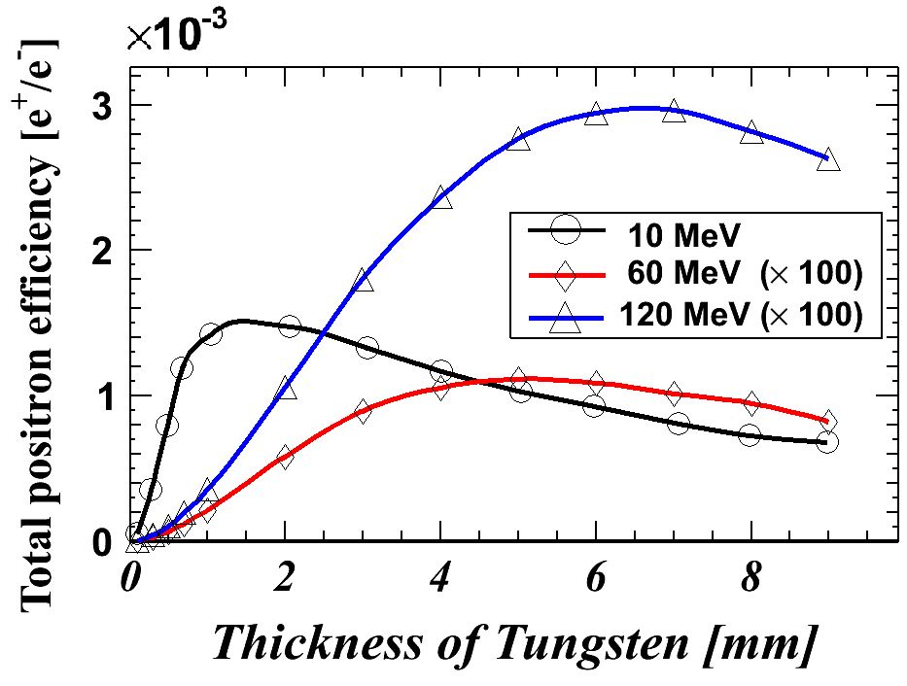
Positron Yield using 10 MeV Electrons
Electro-magnetic Shower
e⁺ yield ~ e⁻ beam power (E*I)
High Z-target increases yield
Operate at low energy below photo-neutron threshold to mitigate radioactivity
10 MeV e⁻ shower
e⁺/e⁻ yield ~ 0.1 % (optimized)
Collection efficiency ~ 1-10 %
>100nA e⁺ at IP2 for CEBAF => >1.0 milliAmp e⁻ beam

Slide 25
JLEIC/CEBAF Positron Injector
Polarized
Electron
10 MeV Injector
500-Turn
Accumulator Ring
(22m)
Harmonic
Extraction Ring
(22m)
Positron Conversion/Collection Efficiency ~ 10⁻⁴
Bunch
Management
to CEBAF/JLEIC
10 MeV polarized e⁻
1.33 pC @ 1500 MHz
10 MeV pol e⁻
0.67 nC bunches
@ 1500 MHz
10 MeV polarized e⁻
0.67 nC @ 68.1 MHz
5-7 MeV Polarized e⁺
67 fC @ 68.1 MHz
 | Polarized Electron Source | Accumulator/ Extractor Rings | Electrons at Converter | Polarized Positron Source | R&D Challenge
JLEIC | Ave = 100 μA 1.33 pC @ 1500 MHz 2 mA w/ DF=5% | Ave = 1 A 1500 MHz | Ave = 100 uA 68.1 MHz 44 mA @ DF=0.23% | Ave = 10 nA 68.1 MHz 4.4 uA @ DF = 0.23% | Electron accumulator Harmonic extraction Target: 440 kW peak
CEBAF | Ave = 1-10 mA 4-40 pc @ 250 MHz (cw) | Not Necessary | Ave = 1-10 mA 250 MHz (cw) | Ave = 100 nA - 1 μA 250 MHz (cw) | High-QE photocathode High voltage gun Target: 10-100 kW ave
Slide courtesy of Fanglei Lin
J. Grames, SPIN 2016 @ UIUC, Sep 26-30 2016
25

