Slide 1
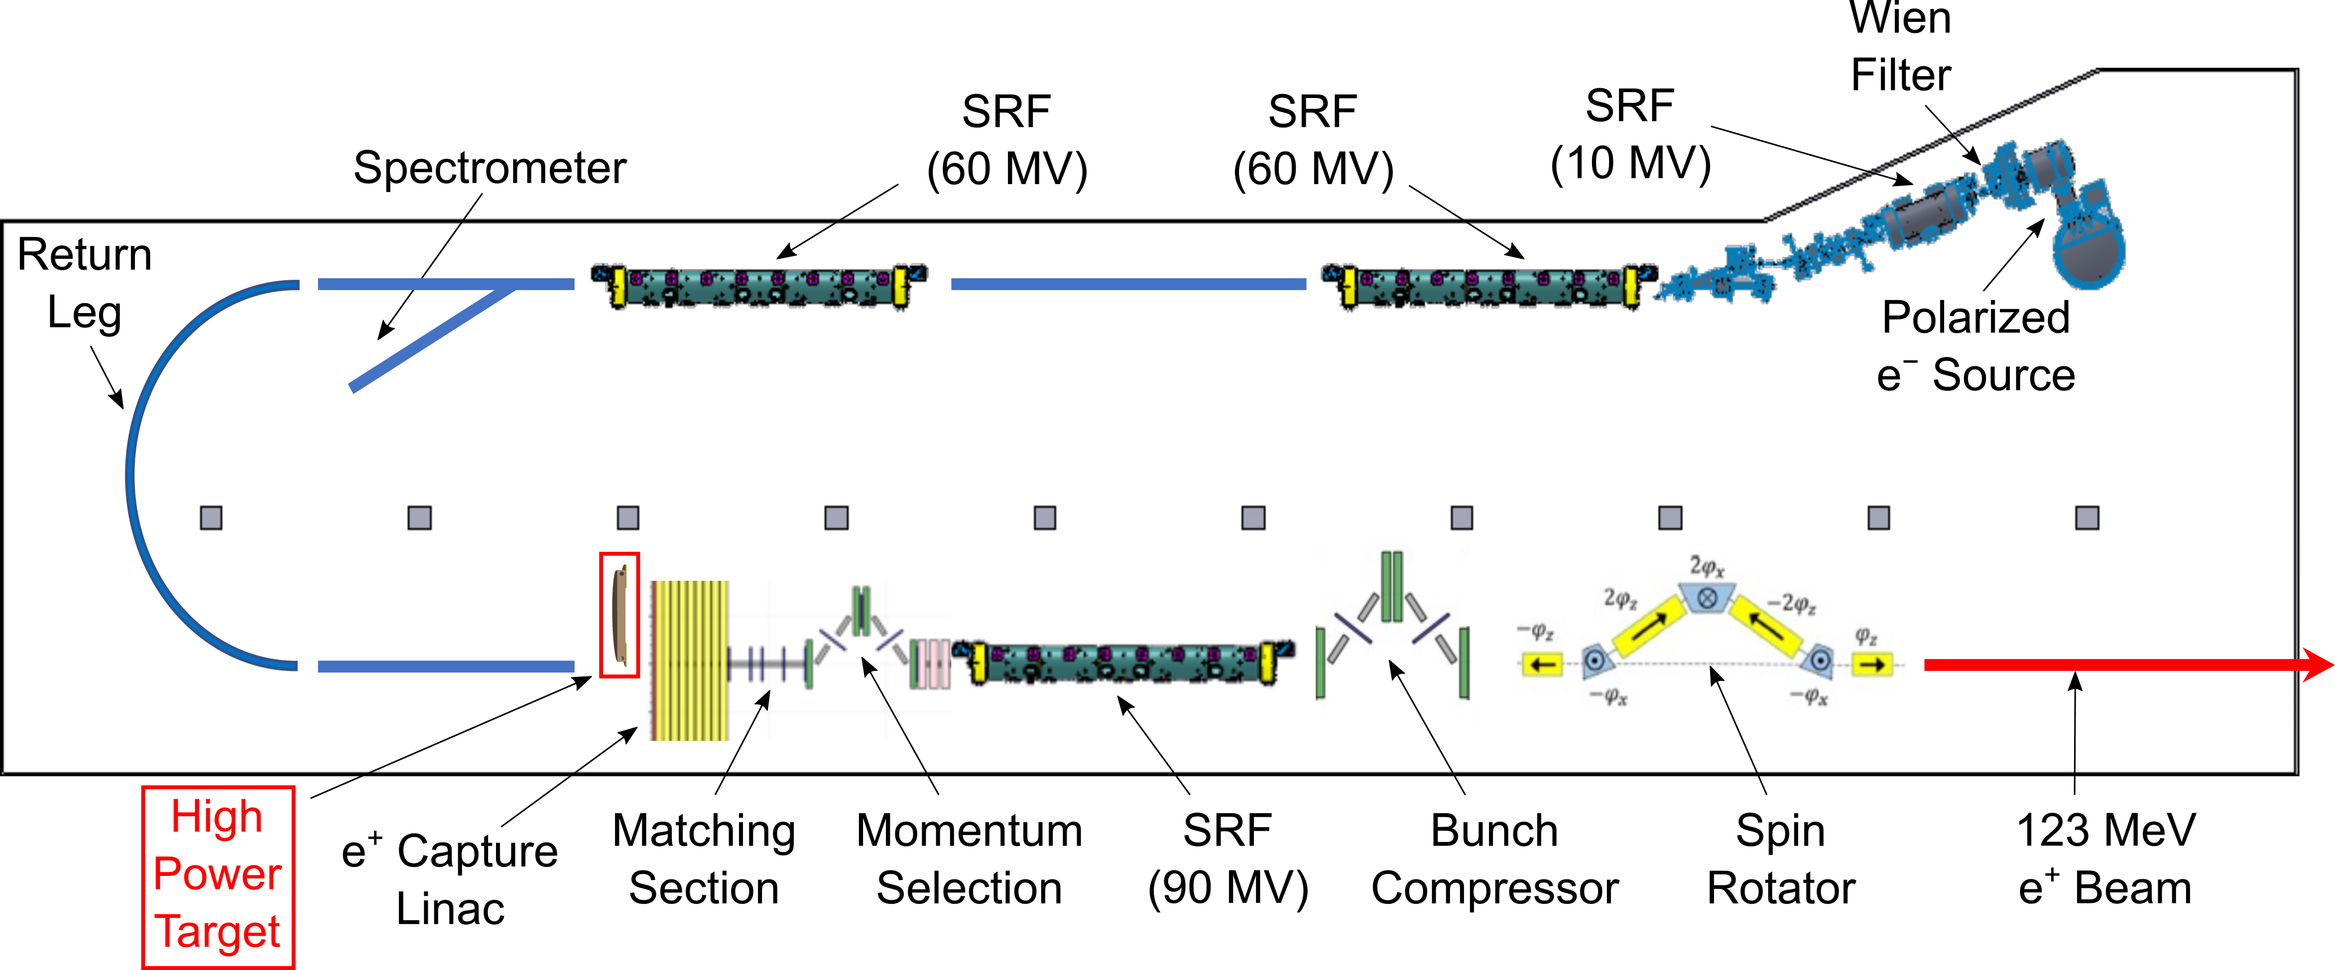
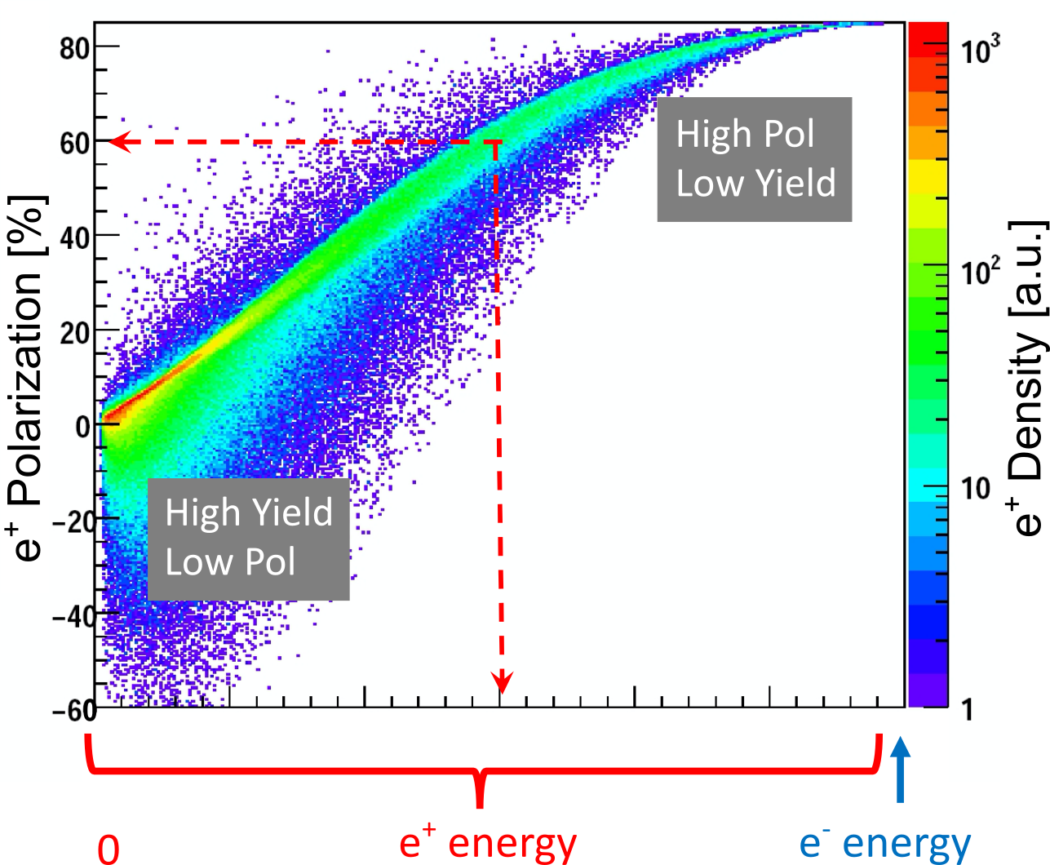
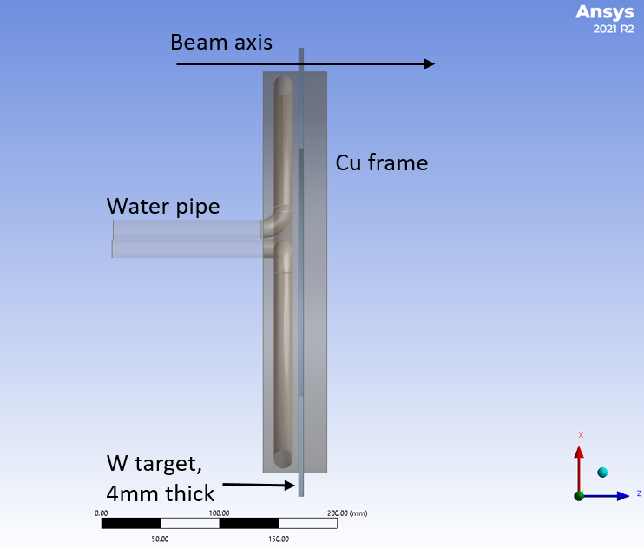
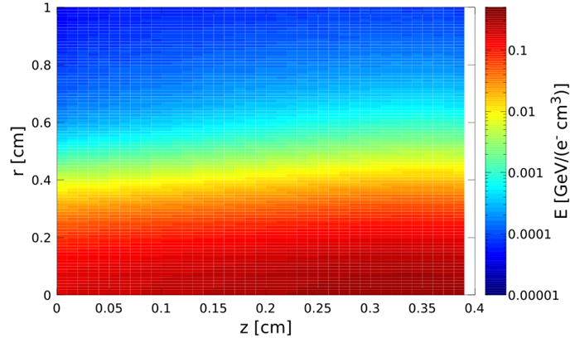
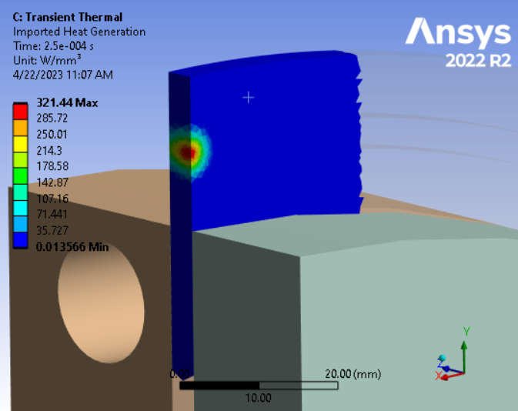
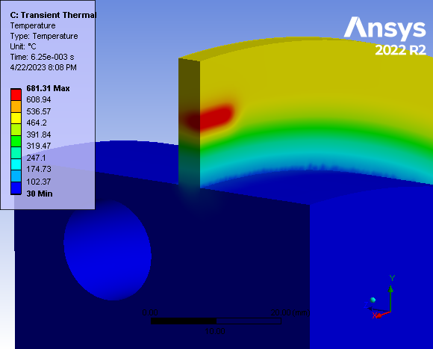
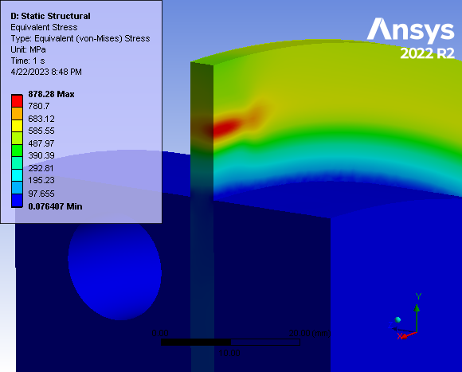
Evaluation of a High-Power Target Design for Positron Production at CEBAF
A. Ushakov^{1,2}, S. Covrig², J. Grames², S. Habet^{1,2}, C. Le Galliard¹, E. Voutier¹
¹Université Paris-Saclay, CNRS/IN2P3/IJCLab, 91405 Orsay, France
²Thomas Jefferson National Accelerator Facility, Newport News, VA 23606, USA
Abstract: An injector for polarized positron beams at the Continuous Electron Beam Accelerator Facility (CEBAF) at Jefferson Lab is being designed. The Polarized Electrons for Polarized Positrons (PEPPo) concept is used to produce polarized e⁺e⁻-pairs from the bremsstrahlung radiation of a longitudinally polarized electron beam interacting within a high-Z conversion target. The scheme under consideration includes a 4 mm thick tungsten target that absorbs 17 kW deposited by a 1 mA continuous-wave electron beam with an energy of 120 MeV. The concept of a rotating tungsten rim mounted on a water-cooled copper disk was explored. The results of ANSYS thermal and mechanical analyses are discussed together with FLUKA evaluations of the radiation damages.
Scheme of e⁺ Source
Yield vs Target Thickness
e⁺ Polarization vs Energy
Δp_{e+}/p_{e+} = ±0.05
Tungsten
For 120 MeV e‒ and max FoM = $YP^{2}$:
Optimal Thickness of W Target = 4 mm
e⁺ Yield $≲$ 10⁻³
Concept of Rotated Water-Cooled Target
e‒ Beam (1 mA)
Power Deposition in
Target (17 kW)
Energy Deposition in W Target by 120 MeV
e‒ Beam with 1.5 mm RMS spot size
Heat Power Density
Temperature vs time
Distribution of Temperature
Distribution of Equivalent von-Mises Stress
Radiation Damage
Summary and Outlook
A high-power target for positron production at the future Ce⁺BAF positron injector [1] was evaluated. The full-time dependent CFD simulations (ANSYS Fluent) were implemented. The temperature, mechanical stress and radiation damage were calculated for the tungsten target with a thickness of 4 mm and 17 kW power deposited by 1 mA CW electron beam with an energy of 120 MeV. The peak temperature of the target rotated with a velocity of 2.3 m/s is 680°C and the maximal equivalent von Mises stress is 880 MPa. The estimated annual radiation damage is 0.21 dpa. To check if the target can be used safely extended period under such conditions and find experimentally the endurance stress limits and the impact of radiation damage on the material properties, the tests of the target materials (tungsten and tantalum) using 50 µA at 3.5 MeV electron beam at Mainz Microtron (MAMI) have been started. Also, the material fatigue tests using the laser light are planned, similar to performed tungsten foil tests for APEX target at Jefferson Lab [2].
[1] J. Grames et al., “Positron beams at Ce+BAF,” To appear in these proceedings (MOPL152)
[2] S. Gopinath and S. Covrig, “Hall A – APEX target thermal assessment,” Jlab Tech. Rep. PMAG0000-0001-A0001, 2020.
This work is supported by the European Union’s Horizon 2020 Research and Innovation program under Grant Agreement No 824093 and the U.S. DOE, Office of Science, Office of Nuclear Physics, contract DE-AC05-06OR23177.

