Slide 1
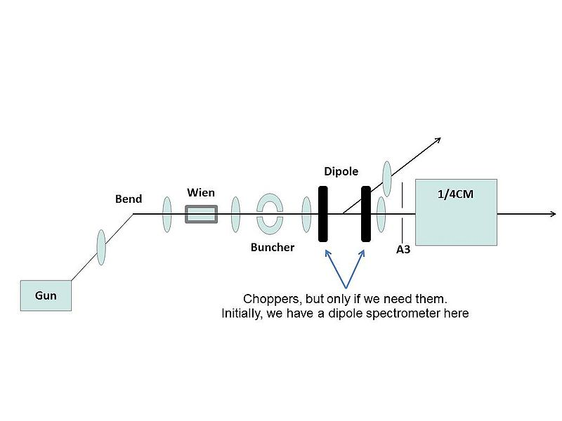
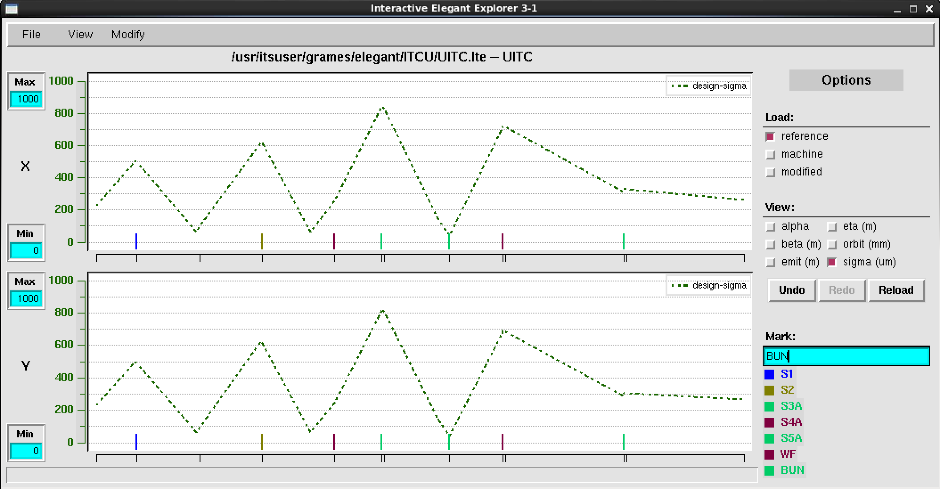
Evolving the UITC layout (Grames, 5/12/14)
S2
S3AB
S4AB
S5AB
S1

Slide 2
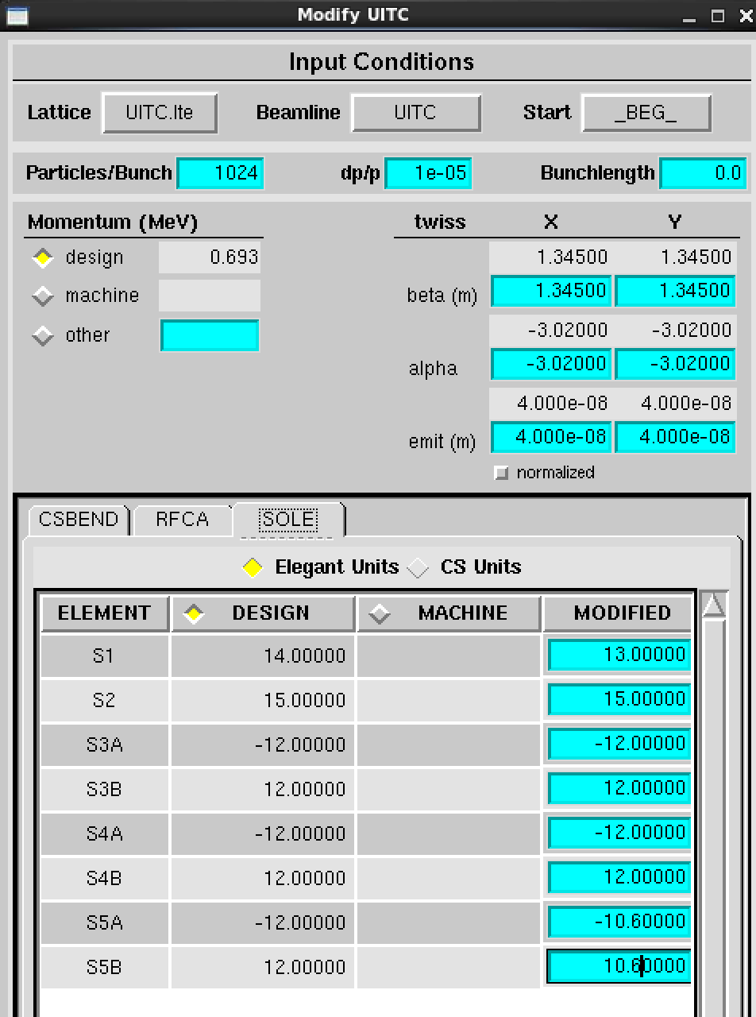
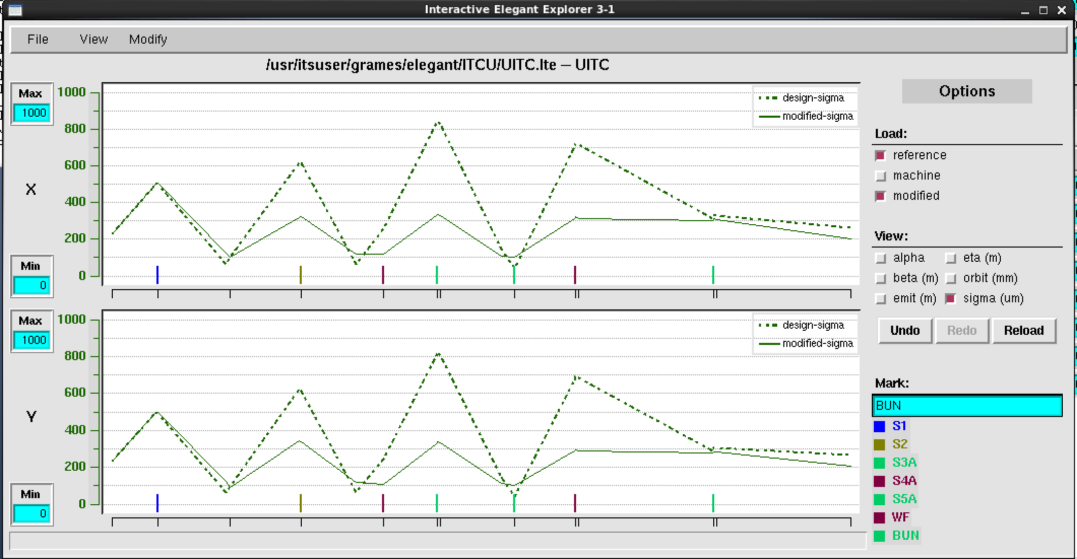
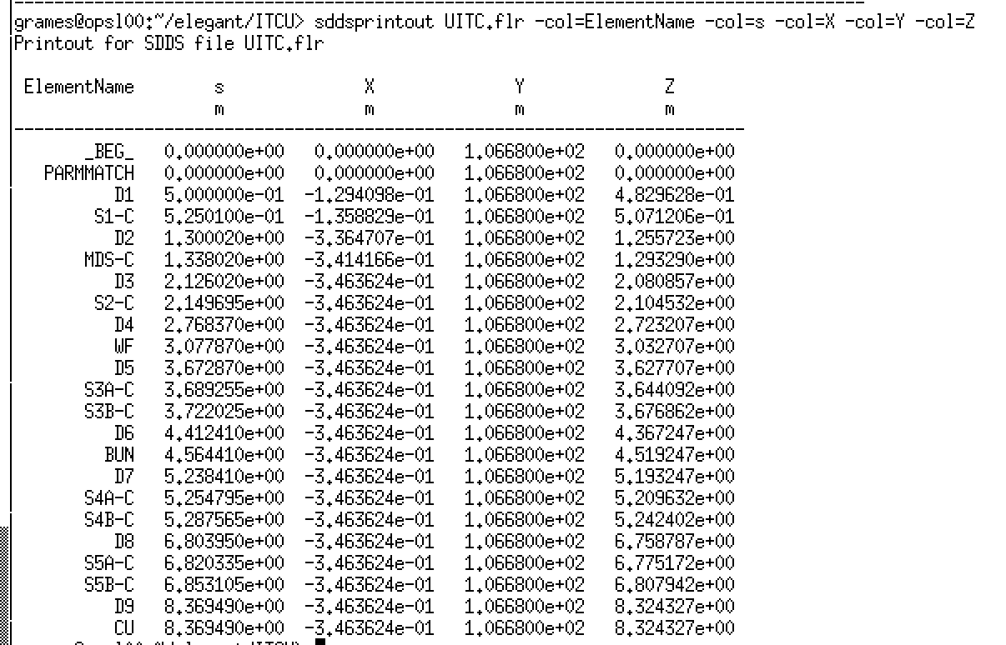
Manual (or auto-optimizing) “knob-tweeking” easy
(magnets, RF, distances, etc)
“K” ~ B/p
L = B²dz/B₀²

Slide 3
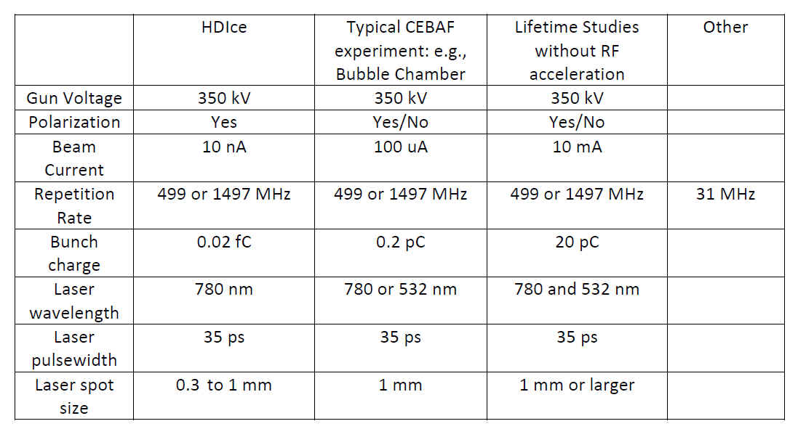
Main Considerations for Layout
How to fold in hardware for…
HDIce/Experiments
Spin manipulation - Wien filter, compensating quads
MeV energies – diagnostics for bunching, energy gain
Gun R&D/Diagnostics
Transverse emittance -
Longitudinal emittance -

Slide 4
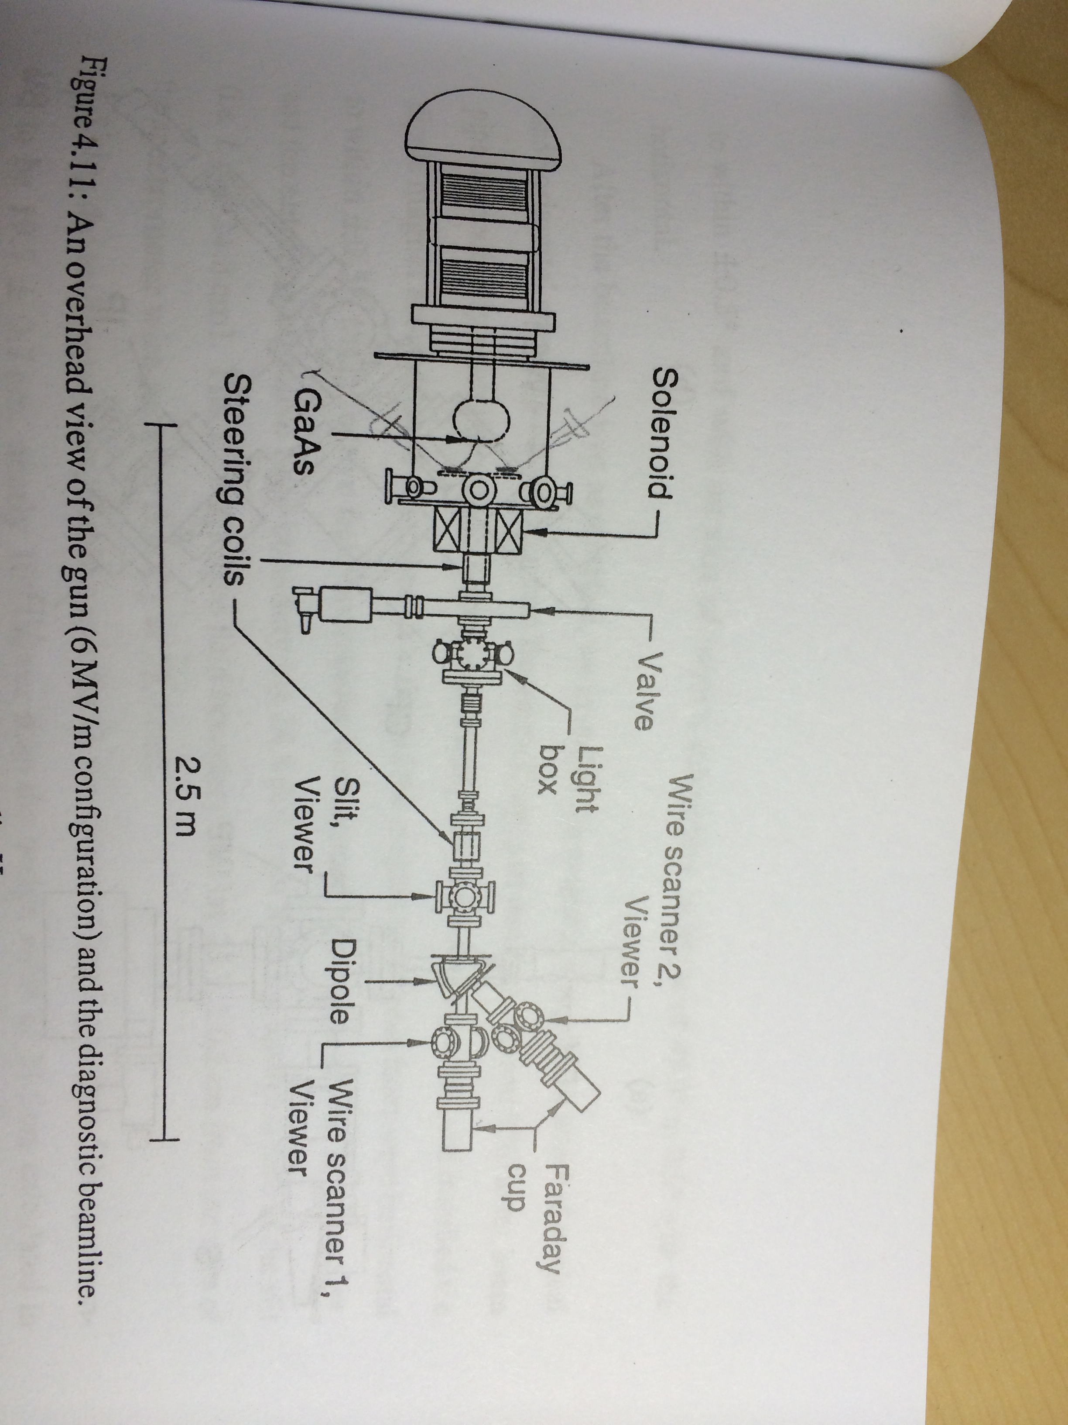
What might a gun R&D diagnostic beam line look like?
Parameter | “Plan” | Measured
Bunch charge | 0.01 – 1000 pC | 0.3 – 125 pC
Laser size (R) | 0.1 – 3.0 mm | 1.06mm, 1.95mm
Pulse length (T) | 15 – 25 psec | 19.3 – 25.2 psec
Voltage | > 500 kV | 250, 300 kV
E-Field | < 10 MV/m | 10.5 MV/m @ 4.8 cm 6 MV/m @ 10.6 cm

Slide 5
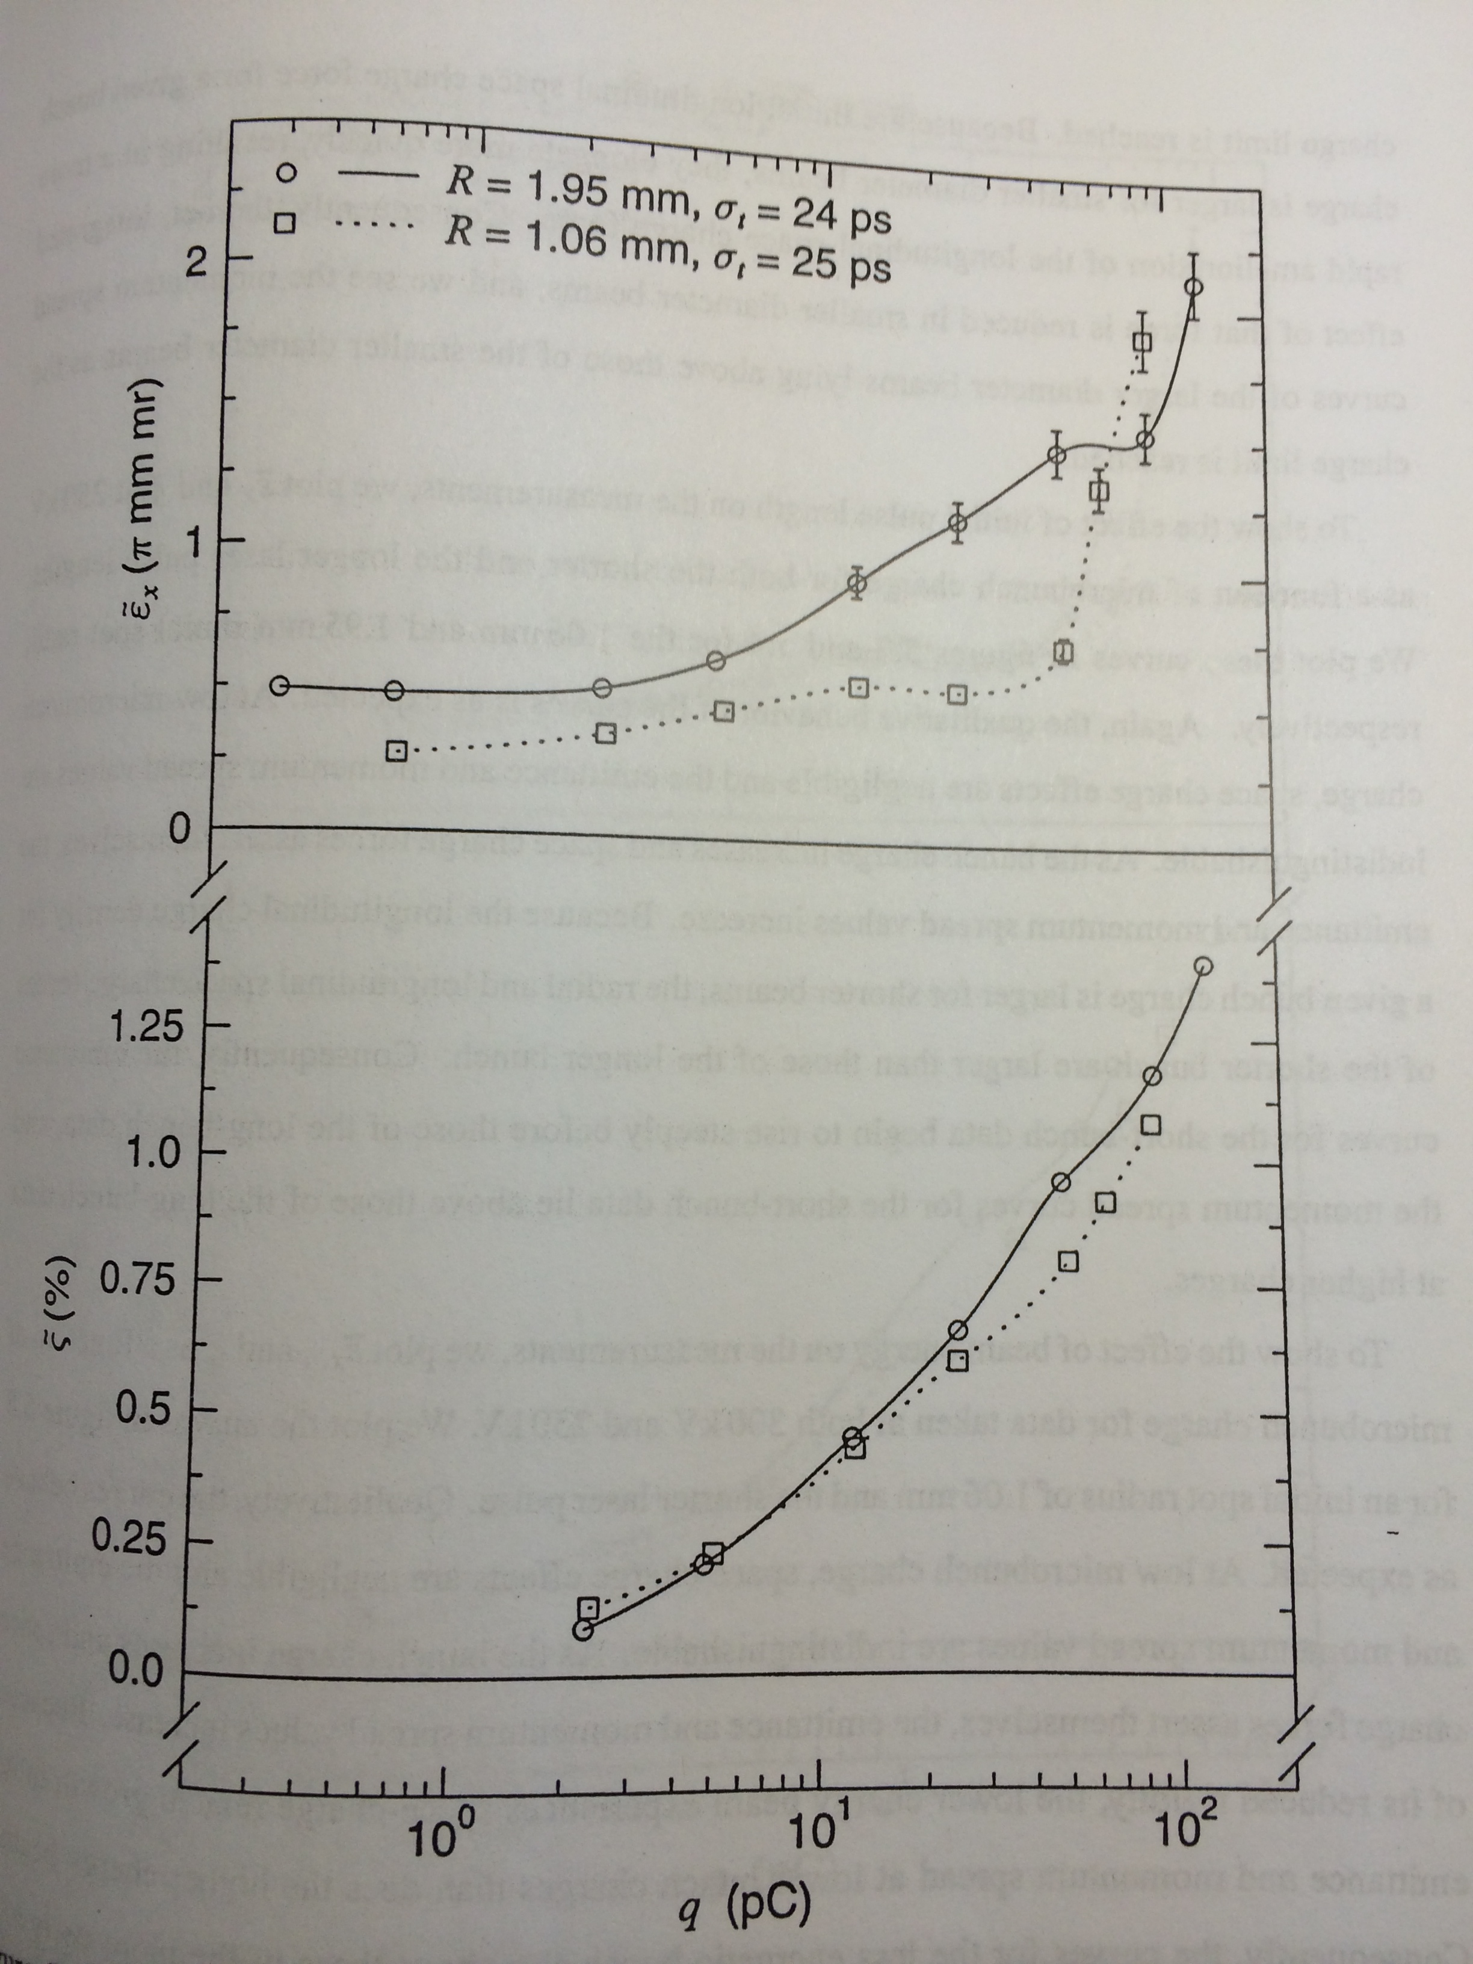
… vs. laser spot size (happens to be 250kV)
At low bunch charge space charge effects are negligible.
Emittance scales with laser spot size.
Momentum spread is indistinguishable
Because transverse space charge forces are larger for smaller radius beam, these are stronger sooner.
Because longitudinal space charge force is larger for smaller radius, bunch elongates faster, suppressing total energy spread.

Slide 6
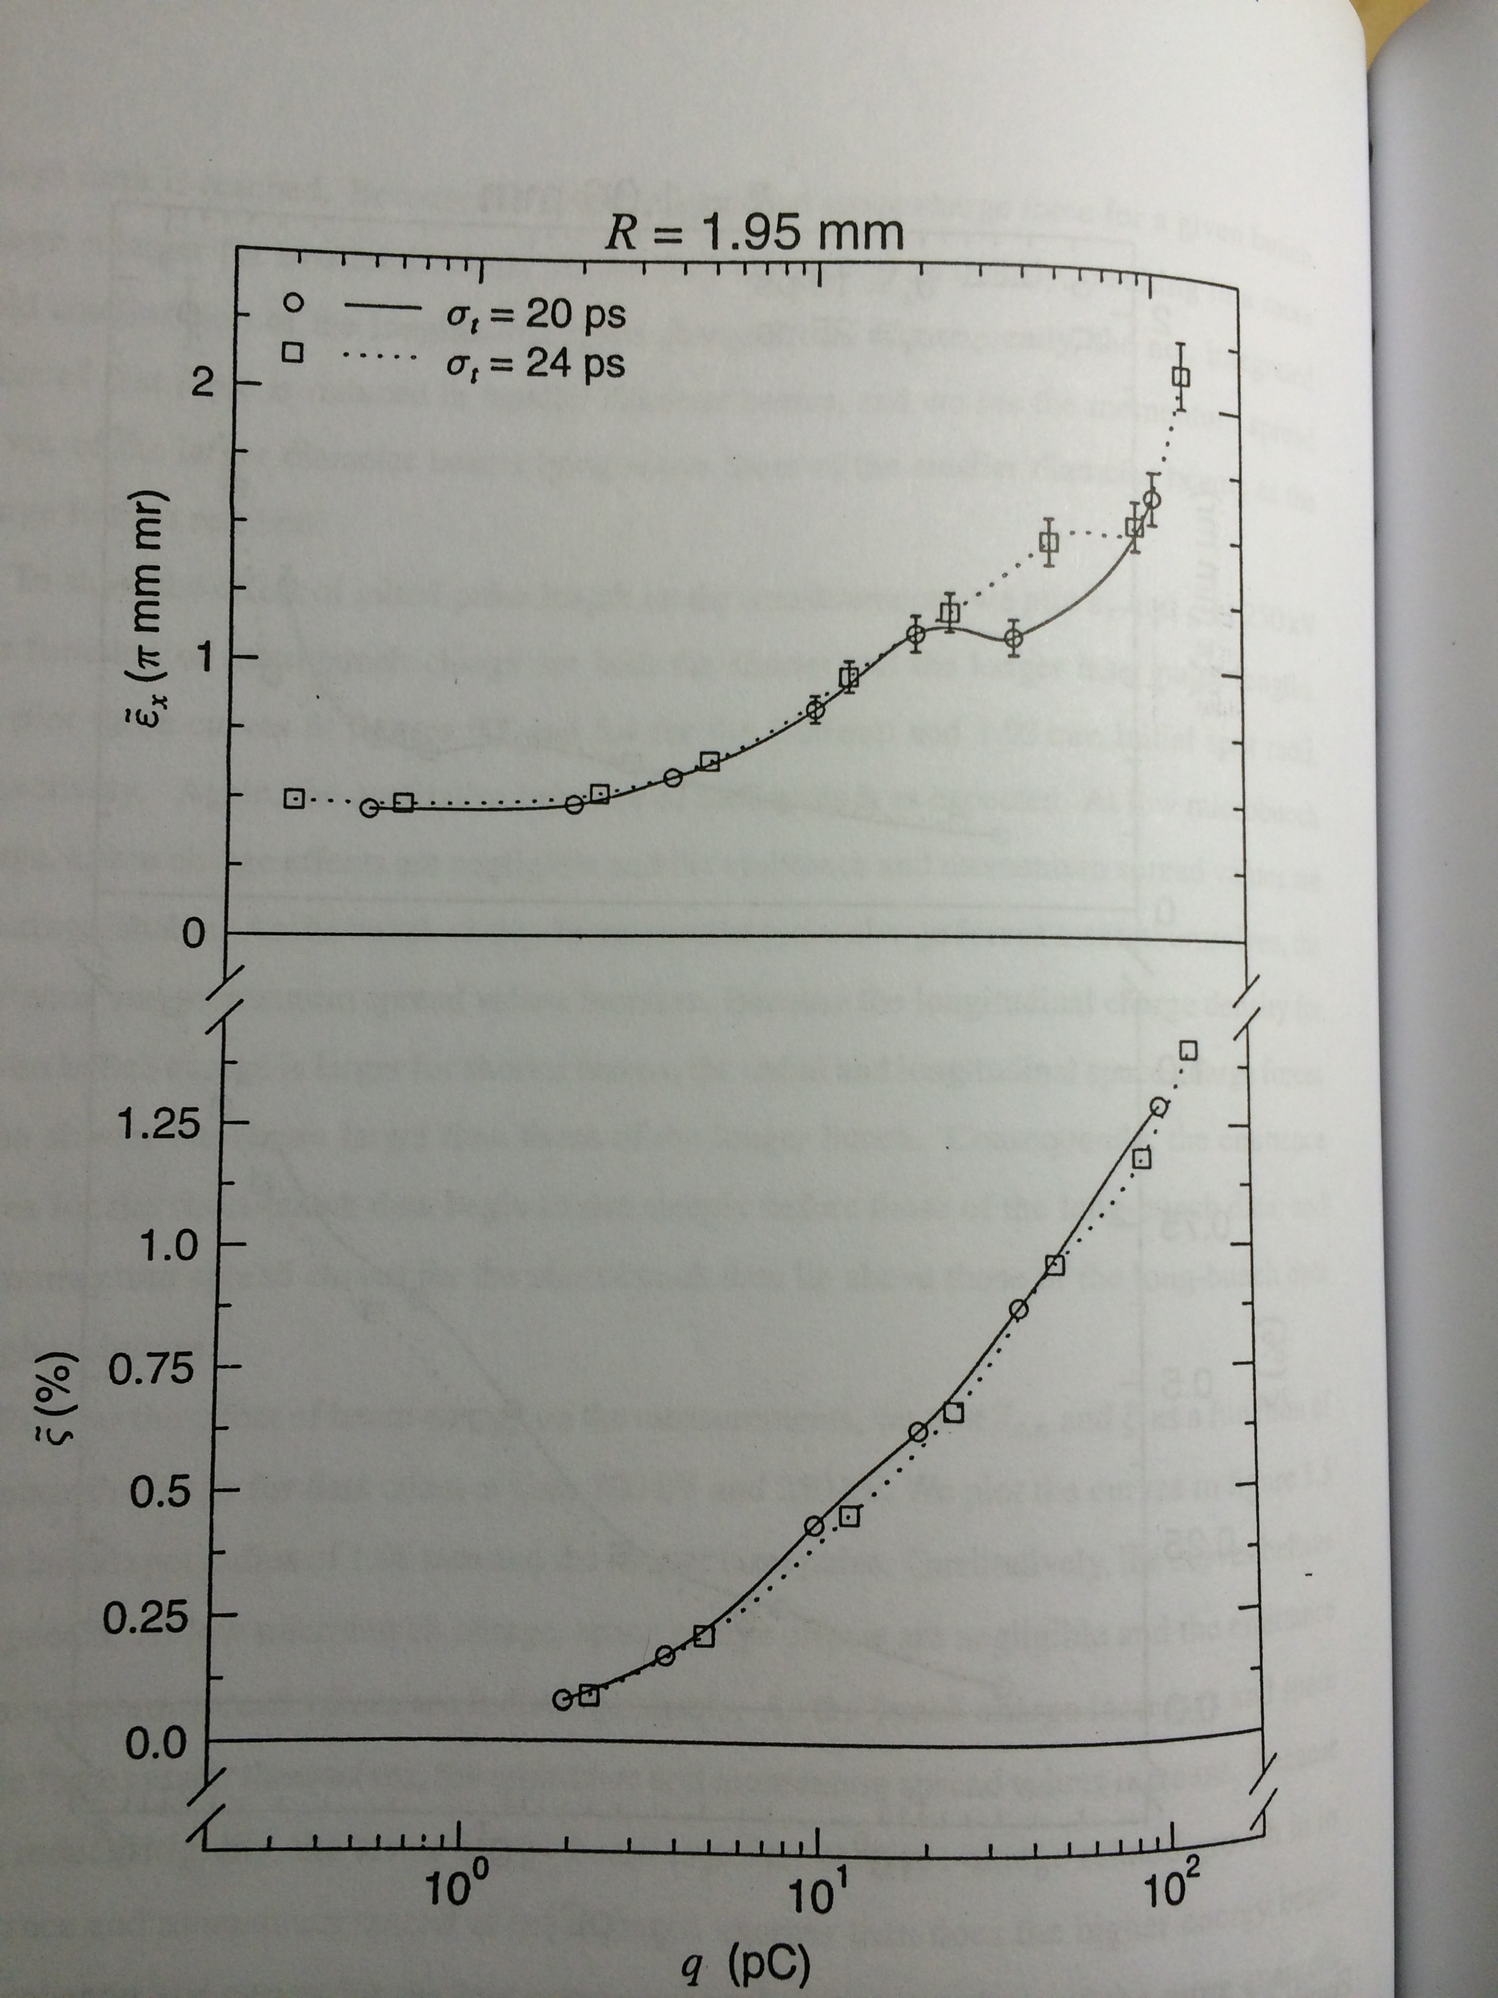
… vs. laser pulse length (happens to be 250kV)
At low bunch charge space charge effects are negligible.
Emittance scales with laser spot size.
Momentum spread is indistinguishable
The longitudinal space charge forces are larger for shorter bunch.
Both transverse and longitudinal forces tend to be larger through evolution and lead growth.

Slide 7
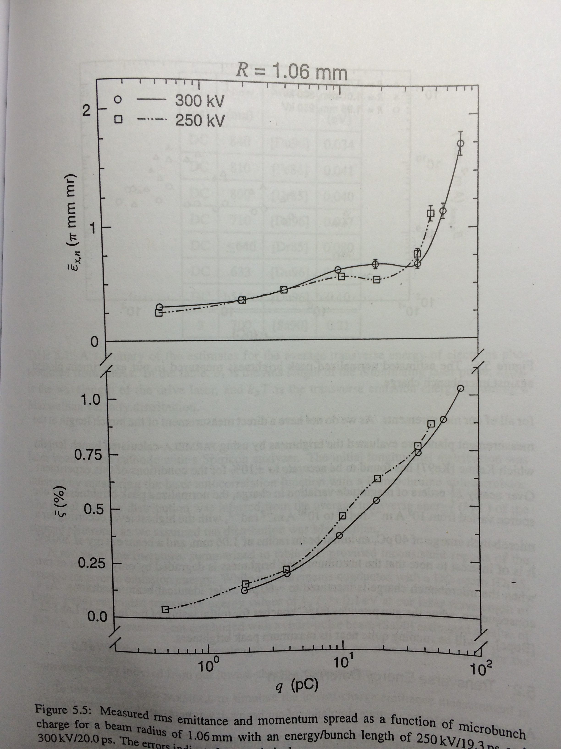
… vs. gun voltage (happens to be 20ps pulse length)
At low bunch charge
Transverse and longitudinal space charge forces are smaller.
There is little to no difference in emittance or energy spread.
The transverse and longitudinal space charge distributions are identical.
The reduced rigidity of the lower voltage beam means longitudinal and space charge forces are weaker at higher energy, i.e. higher momentum.

Slide 8
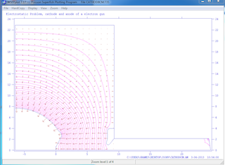
Next steps … discuss beam line “features”
Needed (HDIce) => can turn crank for zeroth-order layout
Spin components
Longitudinal components
Desired (R&D) => characterizing parameters space from gun for features
Geometry
John provided gun .dxf layout
Carlos provided gun POISSON deck (will match/adjust to .dxf)
Simulation
LANL-PARMELA: Erik Werlau setup fast Win7 box (CISPARMELA)
BEARD-PARMELA: CC granted me access to search/backup his files

