Slide 1
Wien filter: Shorter plate gap
03/31/2020

Slide 2
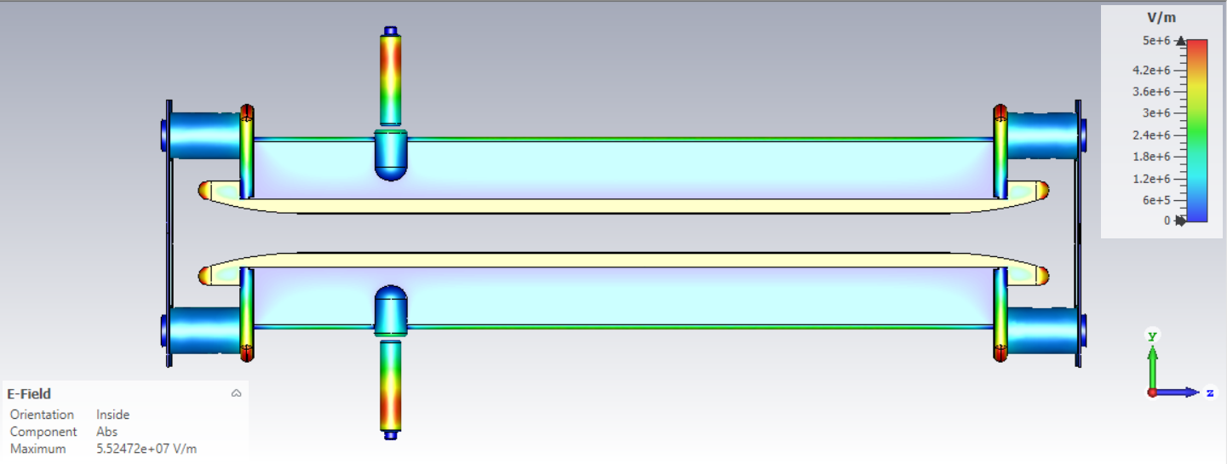
Lateral cross section of the plates: Original
Leff = Integral of Ex(0,0,z)/Emax(center)
Voltage on plates ±20 kV
5.1 MV/m
4.6 MV/m
5.9 MV/m
15 mm gap
Effective length = 31.56 cm
2.69 % diff
B Effective length = 30.71 cm

Slide 3
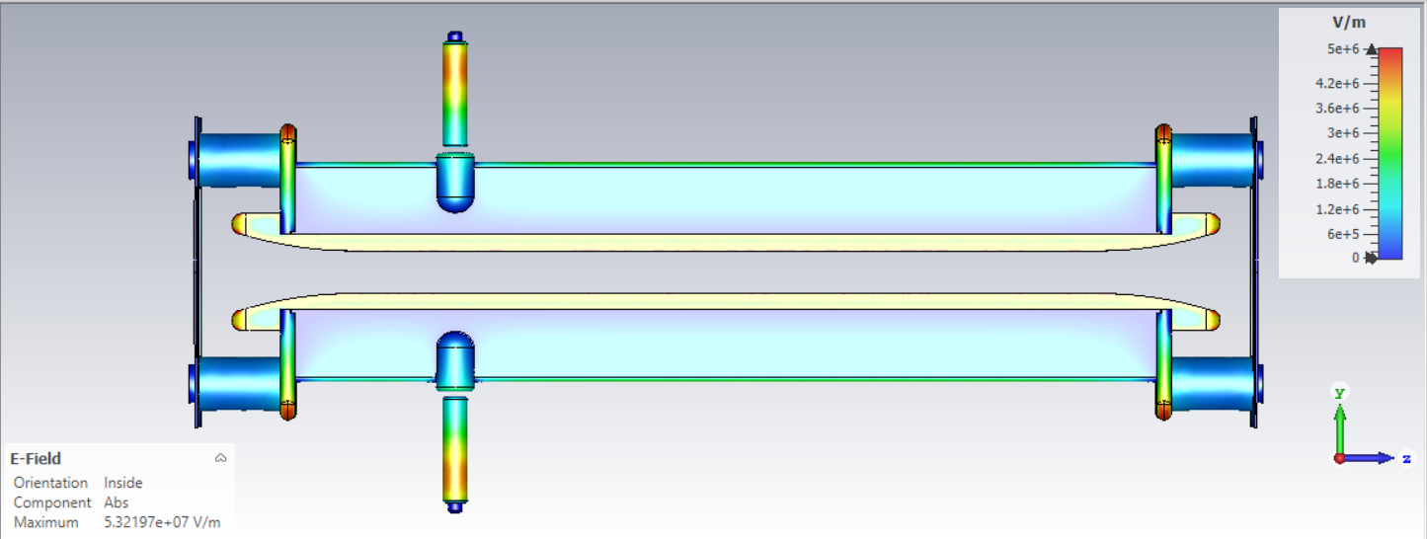
Lateral cross section of the plates: Original
Voltage on plates ±18.7 kV
4.8 MV/m
4.4 MV/m
5.9 MV/m
14 mm gap
Effective length = 31.50 cm
2.50 % diff
B Effective length = 30.71 cm

Slide 4

Lateral cross section of the plates: Original
Voltage on plates ±17.3 kV
4.5 MV/m
4.0 MV/m
5.2 MV/m
13 mm gap
Effective length = 31.37 cm
2.10 % diff
B Effective length = 30.71 cm

Slide 5
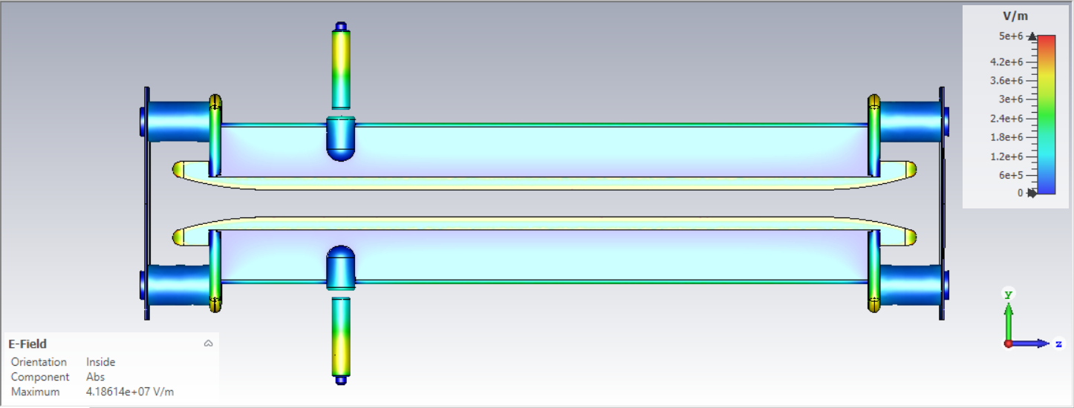
Lateral cross section of the plates: Original
Voltage on plates ±16 kV
4.1 MV/m
3.8 MV/m
4.9 MV/m
12 mm gap
Effective length = 31.26 cm
1.75 % diff
B Effective length = 30.71 cm

Slide 6
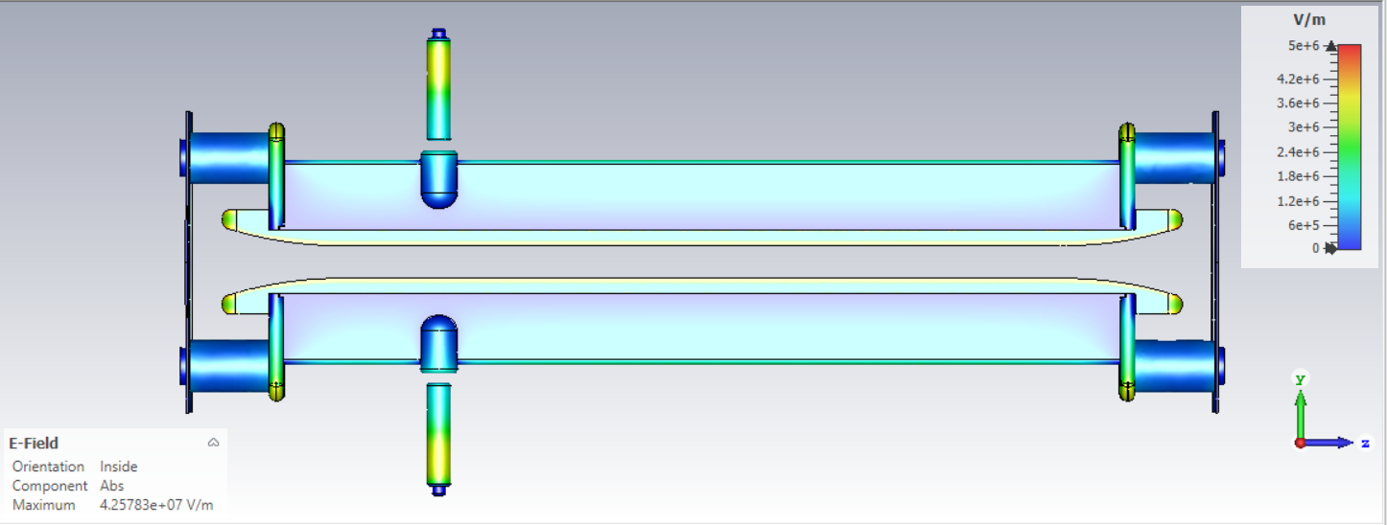
Lateral cross section of the plates: Original
Voltage on plates ±14.7 kV
3.7 MV/m
3.4 MV/m
Stretch HV spring guide 5.5 mm
To close the gap
4.5 MV/m
11 mm gap
Effective length = 31.12 cm
1.31 % diff
B Effective length = 30.71 cm

