Slide 1
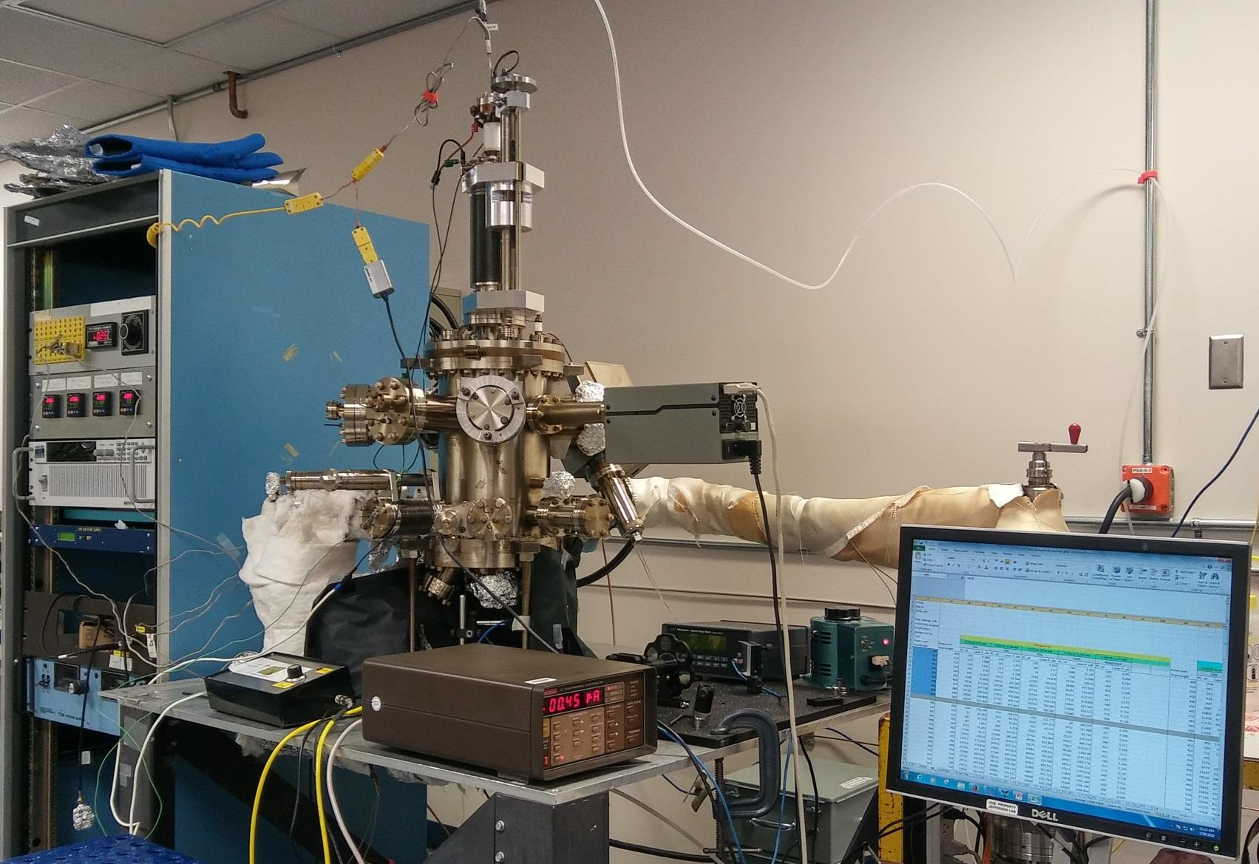
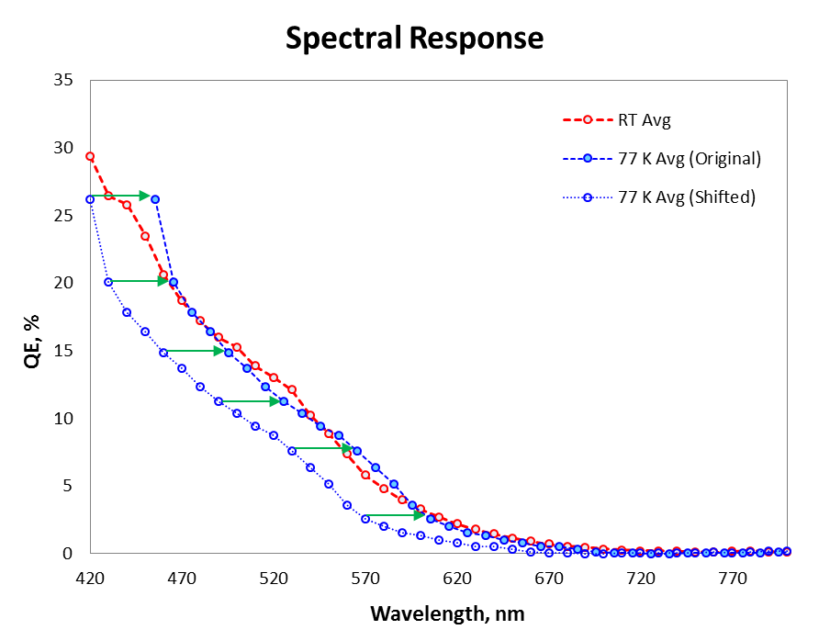
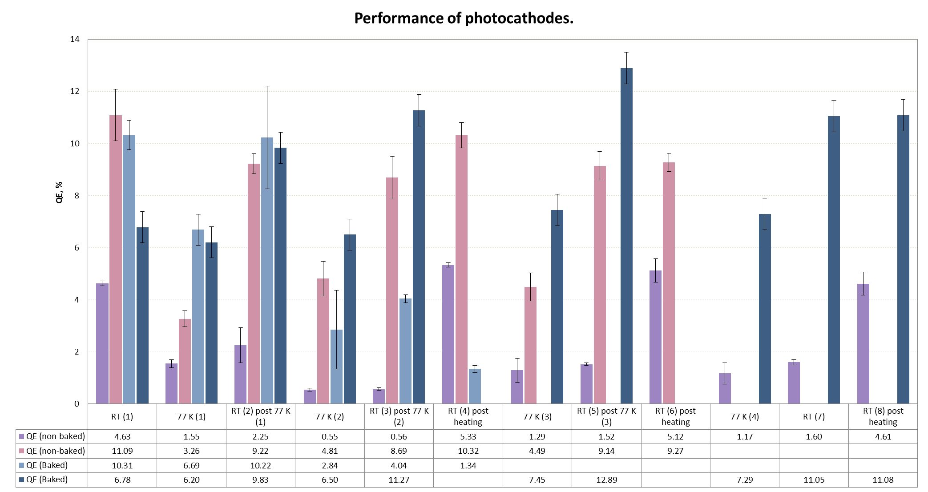
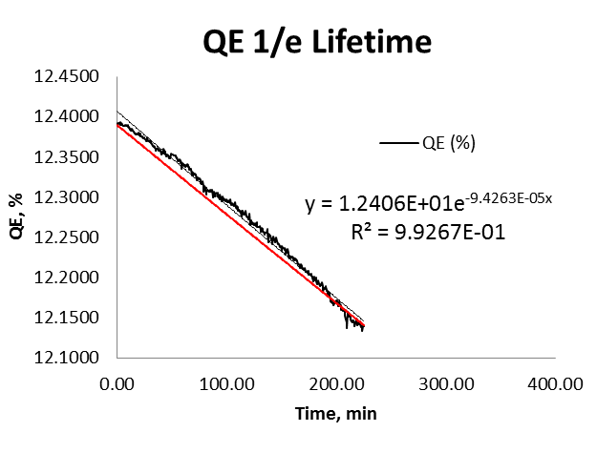
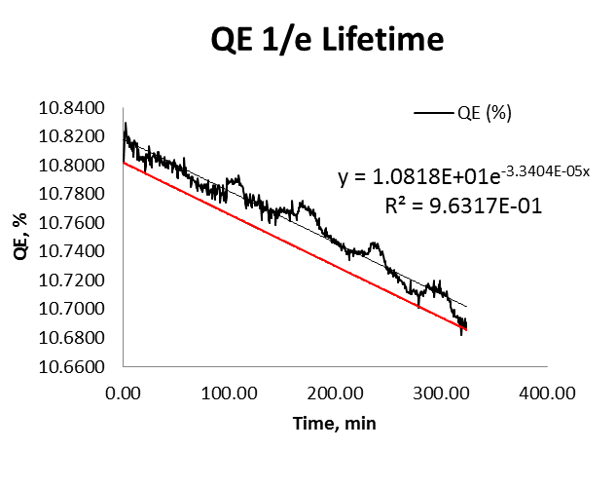
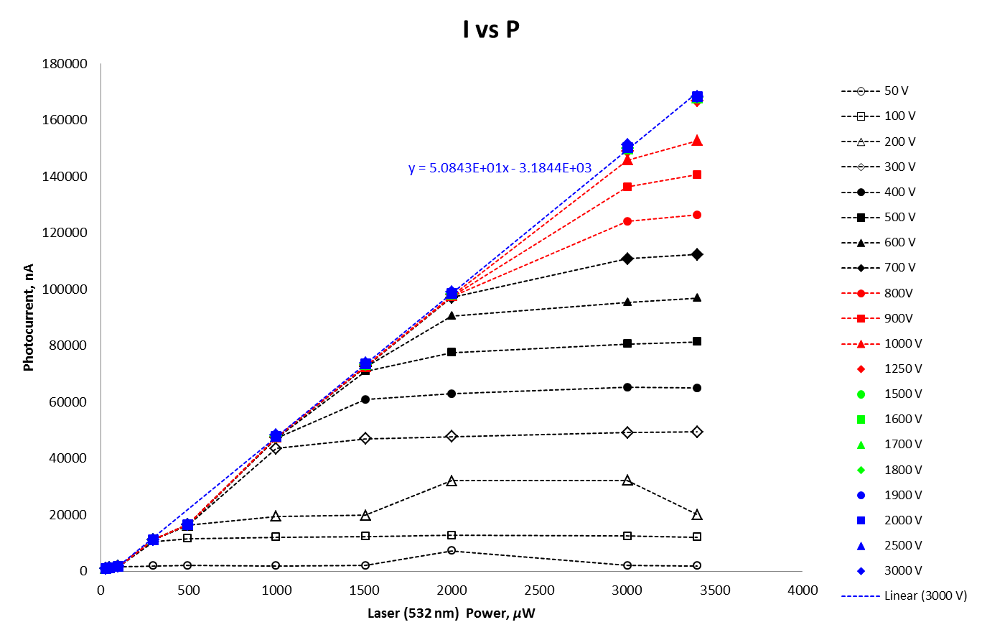
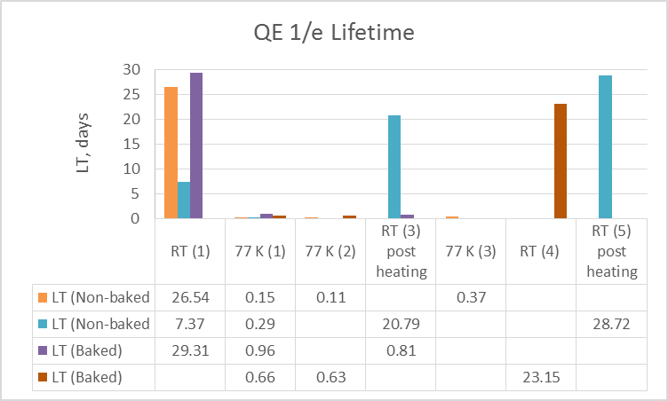
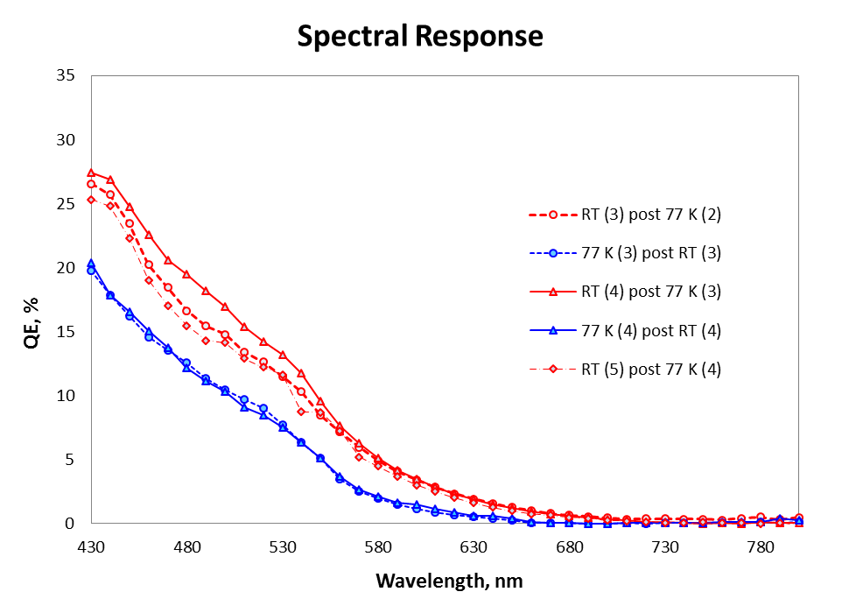
Effects of Vacuum on the performance of Cryo-cooled Bialkali Antimonide Photocathodes Grown on Niobium Substrate
M. Hernandez-Flores¹, M.A. Mamun², and M. Poelker²
¹ Autonomous Metropolitan University Campus Azcapotzalco, Mexico City, DF 02200, Mexico
²Thomas Jefferson National Accelerator Facility, Newport News, VA 23606, USA
ABSTRACT
MATERIALS AND METHODS
RESULTS
An accelerator must be built to implement electron cooling of the proton beam for the Jefferson Lab Electron Ion Collider which requires continuous wave (CW) electron beam at high average current and high bunch charge. A superconducting radio frequency (SRF) photogun represents an ideal candidate electron source for this application, but only if the photocathode can provide high yield, or quantum efficiency (QE), when cooled to cryogenic temperatures. Furthermore, the photocathode QE must remain high for long periods of time while delivering beam, a metric referred to as Lifetime (LT). The focus of this project was to make a bialkali-antimonide photocathode using a niobium substrate and to study its QE behavior at different temperatures for two different vacuum conditions (non-baked and baked chamber). The photocathode was made by depositing antimony and a mixture of potassium and cesium onto a niobium substrate. We optimized photocathode QE by controlling substrate temperature, the partial pressure of the antimony and alkali gasses inside the chamber and the chemical deposition time. Photocathode QE was evaluating by measuring photocurrent when the photocathode surface was illuminated with a 532 nm laser at room temperature (RT) and at 77 K for the two vacuum conditions. In this work, we present results that allow us to predict photocathode QE when an alkali-antimonide photocathode is cooled to 2 K, which is the operating temperature of an SRF gun. Our results also help to distinguish between different QE reduction mechanisms, in particular, the QE reduction due to contamination of the photocathode surface via adsorption residual gas within the vacuum chamber.
A)
Summary plot of QE values of the four photocathodes made under different vacuum systems and at different temperatures
Lifetime decay fitting at different temperatures and LT values summarizes for both vacuum conditions
Photocathode QE spectral response, i.e., photocathode dependence on laser wavelength, at different temperatures.
The QE spectral response shifts by 35.6 nm when photocathode cooled from RT to 77 K
4)
8
9
1
6
11
10
7
3
5
4
2
12
1)
The experimental set up is shown. (A). It consisted of a deposition chamber (1), which contains the niobium substrate inside. A 532 nm laser (2), optical mirrors (3), an electrometer to measure photocurrent (4), an optical power meter (5), a residual gas analyzer (RGA) (6), an alkali reservoir (7), the Sb reservoir (not visible). A heater/liquid nitrogen container (8), temperature controllers (9), an ion pump power supply (10), a turbo pump (11) and a computer to record the data (12).
The thermal treatment given to the photocathodes follows: RT→77K →RT →77K →RT →RT post brief heating to 170-200° C →77K →RT →RT post brief heating.
The photocurrent was measured during this process.
CONCLUSIONS
Niobium is a viable substrate for the production of CsK₂Sb photocathodes, which exhibit high QE and long lifetime. We made the following specific observations:
Non-baked system:
The highest QE at RT obtained was 11.09% and at 77K, 4.81%.
The highest QE lifetime measured was 26.54 days at RT and 0.37 at 77 K.
QE drops by 74±9 % each time when cryo-cooled.
QE can be fully recovered by desorbing water via brief heating at 170-200° C.
Lifetime improves when QE is recovered by heating.
Baked system:
The highest QE at RT obtained was 12.89% and at 77K, 7.45%.
The highest QE lifetime measured was 29.31 days at RT and 0.96 days at 77 K.
QE and lifetime can be recovered and improved by cooling the cathode and leaving it to reach RT by it self.
2)
OBJECTIVES
B)
Make photocathodes on a niobium substrate via co-deposition of Cs, K and Sb gasses to form the compound CsK₂Sb.
Analyze the performance of the photocathodes by measuring quantum efficiency (QE) and lifetime (LT) at different temperatures (Room temperature and 77K).
Compare the QE and LT of the CsK₂Sb photocathodes under different vacuum conditions.
7.37 Days
20.79 Days
In order to measure the QE of the photocathodes, the space charge limit of the photocathode was characterized by measuring the photocurrent obtained by changing the laser power at different voltages (B). With this, the proper conditions to do the research were established. The bias applied to the photocathode was set above 2000 V (~1360 V) in order to avoid the uninteresting behavior of voltage-limited photoemission.
The QE was calculated using the following equation:
$$QE\left(\%\right)=\frac{124 I(μA)}{P(mW)λ(nm)}$$
The QE lifetime is denoted by 1/τ and was calculated using the following equation that describes QE decay:
$$QE\left(t\right)=QE0e^{−t/τ}$$
REFERENCES
ACKNOWLEDGMENTS
Mamun, Md Abdullah A., Abdelmageed A. Elmustafa, Carlos Hernandez-Garcia, Russell Mammei, and Matthew Poelker. "Effect of Sb Thickness on the Performance of Bialkali-antimonide Photocathodes." Journal of Vacuum Science & Technology A: Vacuum, Surfaces, and Films J. Vac. Sci. Technol. A 34.2 (2016): 021509. Web. July 2016.
Mamun, M. A., C. Hernandez-Garcia, M. Poelker, and A. A. Elmustafa. "Correlation of CsK2Sb Photocathode Lifetime with Antimony Thickness."APL Mater. APL Materials 3.6 (2015): 066103. Web. July 2016.
This project is supported by the JSA Initiatives Fund Program, a commitment from the JSA owners, SURA and PAE Applied Technologies. Initiatives Funds support programs, initiatives, and activities that further the scientific outreach, promote the science, education and technology of the Jefferson Lab and benefit the Lab’s extended user community in ways that complement the Lab’s basic and applied research missions.
To my mentors, A. Mamun and Matt Poelker, and to all the injectors group members. To Hari Areti, the Department of Energy, the Jefferson Lab, Lisa Surles-Law, Old Dominion University, the RESFAC Staff. To the Physics Mexican Society, the Autonomous Metropolitan University and everyone who supported me in Mexico.
3)

