Slide 1
LDRD: Magnetized Source
JLEIC Meeting
November 20, 2015
Riad Suleiman and Matt Poelker

Slide 2
Outline
Magnetized Cooling
Magnetized Bunched Electron Beam Requirements
Magnetized Guns
JLEIC Magnetized Gun R&D
Experimental Overview
  Simulation Plan
  Measurement Plan
Progress

Slide 3
Magnetized Cooling
JLEIC bunched magnetized electron cooler is part of Collider Ring and aims to maintain ion beam emittance and extend luminosity lifetime
Electrons helical motion in strong magnetic field increases electron-ion interaction time, thereby significantly improving cooling efficiency. Electron-ion collisions that occur over many cyclotron oscillations and at distances larger than cyclotron radius are insensitive to electrons transverse velocity.
Cooling rates are determined by electron longitudinal energy spread rather than electron beam transverse emittance as transverse motion of electrons is quenched by magnetic field
This cyclotron motion also provides suppression of electron-ion recombination

Slide 4
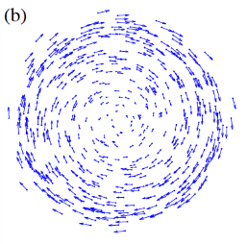
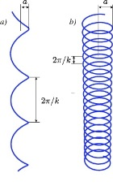
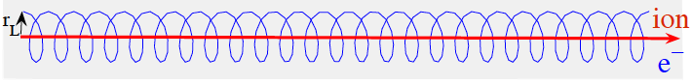
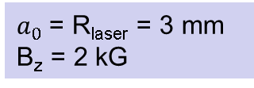
Cooling Solenoid
Cathode Solenoid
SRF Linac
Electrons born in strong uniform B_{z}
Upon exit of Cathode Solenoid
Upon entering Cooling Solenoid
σ_{e}= 0.95 mm
B_{cool} = 2 T
$a_{0}$= R_{laser} = 3 mm
B_{z} = 2 kG
= 528 µm

Slide 5
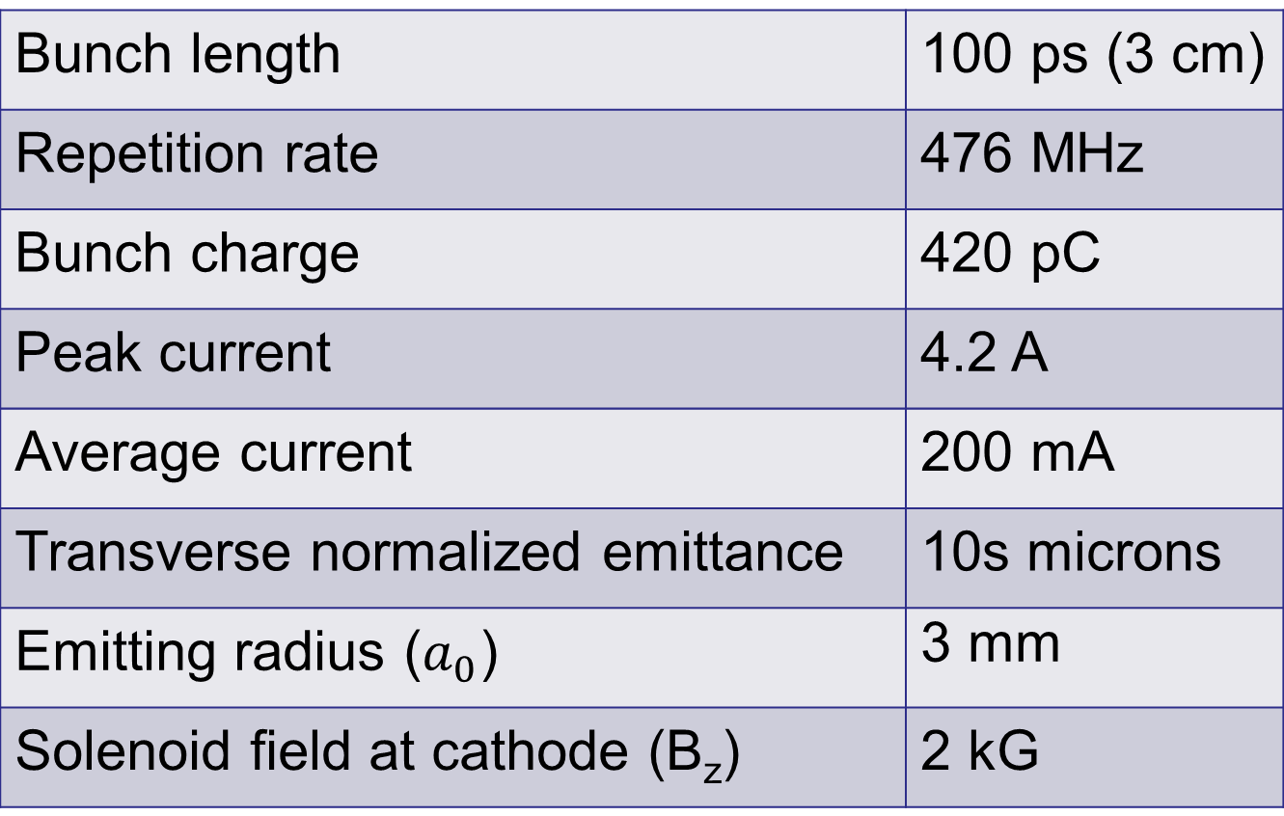
Magnetized Bunched Electron Beam Requirements
Bunch length | 100 ps (3 cm)
Repetition rate | 476 MHz
Bunch charge | 420 pC
Peak current | 4.2 A
Average current | 200 mA
Transverse normalized emittance | 10s microns
Emitting radius ($a_{0}$) | 3 mm
Solenoid field at cathode (B_{z}) | 2 kG

Slide 6
Magnetized Guns
Fermilab Photoinjector Laboratory:
  Pulsed NCRF gun
  Cs₂Te photocathode and UV laser (λ=263 nm)
  Bunch charge: 0.5 nC and bunch length: 3 ps
  0.5% duty factor (average current: 7.5 μA)
    Bunch frequency: 3 MHz
    Macropulse duration: 1 ms
    Number of bunches per macropulse: 3000
    Macropulse frequency: 5 Hz
      No CW beam at high average current
Magnetized beam R&D at University Mainz just started

Slide 7
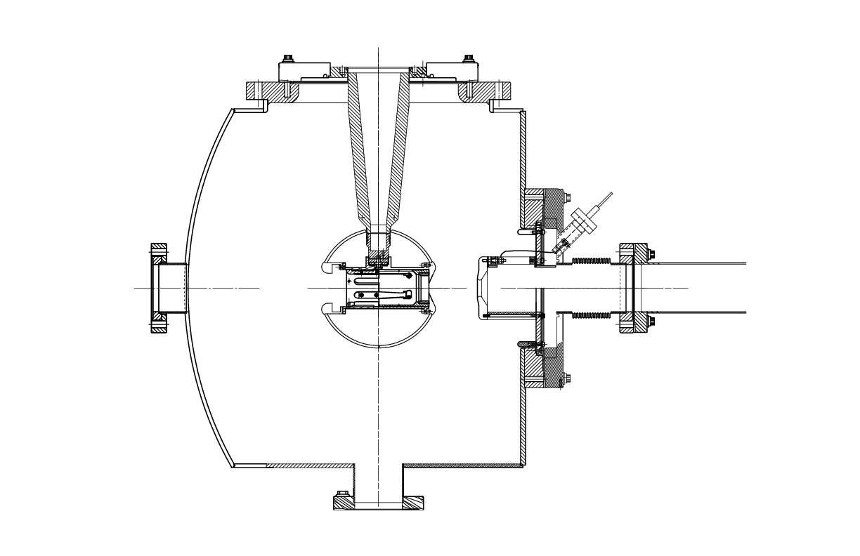
JLEIC Magnetized Gun R&D
Generate magnetized electron beam and measure its properties
Explore impact of cathode solenoid on photogun operation
Simulations and measurements will provide insights on ways to optimize JLEIC electron cooler and help design appropriate electron source
JLab will have direct experience magnetizing high current electron beam
Cathode Solenoid (B_{z} = 2 kG)
Helmholtz pair would be easier to mount on HV Chamber

Slide 8
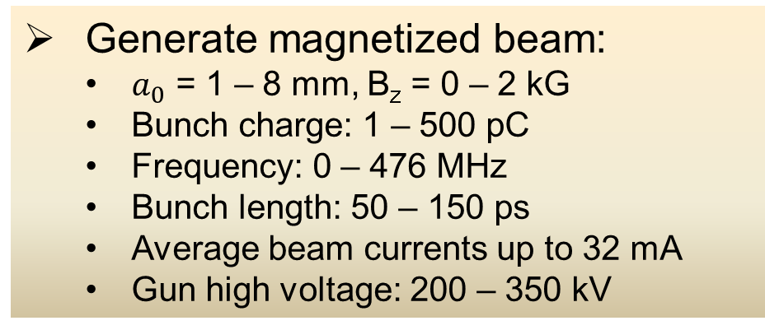
Experimental Overview
Cathode
Solenoid
Diagnostic Cross 3
(YAG Screen)
Cathode
Three Skew Quads
(Round-to-Flat Beam Transformer)
Green
Laser
Anode
K₂CsSb
Photocathode
Injector Focusing Solenoids
Diagnostic Cross 1
(Multislit + YAG Screen)
Diagnostic Cross 2
(H,V slit + YAG Screen)
Generate magnetized beam:
  $a_{0}$ = 1 – 8 mm, B_{z} = 0 – 2 kG
  Bunch charge: 1 – 500 pC
  Frequency: 0 – 476 MHz
  Bunch length: 50 – 150 ps
  Average beam currents up to 32 mA
  Gun high voltage: 200 – 350 kV

Slide 9
Simulation Plan
Design beamline to locate magnets and diagnostics at optimum positions
Benchmark simulation (of different operating scenarios of bunch charge, magnetization, bunch shape etc.) against measurements
Quantify how good or complete RTFB transform can be made for different settings – as beams will be space charge dominated, there will be some limit to emittance aspect ratio that can be achieved
These results will guide injector design for JLEIC magnetized electron cooler

Slide 10
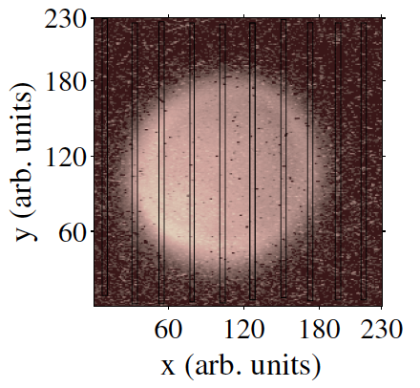
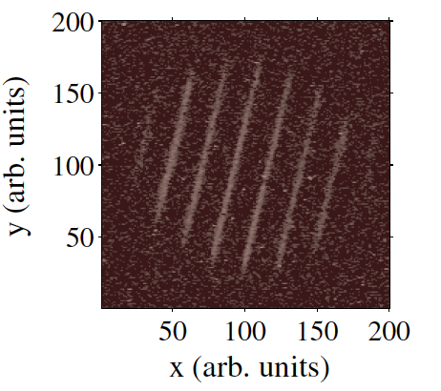
Measurement Plan
Measure mechanical angular momentum
(skew quads off)
σ₁ beam radius measured at Diagnostic Cross 1
σ₂ beam radius measured at Diagnostic Cross 2
D drift between two crosses
p_{z} beam longitudinal momentum
Angular rotation ϕ is measured from beam image at Cross 2 when multislit is inserted at Cross 1
Example of mechanical measurement at Fermilab (Piot et al.)

Slide 11
Use three skew quads – RTFB Transformer – to generate a flat beam with transverse emittance ratios of:
  Measure horizontal and vertical emittances using slit method
Generate very high currents magnetized beam and study beam transport and RTFB transformation versus electron bunch charge
Measure photocathode lifetime versus solenoid field at high currents (up to 32 mA) and high voltages (200 – 350 kV) limited by in-house HV supplies
Study beam halo and beam loss versus magnetization

Slide 12
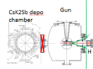
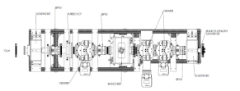
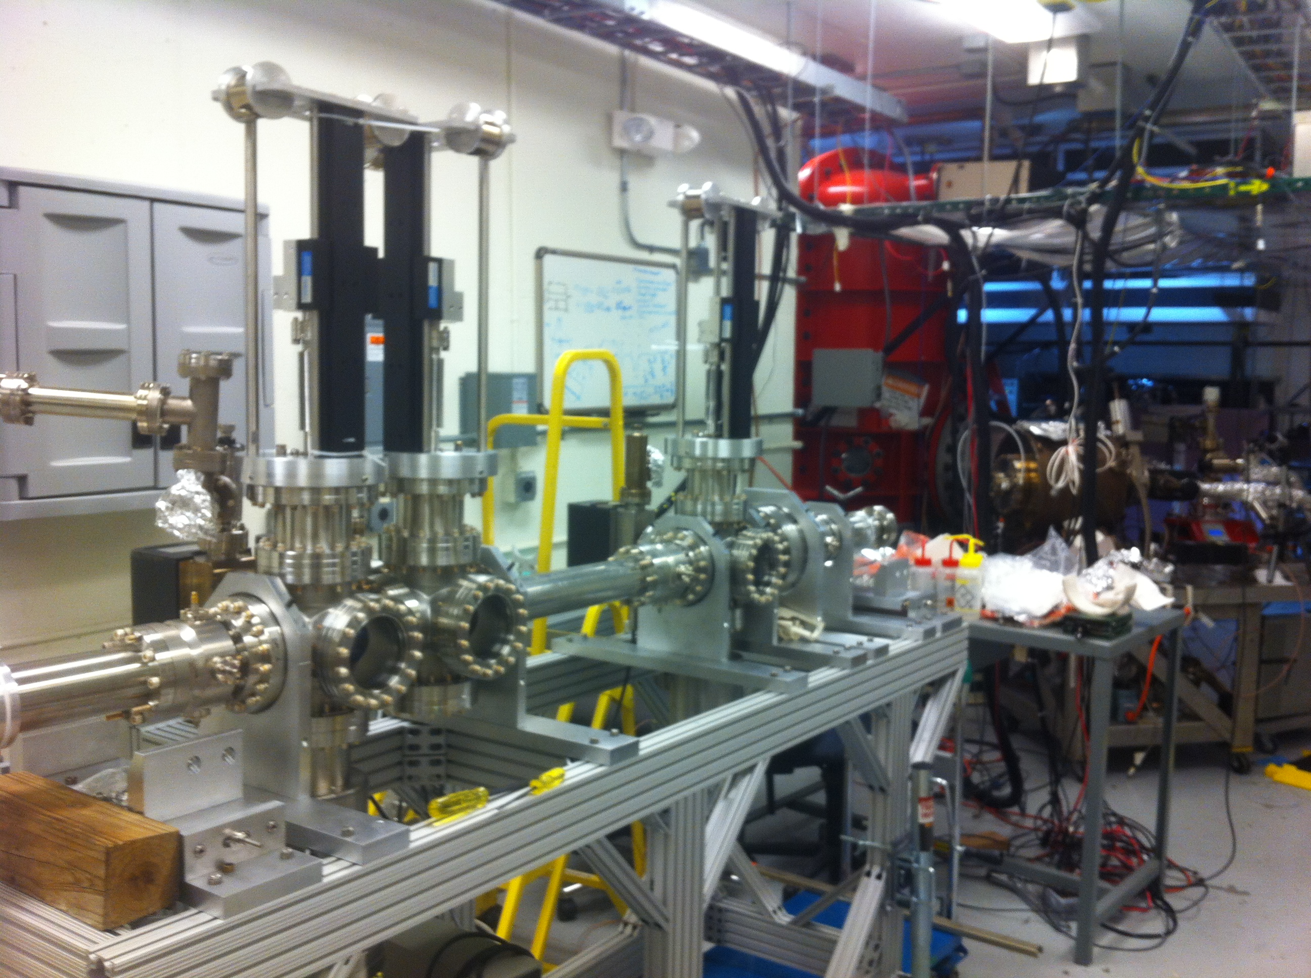
Location of Work: LERF Gun Test Stand

Slide 13
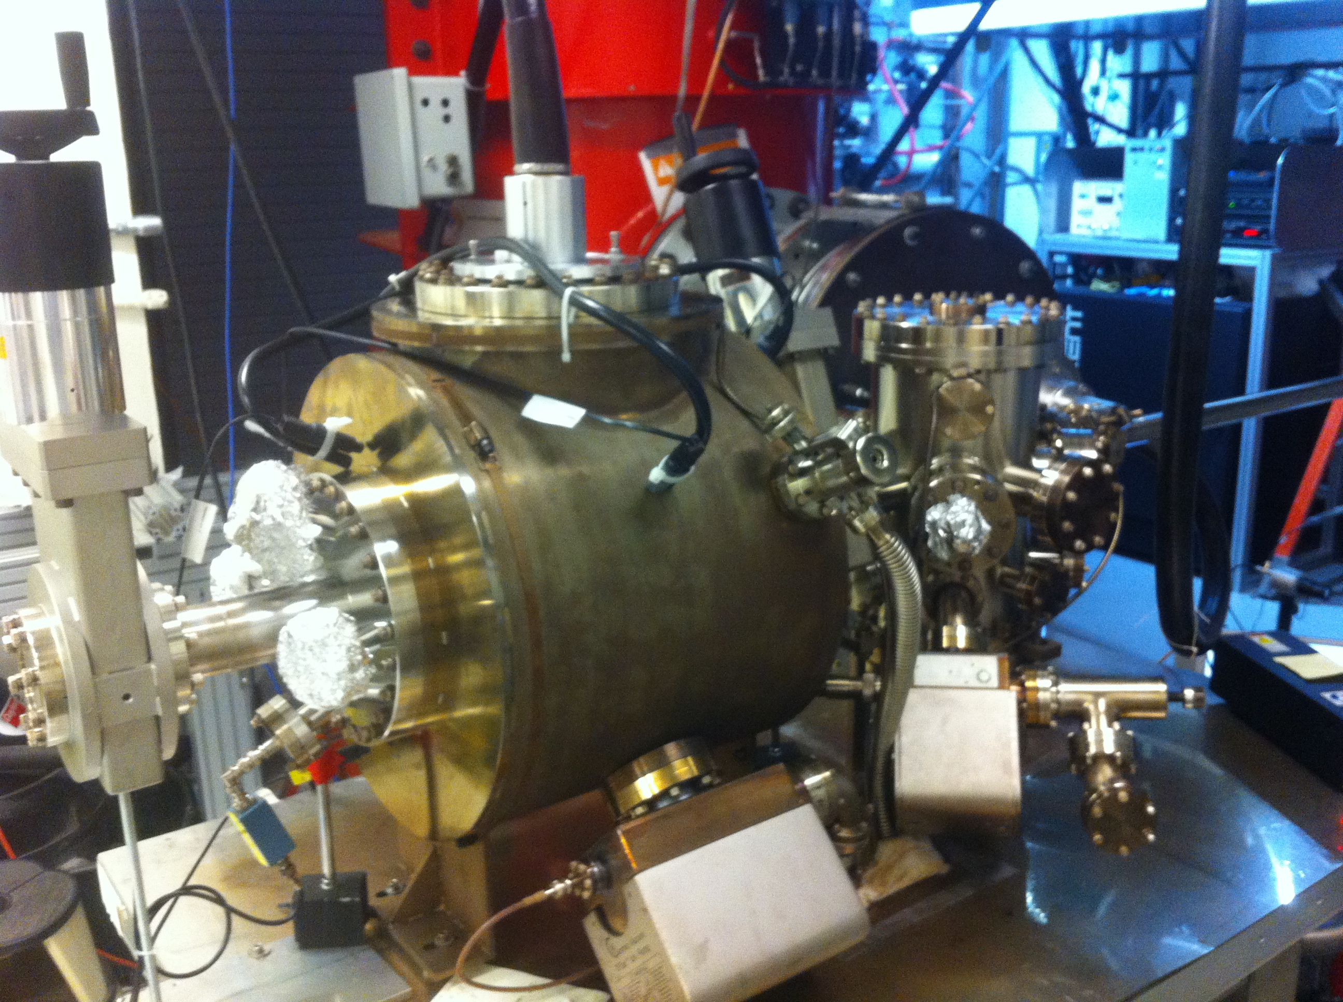
Progress
HV conditioning: reached 292 kV on November 18, 2015
K₂CsSb Preparation Chamber
HV Chamber

